Slide 1
The B2 SERVICE SUITE
www.eudat.eu/services
This work is licensed under the Creative Commons CC-BY 4.0 licence.
Attribution: EUDAT – www.eudat.eu

Slide 2
B2 SERVICE SUITE
EUDAT offers a complete set of research data services, expertise and technology solutions to all (European) scientists and researchers.
These shared services and storage resources are distributed across 15 European countries.
Data are safely stored alongside some of Europe’s most powerful supercomputers.

Slide 3

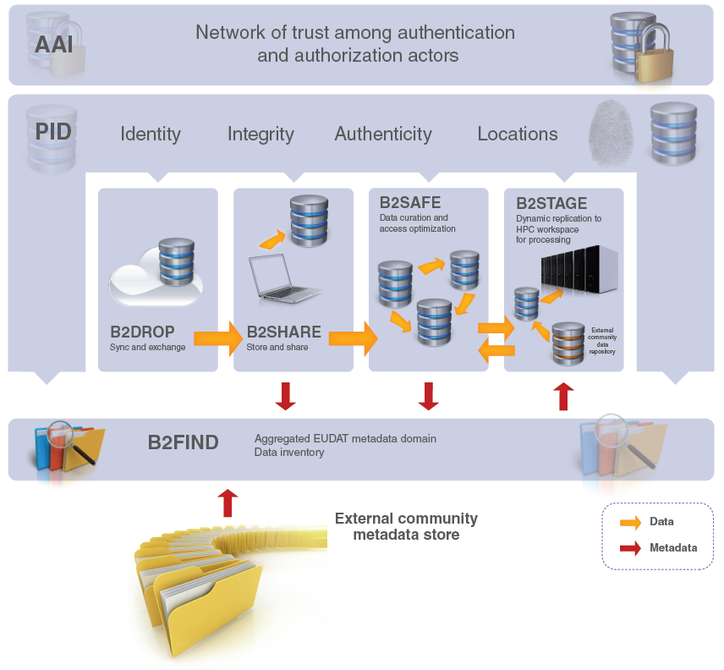






B2 Services
3

Slide 4
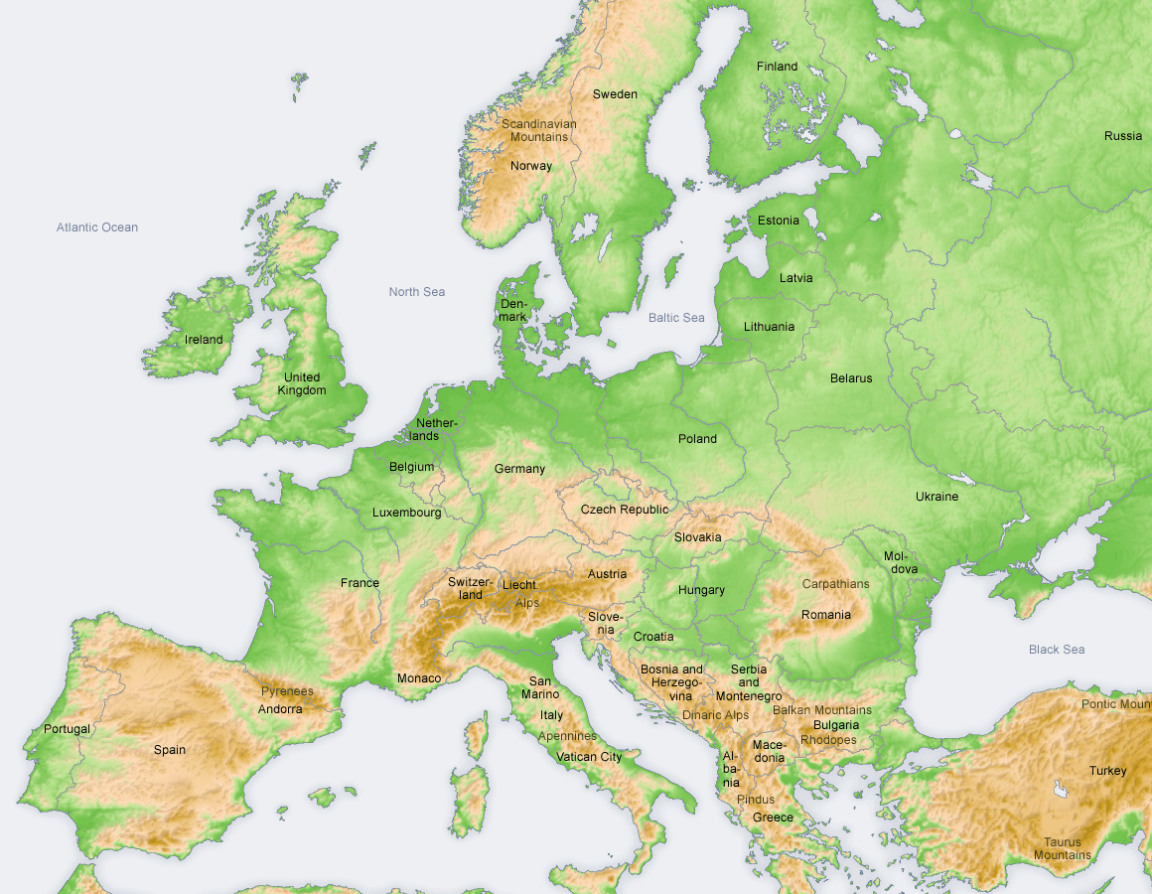


B2 SERVICE SUITE is part of EUDAT...
a pan-European initiative building a sustainable cross-disciplinary and cross-national data infrastructure providing a set of shared services for accessing and preserving research data
supporting multiple research communities by working closely with them to deliver these technical services as part of the EUDAT Collaborative Data Infrastructure (CDI)

Slide 5
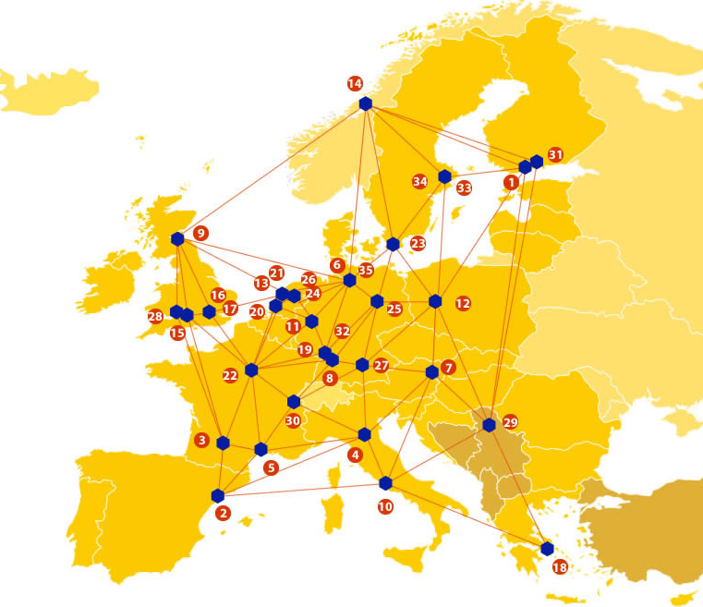
A truly pan-European Infrastructure
EUDAT offers common data services, supporting multiple research communities as well as individuals, through a geographically distributed, resilient network of 35 European organisations
Our vision is to enable European researchers and practitioners from any research discipline to preserve, find, access, and process data in a trusted environment, as part of a Collaborative Data Infrastructure

Slide 6

















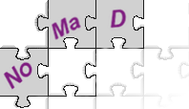












Community-Driven Solutions
EUDAT services are designed, built and implemented based on user community requirements.
ENVIRONMENTAL SCIENCES
BIOMEDICAL & MEDICAL SCIENCES
MATERIALS & ANALYTICAL FACILITIES
MAPPER
SOCIAL SCIENCES & HUMANITIES
PHYSICAL SCIENCES
& ENGINEERING

Slide 7
Why Should I Use it?
Outsource your data management needs…
  Less effort than building your own infrastructure
  More time and money for the research
… to a group of respected and trusted data centres...
  With a national and international remit
  Have a long past and future
... Who have a wealth of experience supporting data management for science.
  Many of whom support long term curation or are working to support it

Slide 8
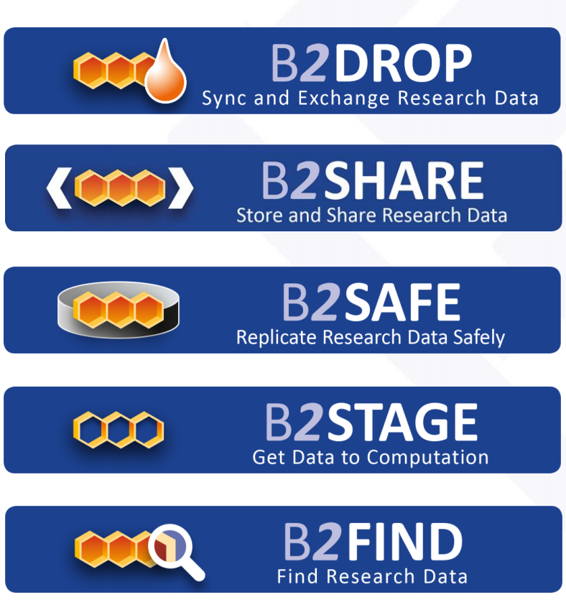
Support throughout the lifecycle
CREATING DATA
PROCESSING DATA
ANALYSING DATA
PRESERVING DATA
GIVING ACCESS TO DATA
RE-USING DATA
Notes:
The B2DROP service helps you to syncronrise and exchange research data like Dropbox; B2STAGE helps you get data to computation when processing and analysing data; B2SAFE helps you to replicate the data safely; B2SHARE is a repository to archive the data and share it with others; and B2FIND is a cataloguing service that allows you and others to find relevant data.

Slide 9
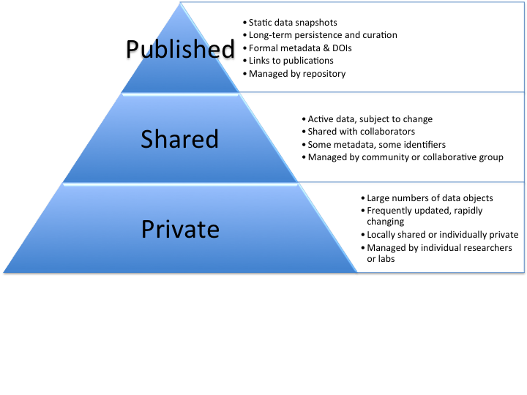
EUDAT DATA DOMAINS
PUBLISHED
DATA DOMAIN
Linking
Digital Objects
to Publications
Discovery of
Digital Objects
REGISTERED
DATA DOMAIN
Stage
Digital
Objects
Register
Digital
Objects
WORKSPACE
(TEMPORARY - TRANSIENT)

Slide 10
B2DROP
EUDAT’s Personal Cloud Storage Service
B2DROP is a secure and trusted data exchange service for researchers and scientists to keep their research data synchronized and up-to-date and to exchange with others.

Slide 11
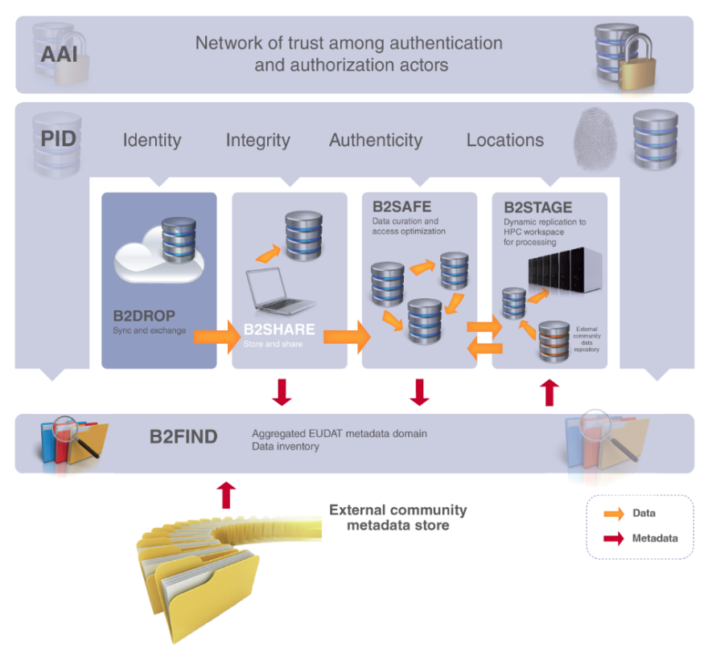
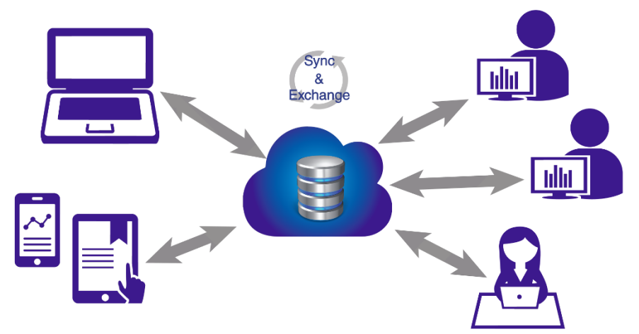
An ideal solution for researchers and scientists to:
Store and exchange data with colleagues and team members, including research data not finalized for publishing
share data with fine-grained access controls
synchronize multiple versions of data across different devices
Features:
20GB storage per user
Living objects, so no PIDs
Versioning and offline use
Desktop synchronisation

Slide 12
B2SHARE
B2SHARE is a user-friendly, reliable and trustworthy way for researchers, scientific communities and scientists to store and share small-scale research data from diverse contexts.

Slide 13
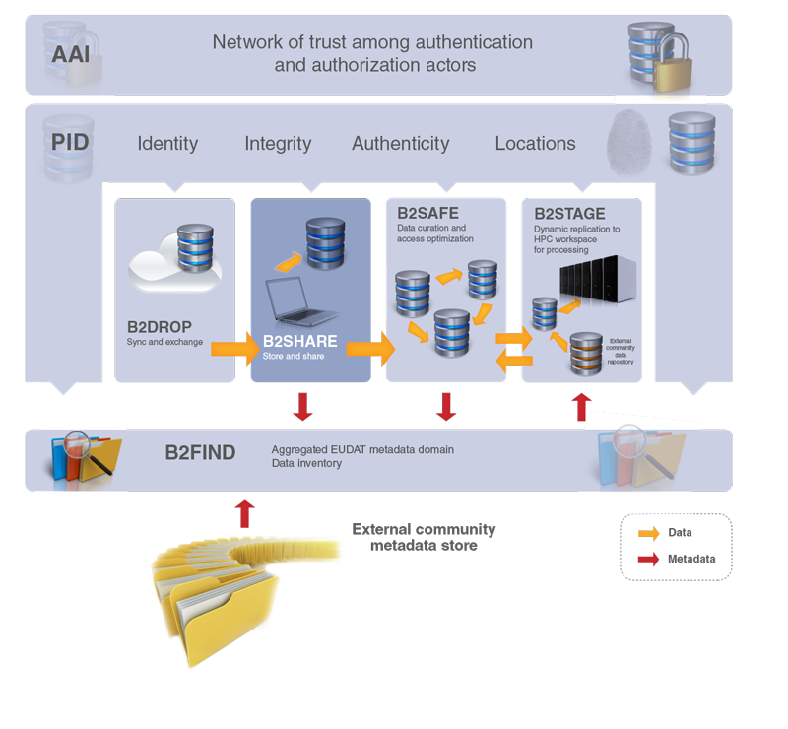
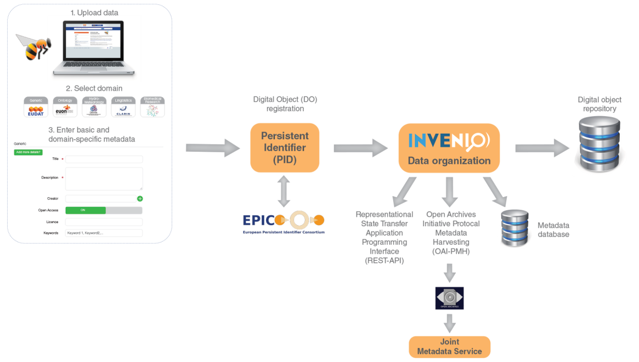
A winning solution for researchers, scientists and communities to:
store data safely at a trusted and certified data centre
preserve data to guarantee long-term persistence
control access and share data with colleagues and the world
Features:
metadata management
permanent PIDs
Open Access support

Slide 14
B2SAFE
B2SAFE is a robust, safe and highly available service which allows community and departmental repositories to implement data management policies on research data across multiple administrative domains in a trustworthy manner.

Slide 15
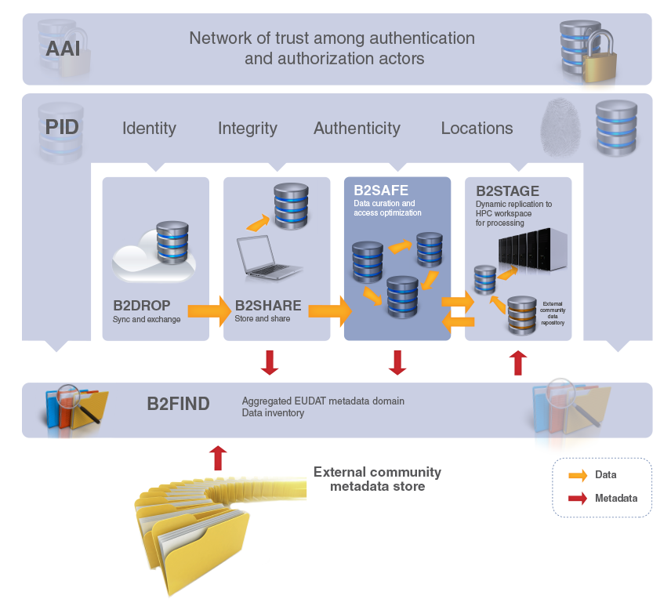
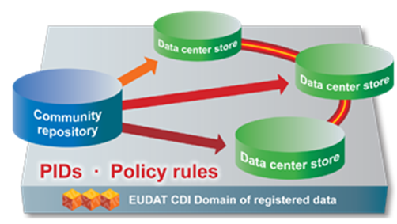
The ideal solution for communities with no facility for archival to:
replicate research data into secure data stores
archive and preserve research data in the long-term
bring data close to powerful compute resources
co-locate data with different communities
benefit from economies of scale
Features:
large-scale storage
robust and highly available
permanent PIDs

Slide 16

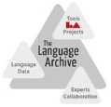



B2SAFE Use Case from CLARIN ERIC
Replication of Linguistic Data
PID
PID
iRODS
SAMQFS
iRODS
iRODS
GPFS
dCache
HPSS
DMF

Slide 17
B2STAGE
B2STAGE is a reliable, efficient, light-weight and easy-to-use service to transfer research data sets between EUDAT storage resources and high-performance computing (HPC) workspaces

Slide 18
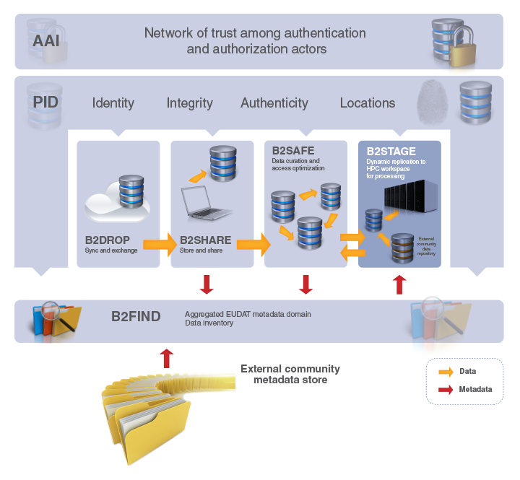
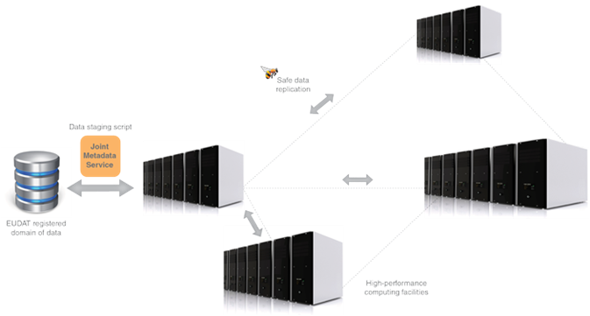
Facilitating communities to:
move large amounts of data between data stores and high-performance compute resources
re-ingest computational results back into EUDAT
deposit large data sets onto EUDAT resources for long-term preservation
Features:
high-speed transfer
reliable and light-weight
manages permanent PIDs

Slide 19
B2FIND
B2FIND is a simple, user-friendly metadata catalogue of research data collections stored in EUDAT data centres and other repositories.

Slide 20
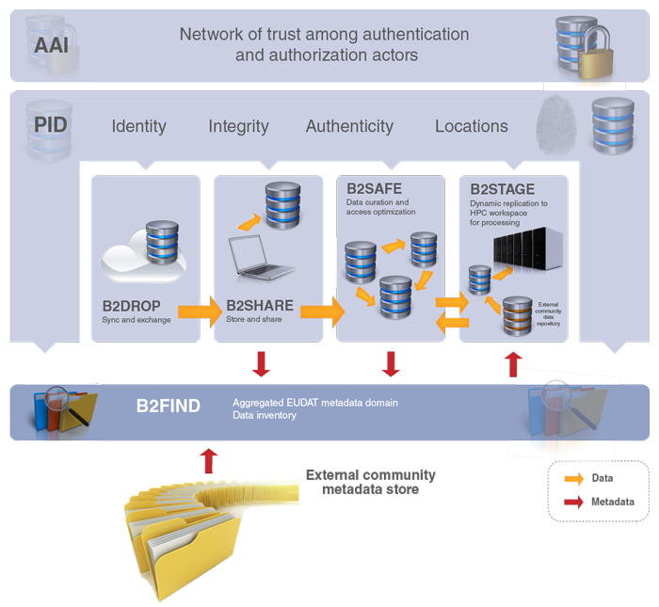
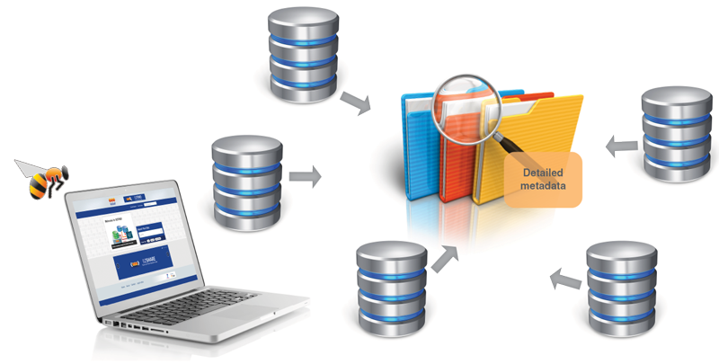
A metadata catalogue service to:
seek data objects and collections using powerful metadata searches
catalogue community data by means of selected metadata
browse through multi-disciplinary data collections filtered by content, provenance and temporal keywords
Features:
simple to use
standards-based
comprehensive catalogue

Slide 21






IDM Integration https://b2access.eudat.eu
Primary Identities
EUDAT Service Endpoints
OpenID IdPs from RIs
B2SHARE
(Oauth 2)
B2SAFE
(X.509)
ORCID
ResearchID
Scopus
e.g.
ESGF, ENES
Author IdP
B2ACCESS IdP
B2STAGE
(X.509)
Google
Facebook
Linkedin
User Profile
Social IdP
B2DROP
(SAML)
B2ACCESS AAI functions
OpenID
eduGAIN
Multi-Protocol
Identity Management,
LoA support
powered by Unity IDM
OAuth 2 authorization server
Access Token
B2HANDLE
(SAML)
SAML IdP
SAML
RIs
e.g.
CLARIN
EUDAT CA
X.509
Data Project
Coordination Portal
PRACE
EGI
WLCG
EUDAT federation database
SAML
Helpdesk TTS
X.509 IdP
PKI
Site & Service Registry

Slide 22
Roadmap Data Access and Re-Use Service Area
M12-M18
M19-M24
+M24
Mar 2016 – Aug 2016
Sep 2016 – Feb 2017
Mar 2017 – Feb 2018
B2SHARE | Release of B2SHARE 2.0 Pilot: integration with B2NOTE Pilot: B2SHARE as EUDAT CDI Metadata Store Integrate with DTR for pilot users | Support for cloud storage services like DropBox and Google Drive Support for more storage back-end solutions, e.g. cloud-storage and object stores Support versioning Support Digital Object Identifiers (DOIs) | Integration with the EUDAT Generic Execution Framework (GEF) Support for metadata extraction and data exploration via the GEF
B2DROP | Integrated with B2SHARE Integrated with B2ACCESS Deployment with Puppet and Docker

Slide 23
Roadmap Data Access and Re-Use Service Area
M12-M18
M19-M24
+M24
Mar 2016 – Aug 2016
Sep 2016 – Feb 2017
Mar 2017 – Feb 2018
B2FIND | Continued community integration Improved user experience Resolve granularity issues Integration with B2NOTE Performance and scalability improvements | Customisation of GUI for communities Prototype of SRU interface Extend harvesting methodes (OGC / CSW ) Improved search functionalities for hierarchical search and taxonomies Improved semantic mapping | SRU interface in production Integrate with EUDAT CDI Metadata Store Integration with Data Type Registry
Registry Services | Pilot instance of the Data Type Registry Collaborate with pilot communities on further evaluation and adaptation of the DTR Integrate the DTR pilot with B2ACCESS for Federated AAI Integration of the pilot DTR with B2SHARE and B2FIND | Further development of the DTR based on feedback from communities and other EUDAT services Integration of the DTR with B2NOTE | Evaluate DTR pilot Bring DTR into production Integrate DTR with other EUDAT services based on pilot evaluation

Slide 24
Roadmap Data Access and Re-Use Service Area
M12-M18
M19-M24
+M24
Mar 2016 – Aug 2016
Sep 2016 – Feb 2017
Mar 2017 – Feb 2018
B2ACCESS | B2SHARE integrated with B2ACCESS for authentication Integration with Data Type Registry pilot Integration with EUDAT CDI common HTTP REST API Integration with B2SAFE & DPM Integration with B2DROP Integration with B2STAGE Integration with Data Project Coordination Portal Installation packages & distributed setup Pilot for XACML based authorisation solution | Support for integration with external community sites Integration with PRACE Integration with EGI Distributed authorisation | Complete integration with external community sites Complete integration with PRACE Complete integration with EGI Improvements based on change requests from communities and partners

Slide 25
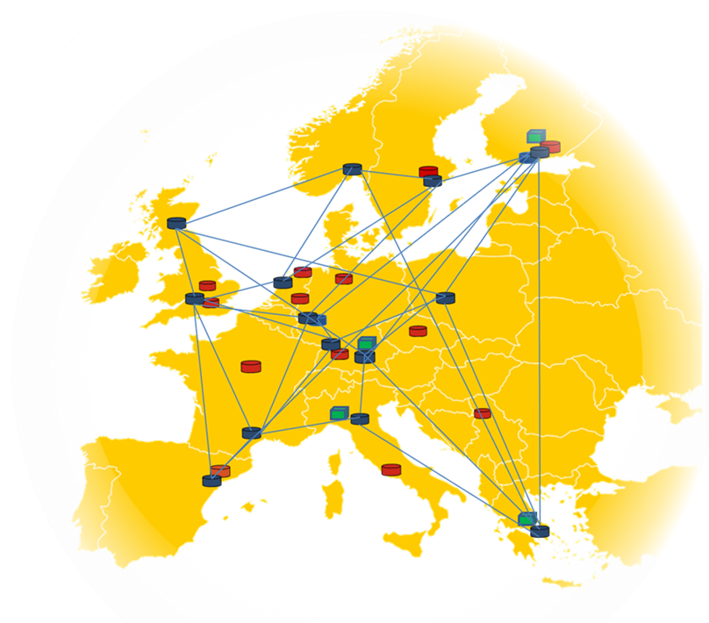


EUDAT Production Environment
Helpdesk & Support
Data Management
Project Enabling
Security Team
Network, Configuration
Compute Resources
Service Hosting,
Service on Demand
Service Deployment
Storage, Storage Services
Service and Resource Provisioning & Coordination
Operational & Central Services
25
14 generic centres, 15PB committed, 5-10Gb/s per site (potential of > 1000 PB aggregated)

Slide 26
Interactions With Users
Data Pilots
  5 biomed and life science
  7 earth science, energy and environment
  5 physical sciences and engineering
  5 Social Science and Humanities
Interactions through data project co-ordination portal
  Allows user to specify the services (QoS) that they want
    https://dp.eudat.eu/communities/EUDAT/example-of-a-data-pilot-description/view
  And request preferences for sites
  … but still needs 1 to 1 discussions on many occasions

Slide 27
Making it REALLY useful
REST API and python library
  Some services have well supported API (B2DROP (webDAV) and B2SHARE (REST)
  Other REST APIs under development

Slide 28
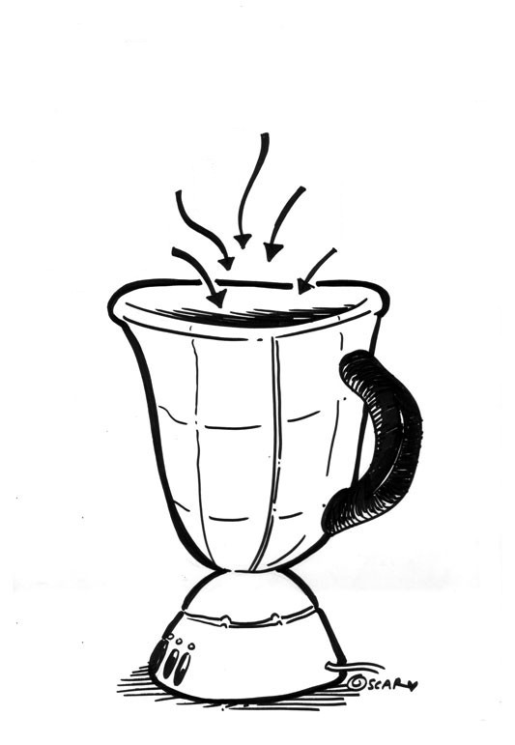

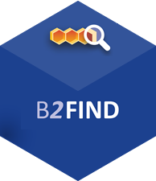
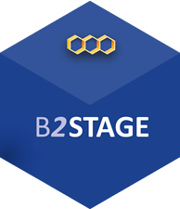
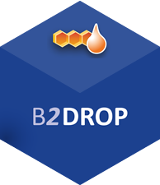
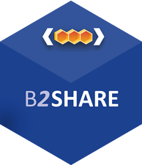
EUDAT python library (ongoing)
A programmable and flexible python API library to create and execute workflows composing different EUDAT services
Let’s make EUDAT scritable!
Enable collaborations with other projects (PRACE, EGI..)
First draft of the library:
  find datasets by community names or tags using B2FIND
  Manage transfers using Globus Online API (and FTS3 later on);
Notes:
Ingredients!
As you have seen EUDAT offers different services: from B2SAFE (for long term preservation), to B2FIND (for discovery) and then B2DROP, B2SHARE, B2STAGE as well.
What is probably missing is something which connects all these services and create synergy between them. We have many ingredients but we need something to create new recipies combaining the ingredients.

Slide 29
EUDAT python library: examples
Data search:
from eudat import b2find
# Get “aleph” dataset
datasets = b2find.get_dataset_source(community='aleph')
print 'First dataset URI = ' + datasets[0]
PID resolution:
from eudat import b2handle
# Get physical URL of the object resolving PID
URL = b2handle.get_url_by_pid("/11100/33ac01fc-6850-11e5-b66e-e41f13eb32b2")
print "Returned URL: " + URL
Data transfer:
from eudat import b2stage
# Initialize the Globus client
globus = b2stage.ClientGlobus(resource_file_path=RESOURCES_FILE, debug=True)
# Perform a data transfer between 2 endpoints (third party transfer)
task_id = globus.transfer(src_endpoint, dst_endpoint, src, dst, recursive=args['-r'])
Notes:
Some examples of what you will be able to do through the library

Slide 30
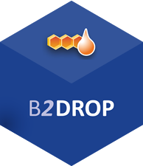

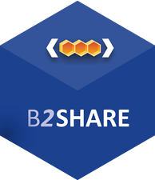

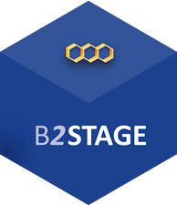
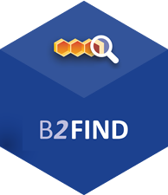
For more info:
https://b2drop.eudat.eu
https://eudat.eu/services/userdoc/b2drop
https://b2share.eudat.eu
https://eudat.eu/services/userdoc/b2share
https://eudat.eu/services/userdoc/b2safe
https://eudat.eu/services/userdoc/b2stage
http://b2find.eudat.eu
https://eudat.eu/services/userdoc/b2find

