Slide 1
Improving Performance using the LINUX IO Scheduler
Shaun de Witt
STFC
ISGC2016

Slide 2
Role of the Scheduler
Optimise Access to Storage
CPU operations have a few processor cycles (each cycle is < 1ns)
Seek operations take about ~> 8ms (25 million times longer)
Reorder IO requests to minimise seek time
Two main operations – sorting and merging
Sorting arranges block reads sequentially
Merging makes two adjacent block reads into one

Slide 3
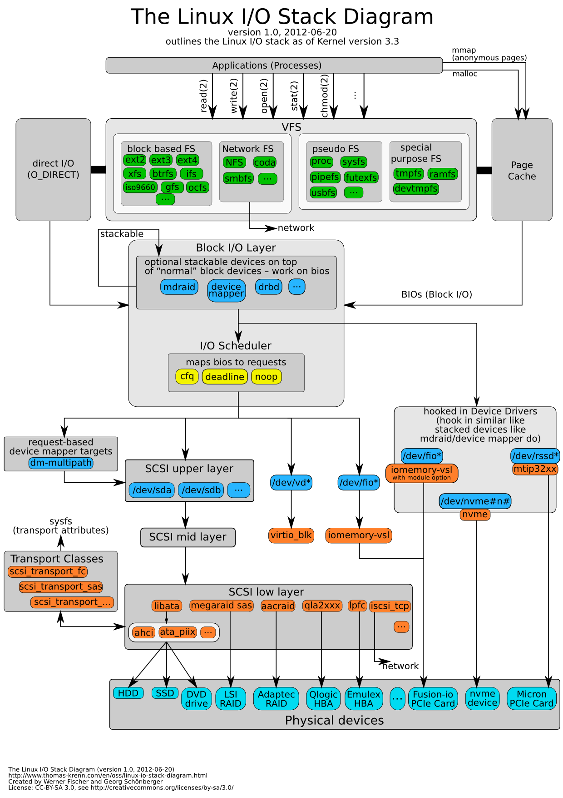
Where the Scheduler Sits
© Werner Fischer & Georg Schonberger
https://www.thomas-krenn.com/en/wiki/Linux_Storage_Stack_Diagram

Slide 4
Available Schedulers
Linux Kernel >= 2.4 has 4 schedulers
CFQ (default)
Deadline
Anticipatory
Noop

Slide 5
Completely Fair Queueing
Each IO device gets its own queue and each queue gets its own timeslice
Scheduler reads each queue in round-robin until end of timeslice
Reads prioritised over writes

Slide 6
Deadline
Three queues
Elevator queue containing all sorted read requests
Read-FIFO queue containing time ordered read requests
Write-FIFO queue containing time ordered write requests
Each request in FIFO queue has an ‘expiration time’ of 500 ms
Normally requests are served from the elevator queue, but as requests expire in the FIFO queue, these queues will take precedence
Gives good avaerage latency but can reduce global throughput

Slide 7
Anticipatory
Similar to deadline scheduler
But with some anticipatory knowledge – expectation of a subsequent read
Read requests serviced within deadline, but then pauses for 6ms, waiting for a subsequent read of the next block
In general, this works well if most reads are dependent (e.g. reading sequential blocks in a streaming operation)
But may be poor for vector reads

Slide 8
NOOP
Simplest scheduler
Only does basic merging
NO SORTING
Recommended for non-seeking devices (e.g. SSDs)

Slide 9
Hardware Set-up at RAL
Diskservers configured in RAID6 or RAID60 with 3 partitions
Allows for two independent disk failures without losing data
Uses hardware RAID controllers
Various vendors dependent on procurement
Unusual Horizontal striping
Minimise RAID storage overhead

Slide 10
RAID Configuration
FS1
FS2
FS3
‘Typical’ RAID6
Configuration
RAL RAID6 Configuration

Slide 11
Impact of Using Hardware RAID
RAID controller has fairly big cache
Able to write quickly for large periods of time
But now CFQ sees only one device (or one for each filesystem)
Scheduler sorts iops assuming a well defined disk layout
But RAID controller has a different layout and will resort it
Not normally a significant overhead, until the iops become large and effectively random
Double sorting and different cache sizes between kernel and RAID controller lead to massive inefficiencies
Almost all application time spent in WIO

Slide 12
What made RAL look at this

Slide 13
CMS Problems
Accessing disk-only storage under LHC Run 2 Load
All disk servers (~20) running at 100% WIO
Only certain workflows (pileup)
Job efficiencies running <30%
Other Tier 1 sites also had problems, but were much better (~60% CPU efficiency)
‘Normal’ CPU efficiencies run >95%

Slide 14
Solutions…
Limit number of transfers to each disk server
Jobs timeout waiting for storage system scheduling
Means few jobs run well, but most fail
Limit number of pileup jobs on the processing farm
No reliable mechanism for identifying them
Add more disk servers
Would work, but would have cost implications

Slide 15
Finally…
Try switching scheduler…
Can be done and reverted ‘on the fly’
Does not require a reboot
Can be applied on a single server to investigate the impact
Preemptive CAVEAT
Don’t try this at home!
Software RAID and different RAID controllers will behave differently
Only do this if either
Your storage system is already ‘overloaded’
You have tested the impact with your hardware configuration

Slide 16
Anecdotal Impact
Switched to NOOP scheduler
WIO reduced from 100% to 65%
Throughput increased from 50Mb/s to 200Mb/s
Based on making a change to 1 server under production workload

Slide 17
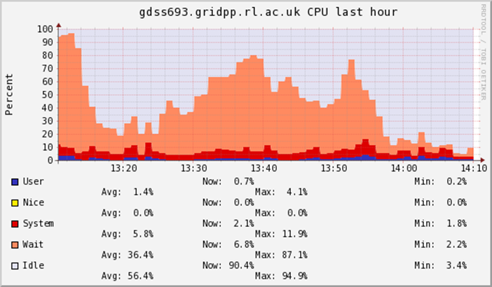
Anecdotal Impact

Slide 18
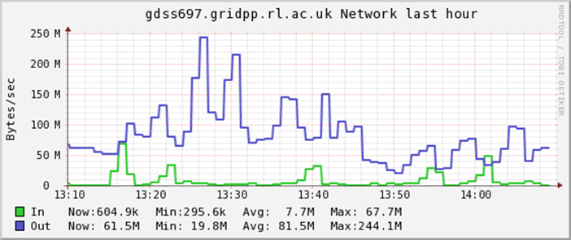
Anecdotal Impact

Slide 19
Attempt to Quantify
Heavy WIO reproduced by
Multiple jobs reading/writing whole files (1GB random data)
Different R/W mixing
Using xrootd protocol
200 different files for reading (try to remove any effect of caching reads)

Slide 20
50-50 Job Mix

Slide 21
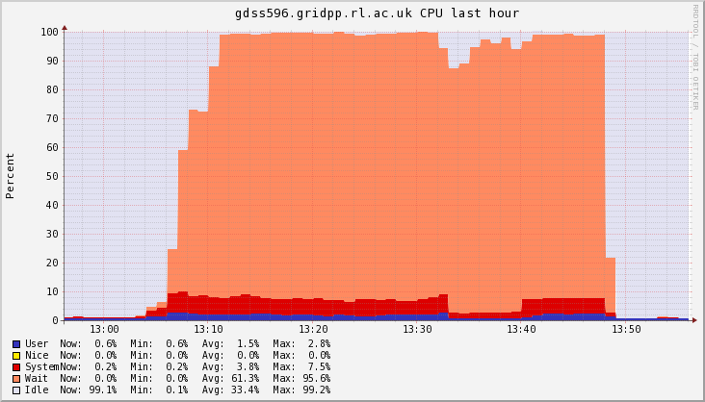
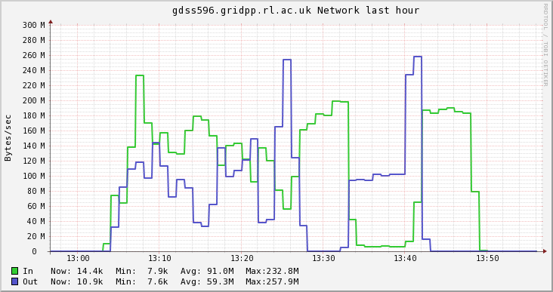
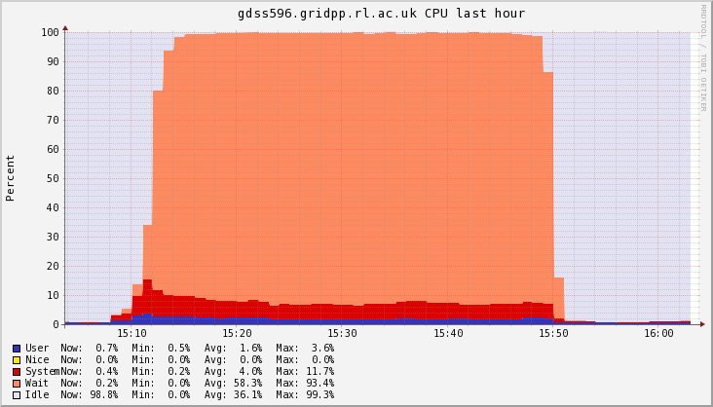
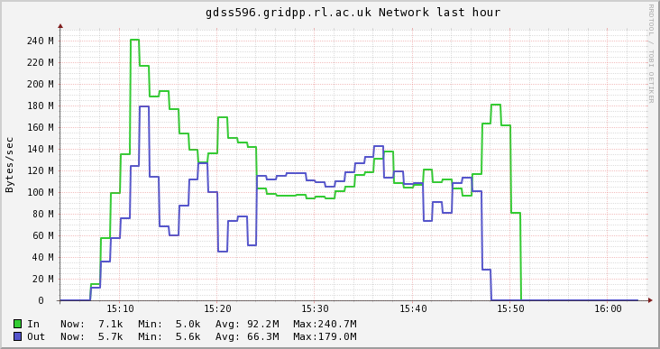
50-50 Job Mix (100 jobs)
CFQ
NOOP

Slide 22
Read Dominated (80-20) Job Mix

Slide 23
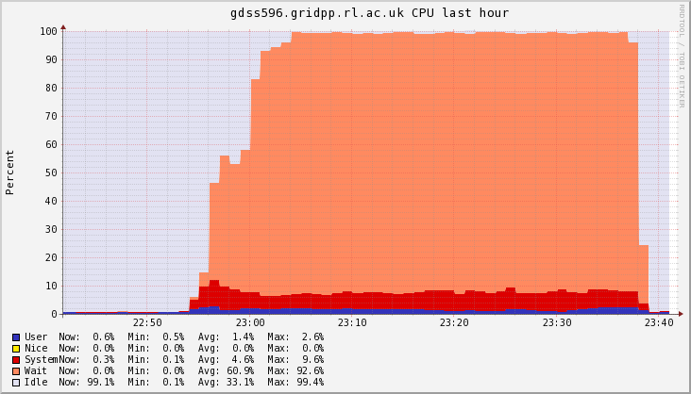
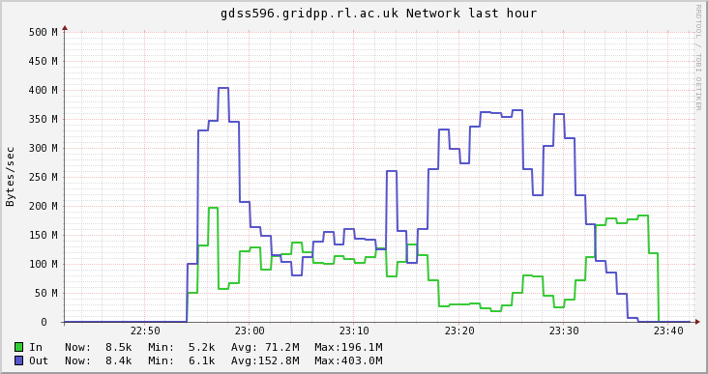
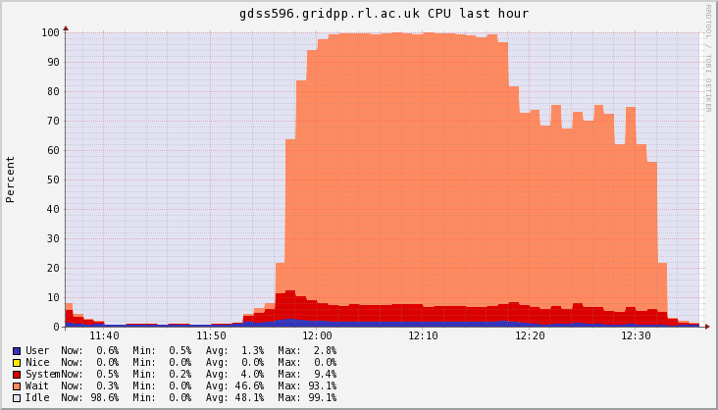
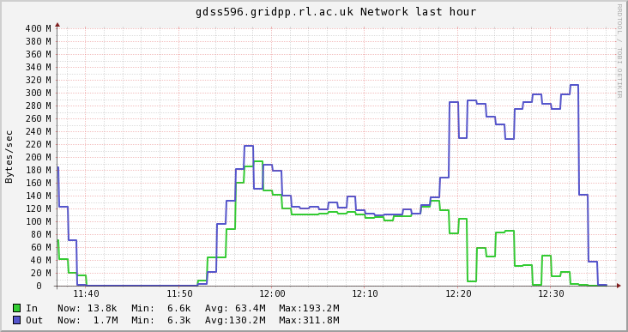
Read Dominated Job Mix
CFQ
NOOP

Slide 24
Write-Dominated (20-80) Job Mix

Slide 25
Read Dominated Job Mix
CFQ
NOOP

Slide 26
Summary & Conclusion
Attempted controlled tests showed no significant benefit of using NOOP or CFQ schedulers
ATLAS problems bear this out
… or to spin results positively
There is no detriment observed to using NOOP over CFQ
Left with the question what is it about the pile-up jobs that causes such a bad impact on the disk servers, and why does NOOP give such a big gain
Questions – Because I still have many!

