Slide 1
An ICT architecture for environmental computing applications
Nils gentschen Felde, Matti Heikkurinen, Dieter Kranzlmüller
Munich Network Management Team
Ludwig-Maximilians-Universität München (LMU)

Slide 2
Environmental computing – working definition
Common characteristics
Involves advanced modelling of environmental phenomena
Multi-model, multi-scale
New phenomena, new approaches
Inter- or transdisciplinary nature
Aiming at producing actionable knowledge
Problem oriented: hazard analysis, risk management and reduction, operational disaster response
With robust management and sustainability approaches
Ambition towards infrastructure-like services
Availability and reproducibility of results – beyond lifetimes or projects and research careers

Slide 3
Demand for environmental computing

Slide 4
GAR – Global Assessment Report on Disaster Risk Reduction 2015
http://www.preventionweb.net/english/hyogo/gar/2015/en/home/GAR_2015/GAR_2015_6.html

Slide 5
Demand for environmental computing

Slide 6
Munich Re – Loss Events Worldwide 2014
http://www.preventionweb.net/files/41773_munichreworldmapnaturalcatastrophes.pdf

Slide 7
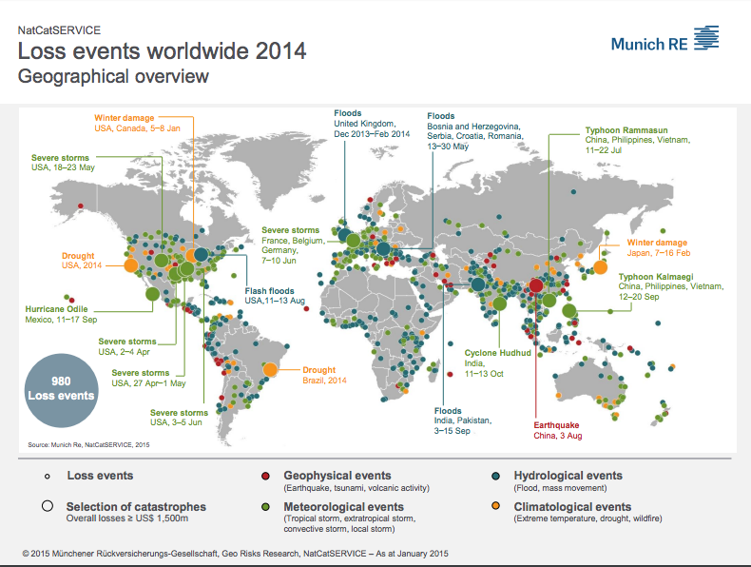
Munich Re – Loss Events Worldwide 2014
http://www.preventionweb.net/files/41773_munichreworldmapnaturalcatastrophes.pdf

Slide 8
Key Gaps
(as observed during the DRIHM project)
Technical interoperability and portability
Models
Data formats
Execution environments
Metadata describing them
Semantics
Workflows linking all of the above together
Pre-DRIHM hydrometeorological model chain would have taken weeks of manual integration work
Despite the fact that webservices and science gateways are available

Slide 9
Actionable Knowledge
How we could have used the information if it was available beforehand?
How could we utilize the outcomes of environmental computing for societey?
Links with civil protection
Risks due to a disaster with a certain probability vs. certain risks related to evacuation
False alarms? We don’t want to be the “computer that cried flood”
There are rules regarding how much of a lead-time warning the population needs (30 minutes warning might make society more vulnerable)

Slide 10
Communicating the Results
How can non-scientists use the information?
Civil protection model probably fairly well-established (“client” is used to data with certain uncertainty built in)
Risk reduction: need to answer questions related to long-term infrastructure development projects and policy formation
Injecting uncertain data into political process!!
Dealing with financial interests unavoidable: protection infrastructure in itself, impact on development:
No building permits on flood-prone areas, housing developers not happy
Re-classifying existing housing, house owners not happy (lose flood insurance or increase in premiums)

Slide 11
How to address the technology-related challenges?
Case: HMR model chains

Slide 12
HMR model chain - conceptual

Slide 13
Initial DRIHM HMR model chain components

Slide 14
eScience infrastructure to support HMR models

Slide 15
eScience infrastructure to support environmental computing
The interface block
Notes:
What you get here for “Free” is the interface to queuing systems (out of the box). What needed to be added was support for arbitrary resources that may not have queue interface, nor do they have the HMR software installed. This was done through the “input.tgz” method that bundles input, config files together with the workflow

Slide 16
eScience infrastructure to support environmental computing
HPC resources used for optimised SW packages
Notes:
Stuff that is mature, used on the scale that requires “big iron”. Optimised, scalable etc. (*Do we have examples of HMR packages that would be pre-installed on the supercomputers?*)
Another use case was SaaS services that were tied to a specific execution environment due to licensing issues
N.B. Jülich ran MesoNH and SuperMUC WRF (pre-installed) – in case someone asks

Slide 17
eScience infrastructure to support environmental computing
“Challenging” resources
Notes:
This is the stuff that is important enough that you don’t get root access, but with low enough opportunity cost that running slightly less optimised software is possible. Essentially you can do more or less anything in the user space, which is nice. In the case of HMR software, the usual practice of sending source code and running the compilation as the first step was deemed unfeasible. The compilation would have taken long (relative to typical job length) and would be error prone (modified libraries)

Slide 18
eScience infrastructure to support environmental computing
Discovery and authentication to the “Challenging” resources
Notes:
Fairly standard stuff – MyProxy service to delegate credentials for Gird resources, information service that lists available resources (*is this maintained manually or is there mechanisms that resources can sign in?*)

Slide 19
eScience infrastructure to support environmental computing
The “Magic part”
Notes:
This is the repository holding application binaries, user-space libraries and static data (e.g. HMR models like WRF and the libraries/tools they depend on - in this case mostly mathematical libraries and phython-related stuff) that is versioned and copied – on demand – to the nodes executing the HMR software.
The actual copying of the binaries and static data is based simply on rsync.

Slide 20
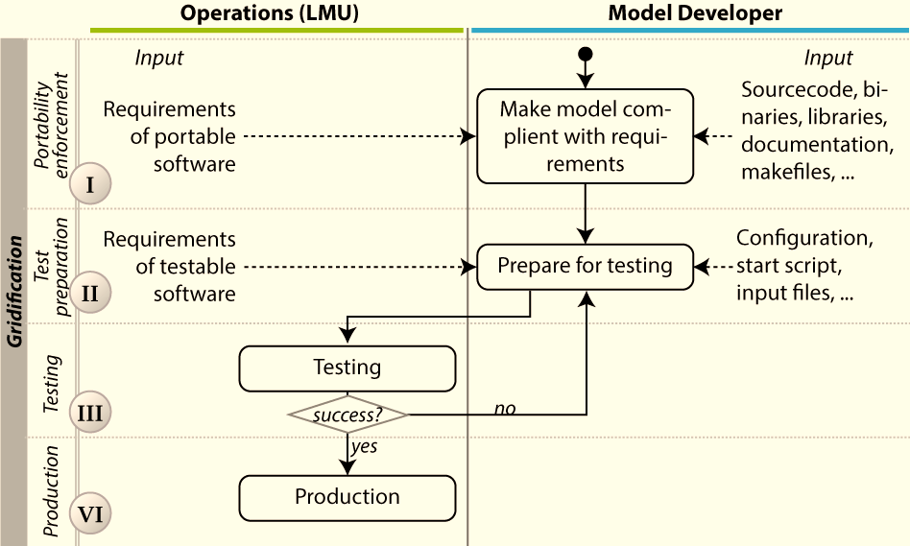
Making “The Magic”
Notes:
The requirements include metadata description: license, documentation of the environmental requirements (specific library versions, environmental variables used to access them etc).
Testing is basic module testing (*How are the test cases described? What tools are used for the module/unit testing*), basically to see that the installation & execution script works
The line between the “model developer” and “Operations” is not a strict barrier, but denotes the process ownership. In practice the progress was dependent on two-way consultation

Slide 21
Model metadata snippet

Slide 22
Running the model

Slide 23
Workflow from other domain – similar use case
Parameter to
earthquake
source from
DB (EMSC)
Wave forms
from
data base
(ORFEUS)
Simulation
runs with
different
solvers and
models (LRZ)
Graphical
representation
of phase and
amplitude
information
Interactive
and
automatic
data mining
(IPGP)
Visualisation of the real
and synthetic
data (SARA)
Update of subsurface
Models
(LMU)
Re-calculation
of all earth-
quake source
parameters with
best model
Update of
event data base
with improved
positioning
Prof. Igel, LMU

Slide 24
Could you just use Cloud or containers?
Yes, but you’d still need to:
Port applications (in most cases) or bridge between different clouds
Bridge between different Cloud systems
Have functions similar to static data & binary repositories
Accept some performance penalty
Find mechanisms to maintain libraries in the VMs (versioning)
And most importantly: collect the model metadata(!)
Will all the resources have a Cloud or container interface
We are starting to lean towards “eventually yes”, but are we certain?
Conceptual framework and many of the components should be reusable
“Export to VMs” functionality for the binary/static data repository?

Slide 25
Conclusions
It is possible to take software components not originally intended for distributed environments turn them into DCI services
The model metadata approach, execution environment (“start.sh process”) and supporting processes protect against errors that could otherwise be hard to detect
E.g. slightly different behaviour of pre-installed libraries
Crucial in a system that contains model chains that are potentially executed automatically
The process of building and testing the “user space” execution scripts:
structured the collaboration
recorded tacit information about the model and its behaviour
E.g. the environmental dependencies included in the metadata

Slide 26
Conclusions 2
The model could easily be extended
To other scientific disciplines
To use container-based resources or arbitrary cloud services
The dedicated effort is mostly related to (technical) model descriptions
The approach leverages development efforts in both DCI and broader Un*x community
The model description overhead should be seen largely as an investment in the model developer/operations relationship
The portability of the model was tested during the DRIHM2US project
Adding XSEDE resources didn’t require any changes in the SW(!)

Slide 27
For more information
Environmental computing
www.envcomp.eu
info@envcomp.eu
DRIHM framework
Nils gentschen Felde (felde@nm.ifi.lmu.de) MNM-Team, LMU, Munich Germany www.mnm-team.org

