Slide 1
Considerations on Using CernVM-FS for Datasets Sharing Within Various Research Communities
Catalin Condurache
STFC RAL UK
ISGC, Taipei, 18 March 2016

Slide 2
Outline
Introduction
Bit of history
EGI CernVM-FS Infrastructure Status
What is a dataset?
Dataset sharing with CernVM-FS
Use cases

Slide 3
Introduction - CernVM-FS?
CernVM File System is a read-only file system designed to deliver experiment software to grid worker nodes over HTTP in a fast, scalable and reliable way
Built using standard technologies (fuse, sqlite, http, squid and caches)

Slide 4
Introduction - CernVM-FS?
Files and directories are hosted on standard web servers and get distributed through a hierarchy of caches to individual grid worker nodes
Mounted in the universal /cvmfs namespace at client level

Slide 5
Introduction - CernVM-FS?
Software needs one single installation, then it is available at any site with CernVM-FS client installed and configured
Relocatable, dependencies included
Standard method to distribute HEP experiment software in the WLCG, also adopted by other grid computing communities outside HEP

Slide 6
Introduction - CernVM-FS?
Due to increasing interest, technology has been optimized also for access to conditions data and other auxiliary data
file chunking for large files
garbage collection on revision level
file system history

Slide 7
Introduction - CernVM-FS?
Also because of use of standard technologies (http, squid) => CernVM-FS can be used everywhere i.e. cloud environment, local clusters (not only grid)
I.e. add CernVM-FS client to a VM image =>
/cvmfs space automatically available

Slide 8
Bit of History – CernVM-FS
Last 5+ years distribution of experiment software and conditions data to WLCG sites has been changed massively
CernVM-FS became the primary method
No need of
local installation jobs
(heavy loaded) network file servers
It relies on a robust decentralised network of repositories replicas and caches

Slide 9
Bit of History – CernVM-FS
In parallel the use of CernVM-FS in communities outside WLCG and HEP has been increasing steadily
Growing number of repositories and CernVM-FS servers around the world

Slide 10
Bit of History – CernVM-FS
~3 years ago RAL Tier-1 started a non-LHC Stratum-0 service
Inception of EGI CernVM-FS infrastructure
The European Grid Infrastructure (EGI) enables access to computing resources for European scientists and researchers from all fields of science, from High Energy Physics to Humanities

Slide 11
EGI CernVM-FS Infrastructure Status
Proxy
Hierarchy
Stratum-0 NIKHEF
nikhef.nl
Current topology
Stratum-1 NIKHEF
Proxy
Hierarchy
Stratum-0 RAL
egi.eu
Proxy
Hierarchy
Stratum-1 CERN
Stratum-1 RAL
Stratum-0 DESY
desy.de
Stratum-1 ASGC
Stratum-1 DESY
Proxy
Hierarchy
Stratum-1 TRIUMF

Slide 12
EGI CernVM-FS Infrastructure Status
Topology follows WLCG model
Stratum-0 are disjoint and represent the source repositories where software is installed by VOs
Stratum-0, Stratum-1 can be geographically co-located or not
It partially makes use of the existent hierarchy of proxy servers used for LHC software distribution

Slide 13
EGI CernVM-FS Infrastructure Status
37 software repos currently hosted and replicated
HEP and non-HEP
Stratum-0s at RAL, NIKHEF, DESY
Stratum-1s at RAL, NIKHEF, TRIUMF, ASGC
5 repos at the time of EGI CernVM-FS Task Force
kick-off (Aug 2013)
BIG change in two-and-half years!

Slide 14
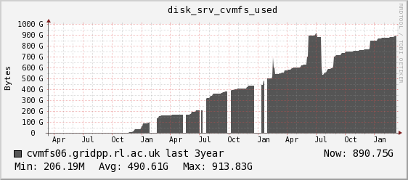
EGI CernVM-FS Infrastructure Status
Stratum-0 at RAL
29 repos
2.15 Mio files
6.65 Mio on uploader
829 GB
~107KB average filesize
(between 36KB and 3MB)

Slide 15
EGI CernVM-FS Infrastructure Status
At RAL – 29 repositories on Stratum-0
Some more dynamic / less dynamic
pheno.egi.eu – 377 releases phys-ibergrid.egi.eu – 5 releases
t2k.egi.eu – 139 releases glast.egi.eu – 4 releases
Some big / not so big
chipster.egi.eu - 313GB phys-ibergrid.egi.eu - 69MB
biomed.egi.eu - 177GB ligo.egi.eu - 2.8GB
t2k.egi.eu – 59GB wenmr.egi.eu – 3.8GB

Slide 16
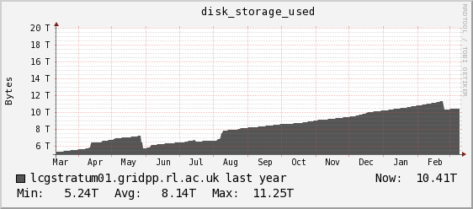
EGI CernVM-FS Infrastructure Status
Stratum-1 at RAL
It replicates 58 repos from
RAL, NIKHEF, DESY, OSG,
CERN
Over 10 TB

Slide 17
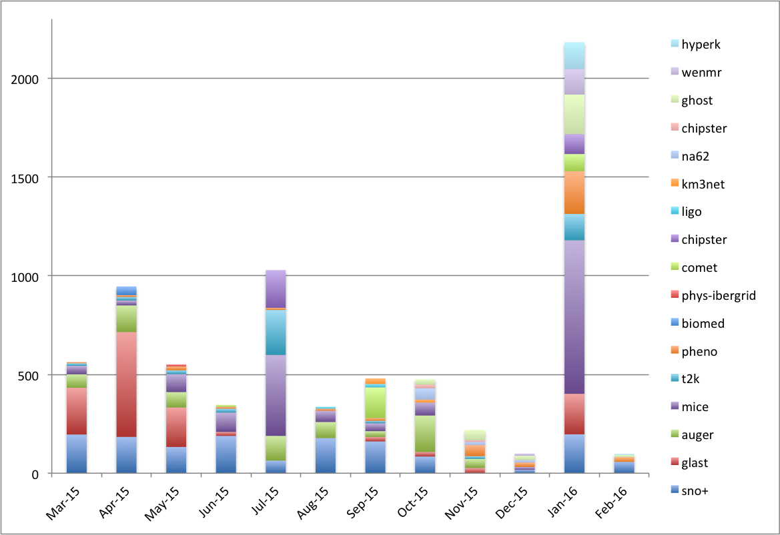
EGI CernVM-FS Infrastructure Status
Last 12 months activity – egi.eu
Hits by repository on Stratum-1@RAL
x1000

Slide 18
What is a Dataset?
Collection of data
A file is the smallest operational unit of data
Files are aggregated into datasets (a named set of files)
Datasets can be grouped into containers (a named set of datasets)

Slide 19
What Is a Dataset?
If possible, files are kept large (several GB)
Datasets often contain thousands of files with events recorded under “constant” conditions
All this from a LHC / HEP perspective
Is this true from an EGI non-HEP research community perspective?

Slide 20
Datasets Sharing with CernVM-FS?
Nowadays CernVM-FS used for software (and conditions data) distribution
Grid jobs tend to be started in large batches running the same code
High cache hit ratio at proxy cache level
In what situations…
Can datasets be shared via CernVM-FS?
Well…

Slide 21
Datasets Sharing with CernVM-FS?
Datasets are usually large amount of data (big-sized files) that are not quite appropriate for distribution via CernVM-FS…
While the system can cope with big files nowadays (file chunking), pure data set distribution would render any kind of cache useless (especially at client level)
The low cache hit ratio would impact the proxy caches engineered with relatively low bandwidth

Slide 22
Datasets Sharing with CernVM-FS?
…but could be considered within some limits though…
There is at least some sharing involved
very frequent data re-accessing
datasets that are required by many nodes simultaneously (i.e. conditions data)
Burst of co-located clients that are using the same data
When datasets are small and proper dedicated storage not first option (or not available)

Slide 23
Use cases
CERN@school
Educational purpose
Small test data sets < O(10MB) included within the repositories
New users can get started straight away with the code
Also for software unit tests

Slide 24
Use cases
As for "production" data sets - currently relying on a multi-VO DIRAC setup to manage the data via the DIRAC File Catalog (DFC) - it has the needed metadata capabilities

Slide 25
Use cases
Using CernVM-FS to distribute several genomes and their application indexes and some microarray reference datasets to Chipster servers
Chipster could also use CernVM-FS for distributing other research datasets too
BLAST databases indexes – needed to do sequence similarity searches for protein or nucleotide sequences (~100GB)

Slide 26
Use cases
Adding BLAST DBs to the current Chipster, would increase the size of the virtual image by 100 GB - too much
New releases of the databases are published about once a month. If incorporated to the Chipster image, the users would need update their (too big) virtual images regularly

Slide 27
Use cases
By using CernVM-FS the latest versions of BLAST datasets could be provided to the Chipster users in a centralized and more effective storage way
Very interested to continue using CernVM-FS for sharing both scientific tools and datasets for the Chipster servers running in EGI Federated Cloud

Slide 28
Use cases
Some dataset distribution
~180 MB of data that have to be always fed as an input to the simulation - it sets up the environment
It is possible to have to upload another set of input data in order to have a different setup

Slide 29
Use cases
LIGO (UK)
Recent dataset was 1.5TB in 5400 files
12 directories, each file up-to 450MB
Not suitable, but…

Slide 30
Use cases
…from time to time people create fake data with fake signals
Fewer files, so might be a good fit for CernVM-FS
Waiting for the opportunity to arrive

Slide 31
Use cases
AUGER
Do not plan to use CernVM-FS for a data distribution in the near future
May consider it for distribution of some relatively small databases, but not yet even a plan for tests

Slide 32
CernVM-FS vs Datasets Sharing - Conclusions
CernVM-FS should not be first option…
It may affect the performance of the service at Stratum-1 and squid level
…if some conditions do not meet
At least some sharing involved, like very frequent data re-accessing
Or data sets that are required by many nodes simultaneously (i.e. conditions data)

Slide 33
CernVM-FS vs Datasets Sharing - Conclusions
Use instead a Storage Element (SE)…
Not always possible
…or setup a Web server…
/cvmfs/<path_to_file> ->
wget http://host/<path_to_file>
Still could make use of squids and caches
…or use NFS for local storage

Slide 34
CernVM Users Workshop, RAL, 6-8 June 2016
- https://indico.cern.ch/event/469775
- registration open!

Slide 35
Other Conclusions?

Slide 36
Thank you!

