Slide 1
QoS and DLC in IaaS INDIGO-DataCloud
Presenter : Patrick Fuhrmann
Contributions by:
Giacinto Donvito, INFN
Marcus Hardt, KIT
Paul Millar, DESY
Alvaro Garcia, CSIC
Zdenek Sustr, CESNET
And many more
With kind contributions by Shaun DEWITT, EUDAT

Slide 2
Content
Introducing INDIGO-DataCloud.
What is the issue with QoS in Storage ?
Which part are we trying to solve ?
What is our approach ?

Slide 3
INDIGO DataCloud Cheat Sheet
H2020 Project
Approved Jan 2015
Started April 2015 – Ends Sep 2017= 30 months
26 European Partners
11 European Countries
> 11 Million Euros
Objective : Develop an Open Source platform for computing and data, deployable on public and private cloud infrastructures.
Requirements and use-cases collected from 11 INIDIGO communities.
For further details : http://indigo-datacloud.eu

Slide 4
INDIGO DataCloud WP structure
WP1 | Management
WP2 | Community requirements
WP3 | Software Management Pilot Services
WP4 | IaaS, Resource Virtualization
WP5 | PaaS, Platform
WP6 | Portals and user access
Stolen from Alvaro’s, Andrea’s presentation

Slide 5
WP4 in detail
Virtualized Computing Resources
Full Container support for Cloud Management Infrastructures and Batch
Container support for special hardware (Infiniband, GP-GPU’s)
Spot Instances
Fair Share Scheduling
Virtualized Storage Resources
QoS and Data Life Cycle for storage (storage management)
Access to data by meta data instead of name space
Dual access to data (Object Store versus POSIX file name space)
Identity Harmonization for storage
Virtualized Network Resources
Orchestrating local and federated network resources
“Software Defined Network” evaluation
Services and Appliances for for virtual networks

Slide 6
Why QoS and DLC
EU requires to provide a “Data Management Plan” from all data intensive EU projects.
Problem :
No common way to describe QoS or Data Life Cycle
No common way to negotiate QoS with storage endpoints (except for SRM systems ☺ )
Common definitions for QoS would be very convenient in general but inevitable for PaaS layers, as the negotiation resp. brokering is done by engines. (Similar to hotel or flight finders)

Slide 7
Description of Work for WP4
Define a common vocabulary for QoS storage properties and their values based on use cases from scientific communities :
Involve standardization bodies, e.g. RDA, OGF
Define a semantics to negotiate QoS with endpoints
Find a real network protocol (prototype or demonstrator) and implement the defined QoS semantics for different systems.

Slide 8
Introducting part of the issue
Storage provisioning for large public infrastructures is facing two contradicting problems
The complexity of storage and storage management
The large variaty of sciencies and their diverging expectations on storage

Slide 9
Infrastructure Problem
Infrastructures
Are growing in
size of storage and
number of supported sciences and communities and
Number of direct customers accessing storage
They all have different ideas on how to use storage.
Serving them in the old fashion doesn’t scale any more
So you need an API’s or portals to let them select what they need
Infrastructures are used by platforms, which
tend to federated resources from different locations and storage providers.
So storage needs to be brokered and procured automatically (or programatically)

Slide 10
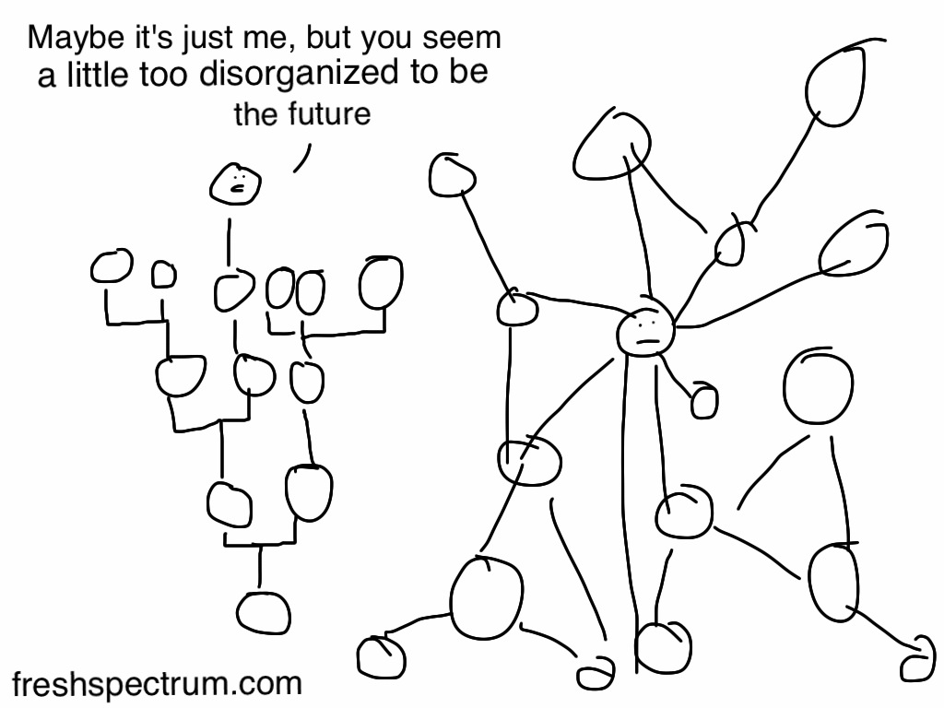
Examples for Storage Complexity

Slide 11
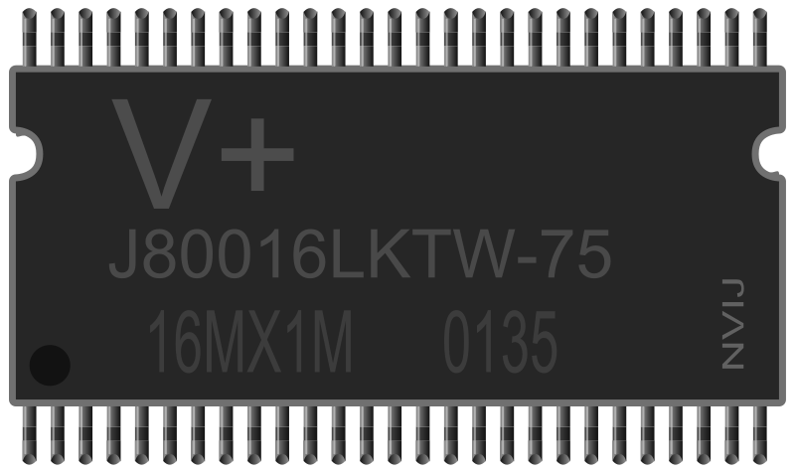
Quality of Service based on media
Media
Quality
Access
Latency
HIGH
MEDIUM
LOW
MEDIUM
MEDIUM
Durability
OK
MEDIUM
Not so clear
Quite OK
OK
Datarate
OK
OK
MEDIUM
OK
OK
Cost
Very low
Reasonable
Very high
MEDIUM
MEDIUM

Slide 12
Not quite as easy as that
It looks simple, but there are issues.
Starting with:
What are storage properties.
What are storage property values.

Slide 13
Storage quality properties and values
Property
Property Value
Access Latency
How long does it take from the request for a byte to receiving that byte.
Retention Policy
What is the probability of data loss.
Access Mechanisms
http, GridFTP, NFS, ….
Security
encrypted during the transfer, on disk, end – to – end.
Authentication
SAML, Open ID Connect, Password, X509

Slide 14
How many QoS properties ?
Is there a sufficiently complete set of properties ?
In WCLG we only had two properties :
Access Latency
Retention policy
That was already too much for most people ☺
Talking to Reagan Moore (IRODS) at the Paris RDA meeting:
He is suggesting about 200 properties
That might be a bit over the top for a start

Slide 15
Even more complexity
QoS Property “Value Ambiguity”
Property dependencies
Property Quantization
Non standard property zoo of existing system

Slide 16
QoS Property Value Ambiguity
1 day
1 hour
1 ms
1 ns
Access Latency
archive
backup
streaming
HPC
High Ambiguity
Cheapest
Fastest

Slide 17
Property dependencies
Durability
Access Latency

Slide 18
Property Quantization
Multi Dimensional Property Quantization
More
Data
Cost
S3
Glacier
Access Latency

Slide 19
Properties zoo of existing systems
Amazon
S3
Glacier
Google
Standard
Durable Reduces
Availability
Nearline
HPSS/GPSS
Corresponds to the HPSS Classes (customizable)
dCache
Resilient
disk+tape
TAPE

Slide 20
Time to tidy up !
Starting with the unambiguous technical view, seen by the storage system.
Canonical Properties

Slide 21
What are canonical properties ?
Class A
Class B
Class C
Access Latency
< 1 ms
< 10 min
Avoiding ambiguities
Durability
< 0.9999
0.99999999
******
Media
Disk / SSD
Tape
Replicas
1 Disk
2 Tape
Price
10 E/m/GB
20 E/m/GB
!!! For EUDAT, those “Classes” are close to their “Services”

Slide 22
How to get …
So after having defined
Canonical Stroage Properties
and their values …..
How to get them
out of existing storage systems ?

Slide 23
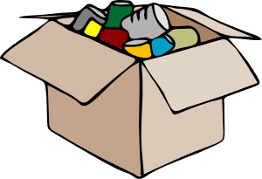
Canonical Storage Properties
Canonical Storage
Property Information
Storage
Access
Storage System
dCache
StoRM
EOS
Slightly extended Information Provider
(internal component)

Slide 24
Canonical Storage Properties
Canonical Storage
Property Information
Storage
Access
Storage System
Canonical Storage
Property Information
System
(external component)
HPSS. GPSS
Google
Amazon
Plug-in
Proprietary Storage
Property Info

Slide 25
Customer View
The canonical view only helps to describe the system on the technical level.
It’s not very helpful for the storage enduser.
We need to introduce more convenient
QoS views.

Slide 26
QoS views
Examples on how a user would decribe his/her needs
Low latency & Lowest price
Highest possible throughput & Short term
Scratch & Very cheap
Long Term Storage & Price not important

Slide 27
That’s what customers would expect
Your
Magic
Storage
Wand
Basic
How much storage do you need ?
100 G
1 T
10 T
100 T
1 P
Dynamic
Quality
Scratch
Pretty Good
Rock Solid
Euros/Month
Access
WebDAV
GridFTP
NFS 4.1 / pNFS
1,05
Advanced
Expert ( Extra Costs may apply ☺ )

Slide 28
That’s what customers would expect
Your
Magic
Storage
Wand
Basic
Advanced
Expert ( Extra Costs may apply ☺ )
Media
Disk
Tape
SSD
Tape Remote
Access Latency
100
Nano Seconds
Euros/Month
Retention
0.999999
Absolute
Access
http
WebDAV
GridFTP
NFS 4.1 / pNFS
1,05
Security
X501
SAML
Open ID Connect
Password
Extre
Attach OID’s
Support Macaroons

Slide 29
Therefore: Introducing a new service

Slide 30
Discover and Match
Canonical Storage
Property Information
Customer View
Property Class ID
Optional Properties
COST = Cheapest
MEDIA=Tape
ACCESS=medium
Class = XYZ
For that particular
system
Discover
&
Match

Slide 31
Translation and discovery
GUI
Discover
&
Match
Platform
Service
Or
High level Broker
Canonical Storage
Property Information
REST API

Slide 32
Canonical property federation
GUI
Platform as a
Service
Canonical Storage
Property Information
System
D&M
REST API
D&M
D&M
GUI
IaaS
REST API

Slide 33
Federated Systems
The federated system provides additional QoS properties.
Number of copies, not in the same location
Minimum geographic distance for disaster cases. (fire, earthquakes)
Legal implications : Privacy laws

Slide 34
To summarize the procedure
Storage Systems provide a set of ‘classes’ describing standardized storage properties with standardized values.
Neither the name of the classes nor the combination of properties are standardized, they depend on the storage system.
Like S3 and Glacier are the names of the class
Matchmaking software tries to match the various classes to the non standard and site specific requirements of the communties or individuals and returns the closest match to the customer.
For further requests, the customer will use the ‘class name’ in the request. That could be a directory, a space token or a container.

Slide 35
More problems to solve
How does the client provide the storage class to the storage system ?
Bucket
Directory
Additional argument in WebDAV, FTP etc
The system only provides the class, it doesn’t ‘promise’ the space.
Do we need a space reservation protocol ?
Similar to hotels.com. Check hotel pictures first, reservation only after payment.
Is reservation required in systems with unlimited space (Clouds) ?
Do we allow to change the storage class, assuming the system will do the necessary data movements ?
This is of course just a storage system property.
Amazon and Goolge don’t
dCache and HPSS do.

Slide 36
Current status
Creating a RDA working group (Paris and Tokyo)
Name : Quality of Service and Data Life Cycle Definitions WG
Currently agreeing on a Charter.
10 Committed members (sites and communites, Elexier …)
Contibuting to the SNIA CDMI reference implementation, as this is our planned transport for QoS steering.
Defined version 1 of RESTFUL API
Defining a CDMI extention to describe the storage properties and values.
Implementations are ongoing for dCache, StoRM and the GPFS and TSM pluggins.
Paul.millar@desy.de
INTERESTED ?

Slide 37
Summary
INDIGO provides funding to standardize QoS and possibly Data Life Cycle of systems
Scientific communities and EUDAT are showing interest in those activities.
Common definition of QoS is essential for Platform as a Service for storage.
RDA ‘Interest Group’ being built to get in touch with more communities.
Prototype implementations are in progress (dCache, StoRM, HPSS, …)
Contribution or ideas from your side are more than welcome.

Slide 38
Further reading
First Proposal for restful representation of our ideas.

