Slide 1
Authentication and Authorisation for Research and Collaboration
Alessandra Scicchitano
NA2 WP Leader, GEANT
Taipei Taiwan
3 March 2016

Slide 2
AARC – Authentication and Authorisation for Research and Collaboration
Started on 1 May, 2015
Two-year EC-funded project
20 partners
  NRENs, e-Infrastructure providers and Libraries as equal partners
About 3M euro budget
https://aarc-project.eu/
Working now on the proposal for AARC2

Slide 3

And where is this coming from????
The growth of demand for federated access
Many use cases for ID Feds
Various existing AAIs
Nice! BUT…
Notes:
Federated access is gaining momentum as demand for it increases.
The advantage of federated access is that the identity of users is verified by the institution that issues the users’ credentials. Users can access different services with the same credentials an at the same time the research e-Infrastructures can offer resources in a more controlled.
Besides eduGAIN and national identity federations, various Authentication and Authorisation Infrastructures (AAIs) like eduroam (federated access to networks), AAIs operated by various research and education collaborations and e-Infrastructures (EGI-AAIs, PRACE-AAI and so on) and Project Moonshot (to enable federated access to non-Web-based resources and services).

Slide 4

It would be nicer if there was also compatibility & interoperability
Notes:
The lack of seamless integration among the different AAIs operated by the various research collaborations and e-Infrastructures,
In addition to interoperability, functional gaps also exist. Like support for aggregating information (attributes) needed for authorisation purposes from multiple attribute providers, better support for Single Sign-On for non-web applications, and so on and so forth.

Slide 5

Common challenges
Attribute aggregation
User
friendliness
Credential translation
Attribute release
Levels of Assurance
Homeless
users
Bridging Communities
Non-web-browser
Notes:
Attribute aggregation: Most federated identity management systems are limited by users' ability to choose only one identity provider per service session. There should be a linking service that lets users securely link their various identity provider (IdP) accounts without having to authenticate separately to each IdP.
User friendliness: The tools that support the FIM framework should be simple and intuitive and integrate with the many other IT tools used in daily life.
Credential translation: Converting credentials to different formats enables interaction between services using different authentication technologies
Level of insurance: 1. level of assurance as to whether someone or something is who or what it claims to be in a digital environment. 2. The way you login. How safe is the digital way to login you are using (password? Crappy. Token? Super safe) 3. How much do I trust your infrastructure (your admin? Your network?)
Bridging communities. FIM is important and it’s becoming even more. Bridging between the various communities is a central issue with an efficient mapping of the respective attributes.
non-browser federated access. Non-browser based interfaces are essential to support machine-machine interactions in secured workflows.

Slide 6

AARC addresses these challenges of interoperability and functional gaps.

Slide 7
AARC - Objectives
Improve adoption of federated access
Pilot components to integrate existing AAIs
  Making identities ‘consumable’ by different e-Infrastructures to access different services
Define policy frameworks and pilot them
Develop Training packages
Notes:
Aim to:
Increase the number of resources and services users can access once they obtain their institutional credentials;
Define a trust framework for identities and attributes that can be supported and adopted;
Pilot solutions for attribute providers, by integrating existing technical solutions;
Improve interoperability between AAIs by defining adequate policies and procedures;
Offer support by means of outreach and training in the area of federated access and more in general on the main technologies, policies and legal aspects (including EU data protection laws) underlying an integrated AAI;
Lower the thresholds for new user-communities to access resources offered by one of the research e-Infrastructures;

Slide 8
AARC - Workplan
OUTREACH and TRAINING
  To lower entry barriers for organisations to join national federations
  To improve penetration of federated access
TECHNICAL and POLICY Work
  To develop an integrated AAI built on production services (i.e. eduGAIN)
  To define an incident response framework to work in a federated context
  To agree on a LoA baseline for the R&E community
  To pilot new components and best practices guidelines in existing production services

Slide 9
Approach
  Use existing e-infrastructures in the delivery chain
  Deliver a cross-discipline framework built on federated access
Liaison with existing e-Infras, communities and initiatives to get feedback on the results
Notes:
The concept behind the AARC project is to build on existing AAIs to analyse them in light of user requirement and to design, test and pilot missing components and integrate them with existing workflows.
There is a consensus that most of the technical components have already been developed and, to a certain extent, tested. The main research work in AARC will focus on verifying whether the integration in the existing workflows is possible and cost-effective and whether the harmonisation of their operations is achievable.

Slide 10
Almost a year has passed…
…and here is where we stand now.

Slide 11
Training and Outreach
Requirements
& existing material
- Value proposition
- Federation 101
- Training for SPs
- Training for IdPs
Repackage and add what is missing
Notes:
Objectives:
promote and further deploy federated access for researchers, educators and students
offer dedicated training and material on the technical and policy aspects of federated access and addressing specific challenges as Service Provider and Identity Provider deployment.
General Dissemination about AARC results (at a later stage)

Slide 12
Training and Outreach
Document describing the approach to the training - MNA2.1 Guideline document for AARC training materials
  https://aarc-project.eu/documents/milestones/
Report on the identified target groups for training and their requirements
  https://aarc-project.eu/wp-content/uploads/2015/04/AARC-DNA2.1.pdf
First two online modules: Federation101 and SP training material
  https://aarc-project.eu/documents/training-modules/
First two trainings based on the modules about to be delivered

Slide 13
Policy and Best Practices Harmonisation
The Policy Puzzle: Many groups and (proposed) policies, but leaving many open issues
AARC is tackling a sub-set of these
  “Levels of Assurance” – a minimally-useful level and a differentiated set, for ID and attributes
  “Incident Response” – encouraging ‘expression’ of engagement by (federation) partners
  and a common understanding
  https://wiki.refeds.org/display/GROUPS/SIRTFI
  “Sustainability models and Guest IdPs”– how can a service be offered in the long run?
  “Scalable policy negotiation” – beyond bilateral discussion (and more IGTF style ?)
  “Protection of (accounting) data privacy” – aggregation of PI-like data in
  collaborative infrastructures
Strategy is to support and extend established and emergent groups so as to
leverage their support base (and ‘multiply’ the effect of policy investments from AARC)
IGTF
FIM4R
REFEDS
SCI
GN4
AARC
. . .
SIRTFI

Slide 14
Key results that have already been adopted and completed
consensus ‘baseline authentication assurance profile’ for many low-risk research cases*
based on depth-interviews with the major research communities and e-Infra’s in Europe ...
  Accounts belong to a known individual (i.e. no shared accounts)
  Persistent identifiers (i.e. are not re-assigned)
  Documented identity vetting (not necessarily F2F)
  Password authN (with some good practices)
  Departing user’s account closes/ePA changes promptly
  Self-assessment (supported with specific guidelines)
pushed to a REFEDS task force to evolve into globally implementable guidelines
Sirtfi – security incident response trust framework for federated identity
  defines basic security incident response capabilities to which organizations can self-assert compliance
  based on SCI grouping of capabilities
endorsed by REFEDS to stimulate adoption – but framework is general for SPs and communities
Data protection in exchange of (accounting) data between infrastructures: regulation survey done
* AARC MNA3.1 (Mikael Linden et al.), see http://www.aarc-project.eu/

Slide 15
But there are lots of challenges still open!
‘baseline assurance’ covers only simple use cases – we need differentiated assurance
and that even with considering access controls to medical patient research data
expression of trust marks in federations is only slowly adopted:
which operational practices and policies are in the way of wider adoption?
how can we prevent 1-on-1 negotiation between all federation participants?
Many technical solutions require the operation of ‘bridge’ services: how can these be best sustained in the federated world? Who can most effectively run these in production?
What policies need to be in place for research communities and e-Infrastructures to gain insight in usage data across federated services – without violating privacy principles?
… let alone what to do with the composite architectures that come out of the AARC blueprint – that’s for the future to tackle, alongside the new EU General Data Protection Regulation, and policy management of community attribute stores and services!

Slide 16
Architectures for an integrated and interoperable AAI
Finalising the first draft of the Blueprint Architecture for interoperable AAIs for Research Infrastructures and e-Infrastructures.
This draft presents a high level architectural pattern that includes all the necessary functional components in order to build integrated and interoperable AAI solutions on top of the eduGAIN.
It is in its final stages and will be made available to the AARC stakeholders any day now.

Slide 17
Architectures for an integrated and interoperable AAI
Furthermore working:
on the problem of Guest Identities and how it can be addressed. Looking to Identity Providers of "last resort", but also at the integration of social network and e-Gov IDs as a mean to cover the users in the long tail of science, who in many cases do not have institutional IDs.
on the topics of Attribute Management, Release and Aggregation and how these can be addressed from the point of view of the Attribute Authorities, the RIs and the e-Infrastructures
on the topics of non-web access and credential delegation. Although these topics often go together, this is not always the case. At the moment the WP is analysing existing solutions and architectural pattern for both topics.

Slide 18
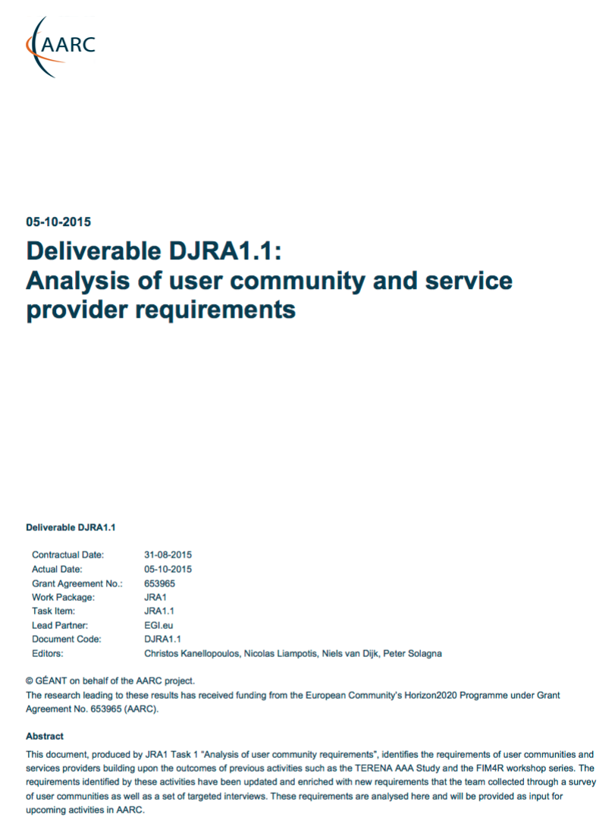
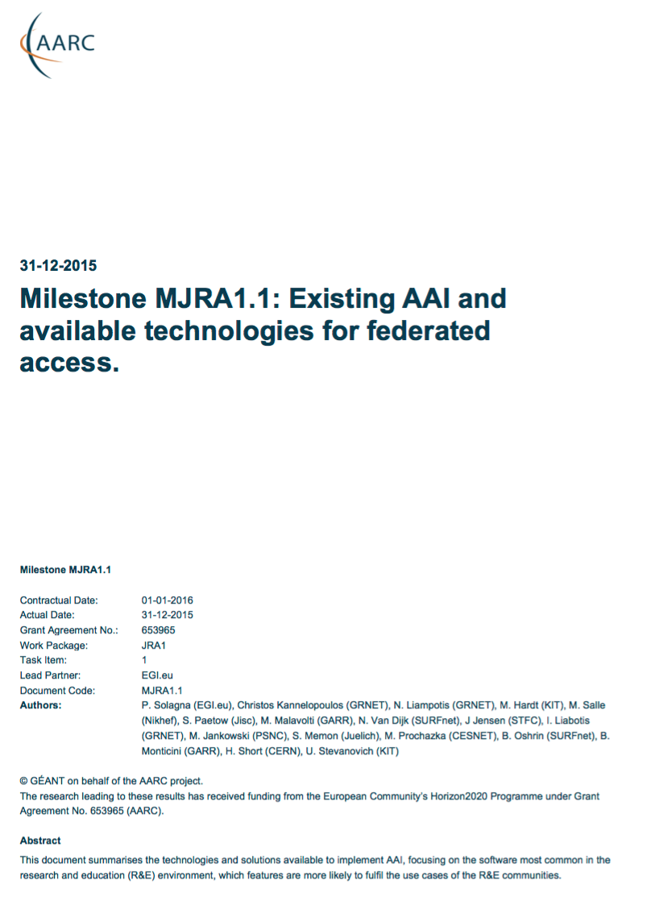
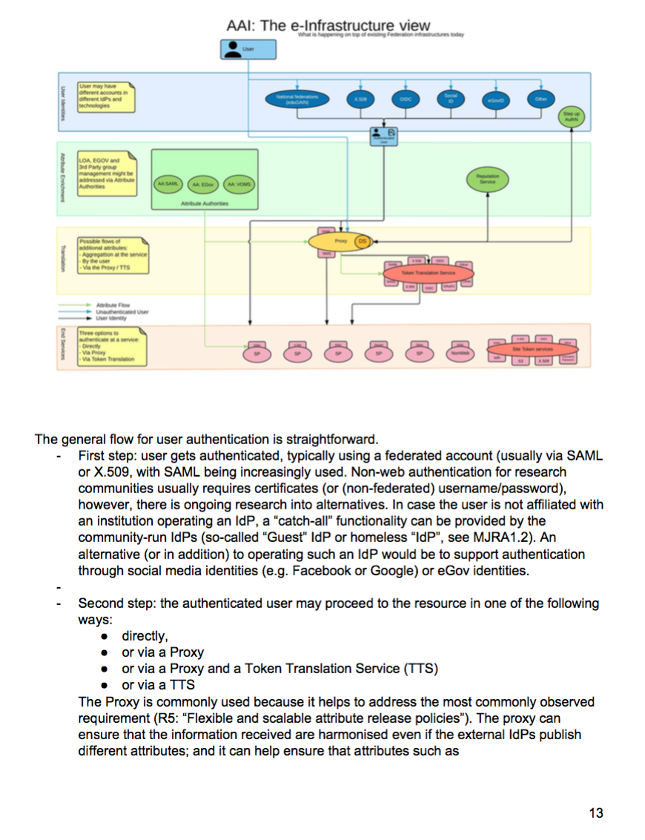
Pilots
Requirements
User Community
Overview Available
AAI Components
Draft Blue-Print
Architecture
Running Pilots
With Communities
aarc-project.eu
Notes:
High level Goals and Approach:
Demonstrate that the solutions identified and proposed by “Architectures for an integrated and interoperable AAI” and ”Policy and Best Practices Harmonisation” are effective in addressing the requirements of the communities
Proof of concepts will involve services from the main e-infrastructures in Europe
Show to what extent different technologies used by the e-infrastructures and service providers are compatible and interchangeable
(Re-)using not building
Started pilots guided by several AARC deliverables
Available @ aarc-project.eu

Slide 19
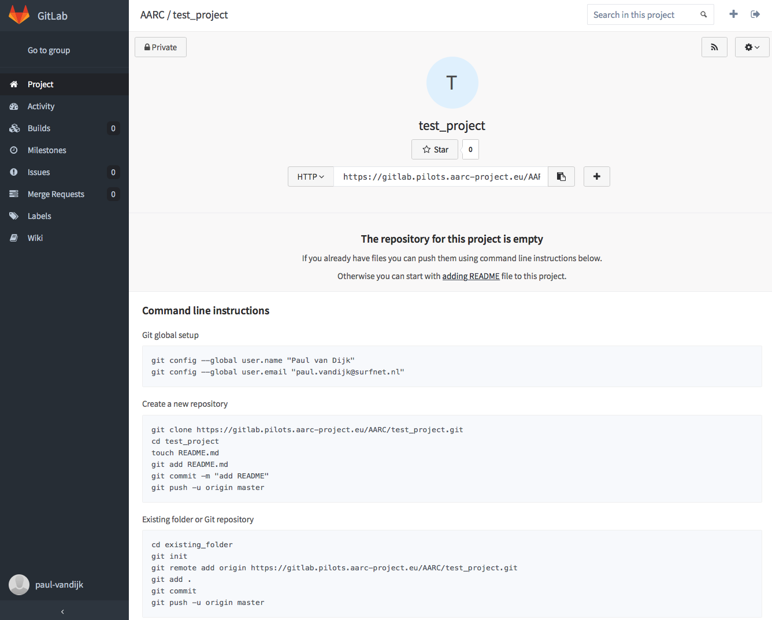
Established a pilot platform *.pilots.aarc-project.eu
A staging area for our services
Technical platform delivered by
>20 VMs instantiated
Using Ansible scripts for deployment
SimpleSAMLphp DIY IdP available
Gitlab for collaborative coding, deployment and
testing: gitlab.pilots.aarc-project.eu
Online support by SURFnet staff

Slide 20
AAI building blocks and pilots commenced
First results expected at Q1 2016
AAI solutions for Library Community
Establishing solutions to bridge SAML authentication with IP-address based access control which is still common practice at publishers
Showcase solutions to enable on-campus access for citizen scientists to library resources
Pilot a proxy between libraries and library reource providers to reduce interactions and complexity.
IdPs
Library, hybrid AuthN
Library, IdP-SP proxy approach
Attribute Authorities
Proxy
Perun and COmanage AAs for BBMRI & EGI
OpenConext attribute aggregation
Token Translation
TTS with CI-logon and VO portal for Elixir
Service Provider
ownCloud & LibreOffice SPs and Integration
ORCID SP

Slide 21
AAI building blocks and pilots commenced
First results expected at Q1 2016
AAI solutions for BBMRI community and EGI e-infrastructure
Manage authorisations on a central level to facilitate the sharing of biological BBMRI resources
Testing the usability of SAML based attribute authorities to regulate service access authorization within the EGI community
IdPs
Library, hybrid AuthN
Library, IdP-SP proxy approach
Attribute Authorities
Proxy
Perun and COmanage AAs for BBMRI & EGI
OpenConext attribute aggregation
Token Translation
TTS with CI-logon and VO portal for Elixir
Service Provider
ownCloud & LibreOffice SPs and Integration
ORCID SP

Slide 22
AAI building blocks and pilots commenced
First results expected at Q1 2016
AAI solutions for the ELIXIR community
Demonstrate that a SAML based login can be used to obtain (command-line) access to cloud VMs and GridFTP (Globus) data transfer portal
IdPs
Library, hybrid AuthN
Library, IdP-SP proxy approach
Attribute Authorities
Proxy
Perun and COmanage AAs for BBMRI & EGI
OpenConext attribute aggregation
Token Translation
TTS with CI-logon and VO portal for Elixir
Service Provider
ownCloud & LibreOffice SPs and Integration
ORCID SP

Slide 23
AAI building blocks and pilots commenced
First results expected at Q1 2016
AAI solutions for (commercial) service providers
Boost the adoption of AAI technologies by service providers in the public and non-public domain by showcasing the the added value of a standardised AAI for both research communities and service providers
IdPs
Library, hybrid AuthN
Library, IdP-SP proxy approach
Attribute Authorities
Proxy
Perun and COmanage AAs for BBMRI & EGI
OpenConext attribute aggregation
Token Translation
TTS with CI-logon and VO portal for Elixir
Service Provider
ownCloud & LibreOffice SPs and Integration
ORCID SP

Slide 24

AARC 2
We are preparing the follow-up of AARC!

Slide 25
AARC 2
Support User-Driven Innovation of Trust and Identity
    Enable federated access for use-cases that meet data intensive and cross e-Infrastructure requirements
Deploy AARC/AARC2 Results
    Support e-Infrastructures and research infrastructures to deploy AARC/AARC2 results to enable seamless service delivery to the users.
Training and outreach
  Offer different level of training and reach out to different communities to promote AAI adoption when building new services.

Slide 26
Alessandra.Scicchitano@geant.org

