Slide 3
AAI … but
This talk is about the second 'A': Authorisation.

Slide 4
Quick recap: which is which?
Credential
Authentication
Authorization

Slide 5
Authorisation without authentication?
How ?
Photo by Alan Cleaver (CC-BY)

Slide 6


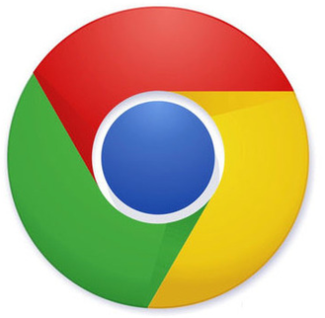
Photon Science portal use-case
Users
Web
Brouser
User
DB
LOGIN
Authentication
dCache
Request Download
Request Download
http
WebDAV
Portal
Redirect
Request Download
Storage
Pool
Stream Data
Stream Data
USER
Community Specific Service Stack
Data Service

Slide 7
Desired: client downloads directly
Users
Web
Brouser
User
DB
LOGIN
Authentication
Request Download
Portal
dCache
Redirect
Request Download (How to authorize this request ?)
http
WebDAV
Redirect
Request Download
Storage
Pool
Stream Data
USER
Community Specific Service Stack
Data Service

Slide 8
Desired: client downloads directly
Users
Web
Brouser
User
DB
LOGIN
Authentication
dCache
Request Download
Portal
Request Token
T
Supply Token
T
Redirect
http
WebDAV
T
Request Download
Redirect
Request Download
Storage
Pool
Stream Data
USER
Community Specific Service Stack
Data Service

Slide 9

What are bearer tokens?
Bearer token is something the user presents with a request so the server will authorise it. There's no interaction between client and server.
Examples of bearer tokens:
HTTP BASIC authn, anything stored as a cookies.
Counter-examples:
X.509 credential,
SAML,
Kerberos.

Slide 10
Bearer tokens for download authz
Redirection should work without JavaScript,
Simple: embed token in redirection URL.
(There are nicer ways of embedding the token, but the URL is the only thing we can control)
Complete token always sent with the request.
What can we do to stop someone stealing this token?
… or make the token useless if they steal it.
http://webdav.example.org/path/to/file?authz=<TOKEN>

Slide 11

Introducing Macaroons

Slide 12
Macaroons 101
Macaroon is a bearer token.
Macaroon contains zero or more caveats.
Each caveat limits something:
  who can use it, or
  what they do with it.
Anyone can add a caveat to a macaroon:
  Create a new macaroon that is more limited.
Nobody can remove a caveat from a macaroon.

Slide 13
Example: 3rd party copy
Portal
Storage
Pool
m
Reducing Authz
only WRITE,
only from <IP addr>,
only for 10 minutes.
M
M
m
m
m
Used to
authorize
Subsequent
transfer
m
Roque
Service
Storage
Pool

Slide 14
3rd party caveats – extra cool!
1st party caveat can be satisfied by the client.
3rd party caveat requires proof from some other service; e.g.
  only fred@facebook,
  only members of VO ATLAS,
  only if not part of a denial-of-service attack.
The proof is another macaroon: a discharge macaroon.

Slide 15
Example: download w/3rd party caveat
Limiting
Permissions
Portal
Storage
Pool
m
M
M
m
m
Group Service
m
Used to
Authenticate
Subsequent
Transfer
m
m
m

Slide 16
Discharge macaroons
The client proves it satisfies a 3rd party caveat by having a discharge macaroon.
The original macaroon is only useful with a valid discharge macaroon.
The discharge-macaroon can have caveats:
  Short-lived discharge macaroon can be used to simulate X.509's certificate revocation list.
  The discharge macaroon can have 3rd-party caveats.

Slide 17
Solution revisited: macaroons
Users
Web
Brouser
User
DB
LOGIN
Authentication
dCache
Request Download
Portal
Request Token
Add Caveat to Macaroon
m
M
Redirect
Macaroon
http
WebDAV
m
Request Download
Redirect
Request Download
Storage
Pool
Stream Data
USER
Community Specific Service Stack
Data Service

Slide 18
For what else are macaroons good?

Slide 19
Enabling sharing: a new interface
Create a macaroon:
  Need to know the macaroon to access the file.
List macaroons:
  Facilitate sharing files.
Facilitate adding caveats:
  Purely in-browser or server-side?
  Third-party caveats? (e.g., member-of-ATLAS caveat)
Destroy macaroons:
  Unclear if this really makes sense.

Slide 20
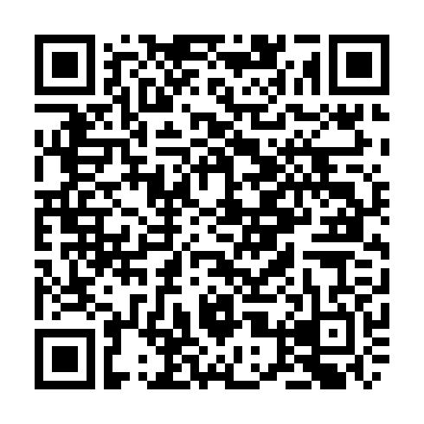
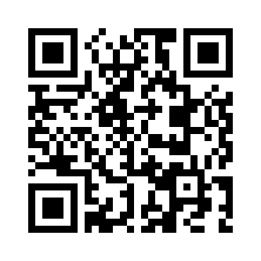
The END
Further reading :
On dCache
www.dCache.org
On macaroons by Google:
Macaroons: Cookies with Contextual Caveats for Decentralized Authorization in the Cloud.
Presentation
Paper
http://research.google.com/pubs/pub41892.html

