Slide 1
Kipper – a Grid bridge to Identity Federation
Andrey Kiryanov

Slide 2
Brief
The Kipper client software combines tools and utilities to extend a Web Application to:
Enable login via federated SSO like eduGAIN
Retrieve a SAML2 Identity Assertion from SSO
Transform a SAML2 Identity Assertion into an X.509 proxy certificate with VOMS extensions
Do it all directly in browser context with JavaScript API
The result: “X.509-free” access to the Grid
ISGC 2016, Academia Sinica, Taipei, Taiwan, 13-18 March 2016

Slide 3
WLCG pilot service
Goal: give access to WLCG resources using home institute’s credentials
No need for X.509 certificates
WLCG working group dedicated to Identity Federation
CLI (job submission, admin tasks)
Web-based (grid portals for job submission, data transfers, etc.)
Focus on the web-based solution
ISGC 2016, Academia Sinica, Taipei, Taiwan, 13-18 March 2016

Slide 4
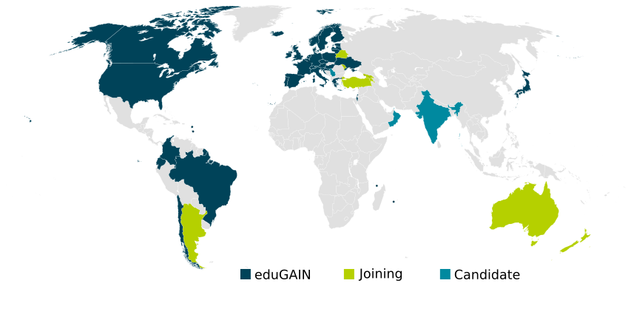
eduGAIN
Built on existing federations and infrastructures
CERN participates in eduGAIN via SWITCHaai
Many NRENs participate in eduGAIN too
ISGC 2016, Academia Sinica, Taipei, Taiwan, 13-18 March 2016
4

Slide 5
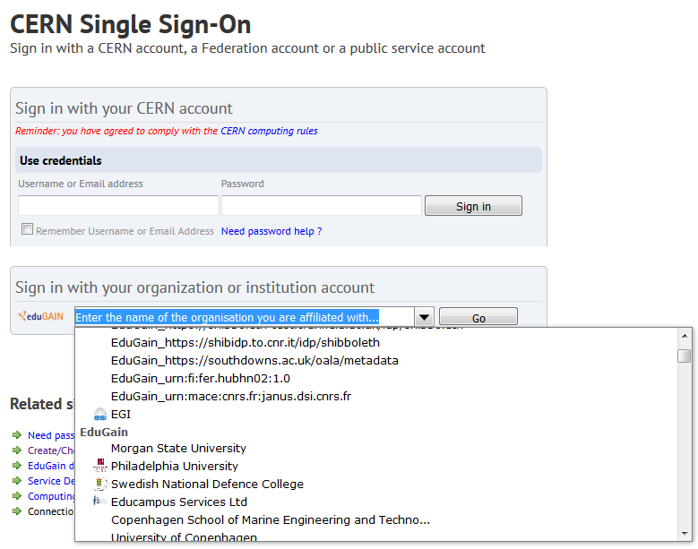
Access via CERN SSO
ISGC 2016, Academia Sinica, Taipei, Taiwan, 13-18 March 2016
5

Slide 6
IdF and CERN SSO
CERN SSO service is based on Microsoft ADFS (Active Directory Federation Services)
In order to benefit from SSO your Apache web server needs a special plug-in:
Shibboleth – first solution supported by CERN, widespread, supports all possible standards, not easy to configure
Mellon – pure SAML2 Service Provider. Minimal configuration, supported by CERN since 2015
Kipper supports both natively
ISGC 2016, Academia Sinica, Taipei, Taiwan, 13-18 March 2016

Slide 7
SSO log-in process
Web browser
HTTPS session
Apache
SSO
Auth. request (redirect)
Auth.
SAML2
SAML2 Assertion
SSO plug-in
SAML2 assertion is an XML-formatted signed attribute list, which contains your name, e-mail address, e-groups, etc.
ISGC 2016, Academia Sinica, Taipei, Taiwan, 13-18 March 2016

Slide 8
Kipper cornerstones
SAML2 to X.509 translation
STS
Short-living X.509 certificates
IOTA CA
VO membership
VOMS
ISGC 2016, Academia Sinica, Taipei, Taiwan, 13-18 March 2016

Slide 9
STS
Security Token Service (STS) consumes SAML2 assertions and produces X.509 credentials in return
STS is an implementation of WS-Trust OASIS standard and it speaks SOAP
STS has been developed in the context of the EMI project and was extended at CERN to support:
CERN IOTA CA specific client
VOMS DN mapping registration and caching (IOTA DN is an alias to VOMS DN)
ISGC 2016, Academia Sinica, Taipei, Taiwan, 13-18 March 2016

Slide 10
STS integration in a Web Application
Grid
VOMS
IOTA CA
X.509
Kipper
Web browser
X.509 VOMS proxy
STS
SAML2 Assertion
SAML2
HTTPS session
Apache
SSO
Auth. request (redirect)
Auth.
SAML2
SSO plug-in
SAML2 Assertion
ISGC 2016, Academia Sinica, Taipei, Taiwan, 13-18 March 2016

Slide 11
IOTA CA
IOTA CA (Identifier-Only Trust Assurance Certification Authority) issues short-living (days) X.509 certificates
First implementation was issuing certificates to any STS client (provided that it had a valid assertion)
Now STS can ask to sign certificates only for users registered in the configured VOMS
Handy if you need a restricted set of eduGAIN members that would get a valid certificate
ISGC 2016, Academia Sinica, Taipei, Taiwan, 13-18 March 2016

Slide 12
DN uniqueness
IOTA CA should use an eduGAIN persistent identifier attribute to return a unique DN
Which attribute(s) can be considered persistent and unique in eduGAIN?
eduPersonPrincipalName is considered unique in theory but it can be reassigned according to local policy
Only Identity Providers that secure unique eduPersonPrincipalName will be enabled in STS
ISGC 2016, Academia Sinica, Taipei, Taiwan, 13-18 March 2016

Slide 13
CERN LCG IOTA CA
A document containing all the details for the new CA at CERN has been prepared in 2015 by CERN IT IdF Team with help from us
The document went through the review process of EUGridPMA and was accepted
CERN LCG IOTA CA is included in IGTF Trusted Anchor Distribution since version 1.72
Deployed on virtually all WLCG sites now
It should “just work” for you
ISGC 2016, Academia Sinica, Taipei, Taiwan, 13-18 March 2016

Slide 14
Open issues
The new IOTA DN is associated to the already existing one in VOMS, but the grid middleware is not aware of this alias
Two different users (not always an issue since proper VOMS extensions are included in the certificate)
Dedicated STS instance per each WebApp+VO combination
VOMS DN mapping and checks
WebApp and STS need to consume the same SAML2 assertion
ISGC 2016, Academia Sinica, Taipei, Taiwan, 13-18 March 2016

Slide 15
Use cases
What kind of web applications could benefit from Kipper?
All kinds of portals that need to talk directly to Grid resources with X.509 authentication
Data and workload management interfaces
What are the benefits?
Clear distinction between users (no catch-all robot proxies)
No need to maintain App-specific user database
Security, VOMS support
What needs to be changed in the WebApp?
Backend web server needs to be Apache on Linux (no IIS yet)
Server side needs to accept user proxies from browser via specific delegation mechanism
A dedicated instance of STS needs to be deployed
ISGC 2016, Academia Sinica, Taipei, Taiwan, 13-18 March 2016

Slide 16
Ongoing work
CERN is developing a portal to enable eduGAIN members that are also members of LHC VOs to get a proxy certificate out of their eduGAIN credentials
There’s an ongoing integration of ATLAS Panda Monitor with SSO which will allow then exploiting Kipper to transparently access job/monitoring log files stored on Grid storage elements
ISGC 2016, Academia Sinica, Taipei, Taiwan, 13-18 March 2016

Slide 17
What is WebFTS?
https://webfts.cern.ch
Web-based tool to transfer files between Grid/cloud storages
Modular protocol support
gsiftp, http/dav, xroot and srm
Cloud extensions: Dropbox
ISGC 2016, Academia Sinica, Taipei, Taiwan, 13-18 March 2016

Slide 18
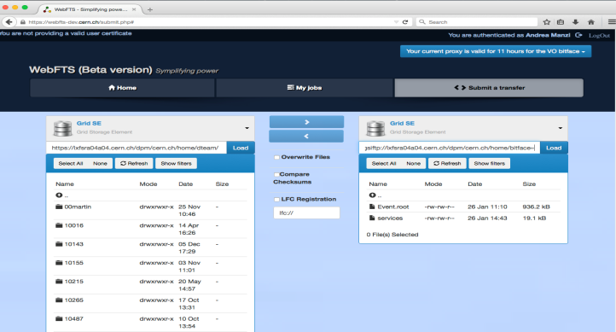
WebFTS pilot
ISGC 2016, Academia Sinica, Taipei, Taiwan, 13-18 March 2016

Slide 19
“X.509-free” access
X.509 delegation is needed to let WebFTS access the Grid resources on user’s behalf
User needs to make his private key available to the browser
Browser keystore is not accessible via JavaScript API
A first prototype integrated with STS and IOTA CA was implemented at the end of 2014
WebFTS-specific solution, no Kipper yet
Initially STS returned a plain certificate then delegated to FTS3 which was in charge of requesting VOMS extensions
ISGC 2016, Academia Sinica, Taipei, Taiwan, 13-18 March 2016

Slide 20
Segregation of Kipper from WebFTS
Detached codebase of STS and Kipper
WebFTS uses Kipper as a library
Following the changes in STS with the generation of VO-specific certificates, we have adapted WebFTS (and Kipper) to use proxy certificates and delegate them to FTS3
Move to RFC proxy generation was needed
Still both scenarios are supported
WebFTS is the first technology demonstrator
ISGC 2016, Academia Sinica, Taipei, Taiwan, 13-18 March 2016

Slide 21
Conclusions
Kipper enables Federated Identity Web-based access to WLCG resources
IdF-enabled WebFTS is a working prototype (available only inside CERN so far)
ATLAS has kindly agreed to provide its VOMS for testing purposes
CERN LCG IOTA CA is globally deployed on WLCG sites
This is an important step towards “X.509-free” access to Grid resources
ISGC 2016, Academia Sinica, Taipei, Taiwan, 13-18 March 2016

Slide 22
Acknowledgements
Andrea Manzi
Oliver Keeble
Henri Mikkonen
Romain Wartel
Emmanuel Ormancey
This work was funded in part by the Russian Ministry of Education and Science
under contract №14.Z50.31.0024
ISGC 2016, Academia Sinica, Taipei, Taiwan, 13-18 March 2016

Slide 23
References
https://gitlab.cern.ch/sts
STS and Kipper sources
https://cafiles.cern.ch/cafiles/
CERN LCG IOTA CA certificates and documents
ISGC 2016, Academia Sinica, Taipei, Taiwan, 13-18 March 2016

Slide 24
Thank you!
ISGC 2016, Academia Sinica, Taipei, Taiwan, 13-18 March 2016

