Slide 1
Who doesn’t need to be WISE?
Bringing into reality global information security collaboration
Alessandra Scicchitano
GÉANT - Project Development Officer

Slide 2
WISE – what is it?
Wise Information Security for Collaborating E-infrastructure
A trusted global framework where security experts can share information on different topics like risk management, experiences about certification process and threat intelligence keeping a special focus on e-infrastructures.

Slide 3
How everything started
Joint effort of GEANT SIG-ISM (Special Interest Group on Information Security Management) and SCI (Security for Collaboration among Infrastructures)
Workshop in Barcelona Spain, October 2015.
50 participants
Notes:
-an open forum where experts from its community exchange information, knowledge, ideas and best practices about specific technical or other areas of business relevant to the research and education networking community
- SCI (Security for Collaboration among Infrastructures) is a collaborative activity of information security officers from several large-scale infrastructures, including EGI, PRACE, EUDAT, WLCG, XSEDE and HBP

Slide 4
How everything started
Main idea: 4 big e-infrastructures EGI, EUDAT, GEANT and PRACE getting together to facilitate the exchange of experience and knowledge on security.
But also NRENs, XSEDE, NCSA, CTSC and communities like HEP/CERN, HBP and many others participated.
A profound need for a real collaboration became evident

Slide 5
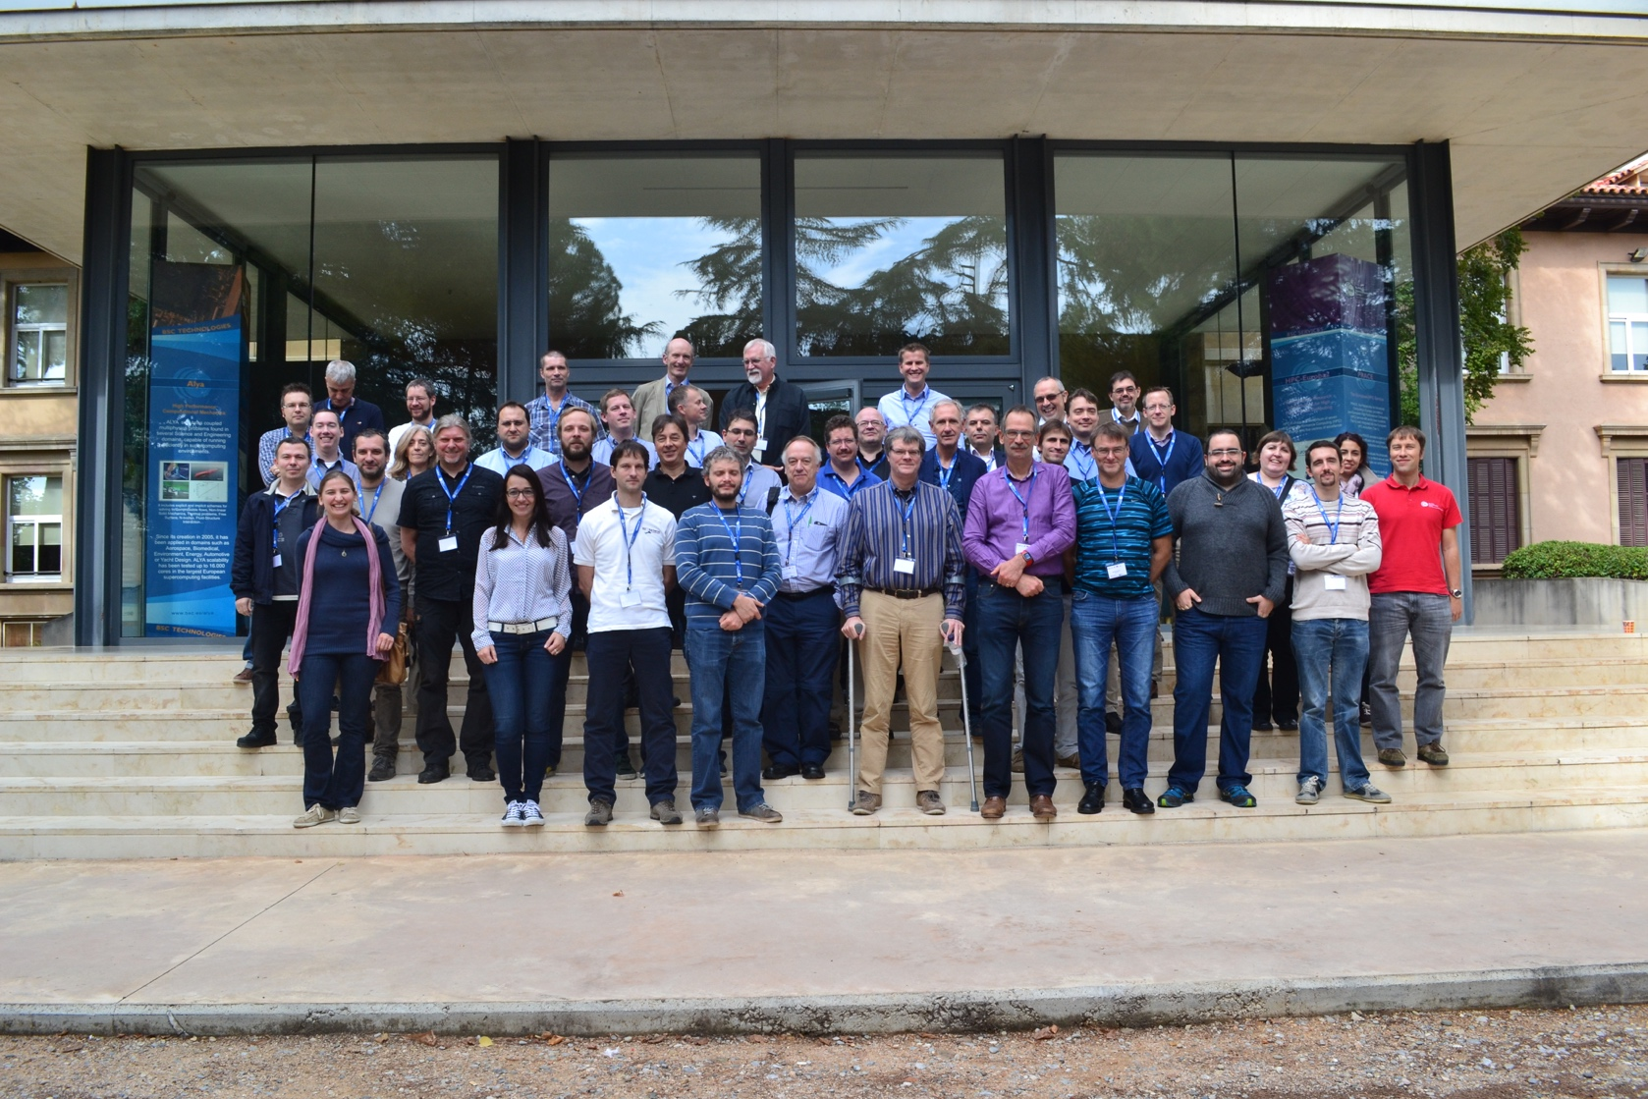
WISE – The new born community
WISE Workshop – Barcelona Supercomputing Center – October 2015

Slide 6
Activities
Led by a Steering Committee
Two face-to-face meetings a year
The main work happens through working groups.
Five WGs:
Updating the SCI framework (SCIV2-WG)
Security Training and Awareness (STAA-WG)
Security Review and Audit (SRA-WG)
Risk Assessment WISE (RAW-WG)
Security in Big and Open Data (SBOD-WG)

Slide 7
SCIV2-WG
Updating the SCI framework:
Already existing framework created by the SCI group http://pos.sissa.it/archive/conferences/179/011/ISGC%202013_011.pdf
SCIV2-WG will work towards version 2 of the SCI document that will become the 1st WISE framework defining best practices, trust and policy standards for collaboration.
A wider range of stakeholders will be involved, specifically the NRENs, whose security issues were not present in the first version.
https://wise-community.org/updating-the-sci-framework/
Notes:
The aim of this work was to establish a common understanding of the security measures each infrastructure has implemented and to start work on guidelines for interoperation such as the exchange of information during security incident handling

Slide 8
SCIv2-WG
The WG has just defined the direction of the work and chose the first topic the group will focus on:
How to share vulnerabilities among e-infrastructures

Slide 9
STAA-WG
Security Training and Awareness:
Training is wanted and needed for security professionals, systems and network managers and engineers, users of the infrastructures and for decision makers, for a wide range of topics.
Main activities of the WG:
Collecting good training practices
Collecting information about relevant existing trainings at the infrastructures
Set up a basic training and awareness program for organizations in the WISE community, identifying which trainings are needed
https://wise-community.org/training-and-awareness/
Notes:
Several organisations already have some or several trainings in place, but not on all topics. Some others have to get started with a training programme. There is a lot of training in the commercial market and there is a lot of open source material available.

Slide 10
STAA-WG
The WG Security Traijning and Awareness will first do an inventory:
What are the target groups for security awareness? What materials are already available and what pratices can NRENs share?
What are the most important subject for security training?
Which free/open training or trainings materials are available?
Which commercual rainings are available?
The purpose is to identify the training needs and make a first match with available training material.

Slide 11
RAW-WG
Risk assessment WISE:
Large e-infrastructures are vulnerable for high impact security incidents because of the relative easy way that an incident may spread among partner organizations because of the collaborative services that exist among the constituent organizations. So it is important that each member organization has a trusted level of implemented security procedures.
The objective of the WG is to provide e-infrastructures and their member organizations with guidelines on how Risk Assessments can be effectively implemented.
https://wise-community.org/risk-assessment/
Notes:
It is an important activity as part of the implementation of an Information Security Management System (ISMS). The implementation of effective security controls depends very much on a reliable risk assessment, so that the right measures can be taken.

Slide 12
SRA-WG
Security Review and Audit:
A proven method to obtain objective and comprehensive information about the current state of information security is to perform security reviews and security audits
Some of the activities of the WG:
Follow and contribute to the development of security audits and reviews among the constituents
Share related best practices for implementations
Contribute to development of security standards and frameworks
https://wise-community.org/review-and-audit/
Notes:
To promote understanding, skills, and exchange of best practices regarding security audits and reviews among national research and education networking organisations (NRENs), research infrastructures, computing centres and related sites, a Security Review and Audit Working Group (SRA-WG) has been created

Slide 13
SBOD-WG
Security in Big and Open Data:
The WG focuses on security issues that arise when dealing with Big and Open data especially within the e-infrastructures.
Main activities of the WG:
list and discuss already existing studies and state of the art the starting point for the rest of the work.
work on a list of issues particularly important for e-infrastructures and on a set of recommendations on how to minimize the impact of these issues.
https://wise-community.org/security-in-big-and-open-data/
Notes:
Big data refers to large datasets that are not always public. Open data refers to datasets that are not necessarily large but are available to everyone and can be used and republished without restrictions. Large datasets from scientific research sources.
Security issues in this context concentrate on confidentiality, integrity and availability. Confidentiality regulates access to the information, integrity assures that the information is trustworthy, i.e. has not been changed without authorisation, and availability guarantees access to the information by authorised people at any time.

Slide 14
SBOD-WG
Published a draft of the case statement https://wiki.geant.org/display/WISE/Case+Statement
Working on providing a clear definition of what is big and open data for the WG.

Slide 15
Participate in WISE
Interested in any of the the working group subjects?
Subscribe to the workgroup mailinglist on the WISE website
Contact the workgroup chair and let’s work together
The Working groups are starting their work now
www.wise-community.org

Slide 16
Thank you
Questions?
alessandra.scicchitano@geant.org

