Slide 1
CESNET – Fermilab LHCONE ? for the NOvA experiment
How to increase the bandwidth?
LHCONE meeting, Taipei

Slide 2
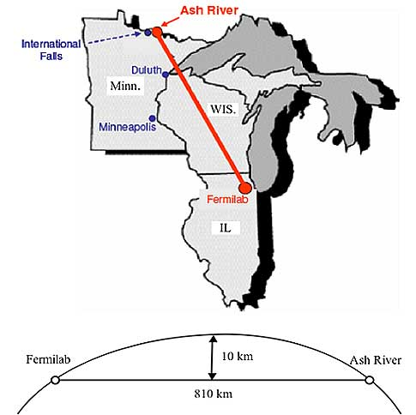
NOvA experiment at FNAL
NOvA experiment Neutrino oscillation accelerator experiment with FD at Ash River
Oscillation parameters
CP violation
…
FZU offers 1500 job slots on its Tier2 25% of computing capacity to NOvA
NOvA is taking data
First publications appearing

Slide 3
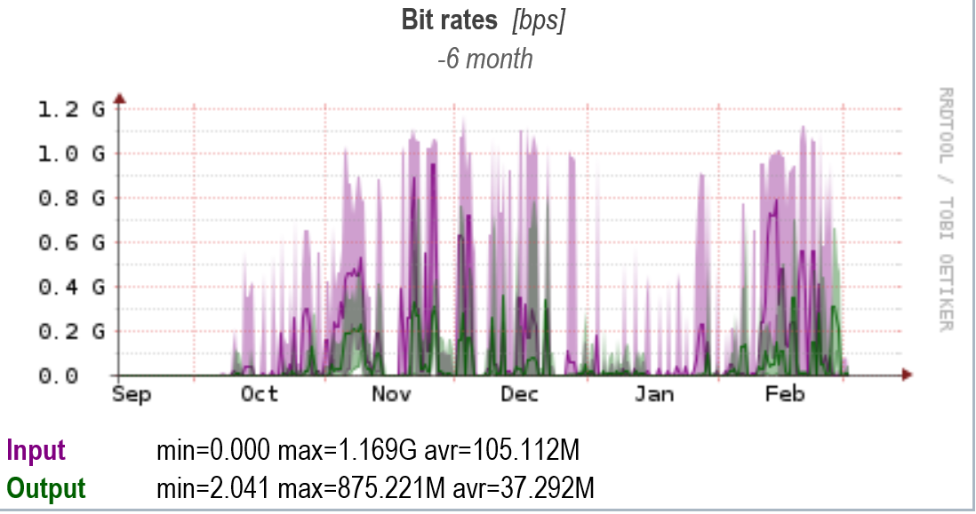
1 Gbps lambda FZU- Fermilab
Filled when 1 500 jobs start to copy input data
3 Gbps might be sufficient
Job slot increase probable

Slide 4
Lambda switched-off, traffic over public network
Seems to be worse than lambda, complaints from people from Fermilab using Prague Tier2
Is possible to use LHCONE for this traffic?
Implementation in Fermilab? Institute of Physics CAS – computing capacity for NOvA is internal capacity of Teir2
Existing LHCONE traffic in Prague
10 Gbps

Slide 5
CESNET – FZU
LHCONE over 10 Gbps
Ready to add another 10 Gbps
CESNET started informative talks with Geant
Adding 3+ Gbps lambda would be too expensive
Using LHCONE seems to be most effective solution
Similar experience exists with change of lambda to BNL

