Slide 1
Educational Informatics
A Paradigm Shift for IT-enhanced Education
Tosh Yamamoto (Kansai University, JP)
Ti-Chuang (Timothy) Chiang (National Taiwan University)

Slide 2
Abstract—This paper proposes a new realm of research field for ICT-enhanced learning, called educational informatics. While arguing the pros and cons of the current issues surrounding the ICT-enhanced education, it is proposed that there should be a need for a research field to measure and visualize the learning effectiveness in the scientific way. In order to achieve such goal, there should be an immediate need for achieving consensus on SOP for educational informatics.
Key Words: Constructivism, Educational Paradigm Shift, Educational Informatics, ICT, SNS, SOP.

Slide 5
Before:
Focus on Education Technology from the engineer’s point of view.
Educators are the last to voice their opinions about the educational technology.-→ Not in our classes!
Teachers’ needs are not reflected.

Slide 6
NOW
After:
Learner-oriented : Active Learning
Focus of education : individual students ➔ learners in teams (video : a rabbit and a turtle)
Pre-fabricated knowledge and values ➔ Learners explore and gain knowledge and values through learning experience.
Pedagogy ➔ Andragogy

Slide 7
Active Learning
Social Constructivism
(Video : A Rabbit and A Turtle)

Slide 8
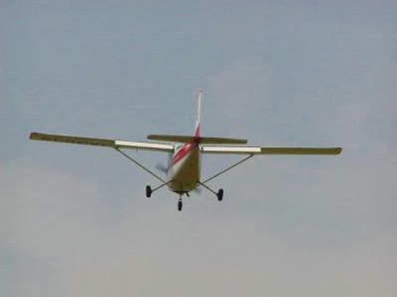
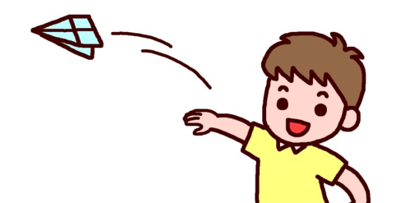
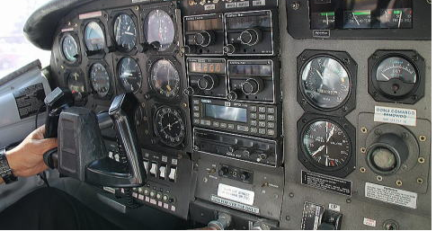
Traditional vs. New Paradigm
Traditional Education
New Paradigm
Goal (set by the professor)
◆ goal (set by the learner)
student
Learner as a pilot / navigator of his/her own learning
Teacher as the co-pilot
professor

Slide 9
It follows that …
We need: NOT Educational Engineers BUT The realm of ICT-Enhanced Education to promote Active Learning from the learner’s point of view. i.e. Social Constructivism

Slide 10
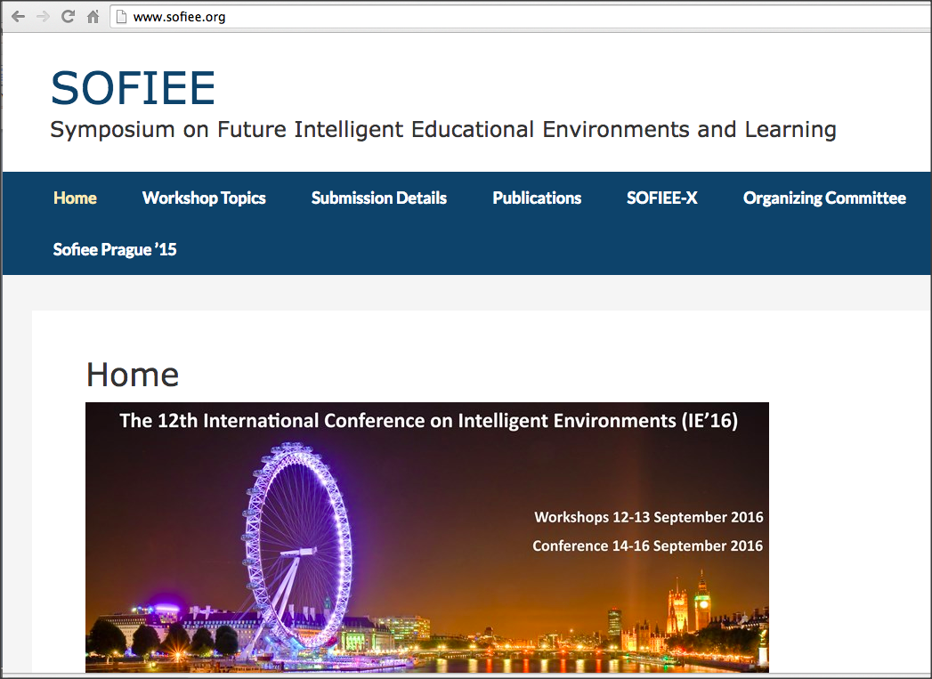
SOFIEE http://www.sofiee.org/

Slide 11
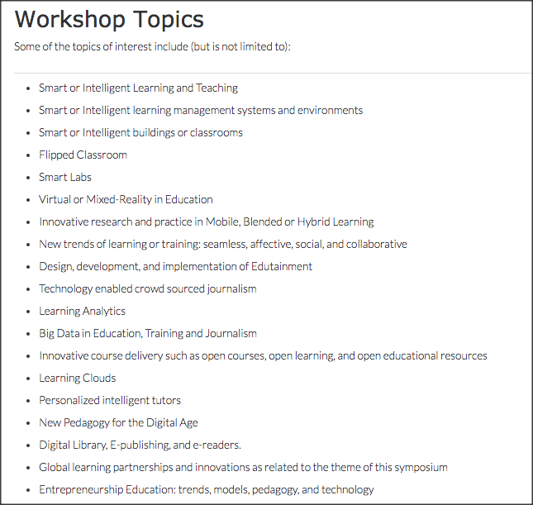

Slide 12
Most of Topics are in the realm of Active Learning, PBL, TBL – Social Constructivism –

Slide 13
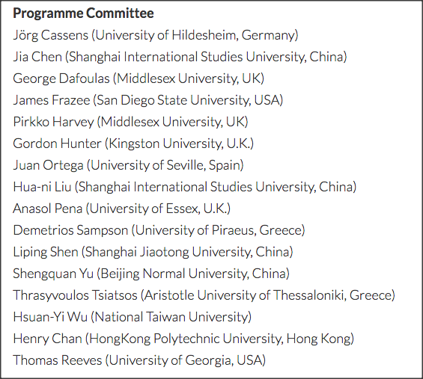

Slide 14
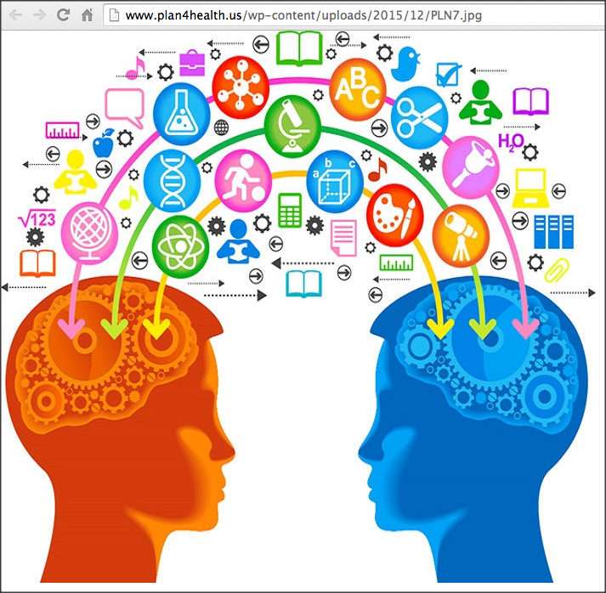
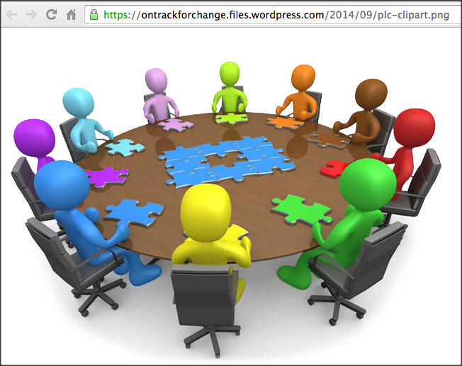
Learners’ Needs
Educational tools to enhance TBL, PBL, Active Learning
to incorporate new knowledge information,
to share, discuss, and define the problem on the same page,
to share the learning process (either face-to-face or online),
to share the accomplishment with others teams (the entire class)
Needs for richer channels for communication enhanced by ICT

Slide 15
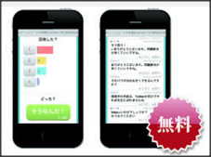
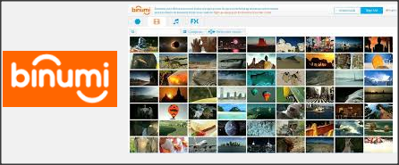
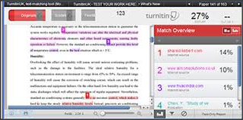
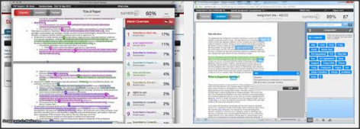
To name a few . . .
Notes:
Technology

Slide 16
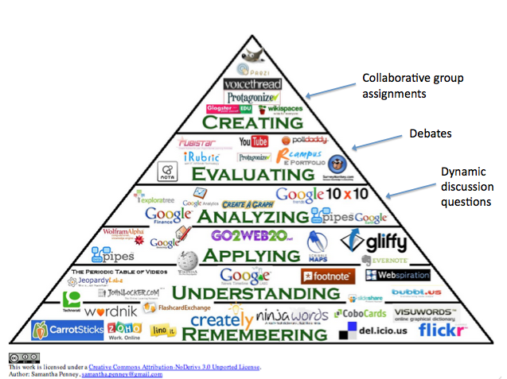
The Future,
Better Life,
Transcendency
http://catlintucker.com/wp-content/uploads/2012/04/Blooms-with-notes.png

Slide 17
+ Global

Slide 18
Future Generation learner

Slide 19
The Future, Better Life, Transcendency
The Future,
Better Life,
Transcendency
(Future Goal)
Isn’t Learning for making the world / life better?
Notes:
Again I put only the key concept on screen and then talk about it.
Slide Note:
This slide illustrates the alignment with a new topic using color. Note that it uses a color-coded Section Header layout.

Slide 20
The Future,
Better Life,
Transcendency
http://www.iftf.org/uploads/media/IFTF_FutureWorkSkillsSummary_01.gif
Notes:
http://www.iftf.org/uploads/media/IFTF_FutureWorkSkillsSummary_01.gif

Slide 21
The Future,
Better Life,
Transcendency
http://www.forbes.com/sites/sap/2014/05/12/are-you-ready-here-are-the-top-10-skills-for-the-future/2/
Sensemaking
Social Intelligence
Novel & Adaptive Thinking
Cross-Cultural Competencies
Computational Thinking
New Media Literacy
Transdisciplinarity
Design Mindset
Cognitive Load Management
Virtual Collaboration
Notes:
Sensemaking
Social Intelligence
Novel & Adaptive Thinking
Cross-Cultural Competencies
Computational Thinking
New Media Literacy
Transdisciplinarity
Design Mindset
Cognitive Load Management
Virtual Collaboration

Slide 22
The Future,
Better Life,
Transcendency
http://catlintucker.com/wp-content/uploads/2012/04/Blooms-with-notes.png

Slide 23
The Future,
Better Life,
Transcendency
http://catlintucker.com/wp-content/uploads/2012/04/Blooms-with-notes.png
WiFi

Slide 24
The Future,
Better Life,
Transcendency
http://catlintucker.com/wp-content/uploads/2012/04/Blooms-with-notes.png
WiFi
Battery !

Slide 25
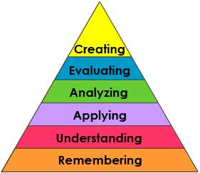
Bloom’s taxonomy Learner’s Activities
Learners
Notes:
Text only to rich text

Slide 26
Learners
Notes:
Text only to rich text

Slide 27
Learners
Notes:
Text only to rich text

Slide 28
Learners
Notes:
Text only to rich text

Slide 29
Learners
Notes:
Text only to rich text

Slide 30
Learners
Most K-12
&
University
Curriculum
Notes:
The top of the normal curve are so-called elite in top schools in the nation.
They will perform in high quality what they are told to do.
However, they cannot think critically or creatively.
Their mission is to maintain the status quo of the cultural values.
Text only to rich text

Slide 31
Learners
Ideally Speaking . . .
The Learner can :
・Think critically and creatively
・Reflect upon their learning meta-cognitively
・View where they stand
・comprehensively with a bird’s eye view
・Appreciate the value in life and the beauty of life
Notes:
Text only to rich text

Slide 32
Learners
Social Constructivism
PBL thru TBL
Problem/Project Based Learning
Thru
Team Based Consensus Agreement
Classroom and Beyond . . . ・No borders in Learning !
・Involving All Stakeholders in the School Community . . . e.g. Regional Partnership
Business/Industry-Academia Partnership
Notes:
Text only to rich text

Slide 33
In other words, Learners must be outside of the fish bowl!
Learners
Notes:
Text only to rich text

Slide 34
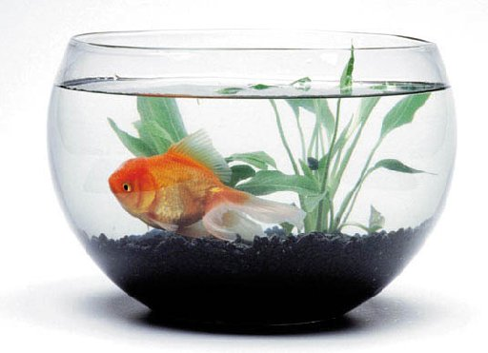
Learners must be outside of the fish bowl!
Learners
Image: ilovetranto.com
Who chose the school to be inside the fish bowl?
image source: www.okeanosgroup.com/
Image source: ilovetronto.com, www.okeanosgroup.com, leap-va.org/wp-content/uploads/2013/03/fish-bowl-jumping-Leap-Day-2012.jpg
Notes:
Text only to rich text

Slide 35
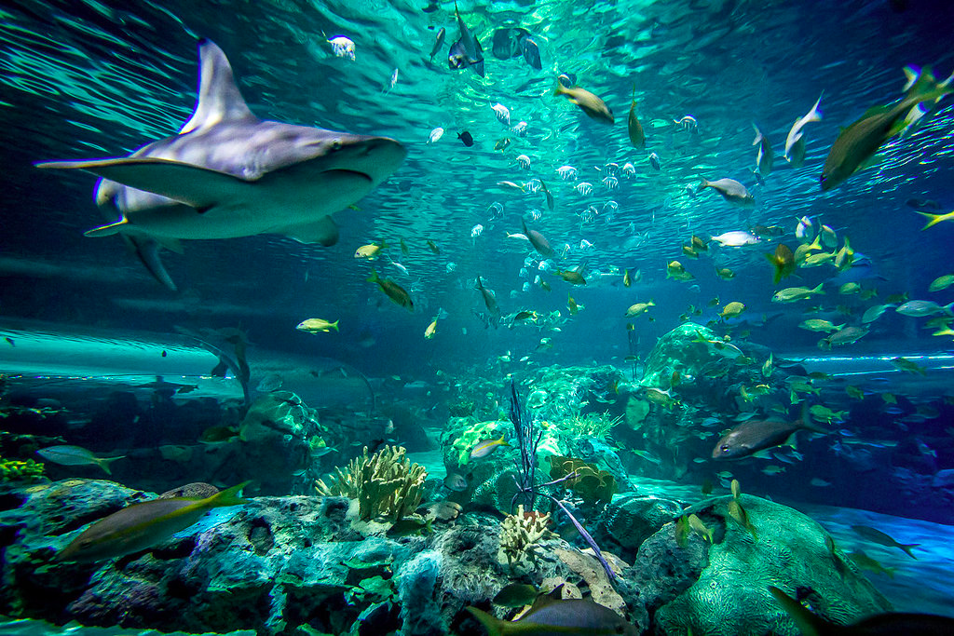
There is a bigger world outside the fish bowl !
Learners
Image: ilovetranto.com
image source: www.okeanosgroup.com/
image source: leap-va.org/wp-content/uploads/2013/03/fish-bowl-jumping-Leap-Day-2012.jpg
Notes:
Text only to rich text

Slide 36
Learners
Image: ilovetranto.com
Learning must happen here!
image source: www.okeanosgroup.com/
image source: leap-va.org/wp-content/uploads/2013/03/fish-bowl-jumping-Leap-Day-2012.jpg
Notes:
Text only to rich text

Slide 37
Learners must find values of what they learn, Not pre-fabricated values by teachers!
Tosh Yamamoto (2014)

Slide 38
Then, what values are not fabricated yet ?

Slide 39
Where we are in edu Today
+ Global

Slide 41
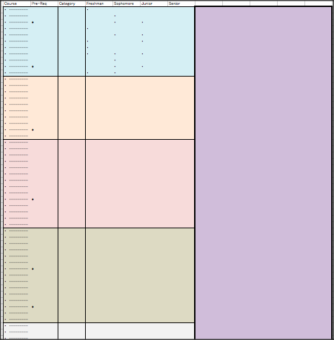
We will be focusing on the ICT enhanced learning in a course today.

Slide 42
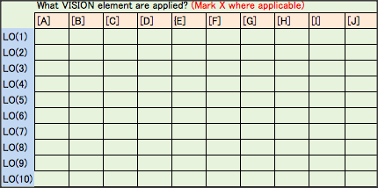
Enhancement by ICT
Course Level
PBL through TBL
Communication and Sharing via Rich Media
Virtual Learning Environment (24/7)
Strong Linkage between the learning environment and the daily life (Physical life – SNS – Learning Environment)
Curriculum Level
Visualization of the relation between the learning objectives in courses and the visions of the school or departments
Curriculum mapping
Matrix for Learning Contents – Vision Components
Institutional Level
Visualization of where we stand as an institution
IR : e-Portfolio incorporating Carrier Design
Proof of Education: students’ growth of fundamental human skills in order to be a member of the global society. i.e. School Mission = Graduating Students’ Accomplishment.

Slide 43
Concluding Remarks
In order to make this realm of research a field of science, we need to define:
The realm of research for the educational paradigm
Methodology: andragogy
Standard Operating Procedures for how to tackle with this field.

Slide 44
Example : Course Level
For the course level, KU has accomplished a course with Japanese students and foreign students in teams.

Slide 45
How to enhance communication ?
Project-Based Learning through Team-Based Learning
Class meets once a week. Everybody meets Face-to-Face
Field Study : over the weekend Only a few members from each team
Team Projects: Product Design Final Team Report (Concept Design to Marketing Strategies & Promotion) Presentation Materials / Promotion Videos

Slide 46
Use of ICT : LINE
For the entire class
For teams: each team has its own LINE group

Slide 47
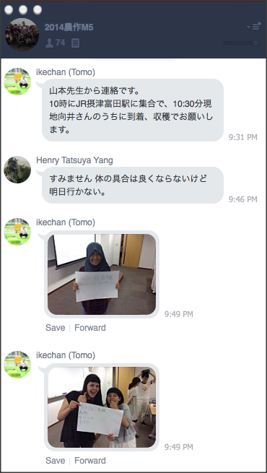
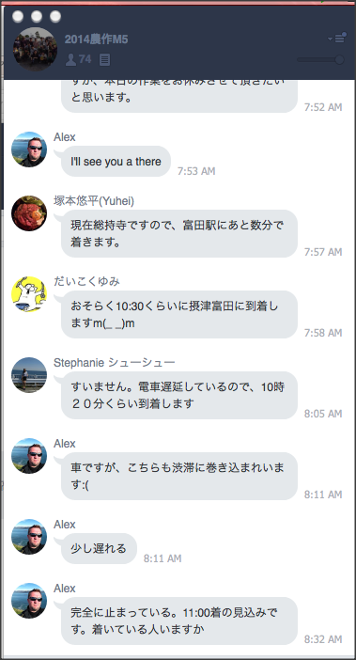
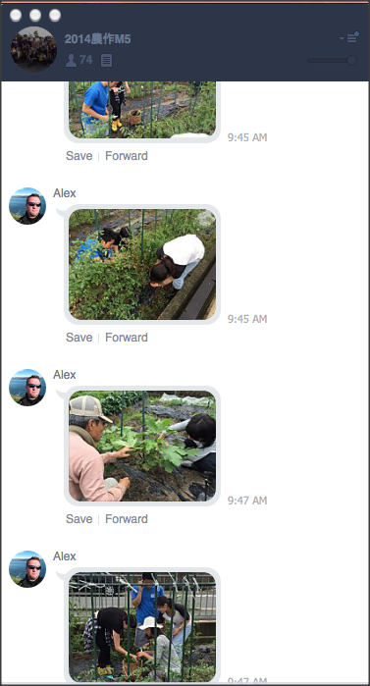
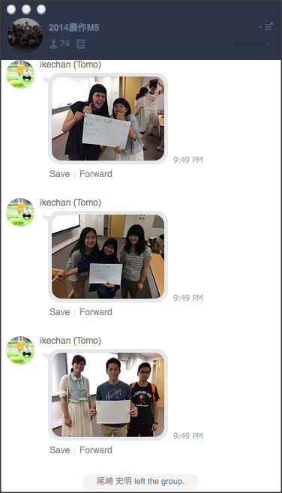
Field Study: Outside Class Learning

Slide 48
Field Study: Outside Class Learning
Announcing who will participate in the Field Study over the weekend.
Sharing plans for activities
Sharing the Field Study Experience in class

Slide 49
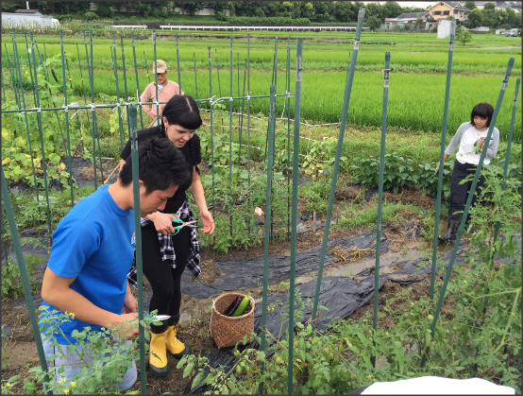
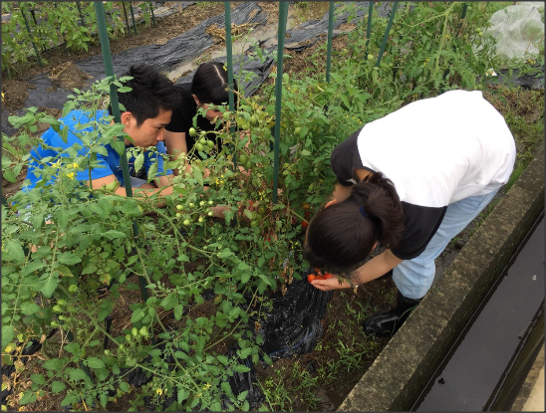
Organic Farm

Slide 50
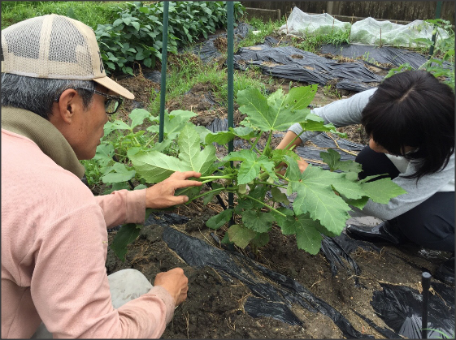
Organic Farm
Local Farmer’s Advice

Slide 51
Use of ICT : LINE
For teams: each team has its own LINE group

Slide 52
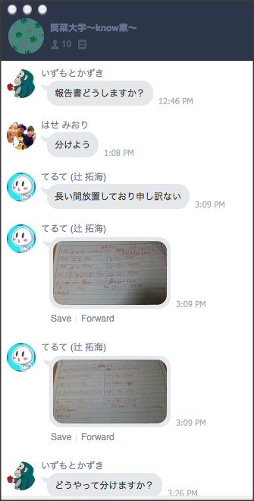
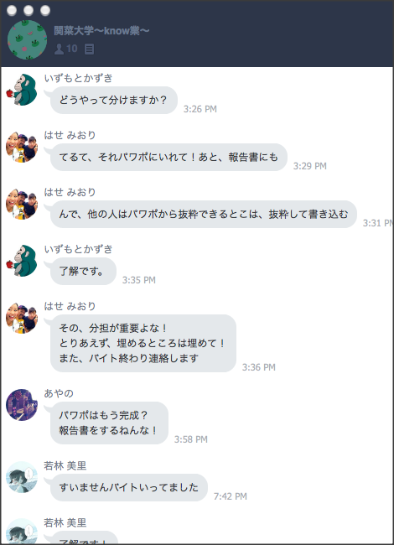
Team activity : TEAM LINE for Discussion (outside class)

Slide 53
Team activity : LINE for Discussion (outside class)
What has been done so far?
Assigning Tasks among members
Sharing plans for activities
Sharing Learning Experience among team members
Preparing for the Team Presentation
- Preparing for the Team Report

Slide 54
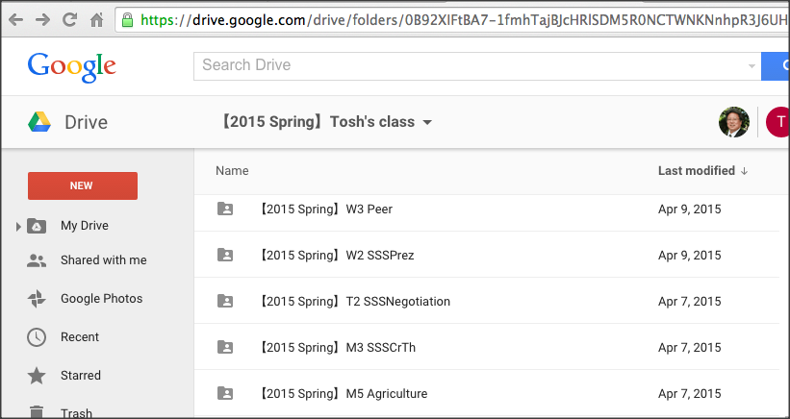
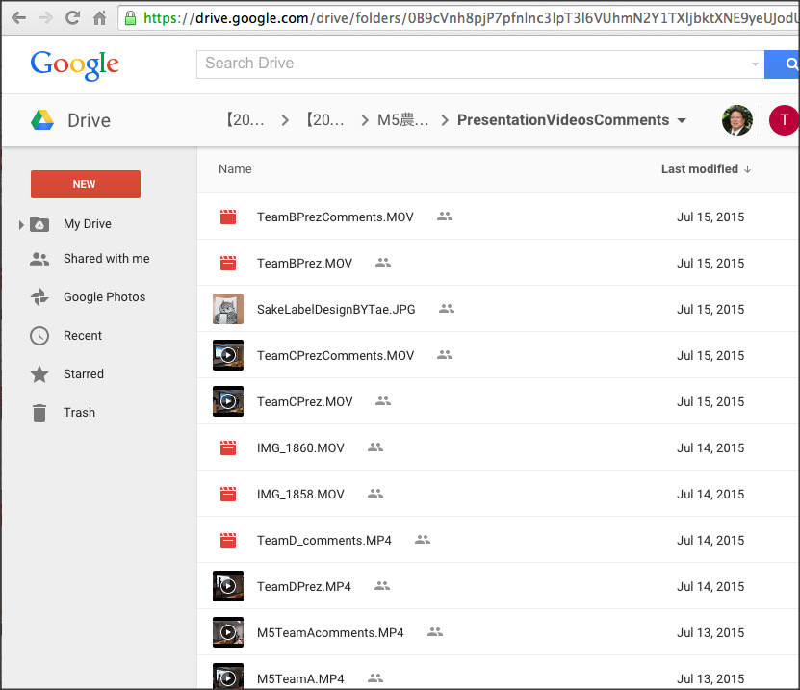
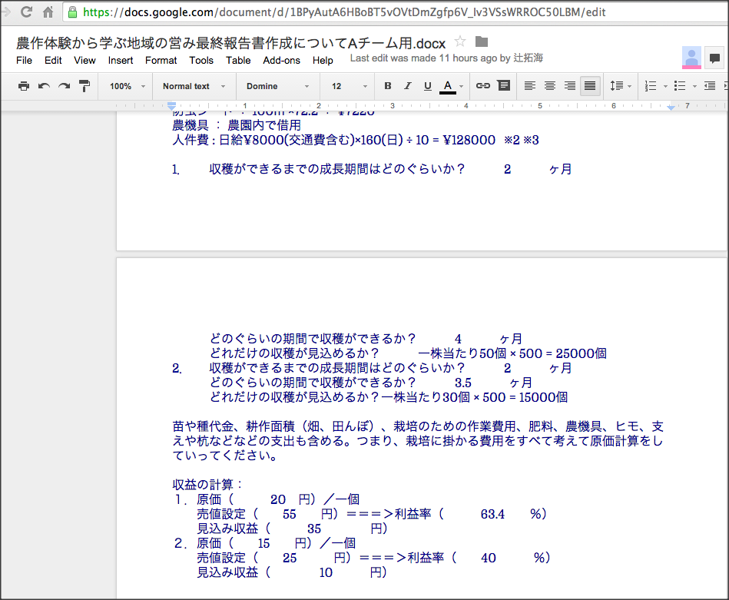
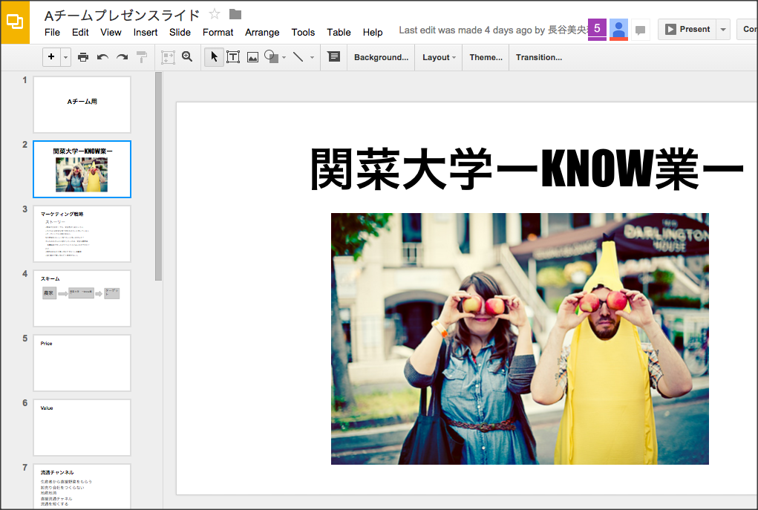
Google Drive Share/Edit
Team presentation videos
comments
All linked with TEAM LINE
All linked with TEAM LINE
All linked with TEAM LINE
Team presentation slides
All can edit online
Team Reports
All can edit online.

Slide 55
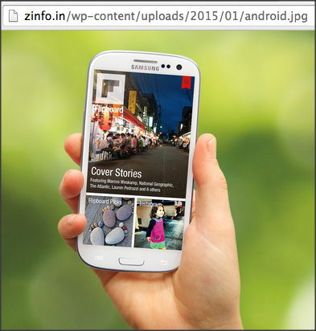
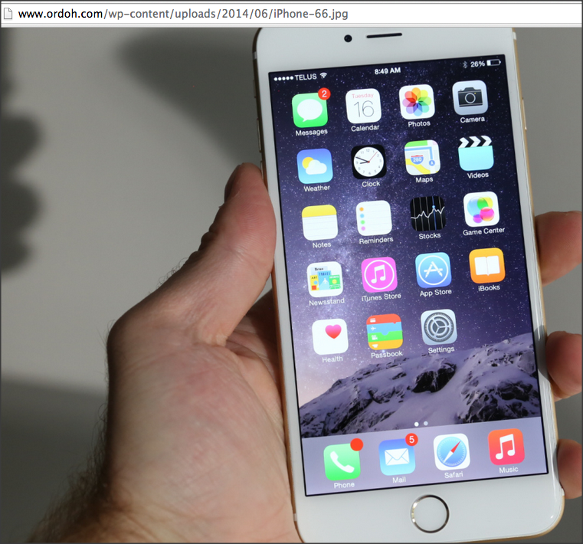
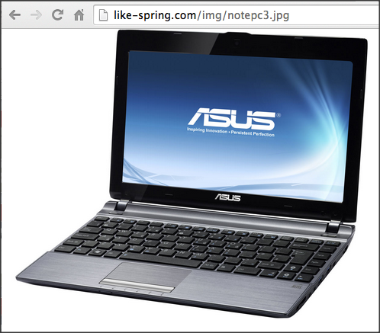
Google Drive Share/Edit
Team presentation videos
comments
All linked with TEAM LINE
All linked with TEAM LINE
All linked with TEAM LINE
Team presentation slides
All can edit online
Team Reports
All can edit online.

Slide 56
Google Drive Share/Edit
Team presentation videos
comments
Gurantees 24/7 team learning environment
All linked with TEAM LINE
All linked with TEAM LINE
All linked with TEAM LINE
Team presentation slides
All can edit online
Team Reports
All can edit online.

Slide 57
Next Step
Targeting at universities in the ASEAN Region: universities with mutual agreement.
eCulture for mutual understanding and sharing of cultural values, daily life, life style, food, school life, rituals, etc.
social entrepreneurship for problem-solving in the society, issues in life. water, food, transportation, school system, concept design of new products, use of IT etc.

Slide 59
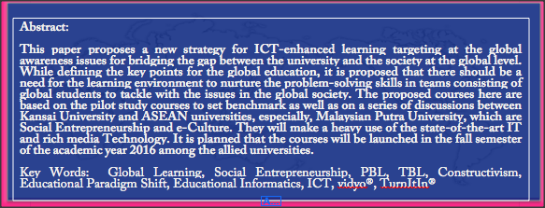

Slide 60
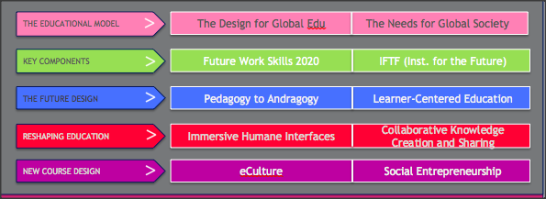

Slide 64
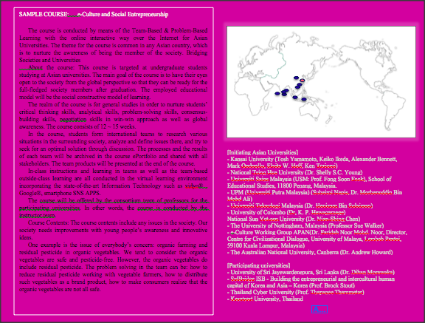

Slide 66
Educational Informatics
A Paradigm Shift for IT-enhanced Education
Tosh Yamamoto (Kansai University, JP)
Ti-Chuang (Timothy) Chiang (National Taiwan University)

