Slide 1
Tosh Yamamoto (Kansai University, JP)
Ti-Chuang (Timothy) Chiang (National Taiwan University)

Slide 2
Instructors
・ Moderator ・・・ Tosh Yamamoto (Kansai University)
CLICA ・・・ Kentaro Kobayashi, Tosh Yamamoto (onsite)
Manaba: COLLAAJ・・・Masaru Komatsu、Yuiko Fujii (online)
Vidyo : Lawrence Lawrence Hsiao (G.M. of Taiwan VCTech Co., Ltd.), Eric Hung (Engineer) (onsite)
Binumi : Gladys (onsite)
TurnItIn ・・・・ Masaki Watanabe, (onsite)
Google File Share ・・・ Tosh Yamamoto (Kansai University)
Tomoya Ikezawa (Facilitator)

Slide 3
Goal
To better understand educational tools for rich-media information/knowledge
To design and create a learning module for your own course
Active Learning
PBL through TBL

Slide 4
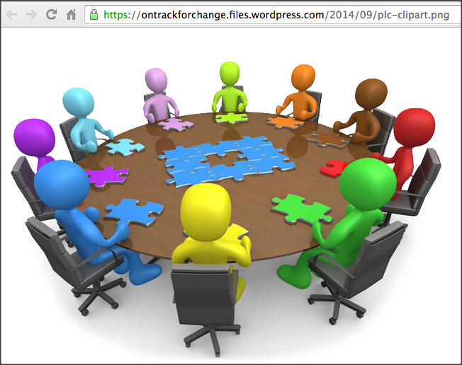
Schedule
Morning Session: ICT Technology Blast!
Defining Today’s Mission in Workshop
Focus on Rich Media
From the learner’s perspective
Afternoon Session:
Hands on & Heads on: Design your own learning module from your course
From the educator’s viewpoint
http://nahar-is.org/wp-content/uploads/2016/01/800x529xCommunity-learning.jpg.pagespeed.ic.DCyfN62PFR.jpg

Slide 5
Morning Session
9:00 – 9:30 General Introduction ICT in a new Educational Paradigm Active Learning Enhanced through Team-Based Learning Rich Media
9:30 – 10:00 Collaaj
10:00 – 10:30 Vidyo
10:30 – 11:00 Coffee Break
11:00 – 11:40 binumi, TurnItIn
11:40 – 12:00 Google Doc Share
12:00 − 12:30 ICT Integrated!

Slide 6
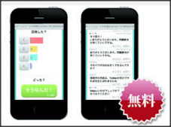
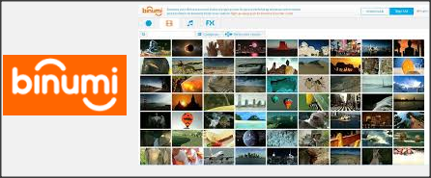
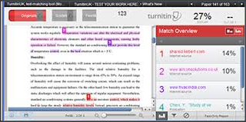
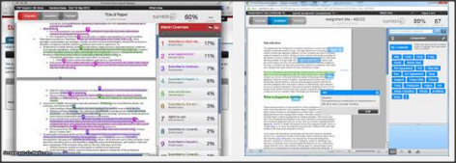
Cutting Edge Technology in Edu
Notes:
Technology

Slide 7
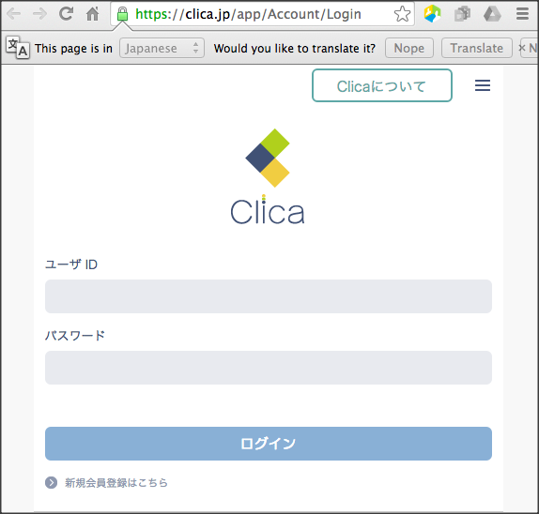
CLICA
From your smart phone
clica.jp
ユーザー名 (user name)
clica-guest-ISGC2016
パスワード (password)
ISGC2016
ログイン(Log In)

Slide 8
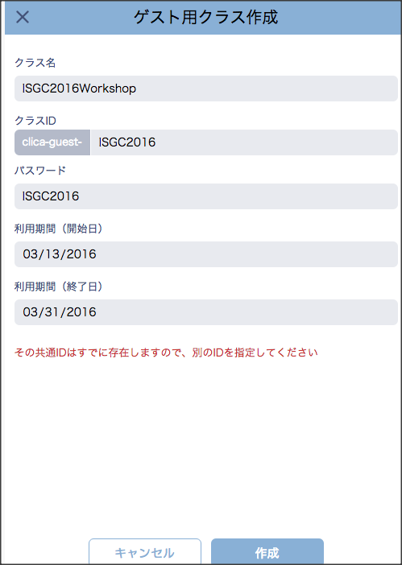
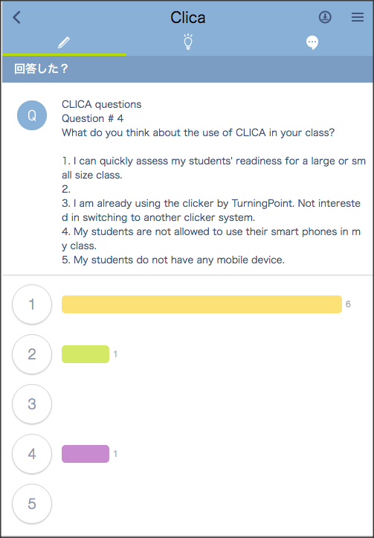
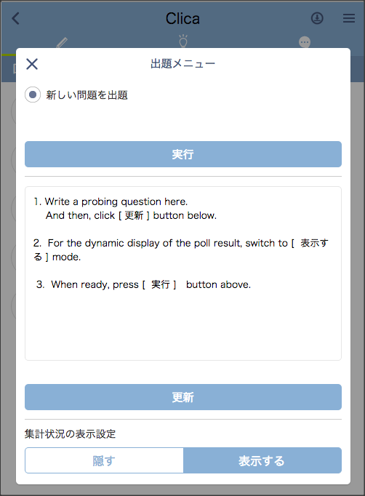
CLICA

Slide 9
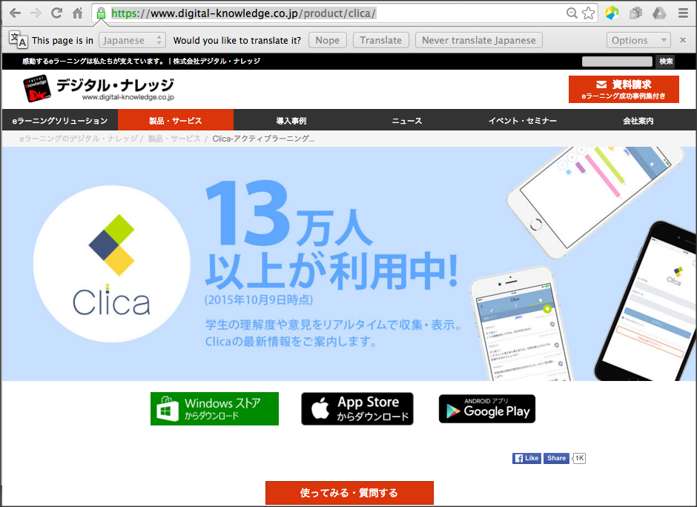
CLICA APPs
Download CLICA APP from https://www.digital-knowledge.co.jp/product/clica/

Slide 10
Strong features
CLICA
Instant Poll & Visualization
Instant Poll even in a large size class
Instant Probe for students’ readiness
Increasing students’ feeling of involvement
Twitter like communication tool
Closed for your students only : Safe! No Public Access!
Available for outside class discussions : linkage to the next week class.
Even in the lecture class, students can share their views among themselves : Peer learning/teaching for unclear concepts
(students) a team-based discussion without getting together face-to-face outside class

Slide 12
Future Generation learner

Slide 13
The Future, Better Life, Transcendency
The Future,
Better Life,
Transcendency
(Future Goal)
Isn’t Learning for making the world / life better?
Notes:
Again I put only the key concept on screen and then talk about it.
Slide Note:
This slide illustrates the alignment with a new topic using color. Note that it uses a color-coded Section Header layout.

Slide 14
The Future,
Better Life,
Transcendency
http://www.iftf.org/uploads/media/IFTF_FutureWorkSkillsSummary_01.gif
Notes:
http://www.iftf.org/uploads/media/IFTF_FutureWorkSkillsSummary_01.gif

Slide 15
The Future,
Better Life,
Transcendency
http://www.forbes.com/sites/sap/2014/05/12/are-you-ready-here-are-the-top-10-skills-for-the-future/2/

Slide 16
The Future,
Better Life,
Transcendency
http://www.forbes.com/sites/sap/2014/05/12/are-you-ready-here-are-the-top-10-skills-for-the-future/2/
Sensemaking
Social Intelligence
Novel & Adaptive Thinking
Cross-Cultural Competencies
Computational Thinking
New Media Literacy
Transdisciplinarity
Design Mindset
Cognitive Load Management
Virtual Collaboration
Notes:
Sensemaking
Social Intelligence
Novel & Adaptive Thinking
Cross-Cultural Competencies
Computational Thinking
New Media Literacy
Transdisciplinarity
Design Mindset
Cognitive Load Management
Virtual Collaboration

Slide 17
The Future,
Better Life,
Transcendency
http://www.forbes.com/sites/sap/2014/05/12/are-you-ready-here-are-the-top-10-skills-for-the-future/2/

Slide 18
The Future,
Better Life,
Transcendency
http://www.forbes.com/sites/sap/2014/05/12/are-you-ready-here-are-the-top-10-skills-for-the-future/2/

Slide 19
The Future,
Better Life,
Transcendency
http://www.forbes.com/sites/sap/2014/05/12/are-you-ready-here-are-the-top-10-skills-for-the-future/2/

Slide 20
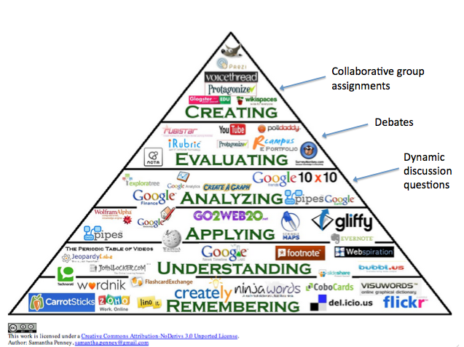
The Future,
Better Life,
Transcendency
http://catlintucker.com/wp-content/uploads/2012/04/Blooms-with-notes.png

Slide 21
The Future,
Better Life,
Transcendency
http://catlintucker.com/wp-content/uploads/2012/04/Blooms-with-notes.png
WiFi

Slide 22
The Future,
Better Life,
Transcendency
http://catlintucker.com/wp-content/uploads/2012/04/Blooms-with-notes.png
WiFi
Battery !

Slide 23
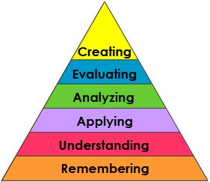
Bloom’s taxonomy Learner’s Activities
Learners
Notes:
Text only to rich text

Slide 24
Learners
Notes:
Text only to rich text

Slide 25
Learners
Notes:
Text only to rich text

Slide 26
Learners
Notes:
Text only to rich text

Slide 27
Learners
Notes:
Text only to rich text

Slide 28
Learners
Most K-12
&
University
Curriculum
Notes:
The top of the normal curve are so-called elite in top schools in the nation.
They will perform in high quality what they are told to do.
However, they cannot think critically or creatively.
Their mission is to maintain the status quo of the cultural values.
Text only to rich text

Slide 29
Learners
Ideally Speaking . . .
The Learner can :
・Think critically and creatively
・Reflect upon their learning meta-cognitively
・View where they stand
・comprehensively with a bird’s eye view
・Appreciate the value in life and the beauty of life
Notes:
Text only to rich text

Slide 30
Learners
Social Constructivism
PBL thru TBL
Problem/Project Based Learning
Thru
Team Based Consensus Agreement
Classroom and Beyond . . . ・No borders in Learning !
・Involving All Stakeholders in the School Community . . . e.g. Regional Partnership
Business/Industry-Academia Partnership
Notes:
Text only to rich text

Slide 31
In other words, Learners must be outside of the fish bowl!
Learners
Notes:
Text only to rich text

Slide 32
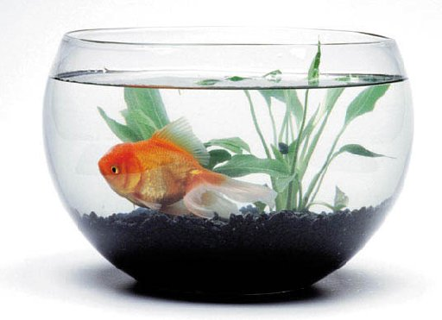
Learners must be outside of the fish bowl!
Learners
Image: ilovetranto.com
Who chose the school to be inside the fish bowl?
image source: www.okeanosgroup.com/
Image source: ilovetronto.com, www.okeanosgroup.com, leap-va.org/wp-content/uploads/2013/03/fish-bowl-jumping-Leap-Day-2012.jpg
Notes:
Text only to rich text

Slide 33
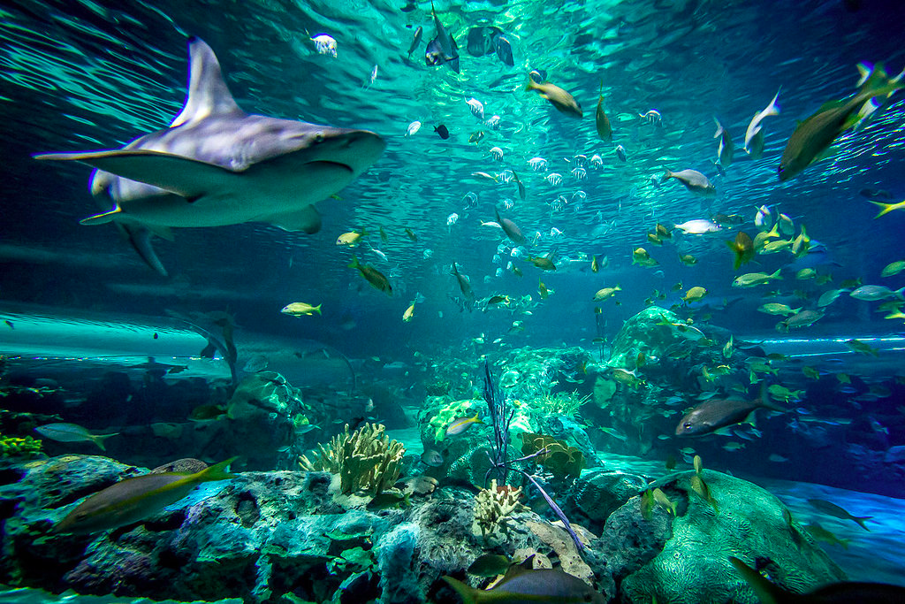
There is a bigger world outside the fish bowl !
Learners
Image: ilovetranto.com
image source: www.okeanosgroup.com/
image source: leap-va.org/wp-content/uploads/2013/03/fish-bowl-jumping-Leap-Day-2012.jpg
Notes:
Text only to rich text

Slide 34
Learners
Image: ilovetranto.com
Learning must happen here!
image source: www.okeanosgroup.com/
image source: leap-va.org/wp-content/uploads/2013/03/fish-bowl-jumping-Leap-Day-2012.jpg
Notes:
Text only to rich text

Slide 35
Learners must find values of what they learn, Not pre-fabricated values by teachers!
Tosh Yamamoto (2014)

Slide 36
Them, what values are not fabricated yet ?
Let’s go to the Future Section !

Slide 37
Where we are in edu Today

Slide 39
We will be focusing on the ICT enhanced learning in a course today.

Slide 40
The Future,
Better Life,
Transcendency
http://catlintucker.com/wp-content/uploads/2012/04/Blooms-with-notes.png

Slide 41
Cutting Edge Technology in Edu
Notes:
Technology

Slide 42
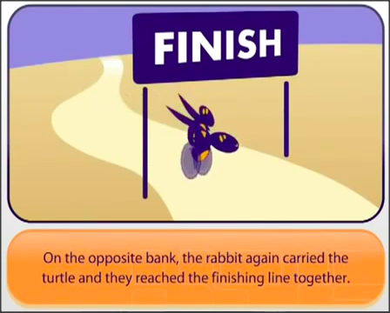
Active Learning
Social Constructivism
(Video : A Rabbit and A Turtle)

Slide 43
Educational ICT
9:00 – 9:30 General Introduction ICT in a new Educational Paradigm Active Learning Enhanced through Team-Based Learning Rich Media
9:30 – 10:00 Collaaj
10:00 – 10:30 Vidyo
10:30 – 11:00 Coffee Break
11:00 – 11:40 binumi, TurnItIn
11:40 – 12:00 Google Doc Share
12:00 − 12:30 ICT Integrated!

Slide 44
Strong features
CLICA
Instant Poll & Visualization
Instant Poll even in a large size class
Instant Probe for students’ readiness
Increasing students’ feeling of involvement
Twitter like communication tool
Closed for your students only : Safe! No Public Access!
Available for outside class discussions : linkage to the next week class.
Even in the lecture class, students can share their views among themselves : Peer learning/teaching for unclear concepts
(students) a team-based discussion without getting together face-to-face outside class

Slide 45
Strong features
Vidyo
In-class students & Online students can share learning in the same virtual classroom (the feeling of being there)
No complicated set-ups or expensive equipment needed: PC or any mobile devices can moderate a session
Students who missed a class can catch up with the learning via on-demand video archive
(students) online team discussions can be recorded and shared with the entire class

Slide 46
Strong features
Collaaj (Lecture Capture)
Easy operation
No fancy and expensive devices
Can create an online lecture session on the fly!
Can share the created contents with your students instantly!
(students) team reports in rich media can be shared with the entire class

Slide 47
Strong features
binumi
Good Tool for meta cognitive learning activities
Tool for Reflection in learning
Organizing what the student acquired in the form of Public Announcement to share with the rest of the class

Slide 48
Strong features
Google
Team-based Preparation for:
Team Discussion Log
Team Report
Team Presentation Slides
Archiving & Sharing the Results and Progress of the Team Learning Activities
(Add examples)
(Two-Tiered Communication: Dividing Tasks of Team Communication)
TO DO
(Create a shared folder for participants)

Slide 49
Strong features
Powerful Plagiarism Detection
Easy and Convenient Editorial Comments with Markers
Rubric Assessment
Grading
All above in one single account!

Slide 50
End of Morning Session
Thank you for attending the morning session!

Slide 51
Lunch Break
We will start the afternoon session at 2:00 pm.

Slide 52
Afternoon Session
2:00 pm – 5:30 pm
Hands on session to create your own learning module.

Slide 53
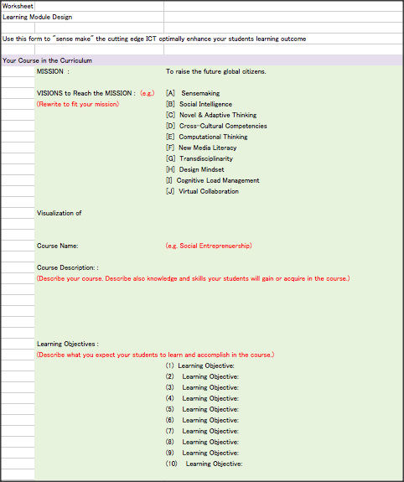
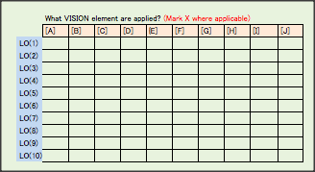
Sample module
You will receive email.
Please check your email and download the worksheet.

Slide 54
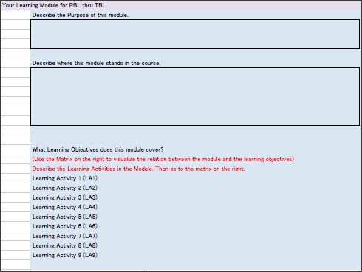
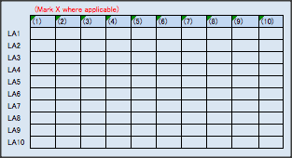
Designing Your Course Module

Slide 55
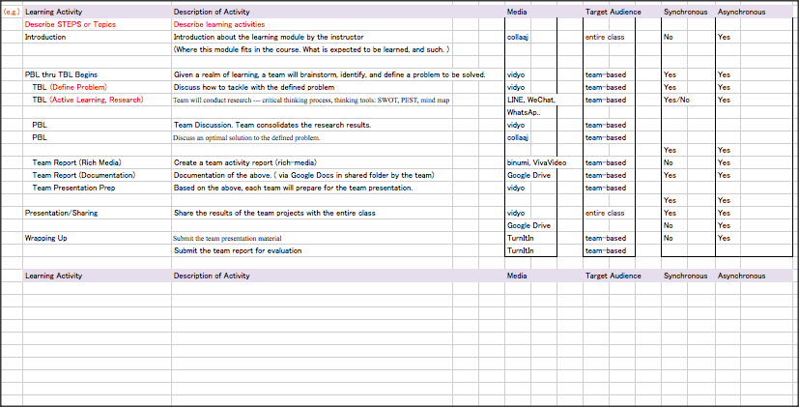
Sample Module
Your Course design Module here

Slide 56
Check your email
You will have trial account information for the rich media software or cloud services that are introduced in the morning by email.
Check your email account and set up the learning environment that will best fit to into your learning module.

Slide 57
Hands-On session
Tech Assistants on the floor will assist you if you have any problems or questions.

Slide 58
Wrapping up
If time allows, share your module with others in the session.

Slide 59
Thank you for your active participation and engagement!
Tosh Yamamoto (Kansai University, JP)
Ti-Chuang (Timothy) Chiang (National Taiwan University)

