Slide 1
KISTI activities and plans
Global experiment Science Data hub Center
Jin Kim
jkim@kisti.re.kr

Slide 2
Agenda
KISTI GSDC
GSDC system overview
GSDC & network
Internal & External
GLORIAD & TEIN
Test
Submarine cable issue

Slide 3
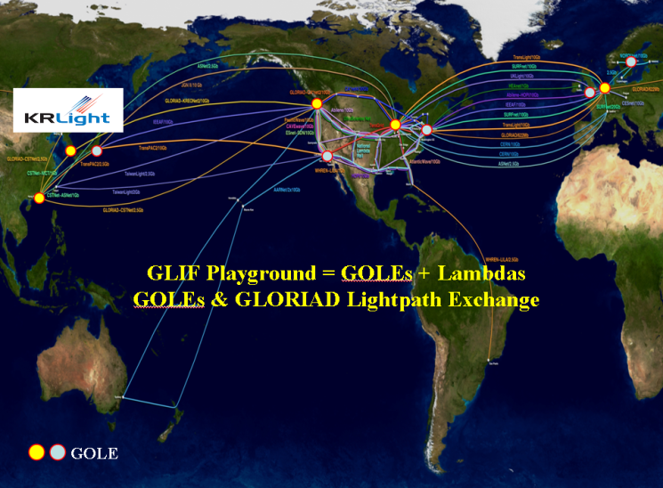
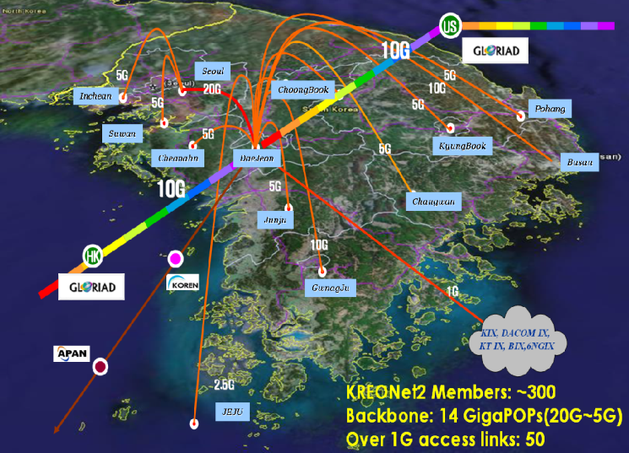
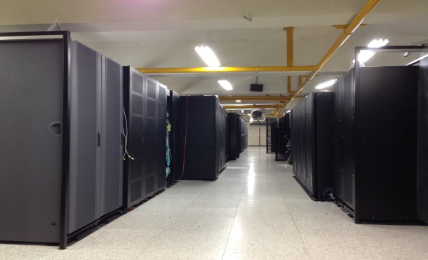
KISTI GSDC
KISTI (Korea Institute of Science and Technology Information)
Government funding research institute for IT founded in 1962
600 people working for National Information Service(distribution & analysis), Supercomputing and Networking
Operating Supercomputing and NREN Infrastructure
Supercomputer: 307.4 TFlops at peak(14th ranked at Top500 in 2009; 201st now)
NREN Infrastructure: KREONet2
Domestic: Seoul ←(100G)→ Daejeon
International: HK ←(10G)→ Chicago/Seattle(Member of GLORIAD)
GSDC (Global Science experiment Data hub Center)
Government funding project to promote research experiment providing computing power and storage
HEP: ALICE, CMS, Belle, RENO
Others: LIGO, Bioinformatics, electronic telescope.
Running Data-Intensive Computing Facility
15 staffs: sysadmin, experiment support, external-relation, administration
Total 6,000 cores, 6,500 TB disk and 1,500 TB tape storage
History of GSDC
7 years of the experience running grid computing centre with the collaboration with the ALICE experiment and WLCG
GSDC Facility
2007
2009
2010
2011
2012
2013
2014
Formation of GSDC
ALICE T2 Test-bed
ALICE T2 operation start
ALICE T1 Test-bed
KISTI Analysis Facility
ALICE T1 candidate
Full T1 for ALICE
CMS T3

Slide 4
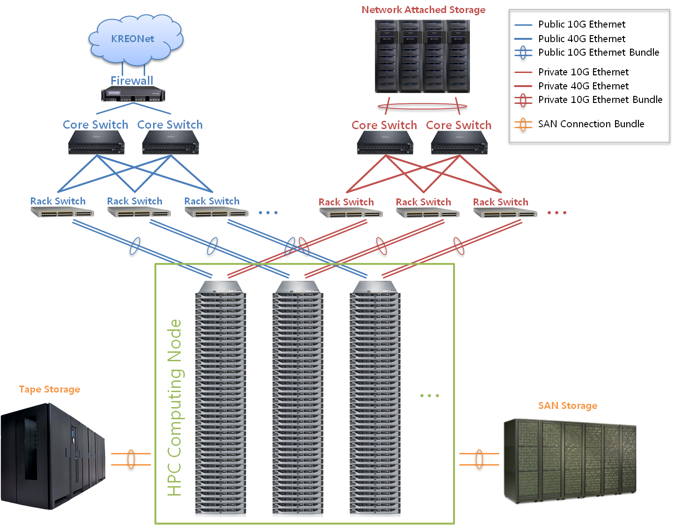
GSDC System Overview
Public
Private
4 Spine switches
74 Leaf switches
500+ Servers in 22 racks
14 Storage racks
4 tape frames
HITACHI HNAS
EMC ICILON
1.5 PB
HTCondor
2,500 slots
CMS T3, LIGO, KIAF
40 computing racks
Torque/MAUI
3,500 slots
ALICE T1, Belle, RENO
1.5 PB
4.0 PB
HITACHI USP/VSP
EMC Clariion/VNX
IBM TSM/GPFS

Slide 5
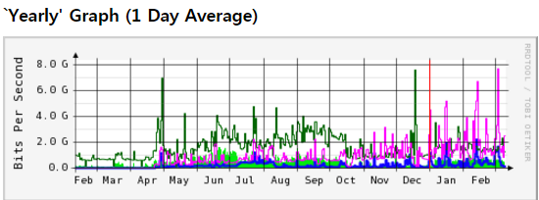
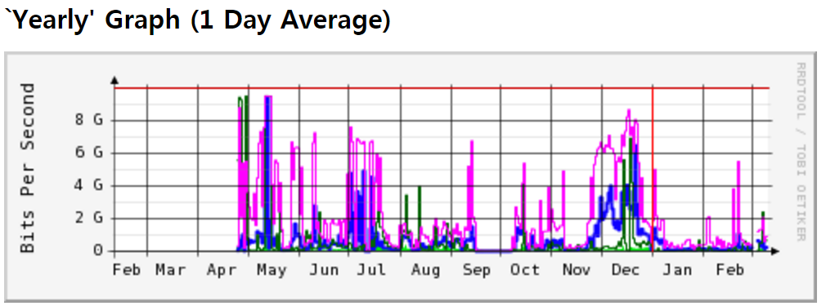
GSDC System Overview
Private
HITACHI HNAS
EMC ICILON
1.5 PB
Dedicated SW for ALICE Tier 1 center
HTCondor
2,500 slots
CMS T3, LIGO, KIAF
Torque/MAUI
3,500 slots
ALICE T1, Belle, RENO
1.5 PB
4.0 PB
HITACHI USP/VSP
EMC Clariion/VNX
IBM TSM/GPFS

Slide 6
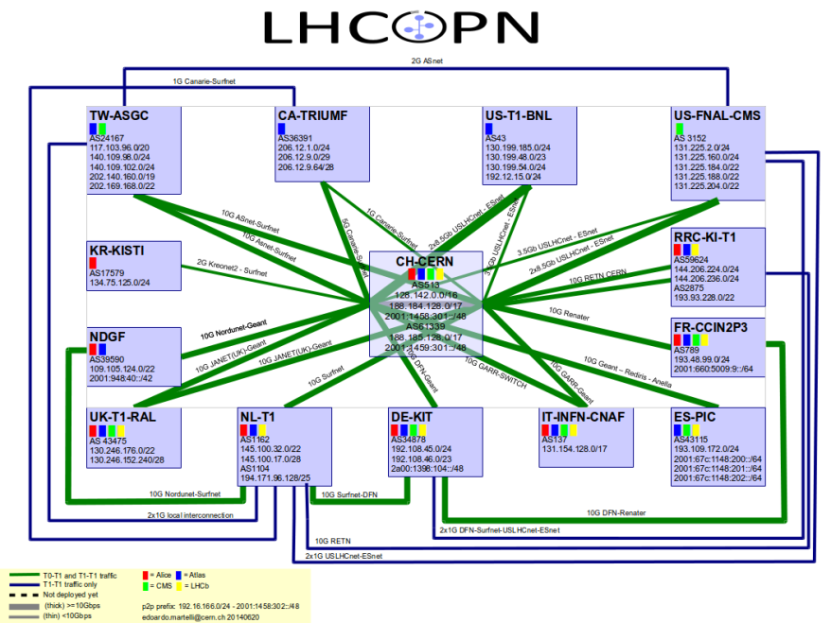
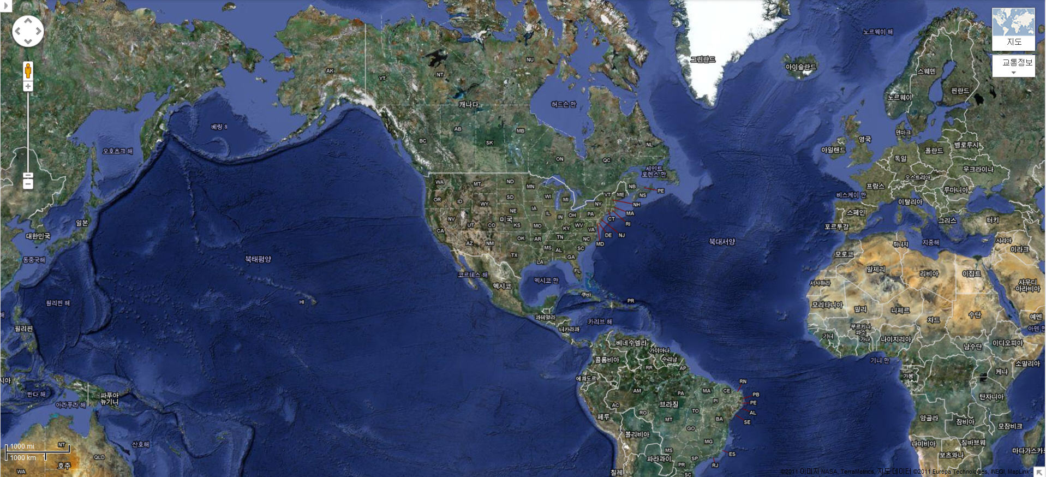
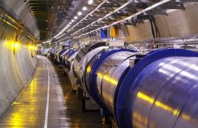
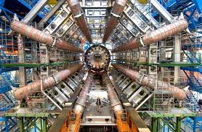
LHCOPN (GSDC/KISTI ~ CERN)
LHC Optical Private Network
GSDC (Global Science Data hub Center) in KISTI as CERN LHC Alice Tier 1 center Since 2013
NetherLight
10Gbps
CERN
KRLight
(Daejeon)
❍
KRLight
(Chicago)
KISTI
10Gbps (protection)
6
10
34

Slide 7
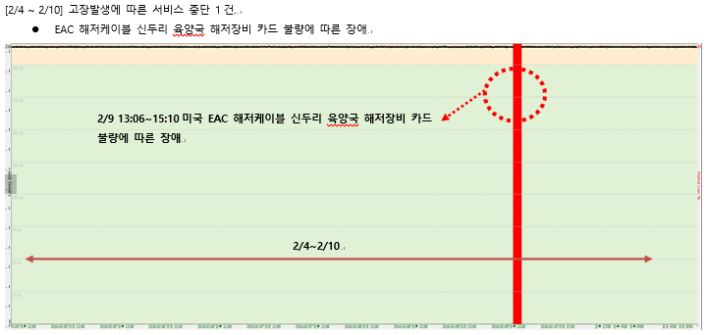
Maintain the LHCOPN
Report by ISP (SKB) once in a month
Latency check every hour
Disable is occured
MRTG graph check
Chicago and KISTI backbone

Slide 8
KISTI’s LHCONE
Implementation (2016.3)
SARA
Netherlands
CERN
Geneva
US LHCNet
Geneva
Amsterdam
GLORIAD-KR
ESnet
USA
CANARIE
Canada
Internet2
USA
TEIN,
ASGCnet
(Asian NREN and CERN TierX network)
Hong Kong
Seattle
Chicago
LHCOPN
GLORIAD-KR
GLORIAD-KR
GLORIAD-KR
KREONet2
Seattle, Chicago, Hong Kong
Daejeon
GSDC/KISTI
LHCONE VPN Domain
R&E International Exchanges
Korea LHC CMS/ALICE, KEK Belle Community
KREONET,
CERN ALICE Network
KREONET
CERN CMS Network
KREONET
HEP(KEK Belle…) Network …
Original by Bill Johnston, Esnet

Slide 9
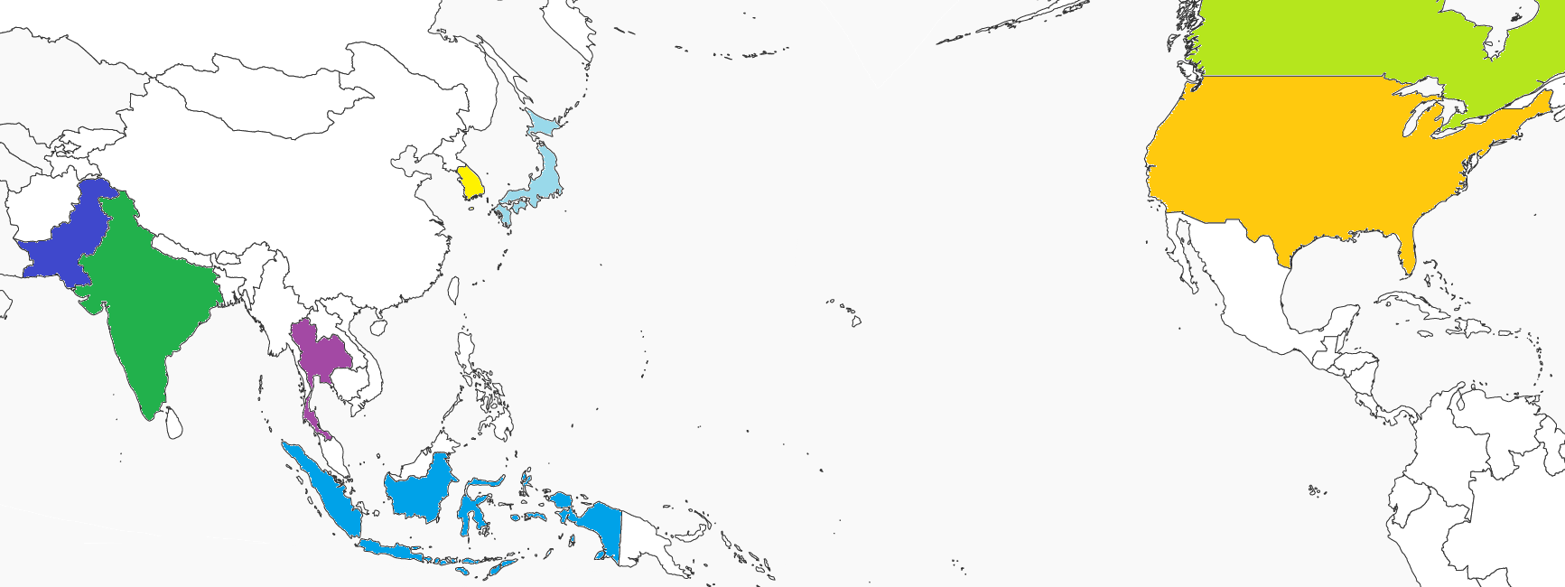
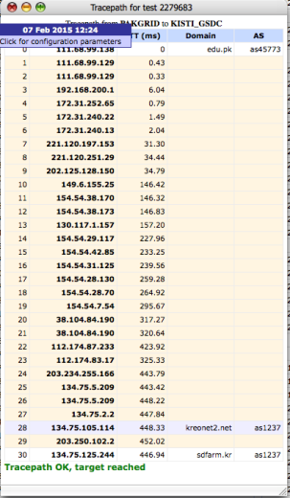
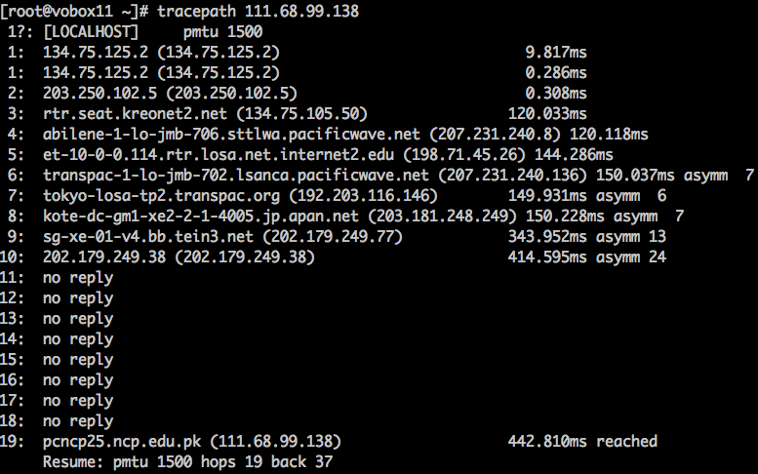
Example: Previous Status
KISTI(KR) ↔ PAKGRID (PK)
KREONET
Seattle
PAKGRID
(PK)
KISTI
Daejeon
PACIFICWAVE
Tokyo
TRANSPAC
LA
HK
APAN-JP
TEIN
Singapore
30 hops
Tracepath
over 400ms latency
KISTI-CERN 250ms latency

Slide 10
LHCONE in Asia
A consensus for LHCONE inter-VRF connection among KREONet2/GLORIAD-KR(KISTI), ASGC and TEIN
^{Asia Tier Center Forum,} ^{KISTI 22-24 September 2015}

Slide 11
TEIN-GLORIAD-KR (KREONet2) Interconnection
Both are col-located in Megai-advantage
GLORIAD-KR MX960: MEGA-TOP(32/F)
TEIN M120: 8/F
Interconnection : 1G -> 10G
Short-term: 1G

Slide 12
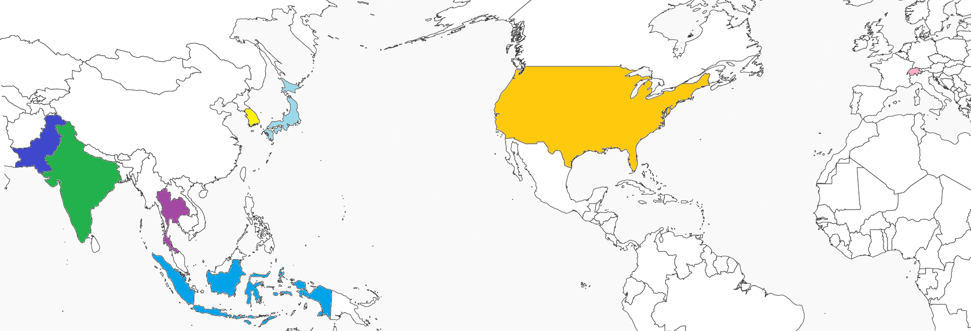
TEIN-GLORIAD-KR Interconnection
100Gbps
10Gbps
Amsterdam
10Gbps
Seattle
KISTI
GSDC
Chicago
CERN
10Gbps
Pakistan
10Gbps
JP
10Gbps
IN
HK
KISTI-CERN LHCOPN
GLORIAD-KR
TEIN
TH
SG
1 ~ 10Gbps
Indonesia

Slide 13
Traceroute test

Slide 14
Test
alice-t1-vobox.sdfarm.kr
IP : 134.75.125.152
VM Host IP : 134.75.125.27 (alice-prd-ovirt-03.sdfarm.kr)
tracepath to Asian ALICE sites
SUT (TH)
COMSATS, PAKGRID (PK)
Kolkata (IN)
Cibinong, Bandung (ID)

Slide 15
Test Summary
Thailand
SUT : 202.28.43.133
Latency = 157.702 ms
Hops = 10
Pakistan
PAKGRID : 111.68.99.138
Latency = 287.264 ms (over 400ms)
Hop = 10 (-9)
COMSATS : 210.56.24.242
Latency = 424.073 ms
Hop = 21
India
Kolkata : 144.16.112.13
Latency = 305.338 ms
Hop = 11
Indonesia
Bandung : 203.160.128.98
Latency = 127.573 ms
Hop = 19
Cibinong : 203.160.128.89
Latency = 109.401 ms
Hop = 16
 |  | Thailand | Pakistan |  | India | Indonesia
Site |  | SUT | PAKGRID | COMSATS | Kolkata | Bandung | Chibinong
Latency | Now | 157.702 | 194.064 | 424.073 | 305.338 | 127.573 | 109.401
 | pre |  | 450 |  | 450.04 | 351.38 | 289.84
Hops |  | 10 | 10 | 21 | 11 | 19 | 16

Slide 16
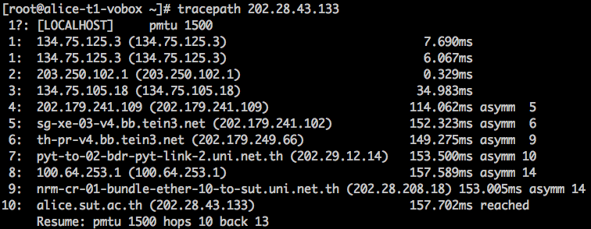
Thailand
SUT : 202.28.43.133
- Latency = 157.702 ms
- Hops = 10

Slide 17
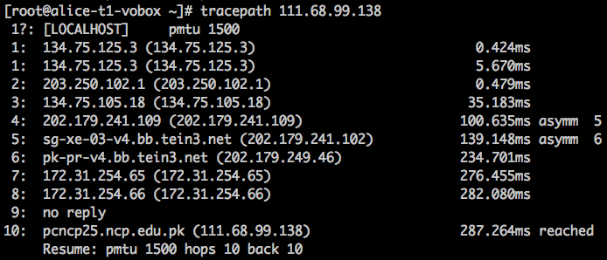
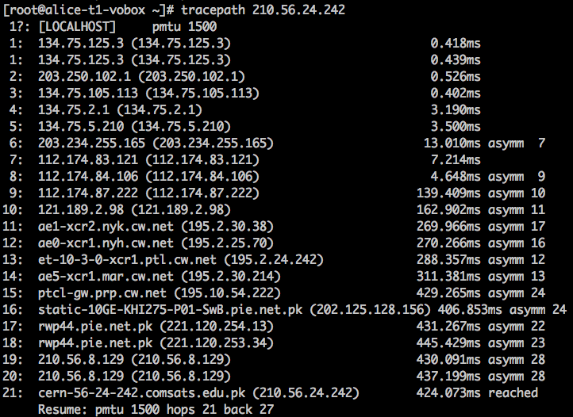
Pakistan
PAKGRID : 111.68.99.138
Latency = 287.264 ms (over 400ms)
Hop = 10 (-9)
COMSATS : 210.56.24.242
Latency = 424.073 ms
Hop = 21

Slide 18
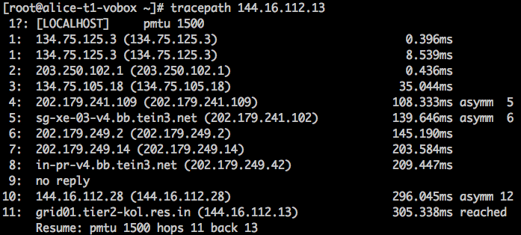
India
Kolkata : 144.16.112.13
Latency = 305.338 ms
Hop = 11
450.04 ms

Slide 19
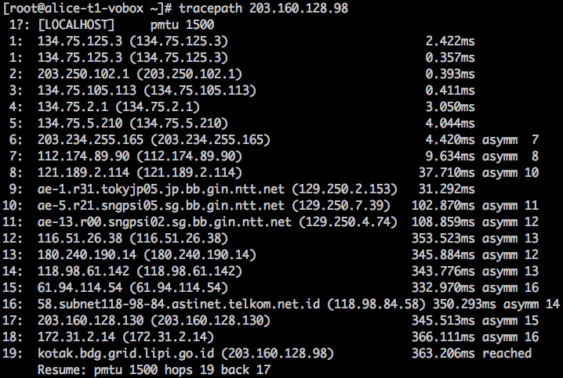
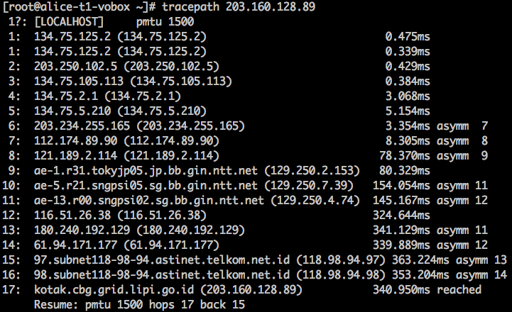
Indonesia
Bandung : 203.160.128.98
Latency = 127.573 ms
Hop = 19
Cibinong : 203.160.128.89
Latency = 109.401 ms
Hop = 17
351.38 ms
289.84 ms
KR-JP-SG

Slide 20
Submarine cable issue

Slide 21
Submarine cable Disable
First disable
2015. 8. 14 sub-cable cut (HK-Taiwan)
2015. 9. 19 main-cable cut (Kor – Jap)
Total disable time: 29H 56M
Second disable
2016. 1. 1 main-cable cut (Kor-Jap)
2016. 1. 19 sub-cable cut (HK-Taiwan)
Total disable time: 9H 14M

Slide 22
Submarine cable Issue (1/2)

Slide 23
Submarine cable Issue (2/2)

Slide 24
Thank You (Q or C)

