Slide 1
KISTI-GSDC Tier-1 SITE REPORT
@ Acamedia Sinica, Taipei, Taiwan
13 – 14 March 2016
Byungyun KONG
on the behalf of KISTI-GSDC

Slide 2
Tier-1 Operations

Slide 3
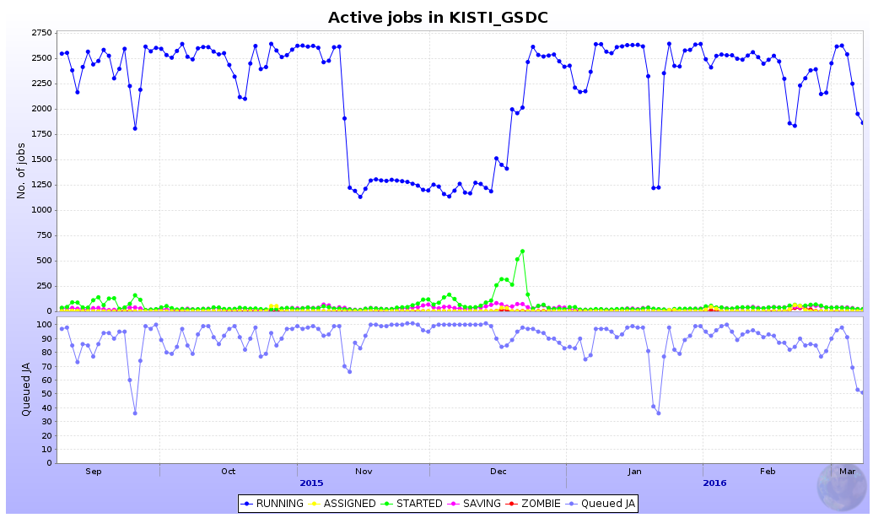
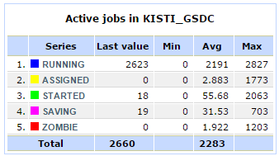
Jobs
• Pledges
 | 2014 | 2015 | 2016
CORE(HS06) (Installed) | 25,000 (28,800) | 28,000 (28,800) | 31,000 (31,000)
Participated in Hi Reco Run with 6GB memory (Doubled)
Maximum 2,688 concurrent jobs
Hi Reco Run
Maximum 1,344 concurrent jobs
> 5GB memory available per job for Hi Reco Run

Slide 4
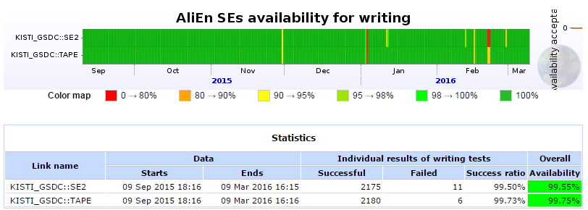
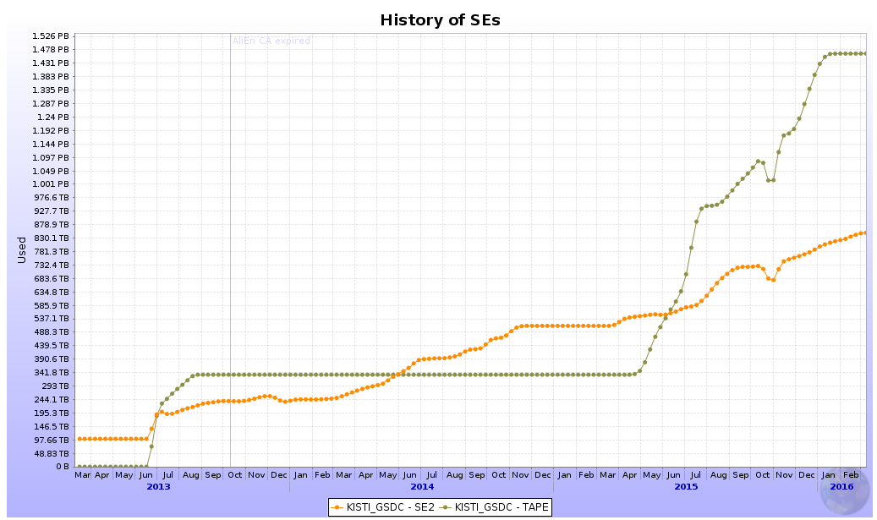
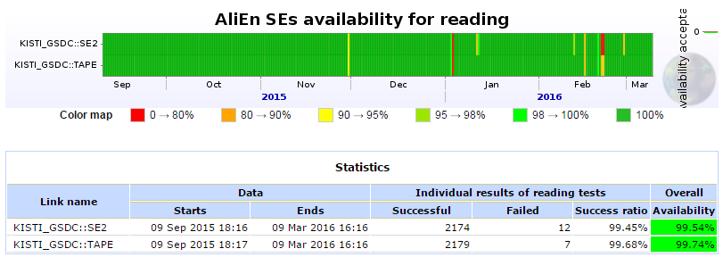
Storage
• Pledges
 | 2014 | 2015 | 2016
Tape(TB) (Installed) | 1,500 (1,000) | 1,500 (1,500) | 1,500 (1,500)
Disk(TB) (Installed) | 1,000 (1,000) | 1,000 (1,000) | 1,500 (1,500)
Tape used almost 1,500TB
500TB will be installed
99% availability during 6 months
1.465 PB Used (Tape)
852.7 TB Used (Disk)
Run2 Data Taking

Slide 5
Site Availability-Reliability
100% Reliability for the last 6 month (target : 97%)
On track for a stable and reliable site
Participating in weekly WLCG operations meetings : reporting operation-related issues
24/7 monitoring & maintenance contract
2 people responsible for on-call
< Monthly Availability-Reliability (%) >
 | Aug | Sep | Oct | Nov | Dec | Jan | Average(6M)
Reliability | 100 | 100 | 100 | 100 | 100 | 100 | 100
Availability | 100 | 100 | 100 | 100 | 94 | 100 | 99
The stable operating for a high reliability and availability site
Notes:
In this slide I summarized our site availability based on WLCG monthly report.
Monthly target for reliability is ninety seven percent.
The red line on the bottom plot represents the monthly target,
and you can see the history of KISTI Tier1 site availability and reliability,
of OPS and ALICE VO on every months since March two thousand twelve.
As you can see, it has shown gradual increase of overall availability.
In particular, for the last year, mostly we achieved the monthly target in spite of a few unscheduled downtime.

Slide 6
Asia Tier Center Forum

Slide 7
1st Asia Tier Center Forum
22 – 24, September, 2015 at KISTI, South Korea
Agreed to implement LHCONE VRF in their networks
https://indico.cern.ch/event/395656

Slide 8
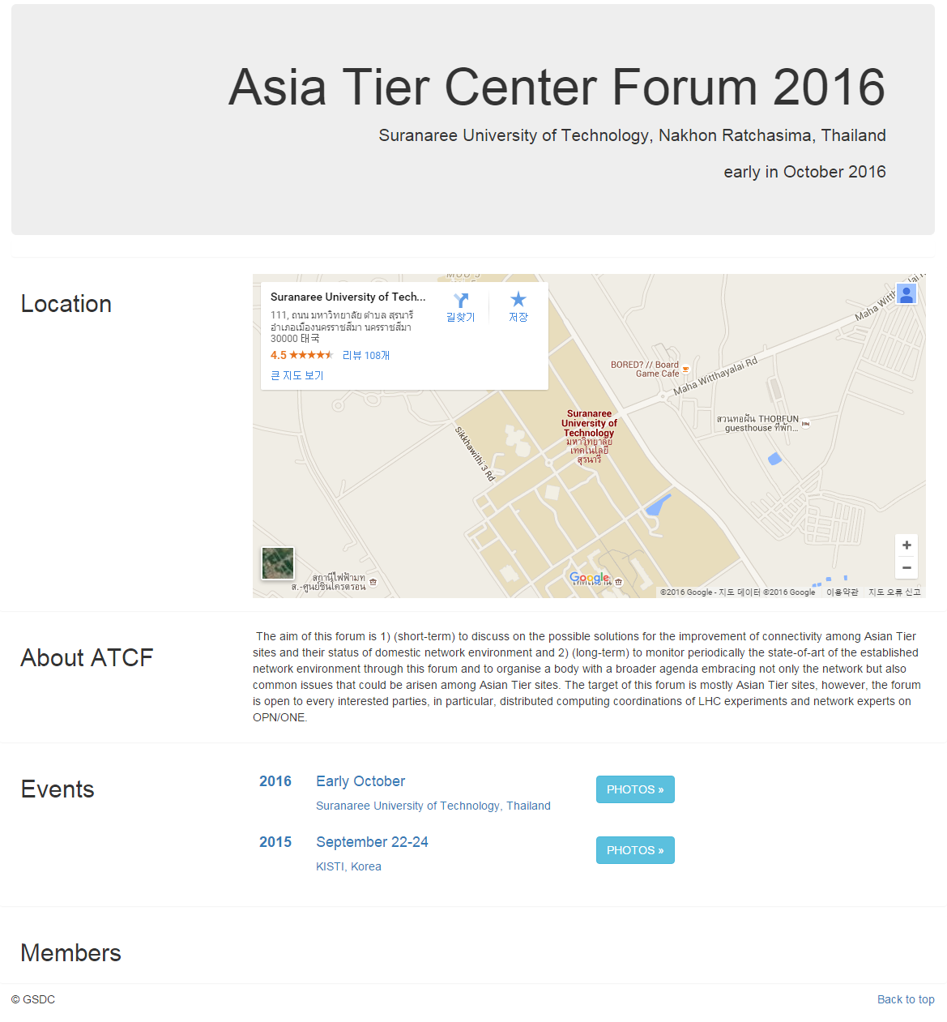
2nd Asia Tier Center Forum
Where? SUT, Thailand
When? Fall, 2016 →be fixed at steering meeting in April
Mailing-list
→asia-tier-center-forum ^{(CERN e-groups)}
Website
→atcforum.org
Thanks to Prof. Chinorat Kobdaj

