Slide 1
Elastic CNAF Datacenter extension via opportunistic resources
INFN-CNAF

Slide 2
INFN
National Institute for Nuclear Physics (INFN) is a research institute funded by the Italian government
Composed by several units
  20 units dislocated in the main Italian University Physics Departments
  4 Laboratories
  3 National Centers dedicated to specific tasks
CNAF is a National Center dedicated to computing applications

Slide 3
The Tier-1 at INFN-CNAF
WLCG Grid site dedicated to HEP computing for LHC experiments (ATLAS, CMS, LHCb, ALICE) works with
~30 other scientific groups
1.000 WNs , 20.000 computing slots, 200k HS06 and counting.
  LSF as current Batch System, Condor migration foreseen
22PB SAN disk (GPFS), 27PB on tape (TSM) integrated as an HSM
  Also supporting LTDP for CDF experiment
Dedicated network channel (LHC OPN, 20Gb/s) with CERN Tier-0 and T1s, plus 20GB/s (LHC ONE) with most of the T2s
  100Gbps connection in 2017
Member of HNSciCloud European project for testing hybrid clouds for scientific computing

Slide 4


WAN@CNAF
LHC OPN
RAL
SARA
PIC
        TRIUMPH
BNL
FNAL
TW-ASGC
NDGF
KR-KISTI
RRC-KI
JINR
Main Tier-2s
LHC ONE
GARR Mi1
IN2P3
General IP
GARR Bo1
20 Gb/s For General IP Connectivity
GARR BO1
20Gb/s
40Gb/s
10Gb/s
40 Gb Physical Link (4x10Gb)
Shared by LHCOPN and
LHCONE.
Cisco7600
NEXUS
CNAF TIER-1

Slide 5

Extension use-cases
Elastic opportunistic computing with transient Aruba resources. CMS selected for test&setup
ReCaS/Bari: extension and management of remote resources
  These will become pledged resources for CNAF
Bologna
Arezzo
Bari

Slide 6
Use-case 1: Aruba

Slide 7
Pros of Opportunistic computing
CMS
  Take advantage of (much) more computing resources.
    CONS: transient availability
ARUBA
  Study case in order to provide unused resources to an “always hungry” customer
INFN-T1
  Test transparent utilization of remote resources for HEP (proprietary or opportunistic)

Slide 8
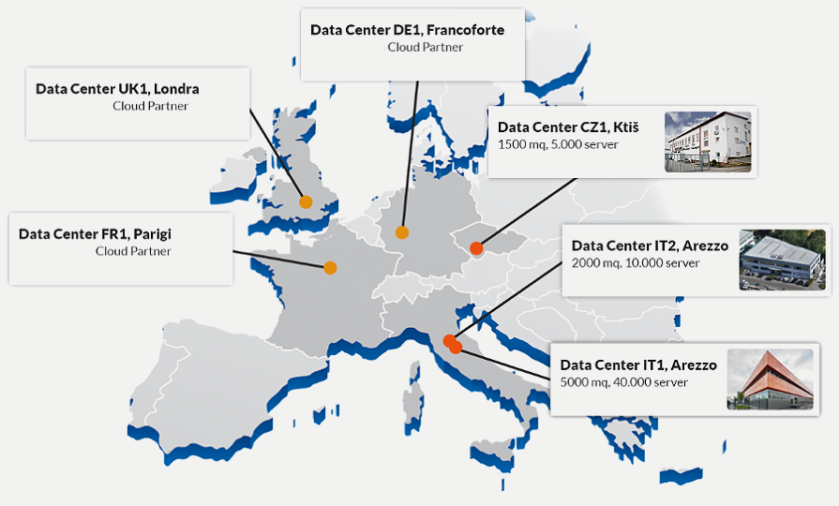
Aruba
One of the main Italian resource providers
  Web, host, mail, cloud ...
Main datacenter
in Arezzo
(near Florence)

Slide 9
The CMS Experiment at INFN-T1
48k HS06 of CPU power, 4PB of online Disk storage and 12PB of tape
Implemented all majors computing activities
  Monte Carlo simulations
  Reconstruction
  End-user analysis
The 4 LHC experiments are close enough in requests / workflows
  extension to the other 3 under development

Slide 10
The use-case
Early agreement CNAF - Aruba
  ARUBA provides an amount of Virtual resources (CPU cycles, RAM, DISK) to deploy a remote testbed
    VMWare dashboard
  When Aruba customers require more resources, the CPU Freq. of the provided VMs in the testbed is lowered down to a few MHz (not destroyed!)
Goal
  Transparently join these external resources “as if they were” in the local cluster, and have LSF dispatching jobs there when available
  Tied to CMS-only specifications for the moment
  Once fully tested and verified, extension to other experiments is
    Trivial for other LHC experiments
    To be studied for non-LHC VOs

Slide 11
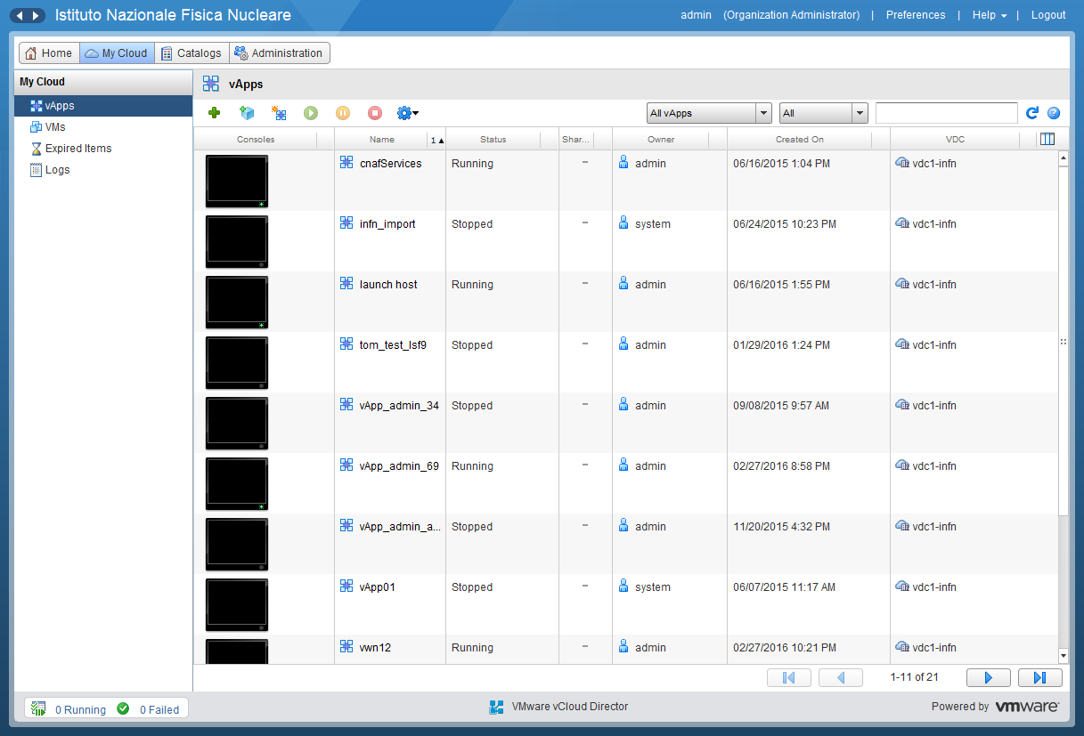
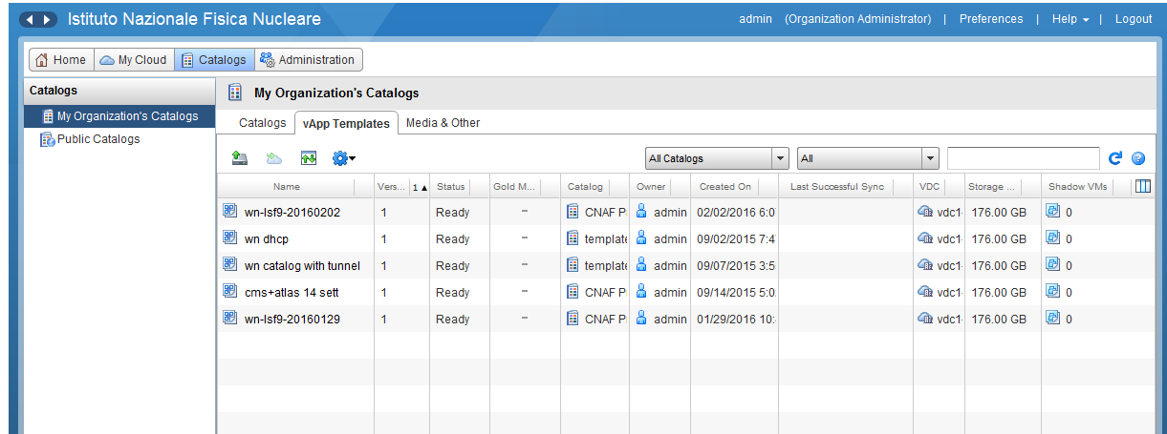
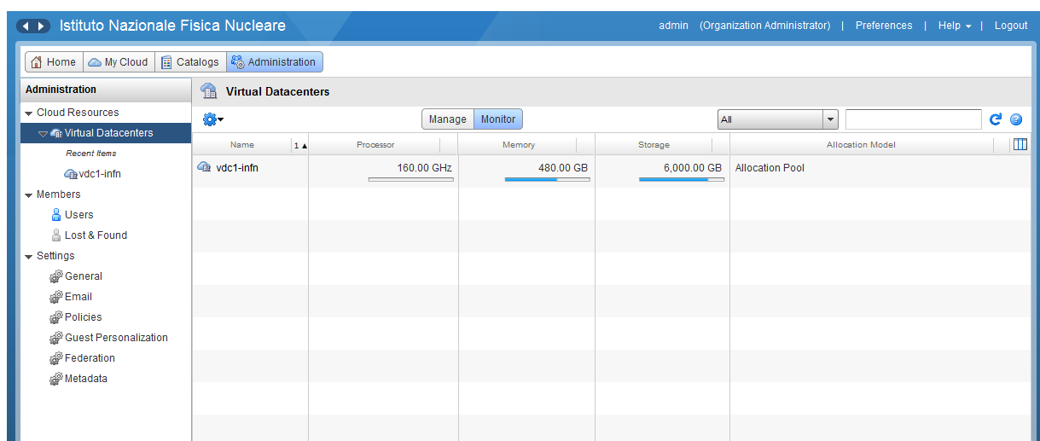
VM Management via VMWare
Proved to be rock solid and extremely versatile
Imported seamlessly a WN image from our WN-on-demand system (WNoDeS)
Adapted and contextualized
Resources allocated to our Data center

Slide 12
The CMS workflow at CNAF
Grid pilot jobs submitted to CREAM CEs
  Late binding: we cannot know in advance what kind of activity it's going to perform
Multicore only
  8 core (or 8 slot) jobs: CNAF dedicates a dynamic partition of WNs to such jobs
SQUID proxy for Software and Condition DB
Input files on local GPFS disk, fallback via Xrootd, O(GB) file size
Output file staged through SRM (StoRM) at CNAF.

Slide 13
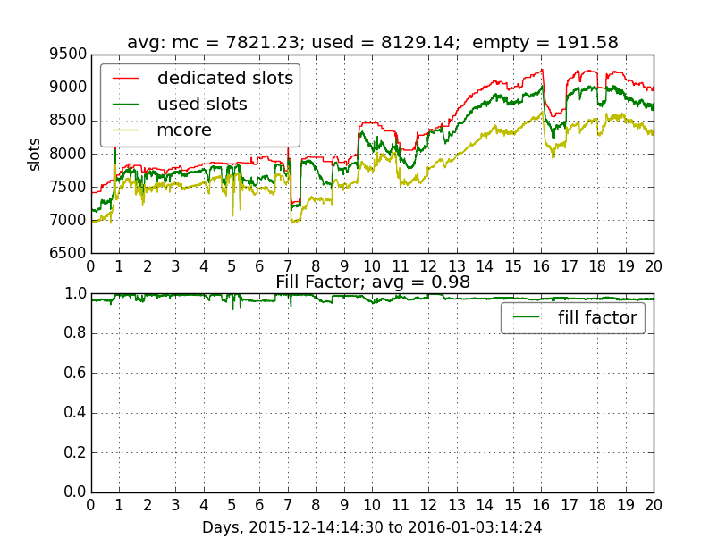
The dynamic Multicore partition
CMS jobs run in a dynamic subset of hosts dedicated to multicore-only jobs.
Elastic resources shall be member of this subset.

Slide 14
Adapting CMS for Aruba
Main idea: transparent extension
  Remote WN join the LSF cluster at boot “as if” local to the cluster
Problems:
  Remote Virtual WN need read-only access to the cluster shared fs (/usr/share/lsf)
  VMs have private IP, are behind NAT & FW, outbound connectivity only, but have to be reachable by LSF
  LSF needs host resolution (IP ↔ hostname) but no DNS available for such hosts

Slide 15
Adapting CMS for Aruba
Solutions:
Read-only access to the cluster shared fs
  Provided through GPFS/AFM
Host resolution
  LSF has his own version of /etc/hosts
  This requires to declare a fixed set of Virtual nodes
Networking problems solved using dynfarm:
  Service developed at CNAF to provide integration between LSF and virtualized computing resources.

Slide 16
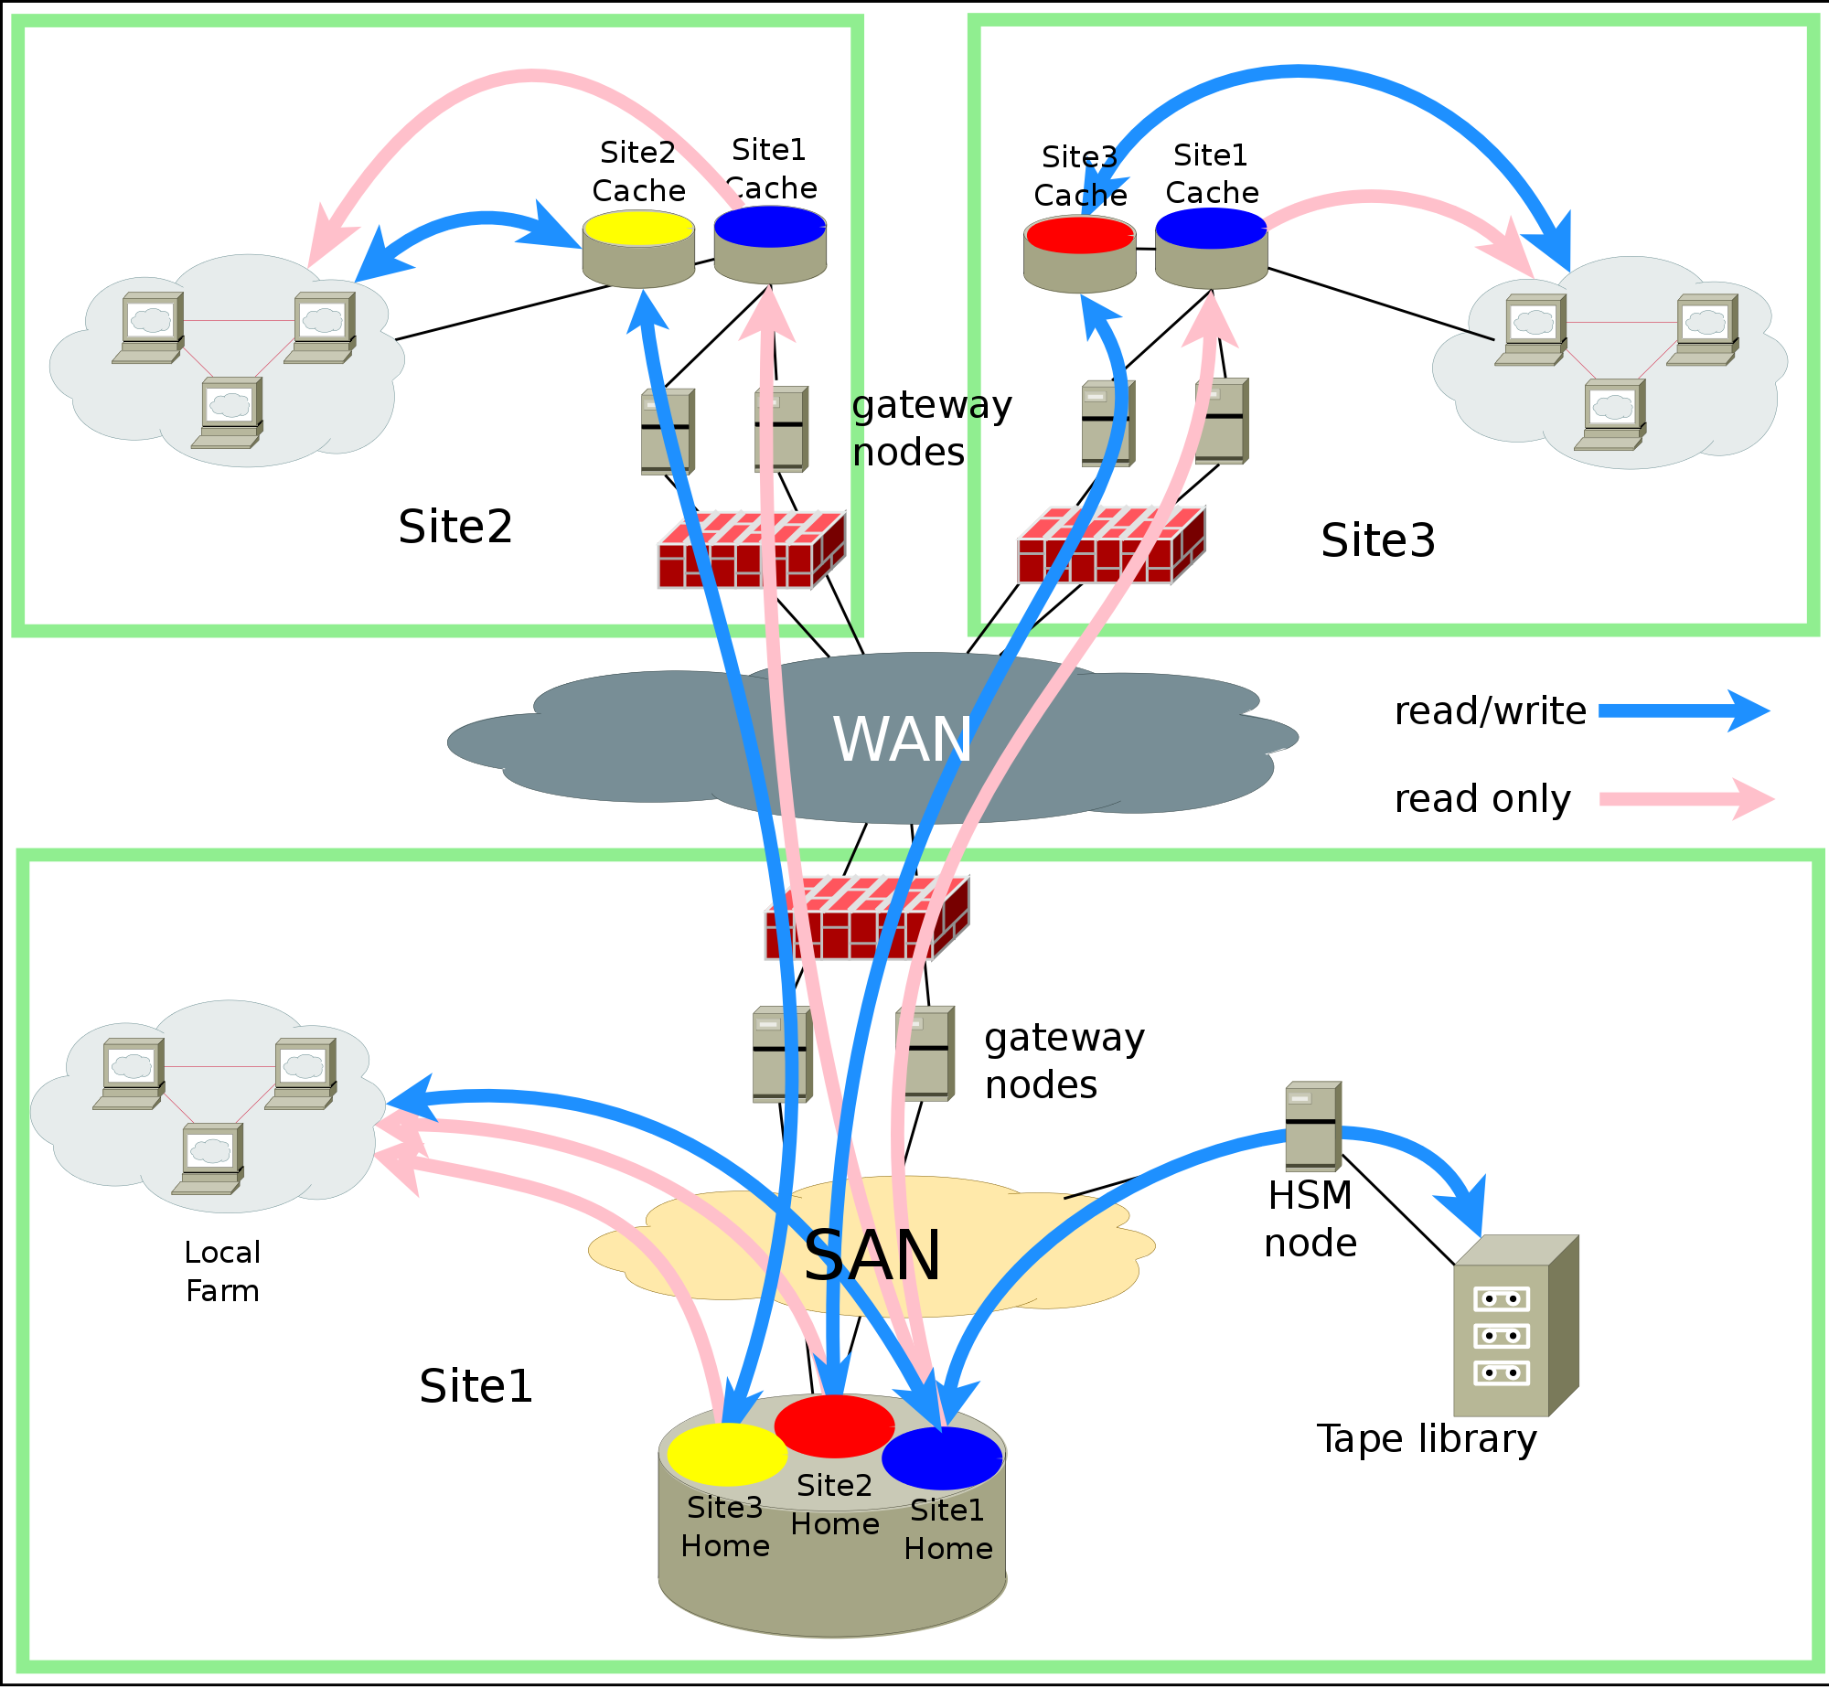
Remote data access via GPFS AFM
GPFS AFM
  A cache providing geographic replica of a file system
  manages RW access to cache
Two sides
  Home - where the information lives
  Cache
  Data written to the cache is copied back to home as quickly as possible
  Data is copied to the cache when requested
Configured as Read-only for site extension

Slide 17
Dynfarm concepts
The VM at boot connects to a OpenVPN based service at CNAF
  It authenticates the connection (X.509)
  Delivers parameters to setup a tunnel with (only) the required services at CNAF (LSF, CEs, Argus)
  Routes are defined on each server to the private IPs of the VMs (GRE Tunnels)
  Other traffic flows through general network

Slide 18
Dynfarm deployment
VPN Server side, two RPMs:
  dynfarm-server, dynfarm-client-server
    In the VPN server at CNAF. First install creates one dynfarm_cred.rpm which must be present in the VMs
VM side, two RPMs:
  dynfarm_client, dynfarm_cred (contains CA certificate used by VPN server and a key used by dynfarm-server)
Management: remote_control <cmd> <args>

Slide 19
Dynfarm workflow

Slide 20
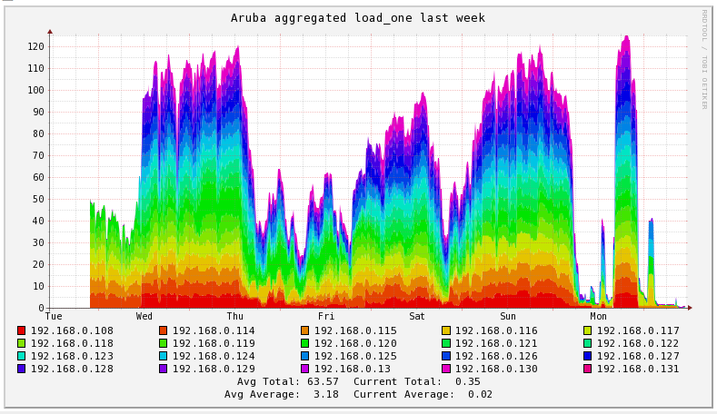
Results
Early successful attempts from Jun 2015
Different configurations (tuning) have followed

Slide 21
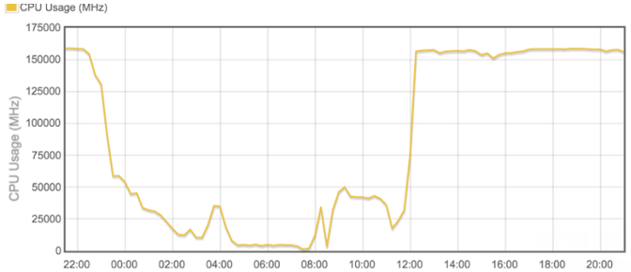
Results
160GHz total amount of CPU (Intel 2697-v3).
  Assuming 2GHz/core → 10 x 8-cores VMs (possible overbooking)

Slide 22
Results
Currently the remote VM run the very same jobs delivered to CNAF by GlideinWMS
Job efficiency on elastic resources can be very good for certain type of jobs (MC)
Special configuration at GlideIN can specialize delivery for these resources.
Queue | Site | Njobs | Avg_eff | Max_eff | Avc_wct | Avg_cpt
CMS_mc | AR | 2984 | 0.602 | 0.912 | 199.805 | 130.482
CMS_mc | T1 | 41412 | 0.707 | 0.926 | 117.296 | 93.203

Slide 23
Use-case 2: ReCaS/Bari

Slide 24
Remote extension to ReCaS/Bari
~17.5k HS06, ~30WN, 64 core, 256GB RAM
  1 core / 1 slot, 4GB/slot, 8,53 HS06/slot (546HS06/WN)
Dedicated network connection with CNAF:
  VPN lev. 3, 20Gb/s
  Routing through CNAF, IP of remote hosts in the same network range (plus 10.10.x.y for ipmi access)
  Similar to CERN/Wigner extension
Direct and transparent access from CNAF

Slide 25
Deployment
Two infrastructure VMs to offload network link:
  CVMFS and Frontier SQUID (used by ATLAS and CMS)
    SQUID requests are redirected to the local VMs
Cache storage GPFS/AFM
  2 server, 10 Gbit
  330TB (Atlas, CMS, LHCb)
  LSF shared file system also replicated

Slide 26
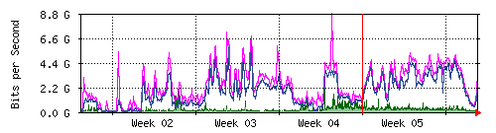
Network traffic (4 weeks)

Slide 27
Current issues and tuning
Latencies in the shared fs can cause troubles
  Intense I/O can lead to timeout :
  ba-3-x-y: Feb 8 22:56:51 ba-3-9-18 kernel: nfs: server nfs-ba.cr.cnaf.infn.it not responding, timed out
CMS: fallback to Xrootd (excessive load on the AFM cache)

Slide 28
Comparative Results
Queue | Nodetype | Njobs | Avg_eff | Max_eff | Avg_wct | Avg_cpt
Cms_mc | AR | 2984 | 0.602 | 0.912 | 199.805 | 130.482
Alice | T1 | 98451 | 0.848 | 0.953 | 16.433 | 13.942
Atlas_sc | T1 | 1211890 | 0.922 | 0.972 | 1.247 | 1.153
Cms_mc | T1 | 41412 | 0.707 | 0.926 | 117.296 | 93.203
Lhcb | T1 | 102008 | 0.960 | 0.985 | 23.593 | 22.631
Atlas_mc | T1 | 38157 | 0.803 | 0.988 | 19.289 | 18.239
Alice | BA | 25492 | 0.725 | 0.966 | 14.446 | 10.592
Atlas | BA | 15263 | 0.738 | 0.979 | 1.439 | 1.077
Cms_mcore | BA | 2261 | 0.444 | 0.805 | 146.952 | 69.735
Lhcb | BA | 13873 | 0.916 | 0.967 | 12.998 | 11.013
Atlas_sc | BA | 20268 | 0.685 | 0.878 | 24.378 | 15.658

Slide 29
Conclusions

Slide 30
Aruba
Got the opportunity to test our setup on a pure commercial cloud provider
  Developed dynfarm to extend our network setup
    Core dynfarm concept should be adaptable to other Batch Systems
  Gained experience on yet another Cloud Infrastructure: Vmware
Job efficiency encouraging
  Even better when we will be able to forward to Aruba only non-IO intensive jobs
Scale of the test quite small, did not reach any bottleneck
Tested with CMS, other LHC experiments may join in future
Accounting problematic due to possible GHz reduction
Good exercise for HNSciCloud too

Slide 31
ReCaS/Bari
T1-Bari farm extension “similar” to CERN-Wigner
Job efficiency (compared to native T1) highly depending on storage usage
  Better efficiency means job on WN is mainly CPU bound (or input file already in cache before start)
General scalability limited by the width of dedicated T1→BA link (20Gb/s)
Assistance on faulty nodes somehow problematic

