Slide 1
KEKCC – KEK Central Computer System
Go Iwai
High Energy Accelerator Research Organization (KEK)
Computing Research Center (CRC)

Slide 2
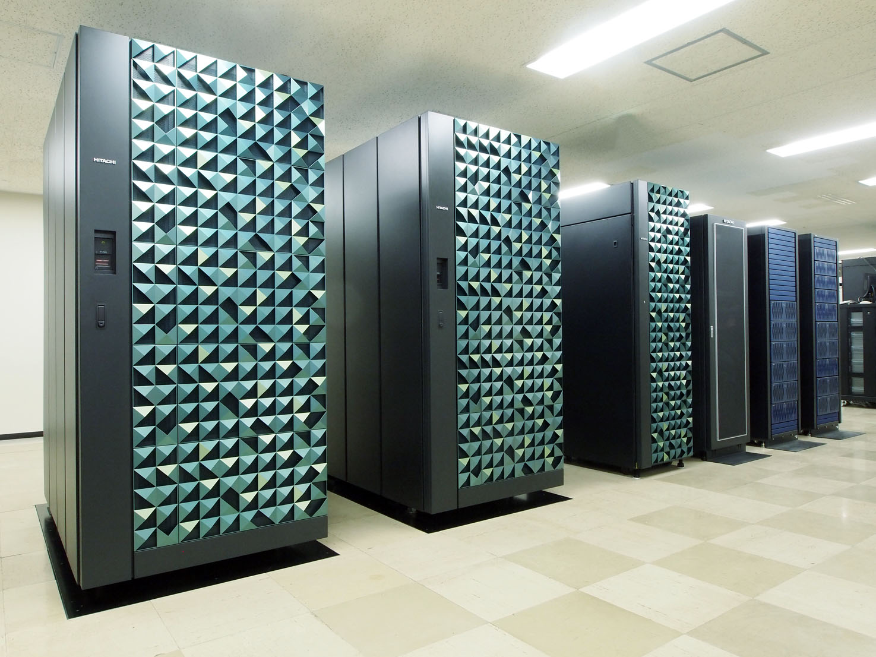
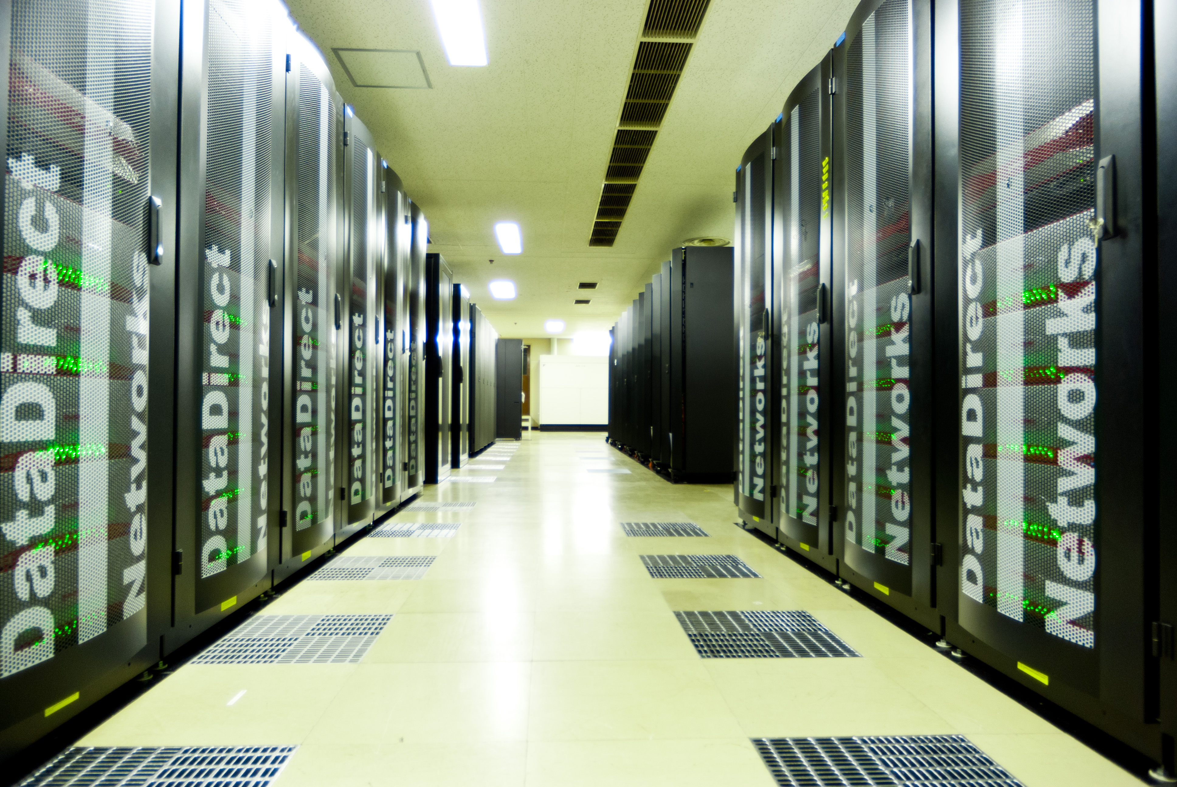
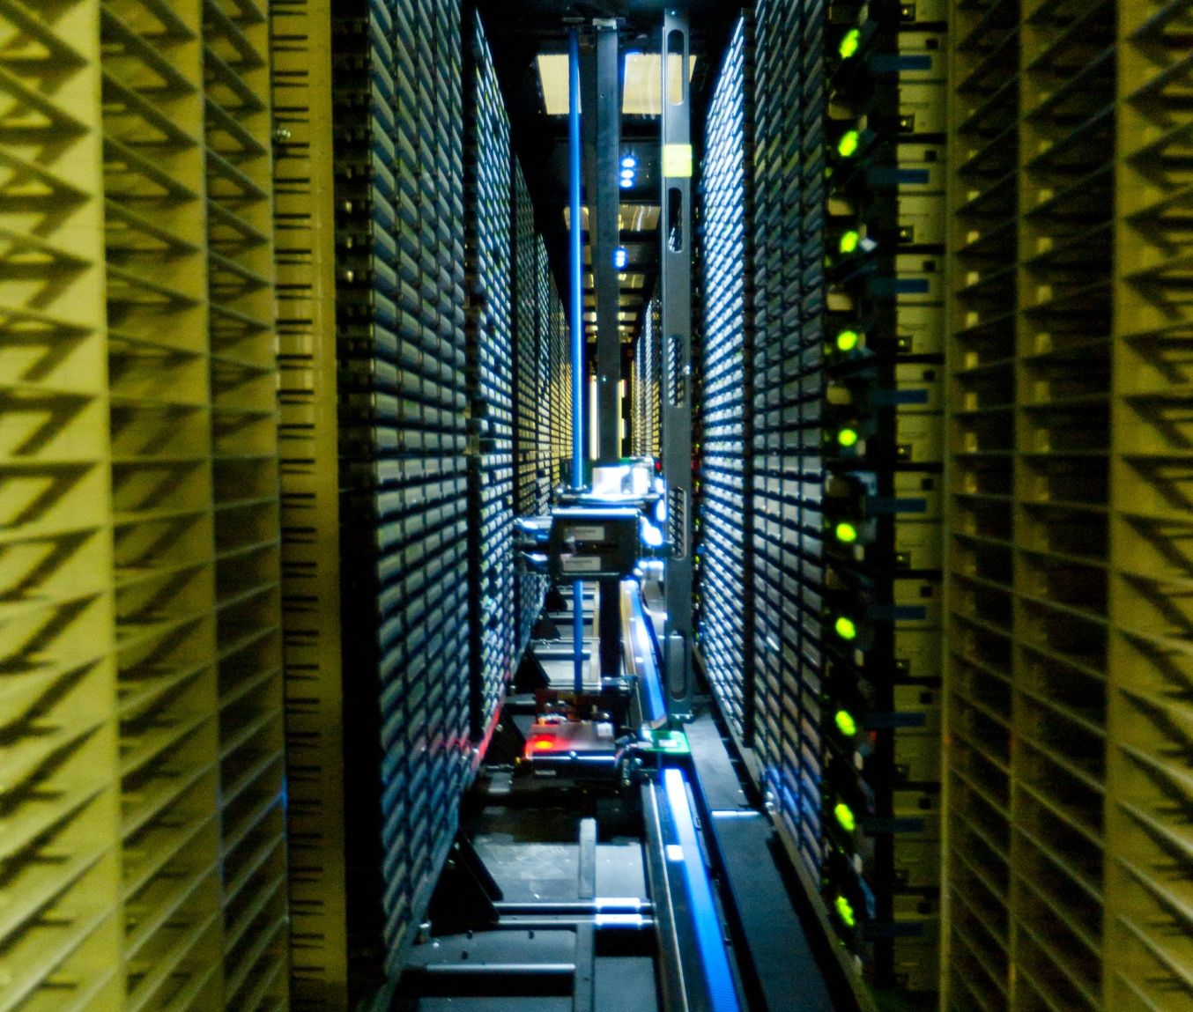
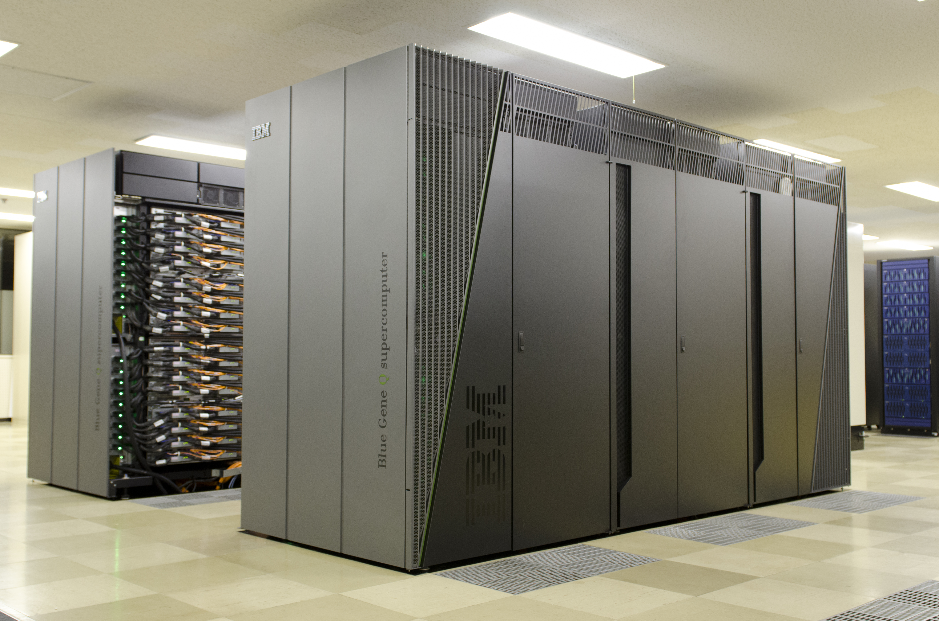
Two Large-scale Computer Systems in KEK
Central Computer System (KEKCC)
Supercomputer System
System-A Hitachi SR16000 model M1
Total peak performance: 54.9 TFplops
Linux Cluster + GPFS/HPSS
4,000 cores (Xeon 5670)
7 PB disk storage and tape library (up to 16 PB)
System-B IBM Blue Gene/Q
Total peak performance: 1.26 PFlops
Grid instance is running in the KEKCC

Slide 3
KEKCC Overview
Central Computer System supporting KEK projects, e.g. Belle/Belle2, ILC, J-PARC, and so on.
Current KEKCC has started in April 2012 and will be ended in August 2016.
Data Analysis System
Login servers, batch servers
IBM iDataPlex, Intel Xeon X5670, 4,080 cores (12cores x 340nodes)
Linux Cluster (SL5) + LSF (job scheduler)
Storage system
DDN SFA10K 1.1 PB x 6 sets
IBM TS3500 tape library (16 PB max)
TS1140 60 drives
GPFS (4PB)+ HPSS/GHI (HSM,3PB)
Storage interconnect : IB 4xQDR (Qlogic)
Grid (EGI) SE, iRODS access to GHI
Total throughput : > 50 GB/s
Grid computing system: EMI and iRODS
System includes common IT services, mail, web (Indico, wiki,...) as well.

Slide 4
Who Are Working on KEKCC
Belle
Belle experiment, precise measurements for CP violation.
T2K
Neutrino experiment for measuring neutrino mass and flavour mixing. Shoot neutrino from Tokai to the detector at Kamioka mine (300km away)
Hadron experiments at J-PARC
Various experiments for kaon and hadron physics
Material and Life science at J-PARC
Neutron diffraction, neutron spectroscopy,
nano-structure analysis, neutron instruments, muon spectroscopy
Belle2
Belle II is the next generation Belle experiment. Aim to discover new physics beyond the SM. Physics run will start from 2017.
Kagra
Gravitational wave (GW) detection experiment at Kamioka
Expected to start operation in 2018
Just started to utilize Grid computing resources for sharing data with LIGO and VIRGO.
ILC
Linear collider experiment
Japan is a candidate site
Two active VOs: ILC and calice
These 3 experiments are big consumers last years.

Slide 5
Experiments |  |  | Start Year | How work on KEKCC
Ongoing or Completed | Belle |  | 1999 | Mainly work on local batch servers
 | J-PARC | T2K | 2009 | Mainly work on local batch servers Partly using Grid for data delivery
 |  | Hadron Exp. | 2010 | Mainly work on local batch servers
 |  | MLF (Material&Life Science) | 2010 | Mainly work on local batch servers Partly using Grid (iRODS) for data transfer
Future | Belle2 |  | 2017 | Actively work on Grid
 | Kagra |  | 2018 | Just started preparation work for sharing data over the Grid
 | ILC |  | 202X | Working on Grid, and local batch servers

Slide 6
Resource History
60 kHS06 of CPU
7 PB of disk
Max 16 PB of tape capacity
x6.6
x9.8
Current System

Slide 7
Grid is Now Using Nearly Half of KEKCC
Local batch jobs

Slide 8
Yearly 1PB of Read/Write to SRM
Belle2 MCC
B2 DC
4 PB of readout and 5 PB of writing to the SRM has been achieved

Slide 9
System Procurement
KEKCC is totally replaced every 4-5 years, according to Japanese government procurement rule for computer system.
International bidding according to GPA (Agreement on Government Procurement by WTO)
Bidding is processed for 1 year.
Purchase and operation model
NOT in-house scale-out model, BUT rental system
Completely different purchase/operation model from US/EU sites
Much less human resource in computer center
25 staffs (KEK/CRC) vs 270 staffs (CERN-IT)
Hardware purchase by lease
+
Service (implementation/operation staffs)

Slide 10
System Replacement Cycle
Jan
Bidding is processed for 1 year.
Committee was launched in Feb/2015.
RFx (Request for Information/Proposal/Quotation)
RFC (Request for comments)
Bidding
Score for price + benchmark
Bid-opening was done on the end of Dec/2015.
System implementation (Jan – Aug / 2016)
Facility updates (power supply, cooling)
Hardware installation
System design / implementation / testing
Feb
Mar
Apr
May
Jun
Jul
Aug
Sep
Oct
Nov
Dec
Service-in of the new system is scheduled on Sep/2016.

Slide 11
CPU Server
Work server & Batch server
Xeon 5670 (2.93 GHz / 3.33 GHz TB, 6 cores/chip)
282 nodes : 4 GB/core
58 nodes : 8 GB/core
2 CPU/node : 4,080 cores, 60 kHS06
Interconnect
InfiniBand 4xQDR (32Gbps), RDMA
Connection to storage system
Job scheduler
LSF (ver.9)
Scalability up to 1M jobs
Grid deployment
EMI & iRODS
Work server as Grid-UI, Batch server as Grid-WN

Slide 12
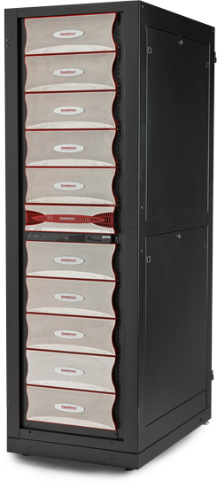
Disk Storage
DDN SFA10K x6
Capacity : 1,152 TB x 6 = 6.9 PB (effective)
Throughput: 12 GB/s x 6
Used for GPFS (4PB) and GHI (3PB)
GPFS File System
Parallel file system
Total throughput : > 50GB/s
Optimized for massive access
IB connection : non-blocking / RDMA
Number of file servers
Separation of meta-data area
Support for larger block size
Performance
>500 MB/s for single file I/O in benchmark test

Slide 13
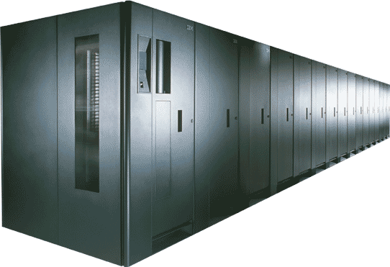
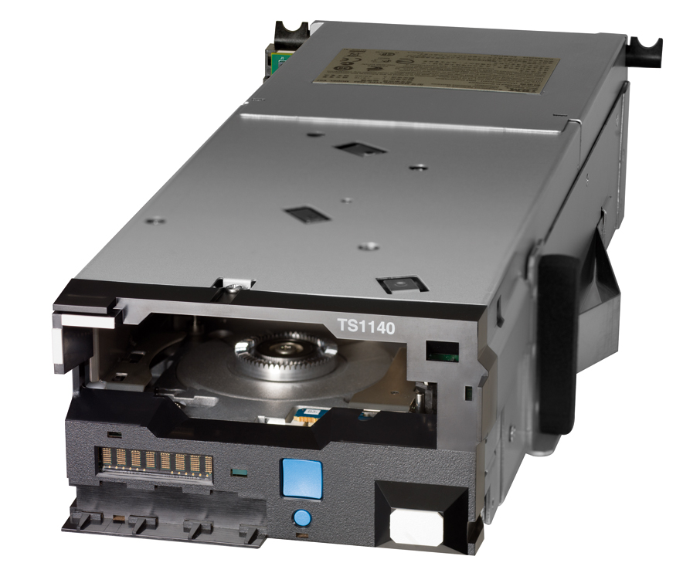
Tape System
Tape Library
TS3500
Max. capacity : 16 PB
Tape Drive
TS1140: 60 drives
latest enterprise drive
We do not use LTO because of less reliability.
LTO is open standard. Could be different quality of tape drive/media for a specification.
Tape Media
JC: 4TB, 250 MB/s
JB: 1.6TB (repack), 200 MB/s
Users (experiment groups) pay tape media they use.
7PB is stored so far.

Slide 14
Data Processing Cycle in HEP Experiments
~10-1,000PB
Raw data
Experimental data from detectors, transferred to storage system in real-time.
2GB/s, sustained for Belle II experiment
Migrated to tape, processed to DST, then purged
“Semi-Cold” data (tens to hundreds PB)
Reprocessed sometimes DST (Data Summary Tapes)
DST (Data Summary Tapes)
“Hot data” (~tens PB)
Data processing to make physics data
Data shared with various ways (GRID access)
Physics summary data
Handy data set for reducing physics results (N-tuple data)
Requirements for storage system
High availability (considering electricity cost for operating acc.)
Scalability up to hundreds PB
Data-intensive processing w/ high I/O performance
Hundreds MB/s I/O for many concurrent accesses (Nx10k) from jobs
Local jobs and GRID jobs (distributed analysis)
Data portability to GRID services (POSIX access)
~10-100PB

Slide 15
High Performance Tape Technology is the Key
Hundreds PB of data is expected for new HEP experiments.
Cost-efficient on capacity
Less electricity cost
Not only the cost/capacity issue,...
Performance, Usability and Long-term Preservation are also very important.
Hardware as well as middleware (HSM) are keys.

Slide 16
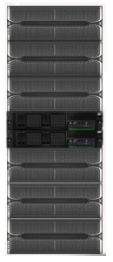
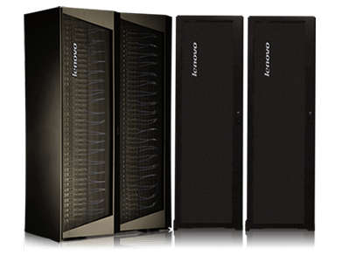
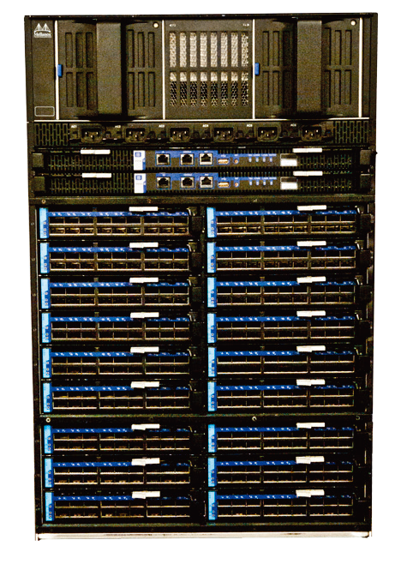
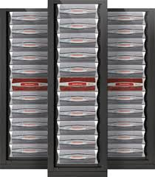
Next System Component
Elastic Storage Server
SX6518
NextScale
TS3500
SFA 12K

Slide 17
Current VS Next
 | Current | New | Upgrade Factor
CPU Server | IBM iDataPlex | Lenovo NextScale
CPU | Xeon 5670 (2.93 GHz, 6 cores/chip) | Xeon E5-2697v3 (2.60 GHz, 14 cores/chip)
CPU cores | 4,000 | 10,000 | x2.5
HEPSPEC (kHS06) | 60 | 250 | x4.1
IB | QLogic 4xQDR | Mellanox 4xQDR
Disk Storage | DDN SFA10K | IBM Elastic Storage System (ESS)
HSM Disk Storage | DDN SFA10K | DDN SFA12K
Disk Capacity | 7 PB | 13 PB | x1.8
Tape Drive | IBM TS1140 x60 | IBM TS1150 x54
Tape Speed | 250 MB/s | 350 MB/s
Tape max capacity | 16 PB | 70 PB | x4.3
Power Consumption | 200 kW (actual monitored value) | < 400 kW (max estimation)

Slide 18
Expected Resource in KEKCC’16
250 kHS06 of CPU
13 PB of disk
Max 70 PB of tape capacity
x4.2
x6.6
x9.8
current system
Expected

Slide 19
Belle2 Dedicated Services
The big change on Grid is many Belle2-critical services, e.g. LFC, SRM, AMGA, FTS, CVMFS S0, are isolated to the other VOs for more stable operation with no downtime.
Example 1
LFC
RW
LFC
RW
LFC
RO
LFC
HA
For other VOs

Slide 20
Example 2
10 Gbps x4
10 Gbps x4
10 Gbps x2
10 Gbps x2
10 Gbps x2
GridFTP
GridFTP
GridFTP
GridFTP
GridFTP
HSM
HSM
HSM
Disk
HSM
Analysis
Every Activities other than raw data transfer
RAW data transfer to US
For other VOs

Slide 21
Situation on Security
We have had no serious security incident during the current contract period of KEKCC.
Nevertheless the security cost is increasing in recent years.
Background:
Many identity fraud: many personal identifiable information has been stolen from governmental institutes some times.
“My Number” (Individual Number) has started in 2015.
Japanese people is getting nervous, government is getting more nervous.
Government suddenly gives us an order to provide the investigative reports for all machines, which connects to the Internet.
Nearly 1,000
We have no full-time staff for these kind of works.
DUTY-STOP during this works

Slide 22
Summary
Grid job is being the biggest consumer in the KEKCC.
30-50% of CPU time
Next KEKCC system will start in September 2016.
CPU : 10K cores (x2.5), 250 kHS06 (x4.1), Disk : 13PB (x1.8), Tape : 70PB (x4.3)
Some Grid components (LFC, StoRM, etc) will be deployed as Belle2-dedicated services on Belle2-dedicated servers with HA.
CVMFS stratum-0 and -1 will start.
Tape system is still important technology for us, not only hardware but software (HSM) points of view.
We have been a HPSS user for long years. We adopt GHI since 2012.
GHI is a promising solution for HSM for large scale of data processing.
Scalable data management is a challenge for next 10 years.
Belle2 experiment will start in 2017.
Data processing cycle (data taking, archive, processing, preservation...)
Workload management w/ cloud technology: Job scheduler (LSF) + Virtualization (KVM, Docker)
Data migration as a potential concern

Slide 23
Thank You!

