Slide 1
Monitoring at a Multi-Site Tier 1
Shaun de Witt (STFC)
With many thanks to Brian Davies, Rob Appleyard and Andrew Lahiff for Invaluable Input

Slide 2
Topics
About the RAL Tier 1
What do we monitor
with what
And where are the problems
What could be done to make problem resolution simpler

Slide 3
The RAL Tier 1 – where we are
Serving 4 LHC experiments plus various other small VOs
Storage System
~ 15PB disk (‘expandable’/capital)
~ 20 PB tape (expandable/recurrent)
4 CASTOR Instances
Moving to CEPH

Slide 4
Batch System
~ 15k cores
Ability to burst out into cloud
Condor batch job Scheduler

Slide 5
Network
Twin 20G fibre links to CERN
Running in failover mode
Two 10G links to JANET
Tier 1 and facilities in separate subnet

Slide 6
Monitoring – The Four W’s
Why do we monitor
Who do we monitor for
What do we monitor
Which tools do we use
Notes:
Add image of vultures from jungle book…

Slide 7
The Why…
Look for long term trends
Identify short term problems quickly
Analyse current and historic issues
Traceability

Slide 8
The Who
Internal Usage
E.g. what is the current file opening times for ATLAS?
VO Usage
‘Why can’t I open file X?’
Because you deleted it 2 months ago!
Plus VOs have their own monitoring
Reporting
Batch farm usage and CPU efficiency
SAR Metrics
BDII

Slide 9
The What…
Notes:
Vultures here

Slide 10
The Which
Generic Tools
Ganglia (Graphite), Nagios (Incinga) , perfsonar, observium
Application Specific Tools
ftsmon, rsyslog
Home rolled tools
ELK Stack
Notes:
Gangllia – long term trends. Nagios linked to call out system, ftsmon we are lucky to be hosting one, elk – elastic search/logstash/kibana

Slide 11
Monitoring Tools (network)
PerfSonar
Observium

Slide 12
Application Based Monitoring
FTSMon
Monitoring interactions with other sites
Good Ol’ syslog
Problem with volume of logging

Slide 13
SUCCESSES
Credits Jason Zurawski, ESNet
Performance is poor when RTT exceeds ~10 ms
Performance is good when RTT is < ~10 ms
Source
Campus
R&E
Backbone
Destination
Campus
S
D
Regional
Regional
0.0046% loss (1 out of 22k packets) on 10G link
with 1ms RTT: 7.3 Gbps
with 51ms RTT: 122Mbps
with 88ms RTT: 60 Mbps (factor 80)
Switch with small buffers

Slide 14
ELK

Slide 15
ELK

Slide 16
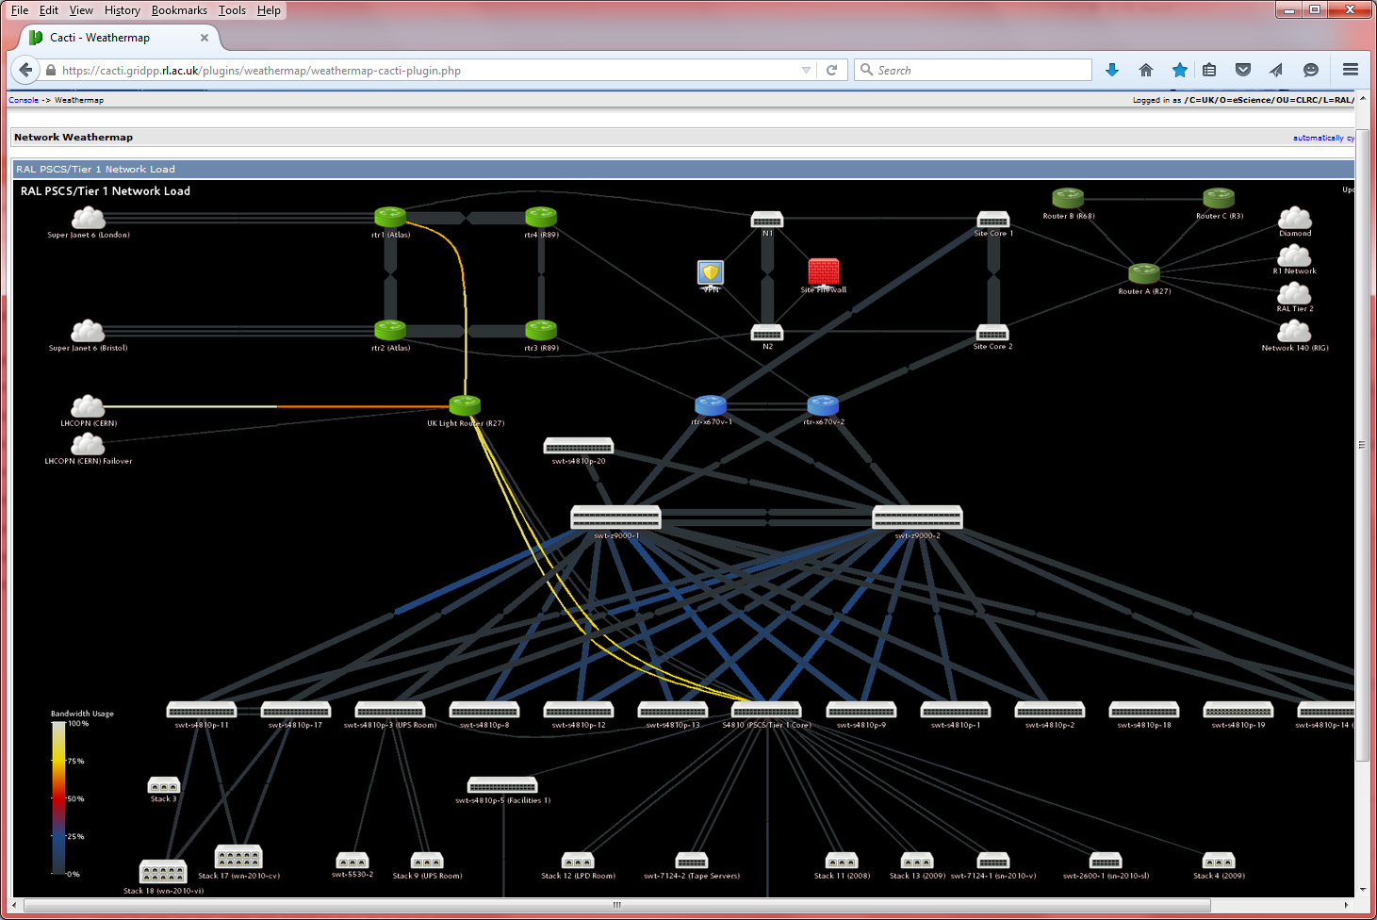
Network Weathermap

Slide 17
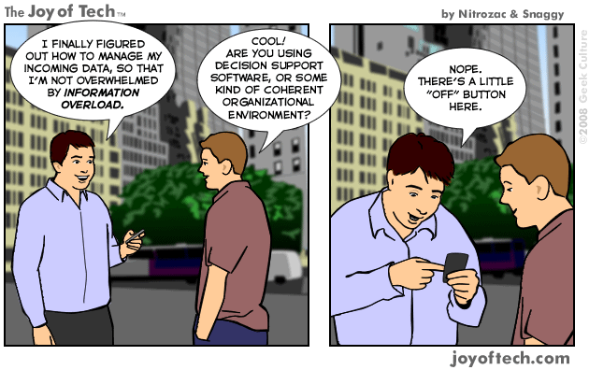
Problems

Slide 18
Specific Problems
Nagios
Too many false positives, Maintaining tests over s/w changes, lack of retirement policy
Ganglia
Information overload, updates over s/w releases, lack of retirement policy

Slide 19
Problems that Keep Me Awake at Night

Slide 20
Distributed Monitoring
Notes:
Xrootd problems

Slide 21
Impact of Workflows
Notes:
Why do different workflows have different impacts

Slide 22
Interactions & Traceability
DIRAC
Condor
Ease of Tracing
Job
PANDA
Protocol
Storage System
IO System
PhedEx
Tape System
Layers of MiddleWare

Slide 23
Wrap-Up

Slide 24
Summary
Monitoring is ESSENTIAL
BUT – AVOID INFO-DUMP
Consider what you are monitoring with what
Choose the right tools to make your life easier
Review (annually) your monitoring
Consider what can be retired
Don’t automatically write a new probe for each problem.

Slide 25
Thanks…
Christophe
Brian Davies, Andrew Lahiff, Rob Appleyard, Shawn McKee, Sebastien Ponce, Giuseppe lo Presti, ….

