Slide 1
ccPortal: KEK Computing Research Center Online Application Portal
International Symposium on Grids & Clouds 2021
Wataru Takase, Sari Kaneko, Shogo Okada, Koichi Murakami
Computing Research Center, KEK, Japan

Slide 2
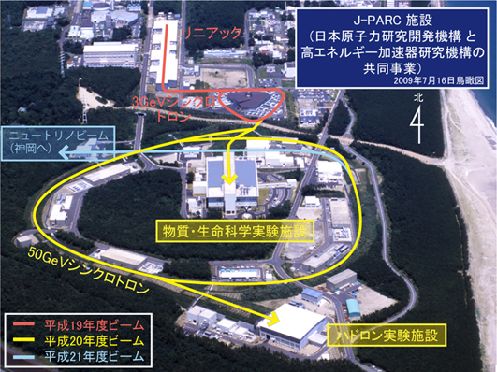
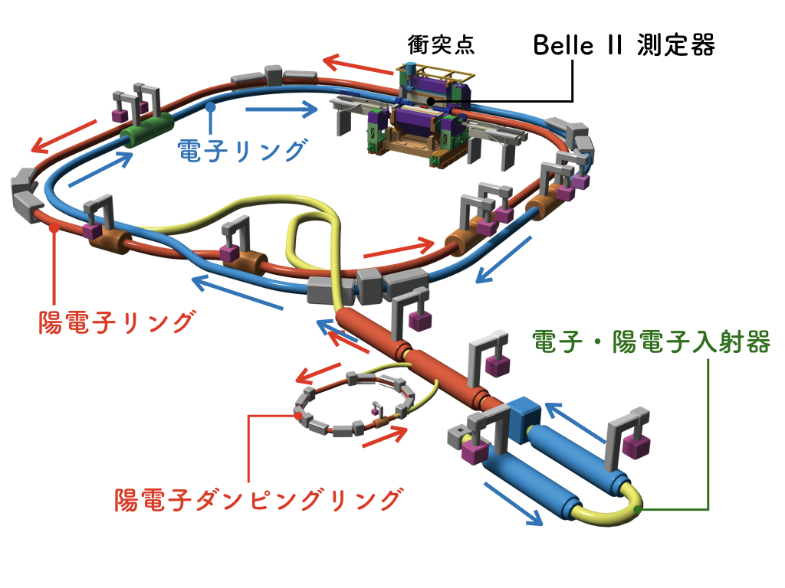
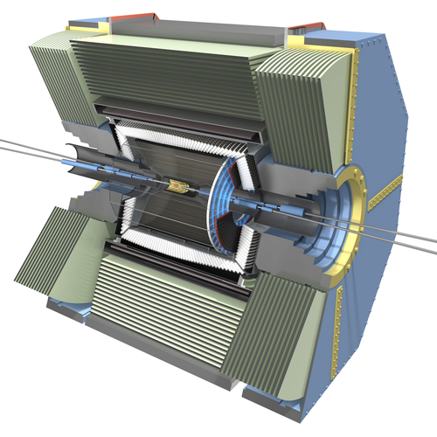
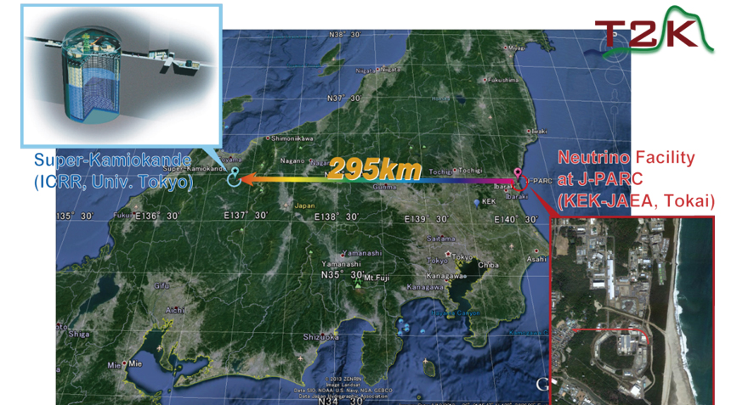
Experiments in KEK
Electron Accelerator
Proton Accelerator
26 countries/regions
123 institutes
1075 researchers
Tokai
Tsukuba
Belle II (e-, e+ collision)
Photon Factory
T2K (Neutrino experiment)
Hadron experiment
MLF (Material and Life science)
Credit KEK

Slide 3
KEK Computing Research Center (CRC)
CRC provides various IT services to support research activities at KEK:
Network: Wired/Wireless LAN, VPN, eduroam, …
Web: Wiki, Indico based service, …
Data analysis: Batch service, Grid service, …
Others: Online storage service, Anti-virus software, …
A user submits paper application forms to apply the services.
25 services

Slide 4
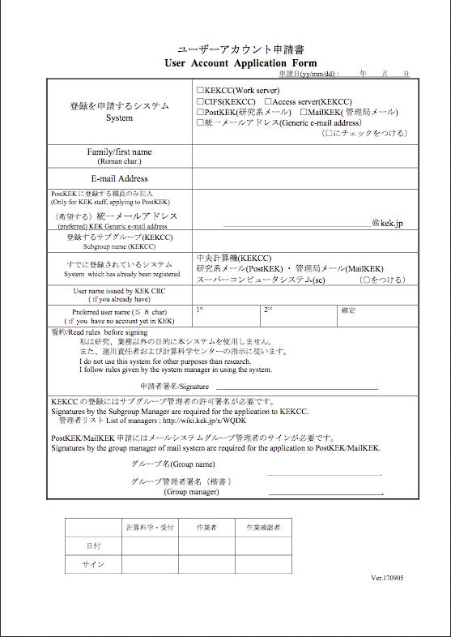
Before: Paper-based Application
Sends completion notice
Submits a form
User
Asks for endorsement
CRC
Endorses
Some application
Requires endorsement
KEK staff

Slide 5
Before: From CRC Point of View
We, CRC, receive applications from many users every day.
These forms are checked, processed, and handed out among the responsible persons to complete applications.
VPN application
CRC
Creates VPN account
Registers to DB
Checks validity
Central DB
Wiki application
Creates Wiki account

Slide 6
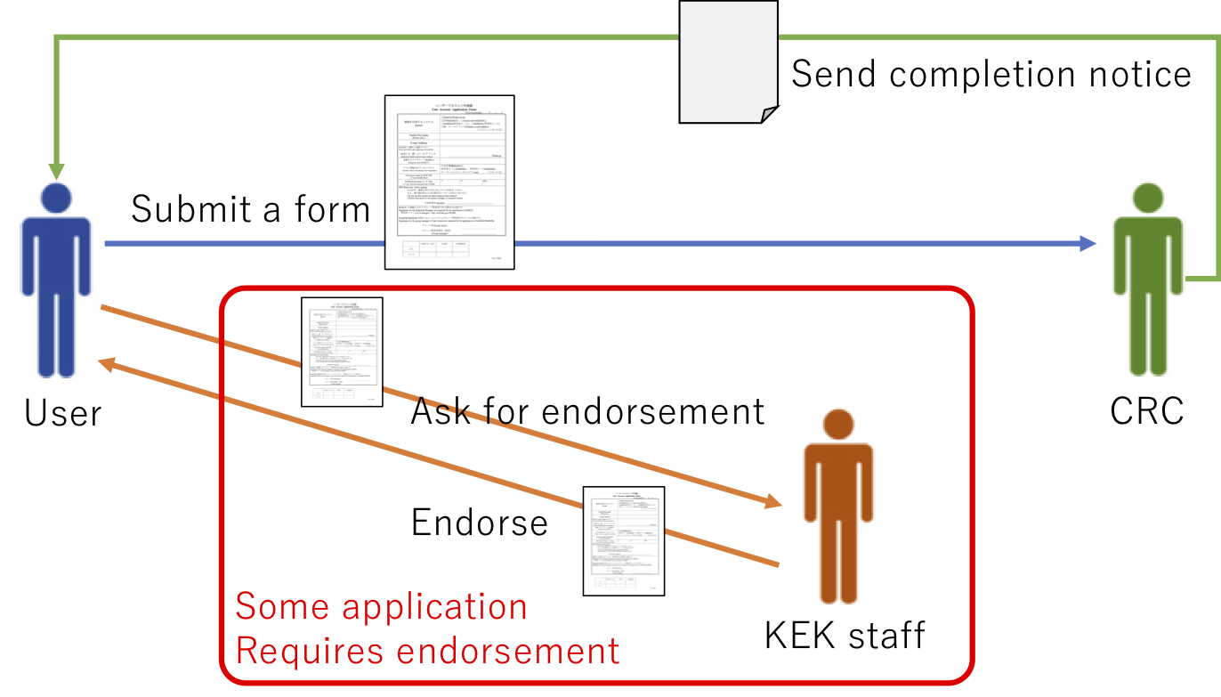
Development of Online Application Portal
It’s named ccPortal.
ccPortal enables:
Users to apply new services and modify account information online
KEK staff to endorse applications online
To support CRC staff’s workflow online

Slide 7
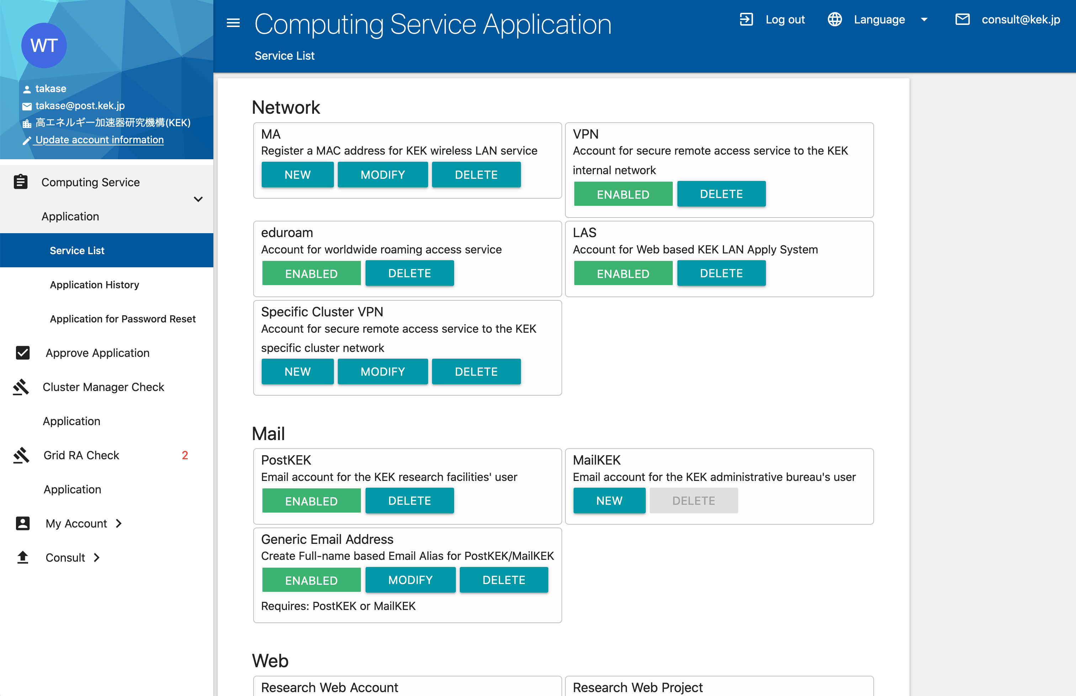
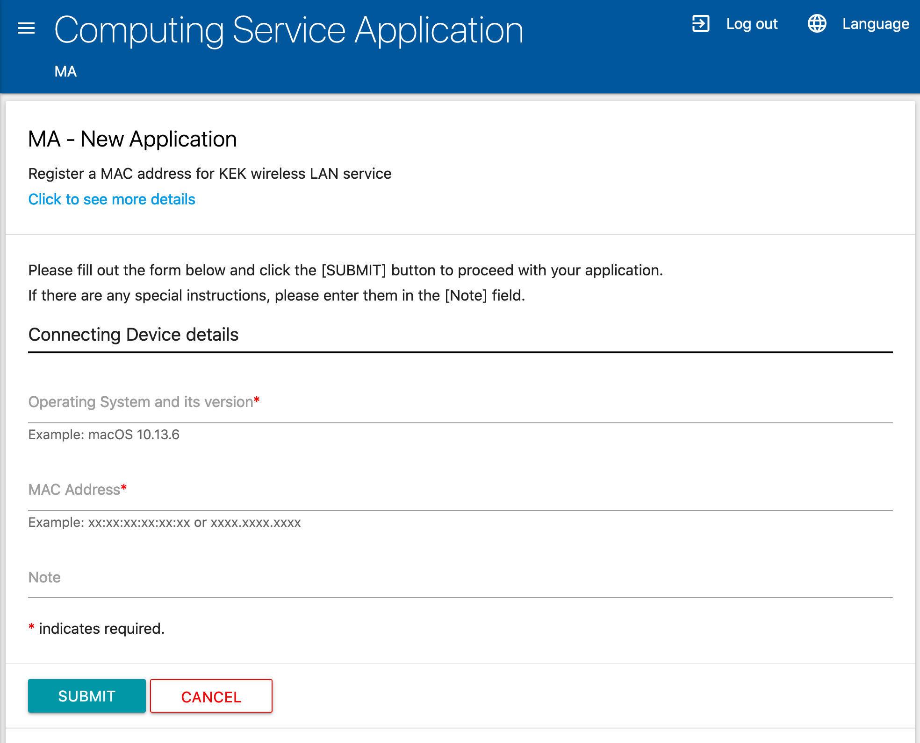
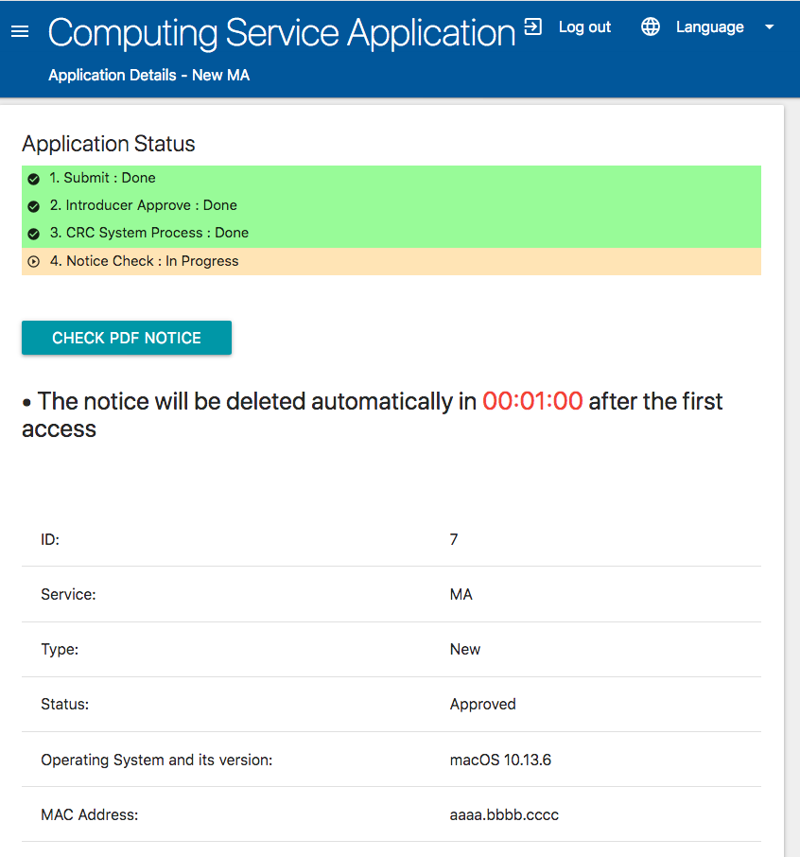
Development of Online Application Portal

Slide 8
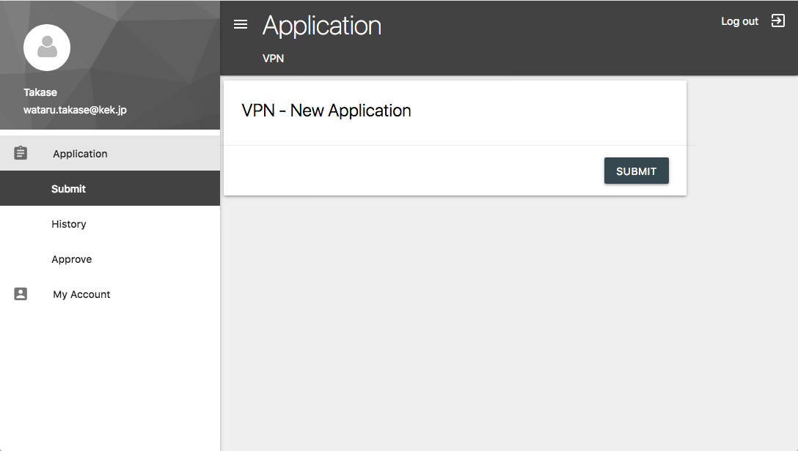
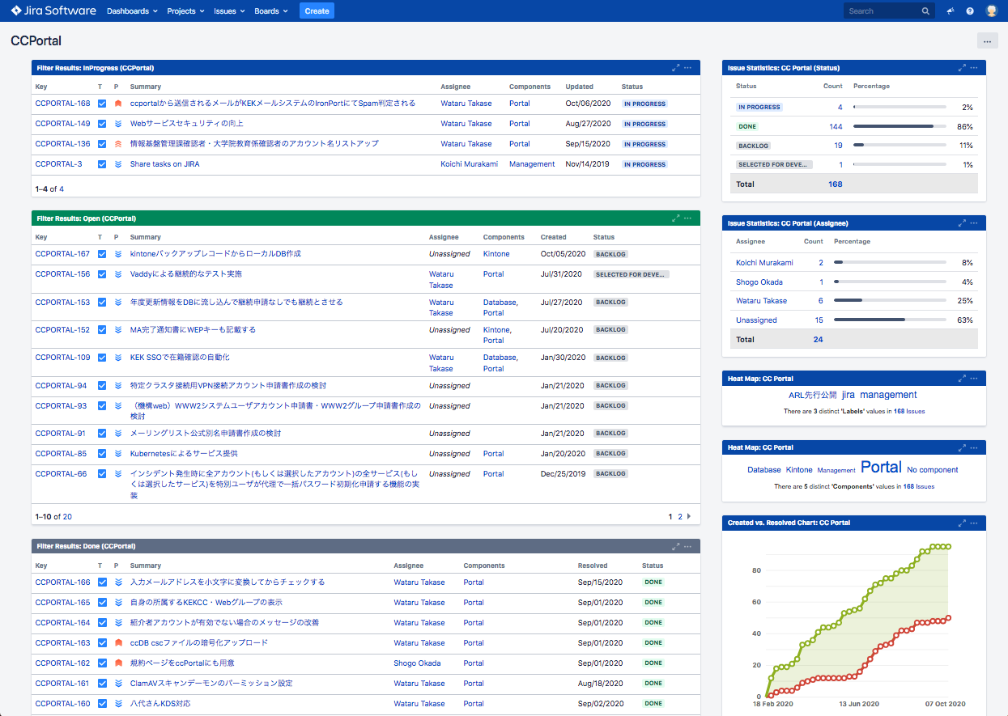
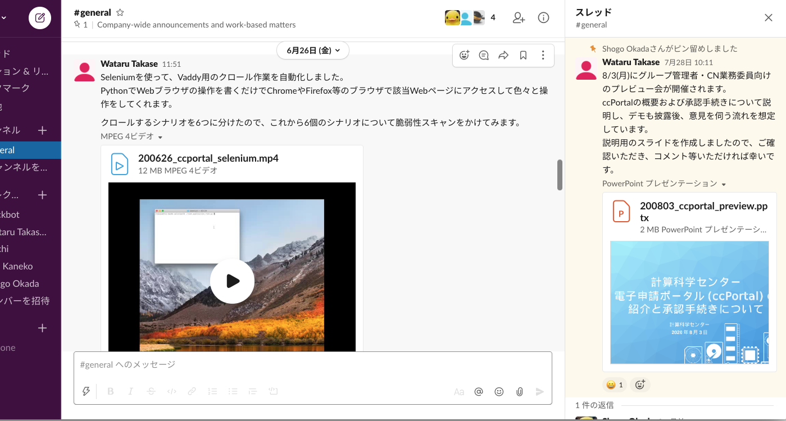
Development of Online Application Portal
We started the project in July 2019.
Current source lines of code:
Python: 34,139 (91%), HTML: 2,510 (7%), JS + CSS: 856 (2%)
First Prototype
Issue Management by JIRA
Communication with Slack

Slide 9
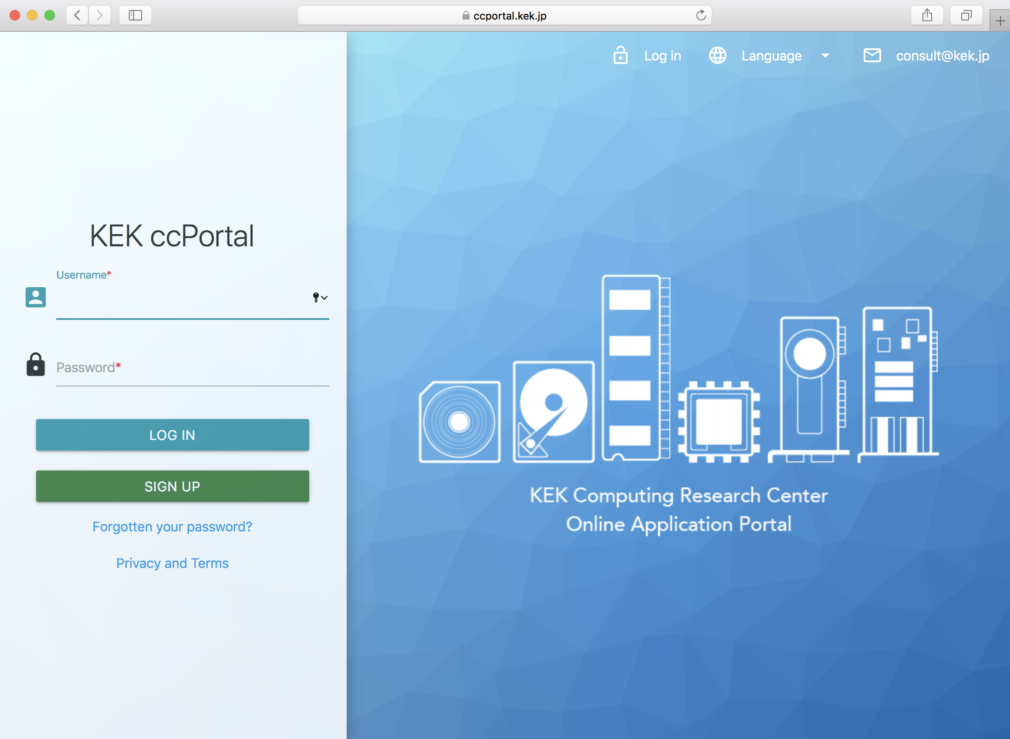
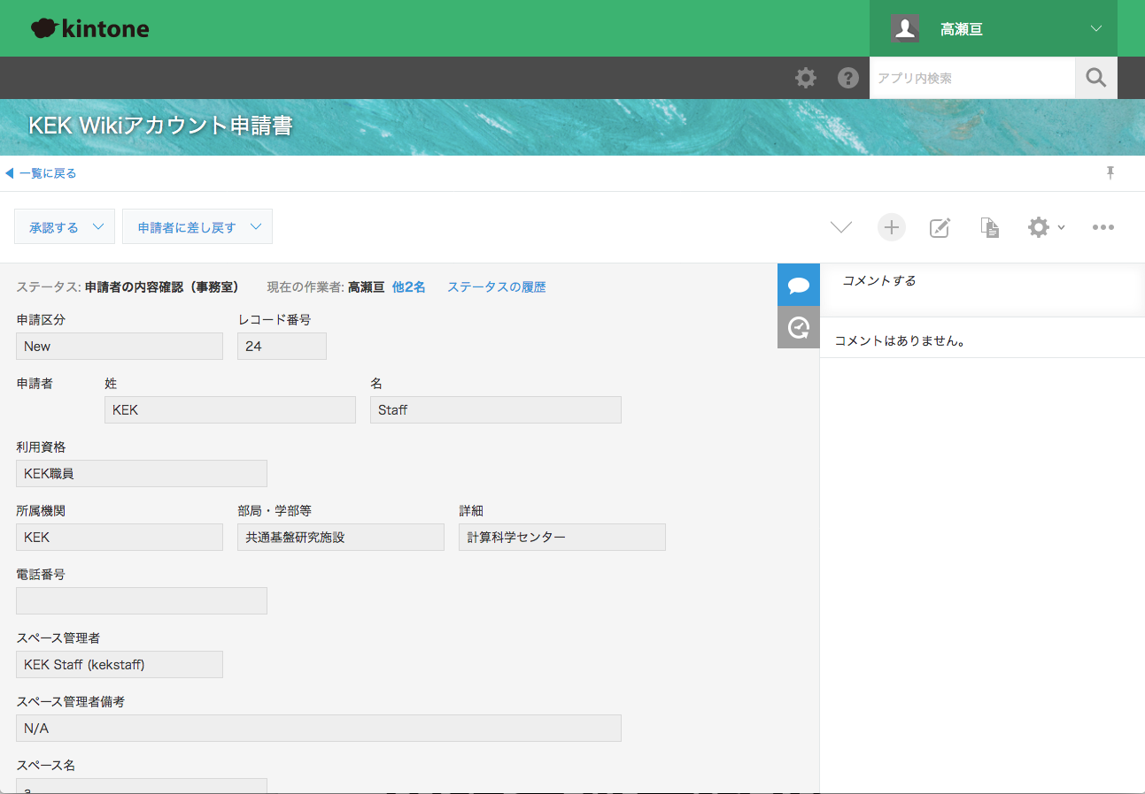
ccPortal Overview
Cloud service for workflow management solution
https://www.kintone.com/
Consists of User Portal and CRC Staff Portal
User Portal
CRC Staff Portal
Web application based on Django
User can:
Submit application
Endorse application
Check application completion notice
Modify account information
Uses kintone
Receives applications from User Portal
Makes CRC internal workflow online
CRC staff can:
Check submitted applications
Proceed an application to the next responsible persons
Sends applications
User
Sends finished/rejected notice

Slide 10
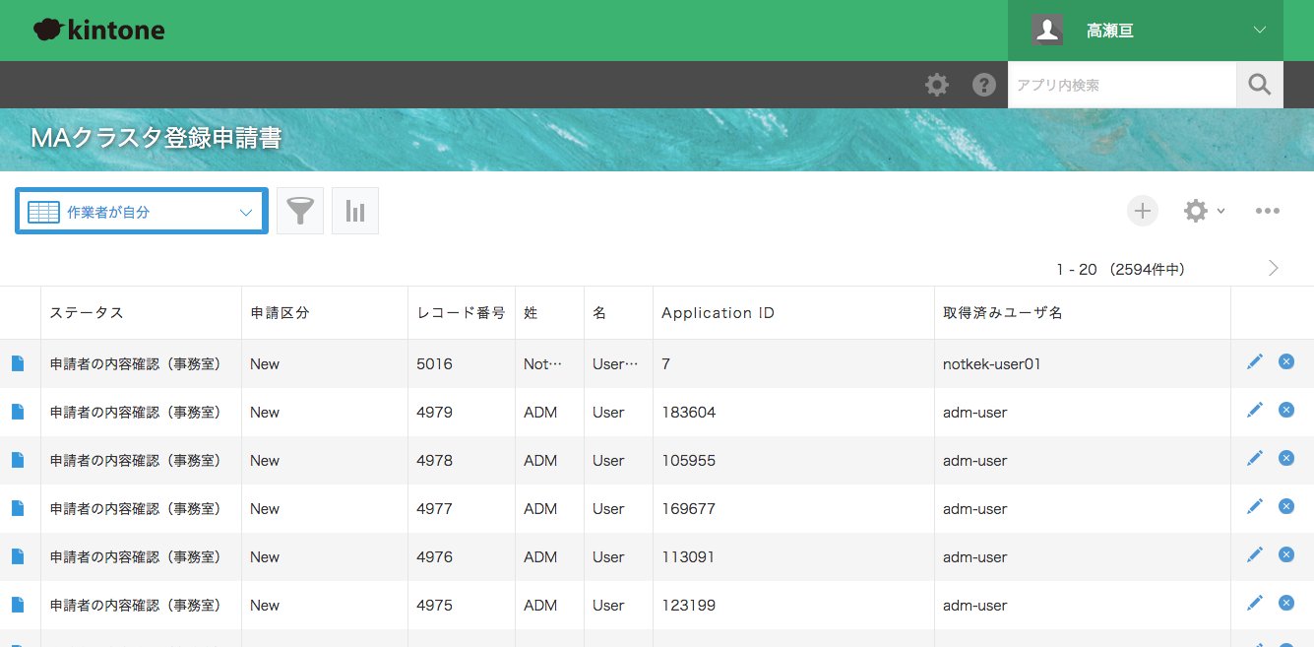
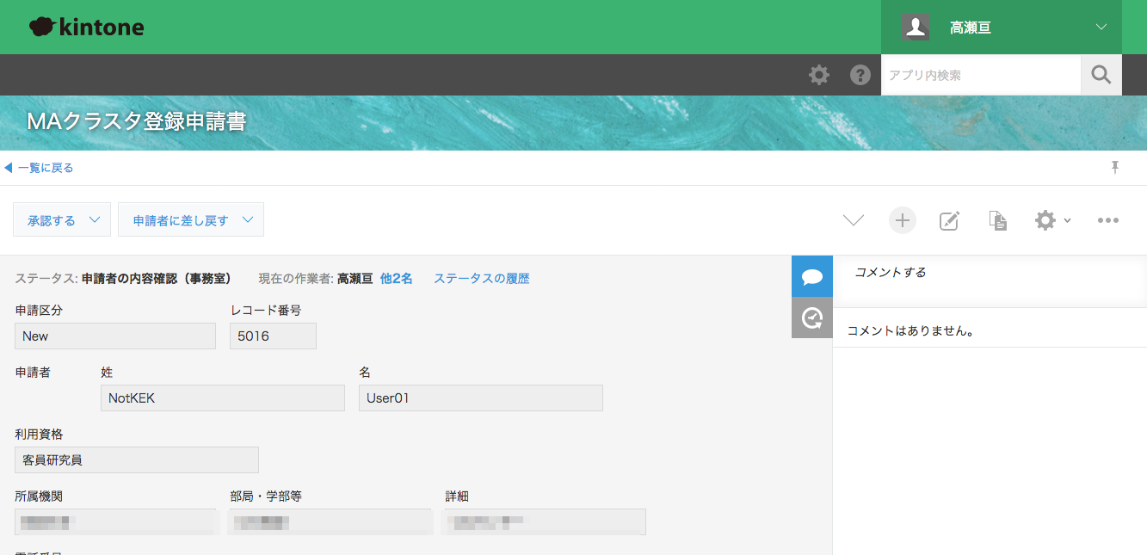
kintone Integration for Making CRC Internal Workflow Online
kintone allows us to:
Define variable workflows depending on the service
Create roles for based on responsibility and set permissions
The Django application creates a new kintone record using REST API.
When kintone status becomes Done/Rejected, kintone sends email to the Django application.
The Django updates the application status based on the email.
Record list
Each record details
Proceeds to the next responsible persons

Slide 11
Automated CI/CD Pipeline with GitLab
We use Docker + Docker compose for portable environment.
“Git commit” triggers CI test.
Test and production deployment are automated.
kintone for Production
kintone for Test
LDAP
Central DB
For Production
Development Environment
Testing Environment
Production Environment
Django
LDAP
Central DB
Django
LDAP
Central DB
Django
Docker compose
Docker compose
Docker compose
Push
CI Test
Merge to develop branch
Merge to main branch
Deploy
CI Test on Testing Environment
GitLab

Slide 12
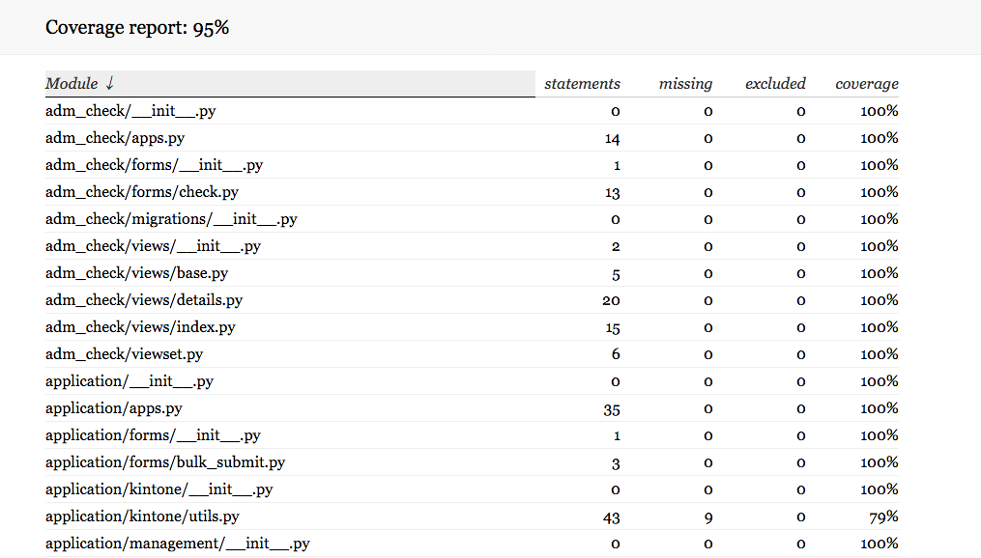
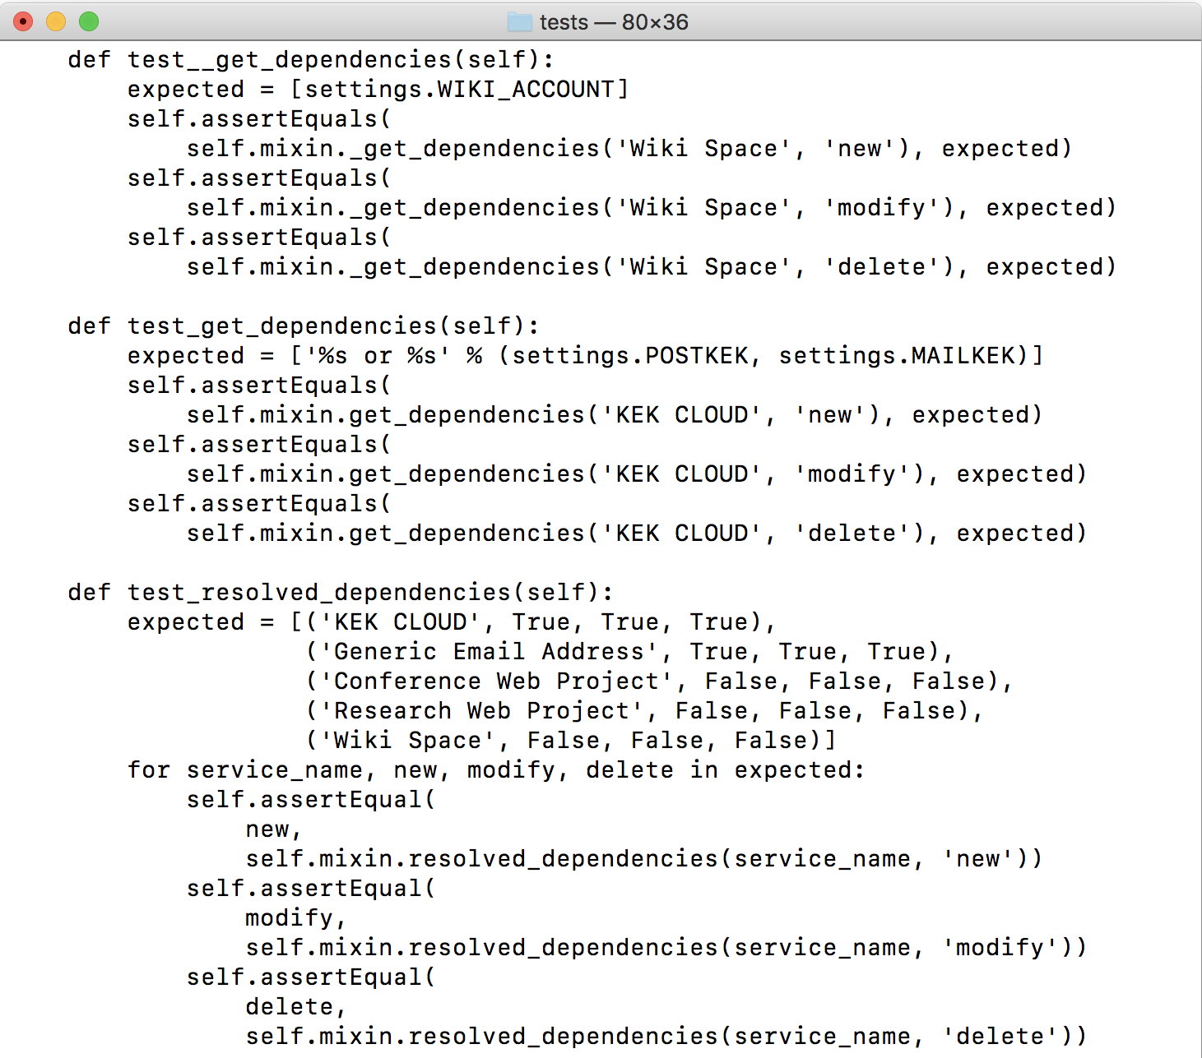
CI Test
We have spent more than 50% time on writing the test.
CI test covers from unit tests to integration test with kintone.

Slide 13
Defined CI/CD Jobs
We defined CI/CD jobs for each GitLab branches and automate tests and deployment.
Branch | Job Trigger | Job
feature/xxx, fix/xxx | Commit | Unit tests, HTTP-level tests
develop | Commit | Unit tests, HTTP-level tests, Integration tests, Deployment to pre-production environment
main | Commit | Deployment to production environment
develop | Every Sunday morning | Unit tests, HTTP-level tests, Integration tests, Deployment to pre-production environment, Vulnerability scan

Slide 14
Browser Testing using Selenium
Selenium automates cross browser Testing.
https://www.selenium.dev/
We define page transition flows using Python and check HTML + CSS + JavaScript functionality.

Slide 15
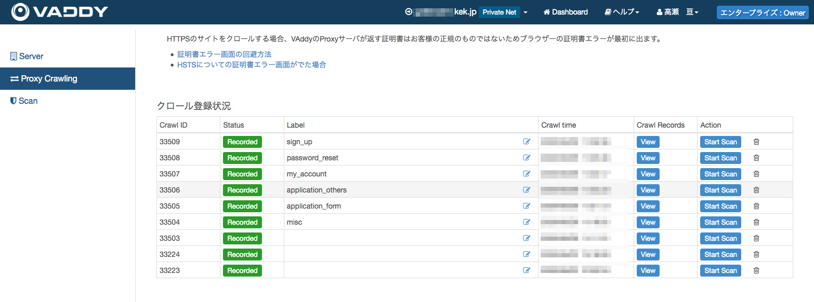
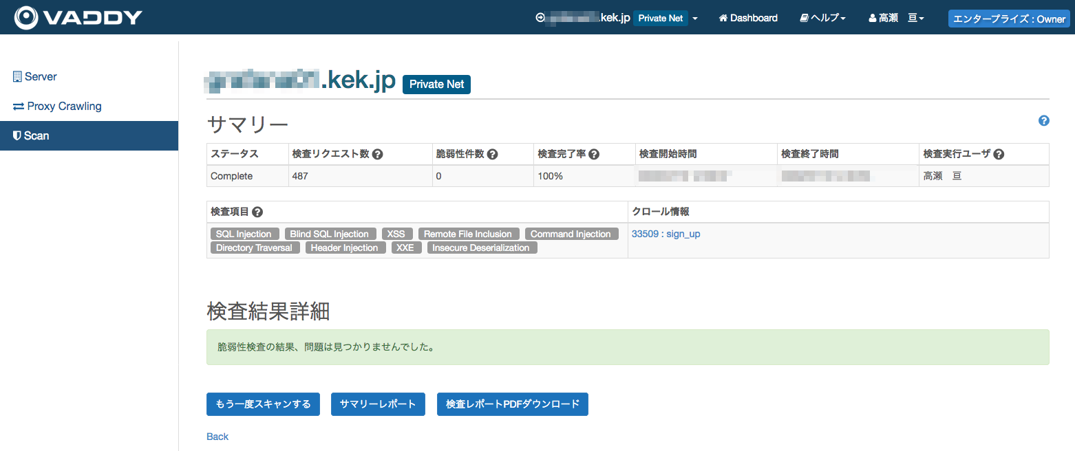
Continuous Security by VAddy
https://vaddy.net/
VAddy is an automated vulnerability scanner provided under the SaaS model.
SQL injection, Blind SQL injection, XSS, Remote file inclusion, Command injection, Directory Traversal, Header injection, XXE, Insecure Deserialization
VAddy scan has been integrated with CI.
KEK Network
ccPortal Test Server
Security Test
VAddy
Define Test Scenarios
Download Test Report

Slide 16
Use Cloud WAF
https://www.nttpc.co.jp/lp/cloudwaf/
To improve security, we use Cloud WAF service.
The Cloud WAF service acts as reverse proxy and provides FW, IDS/IPS, and WAF functionality. And the service includes SOC 24/7 monitoring.
We set DNS A record to the Cloud WAF IP address.
Before
KEK Network
https://ccportal.kek.jp
ccPortal Server
After
Cloud WAF
FW + IDS/IPS + WAF
https://ccportal.kek.jp
KEK Network
ccPortal Server

Slide 17
Current Status
The ccPortal service was rolled out to KEK staff from the middle of September 2020.
Then opened to all others on January 25th, 2021.
Current active users: 1384
So far, so good. There are no critical/major issues.
ccPortal contributes to:
Break away from traditional sign/seal usage
Make application handling contactless

Slide 18
Summary
We have developed an online application portal system named ccPortal.
This portal allows users to apply new services and modify account information online.
The portal also supports the CRC staff's online workflow.
Checking validity, creating an account, DB registration, and sending a completion notice.
We have spent much time on writing tests. CI/CD is very important for providing stable service.
By using kintone and VAddy, and Cloud WAF SaaS services, we have succeeded to develop ccPortal rapidly.

