Slide 1



Exploring the Awareness of Health and Life Promotion from the Differences in the Life Styles of Young People Before and During the Epidemic
Author：WeiJie-Pan
Advisor : ShengMing-Wang
2021.03.12
Notes:
Hello everyone
My name is WeiJie-Pan from the Department of Interaction Design, National Taipei University of Technology.
My Advisor(why) is Mr. ShengMing-Wang
today's presentation is entitled of
Exploring the Awareness(where) of Health and Life Promotion
from the Differences in the Life Styles of
Young People Before and During the Epidemic.
大家好
我是臺北科技大學，互動設計系的潘偉杰
指導教授是王聖銘老师
今天的報告主題是
從年輕族群疫情前後生活樣態的差異探究健康促進生活之意識

Slide 2
01
Research Background
02
Research Objectives and Contributions
CONTENT
03
Research Process and Results
04
Future Research
Notes:
My report is divided(why) into four main sections as the following contents.
我的報告主要分爲四個部分
接下來，我將逐一為大家介紹

Slide 3

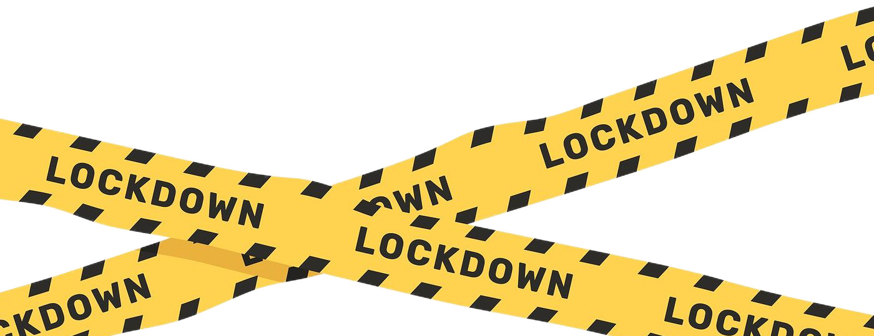
COVID-19
01
Research Background
At least 1/3 of the world's population isolated at home during the epidemic.
Notes:
The first part is the background of the study.
Due to the outbreak of the COVID-19 epidemic,
the Countries took safety measures appropriate to their national conditions, such as city lock-down, the suspending of work and school activities.
At least 1/3 of the world's population has been isolating at home during the outbreak to prevent further spread of the epidemic.
第一部分是研究背景
由於COVID-19疫情的爆發，
各國家均採取了適宜本國國情的防疫措施，如封城、停工、停學
全球至少有1/3的人口，在疫情期間進行了居家隔離，
以防止疫情的進一步擴散

Slide 4


01
Research Background
Sub-health status!
Young people are the most vulnerable group
Notes:
According to the journal paper of The Lancet public health
Home isolation during an outbreak
It may caused （calls） abnormal changes in the work schedule
This can lead(li-d) to the development of suboptimal -health states (s-days)
Sub-health is a state of body transition between health and disease(see).
Therefore, Young people are one of the most infected groups
對於在疫情期間的居家隔離
醫學期刊《柳葉刀》相關論文指出，
將可能造成作息的不正常改變
因此會導致亞健康狀態的產生
亞健康狀態是指人體處於一個健康與疾病之間的過渡時期
其中年輕族群為受影響較大的群體之一

Slide 5
02
Research Objectives and Contributions
Objectives ：
Contributions ：
To investigate the differences in the lifestyle of young people before and during the epidemic, and to further analyze the factors that may affect their health due to the changes in their lifestyle.
What are the factors that may influence the emergence of suboptimal health status in the epidemic.
The impact created by city-lockdown to the young people’ health.
Notes:
The purpose of this study is to investigate the differences of young people’s lifestyle before and during the epidemic
And to further analyze the factors that may affect the health of the young people.
The contribution of the study is to:
One: Identify the factors that may have influenced the emergence of sub-health status (s-day-t-s) during the epidemic.
Two: The impact created by city-lockdown to the young people’ health.
因此本研究目的為
針對年輕族群在疫情前及疫情中的生活型態進行差異化調查，
並進一步分析相關生活型態的改變可能影響健康的因素爲何。
研究貢獻為：
得出疫情中，可能影響亞健康狀態出現的因素爲何
實行city-lockdown對于年輕人健康的影響

Slide 6
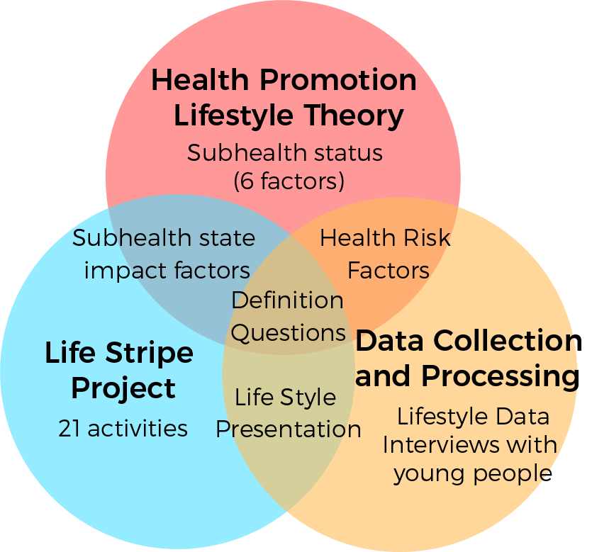
Research
Framework
03
Notes:
Next, is the research framework
There are three main parts
Health Promoting Lifestyle Theory (HPLT)f-er-v
which contains 6 important factors due to sub-health status.
Then comes to the Life Stripe Project, in which the authors(o-f) summarize 21 common human activities.
We collected and processed lifestyle data.
and Finally, this study will defined the problems that young people may face during the epidemic
接下來是研究架構
主要有三大部分
分別為健康促進生活型態理論，
包含6個因素，是導致亞健康狀態產生的重要原因
再來是生命色帶專案，作者歸納了人類常有的21項作息活動
最後是生活形態數據的收集與處理
最終定義出疫情中年輕族群可能面臨的問題

Slide 7
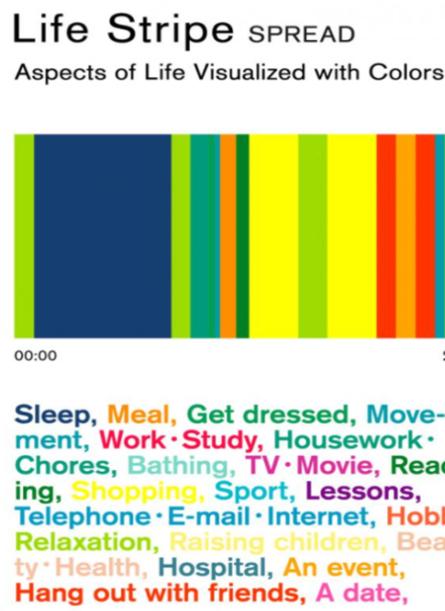
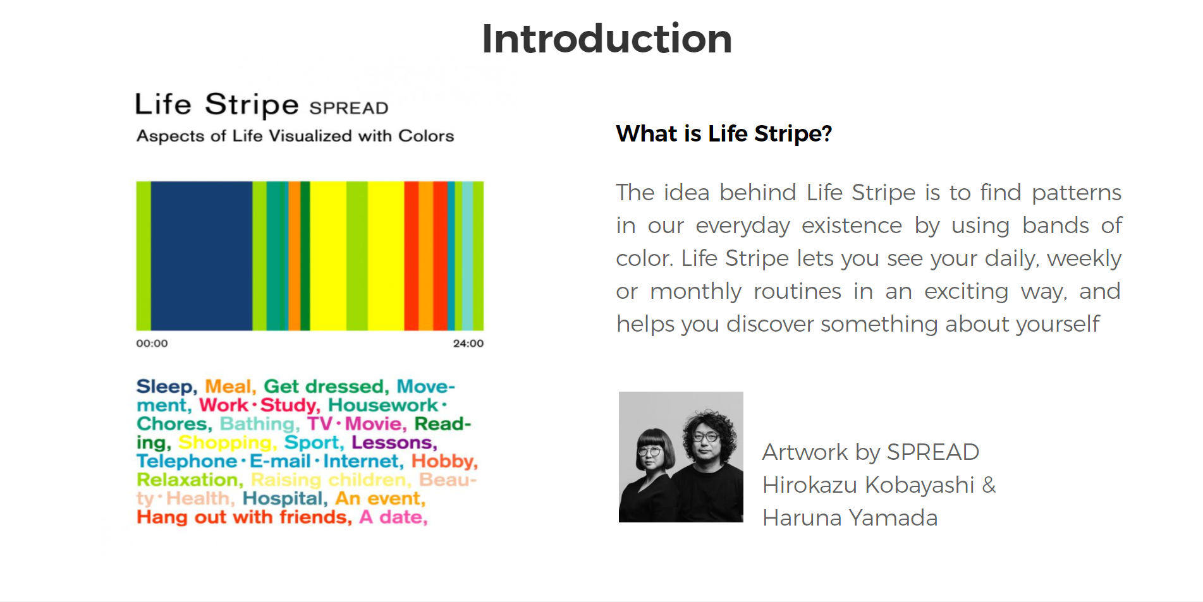
Life Stripe Project
Notes:
First of all, I want to explain a bit about the life stripe project.
Life Stripe is a project founded by a couple of Japanese designer.
It is a documentary, and experimental art project
The designers initially (in-ni-s-li) conducted (con-duck-t)a statistical survey of behavioral projects and color definitions.
In summarize, 21 types of activities and their corresponding colors were decided.
Then, the length of each activity was being indicated by the stripes of different thicknesses. (fv-k-ness)
to show the distribution of time spent by the subjects
The distribution of the time occupied by each activity
首先簡單介紹一下生命色帶專案
生命色帶是由一對日本設計師夫婦創辦的專案
是一個紀實類，具有實驗性質的藝術項目
最初設計師透過統計學做了行為專案的問卷及色彩定義的調查，
最終決定了21種作息活動項目及其對應的色彩，
而後用粗細不一的條紋來表示每一個作息活動的時間長度，
以展現受測者一天所有作息
各自佔據時間分佈上的呈現

Slide 8
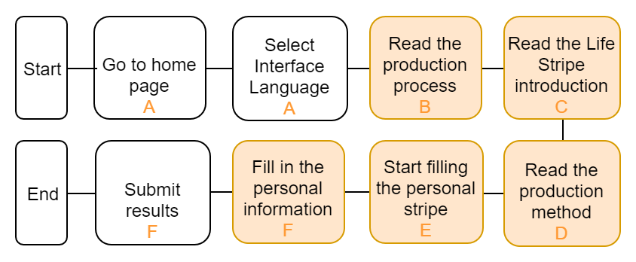
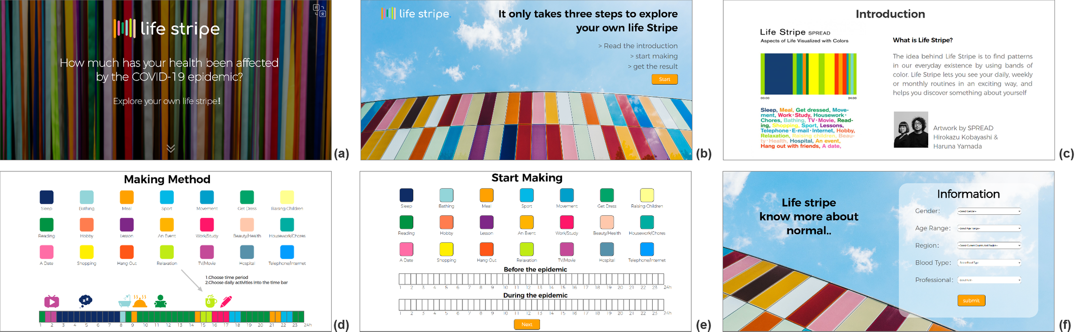
Data Collection
and Processing
Notes:
In order to collect and analyze data more effectively
this study used the twenty-one activities and their corresponding colors
from the Color of Life stripe project
as a reference for online questionnaire collection and
the subsequent color presentation of the Life Zones.
Then, a web-based data collection system was developed
To collect the data on the activities
爲了更有效的收集及分析數據
本研究藉鑒生命色帶專案中21項作息活動及其對應色彩，
做為線上收集問卷設計及
後續生命色帶色彩呈現的參考，
而後實際開發網頁版的線上收集系統
進行作息活動數據的收集

Slide 9

03
Notes:
Now, I am going to show you a short demonstration video
of how this research conducted a data collection process through the online system mechanism tool.
我將會播放一個簡短的視頻
展示綫上收集系統收集數據的過程

Slide 10
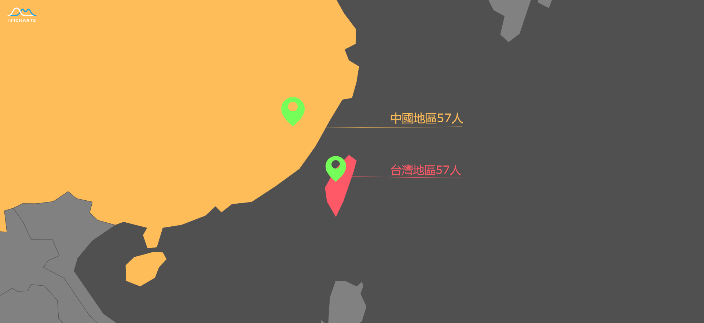
Data Source
China Region 57 (valid data)
（有效數據）
有效數據
Taiwan Region 57 (valid data)
（有效數據）
Notes:
The current online data is mainly from
Taiwan and China
The main reason is because China had been adopting city-lockdown for some periods of time, while as Taiwan does not,
Therefore, based on this case study, we can compare the differences between these two places
Two of the regions with number of valid (va li) data of fifty-seven respectively and
one hundred fourteen people in total
目前綫上數據主要來源於
台灣及中國兩個地區
因爲中國有city-lockdown ，
但是台灣沒有，
我們可以對比他們的差異
其中兩地區
有效數據分別為57人
一共114人

Slide 11
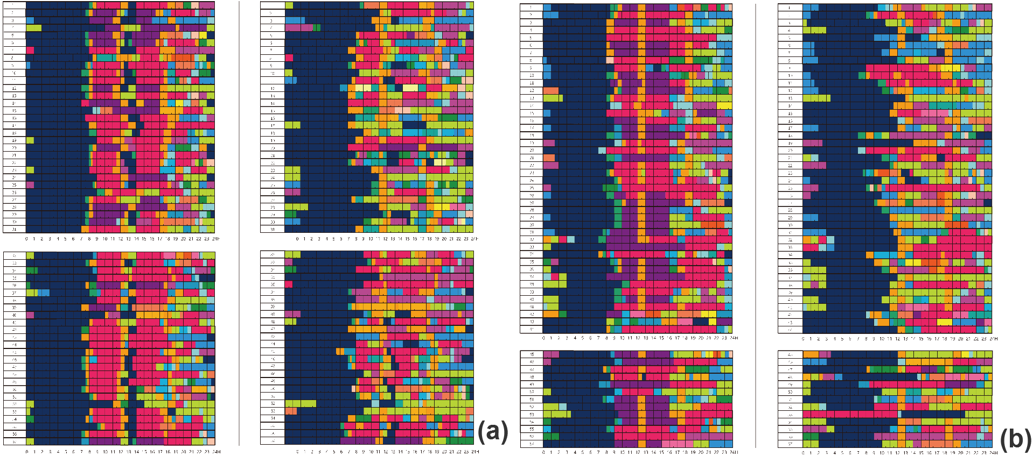
03
Data Processing - Visual Representation of Life Stripe
China- Pre-epidemic
China-during the epidemic
Taiwan- Pre-epidemic
Taiwan-during the epidemic
Notes:
The next step is data processing
The collected data are presented (pe-sion-t) as stripes
and distinguished by region, before and during the epidemic
During the analysis
The data can be presented (pe-sion-t) by individual activities as will be explained on the next slide.
接下來是數據的處理
將收集到的數據以色帶的方式呈現
並按照地區，疫情前及疫情中去區分
在分析的時候
可以按個別活動作息來呈現

Slide 12
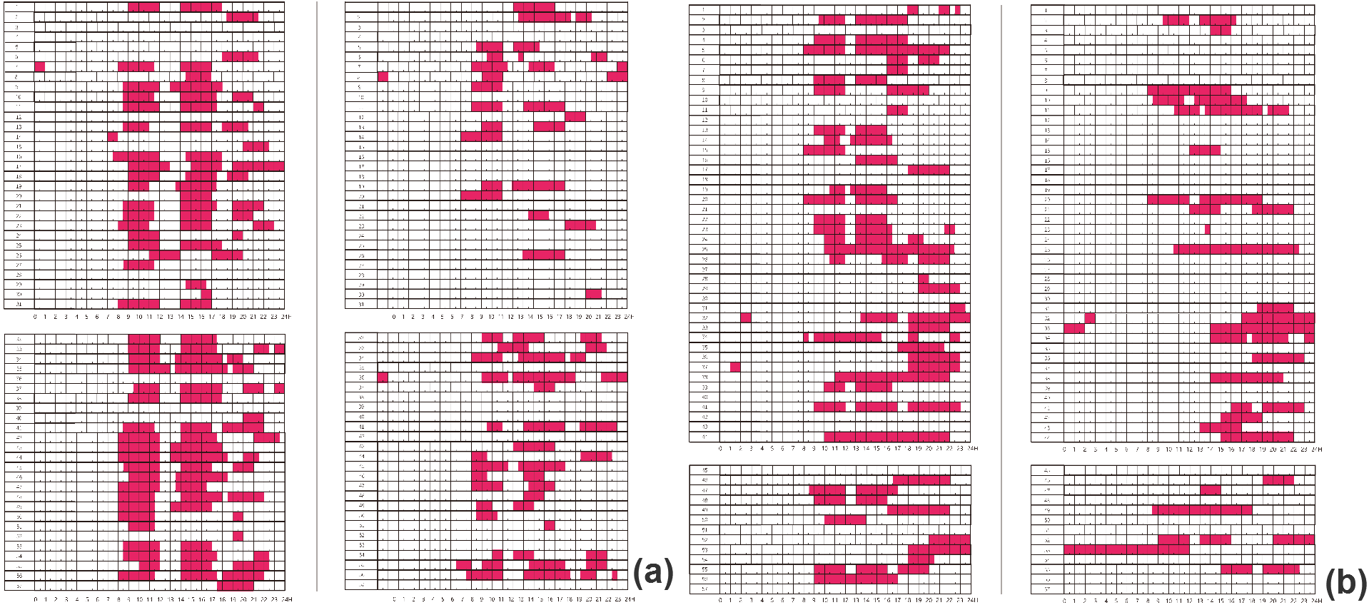
03
Presented by Learning activity
China- Pre-epidemic
China-during the epidemic
Taiwan- Pre-epidemic
Taiwan-during the epidemic
Notes:
For example, the color block that shows the study schedule alone.
Here it can be clearly seen that
during the epidemic compared to the pre-epidemic period.
learning habits have significantly decreased
and have become more dispersed (dis-per-s-t)
比如說單獨呈現學習作息的色塊
這邊可以很明顯的看出
疫情中相比疫情前，兩個地區
學習作息是有明顯的減少
并且也變得更加的分散

Slide 13
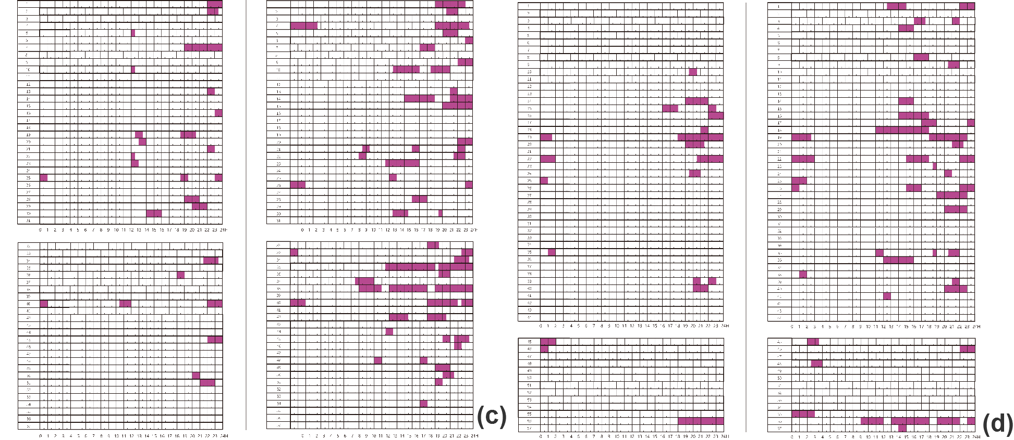
03
Presented by TV and Movie activity
China- Pre-epidemic
China-during the epidemic
Taiwan- Pre-epidemic
Taiwan-during the epidemic
Notes:
Then again, if it is a watching TV or Movie habit
can also be clearly seen
People spent more time on the entertainment activities in compare to pre-epidemic period
However, based on the data result,
the participants from china have also been reported of exposing higher time
compare to the others in doing entertainment activities.
再來，如果是電視電影作息
也可以清晰的看到
在疫情中相比疫情前
會有更多的時間花在娛樂上
然而根據數據結果，中國地區更多人花在這個作息上

Slide 14
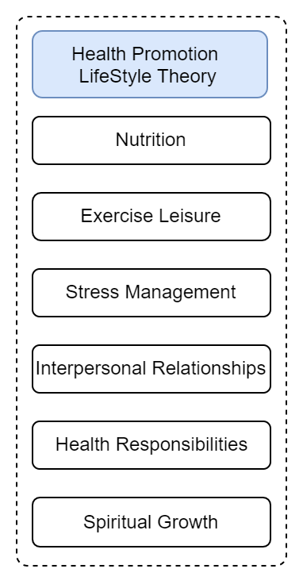
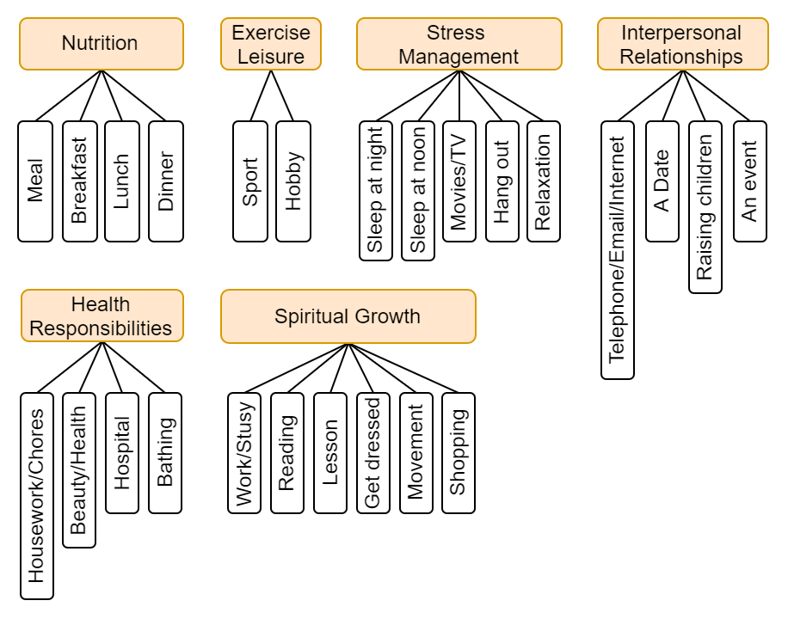
03
Integrating Health Promotion Lifestyle Theory
14
Notes:
This study was conducted (con-duck-t) to better understand how the lifestyle’s habits changes of young people
And how it will affect on their health.
We introduced the health promotion lifestyle theory
and categorize the twenty one items (ai tem) of the Life Stripe into activities
As shown in the figure
本研究為了更加瞭解年輕族群生活習慣的改變
將會對健康產生怎麽樣的影響
導入健康促進生活形態理論
並將生命色帶21項目作息活動分類到裏面
如圖所示

Slide 15

03
Data processing - analysis by spss
Notes:
According to the data classification of the previous page
Also, the collected data in this study were imported into SPSS software
to calculate the time spent on each work schedule
and the percentage of people who have that work schedule.
The comparison and analysis can be done more precisely (p-side-s-li)
It is found that the orange marked daily life have significant difference.
However, the specific information about their activities and habits are not yet clear.
根據上一頁的分類
同時本研究將收集到數據導入spss軟體中
計算出各作息所花費的時間
及佔有該作息的人數占比
方便進行更加精確的對比與分析
發現橙色標記出來的作息
有顯著差異性
但是還不能清晰的瞭解他們活動作息的具體信息
因此本研究進行了目標群體訪談

Slide 16



03
Target Group Interviews and Analysis
Target Group Interviews
Integrating the problematic points
Understand the activities of the target group to make up for the lack of online questionnaire collection
Combining quantitative questionnaire collection and qualitative interviews to identify problematic points
Interview Content Analysis
Verbatim scripting with MaxQDA and then Analyze word association using KH-coder
Notes:
So this study conducted Target group of interview study.
the target group interview and analysis workflow are organized into verbal (ve-bo) transcripts (trans-gv)
Then analyze the textual content To understand the specific lifestyles of young people
and combine the results of SPSS
With purpose of figuring out the problem of young people will be faced
目標群體訪談與分析的内容是
通過訪談並將訪談内容整理成逐字稿
然後對文字内容進行分析
以瞭解年輕族群的具體生活型態
並結合SPSS的結果
得出疫情中
年輕族群將會面臨什麽問題

Slide 17


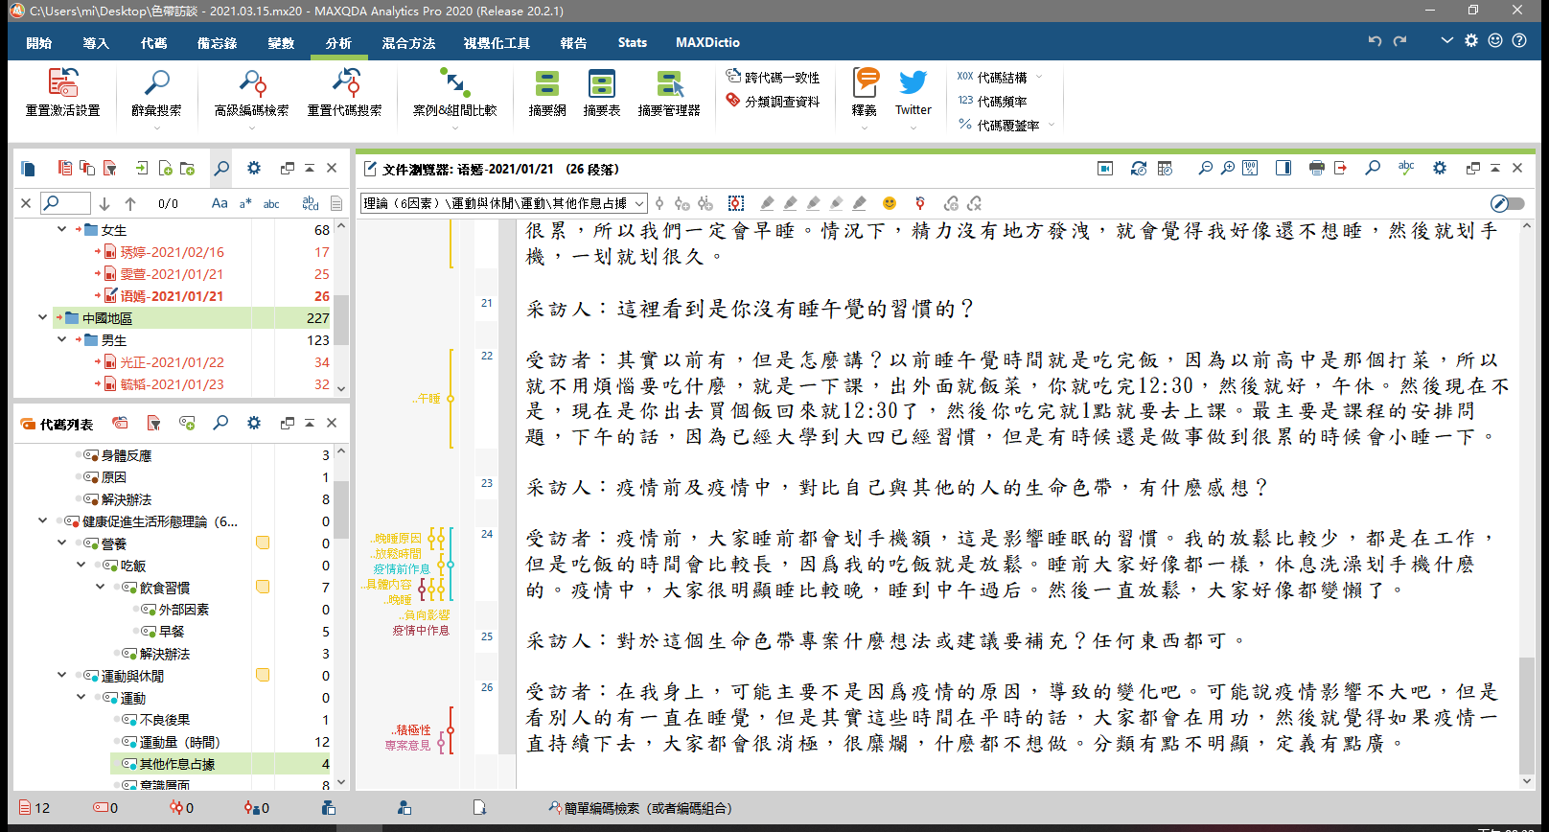
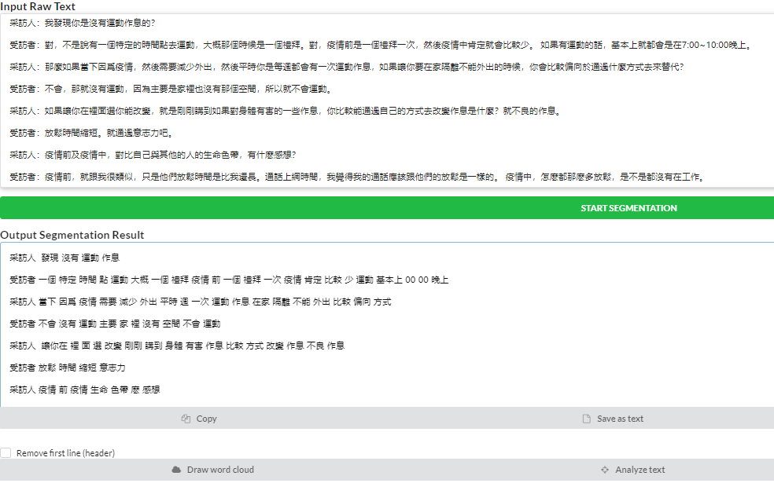
03
MaxQDA and JIEBA library
MaxQDA collates verbatim drafts
Chinese word breaking through jieba library
Notes:
The total of twelve(12) university students have been interviewed.
There were distinguished into 6 participants per each of Taiwan and China region.
The verbal transcript were compiled by MaxQDA
And since language-used is Chinese, so we employed a python jieba library to break the word and analyzed it into KH-coder.
目前已訪談了12名大學生
分別是台灣與中國地區各6人
同時通過MaxQDA整理了逐字稿
因爲語言是中文
所以使用了Python Jieba庫進行斷詞
並通過KH-coder對斷詞内容進行分析

Slide 18
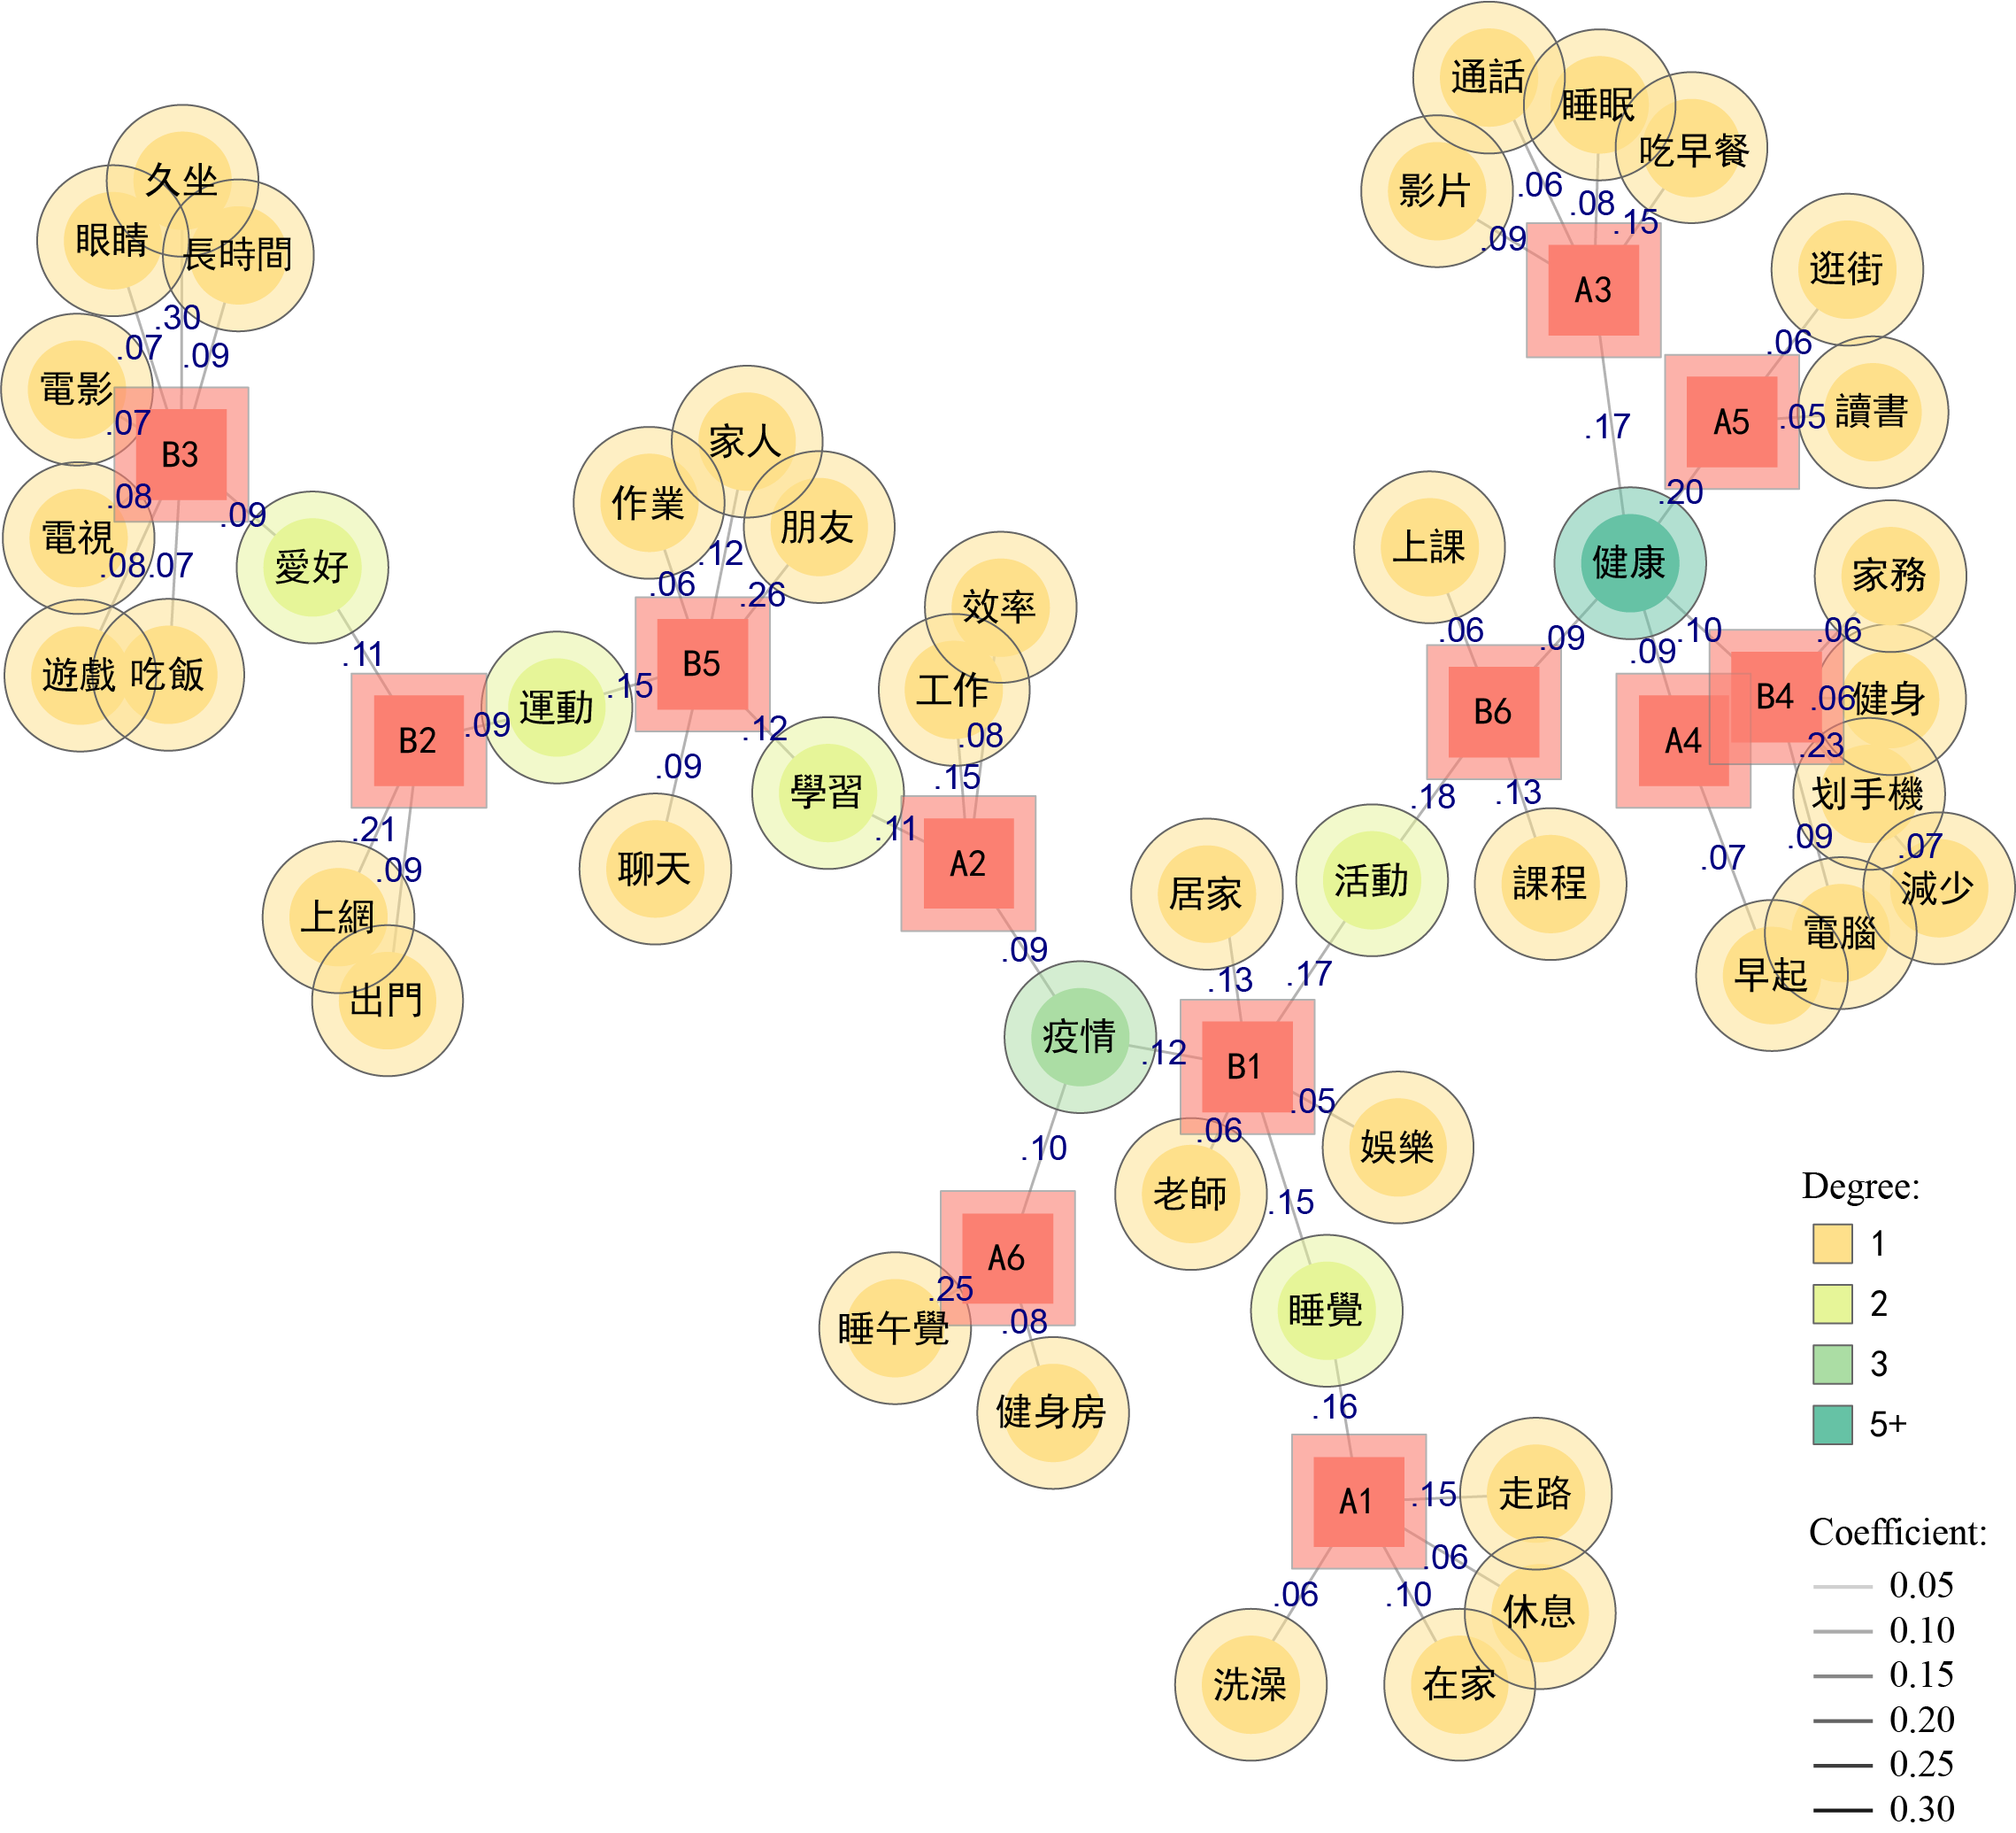


03
Co-Occurrence Network
KH-coder analysis
Notes:
This is the analysis result of KH-coder's Co-Occurrence Netword
I've translated the Chinese into English for easier understanding
Like this
這是KH-coder的Co-Occurrence.Network 的分析結果
爲了方便閲讀，我將中文翻譯成了英文
就像這樣

Slide 19
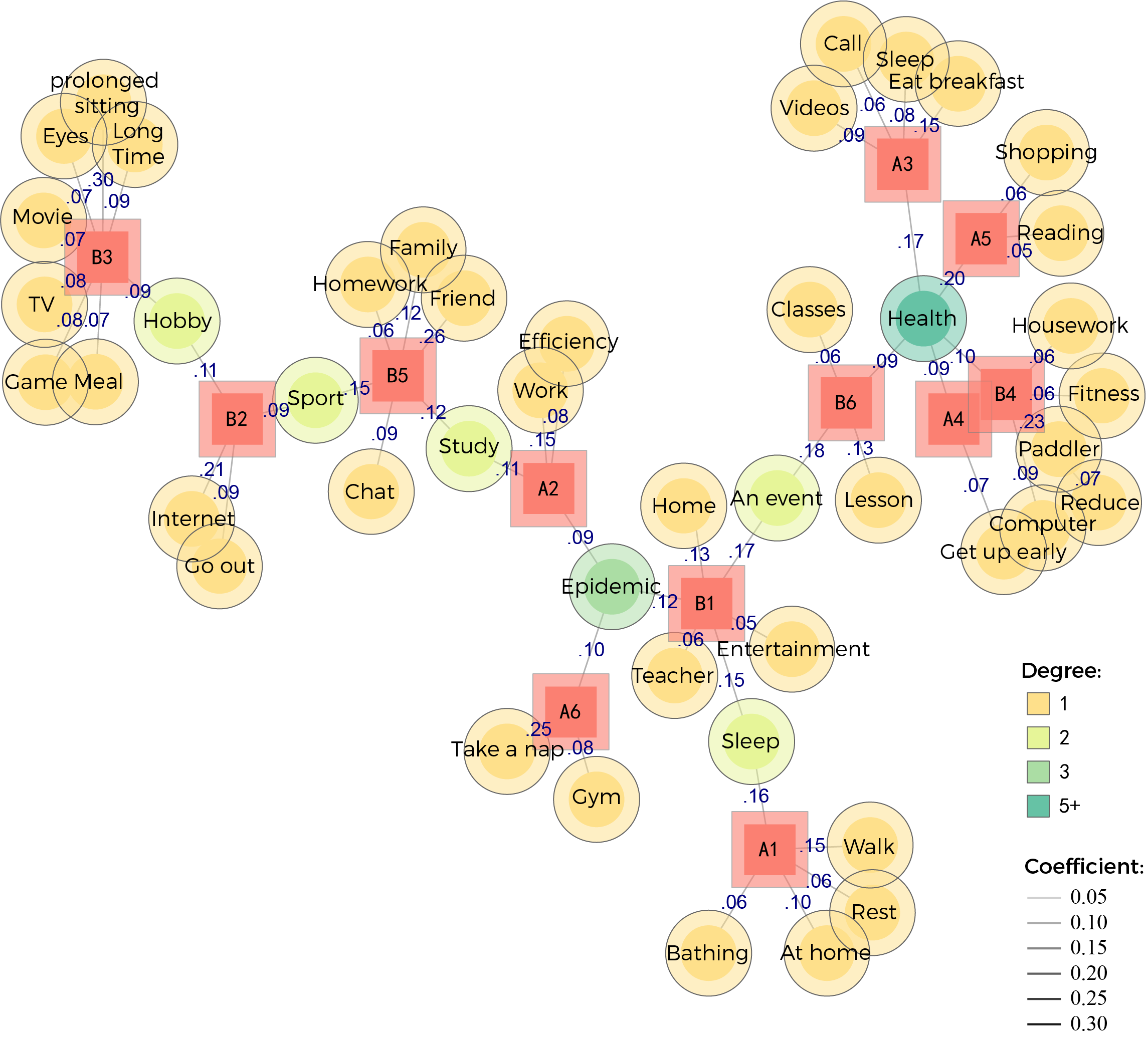
A5-Shopping:
"Because of the epidemic came, then there can not go shopping, a lot of actually quite a lot. There is no way to go shopping because I am also afraid of the spread of the epidemic."
(A5-2021/01/21, Location 6)
03
KH-coder analysis
China
Taiwan
Notes:
In the picture
An initial (in li so) Letter represents regions
A is for Taiwan
B stands for China
Numbers represent the quantity of respondents
圖中
字母代表地區
A代表的是台灣
B代表的是中國
數字代表受訪者
黃色代表的是高頻詞
如果兩個受訪者有共同的高頻詞將通過綠色來呈現
通過這個圖可以很客觀的瞭解
全部訪談内容及關係
對日後的訪談内容分析很有幫助

Slide 20
A5-Shopping:
"Because of the epidemic came, then there can not go shopping, a lot of actually quite a lot. There is no way to go shopping because I am also afraid of the spread of the epidemic."
(A5-2021/01/21, Location 6)
high-frequency words
03
KH-coder analysis
Notes:
The yellow color represents high-frequency words
圖中
字母代表地區
A代表的是台灣
B代表的是中國
數字代表受訪者
黃色代表的是高頻詞
如果兩個受訪者有共同的高頻詞將通過綠色來呈現
通過這個圖可以很客觀的瞭解
全部訪談内容及關係
對日後的訪談内容分析很有幫助

Slide 21
A5-Shopping:
03
KH-coder analysis
"Because of the epidemic came, then there can not go shopping, a lot of actually quite a lot. There is no way to go shopping because I am also afraid of the spread of the epidemic."
(A5-2021/01/21, Location 6)
common
high-frequency word
Notes:
If two respondents have a common high-frequency word, it will be transformed into green.
Through this chart, we can get an objective understanding of
The content and relationship of all interviews’ result
Moreover, It will be an useful content analysis result for the continuous steps. Like….
圖中
字母代表地區
A代表的是台灣
B代表的是中國
數字代表受訪者
黃色代表的是高頻詞
如果兩個受訪者有共同的高頻詞將通過綠色來呈現
通過這個圖可以很客觀的瞭解
全部訪談内容及關係
對日後的訪談内容分析很有幫助

Slide 22
03
KH-coder analysis
A5-Shopping:
"Because of the epidemic came, then i can not go shopping, a lot of actually quite a lot. There is no way to go shopping because I am also afraid of the spread of the epidemic."
(A5-2021/01/21, Location 6)
Notes:
We can take an example of
the high-frequency of A5 respondents in the phrase of “shopping”
This research was using maxQDA's keyword search function
To Find the sentences that contain the word “shopping” in A5’s category
afterward this research can fully analyze the content based on this word.
According to the graph, we can also understand that A5 which represents in Taiwan behavior,
The data can say that, although there was no city-lockdown happened, but there is still an impact to shopping activity.
以受訪者A5的高頻詞Shopping為例子
通過maxQDA的關鍵字搜索功能
找出A5說過的話中包含Shopping的句子
即可瞭解到A5是在台灣，雖然沒有city-lockdown，但是對shopping還是有影響的
等等

Slide 23
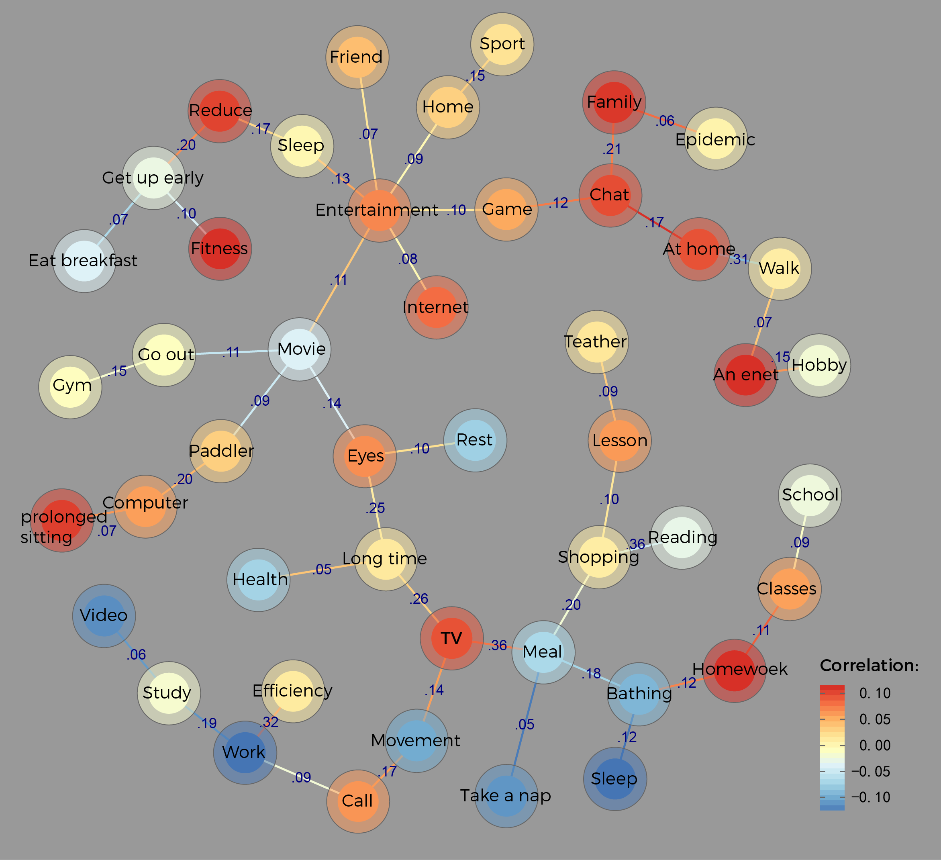
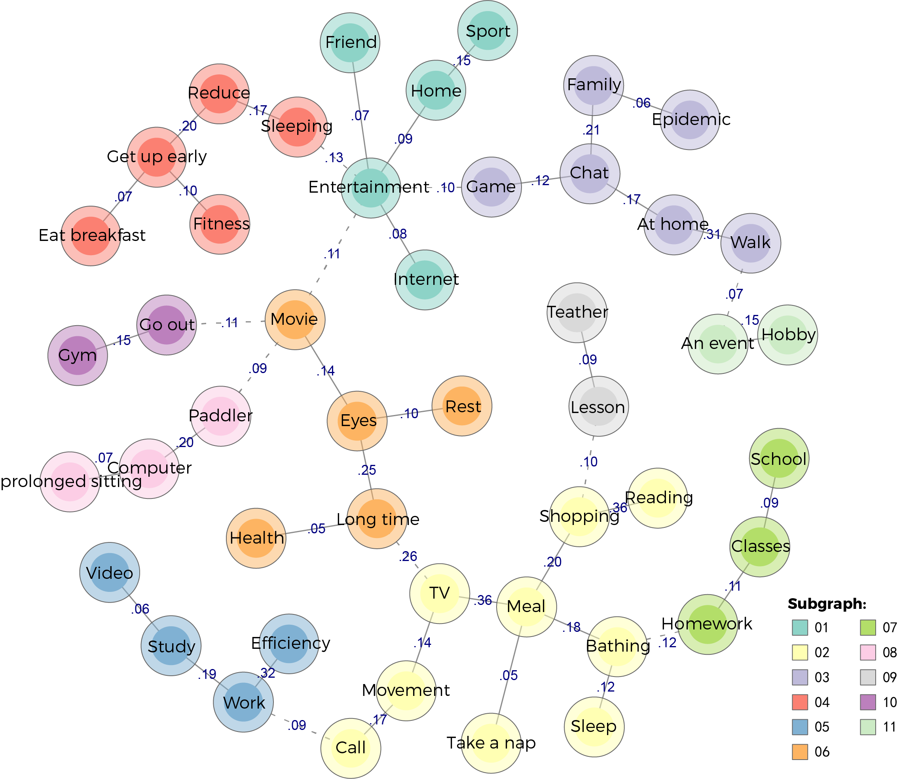
04
Future Research
Co-Occurrence/Network-Correlation
Co-Occurrence/Network-random-walks
Notes:
We have also produced other results in KH-coder
But it is still on being researching.
In the future, we will integrate the results of the interview analysis into a pre-study
The results of the interview analysis will be integrated and
analyzed to determine (d-te-min) what issues of young people may face in the epidemic
so that they can be better protect themselves
我們在KH-coder中還產出了其他的成果圖
但是目前還在研究中
未來將會把訪談分析結果結果前期研究
整合分析得出年輕族群在疫情中將可能面臨什麽樣的問題
使得他們可以更好的保護自己

Slide 24
THANK
FOR
LISTENING
Q&A.
Author ：WeiJie-Pan
Email：xiaopanzizi@gmail.com
Notes:
This is the end of my presentation. Thank you for listening
以上是我的報告
謝謝

Slide 25
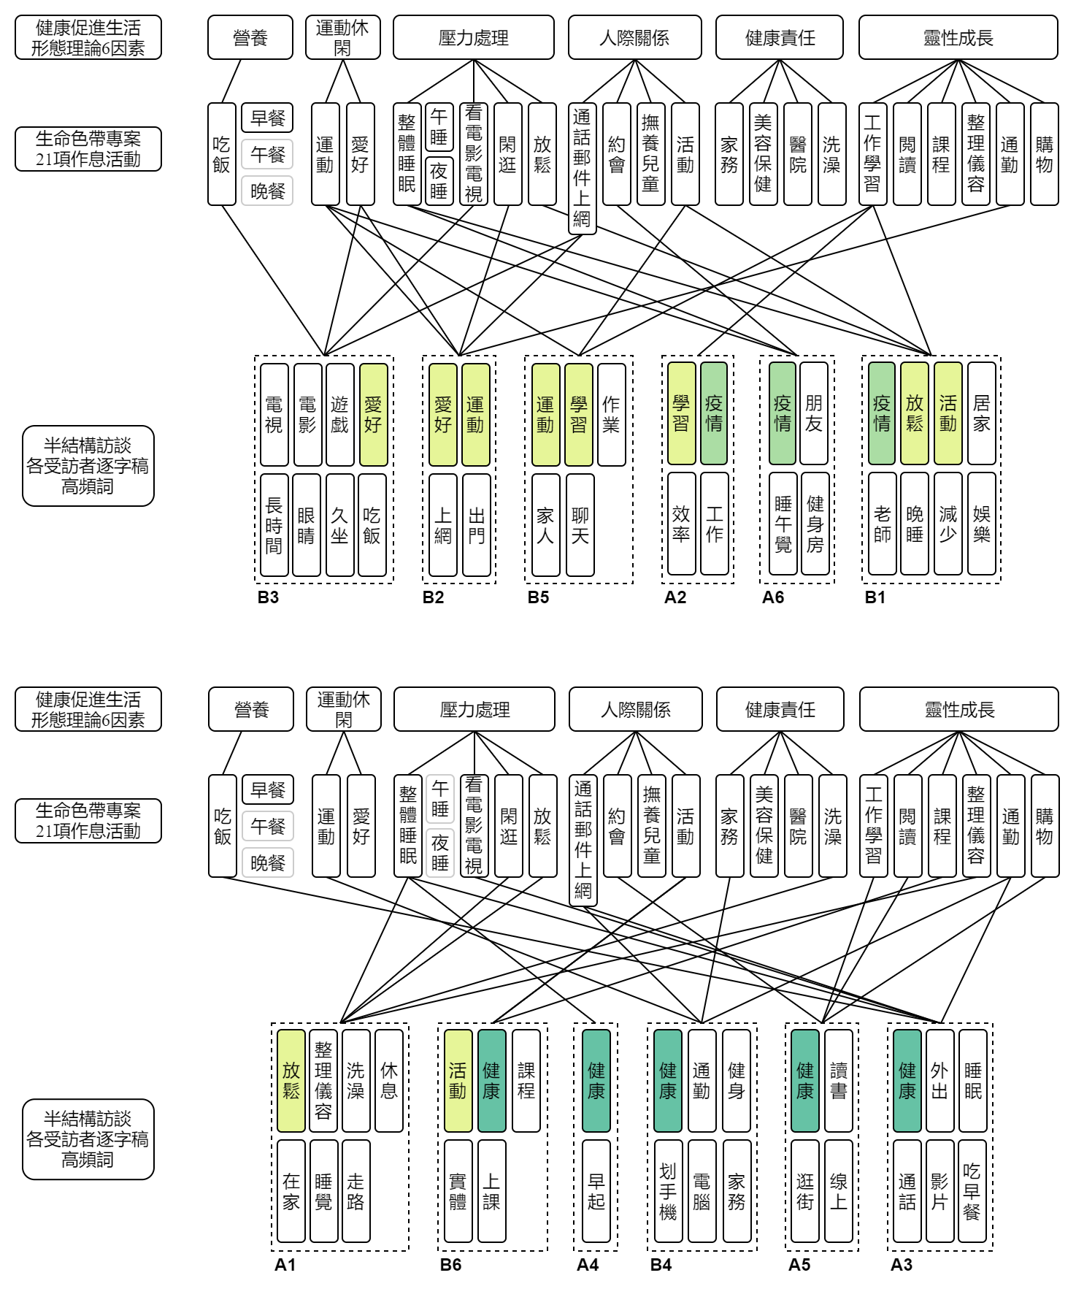
03
高頻詞與健康促進生活形態的關係
Notes:
後續研究中
目前已訪談了12名大學生
並通過KH-coder對逐字稿進行分析
有發現一些關鍵字的群聚與分類
後續會結合前面的研究成果
做整合分析

Slide 26
03
高頻詞與健康促進生活形態的關係
Notes:
後續研究中
目前已訪談了12名大學生
並通過KH-coder對逐字稿進行分析
有發現一些關鍵字的群聚與分類
後續會結合前面的研究成果
做整合分析

Slide 27
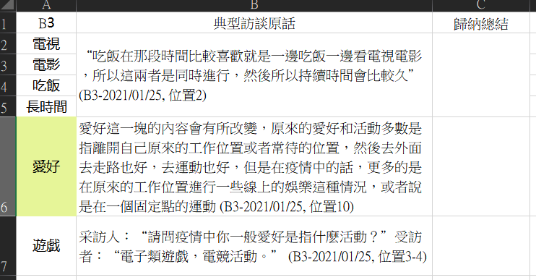
03
各受訪者典型語句與分析
Notes:
後續研究中
目前已訪談了12名大學生
並通過KH-coder對逐字稿進行分析
有發現一些關鍵字的群聚與分類
後續會結合前面的研究成果
做整合分析

Slide 28
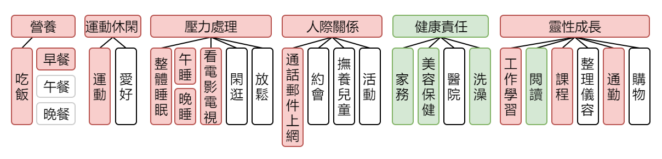
03
研究結果-以健康促進生活形態理論分析
正向發展
負向發展
Notes:
研究結果，利用健康促進生活理論中的6個因素進行分析
首先將生命色帶中的21項作息活動分類到營養、運動休閑、壓力處理、人際關係、健康責任、靈性成長中
結合spss計算結果，對比疫情前及疫情中的作息變化，可以得出
疫情對年輕族群的影響
綠色為正向發展
紅色為負向發展
無顔色為無顯著影響

Slide 29
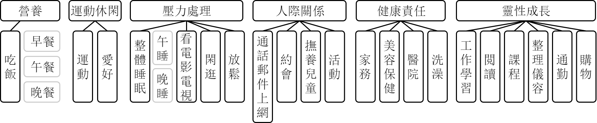
03
研究結果-以健康促進生活形態理論分析
疫情對年輕族群的影響
正向發展
負向發展
Notes:
研究結果，利用健康促進生活理論中的6個因素進行分析
首先將生命色帶中的21項作息活動分類到營養、運動休閑、壓力處理、人際關係、健康責任、靈性成長中
結合spss計算結果，對比疫情前及疫情中的作息變化，可以得出
疫情對年輕族群的影響
綠色為正向發展
紅色為負向發展
無顔色為無顯著影響

Slide 30
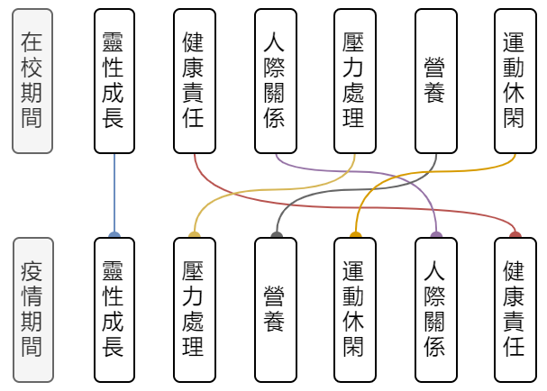
04
研究結果-6個因素-負面影響亞健康狀態產生的排序
1
2
3
4
5
6
陳潔瑜-2017：
本研究：
1
2
3
4
5
6
Notes:
對於健康促進生活型態理論中的6個因素負面影響健康狀態產生的排序
在2017年陳潔瑜發表的論文中，大學生在校期間
6個因素的負面影響排序為：
靈性成長、健康責任、人際關係、壓力處理、營養、運動休閑
而本研究為在疫情中，與在校期間存在差異
排序為：第一是：
靈性成長，年輕族群主要為學生，首要任務是在校獲取知識，但由於疫情緣故，可能導致停學，日常規劃被打亂
再來是壓力處理，在疫情中，身體健康和學業的壓力會變大
然後是營養，疫情中相比在校期間，飲食習慣會變得混亂，甚至過量
接下來，運動休閑，在疫情中，為增强免疫力，運動意識會提升
第5，人際關係，雖然是限制社交距離，群聚，但還是可以通過社群網絡進行溝通
第6，健康責任，由於疫情的爆發，自我健康意識會普遍提高

