Slide 1
SERIOUS GAME DESIGN
FOR PLAYFUL
URBAN EXPLORATORY SIMULATION
ISGC
2021
Researcher: Vu Hong Lan
Advisor: Sheng-Ming Wang
National Taipei University of Technology
Department of Interaction Design

Slide 2
Vu Hong Lan (Kenny)
kennyvulan@gmail.com
Ho Chi Minh City (HCMC), Vietnam
Bachelor of Information Technology
Master of Interaction Design and Innovation
Research topic interest: Purposeful usage of video game

Slide 3
TABLE OF CONTENTS
01
RESEARCH MOTIVATION & CONTRIBUTION
02
INTRODUCTION
03
RESEARCH METHOD & EVALUATION
04
CONCLUSION & FUTURE WORK

Slide 4
01
RESEARCH MOTIVATION & CONTRIBUTION

Slide 5
Motivation & Contribution
Serious Games - Games’ other purpose besides entertainment
Pandemic Traveling Restriction and Risk
Immersive & Playful virtual exploration experience
Crowdsourcing public spaces
Motivational learning and training to explore new knowledge and skills.
Users have extra time to try virtual world
Discover the necessary game elements for developing an immersive & playful experience
Create a Co-working, co-sharing virtual playground.

Slide 6
02
INTRODUCTION

Slide 8
Serious Games
Minecraft and Serious Game Design
A Digital Twin Concept For Urban Exploration and Simulation
Main purpose of serious games is to educate and to train.
Suitable game elements can motivate Serious gamers/ learners to discover new skills, knowledge and even change their behavior.
Minecraft itself is a game but its modifiability can change how users experience it.
Minecraft have been used to motivate children in learning programming and urban planning.
Educators and content creators can create contents to deliver new information and knowledge in the virtual learning environment
Using digital twin concept, we design a virtual system of public spaces inside Minecraft, which capable of scenario design, to empower spatial awareness as well as scenario awareness, which later impact users’ decision intelligence and co-working ability.

Slide 9
Playful Immersive Experience with Serious Games
Traditional Immersive with VR is only Visual => The content is fixed
They have some interaction operation but it is not enough => Use “Play” to create more interaction
Create a platform on multiple system for everyone to collaborate => Improve the contents and make them more dynamic as it is renew at all time so users/players can experience this platform differently every time they visit.
Virtual visual experience
Traditional Immersive Experience | Playful Immersive Experience
Fixed visual content | Dynamic visual content, content improved, renewed at all time
Lacks of interaction | “Play” as interaction
Mostly VR | VR, PC, Game consoles
Individual virtual platform | Virtual platform for co-working, co-sharing
Designer do everything | Everyone work together as a platform

Slide 10
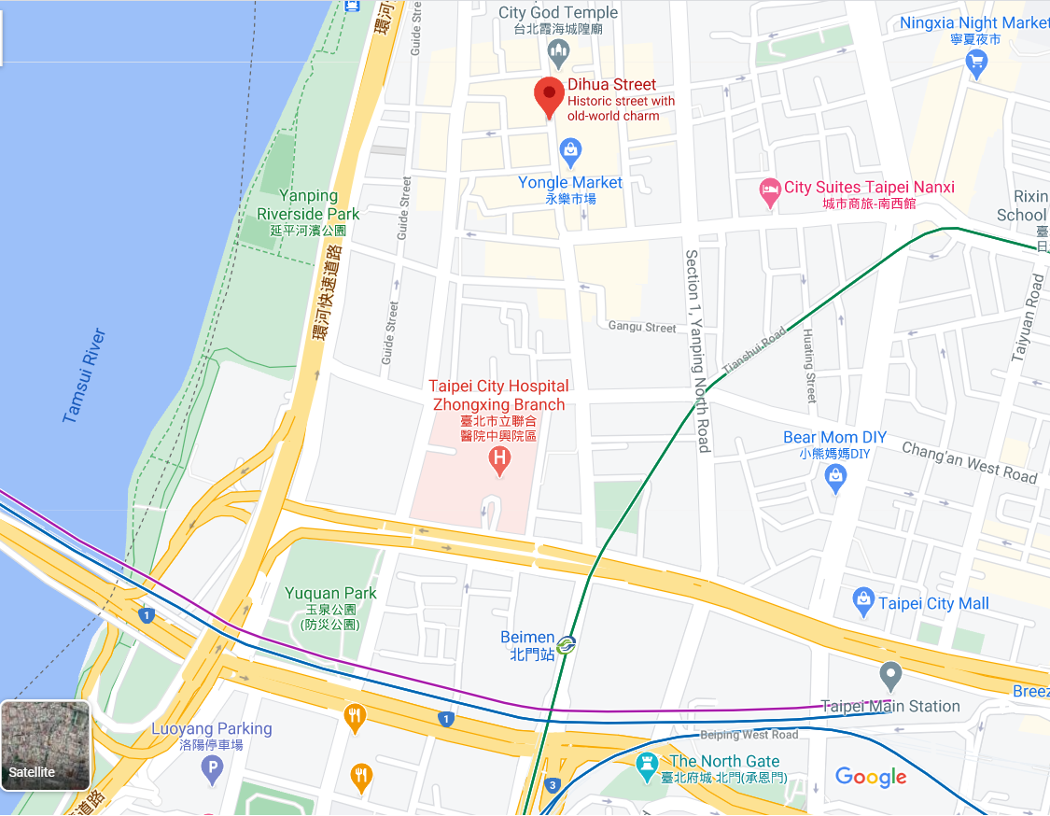
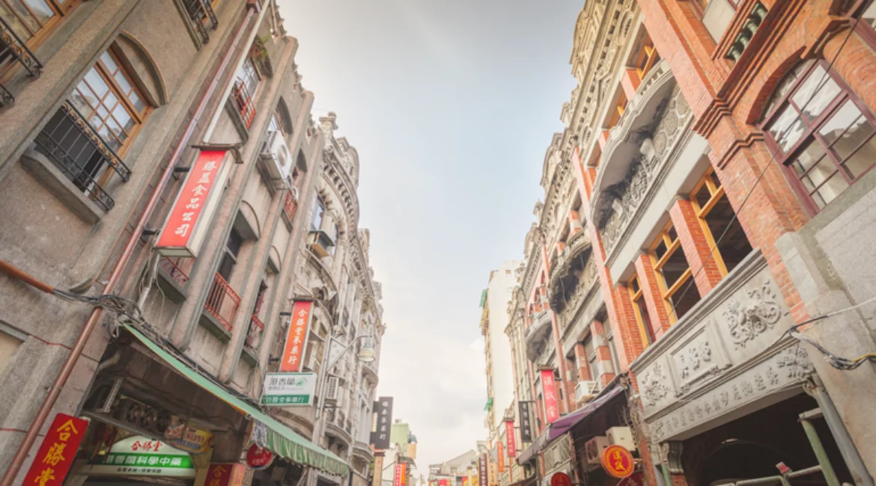
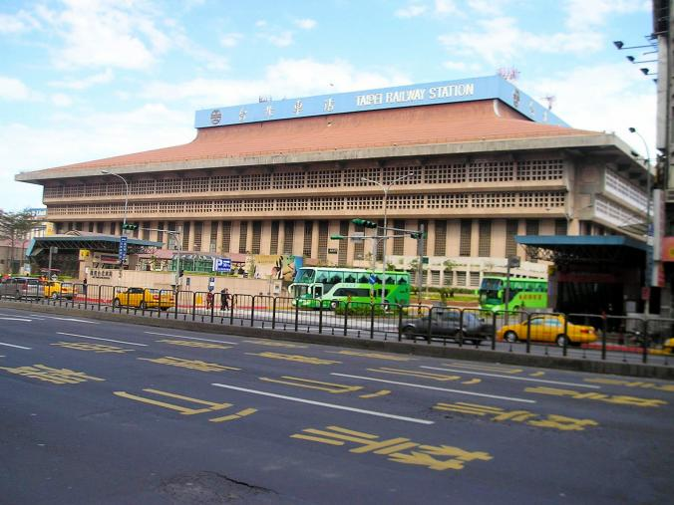
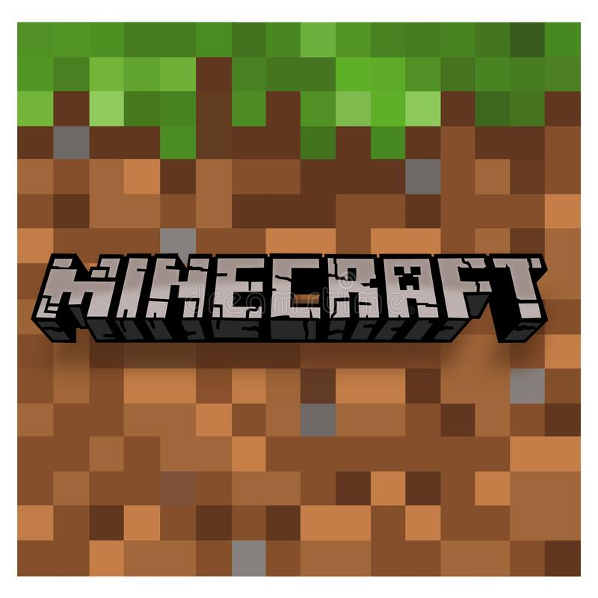
Digital Twin Framework
Physical Entities
Digital Twinning
Virtual Entities
Data
Minecraft World File
(BIM +GIS)
Urban Virtual World in Minecraft
Playful Urban Exploratory
Simulation
Minecraft
Models
SERVER
Data
Co-play
Co-design
Co-develop
(BIM)
Minecraft
Mod packs
Decision-intelligence
Situation Awareness
Spatial Awareness
Building Information Modeling (BIM) Geographic Information System (GIS)

Slide 11
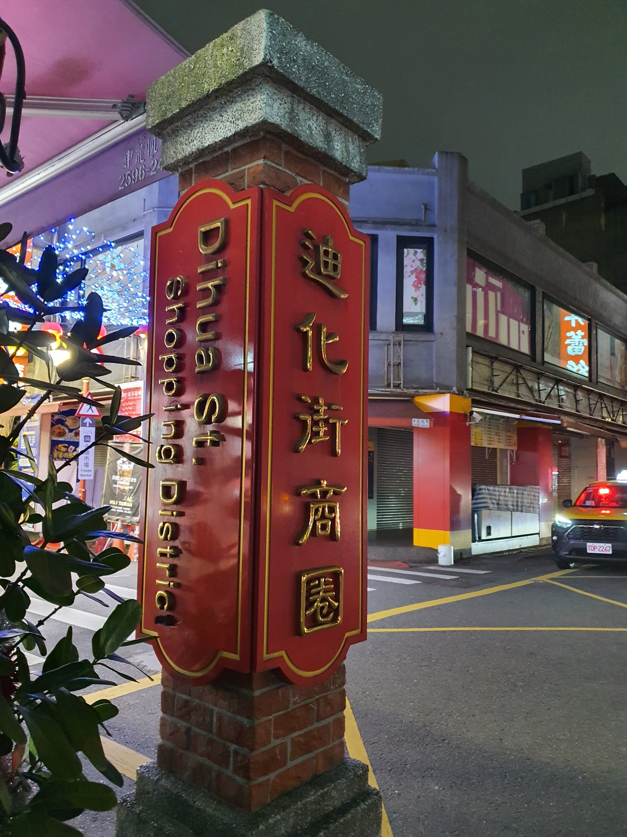
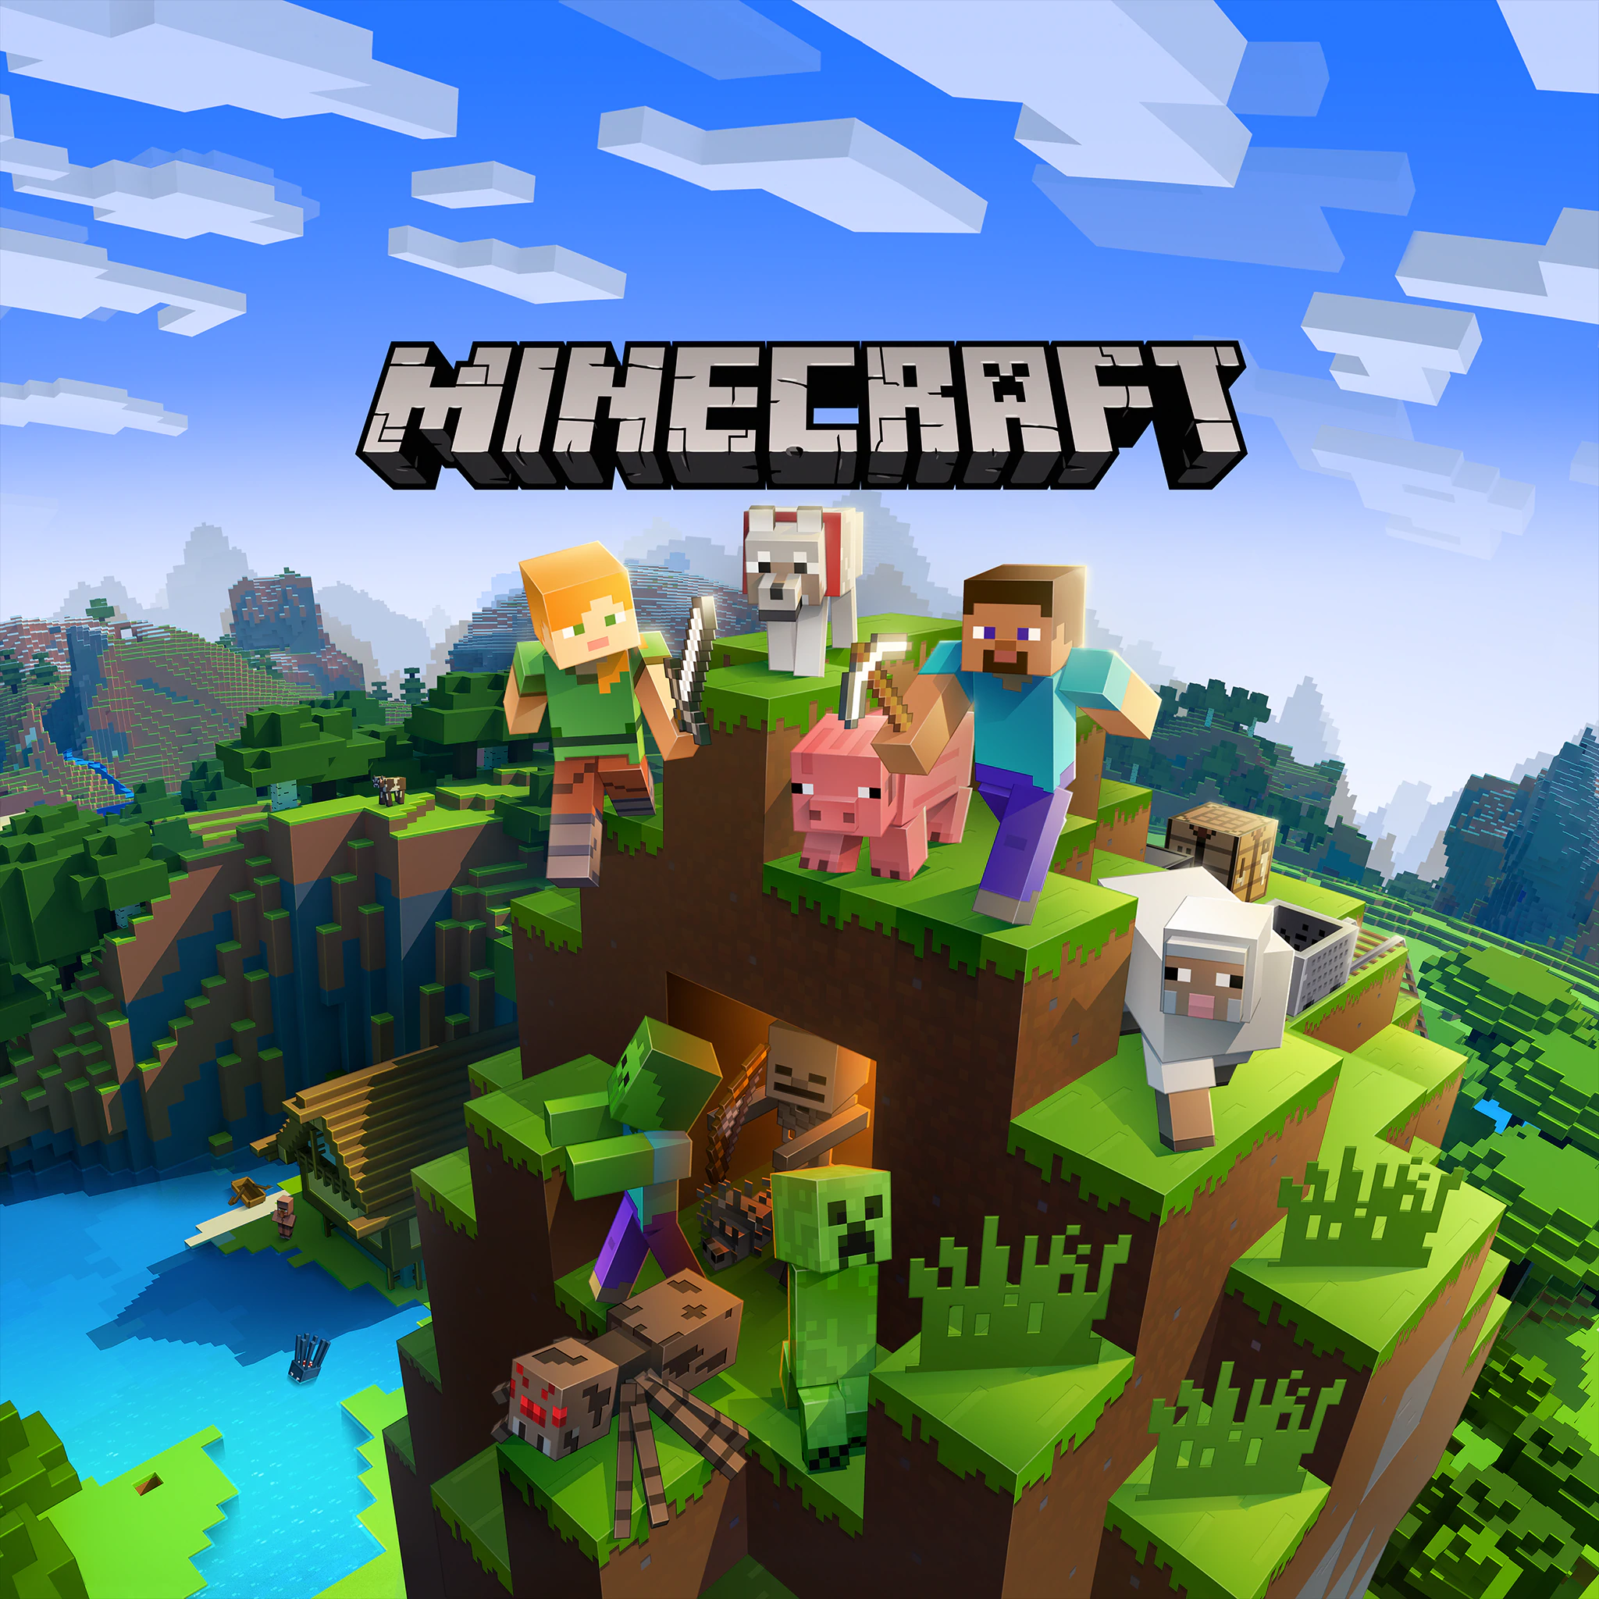
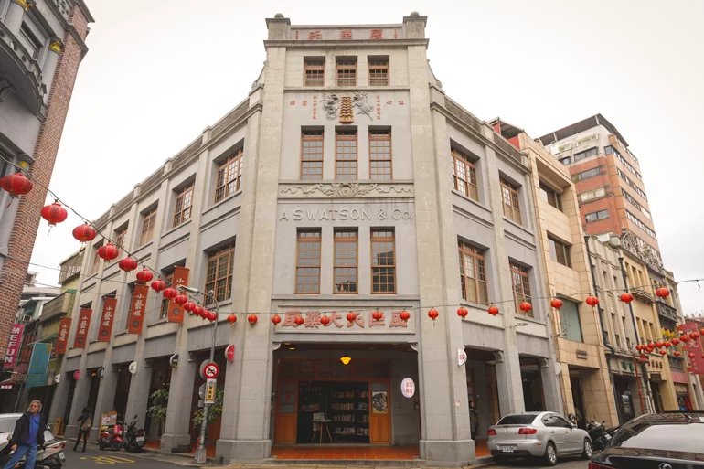
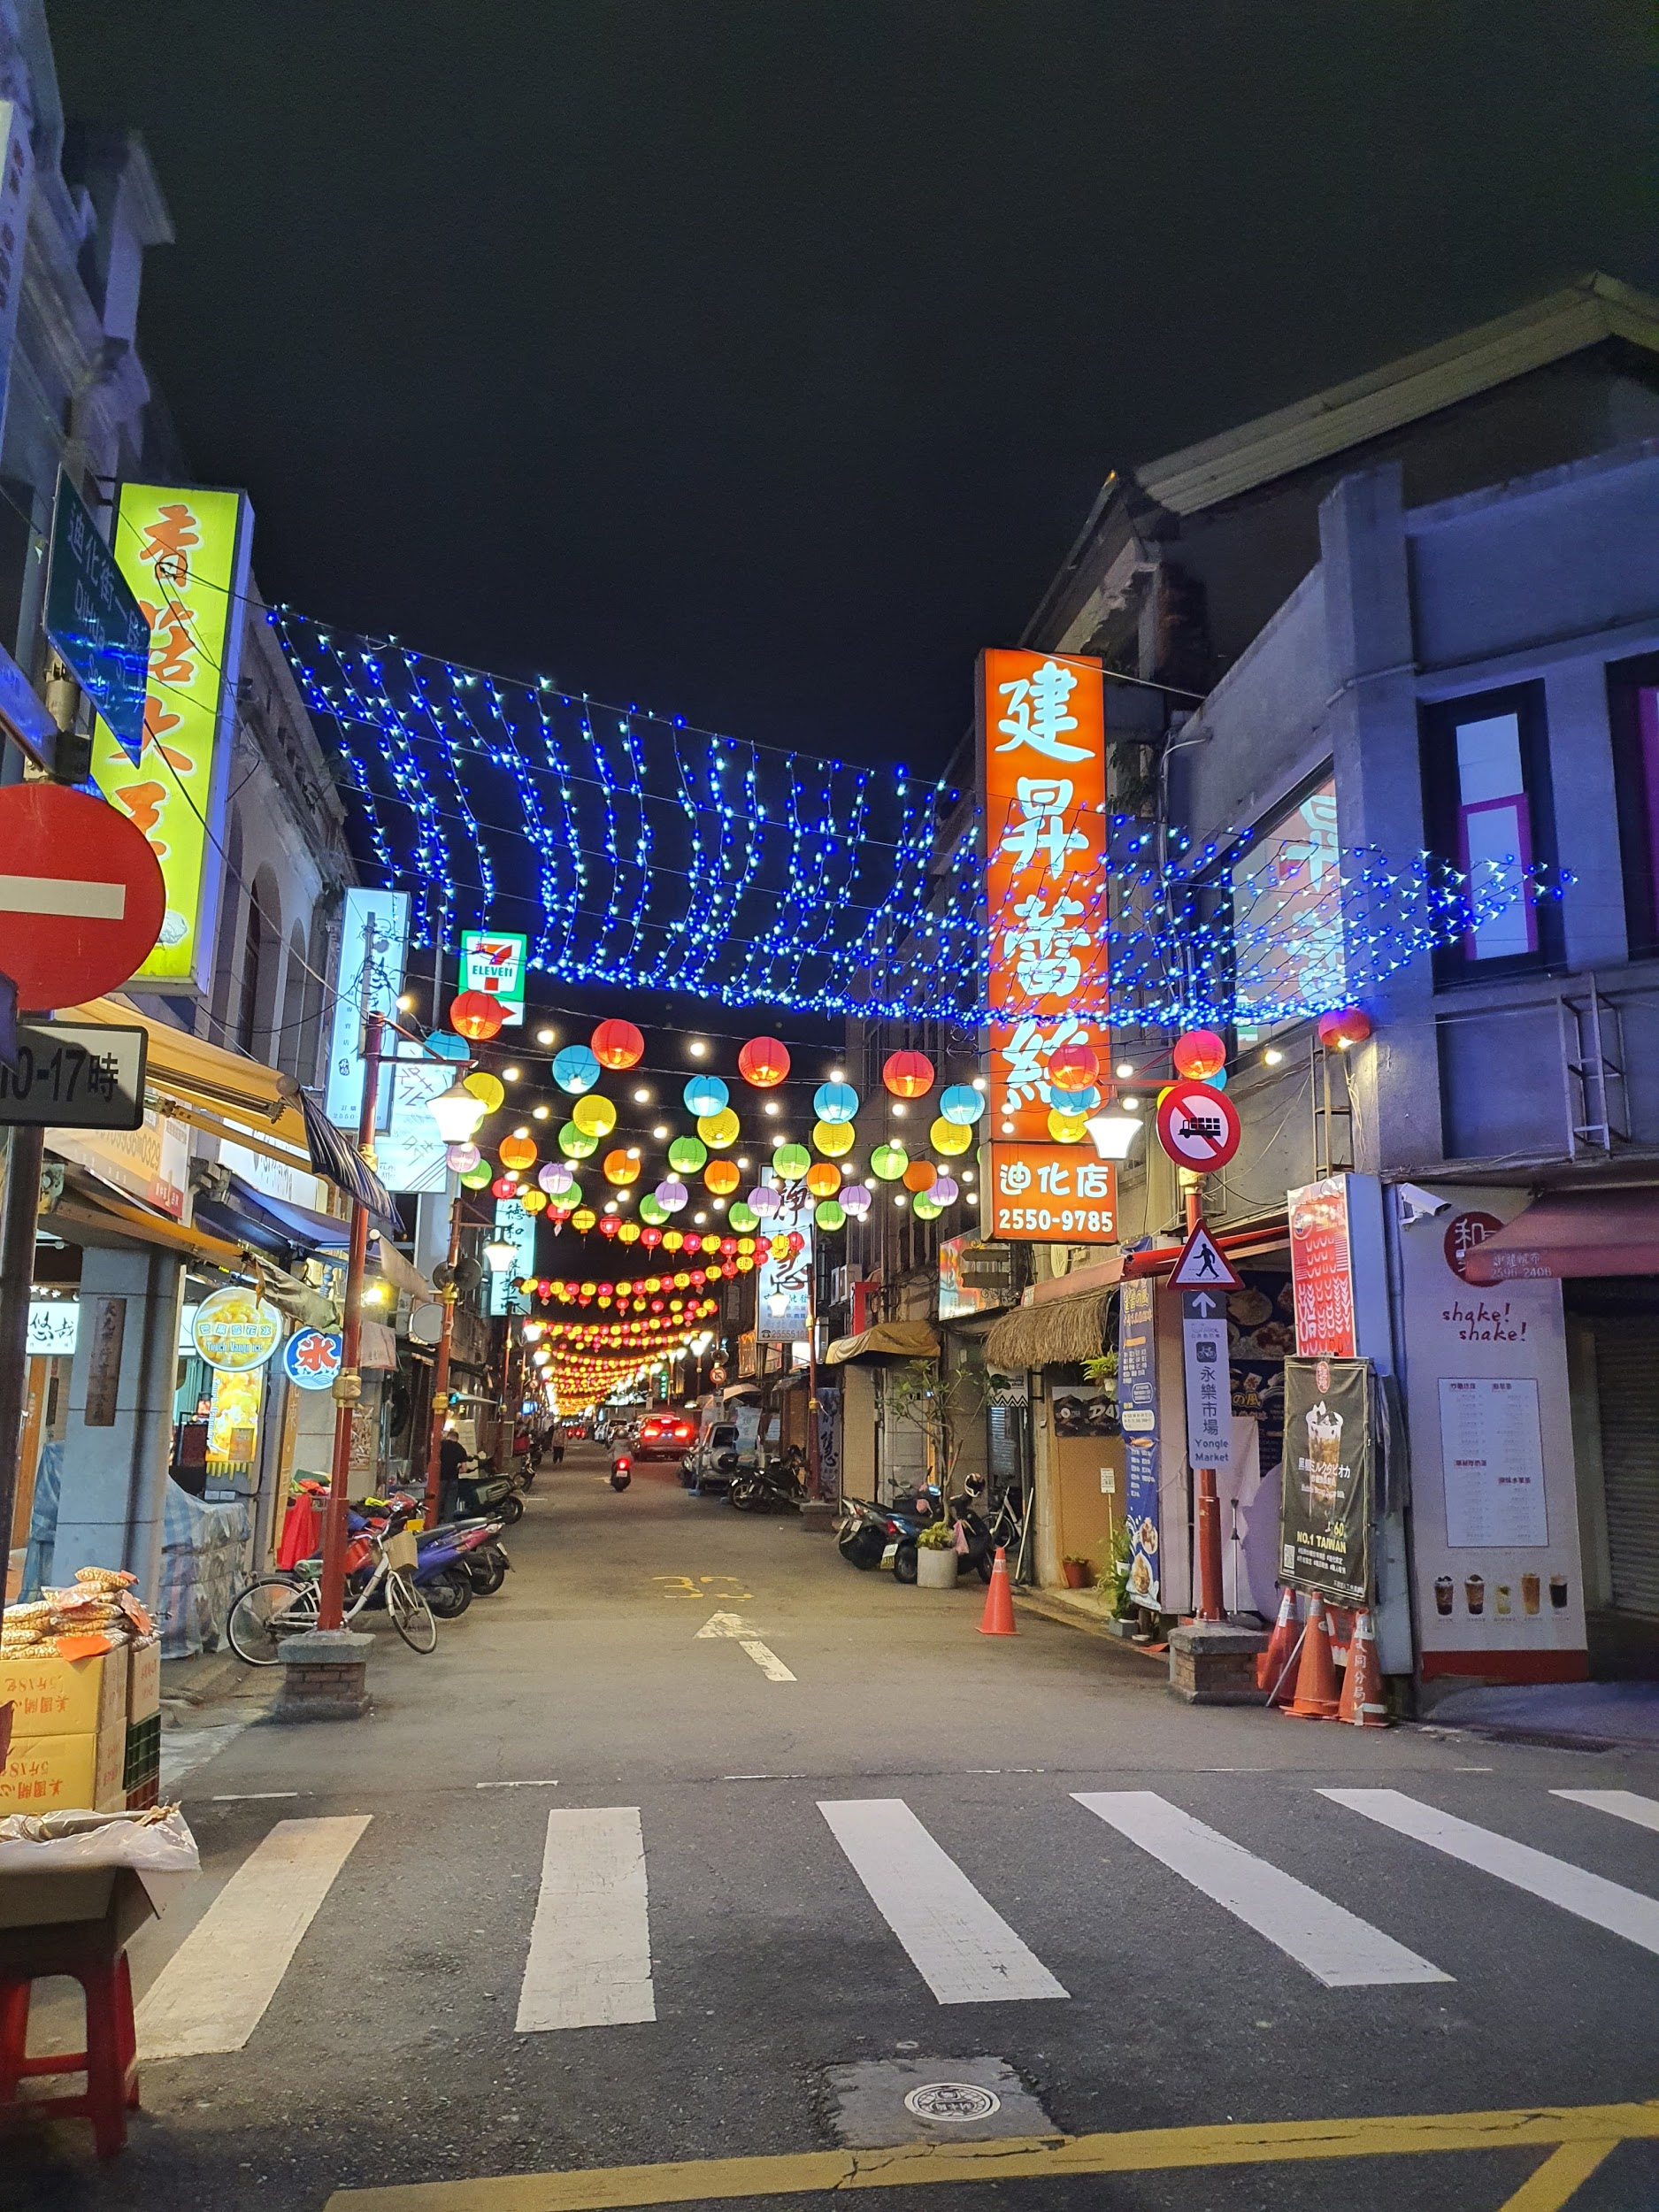
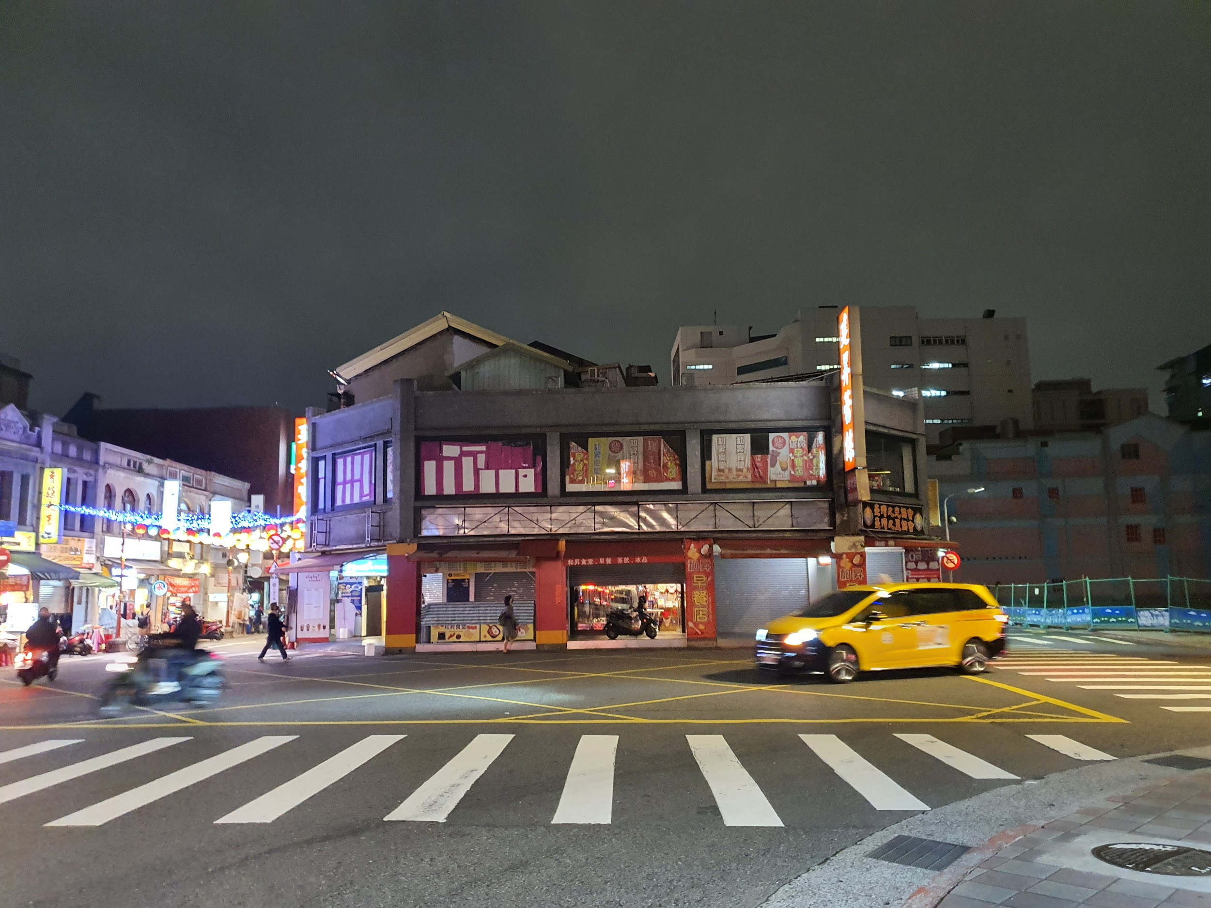
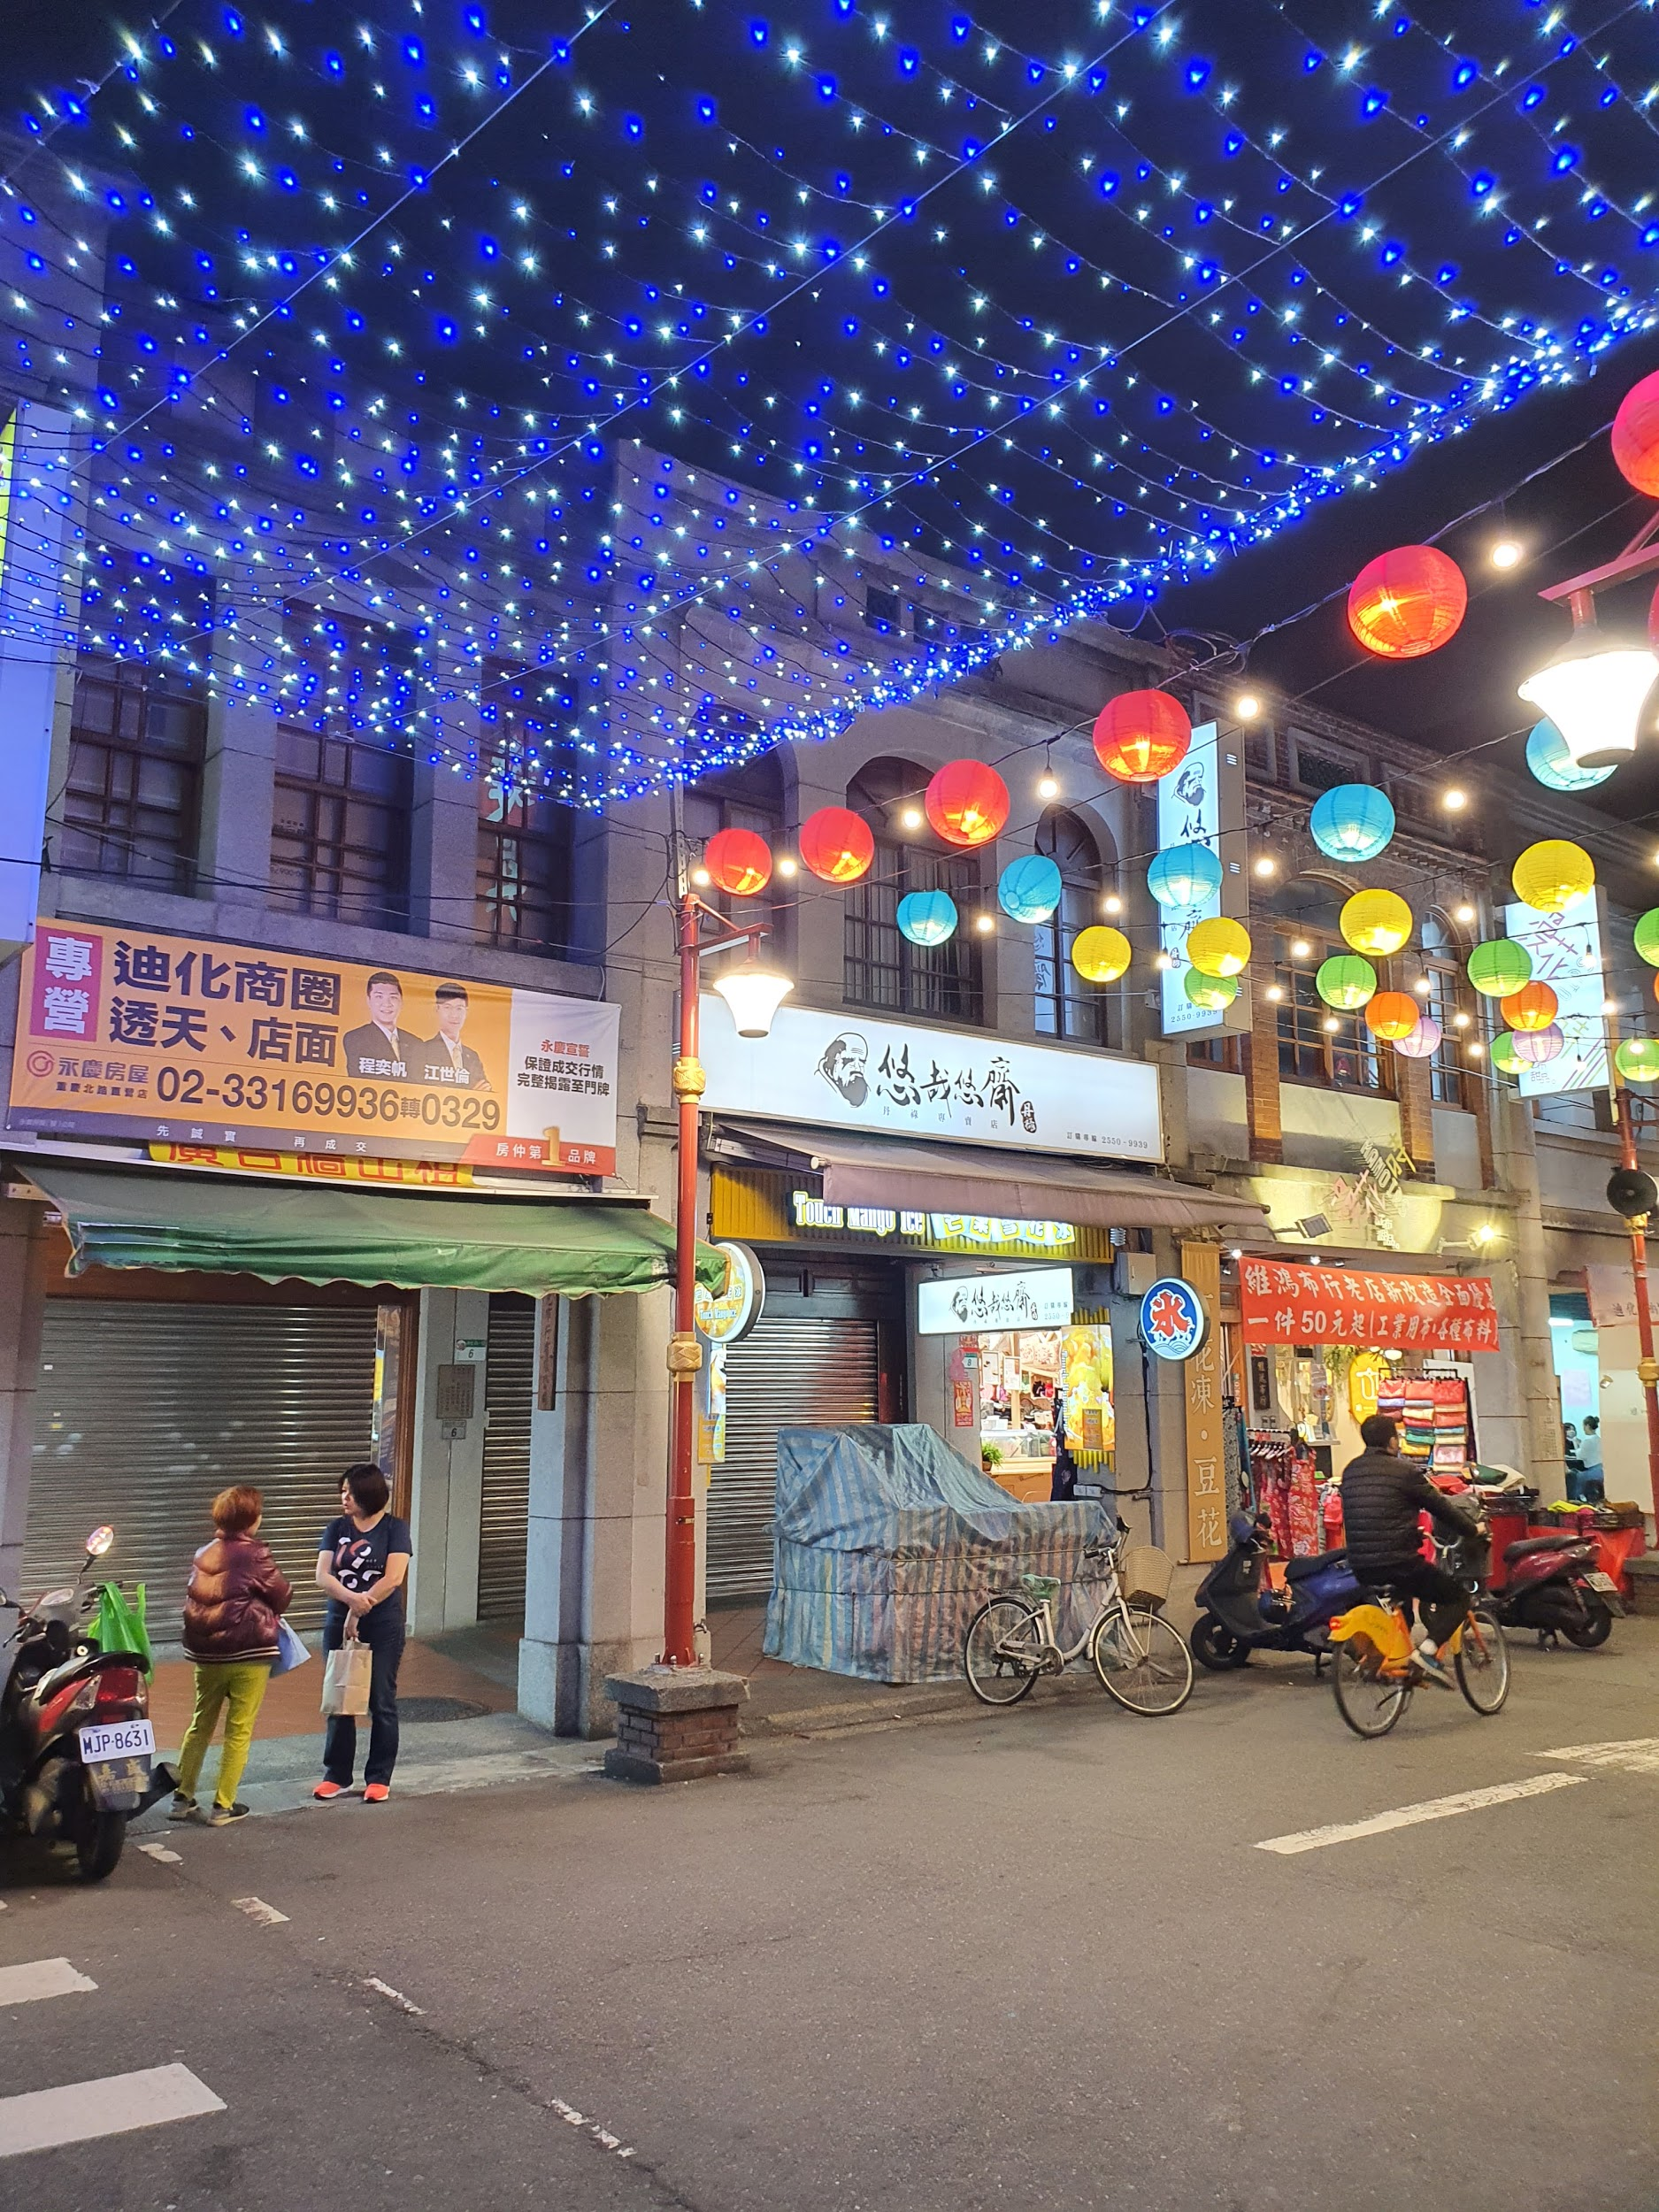
DADAOCHENG: Historical Town/Tourist Destination

Slide 12
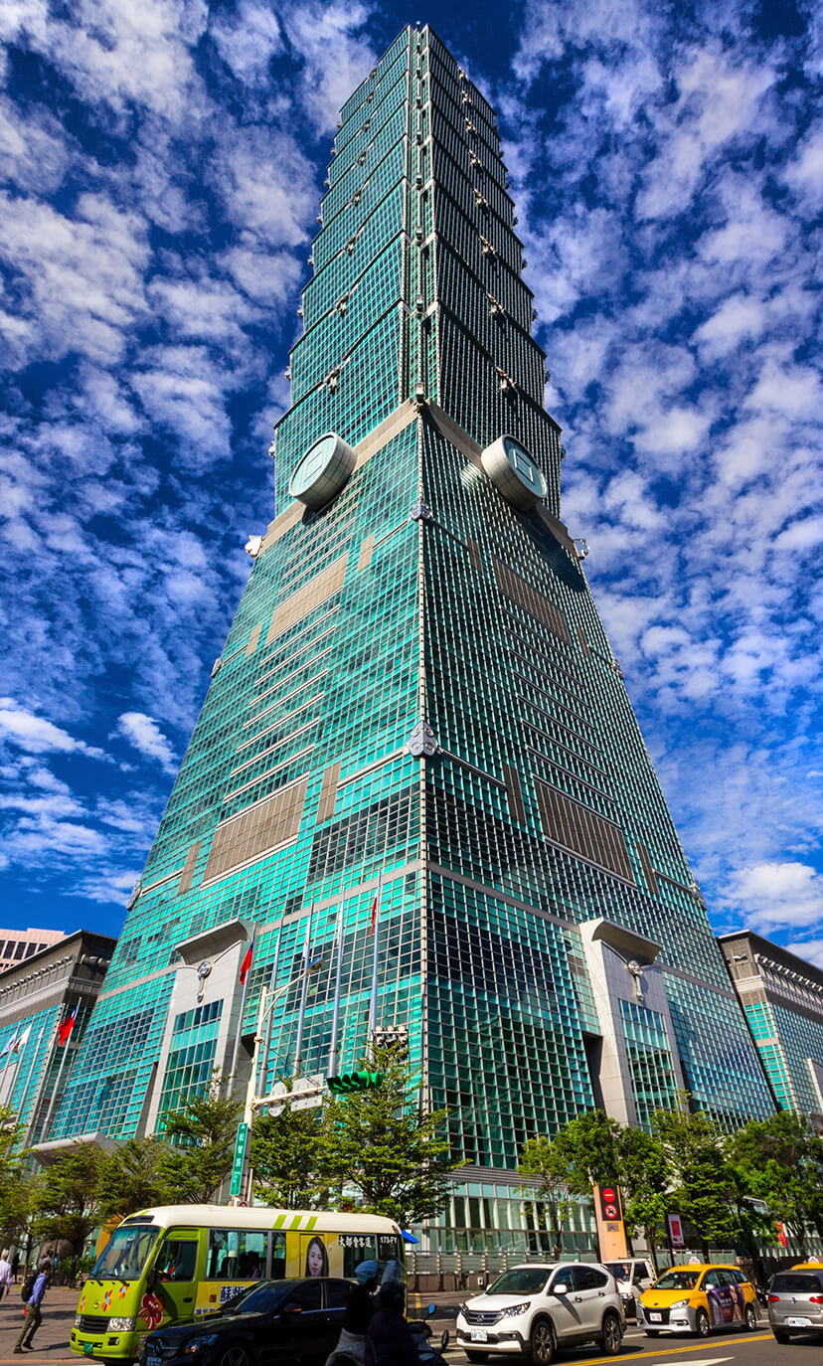
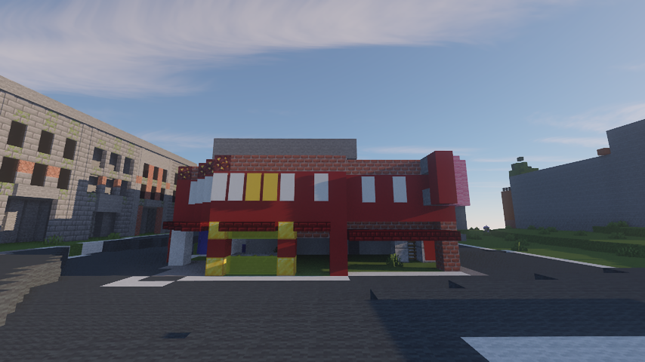
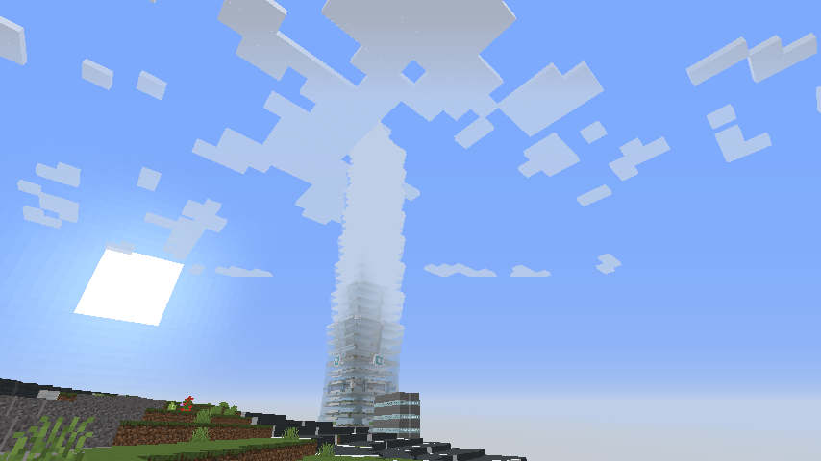
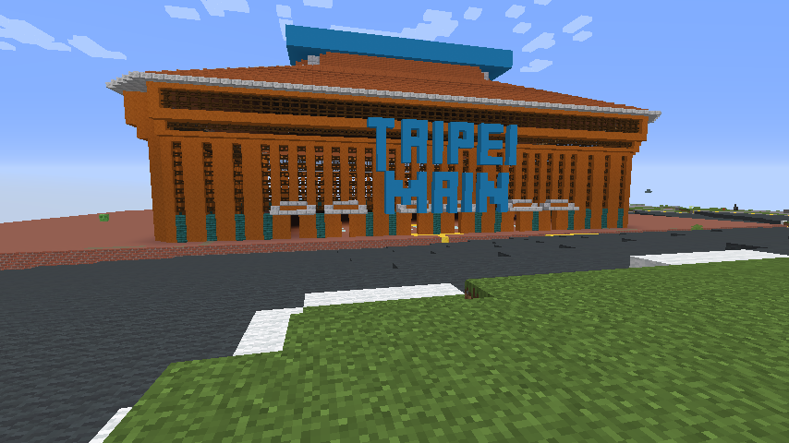
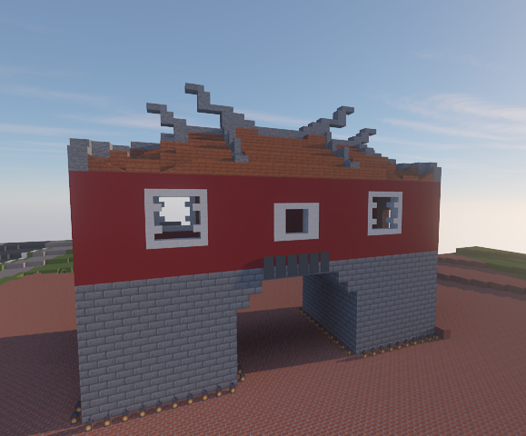
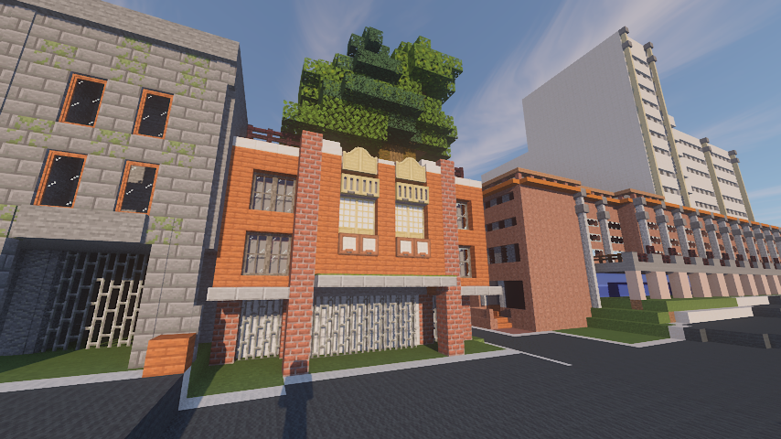
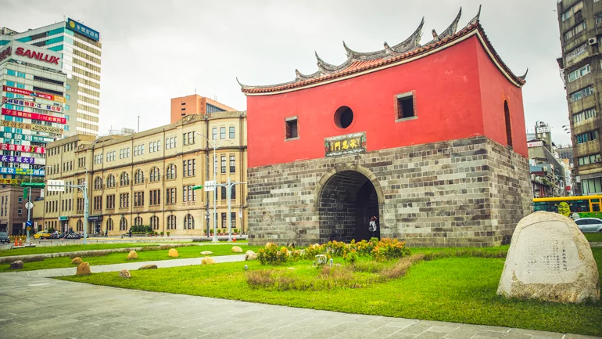
Taipei 101
Dihua Street - Dadaocheng
Taipei Main Station
Beimen

Slide 13
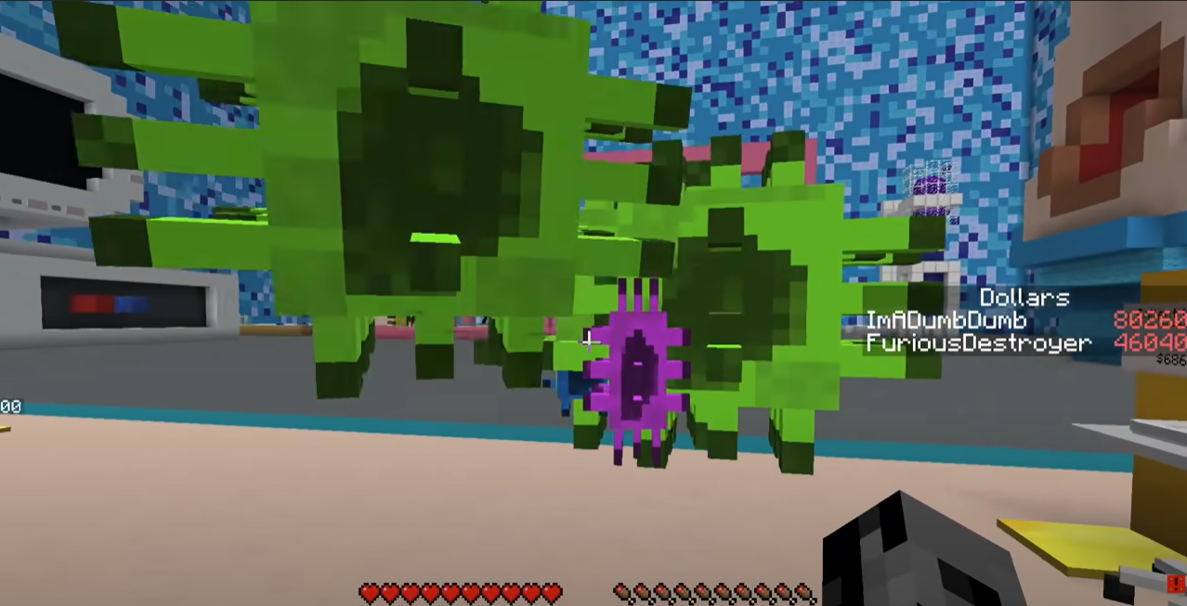
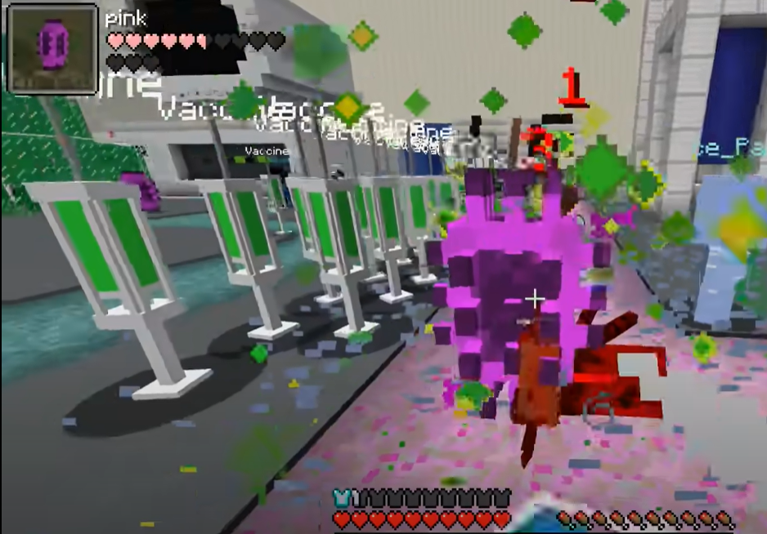
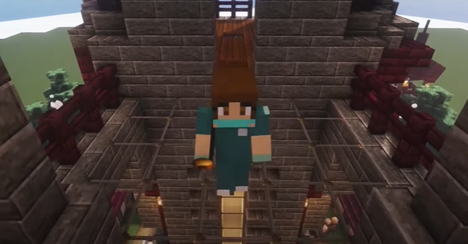
COVID-19 Mini-game
COVID-19 Simulator

Slide 14
03
RESEARCH METHOD & EVALUATION

Slide 15
DESIGN METHODOLOGY:
DON NORMAN’S 3-LEVEL OF EMOTIONAL DESIGN
EVALUATION METHODOLOGY:
KANO MODEL

Slide 16
DON NORMAN’S 3-LEVEL OF EMOTIONAL DESIGN
VISCERAL
BEHAVIORAL
REFLECTIVE
Notes:
Why we love (or hate) everyday things distinguishes between three aspects, or levels, of the emotional system which influences our experience of the world in a particular way.
The visceral level = the ingrained, automatic and almost instinct of human emotion, almost entirely out of our control.
The behavioral level = more controllable of human action, where unconsciously analyze a situation to develop effective goal-directed strategies in the shortest time, with the fewest actions.
The reflective level conscious thought, of learning of new concepts and generalisations about the world

Slide 17
DON NORMAN’S 3-LEVEL OF EMOTIONAL DESIGN
A serious game platform for multiple users to co-work, co-share
Users can create contents freely using Minecraft gameplay
Users can create contents with less efforts using commands like programming
Users can freely move, control inside the virtual world
Users can feel rewarding or achieving.
The product can create scenarios, tell story so users can immerse in the environment
Enable users’ spatial awareness inside virtual environment by help them locate inside the virtual world
Improve visual and auditory experience

Slide 18
DON NORMAN’S 3-LEVEL OF EMOTIONAL DESIGN (Elements/Features)
Level of Emotional Design | Characteristics | Relation to the product | Domain of Engagement
Visceral | Attractiveness: Initial Instinct Impression | Triggers the first reaction when entering the virtual world. How does it look and feel? (Emotional consciousness of the game appearance elements ) Memory emotional cognition to the recognition of location | Affective (Emotional, interpersonal development)
Behavioural | Usability: Effectiveness of use in the shortest time, with fewest actions | The pleasure and satisfaction with the game elements Does it function well? Is it easy to use and reliable? | Psychomotor (Physical interaction)
Reflective | Conscious thought: Meaning of product Sharing experience Cultural meaning | Reflection of the users in relation to the location brand. Creating appreciation, making emotional connection with the environment and other people they work with | Cognitive (Thinking, problem solving)

Slide 19
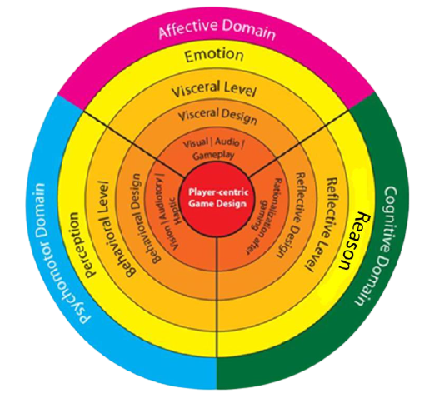
DON NORMAN’S 3-LEVEL OF EMOTIONAL DESIGN (Elements/Features)
Level of Emotional Design | Features/Elements
Visceral (Simple/Basic design that interest users) | 3D environment for visiting Visit destinations inside Minecraft Details close to real models Mini-map Quest, Reward & Achievement System Extra decorative items/ options Visual quality enhancement close to realistic Dynamic auditory surrounding enhancement
Behavioural (The guide to use the product and what to do next) | Risk-free interaction Distance travel while at home Virtual explore at any time Output device control to move in virtual world Move instantly cheat code Placing building instantly cheat code
Reflective (Self-image and message sending to users) | Scenario, Storytelling, Social problem reflection Multiple people visit together/Multiplayer Co-work, co-share to build/rebuild/decorate virtual models
Notes:
When we are designing a Serious Game, we have to make sure the usability of the features is right so that users would not get frustrating with the lack of interaction of the product .

Slide 20
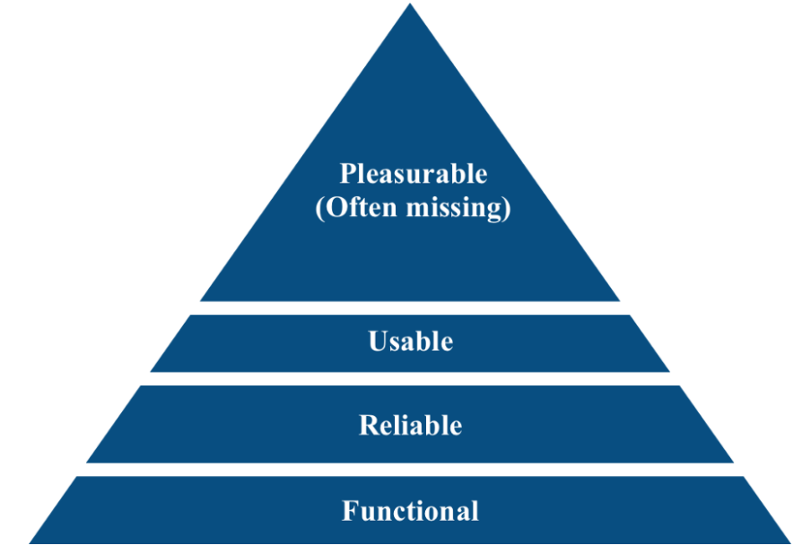
Remapped Pyramid of Maslow by Aaron Walter

Slide 21
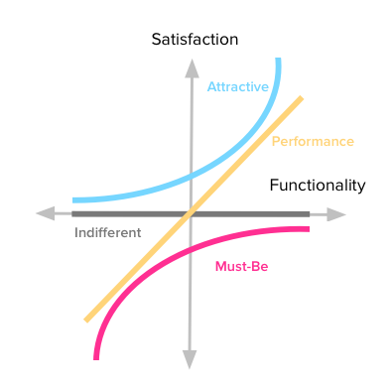
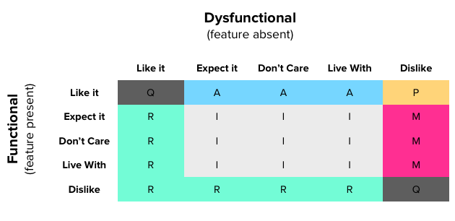
KANO MODEL
categories
Attractive (A)
Unexpected features that excite the customers, draw their attention to the product.
Performance (P)
The more we provide, the more satisfied our customers become.
Must-be (M)
Most expected features by the customers. Without them, the product is incomplete.
Indifferent (I)
Users may find it strange or do not care about it at all.
Reverse (R)
The other way around. (E.g. Users dislike the functional but like the dysfunctional - they either do not care or mean the opposite)
Questionable (q)
Usually used for identifying a mistake. (E.g They like both the functional and dysfunctional)
Notes:
The Kano model is a standardized method of finding out how features of a product or service are perceived by customers.
Reason: don't know what features to invest time & money in;/have a lot of internal discussions about what your product roadmap should be;/want to know what will separate you from your competition (as seen from the customer's perspective).

Slide 22
FEATURES/ELEMENTS
F1- Risk-free interaction | F2- Scenario, Storytelling, Social problem reflection | F3- Distance travel while at home |  | F4- 3D environment for visiting | F5- Visit destination inside Minecraft
F6- Virtual explore any time | F7- Multiple people visit together/Multiplayer | F8- Co-work, co-share to build/rebuild/decorate virtual models |  | F9- Details close to real models | F10- Output device control to move in virtual world
F11- Mini-map | F12- Move instantly cheat code | F13- Placing building instantly cheat code |  | F14- Quest, Reward & Achievement System | F15- Extra decorative items/ options
 | F16- Visual quality enhancement close to realistic |  | F17- Dynamic auditory surrounding enhancement

Slide 23
DISCRETE
CONTINUOUS
Notes:
Discrete: To get a rough idea of how customers perceive your product features
Continuous: use the averages (means) of the answers' satisfaction potential to categorize the features

Slide 24
Stakeholders
DESIRABILITY
FEASIBILITY
Design
Design-focused perspective in developing product’s experience
Design
Technological
IMMERSIVE/
PLAYFUL
EXPERIENCE
Technical
Engineer-focused perspective whether technologies today can accomplish desired goal
Business
Business
Analytical perspective around business and core users’ experience
VIABILITY

Slide 25
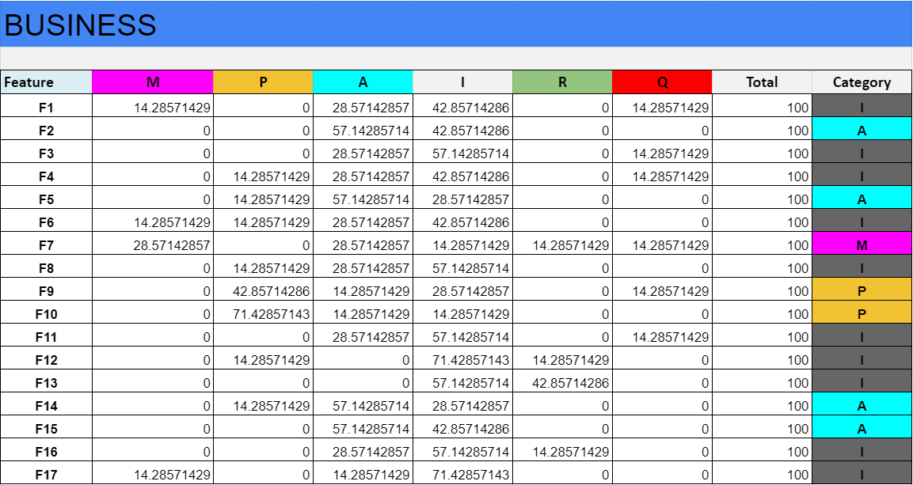
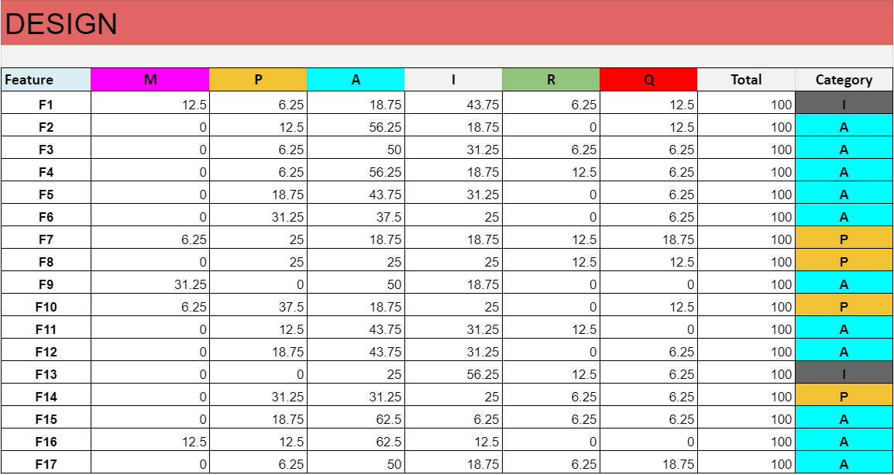
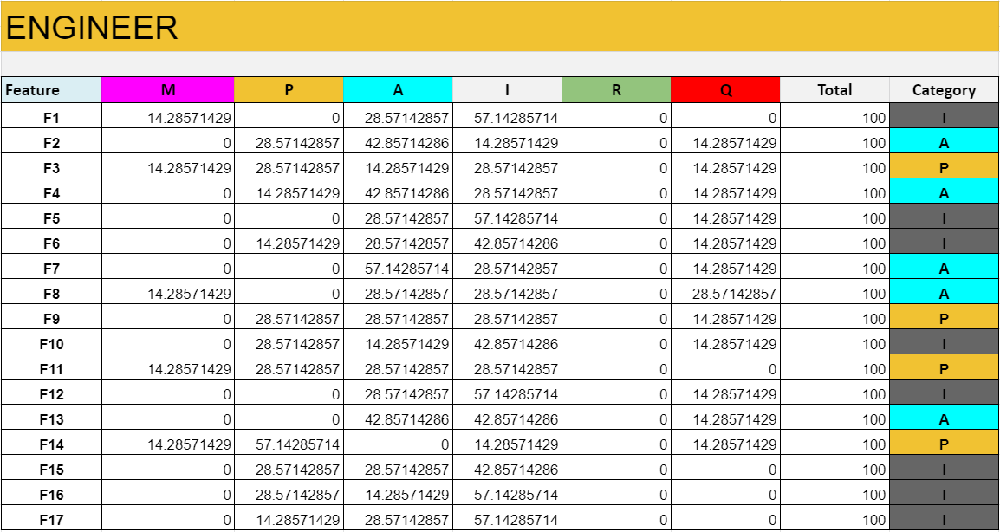
D
I
S
C
R
E
T
E
A
N
A
L
Y
S
I
S

Slide 26
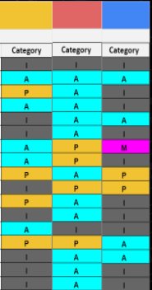
D
I
S
C
R
E
T
E
A
N
A
L
Y
S
I
S
Attractive (A)
F1
F2
F3
F4
F5
F6
F7
F8
F9
F10
F11
F12
F13
F14
F15
F16
F17
Performance (P)
Must-be (M)
Indifferent (I)
Reverse (R)
Questionable (q)
Engineer
Design
Business
F1- Risk-free interaction | F2- Scenario, Storytelling, Social problem reflection | F3- Distance travel while at home | F4- 3D environment for visiting | F5- Visit destination inside Minecraft | F6- Virtual explore any time | F7- Multiple people visit together/Multiplayer | F8- Co-work, co-share to build/rebuild/decorate virtual models | F9- Details close to real models | F10- Output device control to move in virtual world | F11- Mini-map | F12- Move instantly cheat code | F13- Placing building instantly cheat code | F14- Quest, Reward & Achievement System | F15- Extra decorative item/s options | F16- Visual quality enhancement close to realistic | F17- Dynamic auditory surrounding enhancement
Notes:
I try to show the features where the users from 3 departments have in common but I don’t think it work that way

Slide 27
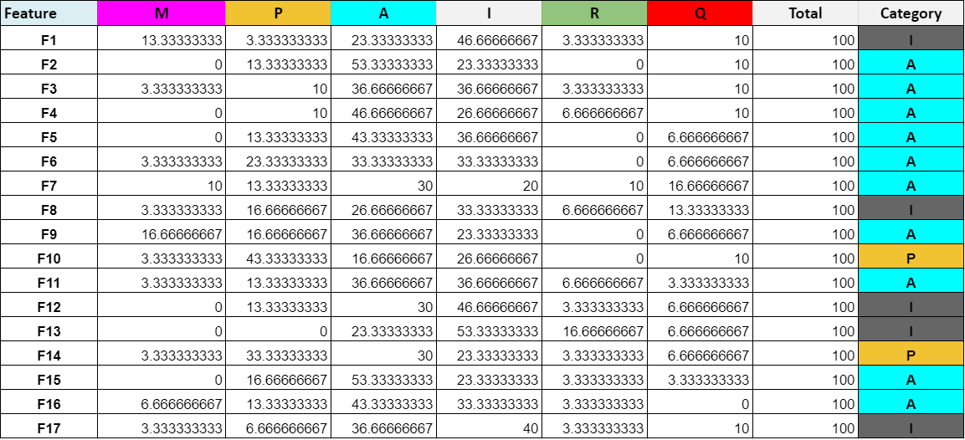
D
I
S
C
R
E
T
E
A
N
A
L
Y
S
I
S
F1- Risk-free interaction | F2- Scenario, Storytelling, Social problem reflection | F3- Distance travel while at home | F4- 3D environment for visiting | F5- Visit destination inside Minecraft | F6- Virtual explore any time | F7- Multiple people visit together/Multiplayer | F8- Co-work, co-share to build/rebuild/decorate virtual models | F9- Details close to real models | F10- Output device control to move in virtual world | F11- Mini-map | F12- Move instantly cheat code | F13- Placing building instantly cheat code | F14- Quest, Reward & Achievement System | F15- Extra decorative item/s options | F16- Visual quality enhancement close to realistic | F17- Dynamic auditory surrounding enhancement

Slide 28
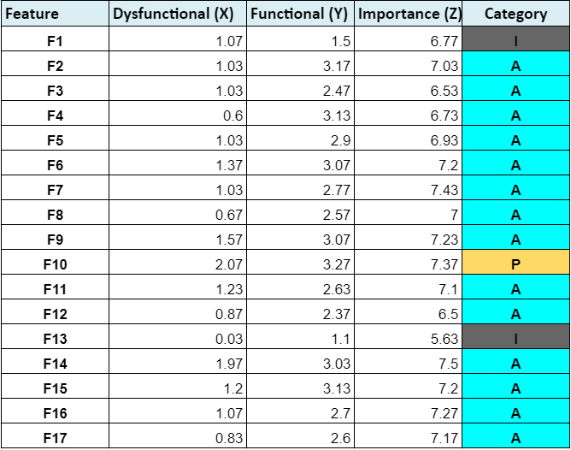
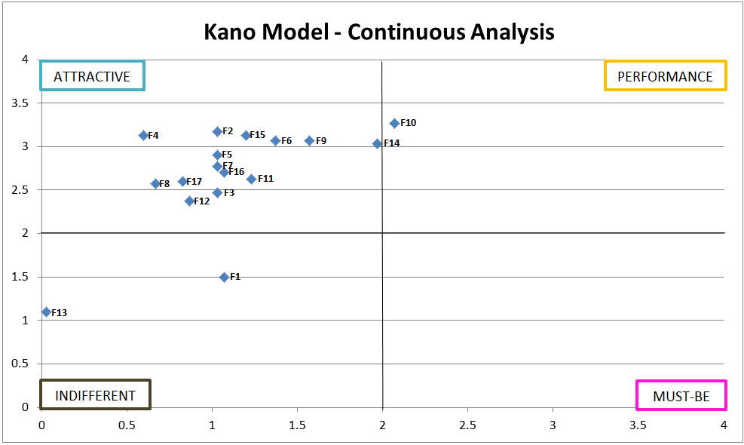
C
O
N
T
I
N
U
O
U
S
A
N
A
L
Y
S
I
S
F1- Risk-free interaction | F2- Scenario, Storytelling, Social problem reflection | F3- Distance travel while at home | F4- 3D environment for visiting | F5- Digital Twin public space in Minecraft | F6- Virtual explore any time | F7- Multiple people visit together/Multiplayer | F8- Co-work, co-share to build/rebuild/decorate virtual models | F9- Details close to real models | F10- Output device control to move in virtual world | F11- Mini-map | F12- Move instantly cheat code | F13- Placing building instantly cheat code | F14- Quest, Reward & Achievement System | F15- Extra decorative item/s options | F16- Visual quality enhancement close to realistic | F17- Dynamic auditory surrounding enhancement

Slide 29
C
O
N
T
I
N
U
O
U
S
A
N
A
L
Y
S
I
S
Result
C
A
T
E
G
O
R
Y
O
R
D
E
R
I
M
P
O
R
T
A
N
C
E
O
R
D
E
R
F10 | Output device control to move in virtual world
F14 | Quest, Reward & Achievement System
F7 | Multiple people visit together/Multiplayer
F16 | Visual quality enhancement close to realistic
F9 | Details close to real models
F15 | Extra decorative item/s options
F6 | Virtual explore any time
F17 | Dynamic auditory surrounding enhancement
F11 | Mini-map
F2 | Scenario, Storytelling, Social problem reflection
F8 | Co-work, co-share to build/rebuild/decorate virtual models
F5 | Visit destination inside Minecraft
F4 | 3D environment for visiting
F3 | Distance travel while at home
F12 | Move instantly cheat code
F1 | Risk-free interaction
F13 | Placing building instantly cheat code
F14 | Quest, Reward & Achievement System
F7 | Multiple people visit together/Multiplayer
F10 | Output device control to move in virtual world
F16 | Visual quality enhancement close to realistic
F9 | Details close to real models
F15 | Extra decorative item/s options
F6 | Virtual explore any time
F17 | Dynamic auditory surrounding enhancement
F11 | Mini-map
F2 | Scenario, Storytelling, Social problem reflection
F8 | Co-work, co-share to build/rebuild/decorate virtual models
F5 | Visit destination inside Minecraft
F1 | Risk-free interaction
F4 | 3D environment for visiting
F3 | Distance travel while at home
F12 | Move instantly cheat code
F13 | Placing building instantly cheat code

Slide 30
04
CONCLUSION &
FUTURE WORK

Slide 31
CONCLUSION
The post-COVID-19 creates some New Normal behavior so it become more complex to distinguish with who or whom this product is perceiving. With Don Norman’s 3-Level of Emotional Design, it reduces the anxiety and directly links the users with a community-based virtual environment before fully develop Crowdsourcing public spaces.
The Kano model thoroughly analyze the pleasurable/ satisfaction that Don Norman’s lack of in measuring Immersive & Playful virtual exploration experience.

Slide 32
CONCLUSION
From the Discrete Analysis, Business Stakeholder Group thinks that the Multiplayer is a Must-Be feature to provide a playful and immersive experience in this service.
The two features that 3 groups have in common that affects the playful + immersive experience are:
Risk-free interaction
Scenario, storytelling, social problem reflection

Slide 33
CONCLUSION
From the continuous analysis, the top 3 features should be prioritized are:
Using output device control to move inside the virtual world
Multiple people visit together/ Multiplayer
Quest, Reward & Achievement System
The bottom 3 features such as:
Move instantly with cheat code
Placing building with cheat code
Risk-free interaction
Shows that users prefer to maintain the core gameplay without using cheat code while asking for some challenges.

Slide 34
FUTURE WORKS
FUTURE GOAL 1
FUTURE GOAL 2
Develop Quest, Reward & Achievement System and design the scenarios.
Collect gameplay data and how users collaborate in Multiplayer Mode. In addition, discover how they response to the scenario and what kind of decision they would make in that situation.

Slide 35
THANK YOU
Q&A
kennyvulan@gmail.com
+865 971 650 649

