Slide 1
The Design of Data Management System(DMS) at HEPS
Hao Hu, Fazhi Qi, Hongmei Zhang, Haolia Tian, Qi Luo
Computing & Communication System, High Energy Photon Source
Computing Center, Institute of High Energy Physics

Slide 2
Outline
1
About HEPS & HEPS CC
2
Missions & Requirements
3
System Design
4
Testbed progress
5
Summary & Future Plan

Slide 3
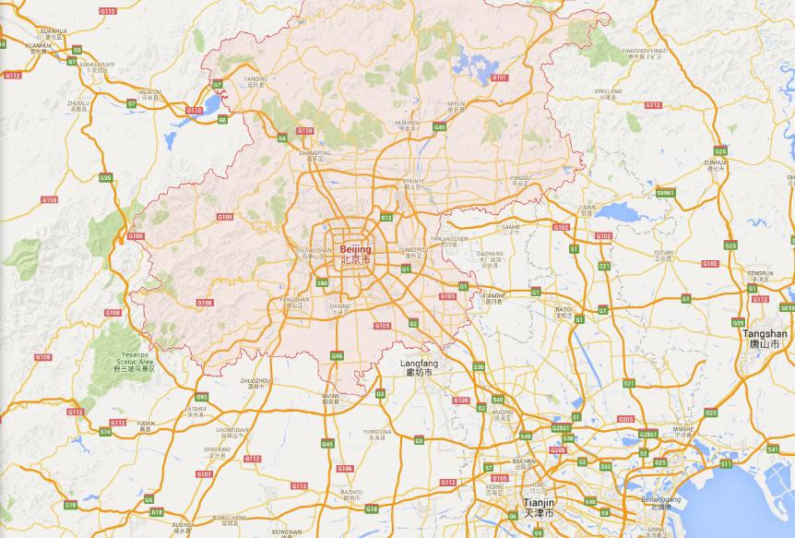
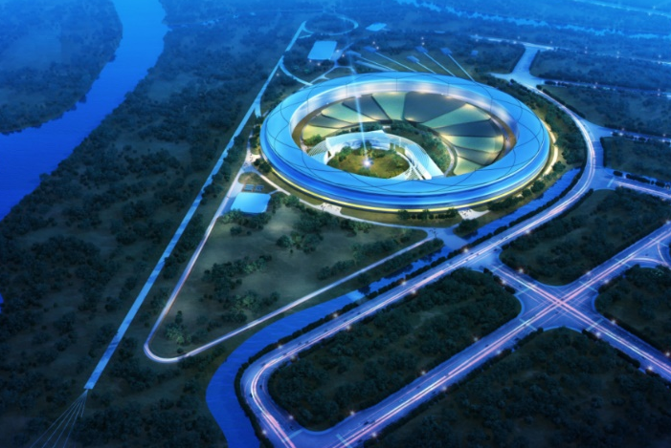
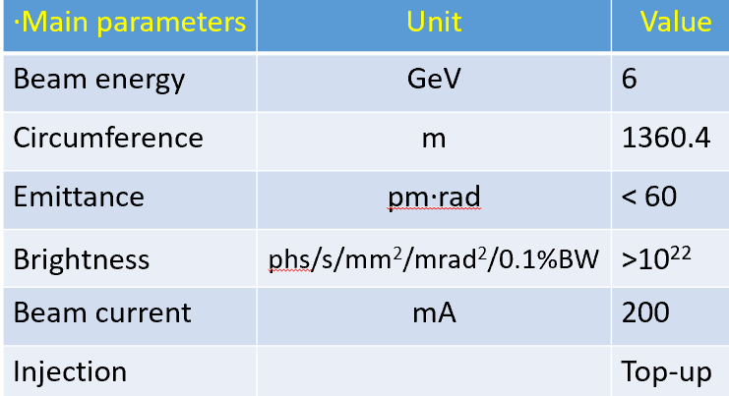
HEPS： High Energy Photon Source
New light source in China — High energy, high brightness
Located in Beijing - about 80KM from IHEP
Officially approved in Dec. 2017, the construction was started at the end of 2018 and will be completed in 2024
The whole project will be finished in mid-2025 after commissioning
A new photon science research center at the northern China
IHEP
SSRF
About 80 km from IHEP

Slide 4
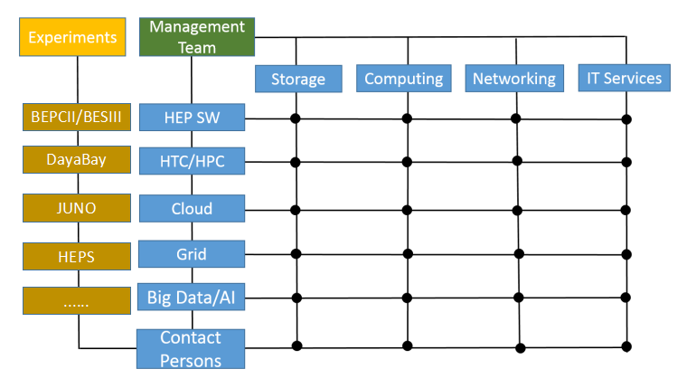
HEPS CC: the Computing & Communication System for HEPS
30+ members
All the people are part time for HEPS
Most of the members are coming from Computing Center (IHEP CC)
3 from CSNS/Computing and Software group
1 from Beamline
9 work groups are set up according to the tasks
Infrastructure , Network, Computing & Storage, Scientific Software,
Data management, Database & Public Service , Monitoring, Security
Matrix management
Across Group Boundaries and Experiments
Sharing talents and skills

Slide 5
HEPS Introduction – Beamlines & Data volume
More than 90 beamlines volume
Phase I, 14 ID beamlines+1Bending Magnet beamline selected
Estimated data rate of beamlines
Beamlines | Burst output(Byte/day) | Average output(Byte/day)
B1 Engineering Materials Beamline | 600TB | 200TB
B2 Hard X-ray Multi-analytical Nanoprobe (HXMAN) Beamline | 500TB | 200TB
B3 Structural Dynamics Beamline（SDB） | 8TB | 3TB
B4 Hard X-ray Coherent Scattering Beamline | 10TB | 3TB
B5 Hard X-ray High Energy Resolution Spectroscopy Beamline | 10TB | 1TB
B6 High Pressure Beamline | 2TB | 1TB
B7 Hard X-Ray Imaging Beamline | 1000TB | 250TB
B8 X-ray Absorption Spectroscopy Beamline | 80TB | 10TB
B9 Low-Dimension Structure Probe (LODISP) Beamline | 20TB | 5TB
BA Biological Macromolecule Microfocus Beamline | 35TB | 10TB
BB pink SAXS | 400TB | 50TB
BC High Res. Nanoscale Electronic Structure Spectroscopy Beamline | 1TB | 0.2TB
BD Tender X-ray beamline | 10TB | 1TB
BE Transmission X-ray Microscope Beamline | 25TB | 11.2TB
BF Test beamline | 1000TB | 60TB
Total average: |  | 805.4TB/day, 24.16PB/month
Raw data

Slide 6
IT Architecture of HEPS
Beamline control
Devices
Area detector
Epics
DAQ/Control
System
Ophyd
bluesky
data
Terminal Host
Mamba Server
Data Host
HiDRA
...
Device Host
Metadata
（GUI）
Mamba Client
Analysis parameters
Software framework
Tomopy
Pyfai
…
Metadata
Catalog
Database
Catalog API Server
Workflow Client
Work Flow
Data
Feedback
...
Resource request
Resource allocation
Data Portal
DMS
Terminal Widget
User service
Computing System
Access route controller
Resource dispatch
Resource allocation
Data Transfer Server
Plot Widget
data
access/download
User authentication
Load resource
Load resource
Motor Control Widget
Beamtime Management
CPU
GPU
FPGA
Beamline storage
Central storage
Scan Mechanism
Computing resources
Storage
DAQ/Control system
HEPS Computing & Communication System
Notes:
heterogeneous methodology applications ,computing system provides a cloud platform to manage CPU/GPU/FPGA and storage resources

Slide 7
Data management requirement
Data policy
Guidelines for the design and implementation of DMS
Metadata catalogue
Catalogue framework
Metadata database
Metadata ingestor
Acquire metadata from DAQ/control system
Data transfer system
Beamline storage → Central storage → Tape
APIs for interacting with other systems
DAQ system, storage system, data analysis system, user service system, proposal system
Data service
Data access, data search, data download
Notes:
Storage policy for different types of data,

Slide 8
HEPS Data Policy
The ownership, curation, archiving and access to scientific data and metadata
Data classification: raw data, processed data, calibration data, result data
Recommend providing at least 3 months disk storage and permanent tape archive (depends on final funding)
Provide permanent storage for raw data, calibration data and result data
Provide temporary storage for processed data
Each dataset will have a unique persistent identifier(CSTR/PID21/doi)
Experimental teams have sole access to the data during the embargo period. After the embargo, the data will be released with open access to any registered users of the HEPS data portal.
A draft version of The Data Policy for HEPS is finished, which will be discussed and approved by the HEPS council.
Reference:
http://pan-data.eu/sites/pan-data.eu/files/PaN-data-D2-1.pdf
https://in.xfel.eu/upex/docs/upex-scientific-data-policy.pdf

Slide 9
Data Flow
Data center
Beamline Storage
Central Storage
Raw Data Files &
Scientific Metadata Files
Raw/Processed/Result Data Files
Data files
Transfer
User Data(HDF5) Files
Beamline
Stream data
Data Reduction
Data Reconstruction
Proposal
User
Sample
Metadata Ingestor
Online data process
Metadata Catalogue
Portal
(Data/User/Proposal)
Catalogue
Computing resource
Data search
Data visualization
Data download
Offline Analysis

Slide 10
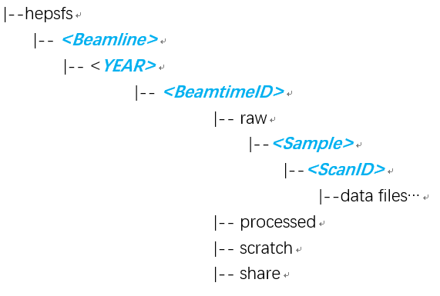
Predefined directory structure
Beamline file system: Lustre/NFS
Central file system: Lustre
Directory structure of data files on storage
Logical structure of experiment and runs
Beamline
File system structure on storage
HEPS
RAQ
B1
20200505
Beamline file system & Central file system
Reference: A. Rothkirch, Handling the Data Deluge in Photon Science Experiments: Current Status and Future Plans at DESY, talk given at the 12th NOBUGS Conference, Brookhaven National Laboratory, October 22–26, 2018.
Notes:
Closely related to storage policy and user access authorization, they have respective directory.

Slide 11
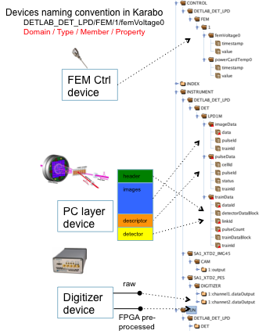
Metadata
Administrative metadata
proposal Info, experiment group, measurement technique, beamline; dataset Info(PID, format, size, path, creation time);
data files (file size, format, storage path, time, checksum);
analysis software, update time…
From:
Proposal system, User service system, File transfer tools, Analysis software
For: catalogue
To: catalogue database
Scientific metadata
Sample info, Experiment environment parameters…
From: DAQ/Control system
For: analysis & catalogue
To: files(HDF5/Nexus) , catalogue database
Administrative metadata
Proposal system
User system
Metadata ingestor
Metadata
catalogue
API
File transfer tools
DAQ/Control system
Analysis software
Summary files
Administrative metadata
Scientific metadata
HDF5/Nexus files
Q: What kind of metadata are needed cataloging?
A: Those metadata necessary and significant for data searching and sharing!

Slide 12
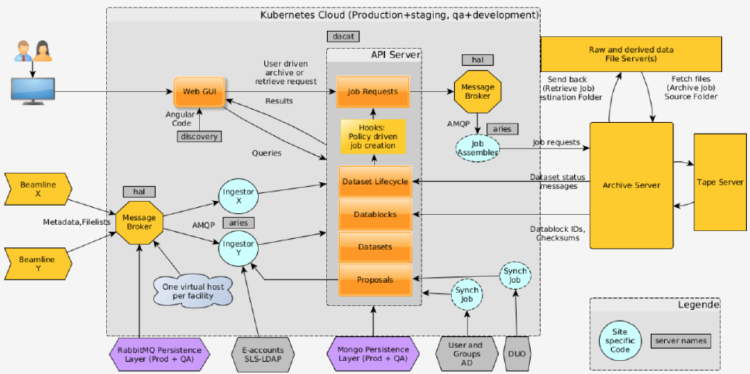
Metadata catalogue framework--SciCat
SciCat：open source, developed by PSI and ESS (and MAX IV) to create a data catalog management system
Message queue: RabbitMQ
LoopBack
metadata models are defined in JSON format
RESTful APIs are exposed via a NodeJS web server
NoSQL database: MongoDB
Web front end: Angular8
HEPS:
Kafka as message queue
use LoopBack to create REST APIs
MongoDB as the metadata database
https://scicatproject.github.io/
Notes:
some experimental metadata are technique-specific and complex

Slide 13
Metadata acquisition approaches
Depends on how metadata are provided
Interfaces are provided for control system to write metadata to DMS(recommended)
Metadata-ingestor plugins are designed to collect metadata from nexus/txt/HDF5 files

Slide 14
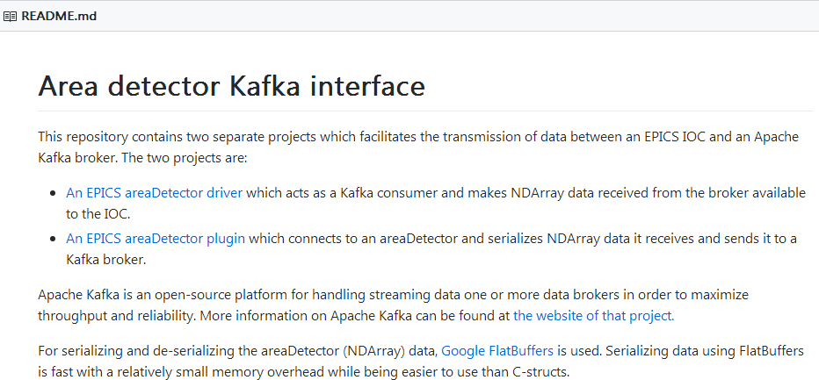
Metadata acquisition approach（1）
Suitable for self-designed detector, having ability to program to control software(Epics/Tango）
Interfaces with control system are provided
With which control system can send metadata (JSON-based) to kafka broker when a dataset is produced
{ topic: ‘bm01_detector1_topic',
messages: [{
“proposalID”:”p0001”,
“sampleID”:”s0001”,
“userAccount”:”wch@ihep.ac.cn”,
“creationLocation”:”bm01_detector1”
“file_name”:”bm01_1_38883”,
“dataFormat”:”hdf5”,
“scientificMetadata”:{
elog_id:”234”,
optical_coupling:”dryfit”},
“description”:”dataset description”
}]
}
Example from github

Slide 15
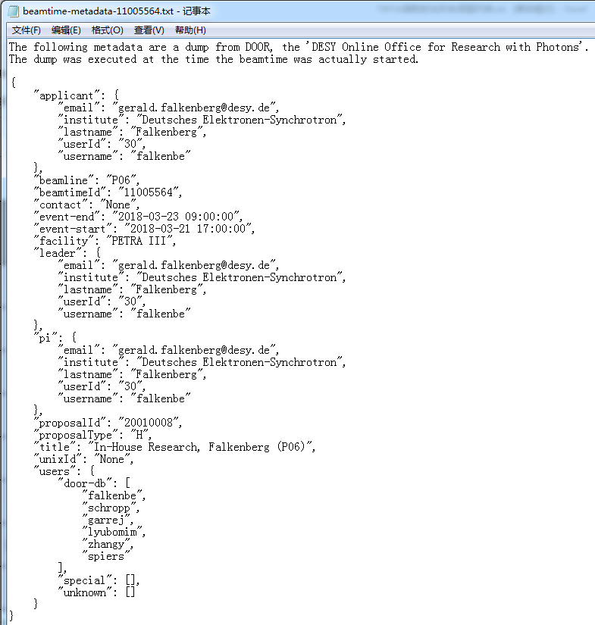
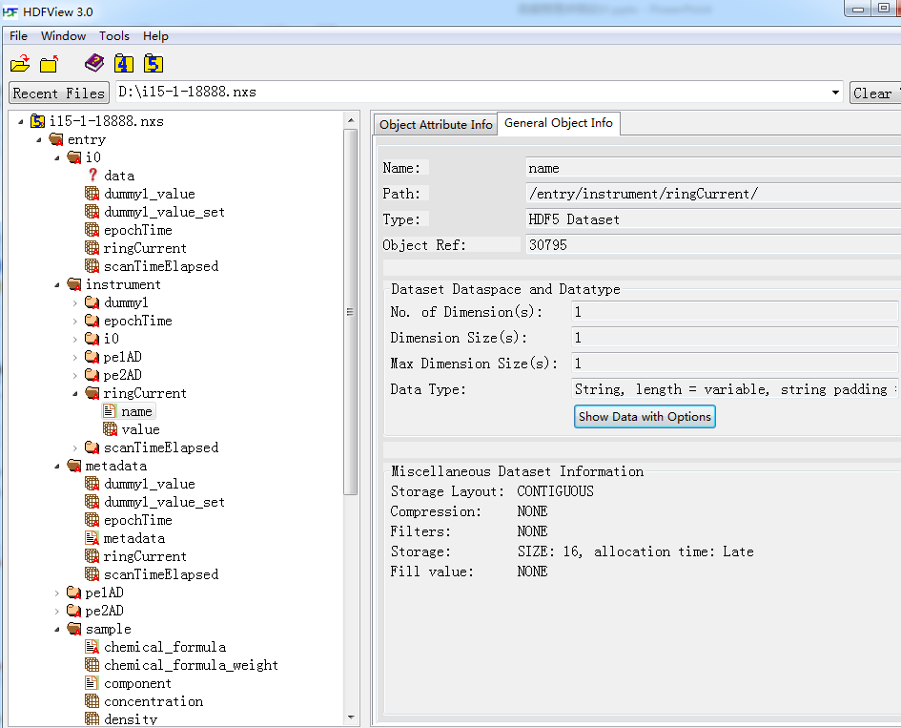
Metadata acquisition approach（2）
Suitable for those that metadata are collected and saved to files (txt/nxs)
Metadata-ingestor runs in flexible plugin mode.
In addition to user and experiment information, the plug-in also records information such as file size, checksums, processing time, and file replicas.

Slide 16
Metadata acquisition— for cataloging
DAQ
Database
Metadata
Ingestor
Metadata
Creator
API
SciCat
Kafka
Cluster
Metadata Catalogue
Notes:
No matter how metadata are collected, a unified architecture to realize the metadata acquisition and cataloging functions

Slide 17
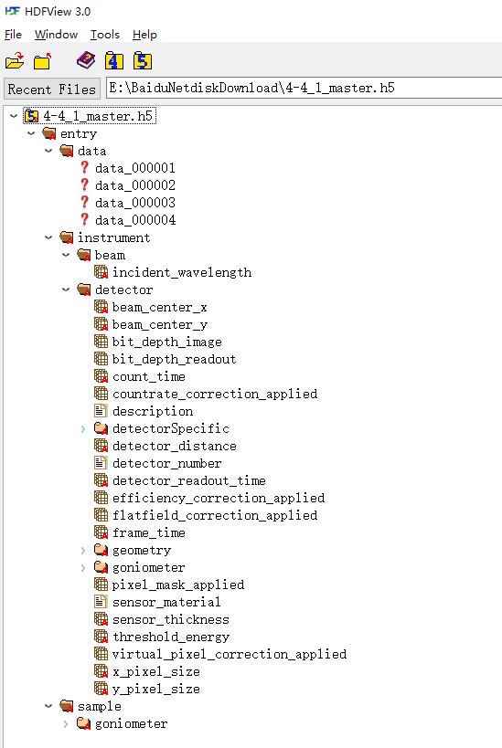
Data format standardization
Data formats used by X-ray experiments:
txt/tif/binary/dat/jpg/hdf5/…
HDF5 is chosen as the standard data format
HDF5 file schema follows NeXus conventions
NeXus is a common data format for neutron, x-ray, and muon science
https://www.nexusformat.org/
NeXus add meaning to HDF5
Data + beamline + detector + Sample
Data files
Beamline Info
Detector Info
Sample Info

Slide 18
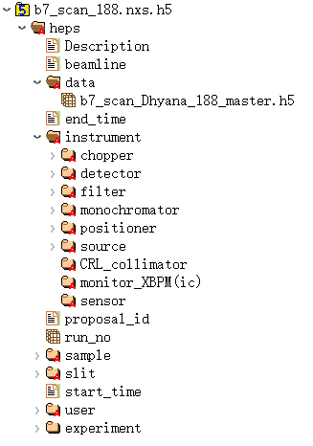
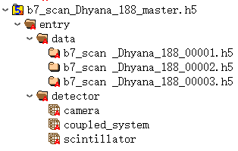
HDF5 file format design for B7(Hard X-Ray Imaging Beamline)
CT data consists of three types:
dark—images without X-ray
flat– images without sample
Projection– images with X-ray and sample
Demo: a set of CT data files
b7_scan_188.nxs
b7_scan_Dhyana_188_master.h5
b7_scan _Dhyana_188_00001.h5
b7_scan _Dhyana_188_00002.h5
…
…
b7_scan _Dhyana_188_02000.h5
Need more discussion and verification

Slide 19
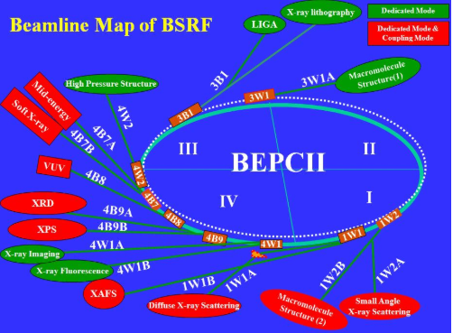
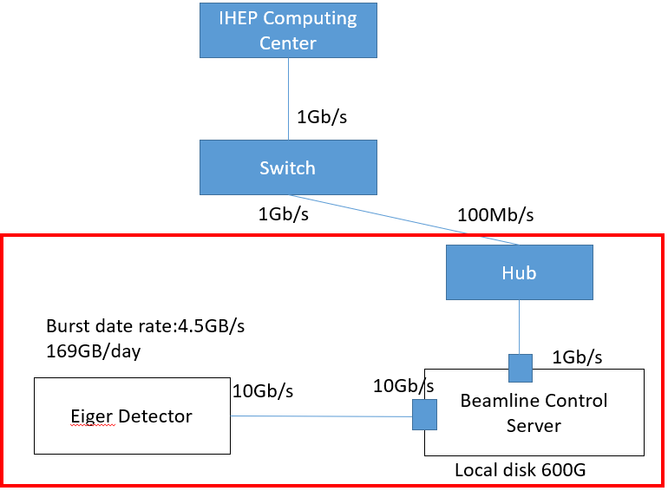
DMS testbed at 1W1A of BSRF
BSRF: Beijing synchrotron radiation facility, since 1991, IHEP
provides the technology R&D and test platforms for HEPS
1W1A: a diffuse X-ray scattering beamline of BSRF
Eiger area detector, 170GB raw data per day
Task：verify DMS and the whole process of data acquisition, data transfer, data storage and data access

Slide 20
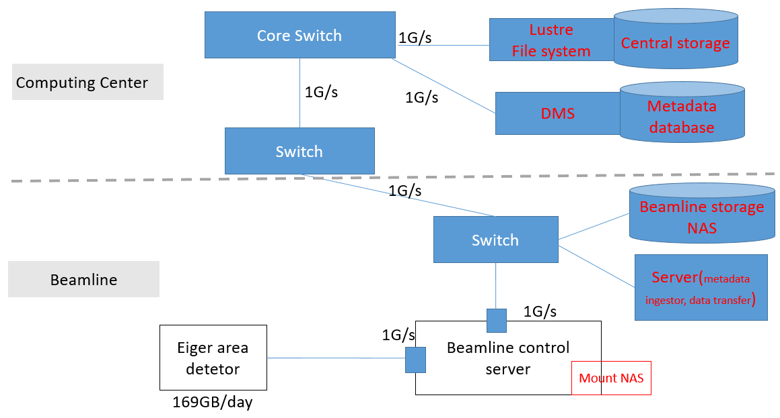
Progress of testbed at 1W1A
1. Network bandwidth is upgraded from 100Mb/s to 1Gb/s
2. Beamline storage: 2TB NAS, Dell EMC NX3240, NFS file system
3. Central storage: 80TB disk array, Lustre file system, located at Computing Center
4. A server located at the beamline, responsible for
metadata ingesting
data transferring
5. DMS API server and database server, located at
Computing Center
6. Data service web portal
authorized users and administrators
access data, download data files
Notes:
One plugin named metadata ingestor collects metadata associated with datasets and data files, including the proposal ID related to the datasets, data file size, data location of the file system, checksum and so on. Another plugin monitors for new data files in a designated folder of NAS, meanwhile moves the produced data files to the central storage.
Metadata associated with datasets and data files are stored in the metadata database, which is backed by MongoDB. The metadata can be accessed, updated and deleted via REST interfaces of

Slide 21
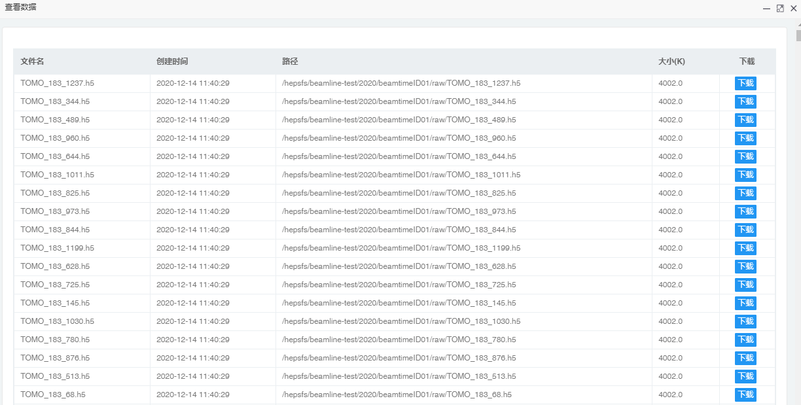
Web front end

Slide 22
Summary and Plan
The Data Management System has passed FDR
Fundamental functions are implemented on the testbed
Optimize the high availability and reliability of the system
Specify the HDF5 data format schema for each experiment technique (cooperate with beamline scientists)
Testbed at beamline 3W1 of BSRF is under way
Integrate with the data analysis framework and computing system
verify the design and performance of the IT infrastructure
the work on testbeds will directly apply to HEPS
We benefit a lot from the papers and reports of other Photon Source Facilities
We hope to have chance to cooperate with other Facilities, like PSI/MAXIV/DESY etc.
Notes:
The HEPS data analysis framework, using Jupyter-Spark-Docker technology stack, can conduct in-situ data reduction and data reconstruction. Dynamic load balance of computing resources is achieved by Kubernetes-based computing system. To obtain preferable performance with low latency and large-scale serving capabilities,

Slide 23
Thanks for your attention!
Any comments or suggestions?

