Slide 1
WLCG benchmarking using
HEP experiment workflows
Extending HEP Benchmark Suite
David Southwick
In collaboration with
WLCG Benchmarking Working Group
CERN, SKAO, GÉANT and PRACE Collaboration
EGI-ACE
26/3/2021

Slide 2

Introduction
Benchmarking for Worldwide LHC Computing Grid (WLCG)
Historically, benchmarking has been CPU focused:
Matching Experiment requests and site pledges
Accounting of CPU usage
Procurement requirements
Subset of SPEC-CPU has been used for past decades,
HEPspec06 remained in use for 12+ years (after spec17 found to be sub-optimal match)
Initially designed for WLCG; found widespread use in other communities (not limited to HEP)
Single number result, definition did not change during lifetime

Slide 3
Looking for the next benchmark
Conditions have evolved
Computing has changed significantly since adoption of HEPspec06:
64bit, new compilers, SMP, VMs, containers, compute accelerators
Reports of scaling deviations of 40% and more
HEPspec06 requires a software license from SPEC
Strong desire to consider license-free successor
Not Representative of full machine potential, nor improved experiment workloads
Working Group formed to develop the next benchmarking tool; to be based on experiment workloads
Notes:
For some years HEP Benchmarking Suite has been in development by WLCG Benchmarking WG
Provided …
Already enabled R&D for ROOT RNTuple HPC optimization..

Slide 4
HEP Benchmarks Project
Comprising of three primary components
HEP Benchmarking Suite:
A benchmark orchestrator, metadata collector, and reporting tool
Allows a top-level entry point for automated benchmarking sets
Orchestrates HEPscore, HS06, SPEC CPU2017, and more…
HEP Score:
Orchestrates & tabulates running of a series of HEP Workloads
Compute HEPscore value (similar to HS06 score)
Generate reports of whole set execution
HEP Workloads
Individual reference HEP workloads (eg CMS RECO).
Common build infrastructure & containment
Find more at:
https://gitlab.cern.ch/hep-benchmarks
Notes:
For some years HEP Benchmarking Suite has been in development by WLCG Benchmarking WG
Provided …
Already enabled R&D for ROOT RNTuple HPC optimization..

Slide 5
HEP Benchmark Suite 1.0
Developed over 2+ years
Build on success in providing an array of benchmarks, including HS06 and newly developed HEPscore. Initially:
Designed for WLCG compute environment
Intended for procurement teams, site administrators
First with VM containment, later nested docker images
None of these approaches are compatible with HPC!
Refactored & re-tooled for execution outside WLCG sites during 2020
Notes:
For some years HEP Benchmarking Suite has been in development by WLCG Benchmarking WG
Provided …
Already enabled R&D for ROOT RNTuple HPC optimization..

Slide 6
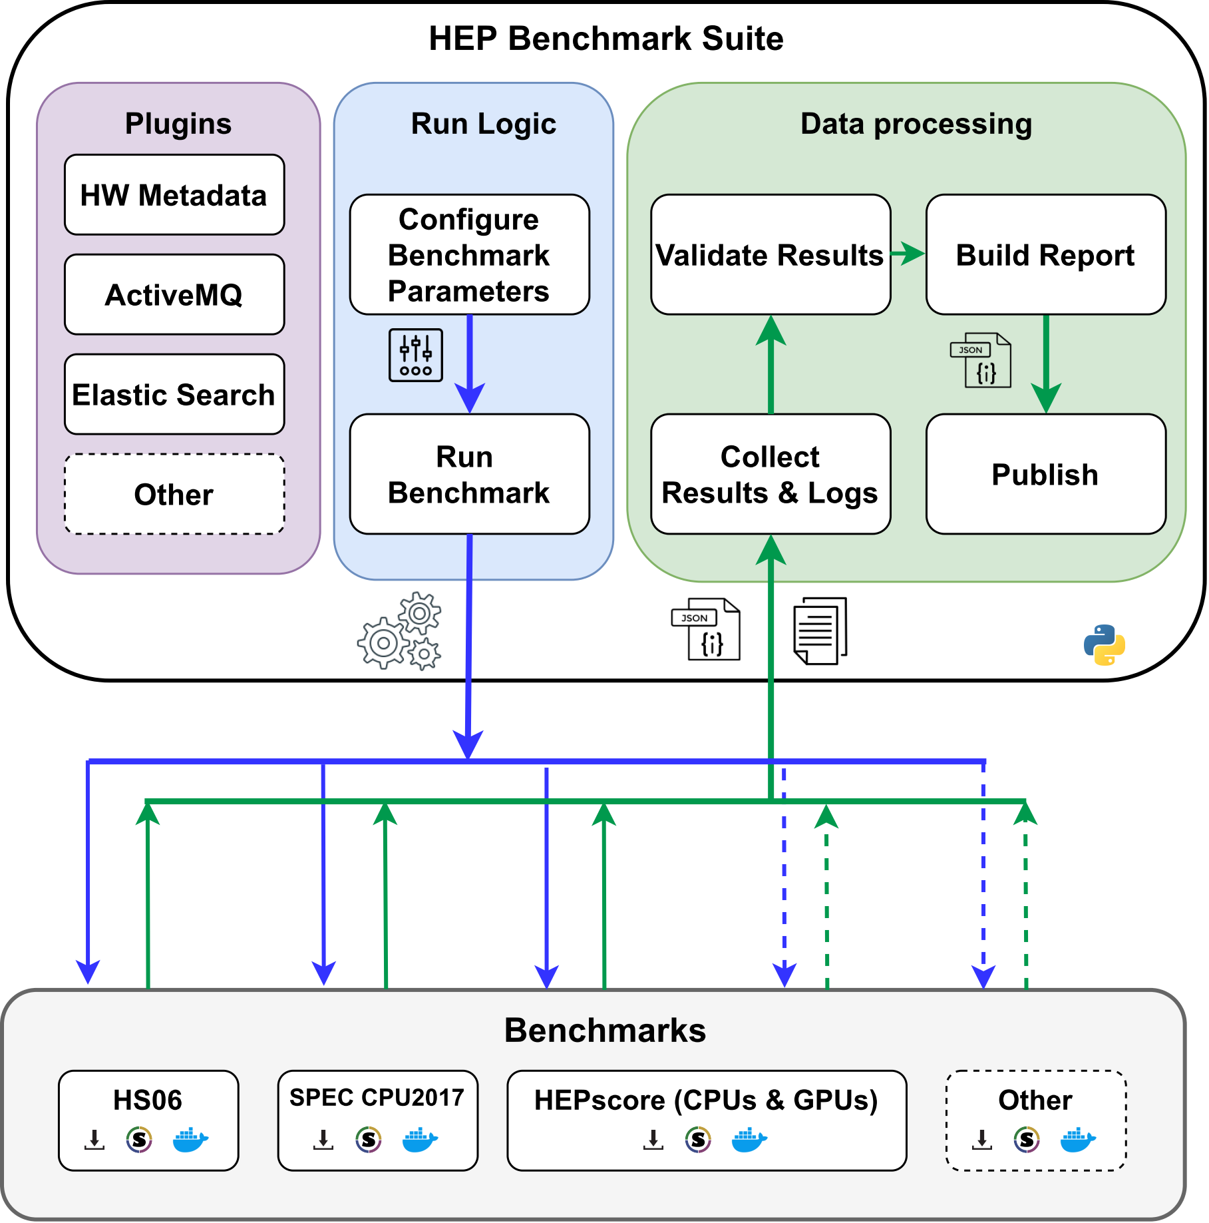
HEP Benchmark Suite 2.0
Improvements since 2020
Minimal Dependencies
Python3.6 + container choice
Variety of containment choices
Singularity (incl. CVMFS Unpacked), Docker, Podman
Repeatable & Verifiable
Declarative YAML config
https://gitlab.cern.ch/hep-benchmarks/hep-benchmark-suite

Slide 7
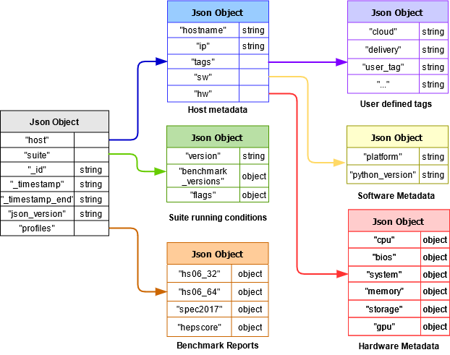
HEP Benchmark Suite 2.0
Features (cont.)
Modular Design
Snap-in workloads & modules
Designed for Ease-of-Use
Simple integration with any job scheduler
Metadata + Analytics
Automated Reporting via AMQ
Hardware Metadata snap-in module API example
https://gitlab.cern.ch/hep-benchmarks/hep-benchmark-suite

Slide 8
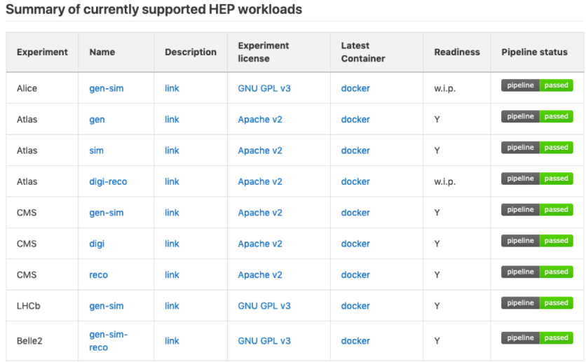
HEP Score
Candidate replacement for HS06
Modular python3 “microservice” approach
Importable / Extendable, architecture agnostic
Executes set of containerized workloads (Singularity, Docker, Podman)
Produced single configurable weighted geometric mean of resulting workload scores
Detailed report delivered in JSON/YAML report
https://gitlab.cern.ch/hep-benchmarks/hep-workloads

Slide 9
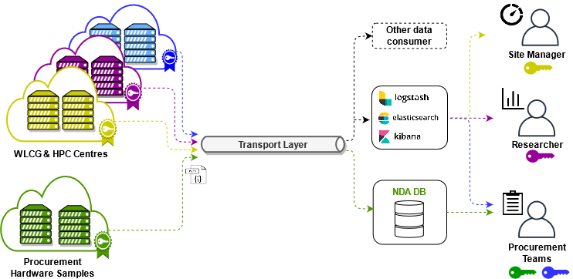

Features on HPC
Benchmarking Heterogeneous architectures
Multi-Arch container workloads (x86, IBM Power, ARM …)
Multi-GPU container workloads (Nvidia, AMD, Intel… )
Easily extendable to other sciences!
Simple integration with SLRUM & other job orchestrators
Single dependency on site Python3.6
# HEP Benchmark Suite requires singularity 3.5.3+, python3.
module load singularity python3
python3 -m pip install --user git+https://gitlab.cern.ch/hep-benchmarks/hep-benchmark-suite.git
echo "Running HEP Benchmark Suite on $SLURM_CPUS_ON_NODE Cores"
srun bmkrun --config default

Slide 10
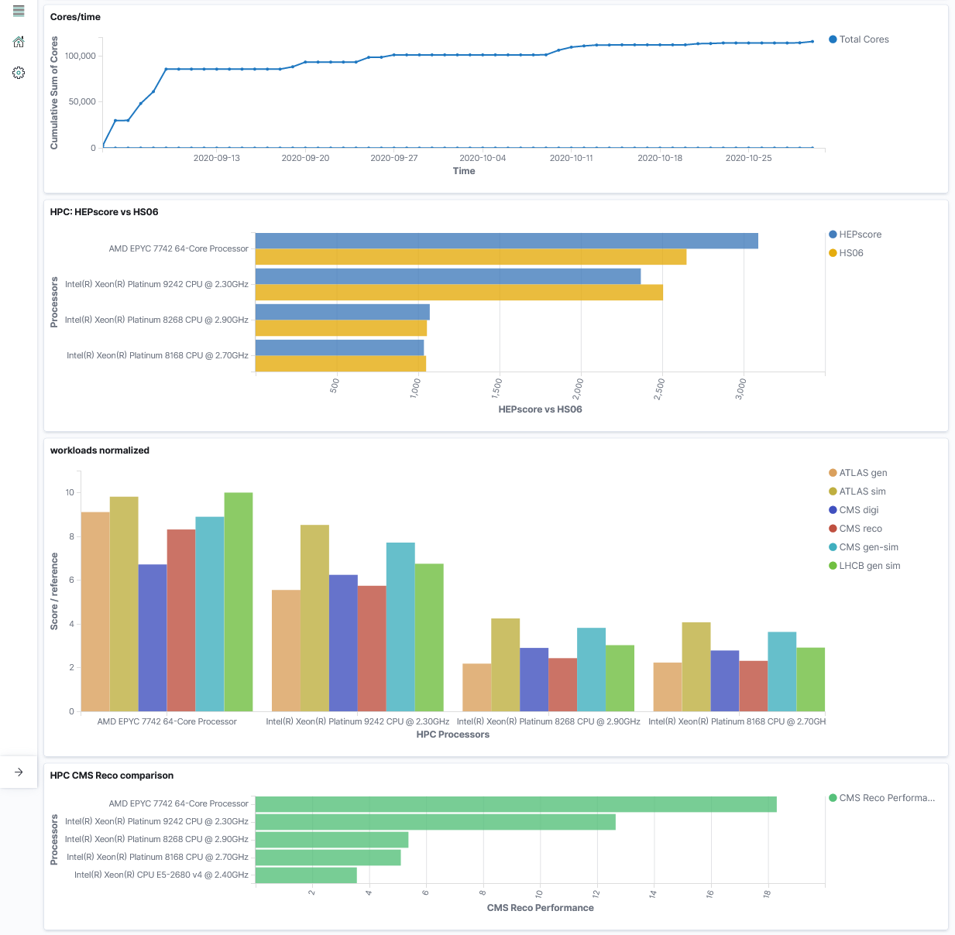
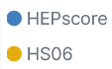

Short Benchmarking Campaign
~120,000 cores
(Sept – Oct)
Aggregation
Analysis via Kibana

Slide 11
Examples
Running HEP Benchmark Suite, HEPscore
Execution is as simple as importing a python module!
You can override YAML settings via CLI arguments!
Run HEPscore in the same manner, without the need for the suite!
YAML examples available in backup slide
# Python 3.4+, pip3 19.1+
python3 -m pip install --user
git+https://gitlab.cern.ch/hep-benchmarks/hep-benchmark-suite.git
bmkrun --config default
# Define custom config (even remote!), override it’s contents
bmkrun --mode docker --config https://your.server/static_config.yaml \
--rundir /mnt/scratch/hep –-benchmarks hepspec06
# Run standalone HEPscore
python3 -m pip install --user
git+https://gitlab.cern.ch/hep-benchmarks/hep-score.git
hep-score /mnt/scratch/hep-score
# Override settings similar to suite
hep-score –-conffile /home/dsouthwi/hepscore.yaml –m docker /tmp/hep

Slide 12
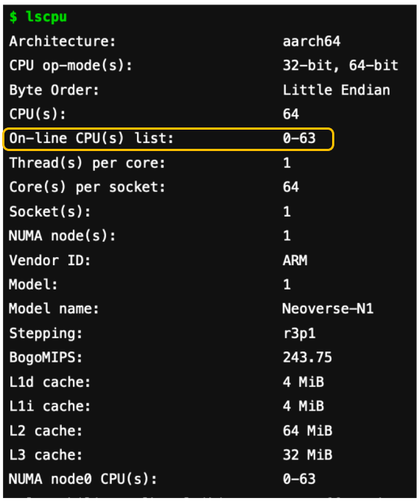
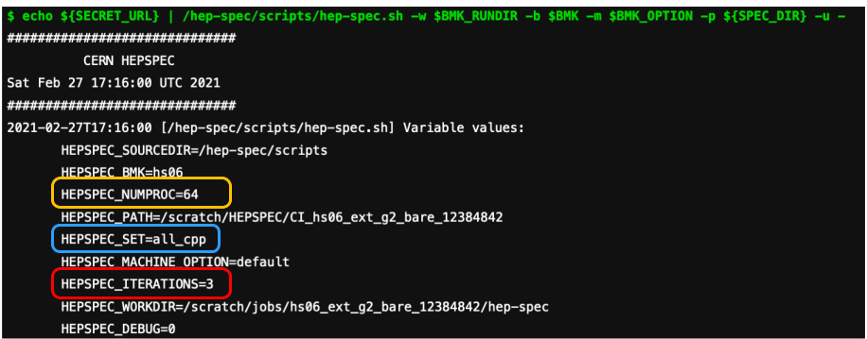
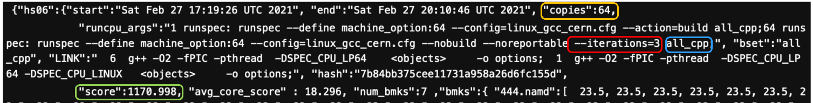
Running HS06 on ARM
HEPspec06 multi-arch demonstrated on
AWS Gravitron2 bare-metal server, ARM64

Slide 13
Adoption
Current status
Deployed across several HPC sites in the past year, several more currently testing independently
Fully adapted to multi-architectures and variety of container solutions
Agnostic – same image for all supported modes (ie single HEPspec image using multi-arch tag, single GPU image – determine mode at runtime)
WLCG HEP Score Deployment task force decision deferred until LHC-run3 experiments examined – Benchmark suite framework is ready for widespread use

Slide 14
Next Steps
Roadmap tasks for 2021
Include LHC Run-3 workloads proposed by WLCG HEP Score task force
Add more alt-arch workloads as they become available
Support for FPGA already enabled, add experiments as available
Continue integration of GPU workloads (MC MadGraph, Atlas O2O)
Run on several PRACE-Tier0 HPC sites
Adoption by WLCG as official replacement for HS06

Slide 15
Conclusions
HEP Benchmark Suite: Extended to benchmark HPC
Designed & tested for generic job submission WLCG + HPC: Flexible, modular, and unprivileged
Heterogeneous support included (multi-GPU and multi-arch containers) Fault-tolerant, Repeatable & Verifiable
Enables statistical & historical analysis via automated reporting
Verified on several HPC sites, soon on PRACE-tier0 testbeds
Suite is ready and available for use today! Please start trying & report issues. Using it is easy!
Join our Discourse Forum, or find Ticket tracking in Gitlab
Full source and examples at:
gitlab.cern.ch/hep-benchmarks/hep-benchmark-suite

Slide 16




THANK YOU

Slide 17
SLURM batch example
#!/bin/bash
#SBATCH --exclusive --hint=multithread
#SBATCH --job-name=HEP-Benchmark-suite
#SBATCH --output=HEP-result-%A-%j.out
#SBATCH --mail-type=END,FAIL
#SBATCH --mail-user=david.southwick@cern.ch
#SBATCH --array=1-200
module purge
# HEP suite requires singularity 3.5.3+, python3.
module load singularity python3
export RUNDIR=/tmp/HEP
export BMKSUITE_TAG_SITE="SDSC"
echo "Running HEP Benchmark Suite on $SLURM_CPUS_ON_NODE Cores"
python3 -m pip install --user git+https://gitlab.cern.ch/hep-benchmarks/hep-benchmark-suite.git
# run
srun bmkrun --config default --tags --rundir $RUNDIR
# Copy local JSON & LOG results to $HOME if not reporting via AMQ
find ${RUNDIR} \( -name \*.json -o -name \*.log \) -exec tar -rvf $HOME/results-${SLURM_JOB_ID}-${SLURM_ARRAY_JOB_ID}.tar {} +

Slide 18
Declarative YAML configuration
Hashed & included in report
global:
# Type of container technology to use: Singularity or Docker
mode: "singularity"
# Run directory where all related suite material will be placed.
rundir: "/tmp/hep-benchmark-suite"
benchmarks:
- "hepscore"
- "db12"
- "hs06"
- "spec2017"
# User defined tags that will show on the metadata file
tags:
cloud: “DEEP"
vo: “DEEP-EST"
other_tag: “V100"
# enable AMQ reporting using credentials in activemq
publish: False
activemq:
server: 'your-AMQ-server.com'
port: 61613
topic: 'hepscore-topic'
#username: 'user'
#password: 'pw'
#key: 'key-file.key'
#cert: 'cert-file.pem'
hepspec06:
image: "/cvmfs/unpacked.cern.ch/gitlab-registry.cern.ch/hep-benchmarks/hep-spec/hepspec-cc7:v1.0"
hepspec_volume: "/tmp/SPEC"
iterations: 3
spec2017:
image: "/cvmfs/unpacked.cern.ch/gitlab-registry.cern.ch/hep-benchmarks/hep-spec/hepspec-cc7:v1.0"
hepspec_volume: "/tmp/SPEC"
iterations: 3
hepscore:
version: "v1.0rc13"
config: "default"

Slide 19



Collaborating HPC Sites
...and their hardware
San Diego Supercomputer Center
Intel Skylake 8168 @ 2.8GHz
Intel Cascade Lake 8268 @ 2.9GHz
Intel Skylake 6148 @ 2.4GHz
AMD EPYC 7742 @ 2.25GHz
Advania (now atNorth) - Iceland
Intel Cascade Lake 9242 @ 2.3GHZ
We thank you for your support!

Slide 20
Backup talks & resources
For further details see previous presentations below
HEPspec06 -> HEPscore talk 26/5/20
https://indico.cern.ch/event/917098/contributions/3855129/attachments/2045174/3426154/WLCG-MB-26-05-2020-giordano.pdf
Status Report to HEPiX on benchmarking suite 13/10/20
https://indico.cern.ch/event/898285/contributions/4034096/attachments/2121862/3571531/HEPiX-Workshop-13-10-2020-giordano.pdf
HEPiX Status update 2021
https://indico.cern.ch/event/995485/contributions/4257475/

