Slide 1
Progress of development firewatch monitoring sensor in Indonesia
Basuki Suhardiman (ITB) , Israr Albar (Ministry Of Environment and Forestry )
basuki@itb.ac.id , Israralbar@gmail.com
Insitut Teknologi Bandung
ISGC 2021, Academia Sinica, Taipei, Taiwan
22nd March – 26th march 2021

Slide 2
Outline
Background
Design Model
Protyping and Testing model
Works and collaboration

Slide 3
Firewatch Initiatives
Ministry of Forestry and LAND-gate Australia
  MODIS-Data from NASA
Collaboration Ministry Forestry with Ministry of Education (2010) for delivering the Hotspot information (Fire) through the Inherent (University of Palangkaraya and University of Riau )
In 2015, ITB initiatives again for firewatch
  Data Analysis through satellite
  Sosialize the environment impact through the social media (Facebook/twitter)
  Prevent air filter system solution in classroom
In 2016
  Prevent initiatives for building the near realtime model with Authomatic Weather System and Environment Sensor
In 2017
  Build the Prototype AWS + Sensor
In 2018
  Running the Prototype , operational test
  Collaboration with SeaHazemon (Interlab AIT) deploy 3 sensor
In 2019
  Ministry of environment and Forestry setup the Sipongi system for monitoring
In 2021
  Seahazemon deployment 10 sensor node for 10 location around Indonesia

Slide 4
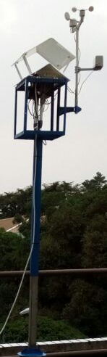
Prototype 1.0 (2017)
Forestry (School)
GSM/GPRS Modul
TCP/IP
ITB
Web Server
For collecting data
And
Portal
Arduinno
Microcontroller
GPS modul
USB /Storage
AWS
-Wind Direction
-Wind speed
-Temperature
Humidity
Rain fall
CO sensor
And other sensors
Middle Ware
Network of Science Community
NASA/NOAA web server ,etc

Slide 5
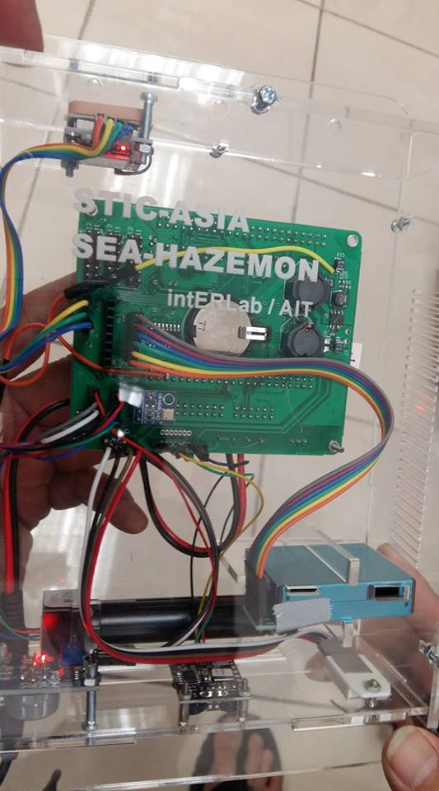
Sea-Hazemon Sensor
Initiated by IntERlab / AIT (TH)
Start with 3 Sensor node
  PM 2.5 microgrm/m3
  Temperature
  Relative Humidity (RH)
Wifi enable
1 sensor put in Bandung
2 sensor put in Sumatra’s Area
  Palembang
  Jambi
https://canarin.net/seahazemon/map.html

Slide 6
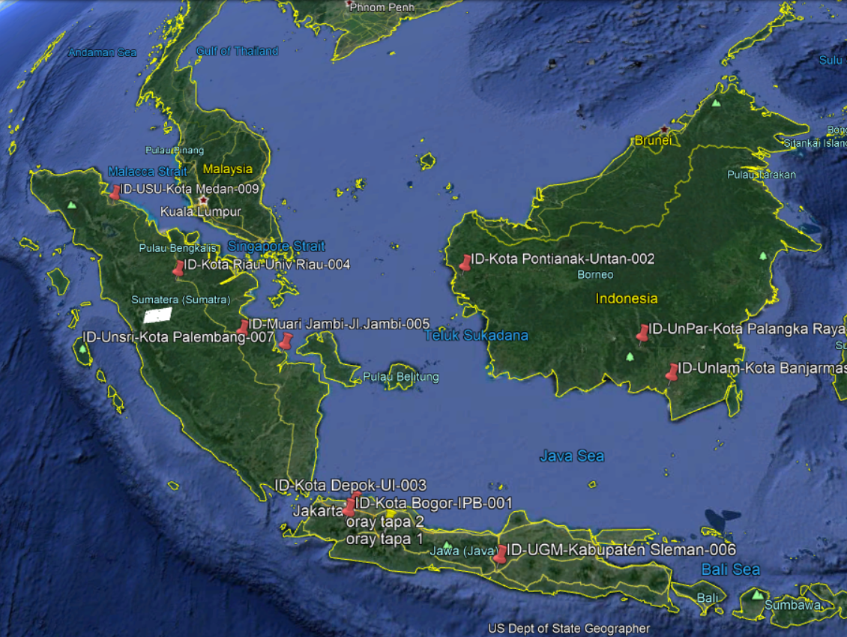
Planning 10 New Sensors (2021)
New sensor for 10 City in Indonesia
    PM 2.5 microgrm/m3
    Temperature
    Relative Humidity (RH)
Planning
  Medan
  Riau
  Banjarmasin
  Jakarta
  Pontianak
  Bogor
  Palangkaraya
  Jogjakarta
  Jambi
  Depok (Jakarta)
Open Data on
https://canarin.net/seahazemon/map.html

Slide 7
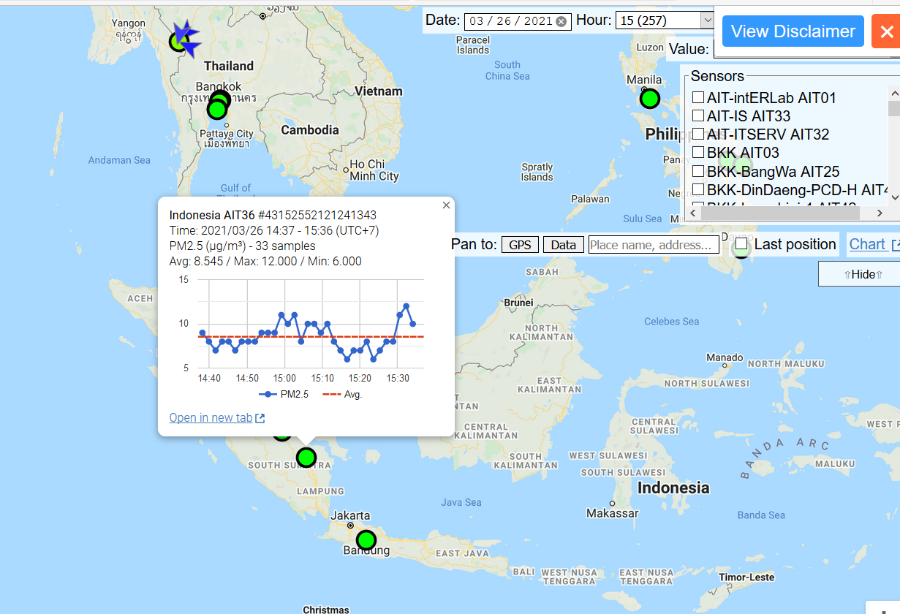
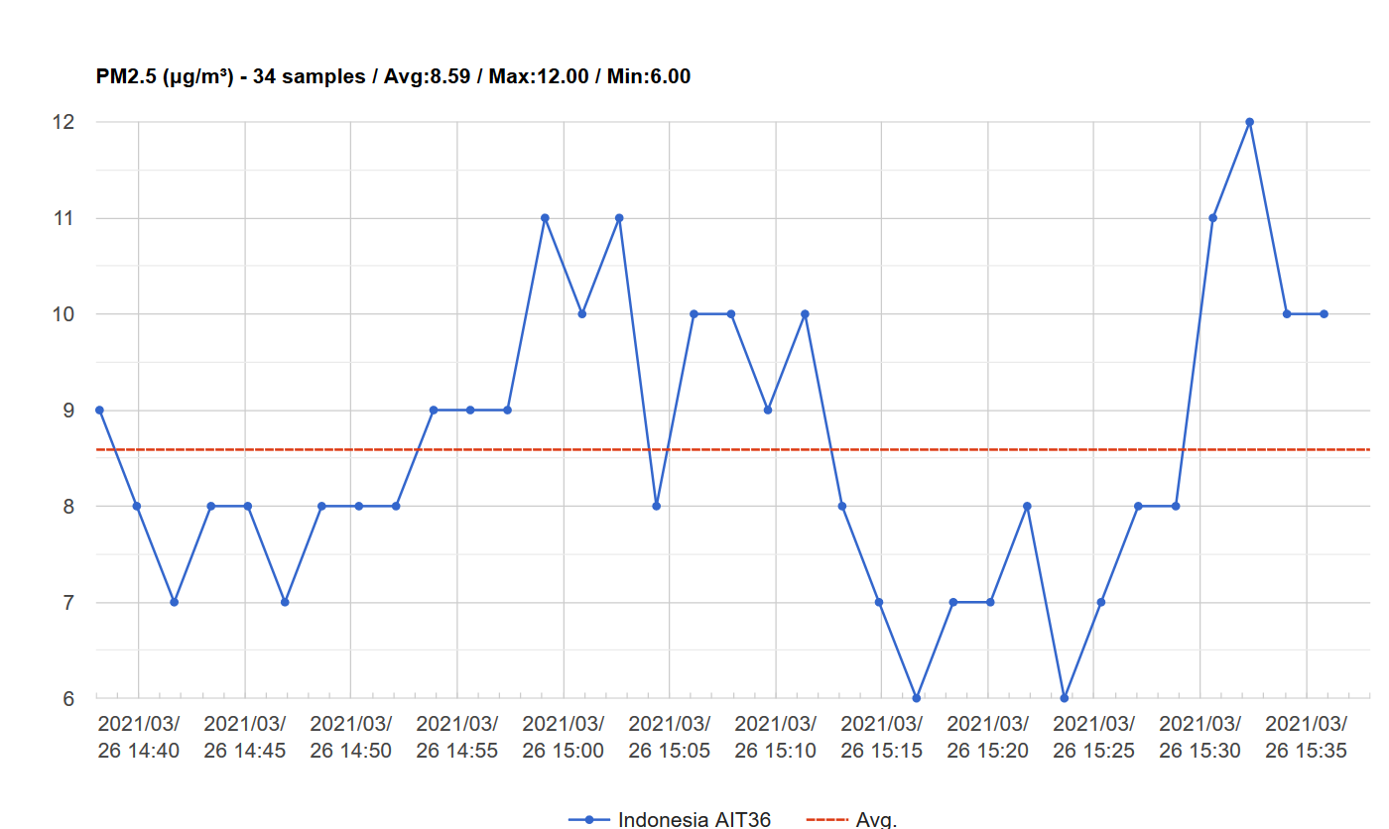
South Sumatra , Indonesia

Slide 8
SIPongi
- SIPOngi (Sistem Informasi Peringatan dan Deteksi Dini pengendalian Kebakaran hutan) , Information System for detection and monitoring for firewatch
Initiatiated by Ministry of Environment and Forestry (Indonesia)
Base on the data from 4 sources
Terra, Aqua , NOAA, SNPP
Data is provided by LAPAN (National Space Agency , Indonesia)
Near Realtime , update every 30 minutes
Modelling and estimated for coverage area for hotspot
http://sipongi.menlhk.go.id/home/main

Slide 9
SiPongi Features
Web base and android base
Information sources
  Terra dan Aqua , NASA ),
  Terra dan Aqua (LAPAN), NOAA LAPAN )
  dan SNPP (LAPAN) dan Landsat 8 (LAPAN)
Sms blast system
Base on android
Information release to community
Publish on social media
  Facebook
  Twitter

Slide 10
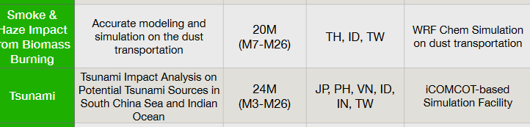
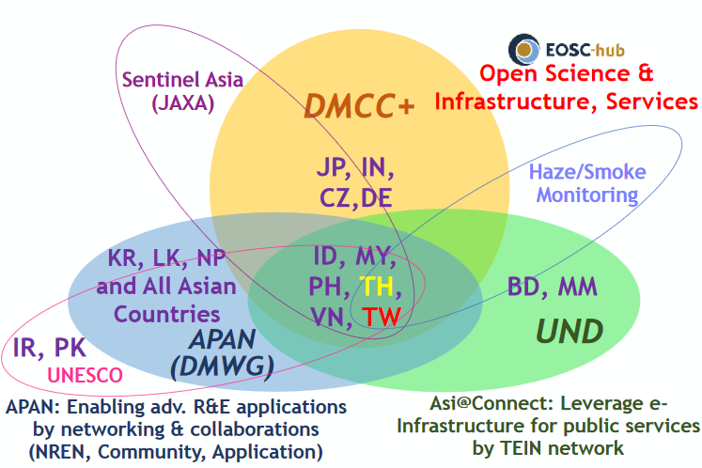
Disaster Mitigation Competence Center (DMCC)
Focus on Case Study for Simulation on Dust Transportation around Indonesia
  Provide some data
  Dissemination on education and research community
Tsunami Impact analysis using iCOMCOT portal

Slide 11
Future (Next) works
Build the webbase enable and repository data
Development with Sea-hazemon project for deployment sensor around Indonesia for Air Quality monitoring (PM 2.5)
Combine the data from field ( Sipongi) and other satellite sources data
Build the case study with DMCC (facilitate for I-Comcot Tsunami and WRF-chem Simulation) → DMCC and EOSC-Hub

Slide 12
Challenge for development and operational Sensor network.
Calibration of the equipment
Sensor Reliability
Format of the raw data (sensor)
Repository for the data
Web Portal
API

Slide 13
Future (Next) works
Build the webbase enable and repository data
Development with Sea-hazemon project for deployment sensor around Indonesia for Air Quality monitoring (PM 2.5)
Development and deploy AWS(Protype 1.0) for delivering data and build model with Ministry of Forestry and Environment
Build the case study with DMCC (facilitate for I-Comcot Tsunami and WRF-chem Simulation)

Slide 14
Thank you
ASGC, DMCC+ and EOSC-hub

