Slide 1
Study of Disaster in Myanmar
22~26 March 2021
Joint DMCC, UND & Environmental Computing Workshop: Deeper Understanding of Natural Disasters
24~26 March 2021
Myint Myint Sein
University of Computer Studies, Yangon

Slide 2
Disaster Research in UCSY
Predict Tropical Cyclone Track
Flooding in Middle Region of Myanmar

Slide 3
Myanmar Hazard Calendar
Hazard | Jan | Feb | Mar | Apr | May | Jun | Jul | Aug | Sep | Oct | Nov | Dec
Cyclone
High Temperature
Low Temperature
Drought
Squalls and Thunderstorm
Flood
Heavy Rain
Monsoon Depression
Hail

Slide 4
Prediction the Tropical Cyclone Track
In this research, the Tropical Cyclone tracking system is developed by combining the Support Vector Machine (SVM) and polynomial regressing model.
After estimating the center of the tropical cyclone by SVM, cyclone track is predicted by using polynomial regressing model.
Ground truth data for cyclone tracking is obtained from JTWC best track. Five tropical cyclones that have been affected to Myanmar are tested to predict the cyclone track.

Slide 5
List of tropical cyclones that affected Myanmar
The Myanmar country is hit by a powerful storm every 1 or 2 years.

Slide 6
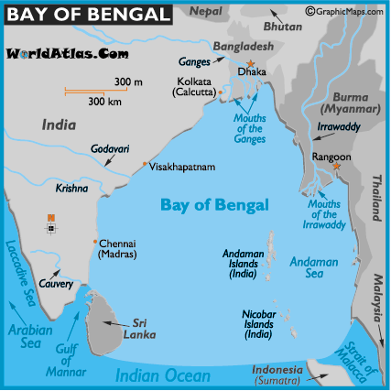
A. Preprocessing
- Tropical cyclone region detection
- Prediction of the tropical cyclone track.
Data Acquition
INSAT, India
25 - Tropical Cyclones
2000~2013
Date,
Time,
Cyclone Intensity,
Wind Speed,
Wind Pressure,
Cyclone center

Slide 7
B. Sampling
The input data samples can support the model to verify and can reduce the uncertainty of the manner as well as evaluate the whole cyclone.

Slide 8
Overview of the System

Slide 9
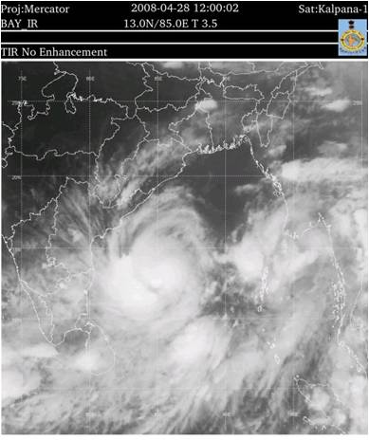
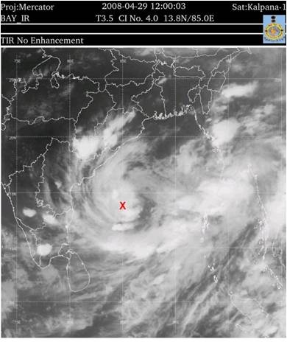
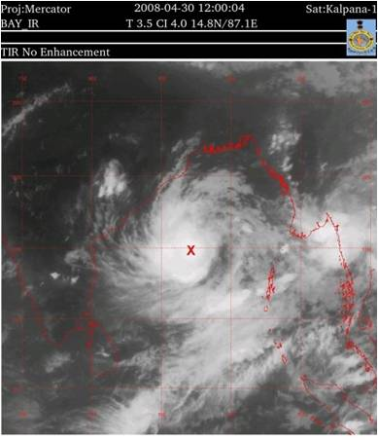
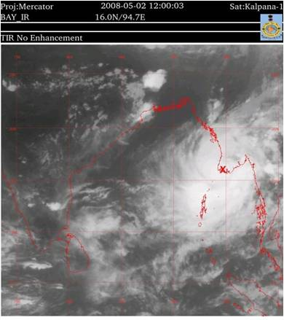
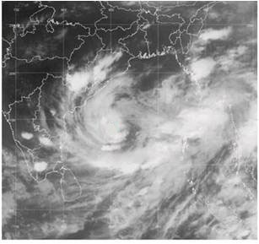
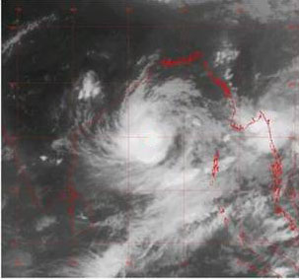
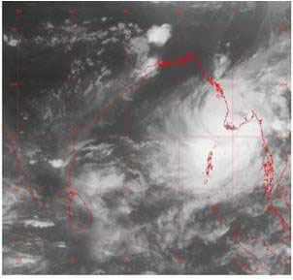
Experiment and Results
(a) 28th April noon
(b) 30th April noon
(c) 1th May noon
(d) 2nd May noon
Fig.1. Multi-dates Satellite images of Nargis cyclone

Slide 10
Experiment and Results
(a) 28th April noon
(b) 30th April noon
(c) 1th May noon
(d) 2nd May noon
Fig.1. Multi-dates Satellite images of Nargis cyclone

Slide 11
Prediction of the Cyclone Track

Slide 12
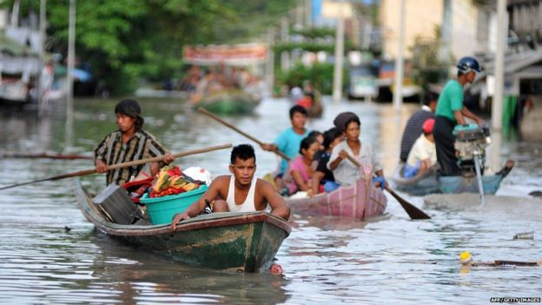
Flooding
Regularly, Myanmar is affected by severe floods comprising
River floods,
Flash floods,
Surface Flood and Costal floods.

Slide 13
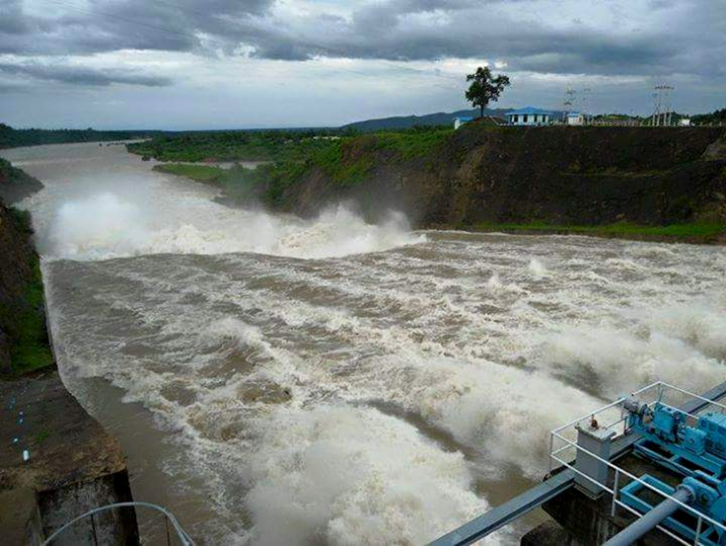
In 2015 and 2018, Myanmar faced flooding in most part of region. The four worst hit regions are
Magway Region,
Sagaing Division,
Chin State and
Rakhine State

Slide 14
Dams Map in Myanmar
Hydroelectric Dams 128
Irrigation Only 4
Total Dams 132
Notes:
Dams are very useful for our humans’ societies that it provides irrigation water for farms and used for electricity. The 128 Hydroelectric Dams and 4 dam for Irrigation Only totally, 132 dams are constructed in Myanmar .

Slide 15
Myanmar dam overflow floods 100 villages, displaces thousands
- Villagers attempt to traverse a road flooded by waters from the Swar Chaung dam, Bago region, Myanmar on August 29, 2018. Photo: EPA

Slide 16
Water Level (28.7.18)
River | Gauge | Alarm Level above 0 level (cm) | 28.7.18 (6:30 am) River Level (cm) | Changes of Surface between 24 hours
Ayeyarwaddy | Hinthada | 1342 | 1282 | -12
 | Zalon | 1160 | 1106 | -12
Sittaung | Taung Goo | 600 | 614* | +35
 | Madauk | 1070 | 1264* | +26
Shwe Kyin | Shwe Kyin | 700 | 830* | +20
Bago | Bago | 880 | 967* | +26
Than Lwin | Hpa-an | 750 | 906* | +32
Nga Won | Ngar Thine Chaung | 1160 | 1146 | -1
 | Thar Paung | 620 | 612 | +2
 | PaThein | 350 | 270 | +12
Toe | Maubin | 720 | 690 | -24
Notes:
This table described the water level of River before flooding.

Slide 17
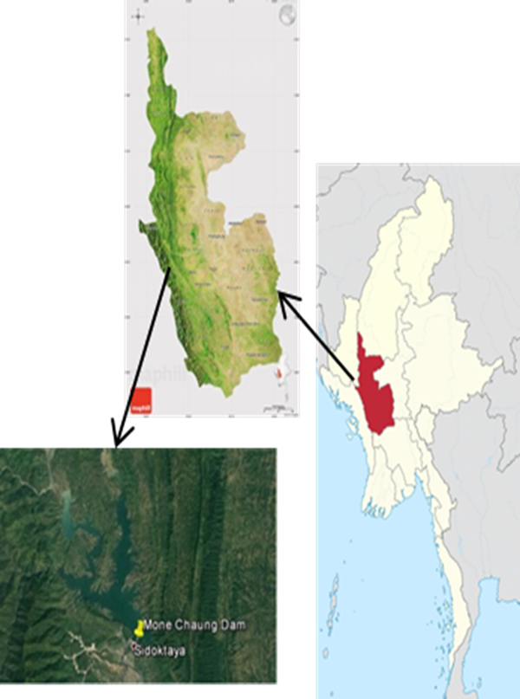
Study Area
The case study of flood conditions for Mone Dam in Magway region
It built across on Mone creek.
Water catchment area is 1467 sq mile
Rainfall amount 47″
Average height level of water is 125′
Area of Dam - 4320′ (length) × 200′ (height)
Water diversion tunnels - 36′ (diameter) × 3625′ (length)
Figure. Location of Mone Chaung Dam

Slide 18
Mone Dam
Mone Dam is situated in Magway region and it is very mountainous area.
The other two dams are situated on low lying area and if it will break or overflow water, affect on about 300 villages and two towns in that region.
Its alarm level is 540' and Dam crack level is 560'.
Year | Water Level (ft) | Overflow water (ft) | Overflow Capacity (cu.ft/s)
2010 | RL 540.30 | 20.30 | 99,200
2011 | RL 536.30 | 16.30 | 71,400
2015 | RL 535.90 | 15.90 | 66,800
Table 1. Flood condition of Mone Dam

Slide 19
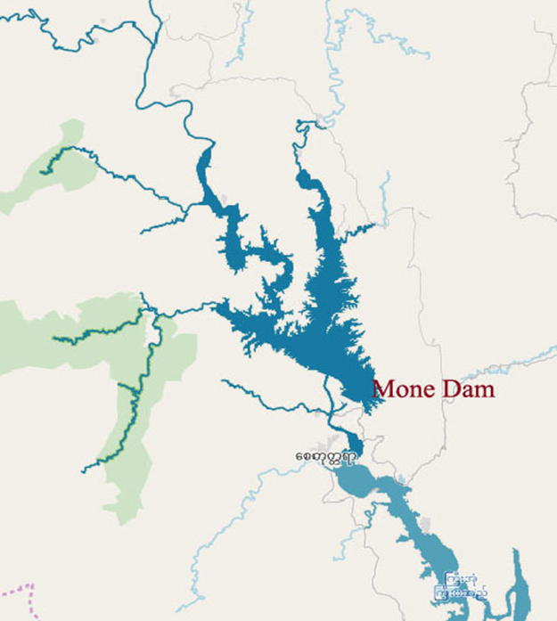
Conditions of Flood in Mone Dam
Dam cannot outlet the water from the spill way when the following condition
- Ayeyarwady River is full of water
- Heavy Rain in Bangladesh
- Heavy Rain in Rakhine Hills and Chin Hills
- Causing Storm in Bay-of-Bengal
Figure2. Inflow water of Mone Dam

Slide 20
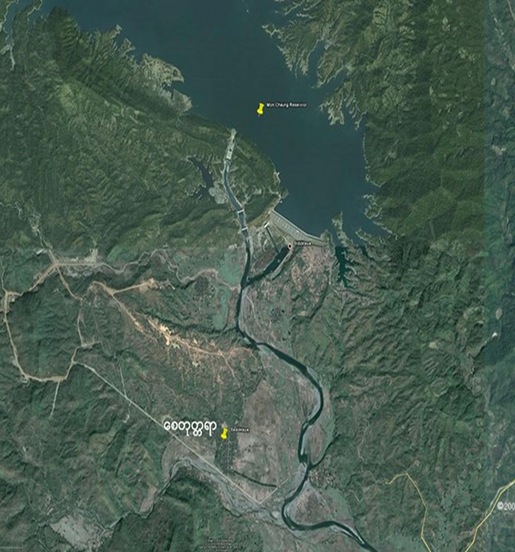
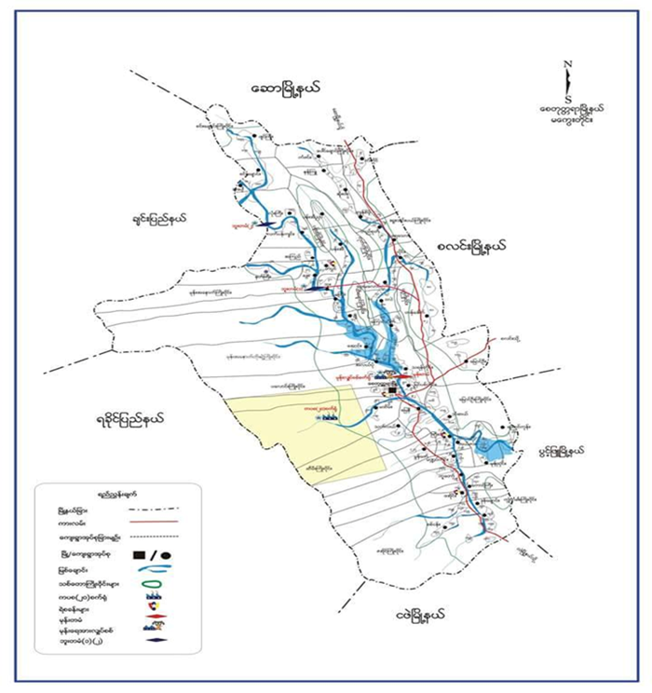
Conditions of Flood in Mone Dam
Figure. Affected flood region of Mone Dam

Slide 21
System Design
Start
Water Level
Weather data from weather API
Arrive alarm level?
No
Heavy rain?
No
No flood
Yes
Yes
Calculate Probability by Markov Chain
Show flood conditions
End
Figure . System Flow Diagram of Flood Alarm System

Slide 22
Implementation
The water level is computed based on the transition probability matrix with Markov Chain
Date | Water Level (ft) | Threshold Value | Predict | Remark
12.6.18 | RL 512.5 | 0 | No Flood | May still be raining and flood may be occur
13.6.18 | RL 526.7 | 1 | Flood | Warning may still be increase water
14.6.18 | RL 537.9 | 3 | Severe Flood | Should move to safe places
17.6.18 | RL 531.1 | 3 | Severe Flood | Still flood but will reduce water level
Table 2. Overflow Prediction Results

Slide 23
Publications
1. Thu Zar Hsan and Myint Myint Sein, "Combining Support Vector Machine and Polynomial Regressing to Predict Tropical Cyclone Track”, 2021 IEEE 3rd Global Conference on Life Sciences and Technologies, March 9-11, Nara, Japan.
2. Phyo Pa Pa Tun and Myint Myint Sein, "Flood Prediction System by using Markov Chain", Proceeding of International Conference on Future Computer and Communication (ICFCC) 2019, Feb. 27th ~ March 1, 2019, Yangon, Myanmar.

Slide 24
Thank You!
myintucsy@gmail.com; myint@ucsy.edu.mm

