Slide 1
eScience Activities in Asia Pacific - Australia
International Symposium on Grids & Clouds 2021
Theme: Challenges in High Performance Data Analytics: Combining Approaches in HPC, HTC, Big Data and AI
Carmel Walsh
March 24th,2021

Slide 2
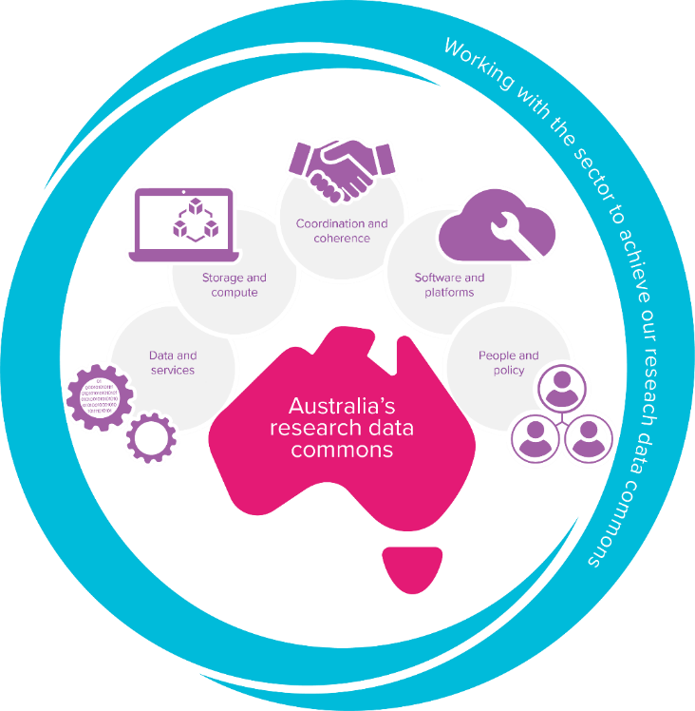
ARDC – The Australian Research Data Commons
Purpose: to provide Australian researchers with competitive advantage through data.
Mission: to accelerate research and innovation by driving excellence in the creation, analysis and retention of high-quality data assets.
Notes:
ARDC supports research across all disciplines: to enable world leading research, facilitate accelerated innovation, and enhance researchers’ ability to translate outputs into societal benefit.

Slide 3
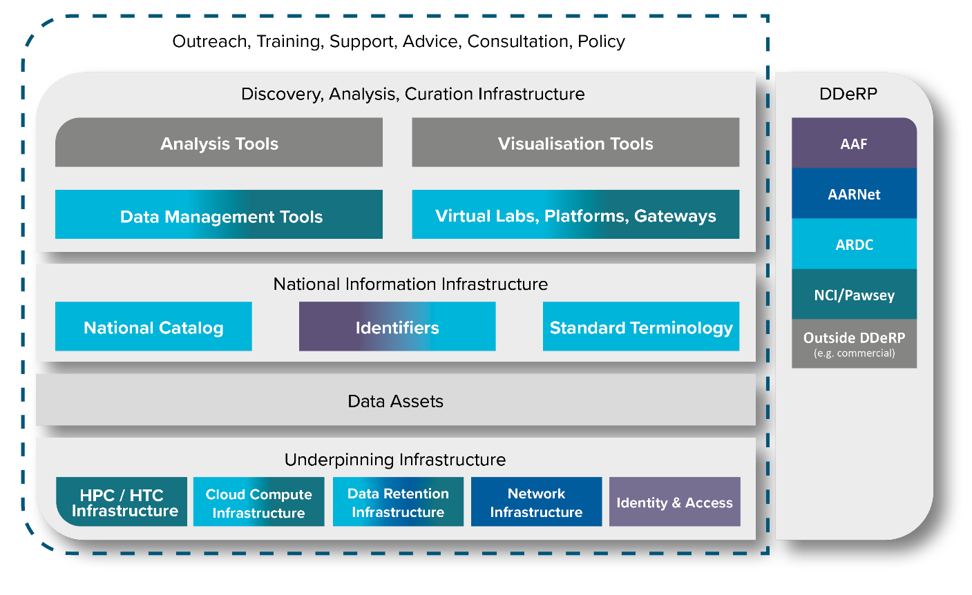
ARDC’s Areas of Activity with DDeRP
DDeRP: Digital Data eResearch Platform formed as part of the 2019 National Research Infrastructure Investment Plan to pool together all digital national providers to develop a National Research Data Commons.
Pawsey: focus is Square Kilometre Array
NCI: focus on Earth Science
AARNet: Data network & sensitive data
AAF: Federation access and Identity Mgmt
Notes:
Digital Data and eResearch Platforms (DDeRP)

Slide 4
ARDC – Four Themes
Notes:
Theme 1 – coordination & coherence

Slide 5
Our Core Strategic Themes
Platforms & Software
Data & Services
Transforming research through establishing advanced platforms that help more Australian researchers
Developing a research software agenda for Australia
Creating portfolio of shared eResearch software services that can be integrated into other solutions
Creating national data assets with our partners to increase research innovation and efficiency
Providing national infrastructure services that accelerate wide uptake of FAIR
Improving discovery linking and citation of data
Notes:
Strategic

Slide 6
Our Enabling Themes
Storage & Compute
People & Policy
Nectar Research Cloud (hardware refresh, support for ARDC projects incl. GPUs, Kubernetes)
Data Retention project – aligning the storage of nationally significant data collections with international standards
Policy focus to advance FAIR agenda
Providing national training activities - e.g. FAIR 101
Mapping the skills landscape
Notes:
Enabling

Slide 7
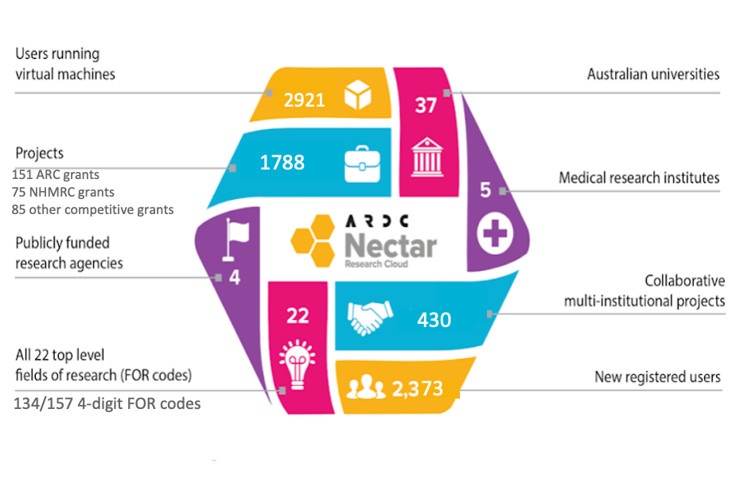
ARDC Nectar - Capabilities
Supporting over 50,000 researchers with 200+ services (platforms, data portals etc)
Usage 2019-20
Notes:
National eResearch infrastructure Leader
Pioneered research cloud computing creating national standards
International leaders in OpenStack and open source technologies
easy to scale technology with increased demand
Federated model enabling borderless research
Allows any institution to add resources to the cloud
Access to local and national data sets enables borderless research
Provision of national and local specialised support to researchers
National Impact
over 200 services supported across 8 sites delivering research data computing to over 50,000 researchers annually
Self-service model for researchers
enabling the development of virtual labs (discipline-specific platforms)
suitable for all research disciplines (additional support)
enables scalability to support 2,000 active projects and 3,000 active researchers annually in cost effective manner
Benefits & pitfalls of federated model:
non-consumption model aligns with block-funding of researchers allowing strategic research planning & infrastructure procurement
co-investment enables partnerships and more strategic infrastructure procurement
freedom of each node to have own business model
hard to balance of cross-federation agreement on standard approach with local customisations to encourage innovation
A national bias and approach:
ARDC has a unique ability to lead and coordinate national standards for new technology – Kubernetes & Containers
ARDC is not a local or a commercial cloud competitor

Slide 8
Big Data and ARDC Platform Projects
2019 Platforms
Australian Characterisation Commons at Scale
Australian Imaging Service (AIS)
Australian Scalable Drone Cloud (ASDC)
Australian Transport Research Cloud (ATRC)
Biocommons
Ecocommons
Environments to accelerate machine-learning based discovery
2020 Platforms
AgReFed: agricultural research platform
Australian Cancer Data Network: Clinical data
Australian Digital Observatory
Australian Electrophysiology Data Analytics PlaTform (AEDAPT)
Global Multi-Resolution Topography for Australian coastal and ocean models
Biosecurity Commons - Managing our Pests and Diseases
Global technologies & standards:human genomics research data
Open EcoAcoustics: A Platform to Manage Ecoacoustic Data
Scalable Governance, of FAIR Sensitive Research Data
Investment in Machine Learning & AI:
GPUs, large memory machines, new skillsets, training, multi-cloud & compute
Big data, sensitive data:, data governance, data integration:
data analytics platforms and software; containers and orchestration, new skillsets & national standards

Slide 9
Infrastructure for Machine Learning/AI
GPUs for ARDC Platforms projects
GPUs initially (2020/21) to meet requirements of ARDC Platforms projects
These new cloud GPU servers will only be available to (and through) the Platforms
A range of GPU servers and GPUs to meet different requirements
Standard approaches to supporting GPUs and GPU virtualization
ARDC Core Services is working with Nodes and Platforms projects on standard approaches to supporting GPUs and GPU virtualization
Standard flavors, allocations, reservation, new Openstack capabilities (e.g. Cyborg), etc.
Support for RedHat as well as Ubuntu to enable GPU virtualisation
General IaaS GPU service
Currently just available at some Nodes, different GPU flavors, allocation processes, etc.
Aiming to develop a general national Nectar Research Cloud IaaS GPU service in 2021/22, based on lessons from use by Nodes and Platforms

Slide 10
Interactive Data Analytics Platform
Provision of simpler access to cloud resources using VDI
National access to standard data analytics tools including Jupyter and RStudio
Leverage existing platforms use to develop ‘vanilla’ service
Requires separate management and maintenance of the underlying software
2019 ARDC Platforms EOI requested a standard data analytics platform with easy multi-site and multi-cloud deployment (using Kubernetes)
ARDC Nectar will work with the Platforms and Nodes to provide standard, generic tools and services of this kind
Tools can be customized for use by various Platforms
Generic national service will be provided on the Nectar Research Cloud
Notes:
including Ecocloud, CVL, Tinker, TPAC VDI already provide this, but customized for their user community

Slide 11
Australian Research Containers Orchestration Service (ARCOS)

Slide 12
ARCOS

Slide 13
Thank you

