Slide 1
e-Science Activities in Thailand
2011-present
Chalee Vorakulpipat, PhD
National Electronics and Computer Technology Center (NECTEC)
National Science and Technology Development Agency (NSTDA)

Slide 2
A great vision from H.R.H. Princess Maha Chakri Sirindhorn that collaborating with CERN, which can help raising the level of fundamental science in Thailand.
National e-Science Infrastructure Consortium was formed with the objective to develop the computing infrastructure to support research projects in Thailand and Thai collaborations with CERN.

Slide 3
A group of Thai universities and research institutes to collaborative development of research infrastructure and provide to e-Science research project in Thailand
Data Storage
HPC
Develop computing
Sustainable infrastructure
Scientific application
Networking

Slide 4
MEMBERS
Regular members
Provide computing resource to the consortium
Associated members
Have to contribute or collaboration with the consortium

Slide 5
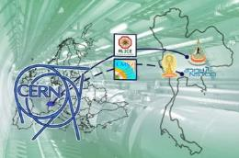
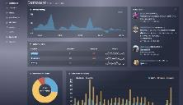
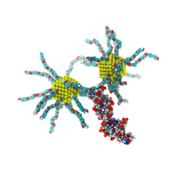
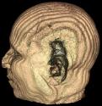
RESOURCES
9 Members
4,292 CPU core; 1,284 TB
Support to 3 application areas
High Energy Particle Physic
Computational Science & Engineering
Computer Science & Engineering

Slide 6
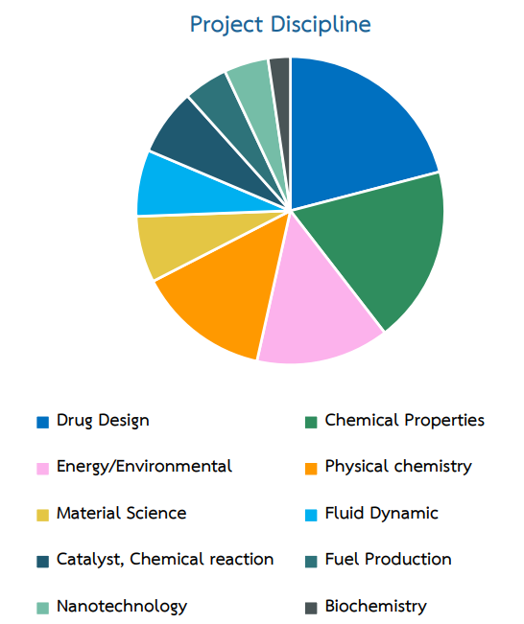
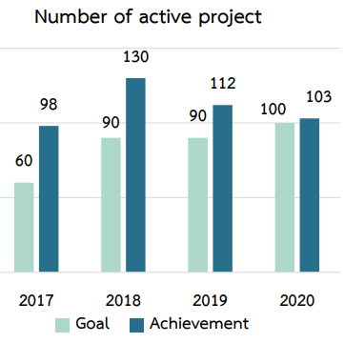

Slide 7
Collaboration with WLCG
Tier2 Computing sites:
T2-TH-CUNSTDA
T2-TH-SUT
Production site for CMS experiment since Jun 2014
Operate by CU and NSTDA
Upgrading and testing a system (ready for operate again by Jul 2018)
260 CPU Cores, 300TB run on GlusterFS
Production site of ALICE experiment since Oct 2014
Operate by SUT
99-100% availability
256 CPU cores, 100TB on GPFS for stored ALICE data

Slide 8
Thailand Supercomputer Center: ThaiSC
NEEDS
CURRENT LIMITS
SOLUTIONS
BENEFITS
Computing infrastructure service to Thai researchers
In house HPC resources
Small/mid research scale
Lack of global competition
Enhancing national research capability
Increasing cost effectiveness in computational resource
Raising Thailand competitiveness among ASEAN
Develop
ThaiSC
National computing infrastructure
Economic/Social Research
Large-scale/complex research problem on computational science and DA
Comp. Sci. Research
Trend Big Data & AI

Slide 9
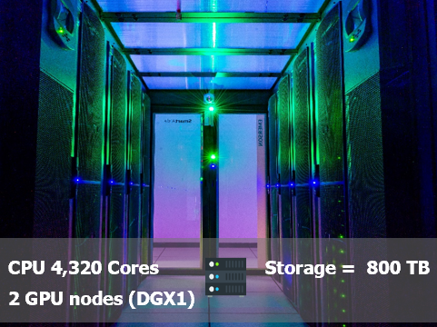
Thailand Supercomputer Center: ThaiSC
Vision
Leading HPC facility and computational science R&D center in ASEAN
Mission
1. Provide HPC computing service for Thailand R&D
2. Perform frontier computational science R&D
3. Promote development of HPC workforce
4. Develop HPC roadmap for Thailand
5. Establish partnership and visibility

Slide 10
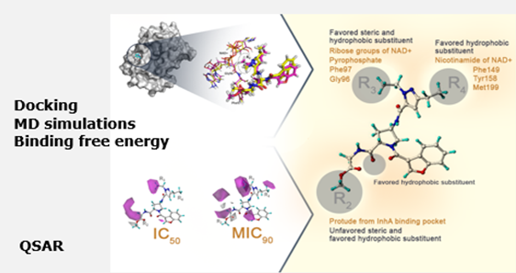
Ex. of RESEARCH PROJECTS
Virtual screening, MD simulations and binding free energy calculations to identify novel ATPase inhibitors against MTB DNA gyrase
Ubon Ratchathani University
Relatd to Anti-tuberculosis agents

Slide 11
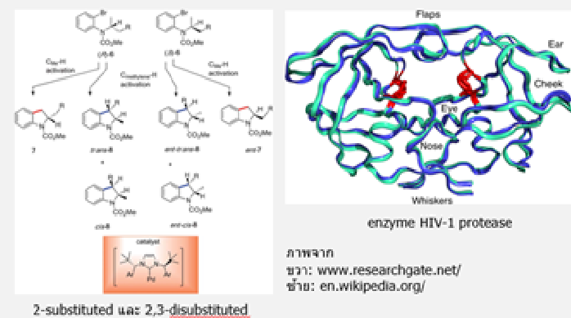
Ex. of RESEARCH PROJECTS
COVID-19 Main Protease – Molecular Docking
Faculty of Pharmacy, Srinakharinwirot University
COVID-19 – Computational Chemistry
Chulalongkorn University

Slide 12
Activities 2019-2020
eHPC2020: Workshop on e-Science and High Performance Computing 2020
17 December 2020
“20 Years Collaboration Thai-CERN, HPC for AI and Big Data”

Slide 13
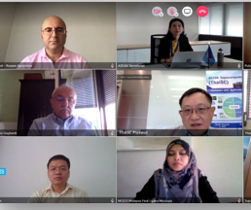
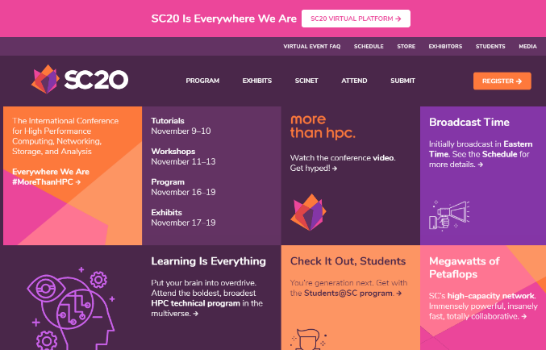
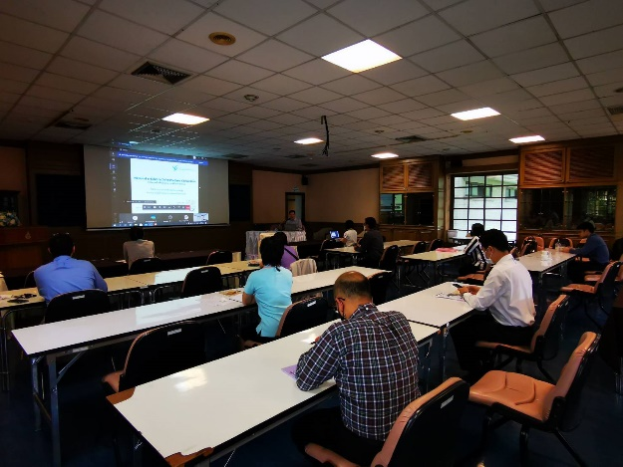
Activities 2019-2020
Supercomputing 2020 - 16-19 November 2020
ASEAN HPC Task Force – February 2020
Join the EU-ASEAN discussion on HPC COVID19 - 10 July 2020

Slide 14
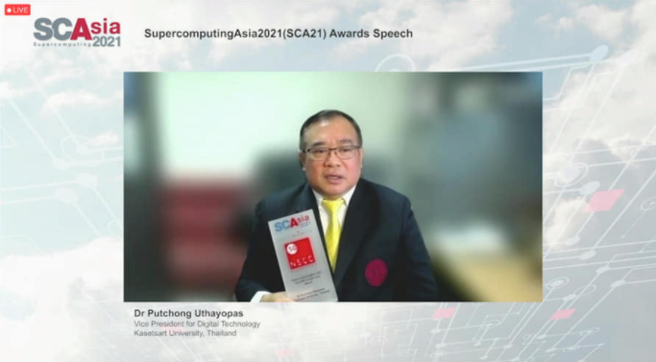
Award
Dr. Puchong Uthayas from Kasetsart University, e-Science Committee received “Asia HPC Leadership Award” at SupercomputingAsia 2021. He is one of the HPC pioneers in Thailand.

Slide 15
e-Science Booklet 2020
Download: https://sharebox.nstda.or.th/d/edb6114e

Slide 16
Thank You

