Slide 1
Machine Learning Infrastructure on the Frontier of Virtual Unwrapping
Stephen Parsons, Jacob Chappell, W. Brent Seales, Lowell Pike
University of Kentucky, USA

Slide 2
Virtual Unwrapping

Slide 3
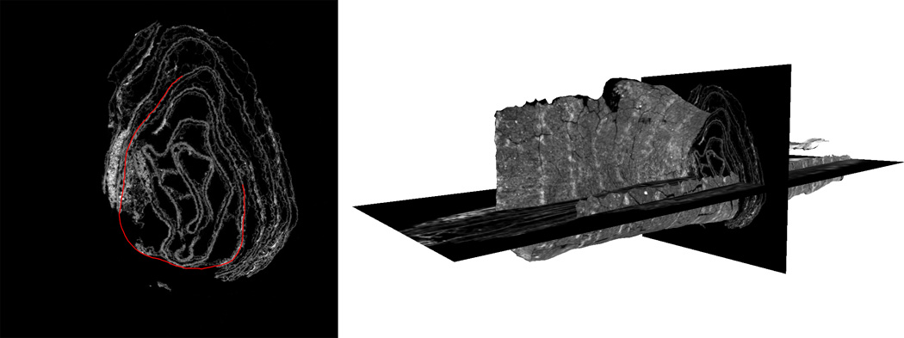
Virtual Unwrapping

Slide 4
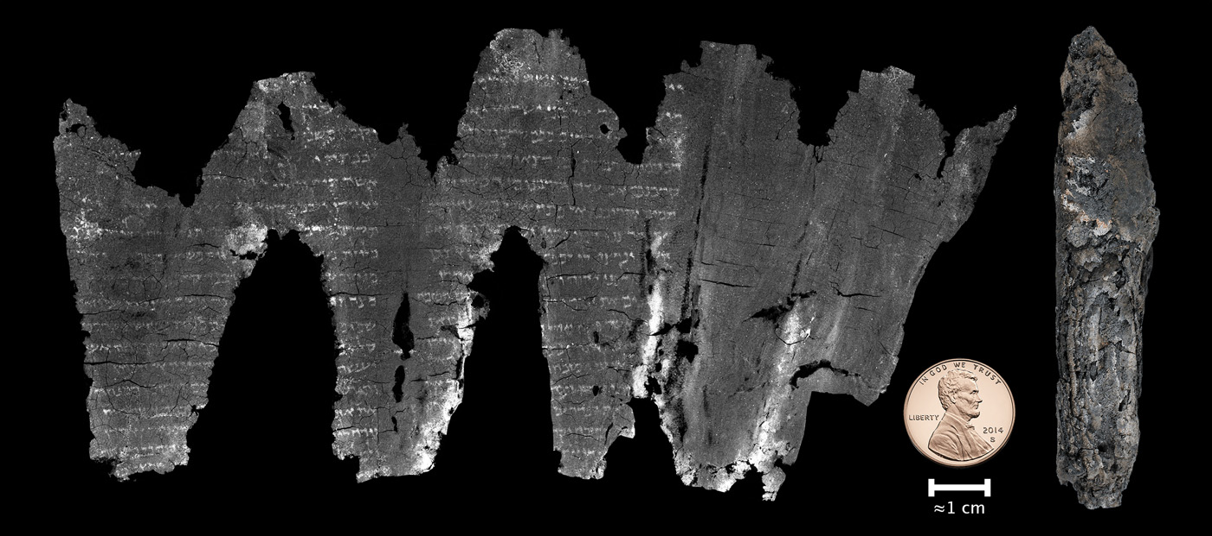
Virtual Unwrapping

Slide 5
Machine Learning for Texturing
Thicker Ink
Original RGB
Traditional Texturing
Carbon Ink/No ink
Learned RGB
Notes:
Well we can!
ML/NN were originally introduced in order to find carbon ink where we could not otherwise find it
But they have this nice side effect:
They can be trained to reproduce any output for which there is training data

Slide 6
Machine Learning Experiments
ML relies on experiments:
Run complicated compute job
See what happens
Easiest in established ecosystem:
Clear metrics, performance benchmarks
Well understood data
Existing software frameworks

Slide 7
Challenges
Large, varied data
Small labeled datasets
No existing standards or libraries

Slide 8
Challenges
Result: building methods and ecosystem simultaneously
Important to be systematic!

Slide 9
Design Principles
Visualization
Automation
Data access
Metadata
Metrics

Slide 10
Experiment Overview
University Compute Cluster
Data
Results
Metadata
Visualizations
Metrics

Slide 11
Visualization
Custom scripts for meaningful results

Slide 12
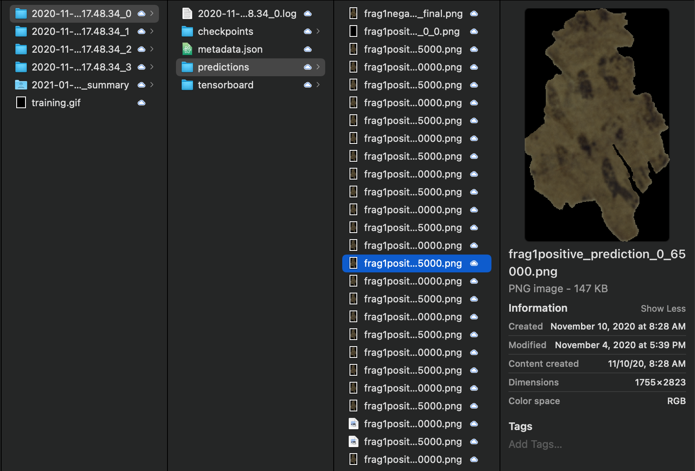

Slide 13
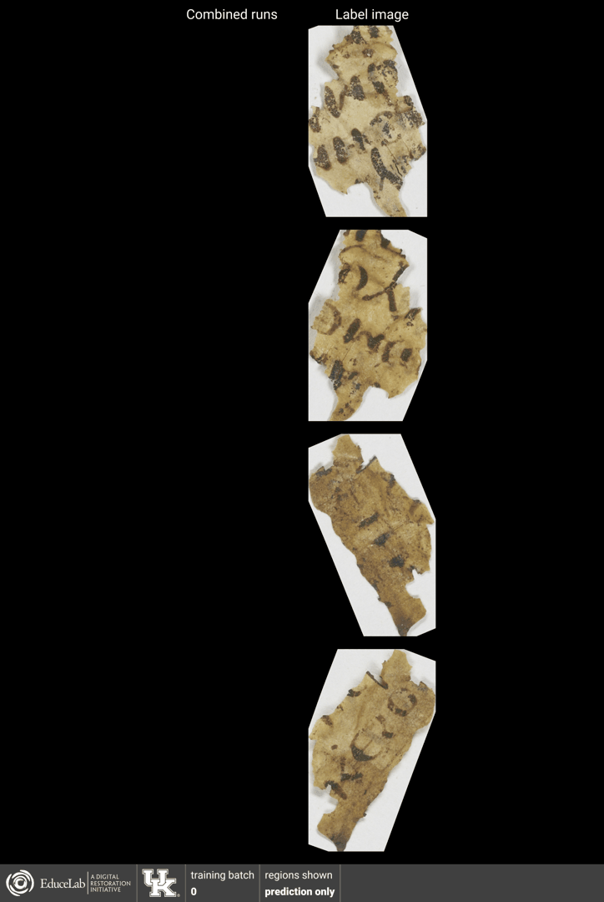

Slide 14
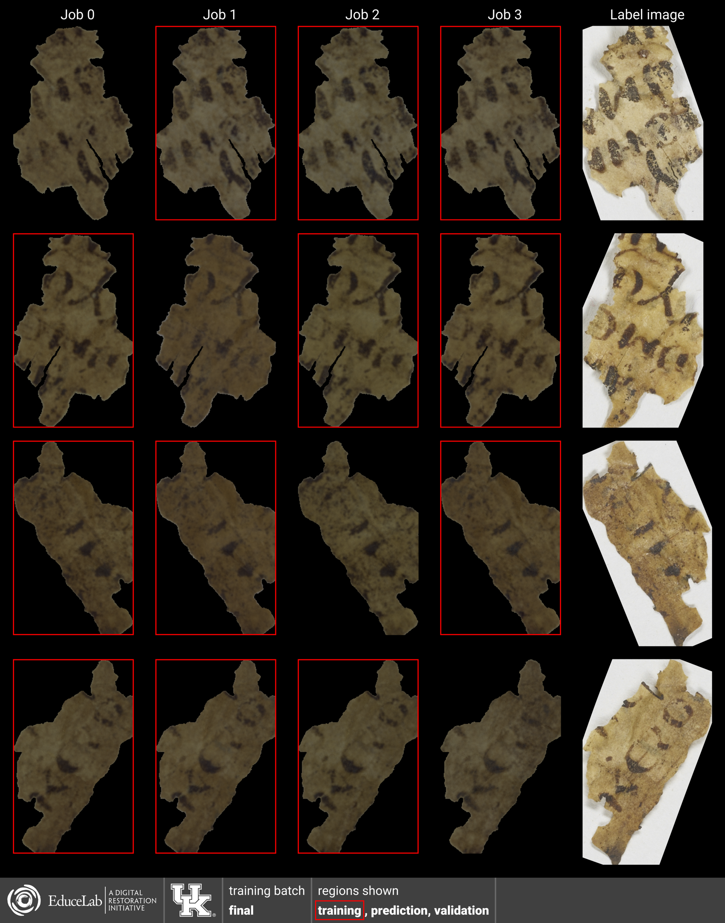

Slide 15
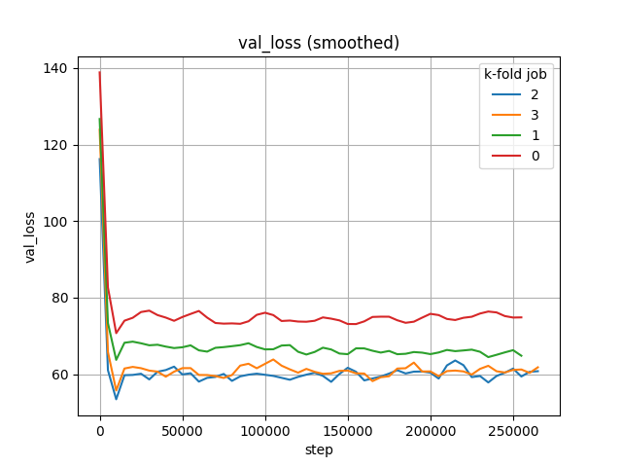

Slide 16
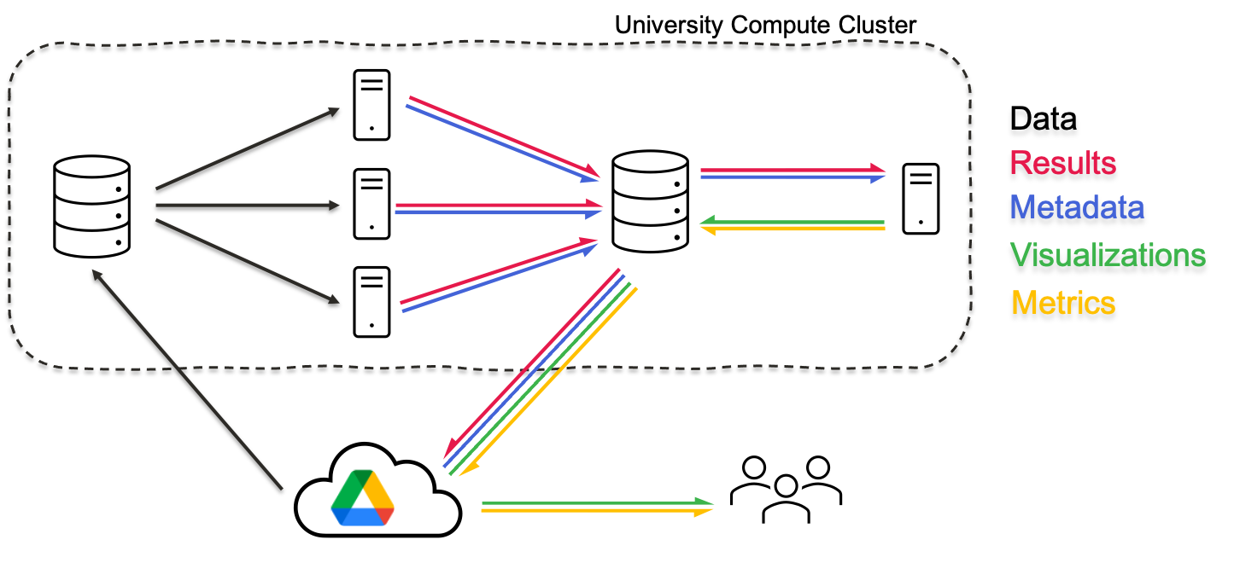
Automation
Every arrow takes time away from experiment design

Slide 17
Automation
Some helpful tools
Singularity containers for reliable environment
SLURM for parallel jobs
Rclone for data transfers
Python for custom scripts
Email notifications when jobs complete

Slide 18
Data access
Needs:
Store large number of files
Make them easily accessible (can send a link)
Best for us: University Google Drive

Slide 19
Metadata
Experiments should be transparent and reproducible

Slide 20
Metadata
{ "Arguments": { "data": "/pscratch/seales_uksr/dri-datasets-drive/MorganM910/MS910.volpkg/working/segmentation/all-fragments.json", "output": "/pscratch/seales_uksr/dri-experiments-drive/inkid/results/MS910/fragments/all/initial/06", "config_file": null, "k": 0, "override_volume_slices_dir": null, "feature_type": "subvolume_3dcnn", "label_type": "rgb_values", "model_3d_to_2d": false, "loss": "cross_entropy", "tversky_loss_alpha": 0.5, "focal_loss_alpha": 0.5, "subvolume_method": "nearest_neighbor", "subvolume_shape": [ 48, 48, 48 ], "pad_to_shape": null, "move_along_normal": 0.0, "normalize_subvolumes": false, "fft": false, "dwt": null, "dwt_channel_subbands": false, "length_in_each_direction": 8, "jitter_max": 4, "augmentation": true, "learning_rate": 0.001, "drop_rate": 0.5, "batch_norm_momentum": 0.9, "no_batch_norm": false, "filters": [ 32, 16, 8, 4 ], "batch_size": 32, "training_max_samples": null, "training_epochs": 1, "prediction_grid_spacing": 8, "prediction_averaging": false, "validation_max_samples": 5000, "summary_every_n_batches": 10, "checkpoint_every_n_batches": 5000, "final_prediction_on_all": true, "skip_training": false, "rclone_transfer_remote": null }, "Region set": { "ppms": { "frag1positive": { "path": "/pscratch/seales_uksr/dri-datasets-drive/MorganM910/MS910.volpkg/working/segmentation/fragment1/007_M910F1_50kV_200uA_8um/v3 (skeleton, 1 PPM)/positive/frag1positive.ppm", "volume": "/pscratch/seales_uksr/dri-datasets-drive/MorganM910/MS910.volpkg/volumes/20200519191237", "mask": "/pscratch/seales_uksr/dri-datasets-drive/MorganM910/MS910.volpkg/working/segmentation/fragment1/007_M910F1_50kV_200uA_8um/v3 (skeleton, 1 PPM)/positive/frag1positive_mask.png", "ink-label": "/pscratch/seales_uksr/dri-datasets-drive/MorganM910/MS910.volpkg/working/segmentation/fragment1/007_M910F1_50kV_200uA_8um/v3 (skeleton, 1 PPM)/positive/frag1positive_ink-labels.png", "rgb-label": "/pscratch/seales_uksr/dri-datasets-drive/MorganM910/MS910.volpkg/working/segmentation/fragment1/007_M910F1_50kV_200uA_8um/v3 (skeleton, 1 PPM)/positive/frag1positive_rgb.png", "invert_normal": true }, "frag1negative": { "path": "/pscratch/seales_uksr/dri-datasets-drive/MorganM910/MS910.volpkg/working/segmentation/fragment1/007_M910F1_50kV_200uA_8um/v3 (skeleton, 1 PPM)/negative/frag1negative.ppm", "volume": "/pscratch/seales_uksr/dri-datasets-drive/MorganM910/MS910.volpkg/volumes/20200519191237", "mask": "/pscratch/seales_uksr/dri-datasets-drive/MorganM910/MS910.volpkg/working/segmentation/fragment1/007_M910F1_50kV_200uA_8um/v3 (skeleton, 1 PPM)/negative/frag1negative_mask.png", "ink-label": "/pscratch/seales_uksr/dri-datasets-drive/MorganM910/MS910.volpkg/working/segmentation/fragment1/007_M910F1_50kV_200uA_8um/v3 (skeleton, 1 PPM)/negative/frag1negative_ink-labels.png", "rgb-label": "/pscratch/seales_uksr/dri-datasets-drive/MorganM910/MS910.volpkg/working/segmentation/fragment1/007_M910F1_50kV_200uA_8um/v3 (skeleton, 1 PPM)/negative/frag1negative_rgb.png" }, "frag2positive": { "path": "/pscratch/seales_uksr/dri-datasets-drive/MorganM910/MS910.volpkg/working/segmentation/fragment2/002_M910F2_60kV_166uA_8um/v2 (skeleton point cloud)/v2/ink-id/positive/frag2positive.ppm", "volume": "/pscratch/seales_uksr/dri-datasets-drive/MorganM910/MS910.volpkg/volumes/20200519144216", "mask": "/pscratch/seales_uksr/dri-datasets-drive/MorganM910/MS910.volpkg/working/segmentation/fragment2/002_M910F2_60kV_166uA_8um/v2 (skeleton point cloud)/v2/ink-id/positive/frag2positive_mask.png", "ink-label": "/pscratch/seales_uksr/dri-datasets-drive/MorganM910/MS910.volpkg/working/segmentation/fragment2/002_M910F2_60kV_166uA_8um/v2 (skeleton point cloud)/v2/ink-id/positive/frag2positive_ink-labels.png", "rgb-label": "/pscratch/seales_uksr/dri-datasets-drive/MorganM910/MS910.volpkg/working/segmentation/fragment2/002_M910F2_60kV_166uA_8um/v2 (skeleton point cloud)/v2/ink-id/positive/frag2positive_rgb.png", "invert_normal": true }, "frag2negative": { "path": "/pscratch/seales_uksr/dri-datasets-drive/MorganM910/MS910.volpkg/working/segmentation/fragment2/002_M910F2_60kV_166uA_8um/v2 (skeleton point cloud)/v2/ink-id/negative/frag2negative.ppm", "volume": "/pscratch/seales_uksr/dri-datasets-drive/MorganM910/MS910.volpkg/volumes/20200519144216", "mask": "/pscratch/seales_uksr/dri-datasets-drive/MorganM910/MS910.volpkg/working/segmentation/fragment2/002_M910F2_60kV_166uA_8um/v2 (skeleton point cloud)/v2/ink-id/negative/frag2negative_mask.png", "ink-label": "/pscratch/seales_uksr/dri-datasets-drive/MorganM910/MS910.volpkg/working/segmentation/fragment2/002_M910F2_60kV_166uA_8um/v2 (skeleton point cloud)/v2/ink-id/negative/frag2negative_ink-labels.png", "rgb-label": "/pscratch/seales_uksr/dri-datasets-drive/MorganM910/MS910.volpkg/working/segmentation/fragment2/002_M910F2_60kV_166uA_8um/v2 (skeleton point cloud)/v2/ink-id/negative/frag2negative_rgb.png" } }, "regions": { "prediction": [ { "ppm": "frag1positive" } ], "validation": [ { "ppm": "frag1positive" } ], "training": [ { "ppm": "frag1negative" }, { "ppm": "frag2positive" }, { "ppm": "frag2negative" } ] } }, "Command": "/usr/local/dri/ink-id/.venv/bin/inkid-train-and-predict /pscratch/seales_uksr/dri-datasets-drive/MorganM910/MS910.volpkg/working/segmentation/all-fragments.json /pscratch/seales_uksr/dri-experiments-drive/inkid/results/MS910/fragments/all/initial/06 --subvolume-shape 48 48 48 --final-prediction-on-all --prediction-grid-spacing 8 --label-type rgb_values -k 0", "Git hash": "663e50", "SLURM Job ID": "1296510", "SLURM Job Name": "inkid", "Final validation metrics": { "loss": 74.98181982885433 }, "Runtime": 67434.52107381995, "Finished at": "2020-11-05 12:32:28" }
{ "Arguments": { "data": "/pscratch/seales_uksr/dri-datasets-drive/MorganM910/MS910.volpkg/working/segmentation/all-fragments.json", "output": "/pscratch/seales_uksr/dri-experiments-drive/inkid/results/MS910/fragments/all/initial/06", "config_file": null, "k": 0, "override_volume_slices_dir": null, "feature_type": "subvolume_3dcnn", "label_type": "rgb_values", "model_3d_to_2d": false, "loss": "cross_entropy", "tversky_loss_alpha": 0.5, "focal_loss_alpha": 0.5, "subvolume_method": "nearest_neighbor", "subvolume_shape": [ 48, 48, 48 ],
...

Slide 21
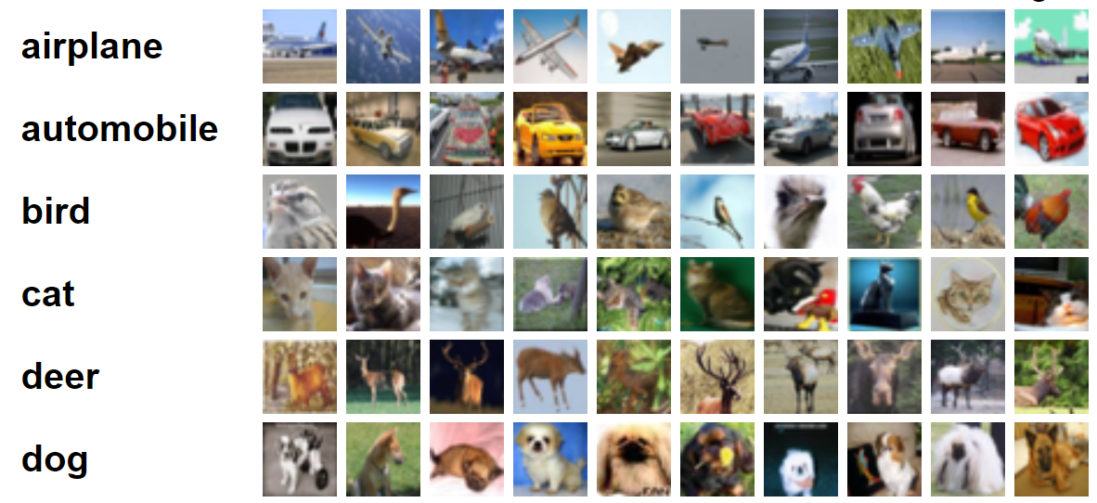
Metrics
Performance metrics, progress tracking
CIFAR-10 Image Classification Dataset

Slide 22
Metrics
Building our own benchmark datasets

Slide 23
Conclusion
Primary challenge: building methods and ecosystem simultaneously
Addressing via systematic approach

Slide 24
Distributed Research in a Pandemic
Remote work has aligned with many of these objectives
Forces us to:
Automate as much as possible
Make visualizations easy for team members to access
Document processes and results

Slide 25
Thank You!
Code:
gitlab.com/educelab
Papers:
www2.cs.uky.edu/dri/news/#publications

