Slide 1
Simulate the social distancing in the new normal
Yu-Chen Wang , Sheng Ming Wang
Department of Interaction Design, National Taipei University of Technology
Notes:
Your honorable chair, ladies and gentlemen! Now we are presenting our paper on “Simulate the social distancing in the new normal”. This paper was written by Yu-Chen Wang, Sheng-Ming Wang. I am the presenter, Yu-Chen Wang.

Slide 2
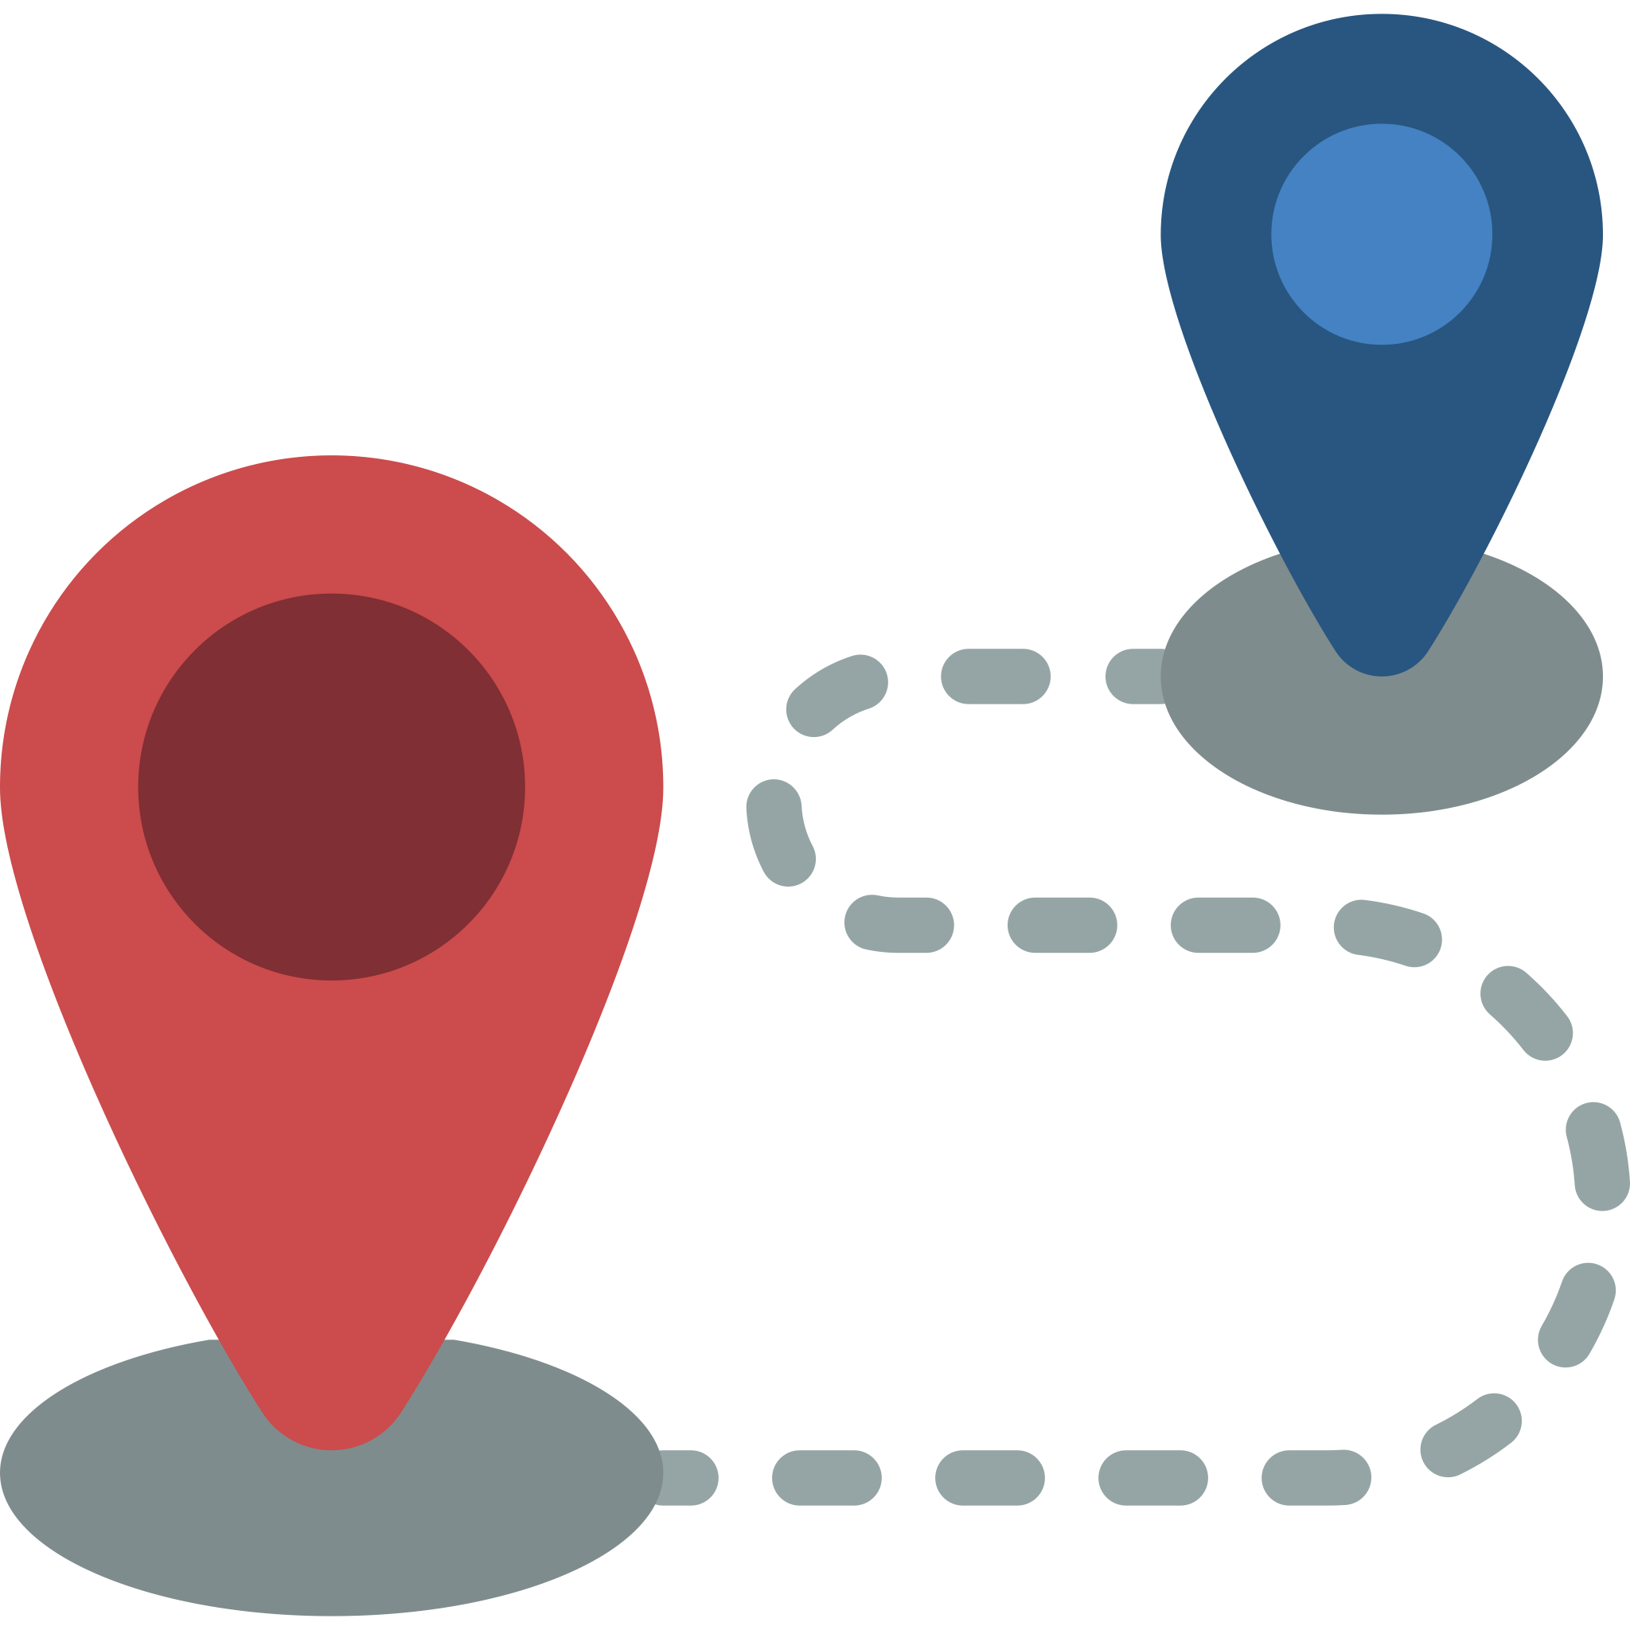
Research Motivation and Contribution
The related studies have recommended maintaining a social distance of 1.5 meters, which avoids mass gatherings in order to reduce the spread of the epidemic by reducing contact between infected and uninfected persons. In the new normal, this study try to know the relationship between Google place API and pedestrian, how the data could reflect to the real world. Hence, there are several results below:
To prove that maintain social distancing cause high-risk of infection.
Establish the simulation model framework for other experiment areas in the future.
To be a reference for decision-maker to know the development of area and the situation of virus spreading
Pedestrian trajectory
Heatmap
Simulation modeling
Notes:
Under the COVID-19 pandemic, the Government in the world suggests that people should abide by social distancing, which is 1.5 meters. Social distancing could reduce the spread of the epidemic by reducing contact between infected and uninfected persons. In this case, we are going to discuss two things.
First, knowing that the high-risk infection without any protection.
Second, knowing that how people move in the public space could affect the whole area.
So, there are several contributions following:
1.To prove that maintain social distancing causes high-risk infection.
2.Establish the simulation model framework for other experiment areas in the future.
3.To be a reference for decision-maker to know the development of the area and the situation of the virus spreading

Slide 3
Introduction and Research Framework
Simulation framework
Agent-based modeling
Validation of modeling and adjustment of parameter
Establishment of simulation modeling
Pedestrian trajectory
Human behavior analysis
Data processing
Notes:
Here are the introduction and research framework.
It mainly divides into three sections, the first one is Agent-based modeling, the second one is the pedestrian trajectory, the third one is human behavior analysis.
Agent-based modeling is a kind of simulation method, you could setting different kinds of agents such as a car, people, building, etc., and then define the behavior for each agent by programming.
The relationship in this picture are following:
1.The relationship between Human behavior analysis and pedestrian trajectory is that doing data processing to classify the group of pedestrians, and then knowing the behavior in each group.
2.The relationship between Human behavior analysis and ABM is that based on the human behavior to set up the parameter and the model around the experiment area.
3.The relationship between ABM and pedestrian trajectory is that trying to evaluate the modeling whether it could reflect the data to the real world.
4.In the end, build a simulation framework to make a simulation in other places.

Slide 4
Representative of area
Diversity of group
Choosing the area
Research Process
Choosing the time
Data normalization
Data classification
Classification of behavior
Characteristic of behavior
Parameter design
Simulation
modeling
SOV(Share of voice)
Evaluation of
modeling
Notes:
Here is the research process of this study.
This case is following this process to do the whole research.
Including why we choose this area and time, how we classify the data and know the characteristic of behavior, what is the result of the simulation modeling, and then using Google place API to prove the modeling.

Slide 5
Background of simulation area-introduction
XimentDing is one of the famous spot in Taipei. Official data shows that there are around 1.83 millions people arrived Ximent MRT station in one month.
Record the trajectory data on the cross road in order to collect more data form people and know where are they going.
Recording area
Notes:
In this slide, I’m going to introduce the background of experiment area.
The reason I choose XimentDing is that this area is one of the famous spots in Taipei.
Another reason is that Official data shows that there are around 1.83 million people arrived at Ximen MRT station in one month and the recording time is around 4pm, it has lots of people there.
And Based on the observation and relative research shows that the most of people here are students( the age is around 15~22 years old), another one is young people( the age is around 24~30 years old)

Slide 6
Background of simulation area- main group
Mrs. Angela
Profession: student
Age: 15~24 years old
Gender: Female
Purpose: Foods, Watch movie, shopping
Mr. Johnson
Profession: young people
Age: 25~34 years old
Gender: Male
Purpose: date with friends, singing, shopping
Notes:
Here is the main group by observation and relative research
Based on the description of the group, you could find that purpose is all focus on foods, social and movie, these purposes are something can make you have fun here
It’s important to collect the data from Google Place API. I will mention it in next few slides.

Slide 7
Method of collecting trajectory data
Notes:
This is the video we take in the dadaocheng and it is how we collect the trajectory data as well.
We integrate 360-degree camera and object recognition to know the distance between camera and people, but it still has some limit of technology, for example,
The first one, it only can detect the area within the square of 20 multiply 20
The second one, the technology itself would detect in the wrong way like person 35
Th third one, Because the 360 videos already became flat, so if the person walks through the border of the video, it will re-recognize again.
In this situation, after I got the trajectory data, I would watch the video and arrange it again

Slide 8
Process of collecting trajectory data
By using deep sort and YOLOV3 to detect the pedestrian in the public space, and going through some data conversion to become a CSV file, including ID, coordinate, frame.
Video Processing
Upload to Google Colab
360-degree video recording
Extend 360-degree video
YOLOv4+DeepSORT
( Video analysis and processing )
Result output
Generate top view coordinate maps
Generate relative coordinates
Get ID, Distance ,Angle and frame number
Graphics conversion
Data conversion
Notes:
In this slide, I’m going to talk about how we collect data from the pedestrian.
The first step is 360-degree camera recording and goes through the video processing to extend the video to a flat one.
Then, we could upload the video to Google Colab to focus on doing object recognition by YOLOV4 and Deepsort.
This step wants to know each person’s ID, distance, angle, and frame to know the time. Distance and angle are trying to know the distance between person and camera, then we could calculate these two parameters to get the coordinate. In the end, convert the coordinate into the format of the Geography information system, then you can know the trajectory by each person.
The detail of the process of collecting data will present by the section of Humanities, Arts & Social Sciences, the title is
The Integration of Deep Learning and 360-Degree Video in Capturing Spatial Pedestrian Movements, if you are interested on it, you can participate it later on.

Slide 9
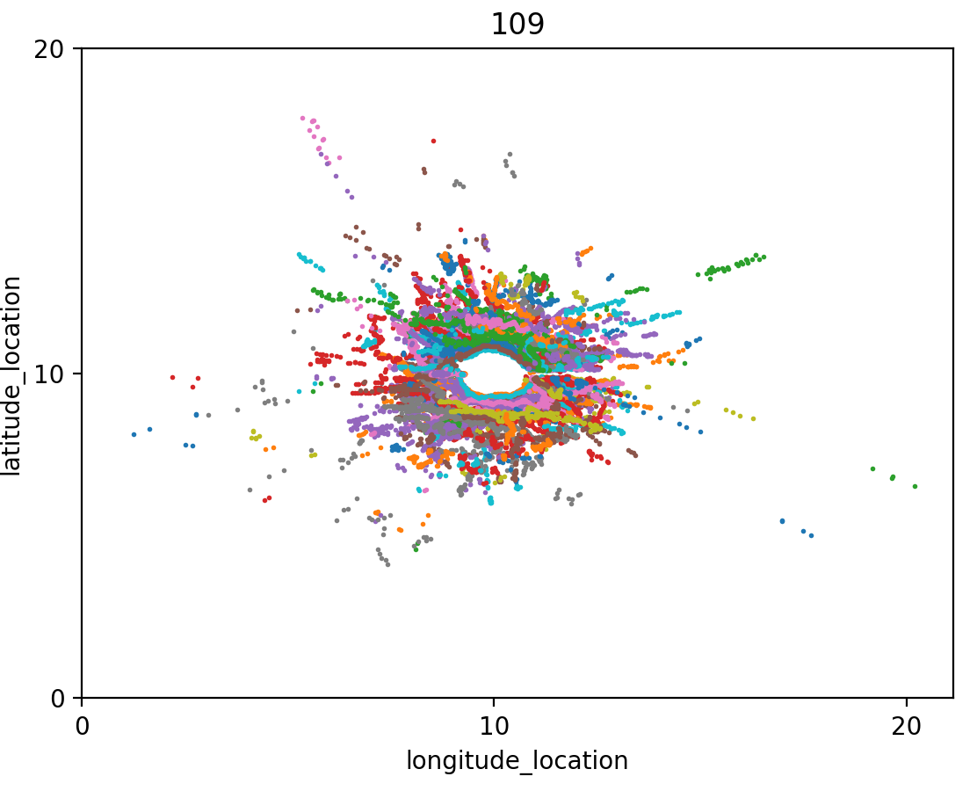
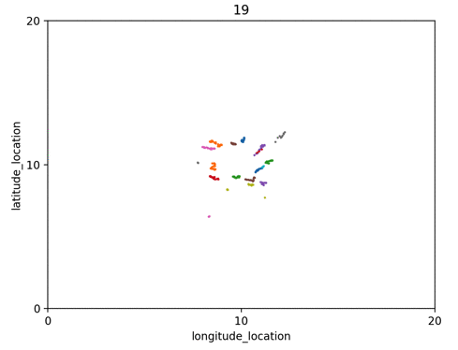
Data Visualization by using Python
This study collected data of 21219 sets of trajectory data. First, normalize these data to become easier to process it, and use matplotlib to visualize it.
Notes:
we mainly collect the data by 360 camera, totally received 21219 sets of trajectory data, and then we use python to visualize it.
On the left hand, it is whole the data present in the picture. And because the area we record is on the crossroad, so you could see pedestrians have different directions to recognize their purpose.
On the right hand, it’s a dynamic picture, it shows the process of the pedestrian trajectory, so you can see each person more clearly.

Slide 10
Data classification & characteristic of pedestrian
Second, By using python to filter the trajectory data (one by one) and then drop the data which is too short to know their behavior (no analytical value).
 | Number | Average speed
Wandering | 68 | X
Directionality | 41 | 0.59m/s
12808 data
Classification of pedestrian
 | Directionality | Wandering
Behavior style | Path: clearly and longer The distance in each second is more regular Less data and the distance in each second is longer. | Path: shorter The distance in each second is not regular Massive data and the distance in each second is shorter.
Characteristic of pedestrian
Notes:
By using python to filter the data, it separates it into two kinds of characteristics, wandering, and directionality. And the valuable data of directionality is 12808 sets of data, we do not discuss data of wandering because the path is too short, can not figure out their purpose
The average speed of a directionality person is 0.59 meter in seconds, The speed could be used in one of the parameter settings in the simulation model
The table shows below is talking about the behavior style in each group.
The directionality path is more clearly, longer and the distance in each data is almost the same
The wandering is opposite, the path of wandering is like a zigzag curve, you cant recognize the direction from them

Slide 11
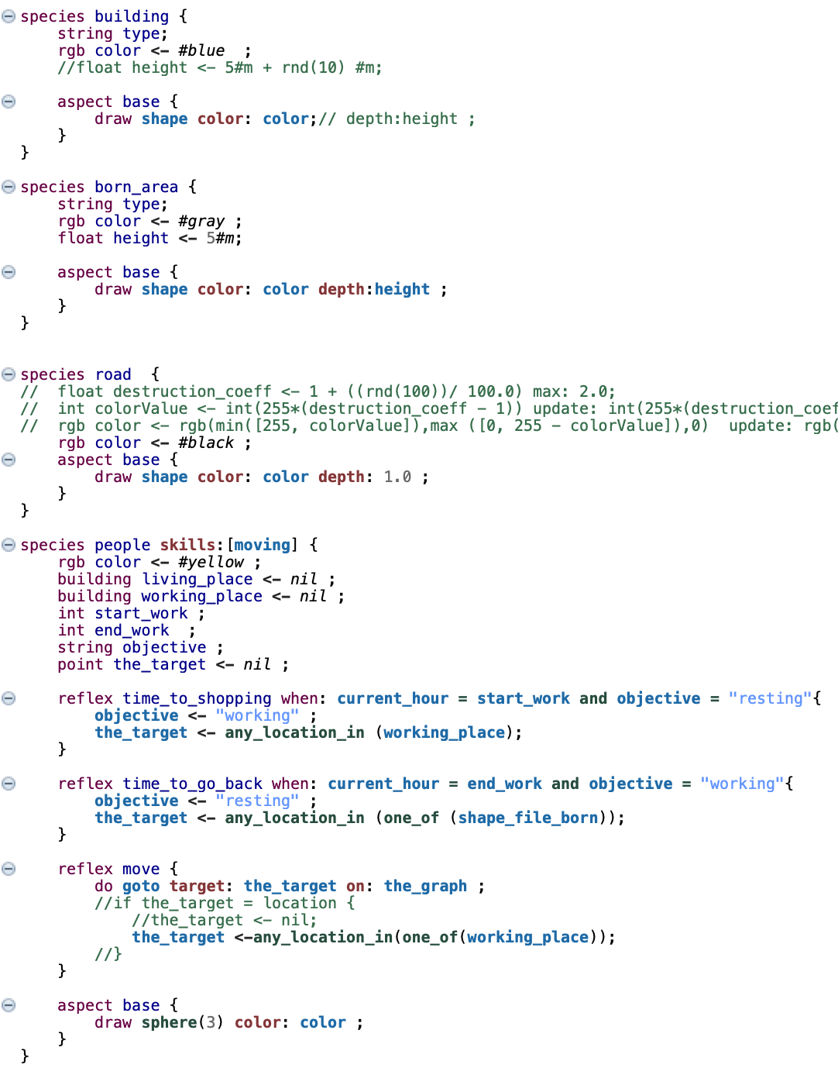
Simulation tool- Gama-platform
Using a open resource called Gama-platform, which is an agent-based simulation modeling. It supports user to import varieties of files, such as csv, 3D model, image, shape file, OSM, SVG .etc.
https://gama-platform.github.io/wiki/Home
Notes:
In this project, I use Agent-based modeling simulation to make it possible. The reason I use agent-based modeling is that I could give each agent-specific behavior and other rules. Gama platform is this kind of software, and it also supports users to import varieties of files, such as CSV, 3D model, image, shapefile, OSM, SVG .etc.
Before I import the modeling and CSV file into Gama-platform, I have to use the Geography information system to transfer the data to shapefile, then it could be used in Gama-platform.
As you can see, the red square on the right hand is how I define the behavior of people, including how to walking on the road, where is the destination. And the other basic condition I already defined it at the beginning such as speed, number of people, the walking path.

Slide 12
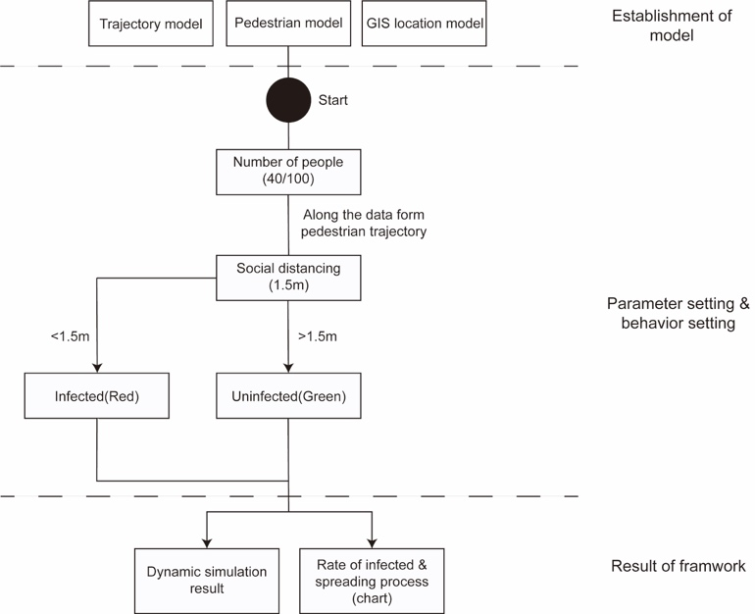
Simulation Structure
Notes:
In this slide, I’m going to talk about the simulation structure, it divided into three parts
In the first part, The modeling needs to import trajectory and the GIS location model to set the specific area up.
The second part, setting the condition to let the system know if people do not abide by the social distancing would cause a high-risk of infection.
The third part, based on the result of simulation to generate the dynamic chart

Slide 13
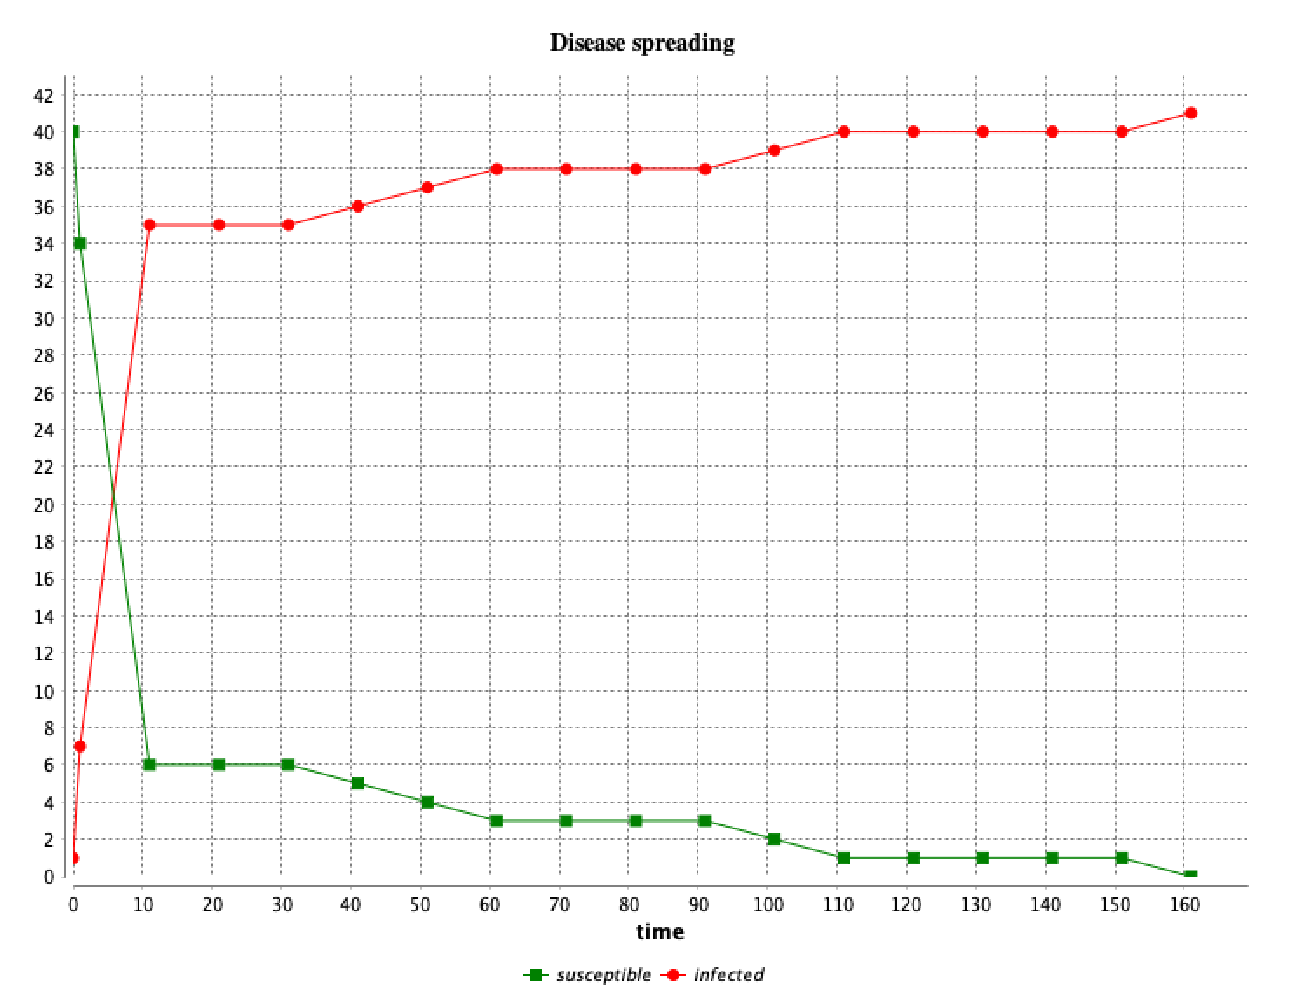
Simulation1-Corona virus
Notes:
This slide shows the result of the simulation of COVUD-19
On the left hand is the dynamic simulation, lines are all based on the trajectory data to generate it. And because we record the trajectory on the crossroad, so the conflict points are around the center points, would cause high-risk infection
On the right hand is the chart of the simulation, the red one is the high-risk infection people, the green one is normal people of keep social distancing.
you could see the rate of high-risk infection already 50% in 5 seconds.
What if the people here are 100 people, I think the situation would get worse
So far, it’s a pilot study, I don’t purpose any decision making, it only shows u that it is necessary to wear the mask in public space

Slide 14
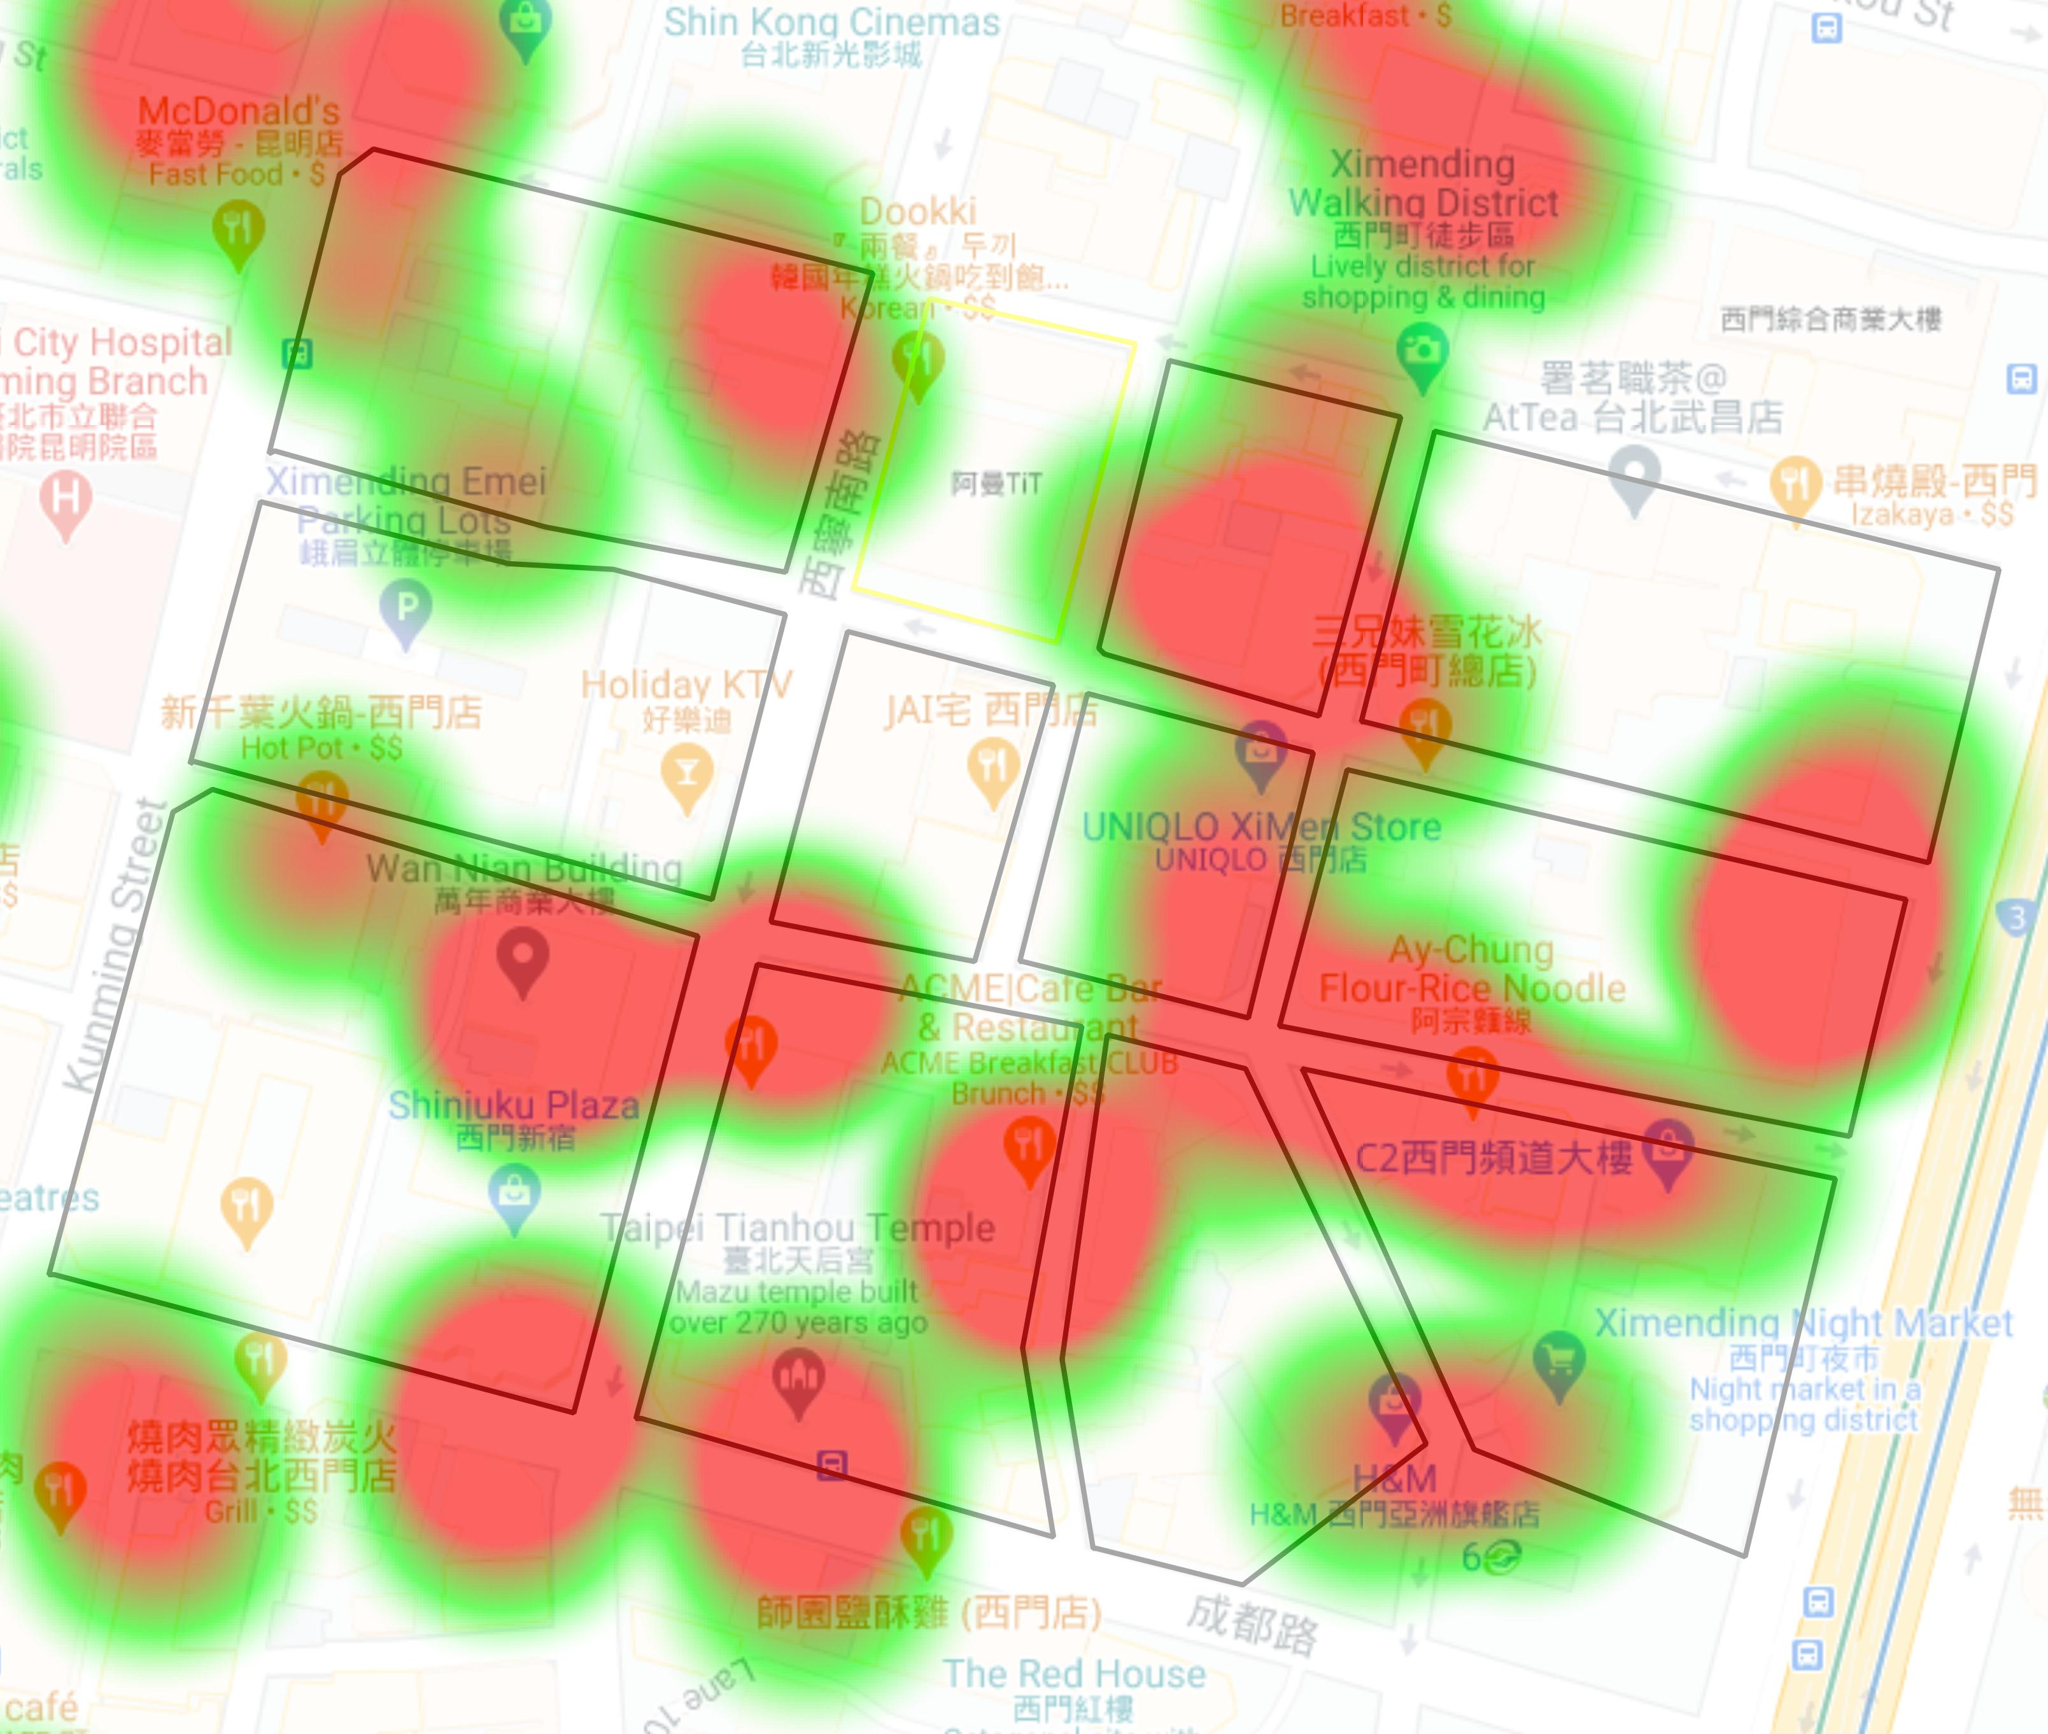
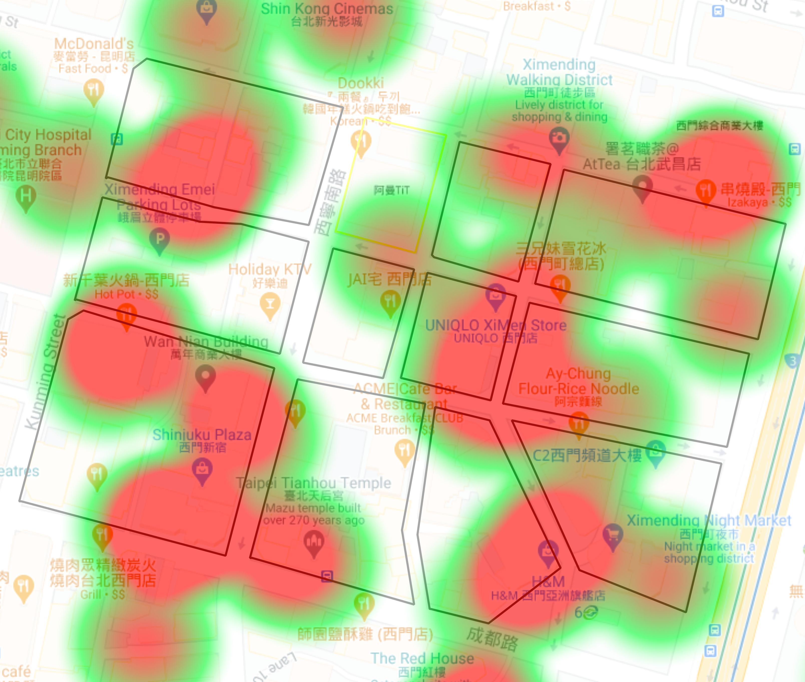
SOV(Share of Voice)-google place API
By using Google Place API to collect the data(933 sets of data) and knowing the famous spot for people who usually comes here. And import the data into QGIS system for visualizing the data by heatmap.
 | Foods | Cheerful
data | 180 | 419
Heatmap(foods)
Heatmap(cheerful)
Notes:
This study collects 933 sets of share of voice data and because limit of google place API, I only can get 60 data from each category. So I distinguish these data into five sections: foods, clothes, living, education, cheerful.
In XimentDing, the most popular section is foods and cheerful. According to the data, we could also know the main group in the area, I already mentioned it a few slides ago.
And we import the data into the Geography information system, then present it by heat map. you could more clear to understand the specific area is popular or not
So, we could based on the result to evaluate the simulation modeling.

Slide 15
Simulation2-Cheerful
Notes:
In the cheerful of simulation modeling, you could see the people are walking on one of the roads, and people would enter the building at random.
So it separates the area into a red one and a blue one, the red one is the hot spot for people.
The result of the simulation is correspond to the heatmap of the share of voice data

Slide 16
Simulation1-Foods
Notes:
In the foods of simulation modeling, it’s the same as the previous slide.
So we basically could say the data on the google map and the simulation is correct.
And in the next step, I will try to use the simulation to generate the different types of a heatmap of area, to predict the development of the area.

Slide 17
Conclusion
The main purpose of this research is to explore the relationship between pedestrian trajectory gathering and social distance to understand human behavior in public space with an agent-based simulation model and use it as a rule of behavior for reference of pedestrian behavior in the future. The result shows below:
More people in the public space would cause a more high risk of infection. In addition, to prove the difficulties of social distancing in public space.
Proving the simulation modeling could based on the spatial data and trajectory data to reflect in the real world
The result of research has been built up the simulation modeling framework, import the model and different types of parameters.
Notes:
In the conclusion, this study focuses on exploring the relationship between pedestrian trajectory gathering and social distance to understand human behavior in public space with an agent-based simulation model and use it as a rule of behavior for reference of pedestrian behavior in the future
There are three points of results following:
1.More people in the public space would cause a more high risk of infection. In addition, to prove the difficulties of social distancing in public space.
2.Proving the simulation modeling could be based on the spatial data and trajectory data to reflect in the real world
3.The result of research has been built up the simulation modeling framework, import the model, and different types of parameters. We only need to modify the different parameters then it can be produced different types of results.

Slide 18
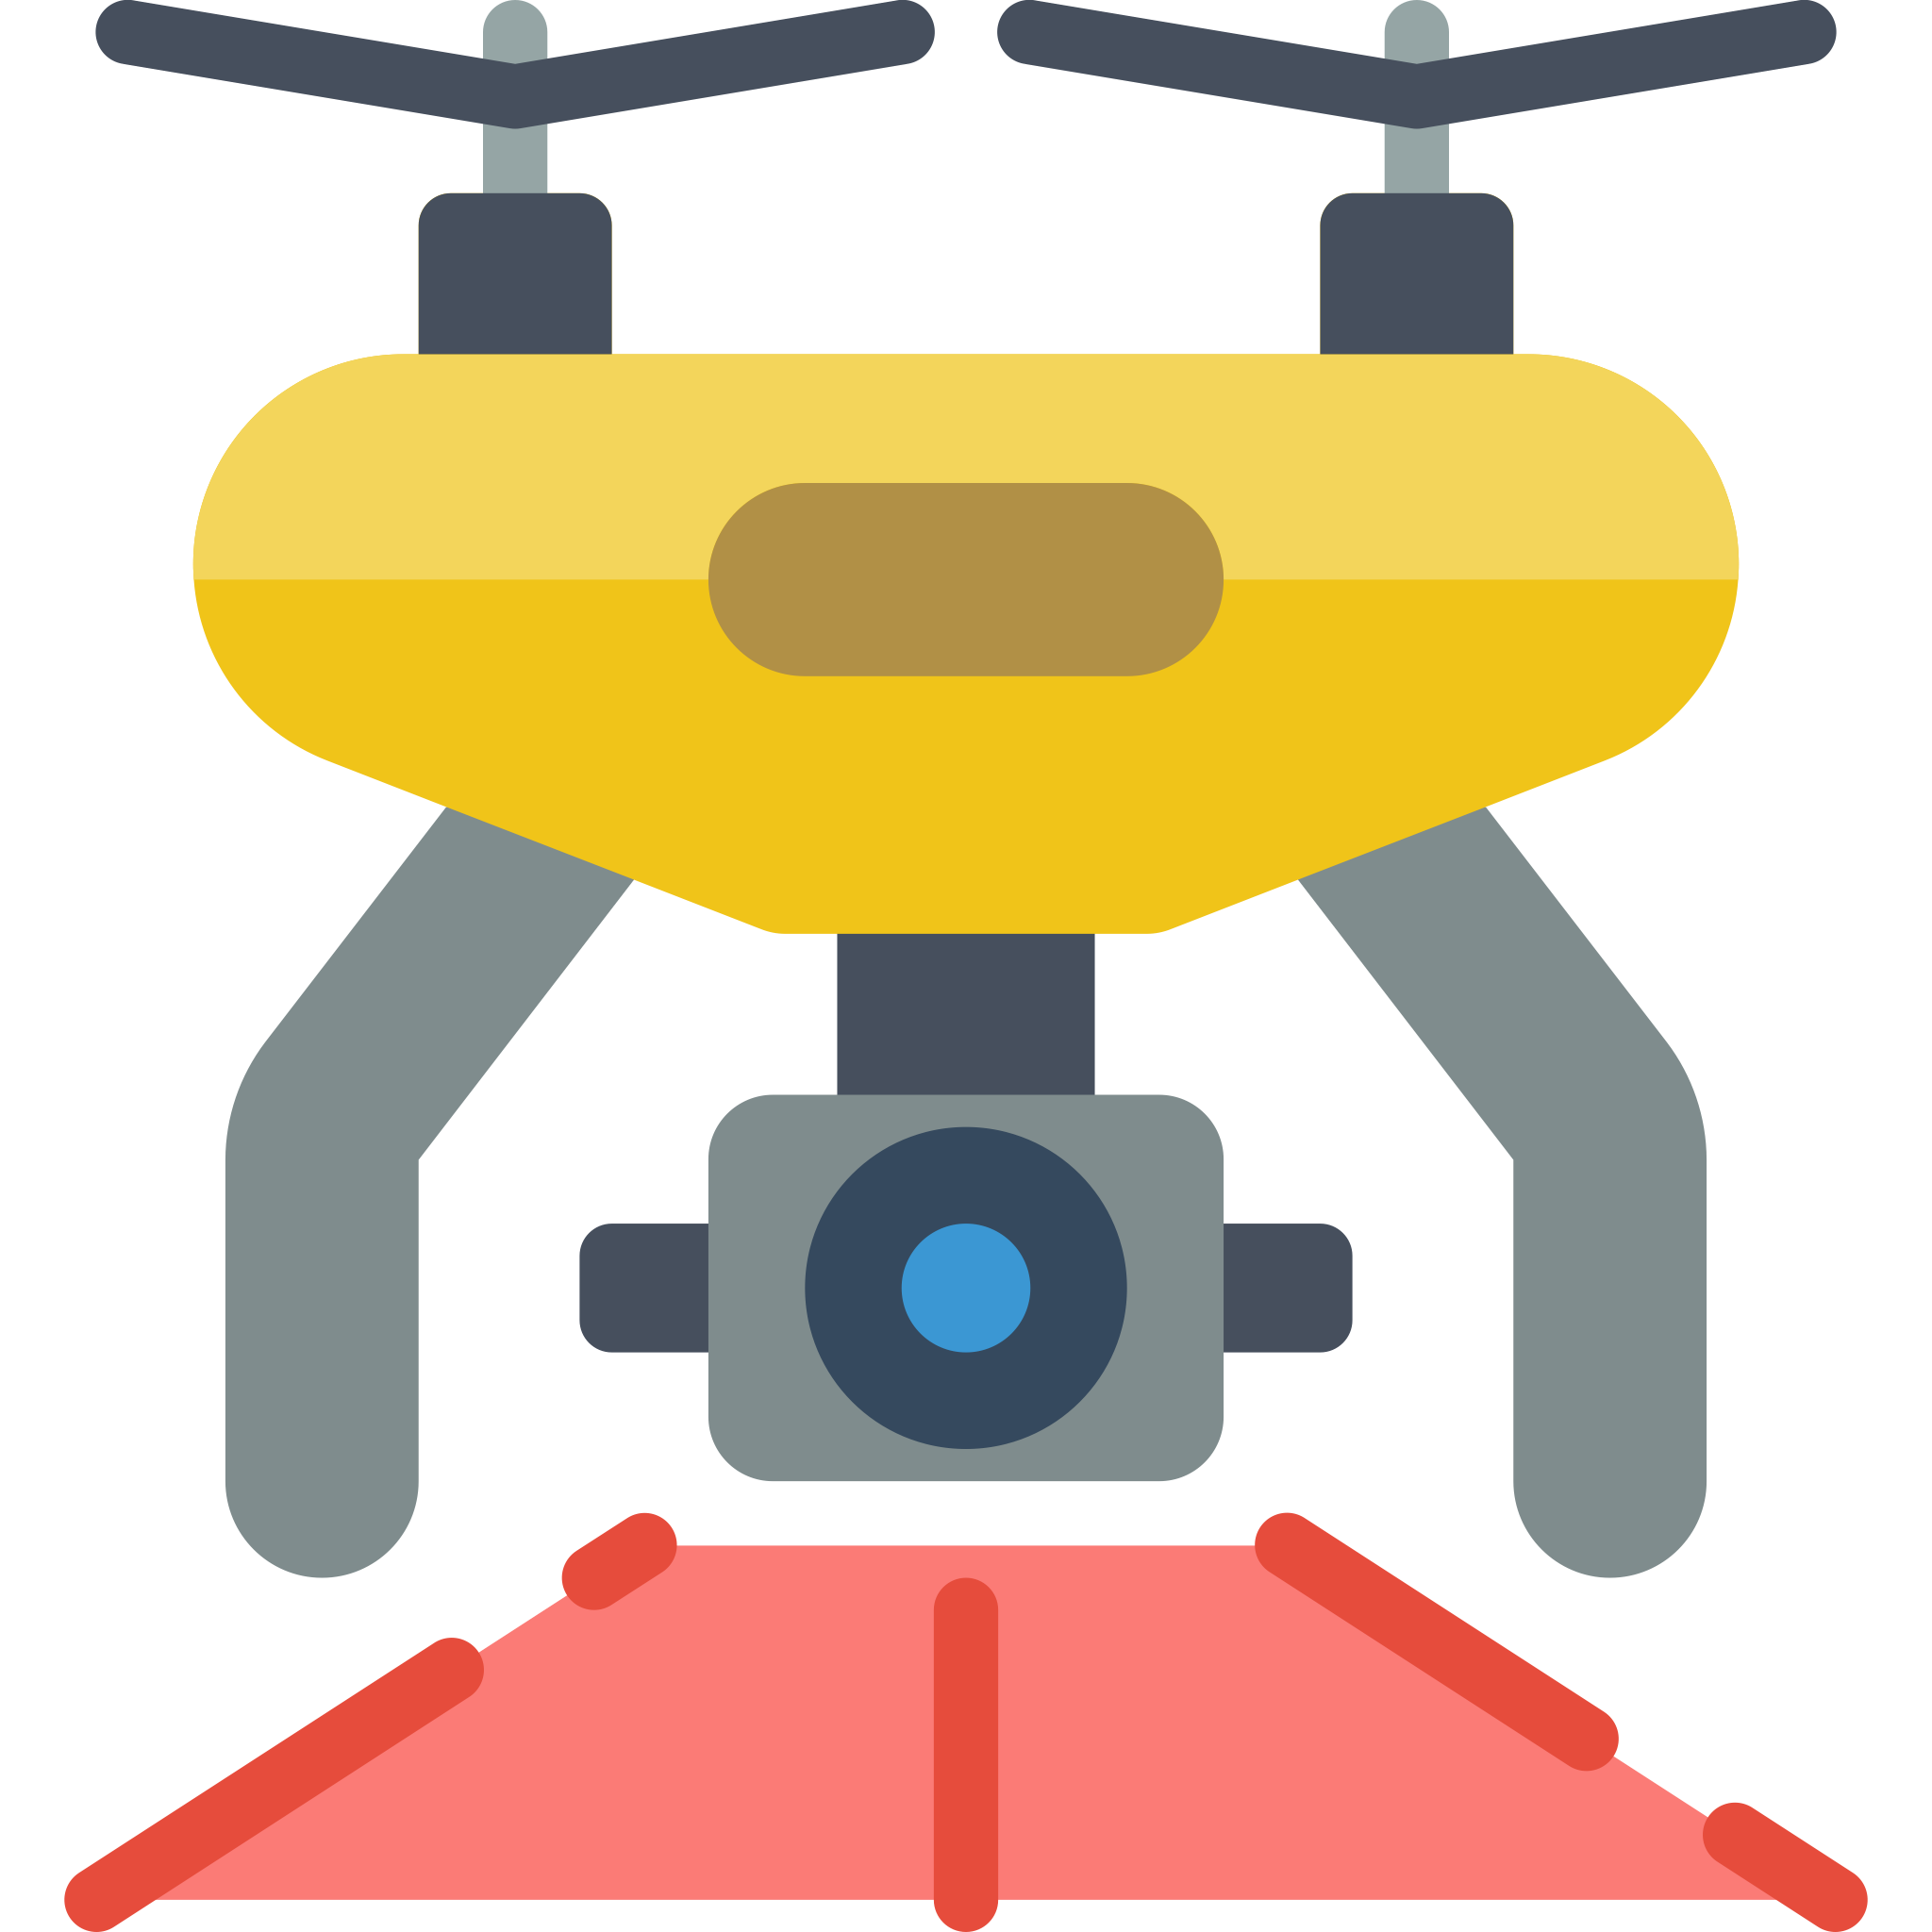
Future works
In this study, we will doing data control of data quality and then find three sample area to do analysis.
The simulation modeling could be used in other fields such as application of 5G, and based on the result to give decision-maker a reference.
In the future, we could use drone or wearable devices for tracking people in public space, to get more longer and complete trajectory.
Notes:
In future work, there are three points that could follow
1.In this study, we will do control of data quality and then find three sample areas to do analysis.
2.The simulation modeling could be used in other fields such as the application of 5G and based on the result to give the decision-maker a reference.
3.In the future, we could use drones or wearable devices for tracking people in public space, to get more longer and complete trajectory.

Slide 19
Thanks for listening

