Slide 1
Integrate deep learning into the 360-degree video to capture spatial pedestrian behavior patterns
Author：Cheng-Yen Lin
Sheng-ming Wang
2021.03.21
Notes:
Your honorable chair ladies and gentlemen.
I am today's presenter Lin Cheng-Yen.
My topic is

Slide 2
01
Research Background
02
Research Objectives and Contributions
CONTENT
03
Research Process and Results
04
Future work
Notes:
These are the four major themes that will be discussed today

Slide 3
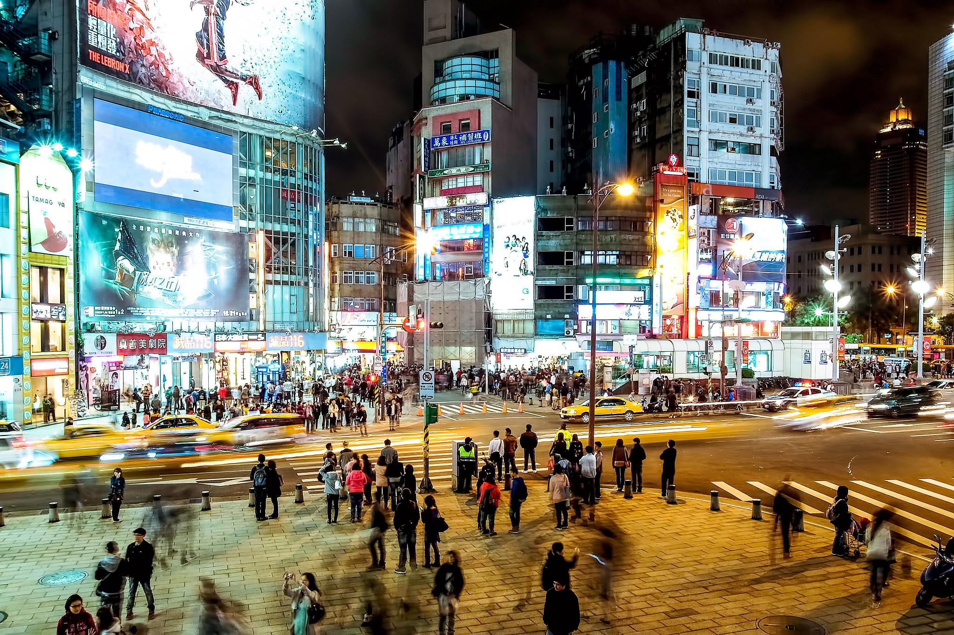
01
Research Background
Notes:
This research focuses on pedestrians in the city.
It is committed to using modern technology to improve the efficiency of pedestrian research

Slide 4
Notes:
Here we provide a short video to give you a general understanding

Slide 5
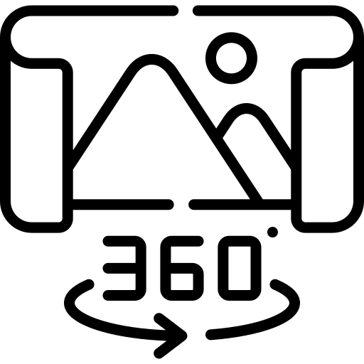
Notes:
Under the background of the development of science and technology, people's observation in cities has been introduced into scientific and technological applications from man-made on-the-spot investigation
For example, from monitoring systems or aerial drone images,
Although the application of the above-mentioned related technologies has gradually matured, it is only in certain specific fields.There are many limitations and undetectable characteristics such as indoor space and low forest
Therefore, this research study proposes to use 360 cameras to capture images containing the interaction between human and space in different spaces, integrate pre-processing, image processing, and deep learning of image recognition, trying to analyze the position of human in space

Slide 6
02
Research Objectives and Contributions
Objectives
Contributions
Use deep learning to analyze 360-degree videos, and calculate the position and distance of the pedestrian relative to the camera. To increase the speed of pedestrian data collection and improve the efficiency of analysis.
Establish a pedestrian search mechanism that can find a specific target among the crowd.
By recording the points, lines and surfaces of the pedestrian path, to find the relationship between the field space and pedestrians.
Notes:
The goal of this research is to combine 360 ​​cameras and deep learning.To increase the speed of pedestrian data collection and improve the efficiency of analysis.
And the Contributions is...

Slide 7
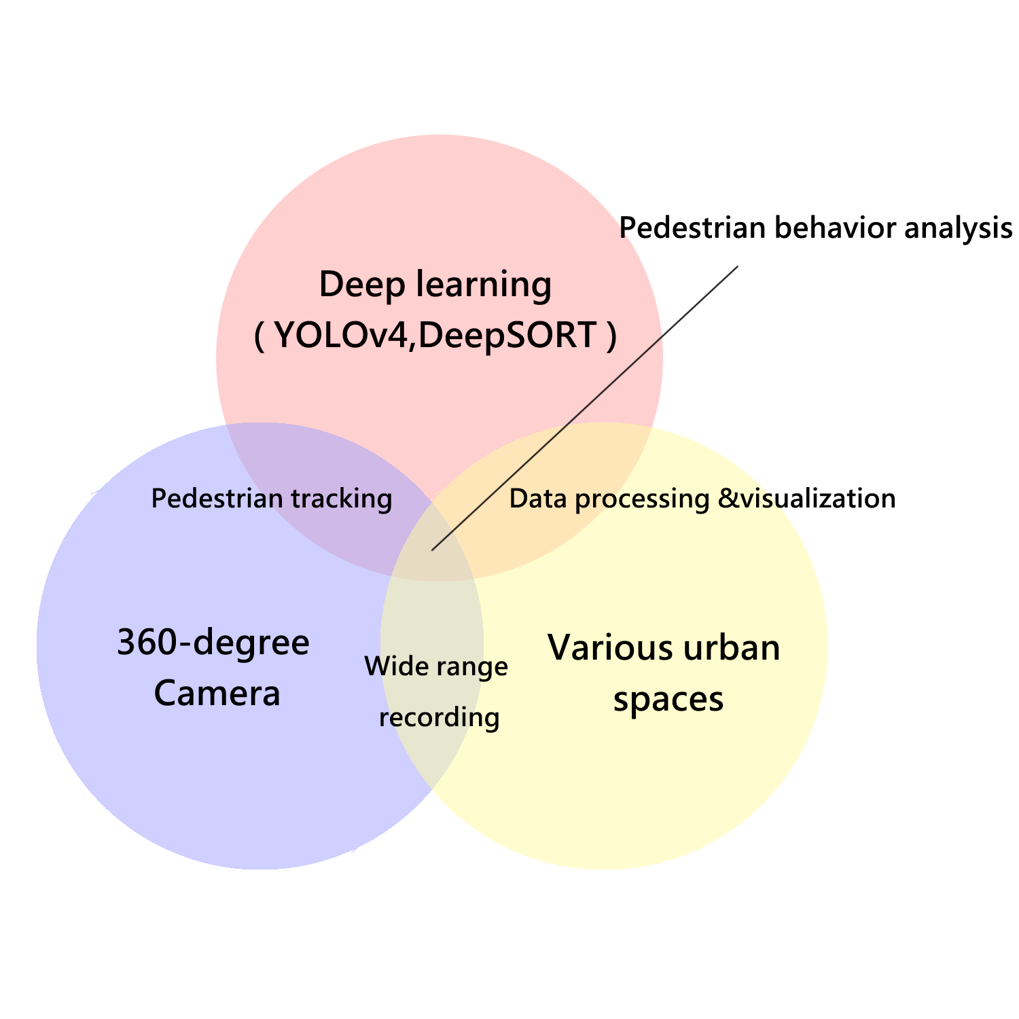
Research Framework
03
Notes:
Now we going to Research framework.
This is the diagram of this study,we will explain deep learning and research fields.

Slide 8
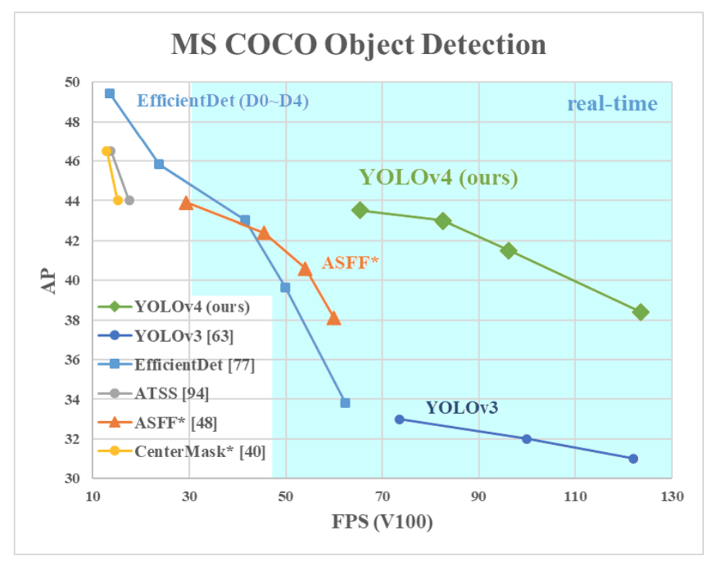
What is YOLOv4 ?
YOLO stands for You Only Look Once. It’s an object detection model used in deep learning use cases. Most people in the field today are used to YOLOv3, which already produces excellent results. YOLOv4 has improved again in terms of accuracy .
Notes:
What is YOLOv4 ?
As the picture in the right
YOLOv4 has improved again in terms of accuracy .

Slide 9
Video Processing
Upload to Google colab
360-degree video recording
Extend 360-degree video
YOLOv4+DeepSORT
( Video analysis and processing )
Data Collection
and Processing
Result output
Generate top view coordinate maps
Generate relative coordinates
Get ID, Distance ,Angle and frame number
Graphics conversion
Data conversion
Notes:
This is the flow chart of the whole experiment.
First, shoot 360 videos in the research space
Throw the video into the editing software and expand it into a 1920*1080 video
As shown in the introduction video just now
Next upload to Google colab for analysis

Slide 10
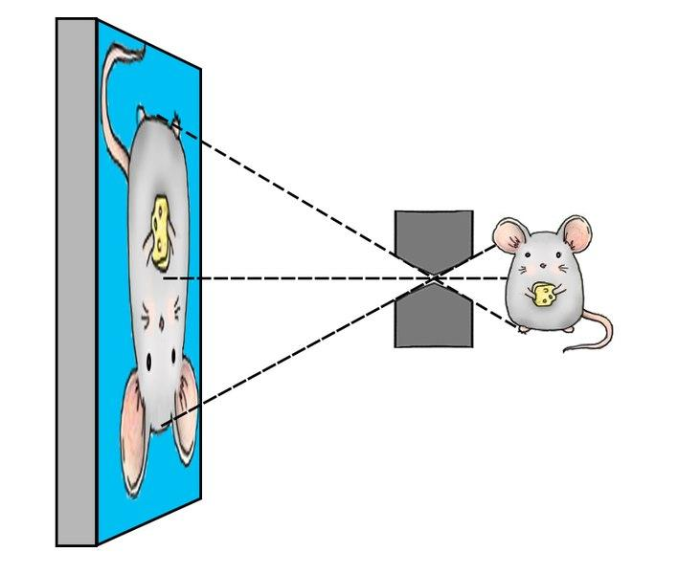
Focal length
Real objects
Image display
Principle of
Distance calculation
Actual distance
Pinhole imaging (Picture from Wikipedia)
Notes:
How to calculate distance
As the picture in the right.This picture introduce how camera works
What we want to know is the Actual distance
At known focal length, average height of pedestrians and image height
We can use the similar triangle theorem to calculate the actual distance

Slide 11
0°
152°
360°
Principle of
Angle calculation
Video width (1920px)
Notes:
How to calculate the angle of the pedestrian relative to the camera?
As shown on the right we can guess the actual angle from the width of the video.
The edges of the 360 ​​video represent 0 degrees and 360 degrees.
By knowing where the pedestrian is in the video, the angle can be inferred

Slide 12
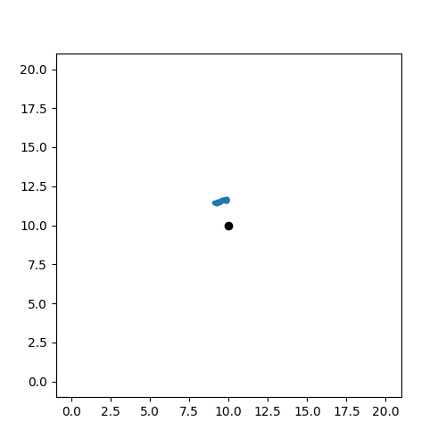
Video analysis and Graphics conversion
Notes:
In order to verify the feasibility of the conversion of the coordinates
I conducted a single-person tracking experiment before collecting pedestrians in public spaces.
The person in the film is me, walking on the squares drawn in advance
The video on the right is tracking result
He shows the way we go

Slide 13
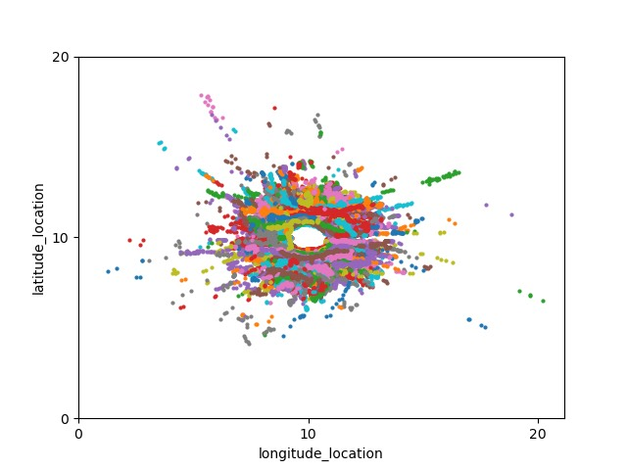
Open space record results
Recorded in the pedestrian area of ​​Ximending.
Due to the large number of people, the records are more complicated.
The space is too large to refer to the influence of nearby stores.
Shops and restaurants
Notes:
After establishing the system availability, we first came to the large open space.
Due to the large number of people, the records are more complicated.
The space is too large to refer to the influence of nearby stores.
Although the effect is not good, we can still track the probability of pedestrian walking and turning at this intersection.

Slide 14
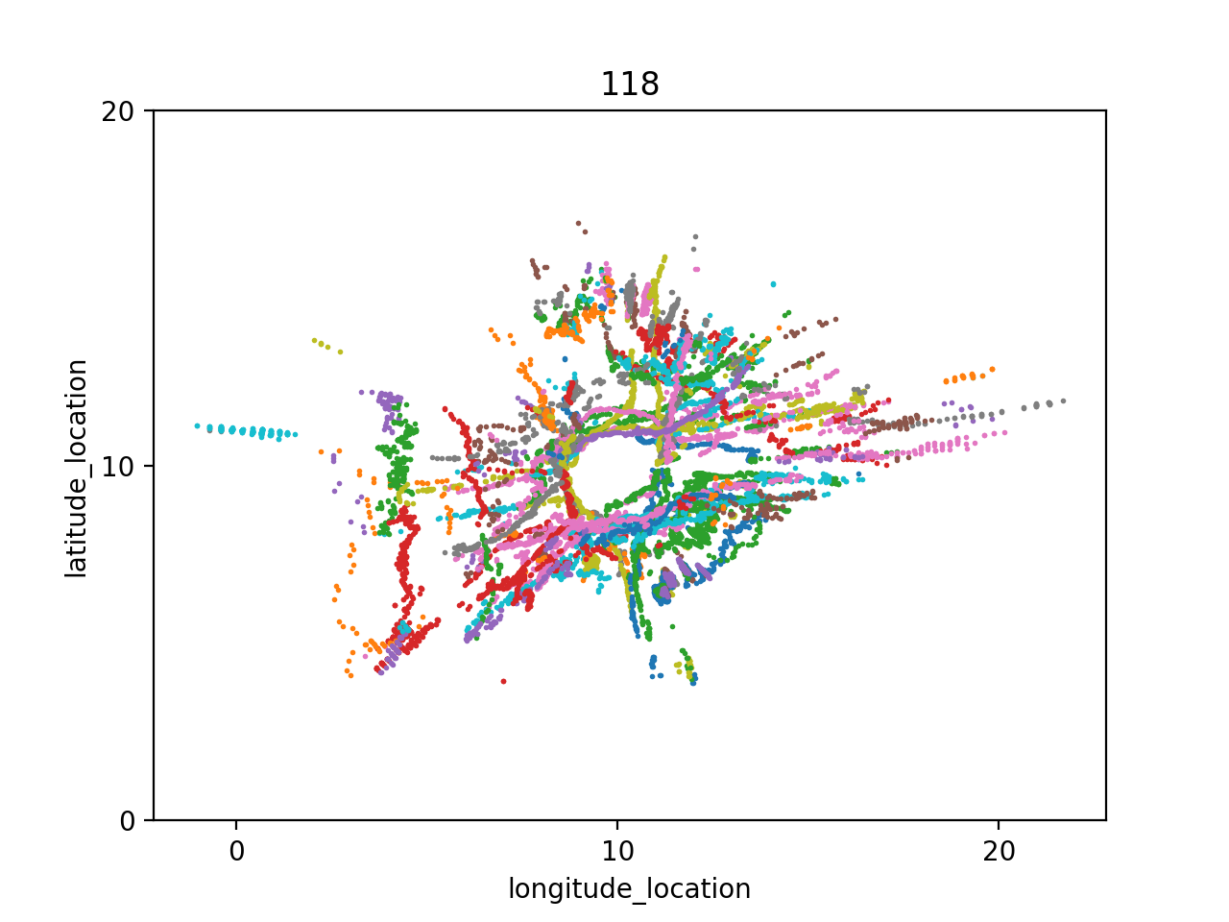
Semi-open space record results
Filming at the boundary of the school teaching hall and open space.
The path is clear and traceable.
Way to the gate
Outside the teaching building
Inside the teaching building
Rest area
Way to another building
Elevator
Notes:
Next we go to record the semi-open space.
This record shows the relationship between pedestrians and space, and can guess the intentions of pedestrians from their behavior, which is also the subject of this research. "to capture spatial pedestrian behavior patterns"

Slide 15
From a single person tracking experiment, we can confirm that it is feasible to convert the relative coordinates of the 360-degree video, and the deviation is less than 0.5 meters.
Due to the problem of blocking between pedestrians, large spaces are harder to track and guess pedestrians’ behavior.
Although this experiment has constructed a data search mechanism, however, due to the above reasons, data cleaning is required.
Conclusion

Slide 16
After collecting enough pedestrian trajectories, then convert these path data into space usage probabilities.
Combine smart city applications and data transmission. The large amount of information collected can be transmitted and be calculated in time. So that we can improve the city’s spatial problem handling capabilities.
Add more tracking information such as gender, age to increase the diversity of subsequent analysis.
Future work
Notes:
First after collecting enough pedestrian trajectories, then convert these path data into space usage probabilities.
The purpose is to incorporate this probability into the simulation software reference.
Second, Combine smart city applications and data transmission.5G and edge computing are getting more powerful the large amount of information collected can be transmitted and be calculated in time. So that we can improve the city’s spatial problem handling capabilities. Such as relieve traffic, look for obstacles or guide the flow of indoor people
Third Add more tracking information such as gender, age to increase the diversity of subsequent analysis.

Slide 17
Thanks for listening
Author : Cheng-Yen Lin
Email : t108ac8005@ntut.org.tw

