Slide 1
EGI Advanced Computing for EOSC
(EGI-ACE)
https://www.egi.eu/projects/egi-ace/
Gergely Sipos (EGI Foundation)
EGI-ACE Technical Coordinator
International Symposium on Grids & Clouds 2021
https://indico4.twgrid.org/indico/event/14/

Slide 2
EGI-ACE objective
Implement the Compute Platform of the European Open Science Cloud (EOSC) and contribute to the EOSC Data Commons by delivering integrated computing, platforms, data spaces and tools as an integrated solution that is aligned with major European cloud federation projects and HPC initiatives.
Duration: 30 months
Start date: 1 January 2021
End date: 30 June 2023
Partners: 33
Budget: 12,380,165 EURO

Slide 3
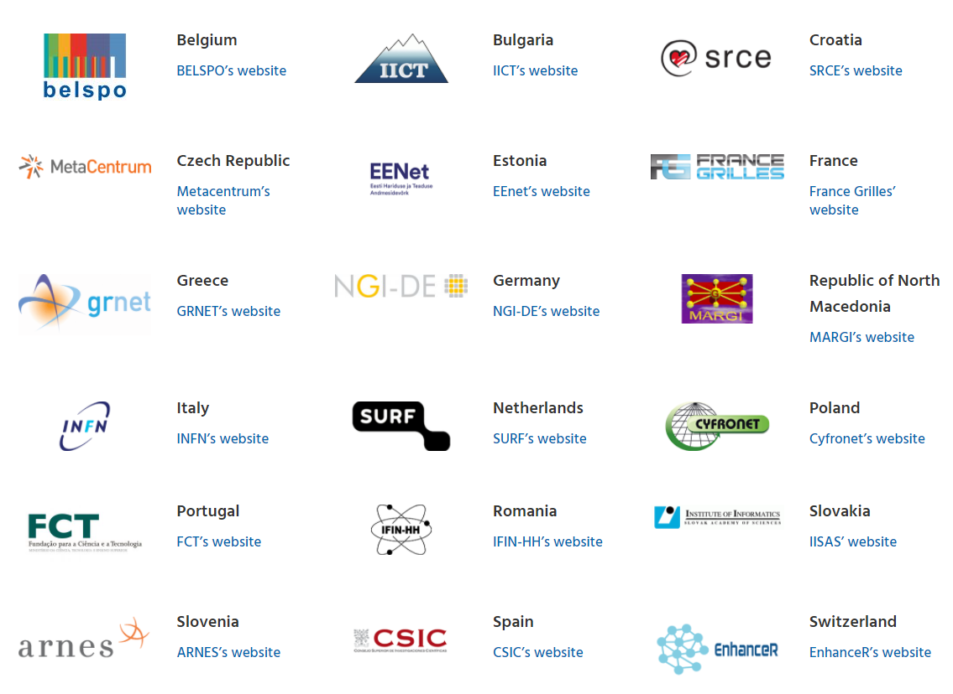
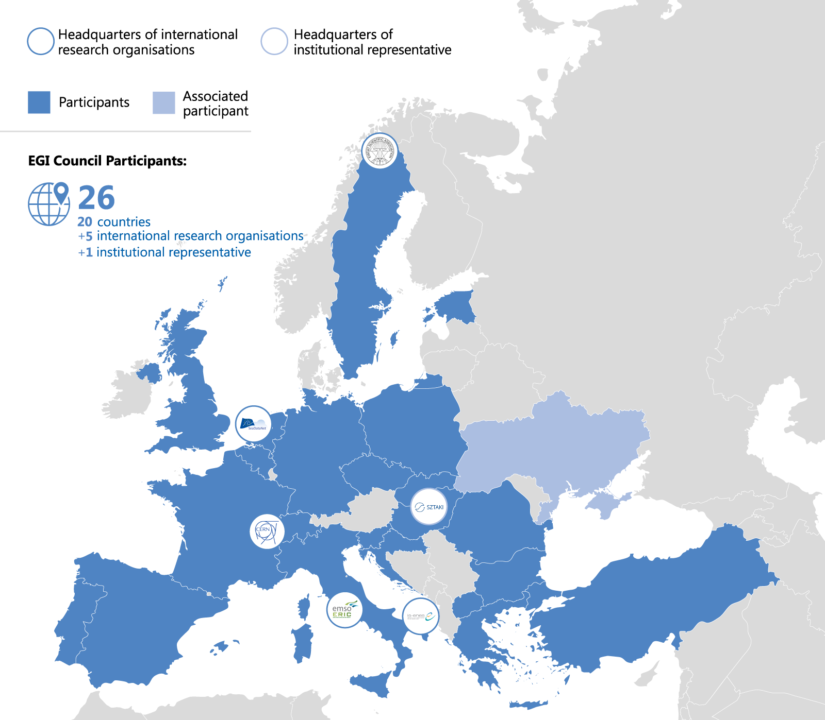
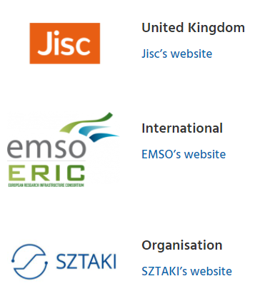
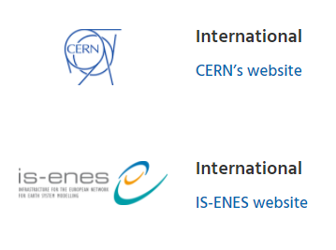
EGI Council
www.egi.eu/about/egi-council

Slide 4
EGI-ACE objectives
Objective 1. Deliver the European Open Science Cloud Compute Platform and expand the supply-side
EOSC-Exchange
Objective 2: Contribute to the implementation of the EU Data Strategy and the EOSC Data Commons to support the Green Deal, Health and Fundamental Research
O4
O1
Federated Data
O5
O2
EGI-ACE
Objective 3: Integrate the EOSC Compute Platform with the EOSC Portal and the EOSC Core
O3
EOSC Core
Objective 4: Contribute to the realization of a global Open Science Cloud
Objective 5: Expand the demand-side of EOSC across sectors and disciplines
EOSC Architecture: Solutions for a sustainable EOSC report from the EOSC Sustainability WG

Slide 5
The family of new EOSC projects
Distributed Computing Services
RELIANCE (Research Lifecycle Management for Copernicus users)
INFRAEOSC-07 Increasing the service offer of the EOSC Portal
Data discovery, deposition, bit preservation storage
Collaboration agreements
C-SCALE (Copernicus EOSC data analytics engine)
Open scholarship services

Slide 6
EGI-ACE consortium at a glance
Lorem 2
6 PaaS providers,
HPC centres and use cases, providers of federating services
Lorem 3
13 Research Infrastructures and Communities
Lorem 4
7 Early adopter user communities
Lorem 5
Lorem 1
International collaborations
16 HTC/HPC/Cloud providers
EISCAT
e-RHIS
VIRGO
MeerKAAT
PHIRI (Health and Medicine)
GEOSS Portal and GEO DAB and ESA
Thematic Exploitation Platform/Terradue
Central Europe (Czech Republic, Germany, Poland, Slovakia)
South Eastern Europe (Bulgaria, Romania, Turkey)
Southern Europe (Italy, Portugal, Spain)
Western Europe (France, The Netherlands)
Workload Management
Orchestration
Deep learning training facility services
Web-based data analytics
Health and Medicine (4)
Climate REsearch (2)
Energy and Physical Sciences (2)
Environmental Sciences (4)
Social Sciences and Humanities (1)
Eastern partnerships: GRENA, RENAM, IMCS UL
Asia Pacific region: AS and DMCC partners
China: CNIC
South Africa: IDIA
USA: OSG
57% of the budget for service provisioning

Slide 7
EGI-ACE concept and methodology: Tier service architecture
Data Spaces
and Analytics
Data and thematic data analytics and processing tools
EOSC portal
Early adopters
Green Deal Data Space
Health Data Space
Fundamental Science Data Space
Humanities Data Space
Platforms
generic added-value platform level services
Interactive Computing
Automated Cluster deployment
Distributed AI training
Workload Management
EOSC
users
Service Management, Tools, Processes, Policies
Federated
Access
Federation-wide management of data and computing
Federated Compute
Federated Identity
Federated Data
Federated
Resources
Compute and storage facilities
Research Clouds
Public Clouds
HTC
HPC

Slide 8
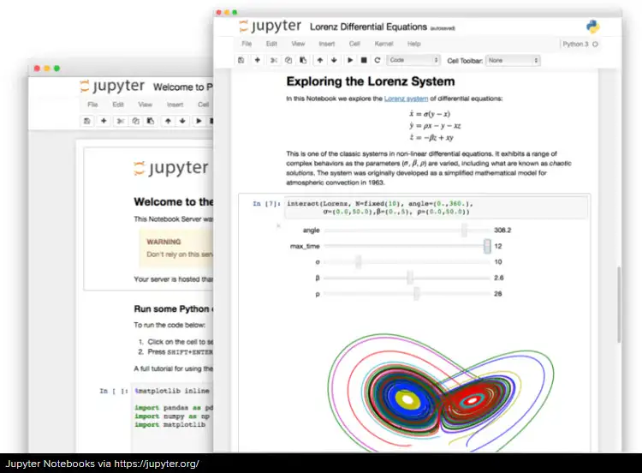
Example: Reproducible big data analytics with notebooks
1
DataHub
Notebooks + Binder + DataHub provide the means to reproducible Open Science with big data
Integrates with zenodo for publishing and discovery of notebooks
Data analysis in
EGI Notebooks
Access big data
Try it at https://notebooks.egi.eu
Publish notebook
Access big data
2
3
Reproduce notebook with binder
Import notebook

Slide 9
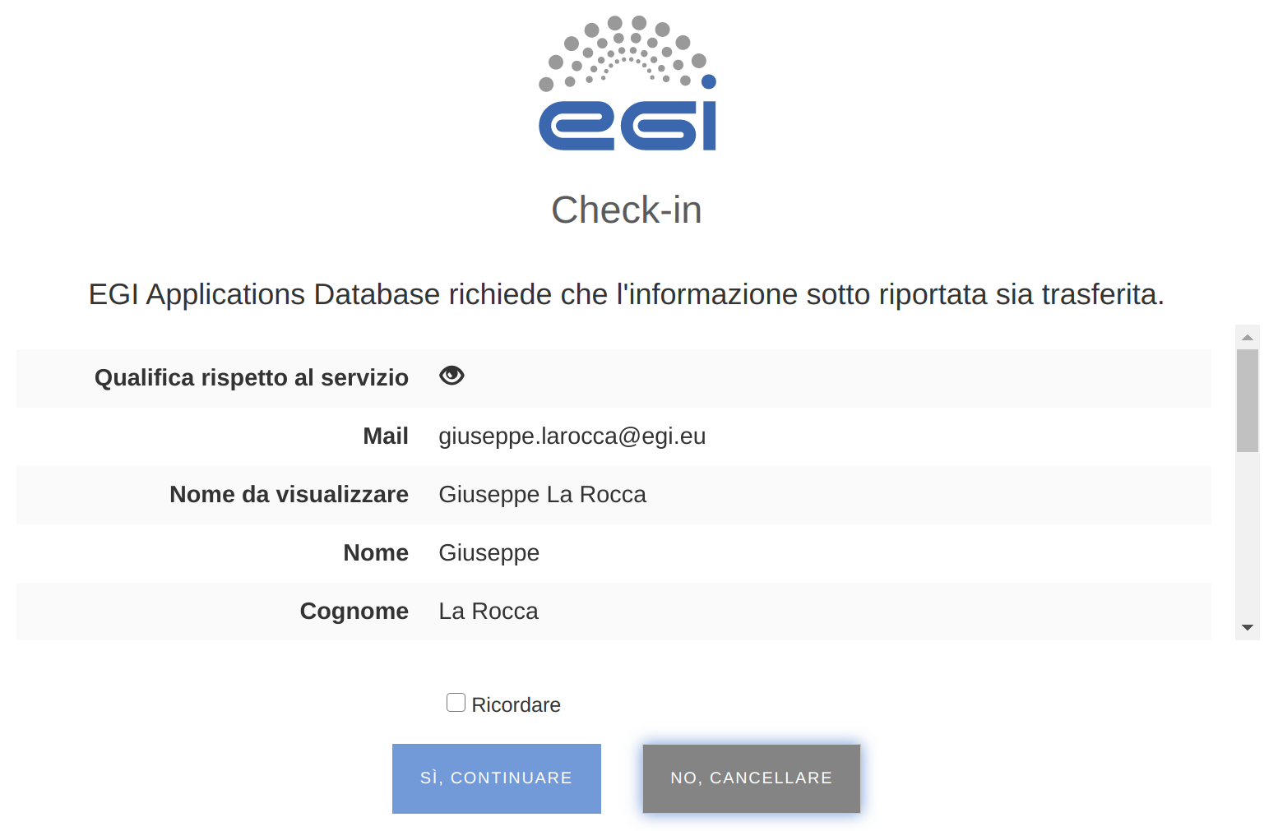
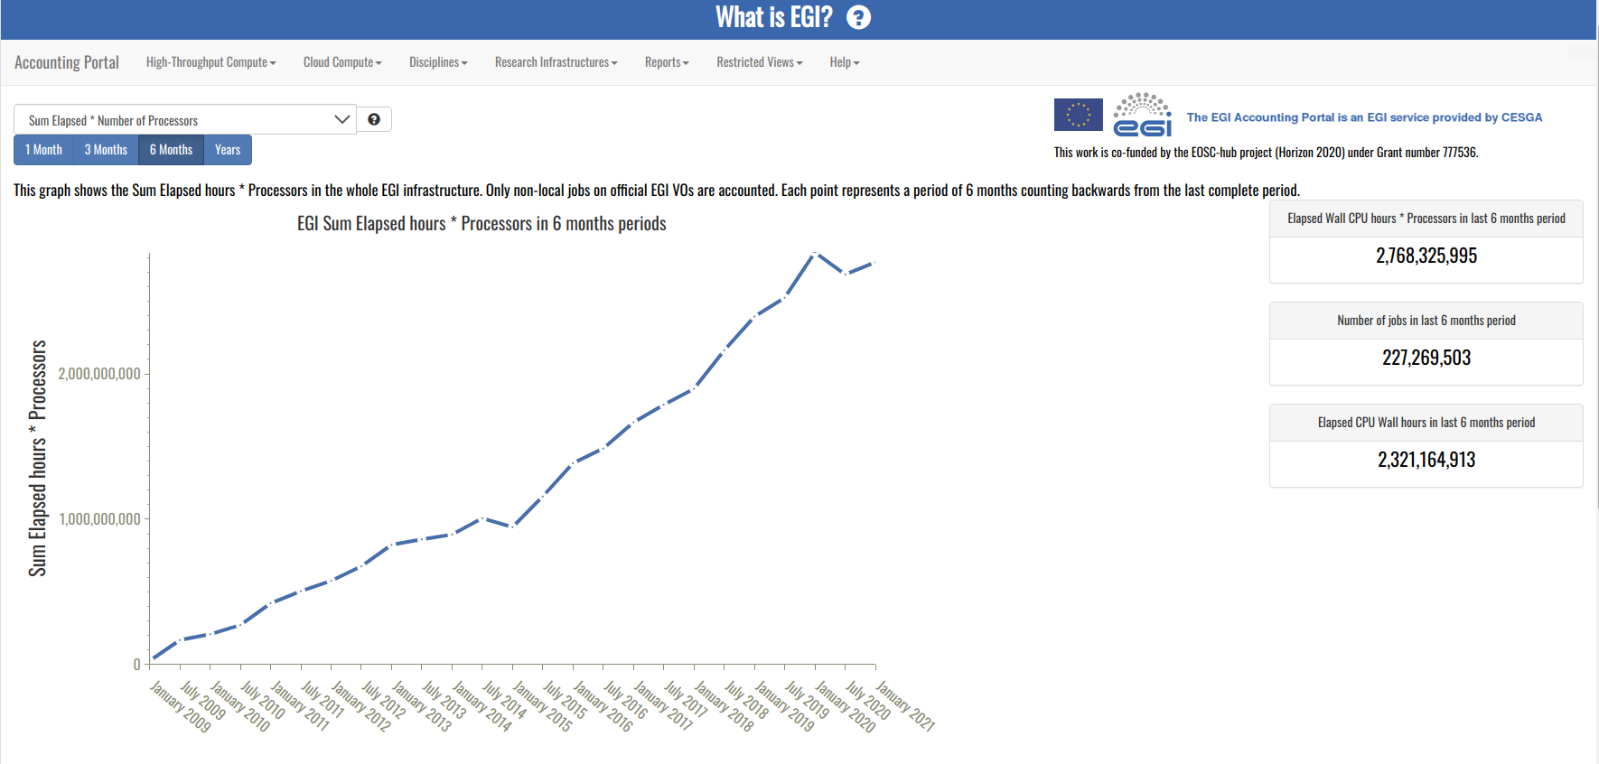
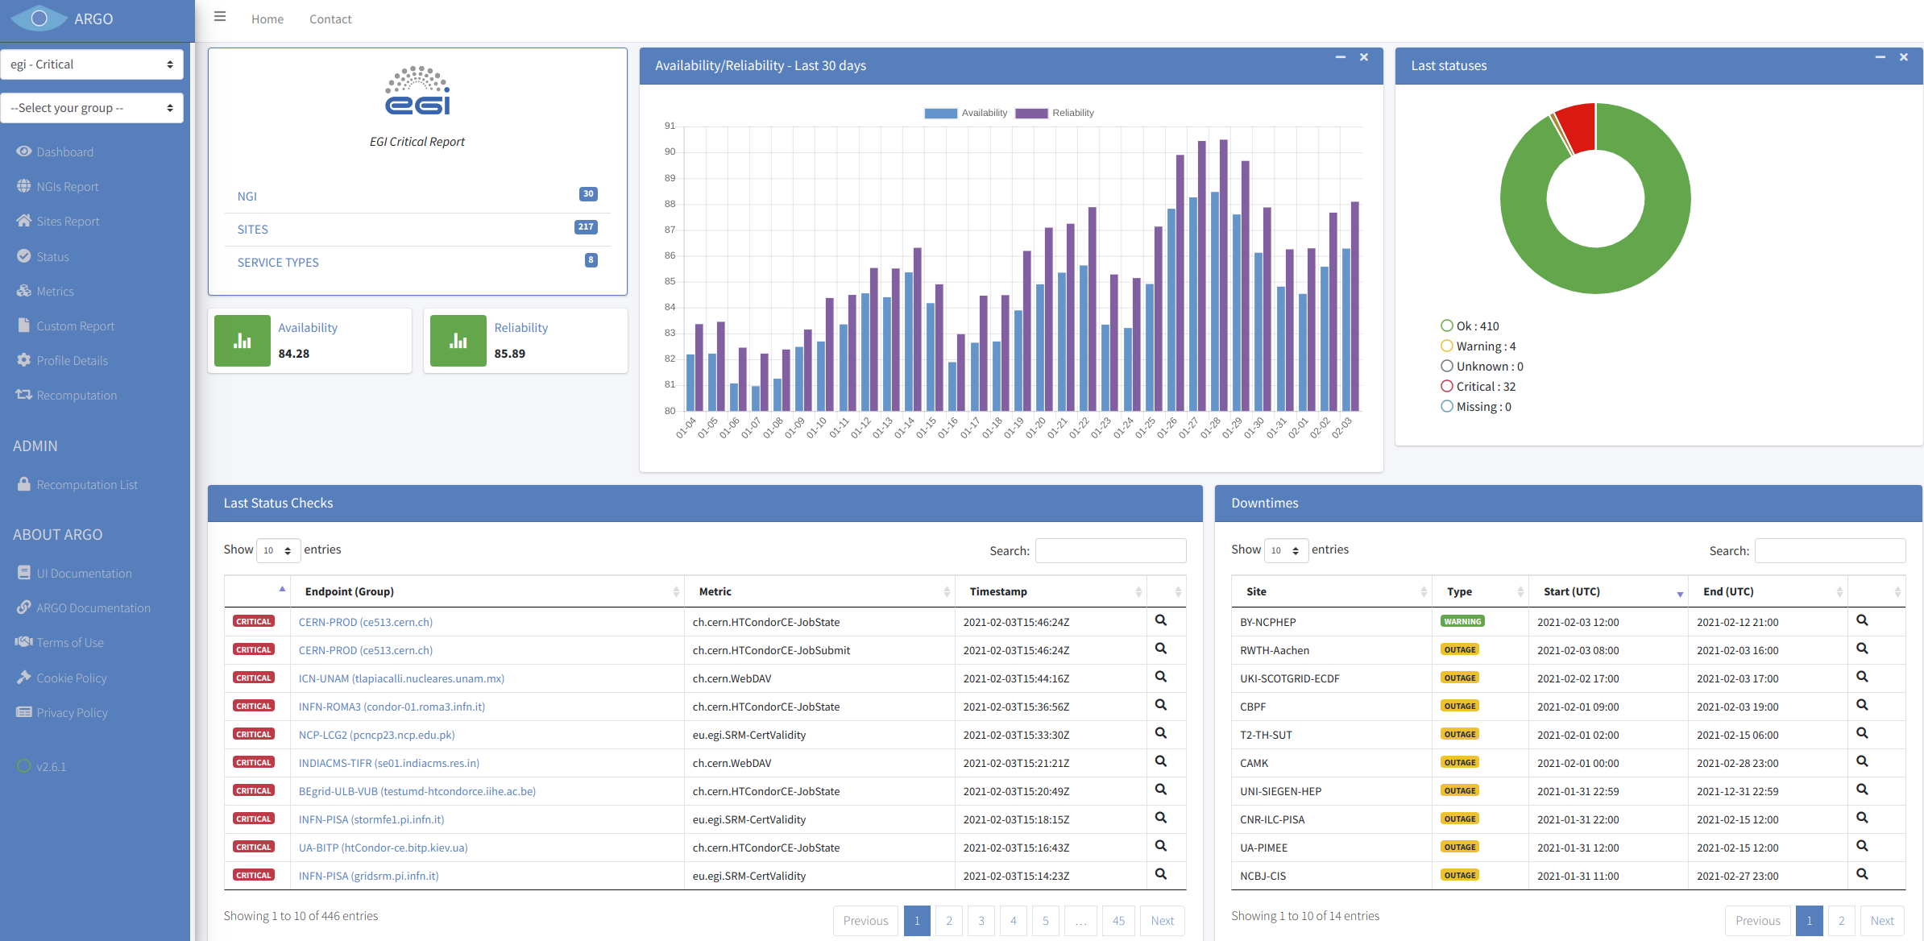
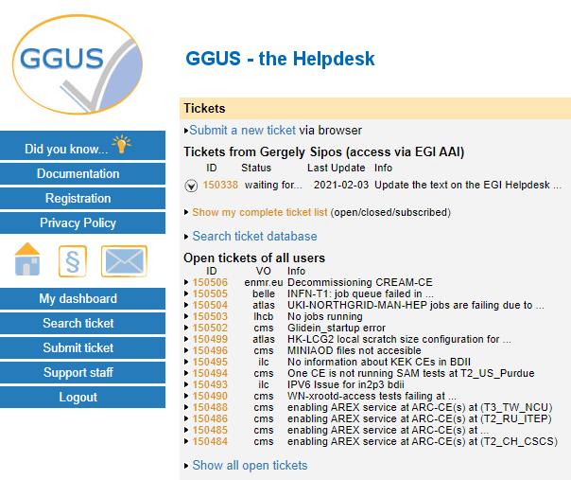
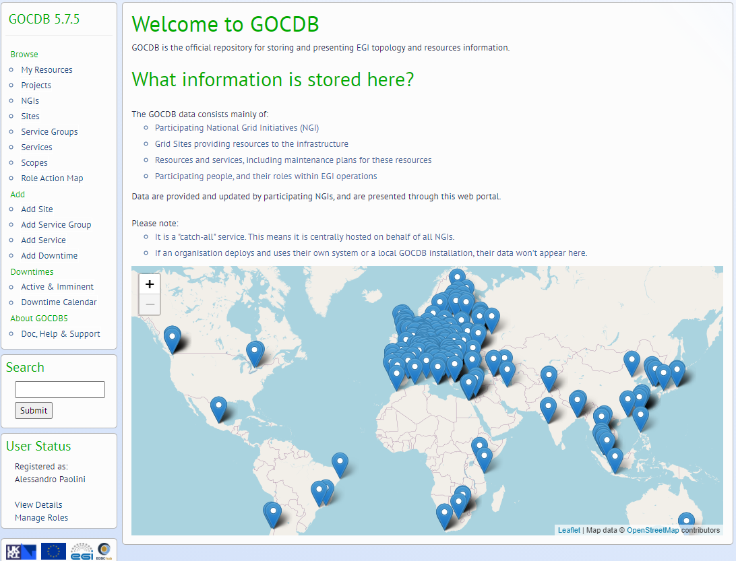
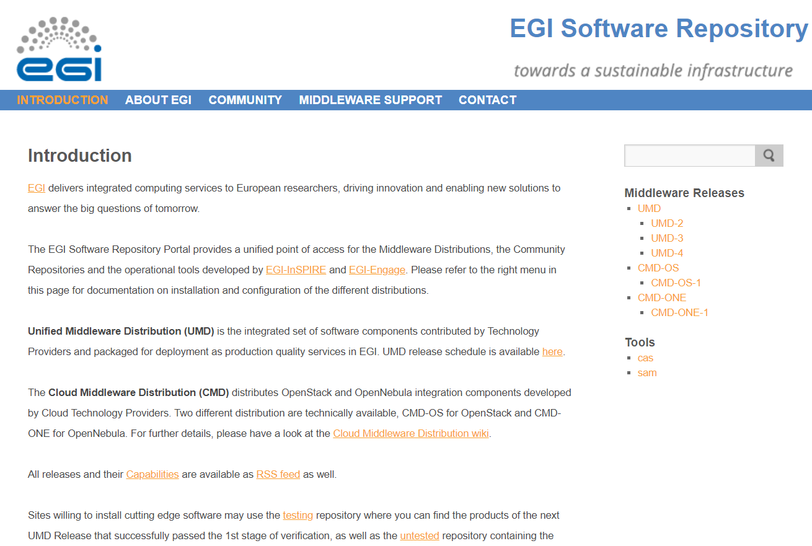
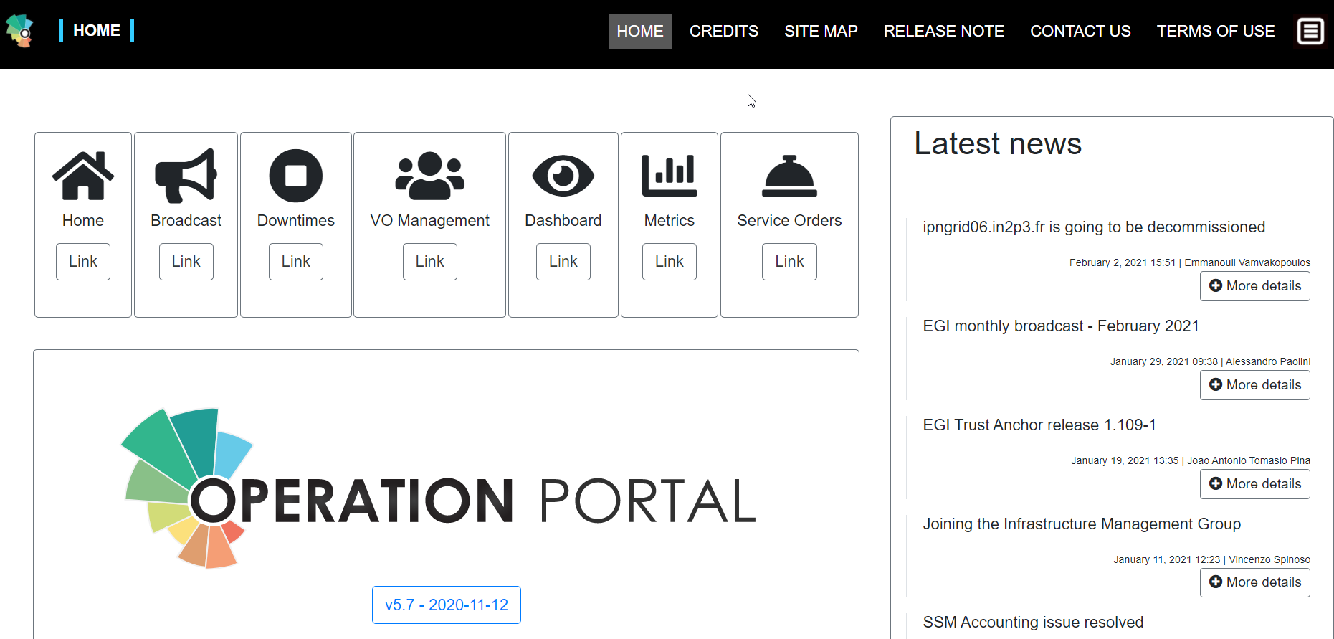
EGI federation - Core tools
Service Management, Tools, Processes, Policies
IT Service Management
Check-in
Early adopters
Green Deal Data Space
Health Data Space
Fundamental Science Data Space
Humanities Data Space
EOSC portal
Interactive Computing
Automated Cluster deployment
Distributed AI training
Workload Management
EOSC
users
Accounting
Monitoring
Helpdesk
Federated Compute
Federated Identity
Federated Data
Research Clouds
Public Clouds
HTC
HPC
Configuration DB
Operations portal
Unified middleware

Slide 10
Compute services | Platform services | Data space services | Federation services (AAI, data, compute)
IM AppDB EGI HTC & Storage dCache Spider Storage Data Processing Compute EGI Cloud Compute AppDB DynDNS MetaCentrumCloud - CPU MetaCentrumCloud - GPU MetaCentrumCloud - Storage SCAI FedCloud v2 EGI - GSIOS IN2P3-IRES-CPU IN2P3-IRES-Storage TR-FC1-ULAKBIM - CPU TR-FC1-ULAKBIM - Storage INFN-BARI-CPU INFN-BARI-Storage INFN-CNAF-CPU INFN-CNAF-GPU INFN-CNAF-Storage INCD-Lisbon (NCG)-CPU INCD-Lisbon (NCG)-Storage EGI – IISAS DESY-FedCloud CESGA-CPU CESGA-Storage IFCA-LCG2-CPU IFCA-LCG2-Storage INCD-LIP-CPU INCD-LIP-Storage CYFRONET-CLOUD-CPU CYFRONET-CLOUD-Storage IICT-BAS-CPU IICT-BAS-Storage CLOUDIFIN-CPU CLOUDIFIN-Storage | EGI Notebooks & Binder EGI Workload Manager DIRAC DEEP training facility CSIC DEEP training facility LIP DEEP training facility DODAS | WeNMR portals UU WeNMR Portals UseGalaxy.eu Virtual Imaging Platform OpenRiskNet/NanoCommons Virtual Env. ENES Data Space OpenCoastS Prominence SURFSARA LOFAR Science Products NWO-I LOFAR Science Products Disaster mitigation and agriculture SeaDataNet WebOcean Data Analysis Iberian GBIF data space CSIC GBIF Cloud data space LIP GBIF Cloud data space EMSO ERIC data service OPERAS Metrics service OPERAS Certification service iop | EGI Check-in PERUN MasterPortal (EGI - Check-in) EC3 Indigo PaaS Orchestrator Rucio CVMFS OpenRDM EGI content distribution CVFMS EGI Data Transfer FTS EGI DataHub Onedata Rucio
31 different services from
61 providers

Slide 11
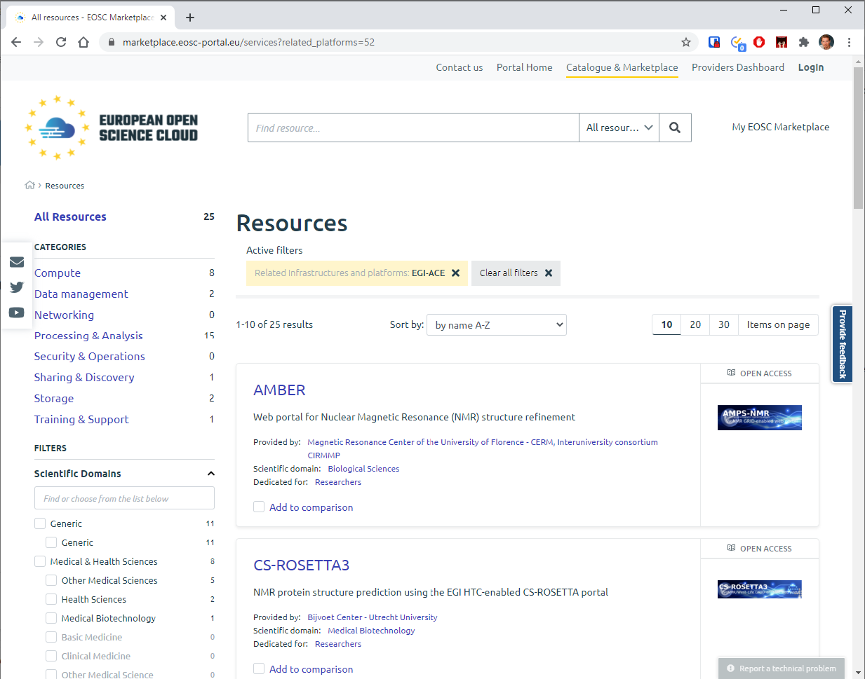
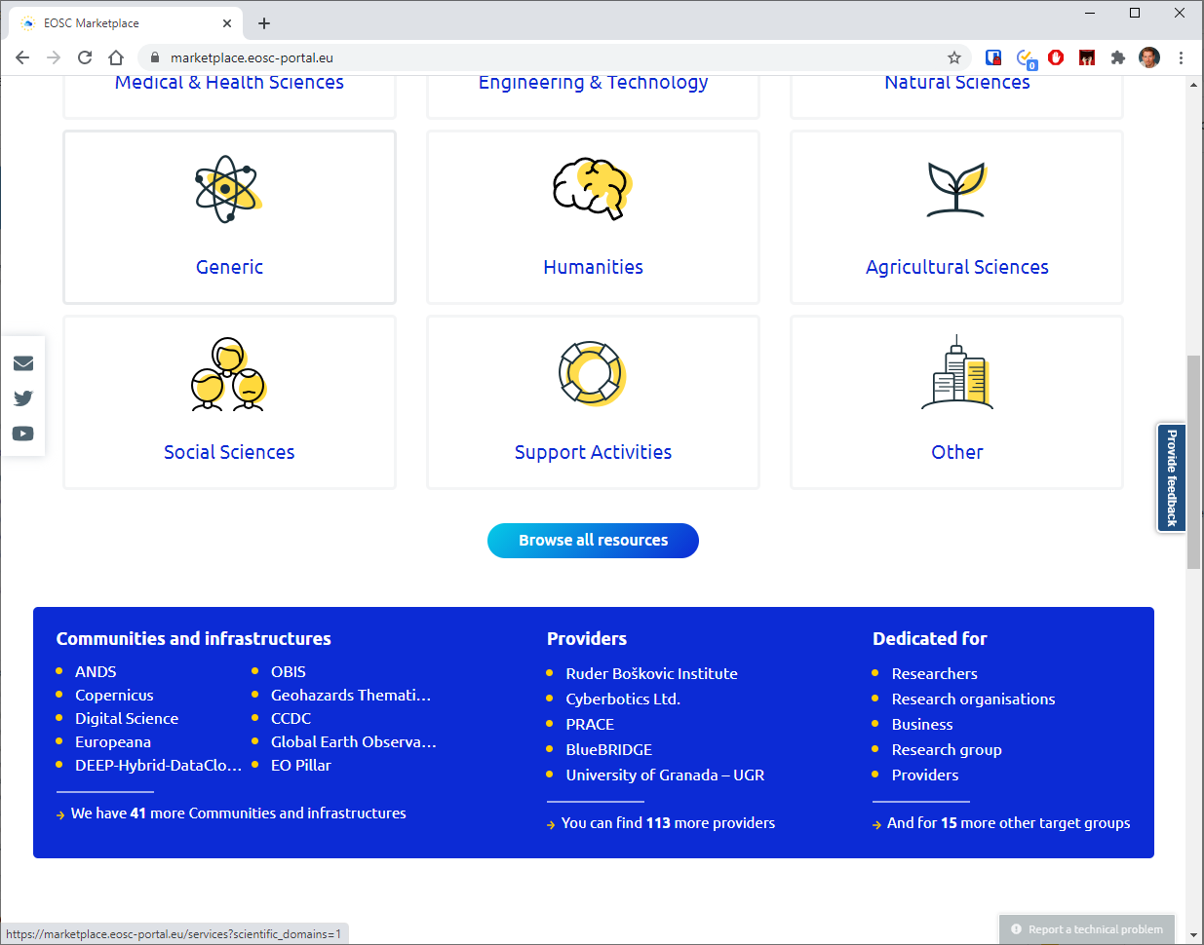
EGI-ACE portfolio in the EOSC Marketplace
http://marketplace.eosc-portal.eu/

Slide 12
Infrastructure layer – Cloud, HTC, HPC
For users and communities within the project AND for new EOSC users
Cloud-HTC compute and short-mid term storage:
80 Million CPU hours / 250,000 GPU hours / 20 PB storage
Mix of funding mechanisms:
Virtual Access:
Local grants enabling policy-based access (EGI Cloud Federation + new partners):
Pay-for-use:
Pilot HPC sites:
Diverse locations AND compute flavors
Moldova
Latvia
Georgia
Hungary
Austria
USA
China
South Africa

Slide 13
Resource allocation, user support
Single users
Small groups
Experimental users
International projects
Multi-national communities
EOSC USERS
Business-to-User
Business-to-Business
EOSC Portal
EGI-ACE Open call
https://www.egi.eu/projects/egi-ace/call-for-use-cases/ Next cut-off date: 15th of April
Ready-to-use resources/services
Self-service configuration
Short term engagement
High capacity demand
Custom configurations
Long term engagement

Slide 14
Resource allocation, user support (2/2)
Single users
Small groups
Experimental users
International projects
Multi-national communities
User profiling
Call evaluation
National resources (more than EGI-ACE)
VMOps
Notebooks
OneData
EC3
Existing Virtual Organisations (more than EGI-ACE)
DEEP training
New community Virtual Organisations
DODAS
DIRAC
INDIGO PaaS
...
Bring the user to ‘fit for purpose’ services
Bring data to user (DataHub)
Bring application to user (AppDB)
Aligned customer relationship mgm.
Select suitable providers
Select suitable services
Deploy, configure, test
Support scale-up and uptake
Project focus on the providers
Project focus on the users

Slide 15
ASGC and AP partners
Simulation portals
Case studies
Stakeholder engagement (events, data)
Humanities
7 Early adopters (users)
OPERAS metrics and certification service
Disaster mitigation and agriculture
WeNMR (structural biology)
Health and medicine
EISCAT_3D Data Portal
(atmospheric physics)
GEO Discovery and Access Broker
Earthquake response and landslide analysis
Environmental sciences
GBIF Cloud data space
Virtual Imaging Platform (medical imaging)
13 Data spaces (users & providers)
EMSO ERIC data services
OpenRiskNet NanoCommons
VIRGO (gravitational waves)
MeerKAT workflows (astronomy)
E-RIHS (heritage object analytics)
The project to perform FAIR maturity assessment & improvement recommendations
SeaDataNet WebOcean Data Analysis
UseGalaxy.eu (bioinformatics)
PHIRI (population health)
JupyterLab
Enes libraries
EC3
Synda & DataHub
ESGF data archive
Cloud and HPC
LOFAR science products (astronomy)
OPENCoastS (circulation forecast)
PROMINENCE (fusion physics)
ENES (climate analytics)
Climate research
Energy and physical sciences

Slide 16
Environmental sciences Data Spaces
Data space | Challenge | EGI-ACE services for integration
GBIF Cloud Data Space | Bring together national Global Biodiversity Information Facilities (GBIF) into a data analysis platform | IaaS Cloud Docker, IM Jupyter Various big data technologies
EMSO ERIC Data Services | Harmonise and serve heterogeneous marine data through the EMSO Data Management platform. | IaaS Cloud (host of Data Man. Platform) Notebooks (Jupyter) Monitoring Accounting
SeaDataNet WebOcean Data Analysis | Host WebODV as a service in the cloud for scalable marine data interpolation, visualisation, subsetting, analysis. | Check-in (user authentication) IaaS Cloud (hosting) Docker (portability) Storage/DataHub (data hosting in cloud)
Disaster Mitigation and Agriculture | Compute interoperability and data interoperability between with WRF and iCOMCOT simulations and 6 types of hazard cases data. | HPC (up to 256 nodes) Data catalogue Jupyter (TBC) Check-in

Slide 17
Summary
EGI-ACE delivers the Compute platform in EOSC
Compute continuum with HTC, Cloud and HPC
Online data analytics services
We are open for business !
Most of our services are already available in the EOSC Portal: https://marketplace.eosc-portal.eu/services?related_platforms=52
Call for use cases with 15th of April cut-off date: https://www.egi.eu/projects/egi-ace/call-for-use-cases/
Disaster Mitigation collaboration participates as a Data Space
Case studies drive compute reproducibility and data sharing

Slide 18
Thank you
https://www.egi.eu/projects/egi-ace/

Slide 19
Infrastructure services: highlights from the compute, security, data areas
Andrea Manzi (EGI.eu)
Diego Scardaci (EGI.eu)
Enol Fernandez (EGI.eu)

Slide 20
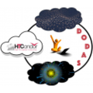
Compute Area
Enol Fernández

Slide 21
EGI Cloud Compute
Federated IaaS
Distributed Infrastructure as a Service (IaaS) powered by the EGI Federated Cloud
Execution of VM based workloads on a distributed infrastructure
Federated identity
Common VM image catalogue
GUI and CLI/API based access
Central accounting and monitoring
EGI Cloud Compute allows users to host data- and compute- intensive applications in a distributed infrastructure (move compute near the data) with complete control on the software and resources used

Slide 22
Expanding EGI Cloud with EGI-ACE
Federated Compute
Platforms
Federated Identity
AppDB VMOps
AppDB
VAs
EGI-ACE Clouds
International Clouds
Other EGI Clouds
Cloud Providers
Dynamic DNS
Federated Data

Slide 23
Bringing capacity for EOSC users
EC funded capacity (Virtual Access):
Phase 1 (month 1-10) ⇒ 13.8 M CPU hours - 41,300 GPU hours - 7.5 PB/month
Phase 2 (month 11-20) ⇒ 27.6 M CPU hours - 83,000 GPU hours - 15 PB/month
Phase 3 (month 21-30) ⇒ 41.4 M CPU hours - 124,000 GPU hours - 23 PB/month
Policy-based and pay-per-use access from members of EGI Federation, international partners and commercial clouds
Diverse locations AND compute flavors

Slide 24
Orchestration
IM deploys virtual infrastructures on Cloud resources
Infrastructure as Code (IaC) / RADL & TOSCA descriptions
Automates deployment, configuration, software installation, monitoring and update of virtual infrastructures
Wide variety of back-ends thus user applications become cloud agnostic
Provisioning of virtualized compute and storage on distributed infrastructure: cloud, HPC and container orchestration platforms
Automatic selection of providers
Federated Data integration: data orchestration, replication, trigger jobs on events
Automatic re-submission of deployments
Notes:
Coordinates the provisioning of virtualized compute and storage on distributed infrastructures, including cloud, HPC clusters and container orchestration platformsAutomatic selection of the best resource providers based on criteria like user’s SLAs, services availability and monitoring metrics and data location
Integrated with Federated Data services (Onedata, Dynafed and Rucio)
Automatic re-submission of the deployment request in case of failures or timeout (for a configurable number of retries)
Support for data orchestration workflow with Rucio (Cern)
Submission of data replication rules
Trigger processing jobs on data ingestion events

Slide 25
Automated Cluster Management
Elastic Cloud Computing Cluster (EC3) deploys virtual elastic clusters on IaaS providers
IM for deployment, CLUES for elasticity
Predefined ansible templates: Kubernetes, Mesos, SLURM, Torque, SGE, HTCondor, Nomad...
DODAS supports the deployment and configuration of distributed (possibly federated) clusters for executing experiment workflows (e.g. data processing, data analysis):
Batch System on demand
Big Data clusters on demand Interactive analysis service for local and remote data processing

Slide 26
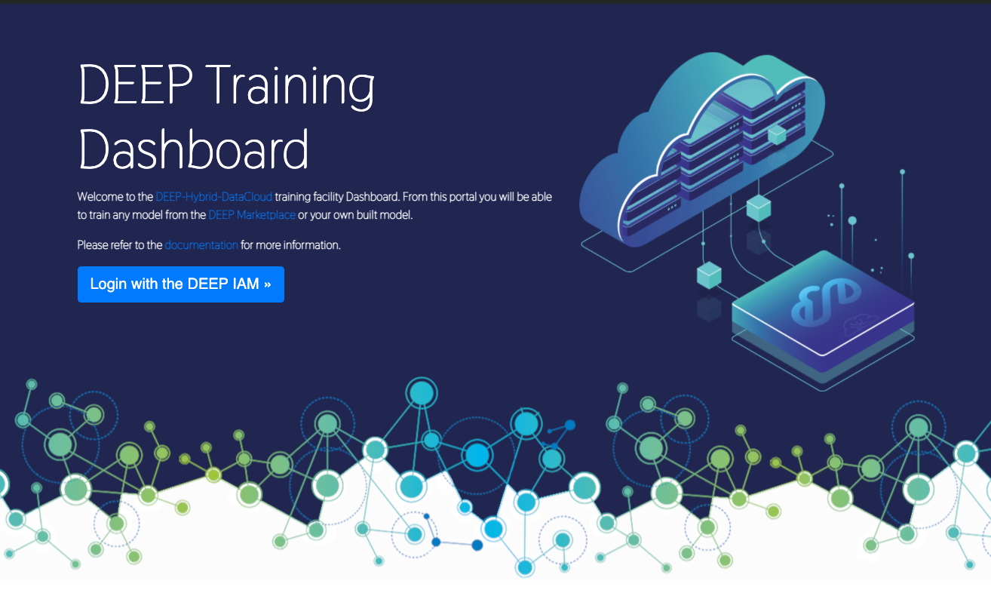
AI/ML: DEEP training facility
1-click development and training environment in cloud and HPC resources
Train, test and evaluate of models through the DEEPaaS API
Transparent access to infrastructure resources
Based on TOSCA templates submitted via INDIGO-DataCloud PaaS orchestrator and Infrastructure Manager

Slide 27
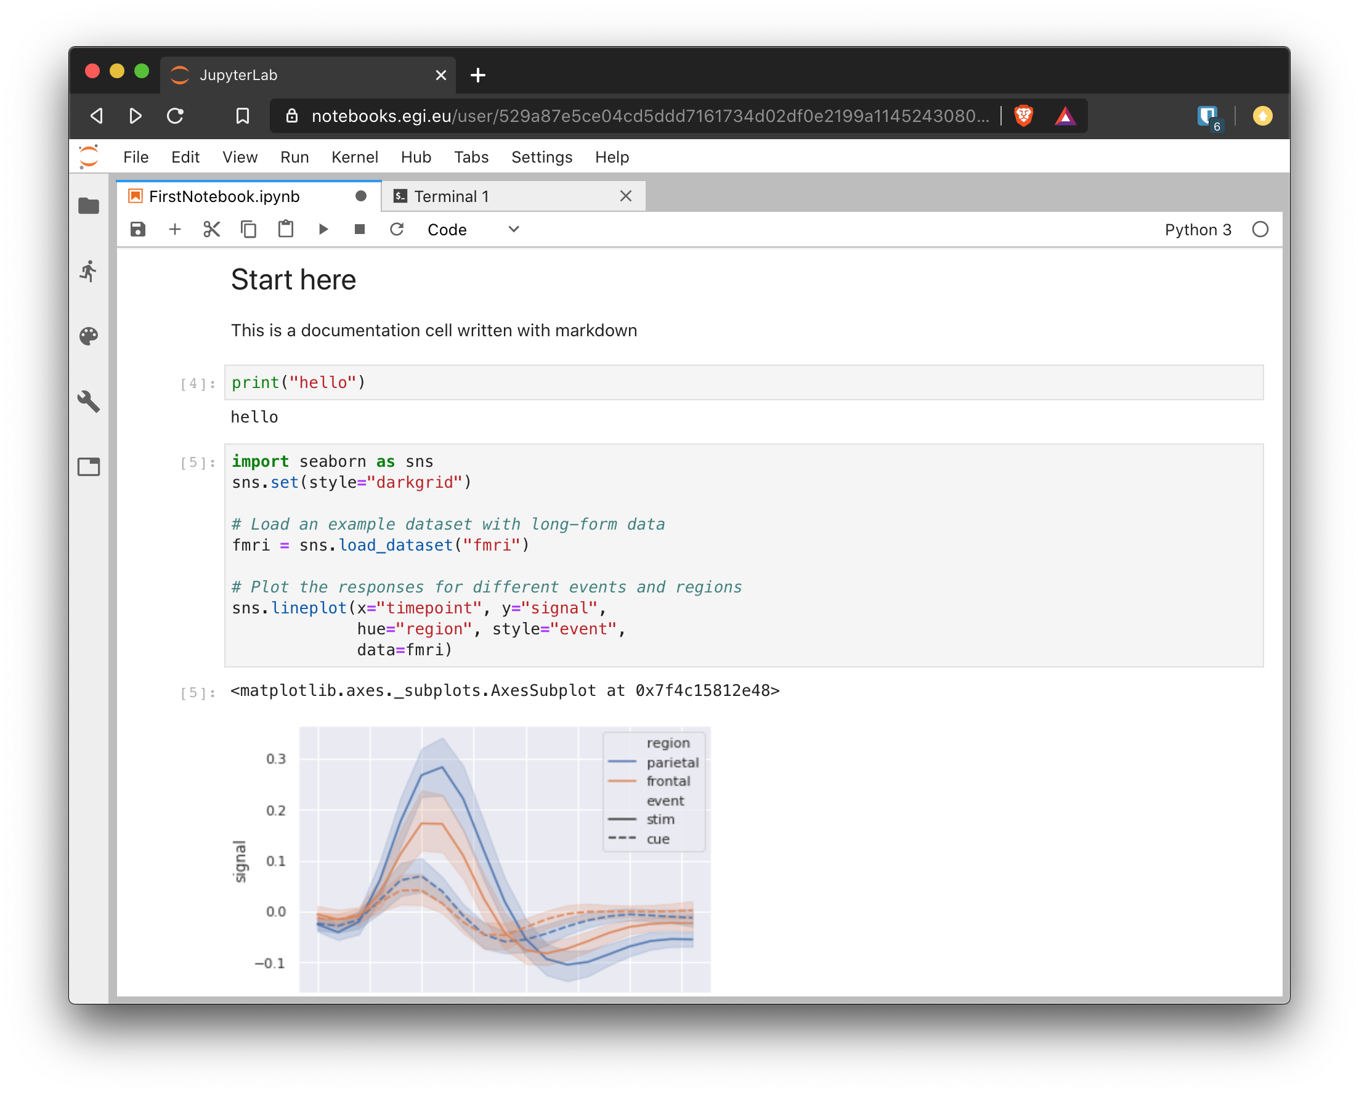
Interactive Computing: Notebooks
JupyterHub hosted in the EGI Cloud
Jupyter notebooks ‘as Service’
One-click solution: login and start using
EGI-ACE will bring:
Binder (reproducible notebooks) support
Better integration with Federated Data (e.g. onedata) and Federated Compute (DIRAC) services

Slide 28
Beyond IaaS Clouds: HTC and HPC
Orchestration
Federated Identity
CVMFS
EGI-ACE HTC
Other EGI HTC
HPC providers
Providers
Federated Data

Slide 29
High Throughput Compute
The EGI High-Throughput compute (HTC) provides users with the capability to access large amounts of computing resources, and to submit hundreds or thousands of computational tasks.
EGI-ACE brings one new option to the HTC service from SURF:
Spider, a versatile high-throughput data-processing platform aimed at processing large structured data sets.

Slide 30
Workload Manager
The Workload Manager helps users to exploit distributed resources in a transparent way.
Based on DIRAC, a framework shared by multiple experiments, both inside HEP, astronomy, and life sciences
Optimises workload placement
Support for massive workload and data operations
Aggregates multiple types of resources, e.g. Cloud / HTC providers, user community resources
User-friendly GUI, CLI and API access for advanced usage
Jupyter notebooks (prototype)
Services customizable for the needs of particular communities

Slide 31
Software Distribution
CernVM-File System (CVMFS) provides a POSIX read-only file system in user space
Scalable software distribution, recently extended to handle container images
Caching at providers for fast access to frequently used software
Mostly used in HTC, but useful also for IaaS
Application Database (AppDB) provides Virtual Appliance (VAs) Catalogue
Public registry of images with detailed metadata
Community-managed VA lists, fine control on what can be executed by users
Automatic distribution as VM images to the cloud providers

Slide 32
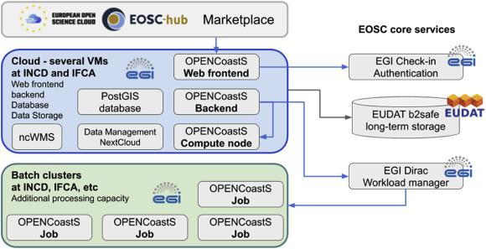
OPENCoastS: forecast systems for coastal sites
OPENCoastS brings together several EGI services to deliver on-demand coastal circulation forecast systems through a web platform with minimal user intervention
Hosting of web frontends / databases and permanent services on Cloud Compute
Dynamic workload managed by Workload Manager and executed on High Throughput Compute

Slide 33
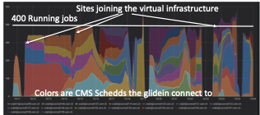
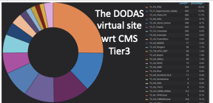
A distributed virtual CMS site powered by DODAS
DODAS used to build a lightweight ephemeral WLCG-Tier on demand distributed across four Cloud providers
Executing actual experiment workload
Dynamically distributing the load as providers join
Uses PaaS Orchestrator to deploy elastic Kubernetes that run HTCondor + CVMFS configured for integrating into CMS submission infrastructure

Slide 34
Security Area
Diego Scardaci
RCAuth.eu & Master Portal
Check-in

Slide 35
EGI Check-in
Proxy service that operates as a central hub to connect federated Identity Providers (IdPs) with EGI service providers
Main characteristics:
Enables multiple federated authentication sources using different technologies
Federated in eduGAIN as a service provider (REFEDS RnS and Sirtfi compliance)
User registration portal to allow accounts-linking
Combines user attributes originating from various authoritative sources (IdPs and attribute provider services)
Integrated with PERUN
Compliant with the AARC Blueprint
Support non-web use cases & delegated access
Integrated with RCAuth.eu and Master Portal
RCAuth.eu & Master Portal

Slide 36
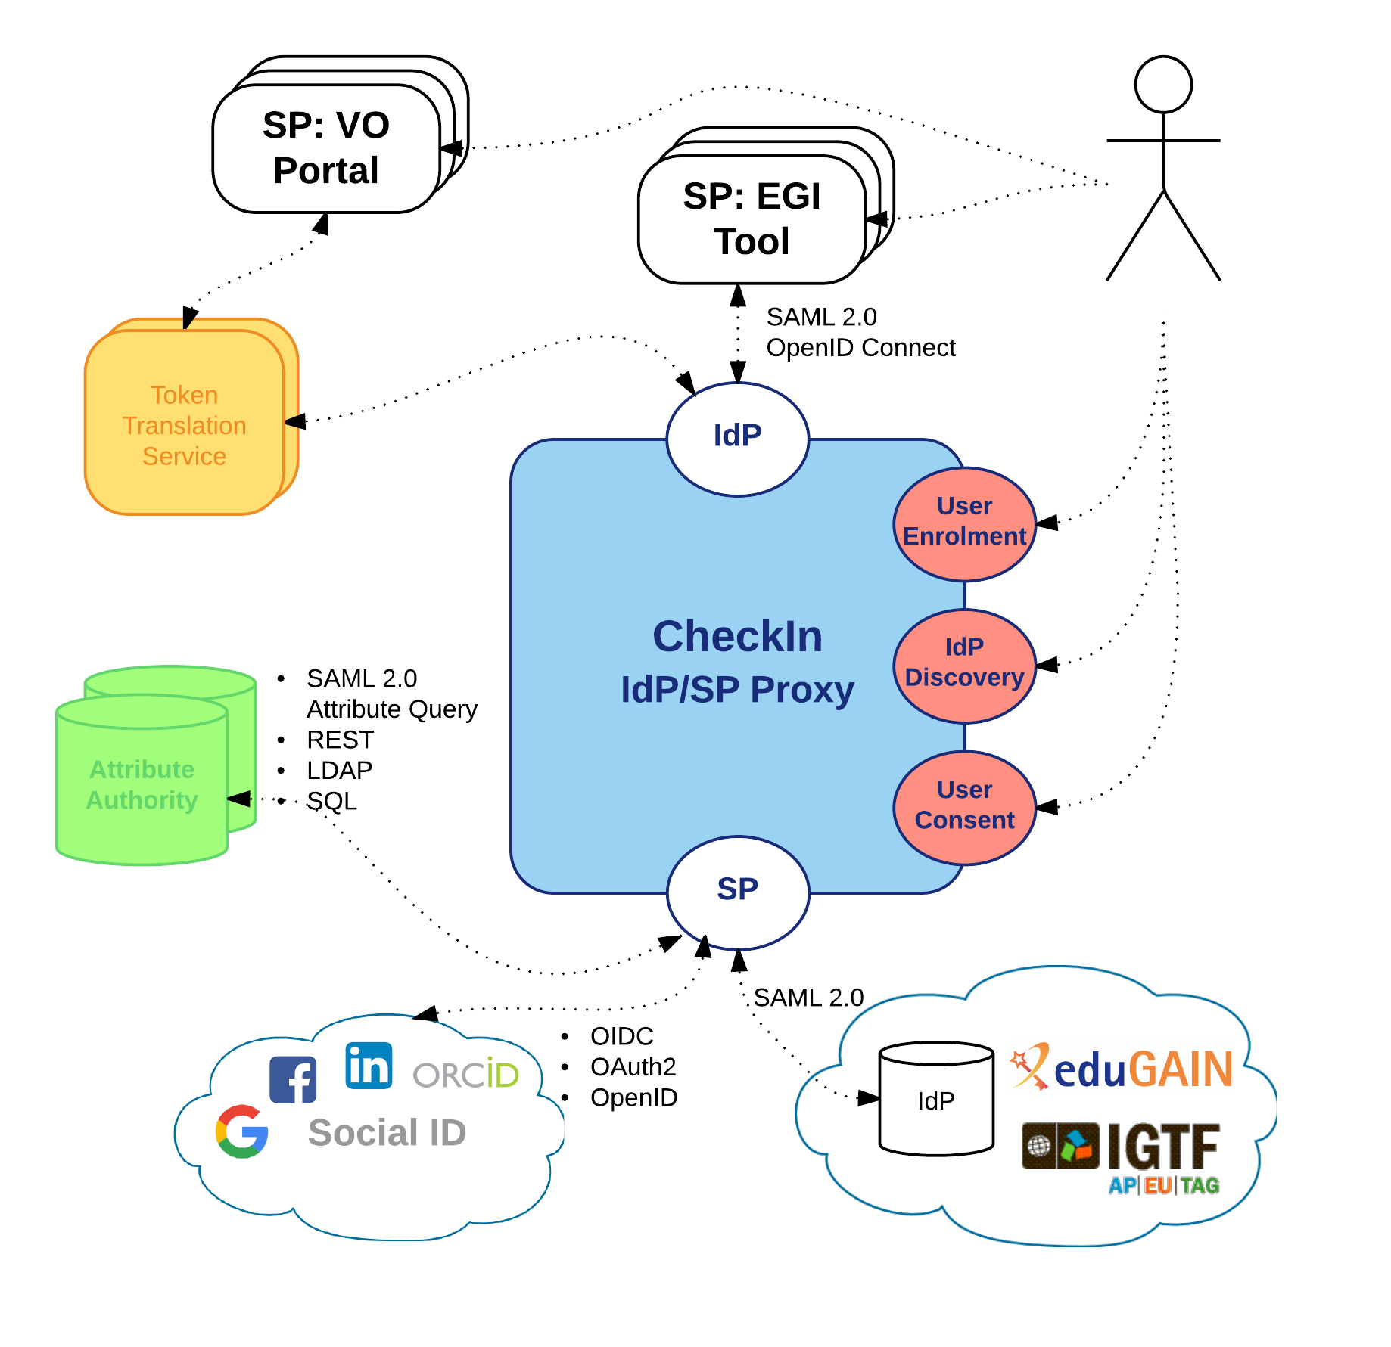
The EGI AAI Platform: Check-in
The IdP/SP Proxy
Identity Providers:
SAML2.0: eduGAIN
OIDC/OAuth2: Google, Facebook, LinkedIn, ORCID, WeChat, BitBucket
X.509: IGTF
Service Providers:
SAML2.0 & OIDC
Attribute Authorities
SAML2.0 Attr. Query, REST, LDAP, SQL
Token Translation Services
SAML2.0-to-X.509: Master Portal to RCauth.eu Online CA
Support for Levels of Assurance
User enrolment & account linking
IdP Discovery
User Consent

Slide 37
Use case: AAI as a Service
Check-in as an authentication proxy to allow user logins from institutional IdPs in eduGAIN and social media for non EGI services
Minimal overhead for the service development
Prerequisites:
Service provider must accept EGI policies on data protection
Social IDPs
eduGAIN
Institutional IdP
EGI CheckIn
EGI Infrastructure
SERVICE

Slide 38
Use case: AAI Integration
Social IDPs
eduGAIN
Institutional IdP
Community operating its own AAI connected as an IdP to Check-in to allow its users to access EGI services & resources
Users can access EGI services without changing their authentication workflow
AAI Proxy
EGI CheckIn
EGI Infrastructure
Service
Service

Slide 39
Use case: External Attribute Provider
eduGAIN
Community managing authorisation information about the users (VO/group memberships and roles) via their own group management service, which is connected to CheckIn as an external attribute authority
CheckIn will handle the configuration of the IdPs and the aggregation of the attributes for the SPs
No need to migrate the group information into an EGI specific attribute authority
Institutional IdP
Social IDPs
Virtual Organization
EGI CheckIn
EGI Infrastructure
Service
Service

Slide 40
Use Case Group Management as a Service
eduGAIN
Communities that do not operate their own group management service can leverage the group management capabilities of the CheckIn platform
Avoid overhead of deploying a dedicated group management service
Authorised VO admins will manage the information about their users independently
Can be used with EGI and non-EGI services
Institutional IdP
Social IDPs
EGI CheckIn
Service
Virtual Organization
Service
EGI Infrastructure
Service
Supported technologies:
CΟmanage
Perun

Slide 41
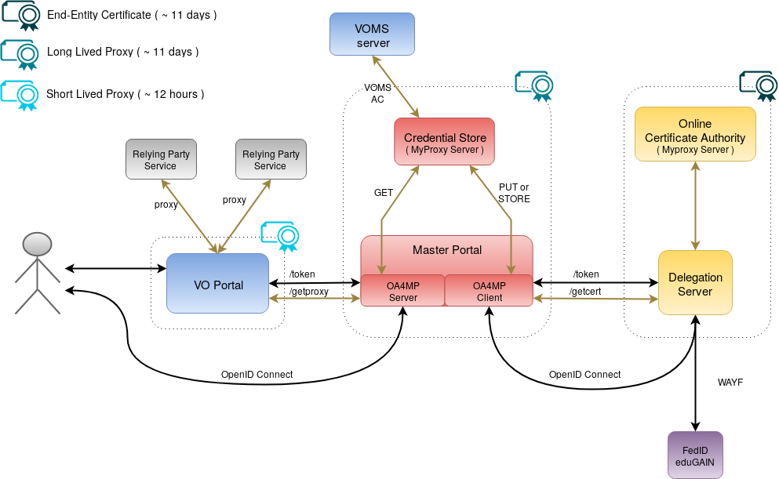
Non-web use cases & delegated access
RCauth.eu Online CA issued certificates
Check-in has been integrated with the production RCAuth.eu Online CA for allowing users to retrieve X.509 proxy certificates using their federated credentials
Master Portal retrieves end-entity certificate from RCauth.eu
Long-lived proxy certificate stored in backend MyProxy server
Short-lived proxies provided via:
Science Gateways via OIDC (so-called VO-portals)
users e.g. via SSH key authentication
EGI Check-in

Slide 42
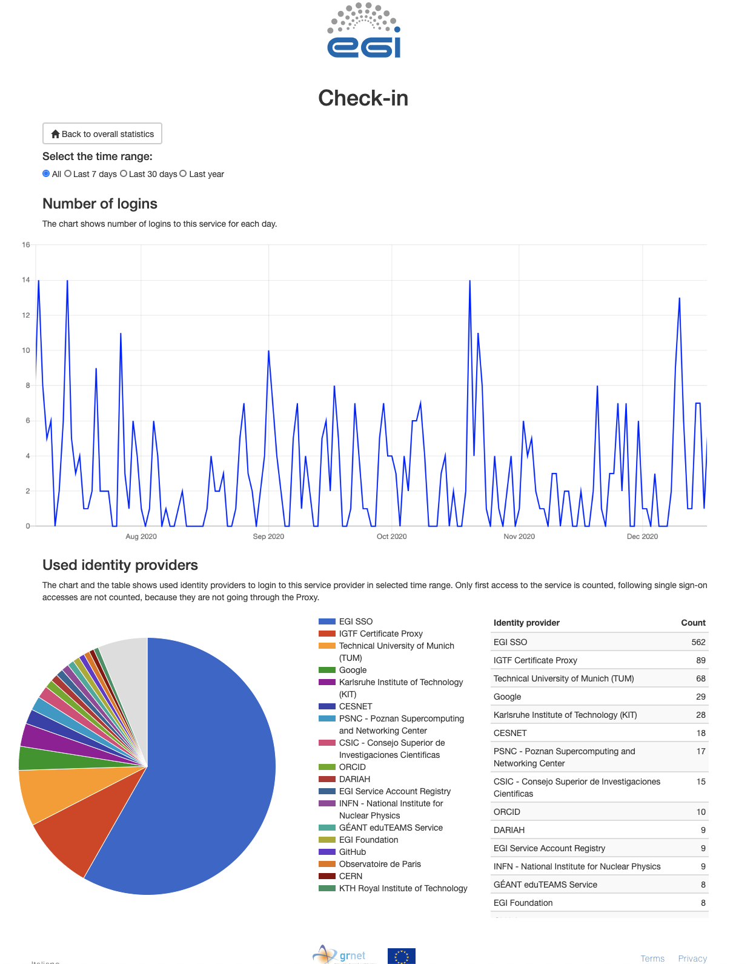
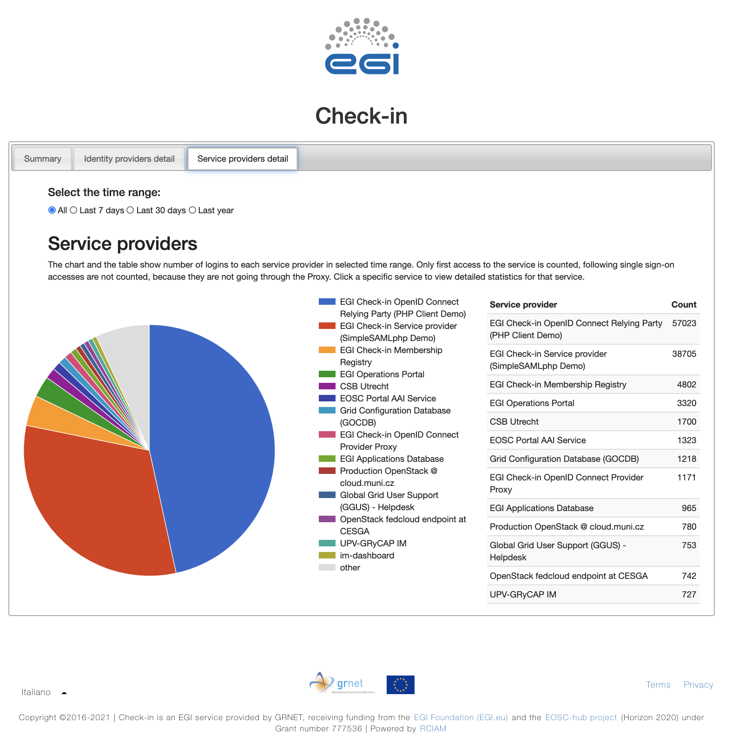
EGI Check-in Statistic viewer
Login statistics for services integrated
EGI Check-in statistics
General view of the login statistics (all services)
Dedicated service view for login statistics:
time trend of user logins
distribution of logins based on the IdPs used by users

Slide 43
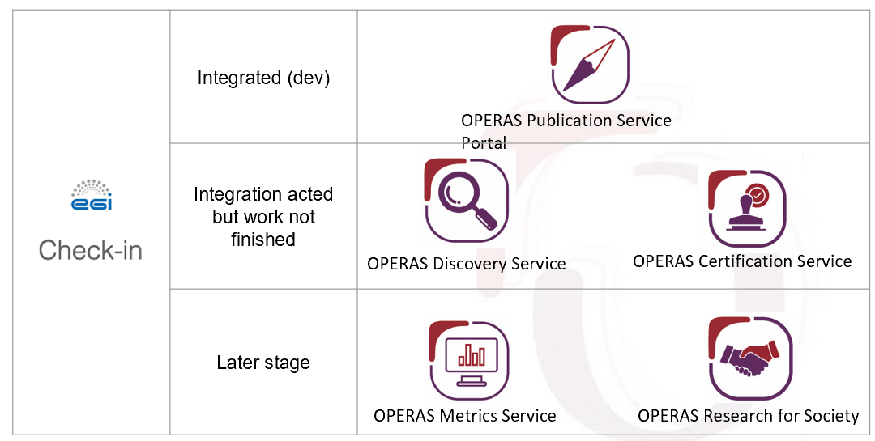
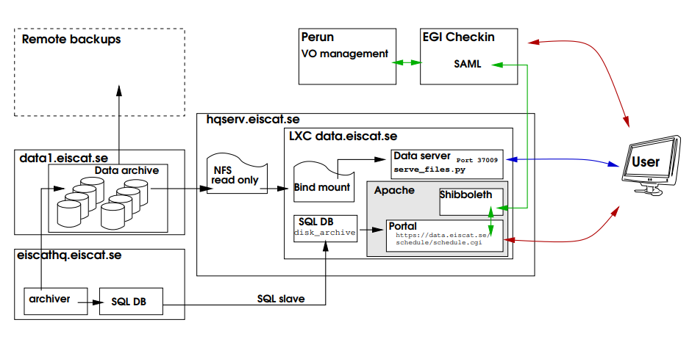
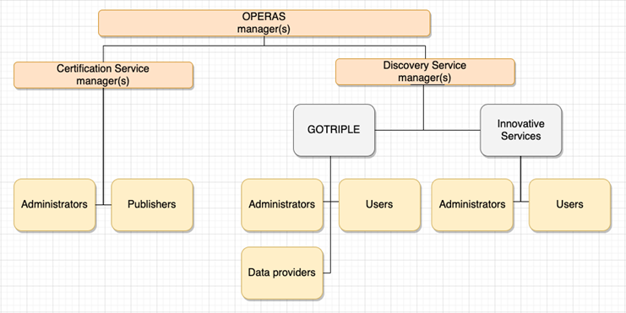
Some examples: EISCAT-3D and OPERAS
OPERAS
EISCAT-3D
Radars for the upper atmosphere and ionosphere
EISCAT-3D users managed in Perun
Access to EISCAT services through Check-in
Open Scholarly Communication in the ERA for Social Sciences and Humanities
OPERAS users managed in Comanage and structured in groups and roles

Slide 44
Check-in Documentation
Usage guide
Integration guide for service providers
Integration guide for identity providers
Getting Support

Slide 45
Data Area
Andrea Manzi

Slide 46
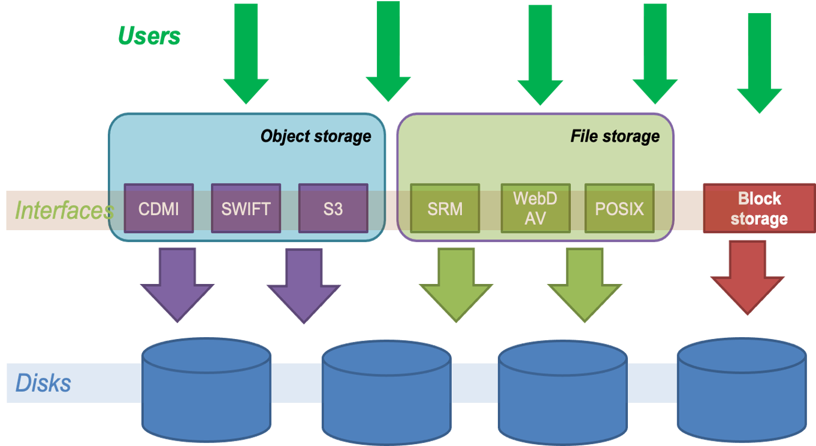
Online Storage
Includes 3 categories of storage services
File Storage
Block Storage
Object Storage

Slide 47
Online Storage
File storage
File storage can be used for storing and accessing files on the infrastructure as input/output to EGI HTC computations
The EGI Workload Management system (DIRAC) is able to access files stored in File Storage instances via different protocols, and schedule the computations in order to be executed close to where the input files are stored
Technologies: DPM, dCache, StoRM
Interfaces: SRM, HTTP/WebDAV, XRootD, gridftp, CDMI

Slide 48
Online Storage
Block storage
Block-level storage solution that allows to expand the storage capacity of instances in the EGI Federated Cloud, offering the lowest possible latency for applications
Increase storage without increasing the size or capacity of the instance or by provisioning new ones; delete servers, keeping data intact
Enhancing Technology: Openstack Cinder
Interfaces: POSIX for access, OCCI and Openstack CLI/GUI for management

Slide 49
Online Storage
Object storage
Manages data as objects. Each object includes the data itself, a variable amount of metadata, and a globally unique identifier.
Cloud object storage allows relatively inexpensive, scalable and self-healing retention of massive amounts of unstructured data
the main uses cases are:
Backups and Data Archive, AI and ML , Cloud Native applications
Technologies: OpenStack Swift, CEPH
Interfaces: S3, Swift, CDMI

Slide 50
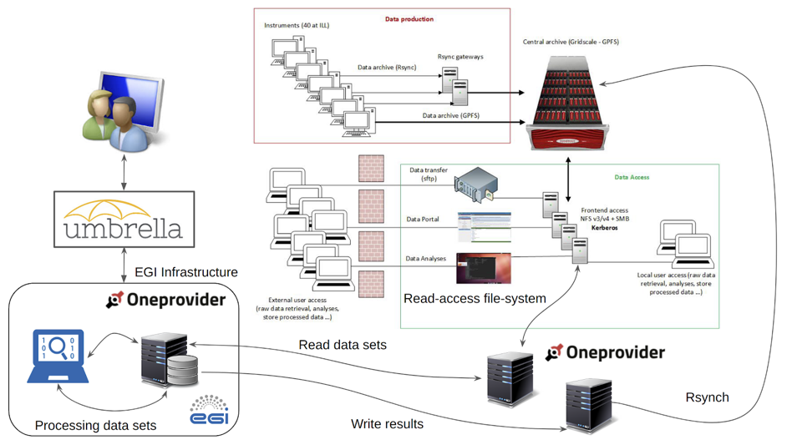
DataHub
Access key scientific datasets in a scalable way
Service based on Onedata technology
It allows transparent data access under a common namespace regardless of the location
Data can be accessed via a GUI or APIs
Developed in EOSC-hub project and
under integration by many communities
Central component and distributed
providers in EGI-ACE are going to be
operated by Cyfronet

Slide 51
DataHub
Main functionalities
Integrated with EGI-Checkin
File/Share Management
Shares can eventually be published via Handle services and have a PID assigned
Extensive backend support
Posix, S3, Swift, CEPH, GlusterFS
Data import
Allows exposing existing datasets
Metadata Management
Metadata associated to files (k-v pairs, json, rdf)
OAI-PMH interface
Harvester Management
Possibility to automatic extract metadata from files published to a space
Metadata updates are pushed to external indexes (e.g. Elastic Search) and automatically synchronized

Slide 52
Data Transfer
Transfer large datasets between storages
Easy users interaction for submitting transfers
Portal for end-users, Real Time monitoring and Web Admin
Checksums and retries are provided per transfer
Multiprotocol support
Different clients to access the service (RESTFul APIs, python bindings)
Transfers from/to different storages (including staging from tape)
Parallel transfers scheduling and optimization to get the most from network without burning the storages
Priorities/Activities support for transfers classification

Slide 53
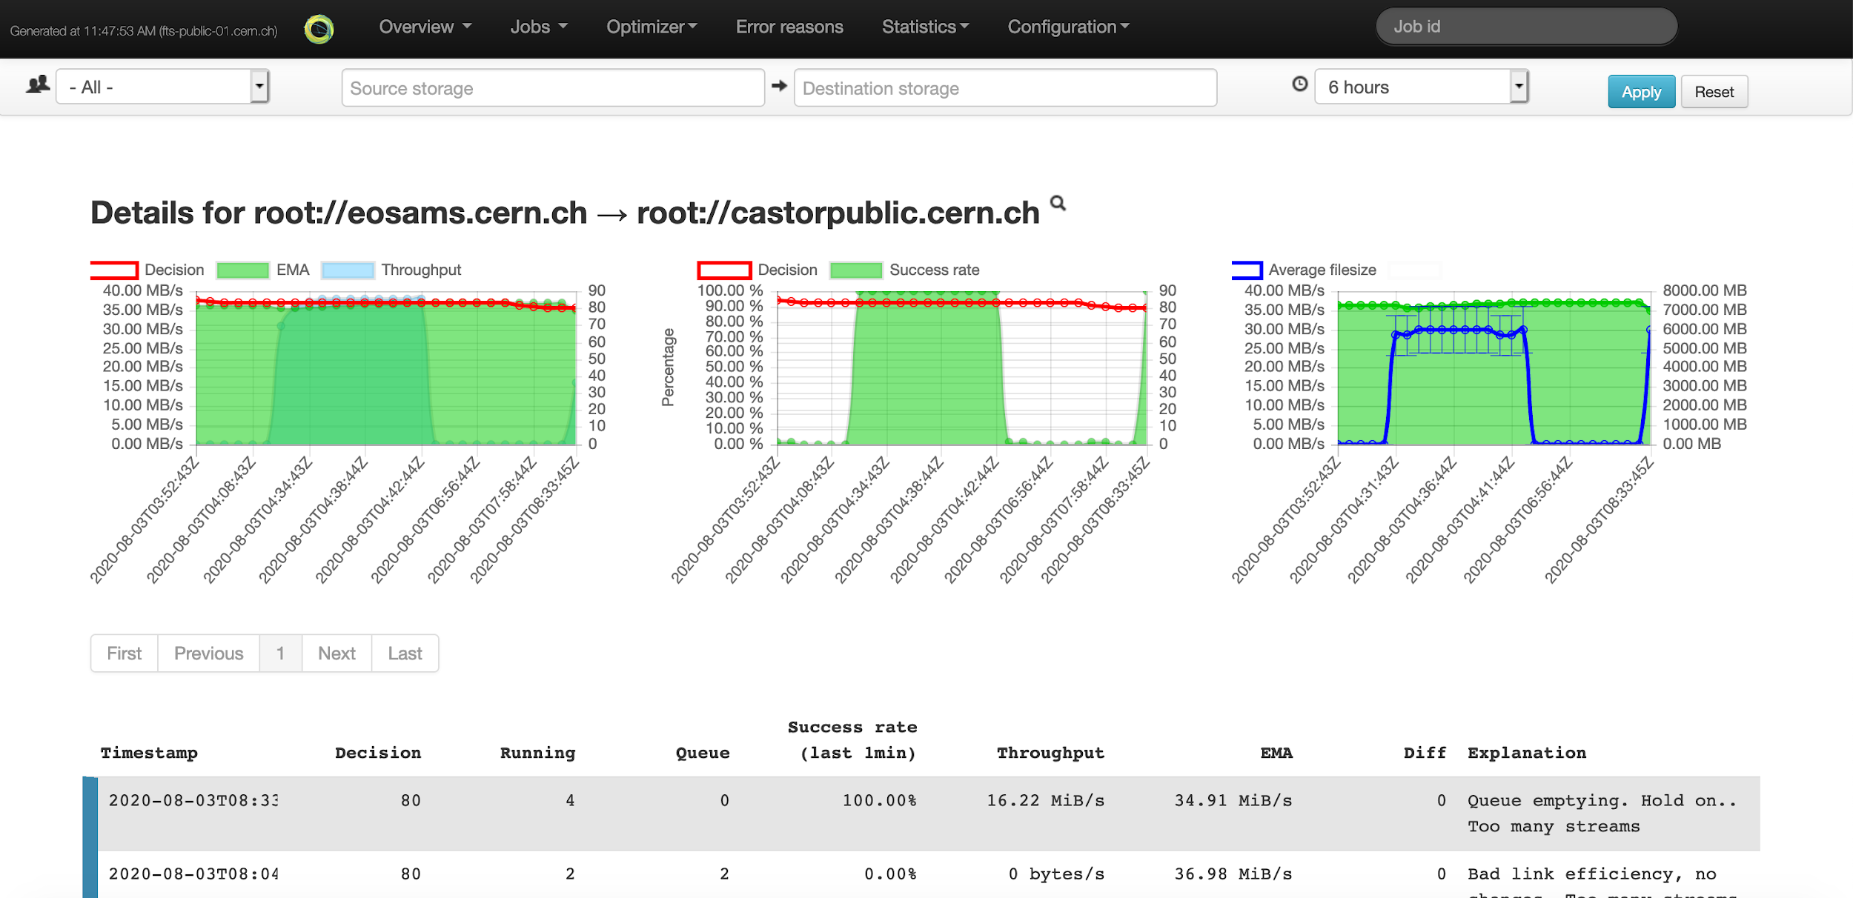
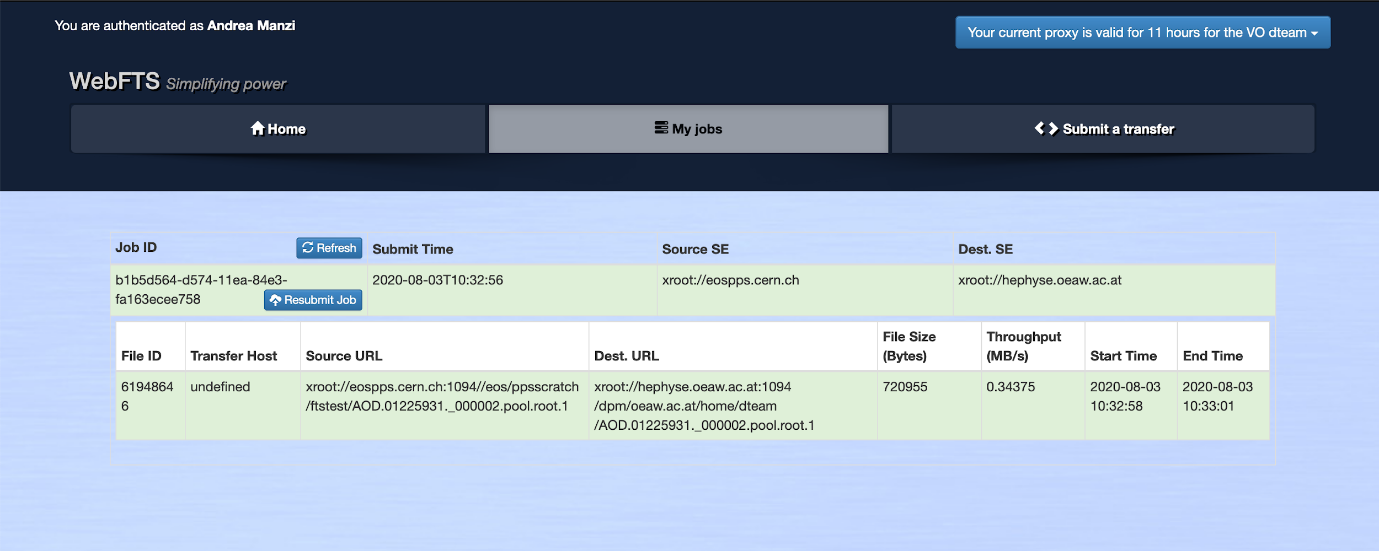
Data Transfer
Service operations
Orchestrates transfers between EGI Online storage instances and external storages using standard protocols ( e.g. HTTP/WebDAV, gridftp)
STFC-UKRI is providing the service and planning to operate the end user graphical interface (WebFTS)

Slide 54
Rucio
Scalable data management
Rucio is the software developed at CERN for the management of LHC experiments data
provides a complete and generic scientific data management service
Rucio manages multi-location data in a heterogeneous distributed environment
Creation, location, transfer, and deletion of replicas of data
Orchestration according to both low-level and high-level driven data management policies (usage policies, access control, and data lifetime)
Interfaces with workflow management systems
Large-scale and repetitive operational tasks can be automated

Slide 55
Rucio
Service operations
Under integration by many communities also outside HEP
Largest user (ATLAS) managing 500PB of data and 20GB/s transfers between 72 official sites
STFC-UKRI implemented extensions for Multi-VO support and will operate the service
Interfaced to FTS for transfer execution and possibly integrated with EGI Workload manager to implement data transfer orchestration linked to workflow executions

Slide 56
OpenRDM
Main functionalities
A complete solution for managing research data, based on the openBIS software. Targeting research labs working with quantitative research data
Inventory management
Keep track of all materials and samples used in a lab
Electronic lab notebook
Describe computational experiments and links to the materials, samples and protocols stored in the inventory
Data analysis integration
Jupyter notebook integration and access to external computing clusters
Data management
Store all data connected to experiments, export to data repos like Zenodo

Slide 57
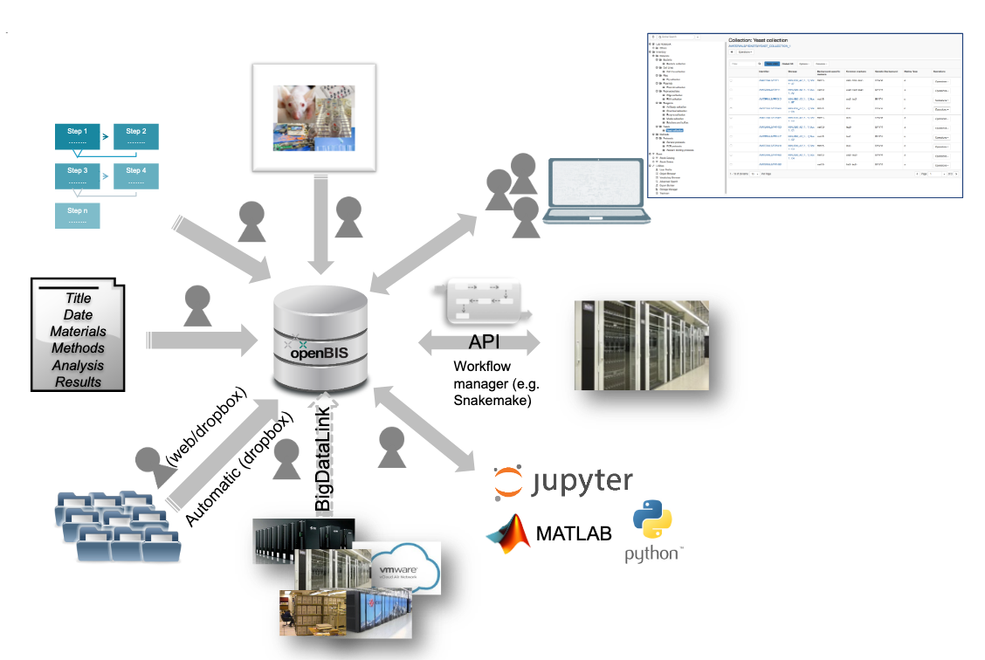
OpenRDM
Service Operations
The service will be provided by EnhanceR as a centrally managed instance (OpenRDM.eu) and will provide access to long-tail of science type use cases
Additionally dedicated instances for
specific communities will be setup on top
of EGI Federated resources

Slide 58
Documentation
Internal and External
Online Storage
DataHub ( user and provider guides )
Data Transfer
Rucio
OpenBIS user guide

