Slide 1
Unroutable LHCONE traffic
Bruno Hoeft / KIT
Samuel Ambroj Perez / KIT
Andreas Petzold / KIT
Evelina Buttitta / KIT
Richard Cziva / ESnet
Notes:
Motivation wieso der Aufwandt darlegen

Slide 2
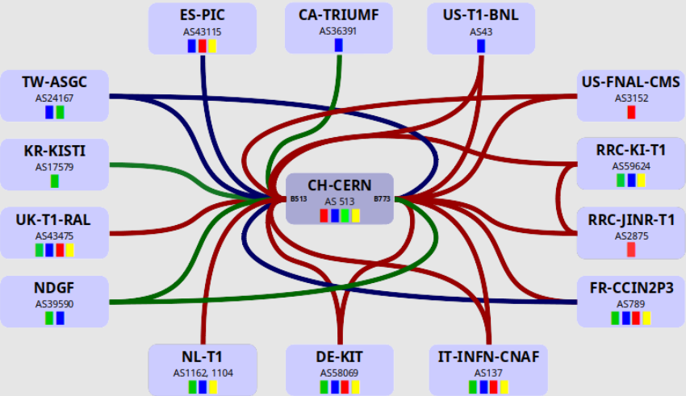
LHC → VPNs
LHCOpticalPrivatNetwork → a CERN centric star VirtualPrivatNetwork
VPN with 15 participants only, mutual agreements between connected partners, no formal rules
no unrouteable packets
Notes:
LHCOPN → clean
LHCONE → reduce/eliminate unroutable traffic , in special TCP payload (could carry malizous contend)

Slide 3
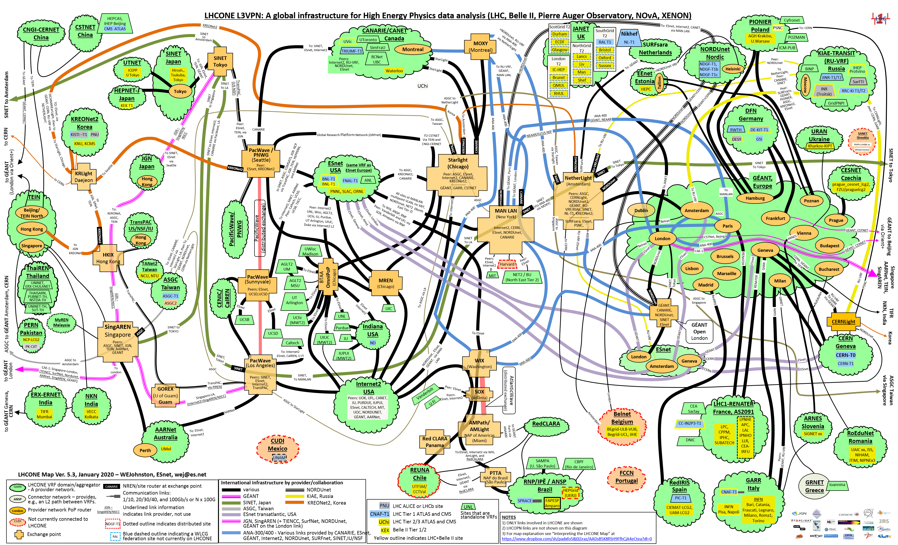
LHCOpenNetworkEnvironment – MAP
LHCONE → a still growing international distributed VPN
VPN with 105 endsites connected through 30 Virtual Routing and Forwarding implenentations at the connecting Network Service Providers (NSPs)
ASIA
AMERICA
EUROPE
Australia

Slide 4
Mission statement
All LHCONE traffic is subject to the following conditions:
traffic injected into the LHCONE must originate from addresses within an LHCONE routeable prefix
only address ranges present in the LHCONE routing table should be transported on the network
Site-A
Site-B
LHCONE
Hosts/Server address CIDR
18.45.46.0/24
…
Hosts/Server address range (CIDR)
192.108.46.0/24
LHCONE Routing Table:
18.45.46.0/24
192.108.46.0/24
204.45.46.0/24
Site-Z
Hosts/Server address CIDR
204.45.46.0/24
…
Notes:
Stichwörter von der Folie verwenden
NSP ausschreiben

Slide 5
NSP Packet Filtering Requirements
Objective: In order to maintain route symmetry and access control, each NSP will implement policy and packet filters to manage their connected customer address prefix ranges.
ensures that a return route exists within the LHCONE network
blocks spoofed packets (similar to BCP 38)
Site-A
Site-B
Filter: allow only
CIDR of Site-A
LHCONE
Filter: allow only
CIDR of Site-B
Hosts/Server address CIDR
18.45.46.0/24
…
Hosts/Server address range (CIDR)
192.108.46.0/24
Filter: allow only
CIDR of Site-Z
LHCONE Routing Table:
18.45.46.0/24
192.108.46.0/24
204.45.46.0/24
Site-Z
Hosts/Server address CIDR
204.45.46.0/24
…
https://twiki.cern.ch/twiki/pub/LHCONE/LhcOneVRF/LHCONEconnectionguide-1.2.pdf
Notes:
Stichwörter von der Folie verwenden
NSP ausschreiben

Slide 6
NSP Border Gateway Protocol (BGP) Import Policy
Prefix lists will be negotiated between connecting institutions and their NSP within the constraints imposed by the LHCONE Acceptable Use Policy (AUP).
LHCONE NSPs have agreed to configure:
BGP import filters
source address packet filters
End sites are encouraged to implement source address filters at their edge in order to eliminate their own unrouteable LHCONE packets. NSPs will generally discard no-compliant packets without informing the site.
Connecting institutions/sites will not add prefixes to the LHCONE routing table without direct cooperation with their NSP.
AUP: https://twiki.cern.ch/twiki/bin/view/LHCONE/LhcOneAup

Slide 7
The Investigation
ESnet
Three months of ESnet netflow IPv4 & IPv6 sampling from Feb. 2019 - April 2019 for the following connected sites and peers
aarnet
aglt2
anl
ansp
asgc
bnl
caltech
canet
cern
cernlight
duke
flr
fnal
geant
ind-gpop
internet2
JGN
kiae
kreonet
ornl
mit
net2
nordunet
ou
pnnl
rnp
sinet
slac
tacc
transpac
uchicago
ucsb
ucsd
uiuc
unl
uta
uwmadison
vanderbilt
ESnet counted:
all LHCONE ingress packets
unrouteable source packets
packets with non-lhcone/missing origin ASN
* corrected for netflow sampling rate (1000)

Slide 8
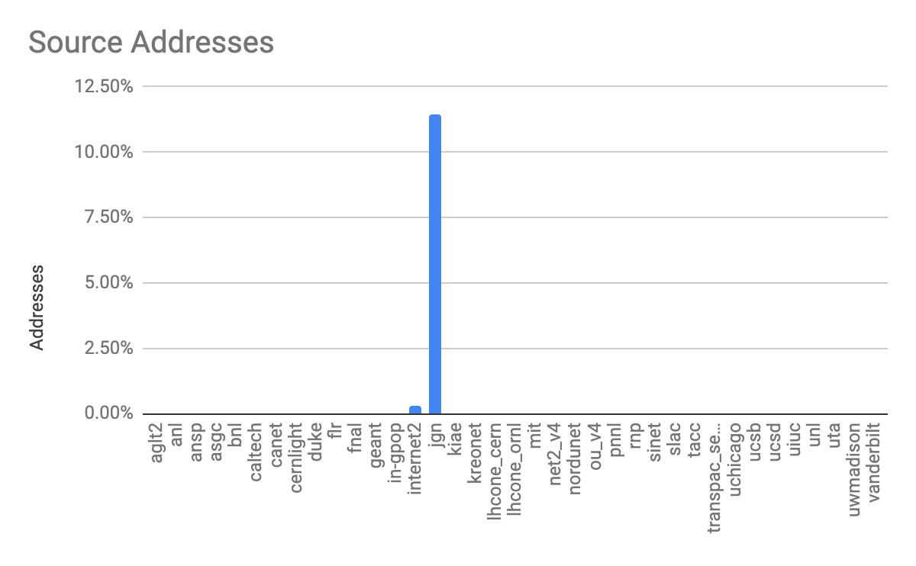
ESnet monitoring Unrouteable Source Addresses by percentage
58 Unroutable source addresses from networks in Thailand arrive via JGN LHCONE transit services
4 Unroutable source addresses from networks in Canada arrive via I2 LHCONE transit services
significant improvement compared to results of 2018
Notes:
z
58 JGN transit sources from:
inetnum:
158.108.0.0 - 158.108.255.255
netname:
KU
descr:
Kasetsart University, Thailand
country:
TH
org:
ORG-KU3-AP
inetnum:
203.158.96.0 - 203.158.255.255
netname:
RIT-TH
descr:
Rajamangala Institute of Technology
descr:
Institute of Information Technology
descr:
RIT center, Pathum Thani
lhc1-bgp-v4:JGN(17934)
lhc1-bgp-v4:161.200.0.0/16 JGN(17934) TEIN2-NORTH(24489) THAIREN(24475) UNINET-TH(836) ERX-CHULANET(3839)
lhc1-bgp-v4:203.185.64.0/22 JGN(17934) TEIN2-NORTH(24489) THAIREN(24475) THAISARN(3836) PUBNET-TH-AS(7588)
lhc1-bgp-v4:192.207.64.0/24 JGN(17934) TEIN2-NORTH(24489) THAIREN(24475) UNINET-TH(836) ERX-CHULANET(3839)
lhc1-bgp-v4:202.122.33.0/24 JGN(17934) TEIN2-NORTH(24489) CNGI-BJIX-AS-AP(23911) CSTNET-AS-AP(7497) ERX-HEPCAS-AS(3460)
lhc1-bgp-v4:202.122.35.0/24 JGN(17934) TEIN2-NORTH(24489) CNGI-BJIX-AS-AP(23911) CSTNET-AS-AP(7497) ERX-HEPCAS-AS(3460)
lhc1-bgp-v4:202.122.36.0/24 JGN(17934) TEIN2-NORTH(24489) CNGI-BJIX-AS-AP(23911) CSTNET-AS-AP(7497) ERX-HEPCAS-AS(3460)
lhc1-bgp-v4:202.28.194.0/24 JGN(17934) TEIN2-NORTH(24489) THAIREN(24475) UNINET-TH(836)
lhc1-bgp-v4:202.28.2.0/24 JGN(17934) TEIN2-NORTH(24489) THAIREN(24475) UNINET-TH(836)
lhc1-bgp-v4:202.28.43.0/24 JGN(17934) TEIN2-NORTH(24489) THAIREN(24475) UNINET-TH(836) SUT-AS-AP(55545)
lhc1-bgp-v4:202.29.12.0/24 JGN(17934) TEIN2-NORTH(24489) THAIREN(24475)
lhc1-bgp-v4:202.38.128.0/24 JGN(17934) TEIN2-NORTH(24489) CNGI-BJIX-AS-AP(23911) CSTNET-AS-AP(7497) ERX-HEPCAS-AS(3460)
lhc1-bgp-v4:202.38.129.0/24 JGN(17934) TEIN2-NORTH(24489) CNGI-BJIX-AS-AP(23911) CSTNET-AS-AP(7497) ERX-HEPCAS-AS(3460)
lhc1-bgp-v4:202.44.204.0/24 JGN(17934) TEIN2-NORTH(24489) THAIREN(24475) THAISARN(3836) PUBNET-TH-AS(7588)
lhc1-bgp-v4:203.185.100.0/24 JGN(17934) TEIN2-NORTH(24489) THAIREN(24475) THAISARN(3836)
lhc1-bgp-v4:203.185.129.0/24 JGN(17934) TEIN2-NORTH(24489) THAIREN(24475) THAISARN(3836) NSTDA-TH-AS-AP(38296)
lhc1-bgp-v4:203.185.131.0/24 JGN(17934) TEIN2-NORTH(24489) THAIREN(24475) THAISARN(3836) NSTDA-TH-AS-AP(38296)
lhc1-bgp-v4:203.185.132.0/24 JGN(17934) TEIN2-NORTH(24489) THAIREN(24475) THAISARN(3836) NSTDA-TH-AS-AP(38296)
lhc1-bgp-v4:203.185.133.0/24 JGN(17934) TEIN2-NORTH(24489) THAIREN(24475) THAISARN(3836) NSTDA-TH-AS-AP(38296)
lhc1-bgp-v4:203.185.134.0/24 JGN(17934) TEIN2-NORTH(24489) THAIREN(24475) THAISARN(3836) NSTDA-TH-AS-AP(38296)
lhc1-bgp-v4:203.185.68.0/24 JGN(17934) TEIN2-NORTH(24489) THAIREN(24475) THAISARN(3836)
lhc1-bgp-v4:203.185.92.0/24 JGN(17934) TEIN2-NORTH(24489) THAIREN(24475) THAISARN(3836)
lhc1-bgp-v4:203.185.93.0/24 JGN(17934) TEIN2-NORTH(24489) THAIREN(24475) THAISARN(3836)
lhc1-bgp-v4:203.185.96.0/24 JGN(17934) TEIN2-NORTH(24489) THAIREN(24475) THAISARN(3836)
lhc1-bgp-v4:203.185.97.0/24 JGN(17934) TEIN2-NORTH(24489) THAIREN(24475) THAISARN(3836)
lhc1-bgp-v4:203.185.98.0/24 JGN(17934) TEIN2-NORTH(24489) THAIREN(24475) THAISARN(3836)
lhc1-bgp-v4:203.185.99.0/24 JGN(17934) TEIN2-NORTH(24489) THAIREN(24475) THAISARN(3836)
lhc1-bgp-v4:103.2.211.224/27 JGN(17934) TEIN2-NORTH(24489) CNGI-BJIX-AS-AP(23911) CSTNET-AS-AP(7497)
lhc1-bgp-v4:202.122.32.160/27 JGN(17934) TEIN2-NORTH(24489) CNGI-BJIX-AS-AP(23911) CSTNET-AS-AP(7497) ERX-HEPCAS-AS(3460)
lhc1-bgp-v4:202.180.40.0/27 JGN(17934)
lhc1-bgp-v4:210.25.189.248/30 JGN(17934) TEIN2-NORTH(24489) CNGI-BJIX-AS-AP(23911)
lhc1-bgp-v4:202.122.32.45/32 JGN(17934) TEIN2-NORTH(24489) CNGI-BJIX-AS-AP(23911) CSTNET-AS-AP(7497) ERX-HEPCAS-AS(3460)

Slide 9
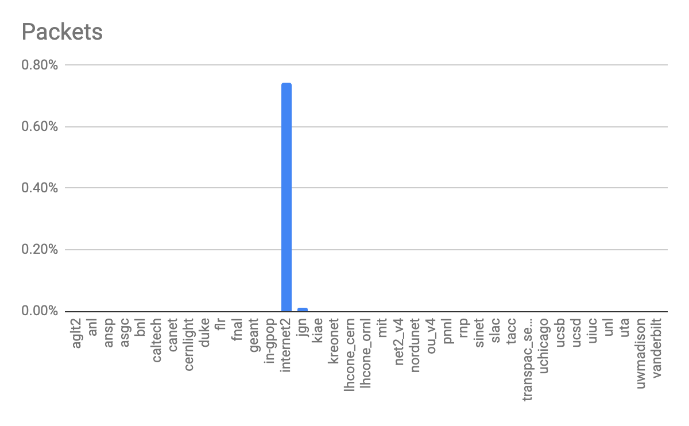
ESnet monitoring
This may be a reachability problem for U Toronto. ESnet no longer has any routes to their ASN 239
A small number of U Toronto hosts are transmitting large amounts of data on LHCONE. ESnet had routes for U Toronto in the past.
Notes:
ESnet does not have a route for this host, but it may be that the route exists elsewhere in LHCONE
Canadian Host 142.150.19.61
Source Registry ARIN
UTORONTO-AS
AS239

Slide 10
unrouteable LHCONE packets at ESnet
ESnet
ingress filter at each customer
ESnet internal → clean
NSP peerings -- a very course grained filter applied only
long term:
Loose-uRPF filter → still in experimental status
verifying source address routes
still a couple of challenges to solve → but it looks promising
ESnet6 → shall be rolled out with NSO automation incl. to generate
customer and
peer filter
this shall enable ESnet without unrouteable LHCONE packet

Slide 11
DE-KIT : unrouteable IPv4/6 LHCONE packet statistics
unsampled Ingress Packet Filters based on LHCONE routing table
Ingress Packet Filters
 | IPv4 | IPv6
Total packets (during 4 weeks) | 1.044.471 | 1.376.338
Packet/day | 37.302 | 35.290
Privat IP destination | 10.0.0.0/16, 172.16.0.0/12, 192.168.0.0/16 | fe00::/16
Number of sources | 44 + private | 33 + private
Unrouteable packet resources of 2019
Total LHCONE traffic → 0,2% / none ICMP → approx. 57%
priv
AARNIEC-RoEduNet
AIT-TH
ASGC-NET
Associação Rede Nacional (BR)
CANARIE
Bcnet Vancouver
CAS-PRG-6TCZ
CAS-TCZ
CERNET
CHINANET-FJ
CIECCHQ-CN
CIEMAT
CZ-RELCOM-19930901
DFN WIN-IPV6
ERNET-IN
ES-REDIRIS-20010521
Fundação Carlos Chagas Filho (BR)
FR-RENATER
FR-IN2P3-LAL-ORSAY
FR-IN2P3-LLR-PALAISEAU
FR-CEA-SACLAY-GRILLES
FR-IN2P3-LPNHE-PARIS
FR-IN2P3-LPC-CLERMONT-AUBIERE
FR-IN2P3-LAPP-ANNECY
FR-IN2P3-CPPM-MARSEILLE
GEANT
GARR-P-P
GARRB-NET
GARRX-NET
GR-GRNET-19991208
GZIN
IANA – reserved
IHEP-IPv6
Imperial College London
Indiana University
INFNNET-LNF
Inst. Nat. de Physique Nucleaire
IT-GARR-20011004
JINR-NET
Kasetsart University, Thailand
KREONet-KR
NL-GEANT-20020131
PNPI
REDIRIS
RoEduNet-IPv6-NET-1
RRC-KIAE-Moscow
RU-ROSNIIROS-20180806
RWTH Aachen
SAVECOM SAVECOM-NET
SINET-JPNIC
SUT-TH
T-NCU.EDU.TW-NET
T-NSYSU.EDU.TW-NET
T-NTHU.EDU.TW-NET
TANET
TANET-B T-HCRC.EDU.TW-NET
TANET-BNETA
TANET-BNETS Taiwan
TANET-NET
TANET-NET Taiwan
TANET Taiwan
TEIN2-CERNET
THAINET-TH
TFN-NET TAI-SHIN-NET
TRIUMF
UAM
UK-GEANT-20020131
UNI Michigan
UNIVERSIDADE DE SAO PAULO
UNI of Nebraska-Lincoln
University of Toronto
IJS-IPv6-NET - Ljubljana
VANDERBILT
WIN-IP
Color legend : IPv6 and IPv4 / IPV4 / IPv6
Notes:
KIT Montoring sichtbar machen
Kein rot → rot/grün blind

Slide 12
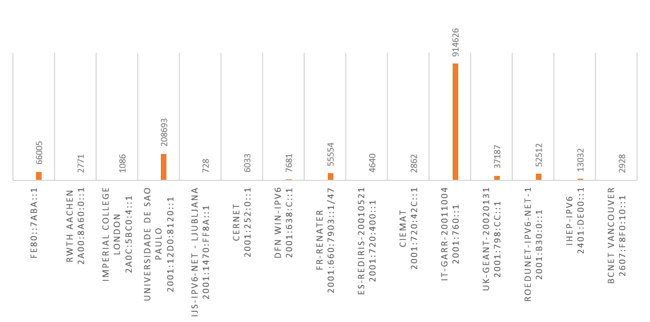
IPv6 Filter : unrouteable LHCONE packet
filter Privat address space (link local)
IT-GARR → ICMP packet of network devices and the main injector (2 Perfsonar Server) became part of LHCONE
FR-Renater → ICMP packets of network devices
1 source
min:
66.005
1 source
min:
208.693
914626
6 different sources
min: average: max:
10 152.437 749.085
208693
66005
55554
52512
11 different sources
min: average: max:
4 5.050 23.712
1 source
min:
52.512

Slide 13
DE-KIT : unrouteable IPv4/6 LHCONE packet statistics
unsampled Ingress Packet Filters based on LHCONE routing table
Ingress Packet Filters
 | IPv4 | IPv6
Total packets (during 4 weeks) | 2.6Mil | 1.9Mil Total approx. 4.5Mil
Packet/day | 82,000 | 70,000
Privat IP destination | 10.0.0.0/16, 172.16.0.0/12, 192.168.0.0/16 | fe00::/16
Number of sources | 38 + private | 28 + private
Total LHCONE traffic → 0,15% / none ICMP → approx. 97%
ARBES-NET
ASGARR
CANARIE-NTN
CESNET2
CMU-TH-AP
CSTNET-AS-AP
CYFRONET AGH
DFN
EENet-AS
FR-Renater
Géant
HEPNET-J
IHEP-SU
INDIANAGIGAPOP US
IU-RESEARCH
Janet
KIAE-COMPUTING-AS
KREONET-AS-KR-KR
LACNIC-1916
LACNIC-11340
MERIT-AS-14
NCTU-TW
NICNET-VSNL-BOARDER-AP
NKN-CORE-NW
NU-AS (US)
NORDUNET
ORG-ITEP1-RIP
PURDUE
PBRU-AS-AP
RAVEL-BR
RedIRIS
RIT-AS-AP
RMTUI-AS-AP
RMUTSV-AS-AP
RoEduNet
RWTH
SINET-AS
SNRU-AS-AP
SUT-AS-AP
TANET
TEIN2-SG-AP
THAI-GATEWAY
TWAREN-TW
TWGATE-AP
U-CHICAGO-AS
UNINET-AS-MFU
UNINET-TH
UNIVERSIDADE DE SAO PAULO BR 28571
University Of Ioannina
UY-CLAR-LACNIC
WISC-MADISON-AS
Color legend : IPv6 and IPv4 / IPV4 / IPv6
Notes:
KIT Montoring sichtbar machen
Kein rot → rot/grün blind

Slide 14
unrouteable IPv4/6 packets
- Reduced to 17 different sites only by
- removed sites with less than 5000 packets (per month)
- pull different subnets of one source/site together
total : 2,612,633 + 1,969,168 = 4,481,801
packets per day: 152,921
ICMP approx. 2.5% = 114,.860
none ICMP = 4,366,941

Slide 15
Unrouteable packets found from CESnet
CESNET
current example of clarified
unrouteable packets
Subnet added to LHCONE BGP routing table:
*>e147.231.98.224/27 188.1.153.65 0 680 20965 2852 i
*>e2001:718:409:7000::/52 2001:638:c:da40::1 0 680 20965 2852 i
➧ Issue solved

Slide 16
CESnet reduced unrouteable IPv4/6 packets
- Reduced to 16 different sites only by
- resolved CESNET
total : 1,132,633 + 739,168 = 1,871,801
packts per day: 59,707
ICMP approx. 6.9% = 114,860
none ICMP 93,1% = 1,756,941

Slide 17
Project @ DE-KIT : unrouteable packet -- web portal
automate unrouteable packet information gathering
→ router packet filter
→ store into a organized and structured database (kibana)
visualise the data (packet beat / elastic search / kibana / grafana) with different levels
abstract overview
and zoomable into detailed view (up to source/dest. of a single packet) this data shall be available for the LHCONE connected sites (but not for the world), one idea:
securing the data
communityrestricted access --> personal authentication enabled (via eduGAIN)
project started again,
first results are available (part of this presentation)
Investigation on enabling access to the LHC (+ NREN) community are still ongoing
Notes:
Monitoring -> projekt namen

Slide 18
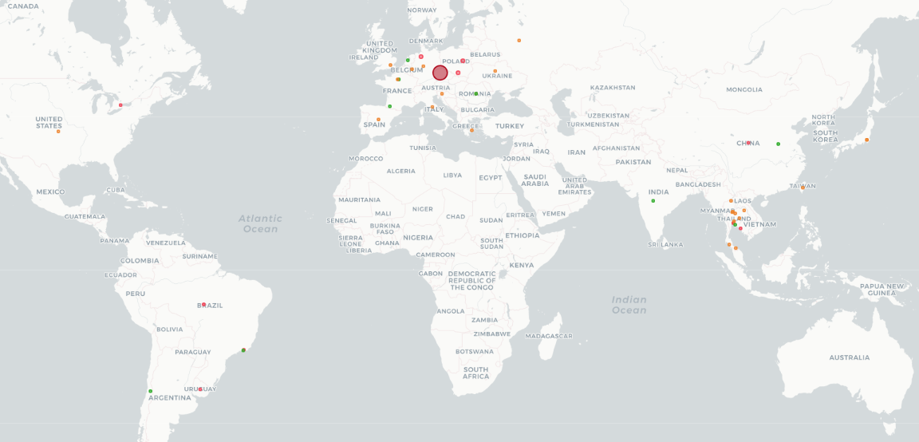
Worldmap of unrouteable packets captured during last month

Slide 19
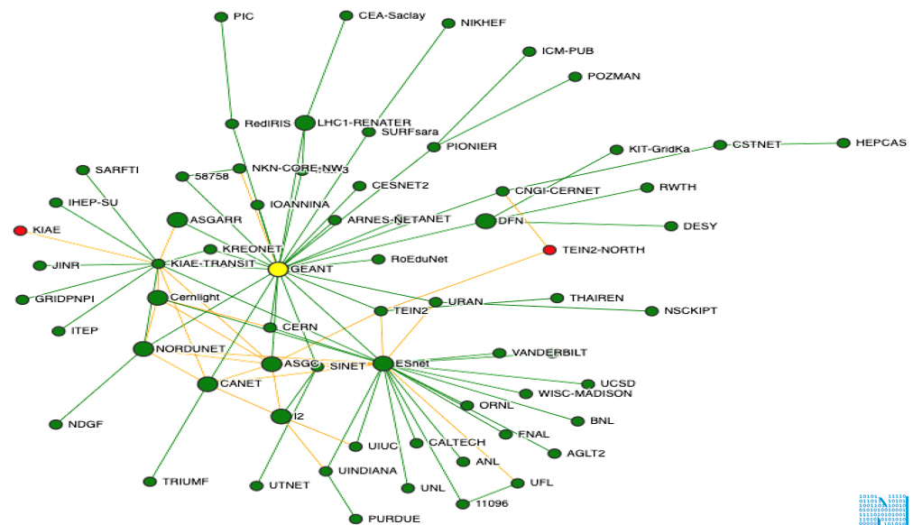
Routing tabel diffrenz e.g: Géant (IPv6)
Missing in LHCONE routing table
KIAE
TEIN2-NORTH

Slide 20
Conclusion / actions
(DE-KIT) Number of unrouteable LHCONE packets reduced from 4.5 million to 1.9 million → found 2.6 million packets marked as false positive
LHCONE ingress filtering/control has improved significantly since measurement began in Q1 2018!
Ratio of “unroutable LHCONE to total traffic at KIT → 2018 : 0,5% – 2021 :0.15%
But still detection will be beneficial:
regularly scheduled monitoring?
periodic NSP self run audits?
Work towards Prevention
NSPs initiative at Edge Site filter configuration
RPF → too strict? → Rather opt for ACLs
templated policy & filter configuration
Routing table inconsistency may also be a source of false positives.
Ongoining work towards an equal the world spanning LHCONE routing table
NREN 1
Site 1
Site 3
ACL
ACL
RPF
ACL
RPF
ACL
NSP
RPF
ACL
ACL
Site 2

Slide 21
Questions
Suggestions
Discussion

