Slide 1
CNIC Grid/SDG CA Status Report
CSTCloud, CNIC/CAS, China
Mar. 23, 2021

Slide 2
Outline
Current status of CNIC Grid CA
Current status of SDG CA
Updates of Operators
Others

Slide 3
CNIC Grid CA
CNIC is an institute of CAS
CNIC Grid CA
The security infrastructure of CNIC Grid
Root CA
CNIC Grid CA Repository
http://ca.grid.cn/
CP/CPS V1.2
Introduction
Manual
CA Certificate
20 years validity --- 2006-2-27 ~ 2026-2-27
Only issues sub-CA certificate and CA servers and operators certificates
Subordinate CA: CN=Scientific Data Grid CA,DC=SDG,DC=Grid,DC=CN
Person Certificate: CN=Morrise Xu (morrise@cnic.ac.cn),DC=Grid,DC=CN
Host Certificate: CN=ca.grid.cn,DC=Grid,DC=CN

Slide 4
SDG CA
Scientific Data Grid (SDG)
Scientific Data Grid (SDG) is an application grid based on scientific data resources sharing and collaboration.
SDG CA
the SDG security infrastructure
The subordinate CA of CNIC Grid CA
SDG CA Repository
http://ca.sdg.grid.cn/
CP/CPS V1.6
Introduction
Manual
SDG CA Certificate
10 years validity --- 2015-12-25 ~ 2025-12-24
Type of certificates
Person Certificate: CN=Morrise Xu (morrise@cnic.ac.cn),DC=SDG,DC=Grid,DC=CN
Host Certificate: CN=sdg6800.sdg.ac.cn, DC=SDG,DC=Grid,DC=CN
Service Certificate: CN=DAS/sdg6800.sdg.ac.cn, DC=SDG, DC=Grid, DC=CN

Slide 5
Current status of CNIC Grid CA
Current Status ( by Mar. 23, 2021）
Valid Certificate | 1
Expired Certificate | 12
Revoked Certificate | 8
Total | 21

Slide 6
Current status of SDG CA
Current Status ( by Mar. 23, 2021）
Valid Certificate | 0
Expired Certificate | 492
Revoked Certificate | 38
Total | 530

Slide 7
Updates of CNIC Grid/SDG CA staff operates
Jianhui Li
Security Officer
Yihua Zheng
Security Officer
CA Operator
Ziming Liu ( instead of Taotao Shi)
User Administrator
Help Desk
Ruiding Han
CA Operator
Shanbo Li
CA Operator

Slide 8
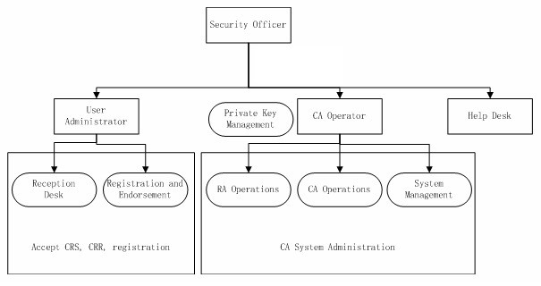
CNIC Grid/SDG CA staff operators
Jianhui Li
Yihua Zheng
Yihua Zheng
Shanbo Li
Ruiding Han
Ziming Liu
All staff
Administrator:
Ziming Liu

Slide 9
Others
Upgrade Nginx server for SDG CA and CNIC Grid CA
A new CA for CAS CSTCloud project
CSTCloud: China Science and Technology Cloud.
Part of CSTCloud AAI
About CSTCloud AAI
CSTCloud AAI Federation (http://www.cstcloud.net)
CSTCloud CA
Under Development

Slide 10
Thanks!

