Slide 1
Air Quality Predictions of Ulaanbaatar using Machine Learning Approach
Otgonsuvd Badrakh
Head of Department of Information Technology,
Institute of Mathematics and Digital Technology,
Mongolian Academy of Sciences.

Slide 2
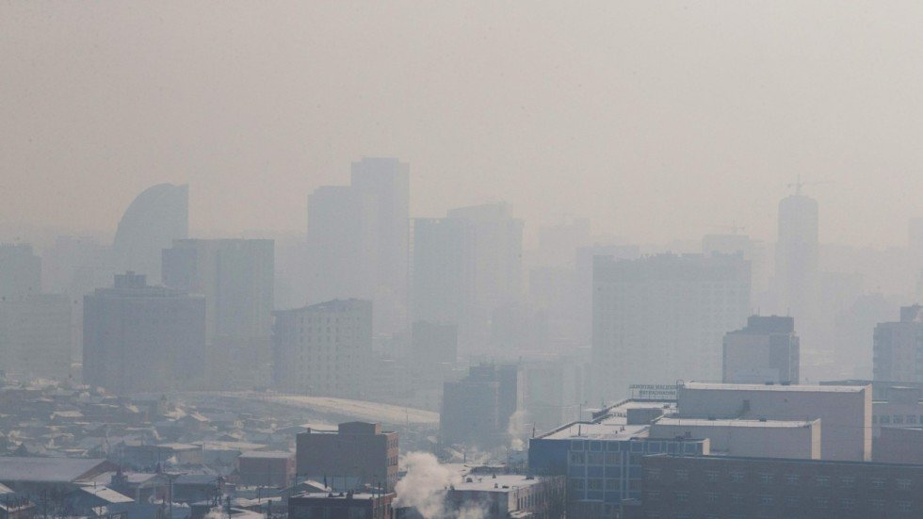
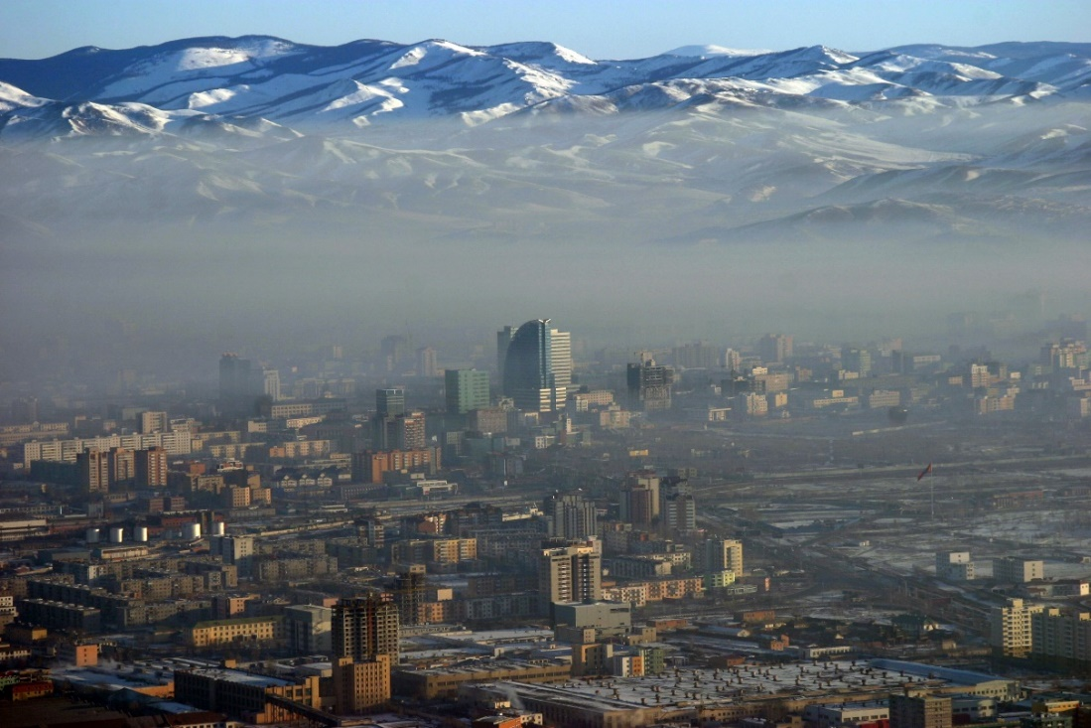
Introduction

Slide 3
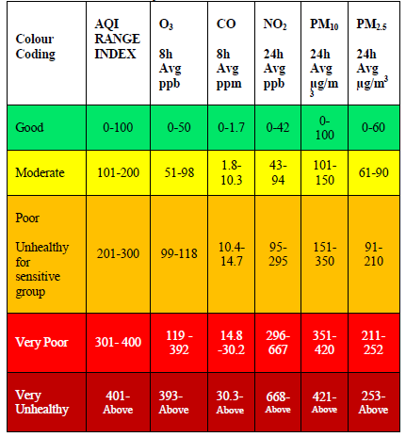
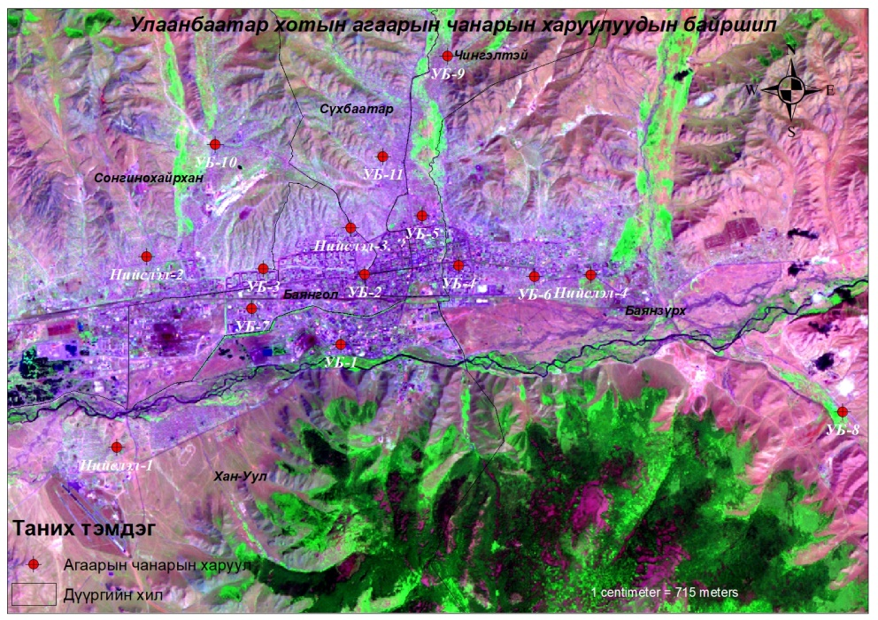
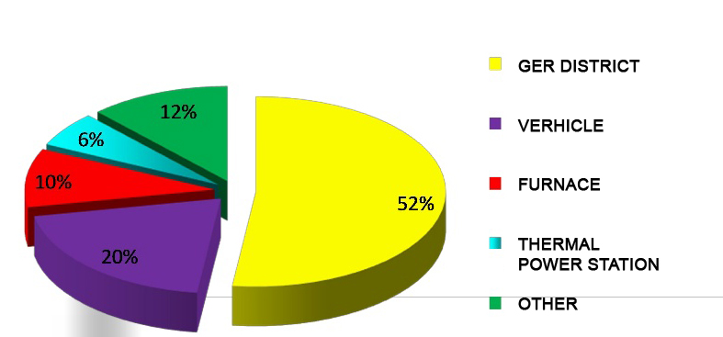
Air quality
PM2.5, PM10, CO, SO2, NO2, O3
Notes:
Air pollution is usually measured by carbon monoxide (CO), sulfur dioxide (SO2), nitrogen oxides (NO) and nitrogen dioxide (N2O5), ozone (O3), and particulate matter (PM2.5 and PM 10). There are 16 air quality stations in Ulaanbaatar that measure air quality and weather information. Recently, it has become possible to predict the level of air pollution using machine learning approaches of artificial intelligence , which is the most important research area in computer science, and developed countries have done a lot of research in this area.
The air pollution of Ulaanbaatar is depends on these factors.

Slide 4
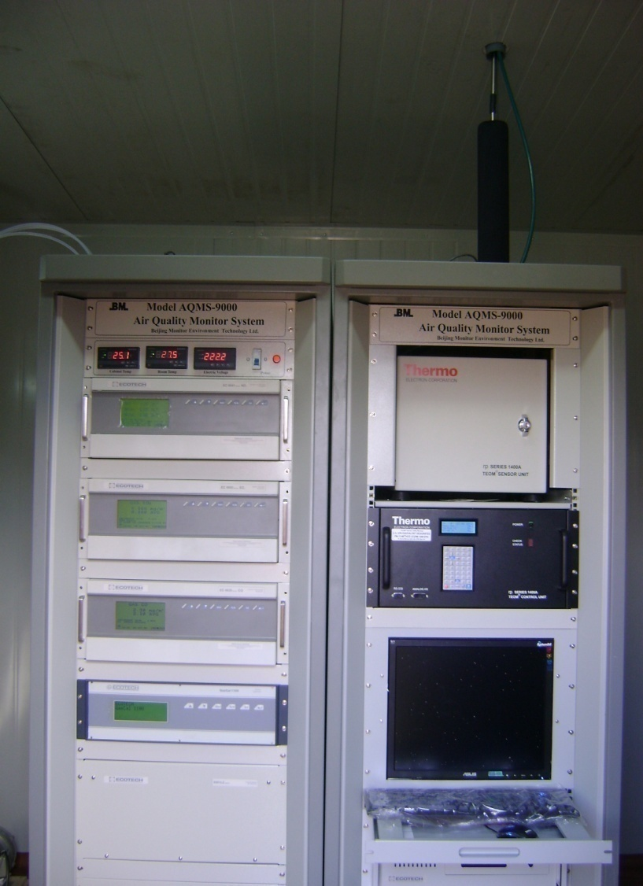
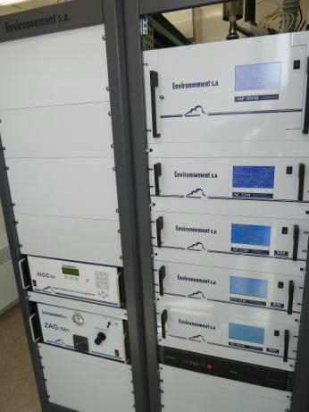
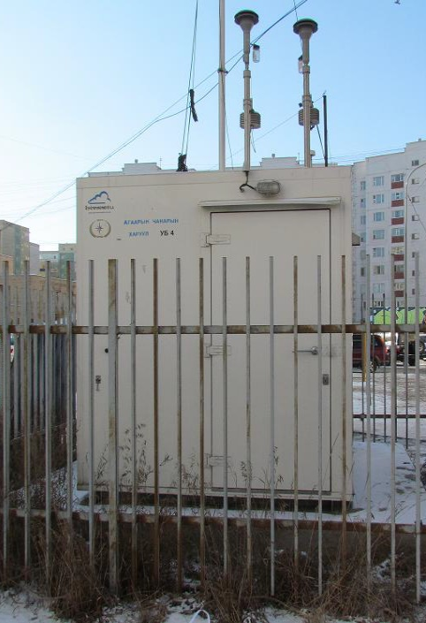
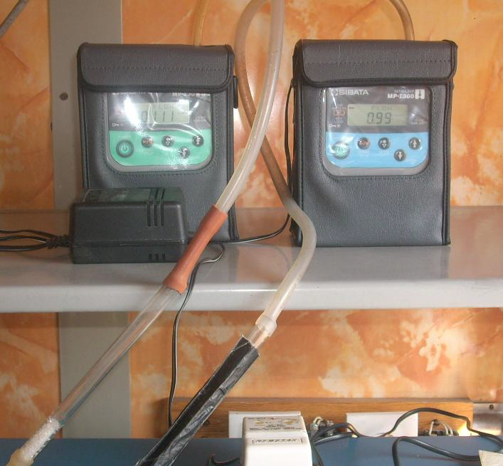
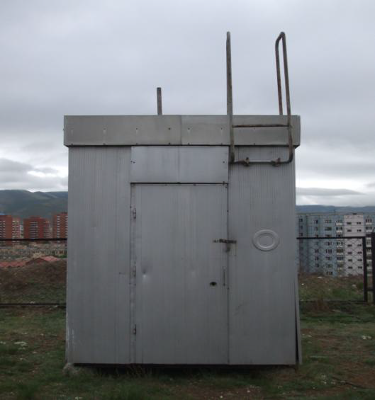
Automatic air quality monitoring station
Manual air quality monitoring station
Parameter | Avg. time | Methodology
Ambient PM concentration | 15-min | β-gauge
SO2 concentration | 15-min | UV-flourescence
NO2 concentration | 15-min | Chemiluminescence
CO concentration | 15-min | NDIR
O3 concentration | 15 min | UV Absorption
Pollutants | Averaging time | Methodology
PM₁₀ concentration | 24-hours | Low volume sampler
SO2 concentration | 24-hours | Tetrachlormercurate /pararosaniline photometric method
NO2 concentration | 24-hours | 1-naphtylamine photometric method

Slide 5
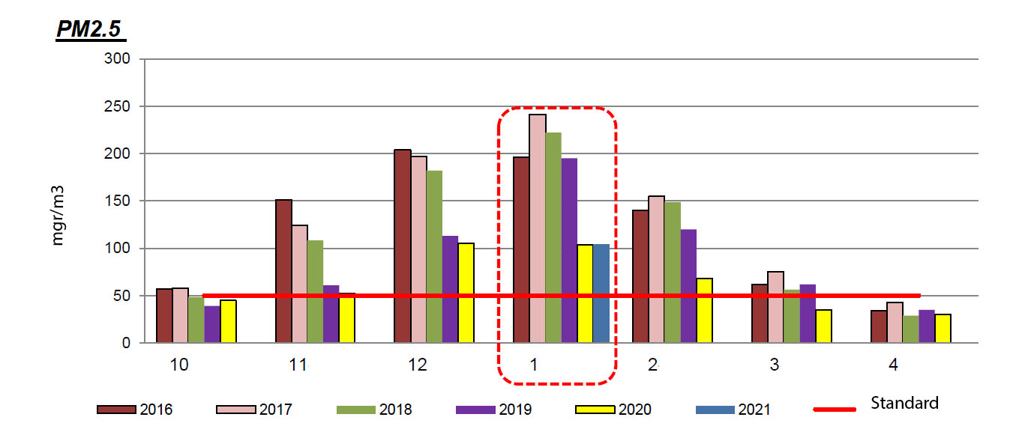
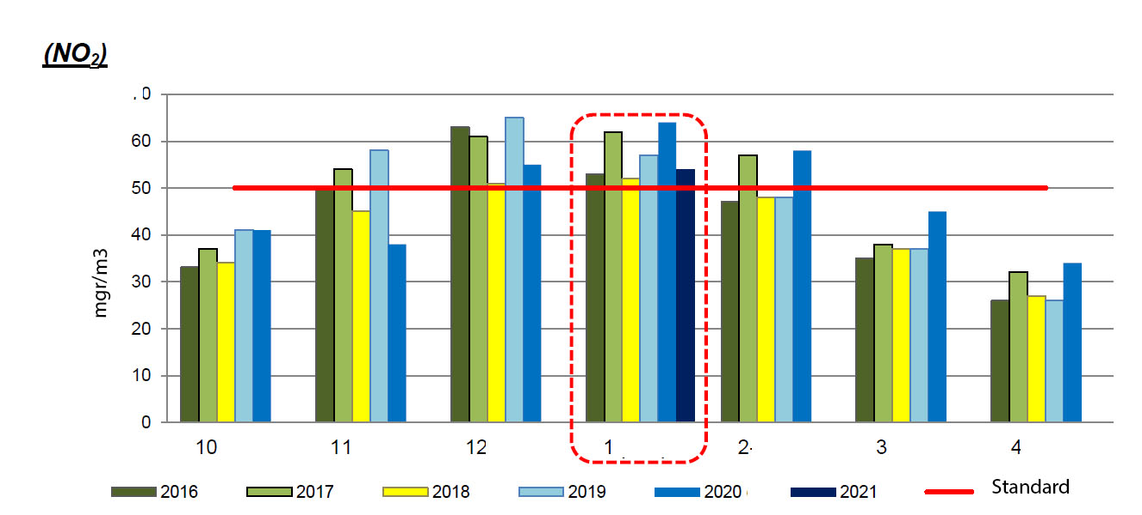
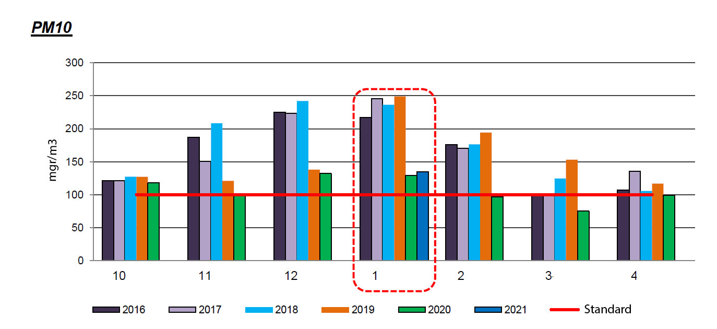
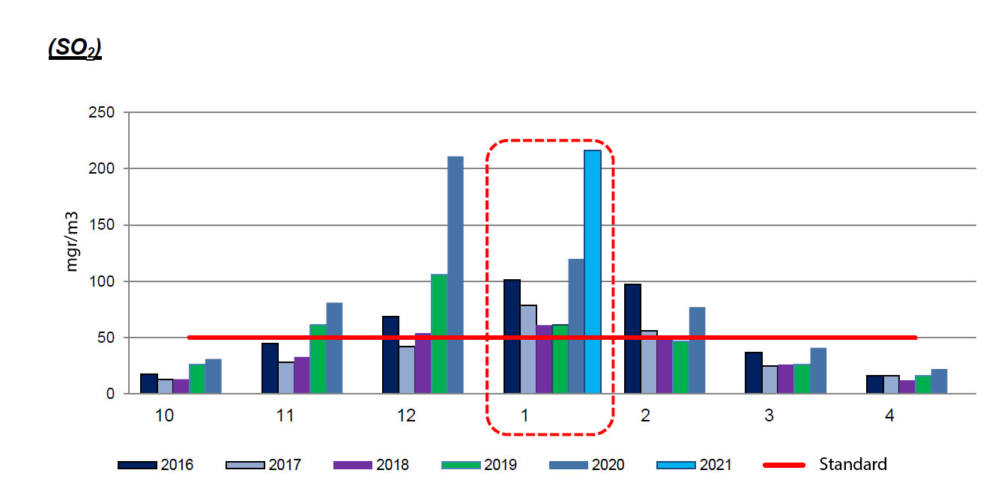
Air quality of UB in January /2016-2021/

Slide 6
Machine learning
Traditional Programming
Machine Learning
Data
Computer
Output
Program
Data
Computer
Program
Output

Slide 7
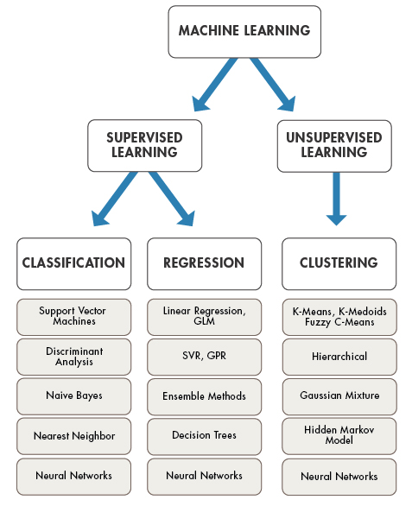
Machine learning

Slide 8
Research purpose

Slide 9
Air quality prediction model

Slide 10
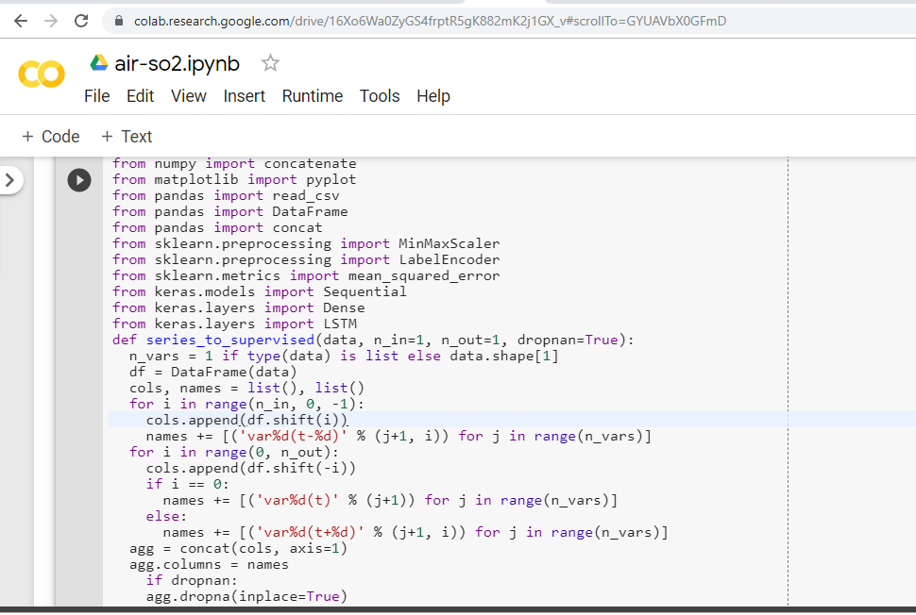
Research method

Slide 11
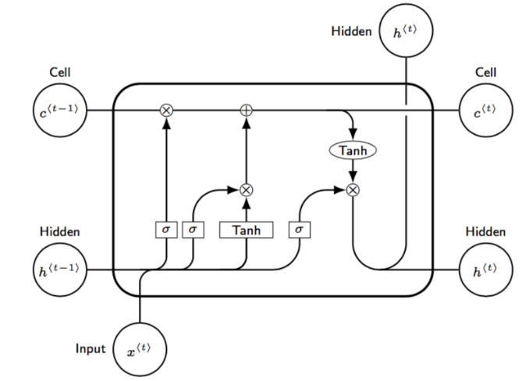
Training model
LSTM model

Slide 12
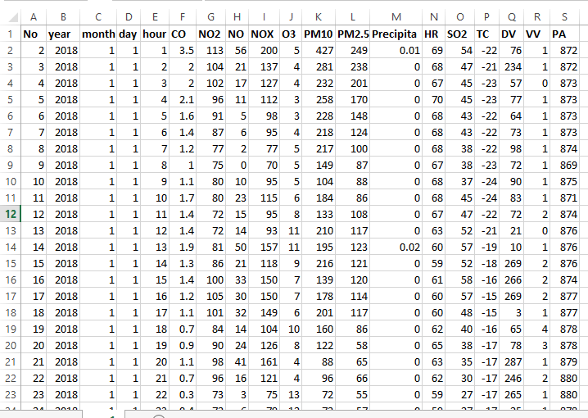
Research data

Slide 13
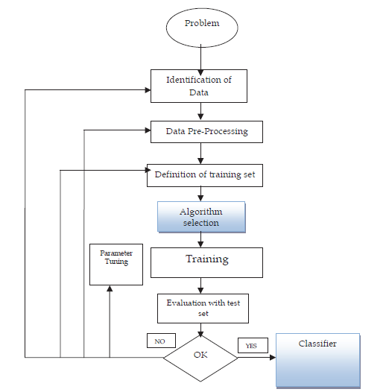
Training process

Slide 14
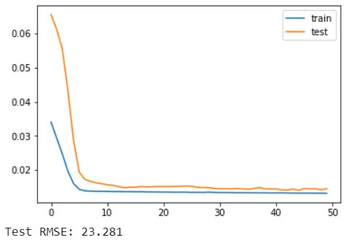
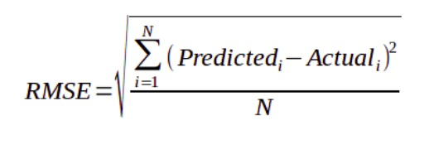
PM10-prediction results

Slide 15
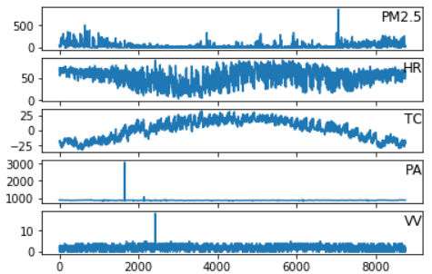
PM2.5-prediction results

Slide 16
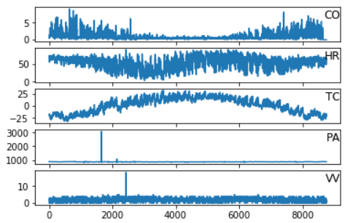
CO-prediction results

Slide 17
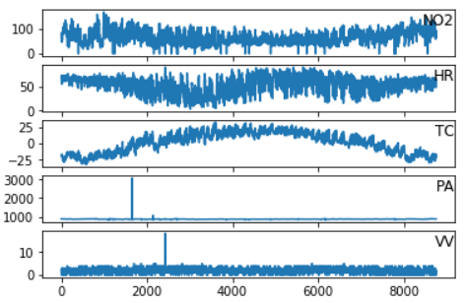
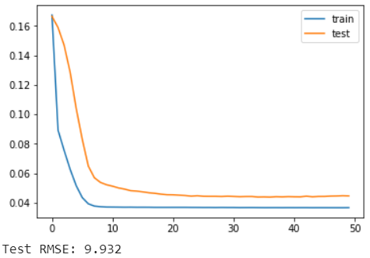
NO2-prediction results

Slide 18
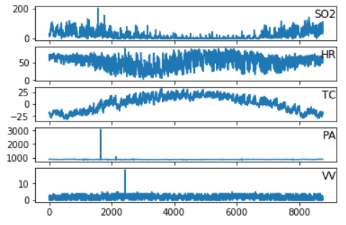
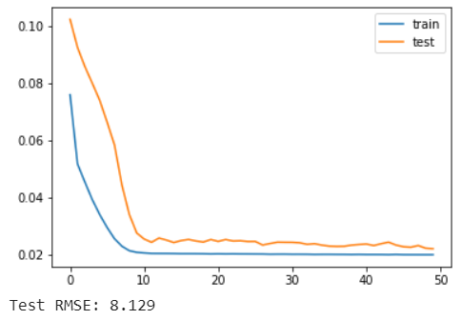
SO2-prediction results

Slide 19
Conclusion
In this study, we studied the machine learning and using the LSTM model
to predict air quality. The results show that if the training period
increased, the standard error was decreased and we conclude that the air
quality prediction training was successful. The experiments correlated the
weather data with each of the air quality parameters and estimated the
possible values. The further aim is to improve this work and create an
online web interface to forecast air quality.

Slide 20
References
[1] Gaganjot Kaur Kang, Jerry Zeyu Gao, Sen Chiao, Shengqiang Lu, and Gang Xie, “Air Quality Prediction: Big Data and Machine Learning Approaches”, International Journal of Environmental Science and Development, Vol. 9, No. 1, January 2018.
[2] V. M. Niharika and P. S. Rao, “A survey on air quality forecasting techniques,” International Journal of Computer Science and Information Technologies, vol. 5, no. 1, pp.103-107, 2014.
[3] E. Kalapanidas and N. Avouris, “Applying machine learning techniques in air quality prediction,” Sept. 1999.
[4] S. Deleawe, J. Kusznir, B. Lamb, and D. J. Cook, “Predicting air quality in smart environment,” J Ambient Intell Smart Environ., pp. 145-152, 2010.
[5] L. Xiang, L. Peng, Y. Hu, J. Shao, and T. Chi, “Deep learning architecture for air quality predictions,” Environmental Science and Pollution Research, vol. 23, no. 22, pp. 22408-22417, 2016.
[6] JürgenSchmidhuber, “Deep learning in neural networks: An overview”, Neural Networks Volume 61, pp.85-117, January 2015.
[7] Pranjal Srivastava, “Essentials of Deep Learning: Introduction to Long Short Term Memory”, Analytics Vidhya, 2017.

Slide 21
THANK YOU

