Slide 1
SOME STUDY RESULTS OF
COLOR CHANGES DEPENDING
ON MONGOLIAN ENVIRONMENTAL
CONDITION
Institute of Mathematics and Digital technology
Mongolian Academy of Sciences
Otgonsuvd Badrakh,
Batzaya.E, Galbaatar.T, Oyuntulga.M
ISGC 2021

Slide 2
Contents
Color measurement
Materials and methods
Results and discussion
Conclusion
References

Slide 3
Color measurements
Visual color measurement Instrumental color measurements

Slide 4
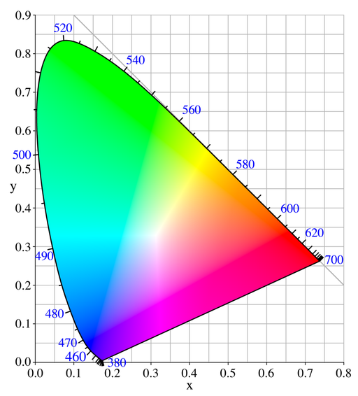
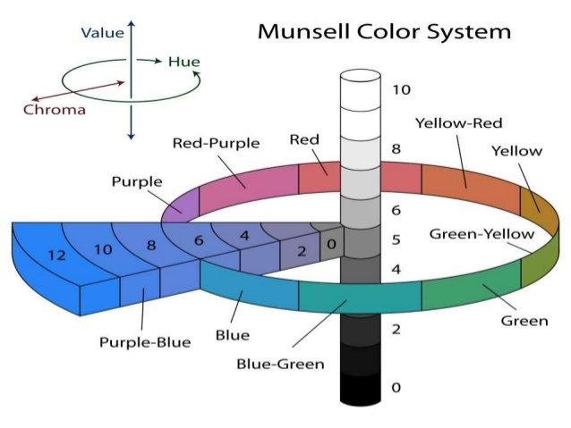
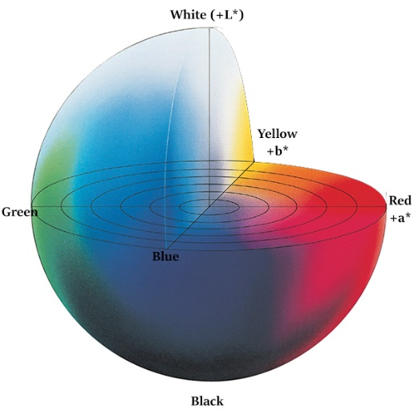
Color spaces
CIE 1931- XYZ
Munsell 1913- L*H*C*
CIE 1976- L*a*b*

Slide 5
Research materials and methods

Slide 6
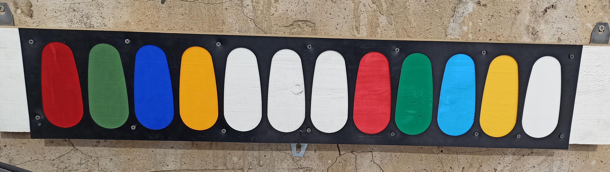
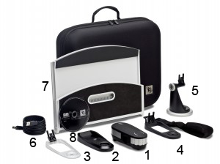
Measurement
№ | Colorants | Origin
1 | Red pigment | Korea
2 | Green pigment | Korea
3 | Blue pigment | Korea
4 | Yellow pigment | Korea
5 | Red dye | Russia
6 | Green dye | Russia
7 | Blue dye | Russia
8 | Yellow dye | Russia
9 | White dye | Russia
Measurement sample
Measurement device: X-rite i1 Pro Colorimeter

Slide 7
Research method
Color measurement
Create a database
Processing of measurement results
Analyze the data

Slide 8
Method of color measurement
Object
Prepare the measurement object
Device
Prepare the instrument by dialing and selecting the measurement mode
Measurement Settings
Make measurement callibration
Reflectance calibration
Save data
Read color
Make a white tile callibration
Make color measurements

Slide 9
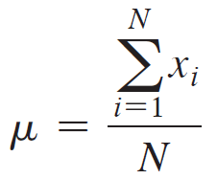
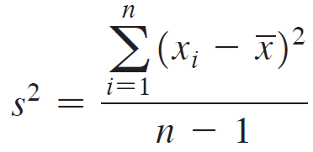
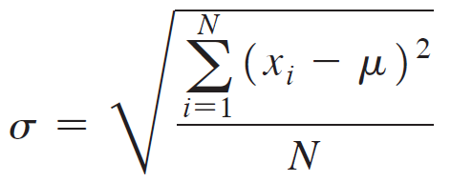
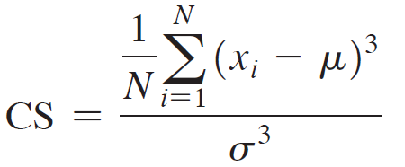
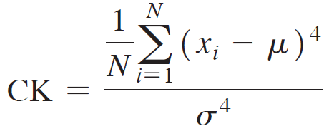
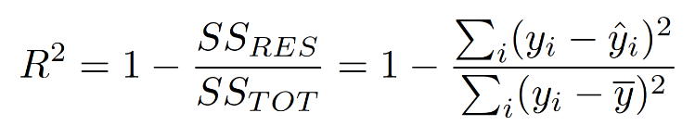
Method of
Data processing
Mean
Variance
Standard deviation
Coefficient of Skewness
Coefficient of Kurtosis
Regression

Slide 10
Results and discussion

Slide 11
Shortterm measurements result
 | XYZ_X | XYZ_Y | XYZ_Z | LAB_L | LAB_A | LAB_B | LAB_C | LAB_H
1 | 20.50452 | 11.3803 | 1.778595 | 40.214 | 56.14 | 41.263 | 69.673 | 36.3
2 | 18.65532 | 10.35196 | 1.69615 | 38.467 | 54.414 | 39.124 | 67.02 | 35.7
3 | 19.69677 | 10.95863 | 1.843279 | 39.511 | 55.199 | 39.384 | 67.809 | 35.5
4 | 20.59455 | 11.44771 | 1.831663 | 40.325 | 56.099 | 40.906 | 69.429 | 36.1
5 | 18.7982 | 10.65397 | 1.935784 | 38.991 | 52.889 | 37.562 | 64.87 | 35.4
2020.02.05 : red pigment

Slide 12
Longterm measurements result
 | Red pigment | XYZ_X | XYZ_Y | XYZ_Z | LAB_L | LAB_A | LAB_B
1 | 2020.02.05 | 18.85279 | 10.29676 | 1.560897 | 38.37 | 55.849 | 40.454
2 | 2020.02.14 | 18.23383 | 9.872264 | 1.516018 | 37.612 | 55.904 | 39.663
3 | 2020.02.27 | 15.44793 | 8.36504 | 1.623151 | 34.732 | 52.888 | 33.482
4 | 2020.03.06 | 15.45708 | 8.389712 | 1.75066 | 34.782 | 52.727 | 32.19
5 | 2020.03.13 | 14.46958 | 7.947754 | 1.854267 | 33.874 | 50.728 | 29.553
6 | 2020.03.20 | 14.46514 | 8.078214 | 2.014673 | 34.145 | 49.531 | 28.439
7 | 2020.03.27 | 13.94034 | 7.936497 | 2.163865 | 33.85 | 47.55 | 26.532
8 | 2020.04.10 | 13.47603 | 7.732853 | 2.131381 | 33.42 | 46.457 | 26.089
9 | 2020.04.17 | 13.48539 | 7.910743 | 2.376161 | 33.796 | 44.896 | 24.556
10 | 2020.04.23 | 12.60324 | 7.512796 | 2.406031 | 32.947 | 42.77 | 22.836
11 | 2020.05.01 | 13.04609 | 7.700111 | 2.340566 | 33.35 | 43.969 | 24.095
12 | 2020.05.06 | 13.59228 | 8.026753 | 2.424199 | 34.039 | 44.536 | 24.563
13 | 2020.05.18 | 13.13937 | 7.833495 | 2.475053 | 33.634 | 43.358 | 23.437
14 | 2020.05.22 | 12.77753 | 7.607822 | 2.339225 | 33.152 | 43.048 | 23.765

Slide 13

Statistical analysis of shortterm measurements
Statistical parameter | LAB_L | LAB_A | LAB_B | LAB_C | LAB_H
Mean | 39.5016 | 54.9482 | 39.6478 | 67.7602 | 35.8
Standard Error | 0.354732 | 0.605529 | 0.666575 | 0.875992 | 0.173205
Median | 39.511 | 55.199 | 39.384 | 67.809 | 35.7
Standard Deviation | 0.793205 | 1.354004 | 1.490508 | 1.958777 | 0.387298
Sample Variance | 0.629175 | 1.833326 | 2.221614 | 3.836808 | 0.15
Kurtosis | -1.90266 | 0.121249 | -0.82762 | -0.25435 | -2.2
Skewness | -0.26779 | -0.94861 | -0.38137 | -0.71531 | 0.430331
Range | 1.858 | 3.251 | 3.701 | 4.803 | 0.9
Minimum | 38.467 | 52.889 | 37.562 | 64.87 | 35.4
Maximum | 40.325 | 56.14 | 41.263 | 69.673 | 36.3
Sum | 197.508 | 274.741 | 198.239 | 338.801 | 179
Count | 5 | 5 | 5 | 5 | 5

Slide 14
Statistical analysis of longterm measurements
Statistical parameter | LAB_L | LAB_A | LAB_B
Mean | 34.40736 | 48.15793 | 28.54671
Standard Error | 0.430888 | 1.270207 | 1.567719
Median | 33.862 | 47.0035 | 26.3105
Standard Deviation | 1.612235 | 4.752681 | 5.865868
Sample Variance | 2.599303 | 22.58797 | 34.4084
Kurtosis | 2.715926 | -1.26491 | 0.227765
Skewness | 1.860959 | 0.484197 | 1.140272
Range | 5.423 | 13.134 | 17.618
Minimum | 32.947 | 42.77 | 22.836
Maximum | 38.37 | 55.904 | 40.454
Sum | 481.703 | 674.211 | 399.654
Count | 14 | 14 | 14

Slide 15
Data analysis 1:

Slide 16
Data analysis 2:

Slide 17
Data analysis 3:

Slide 18
Data analysis 4:

Slide 19
Data analysis 6:

Slide 20
Data analysis 7:

Slide 21
Data analysis 8:

Slide 22
Data analysis 9:

Slide 23
Results
№ | Colorants | L*-R² | a*- R² | b*- R²
 | Red pigment | 0.9195 | 0.5836 | 0.8209
 | Green pigment | 0.2639 | 0.3474 | 0.4832
 | Blue pigment | 0.5645 | 0.0899 | 0.7821
 | Yellow pigment | 0.5772 | 0.3667 | 0.3812
 | Red dye | 0.4968 | 0.0422 | 0.7847
 | Green dye | 0.0141 | 0.5819 | 0.958
 | Blue dye | 0.0479 | 0.1661 | 0.4255
 | Yellow dye | 0.0007 | 0.0338 | 0.1722
 | White dye | 0.5535 | 0.9182 | 0.8614

Slide 24
Conclusion
In the future, it is necessary to increase the measurement data and perform more detailed data analysis, and we are aiming to determine the initial color of the object using machine learning methods based on regression analysis using the color measurement values. Further research is needed to improve the number and quality of measurement objects.

Slide 25
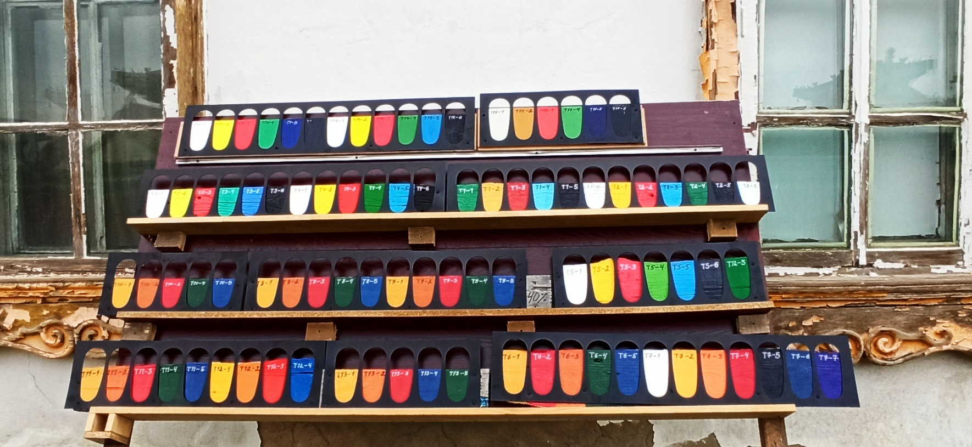
Future research

Slide 26
References
Roy S. Berns, “Principles of Color Technology”, New York, John Wiley& Sons, 2000
Kurt Nassau, “Color for Science, Art and Technology”, Netherland, Elsevier, 2006
User Manual of X-rite i1 Pro Colorimeter, China, Trademark of X-rite, 2017
Ganesh Ramanathan, Understanding Tristimulus Values: Taking the Guesswork Out of Color Measurement Instrumentation, hunterlab.com, 2015
Ч.Авдай, Д.Энхтуяа,”Судалгаа шинжилгээний ажил гүйцэтгэх арга зүй”, Улаанбаатар, 2015
F.M. Dekking C. Kraaikamp, H.P. Lopuhaa¨ L.E. Meester, “A Modern Introduction to Probability and Statistics”, ISBN 978-1-85233-896-1, Springer, 2013
Siegmund Brandt, Data Analysis Statistical and Computational Methods for Scientists and Engineers, ISBN 978-3-319-03761-5 , DOI 10.1007/978-3-319-03762-2, Springer, 2014
Maria Elena Radulescu-Grad, Gabriela Vlase , Gheorghe Ilia, Adelina Andelescu, “Simona Popa, Amido Black 10B Dye Copper Complex–Synthesis, Characterization and Color Analysis”, Revista de Chimie 71 (8), https://doi.org/10.37358/RC.20.8.8276, 2020, 27-38
J Suwanboriboon, W Meesiri, W Wongkokua, “An application of spectrophotometer for ADMI color measurement”, Journal of Physics:1144, doi :10.1088/1742-6596/1144/1/012064, 2018

Slide 27
Thank you for the attention ☺

