Slide 1
Disaster Volunteer Activities for 2021 Fukushima-ken Oki Earthquake
Dai Sato (Tohoku Med. Pharm. Univ.)
Hideaki Sone (Tohoku Univ.)

Slide 2
Index
Disaster Volunteers in Japan
The Activities and the Management
Disaster “ICT” Volunteers
The Fukushima-Oki Earthquake
The Earthquake and Damages
Activities of Disaster Volunteers
What Disaster ICT Volunteers Contribute

Slide 3
Disaster Volunteers in Japan

Slide 4
Brief History
Disaster volunteers support major parts of onsite disaster recovery works in Japan.
the Great Hanshin-Awaji Earthquake (1995)
First large scale volunteer activities in Japan
Some of them distribute information for affected people
Papers, fax, mailing lists, PC communications
The Great East Japan Earthquake (2011)
First large scale volunteer activities on the Web
Sharing information with web applications, GIS, social media
(but papers are still needed by affected people)
Start of Information Supports

Slide 5
Features
Many individual volunteers
Many small groups for local direct support
Independent action with few communication
Some groups for technical support
house repair, heavy equipment, and so on
Several nationwide groups for indirect support
specialized in management, funding, and so on
Cooperation among the support groups
New cooperation platform established in 2016:
Japan Voluntary Organization Active in Disaster

Slide 6
Three Pillars of Disaster Support in Japan
After the Great East Japan Earthquake, the Japanese government changed the policies to help citizens:
NOT only “public support” is important.
They are focused on:
Utilization of civilian groups for “mutual support”
Civic disaster educations for “self help”
Disaster Supporters /
Disaster Volunteers

Slide 7
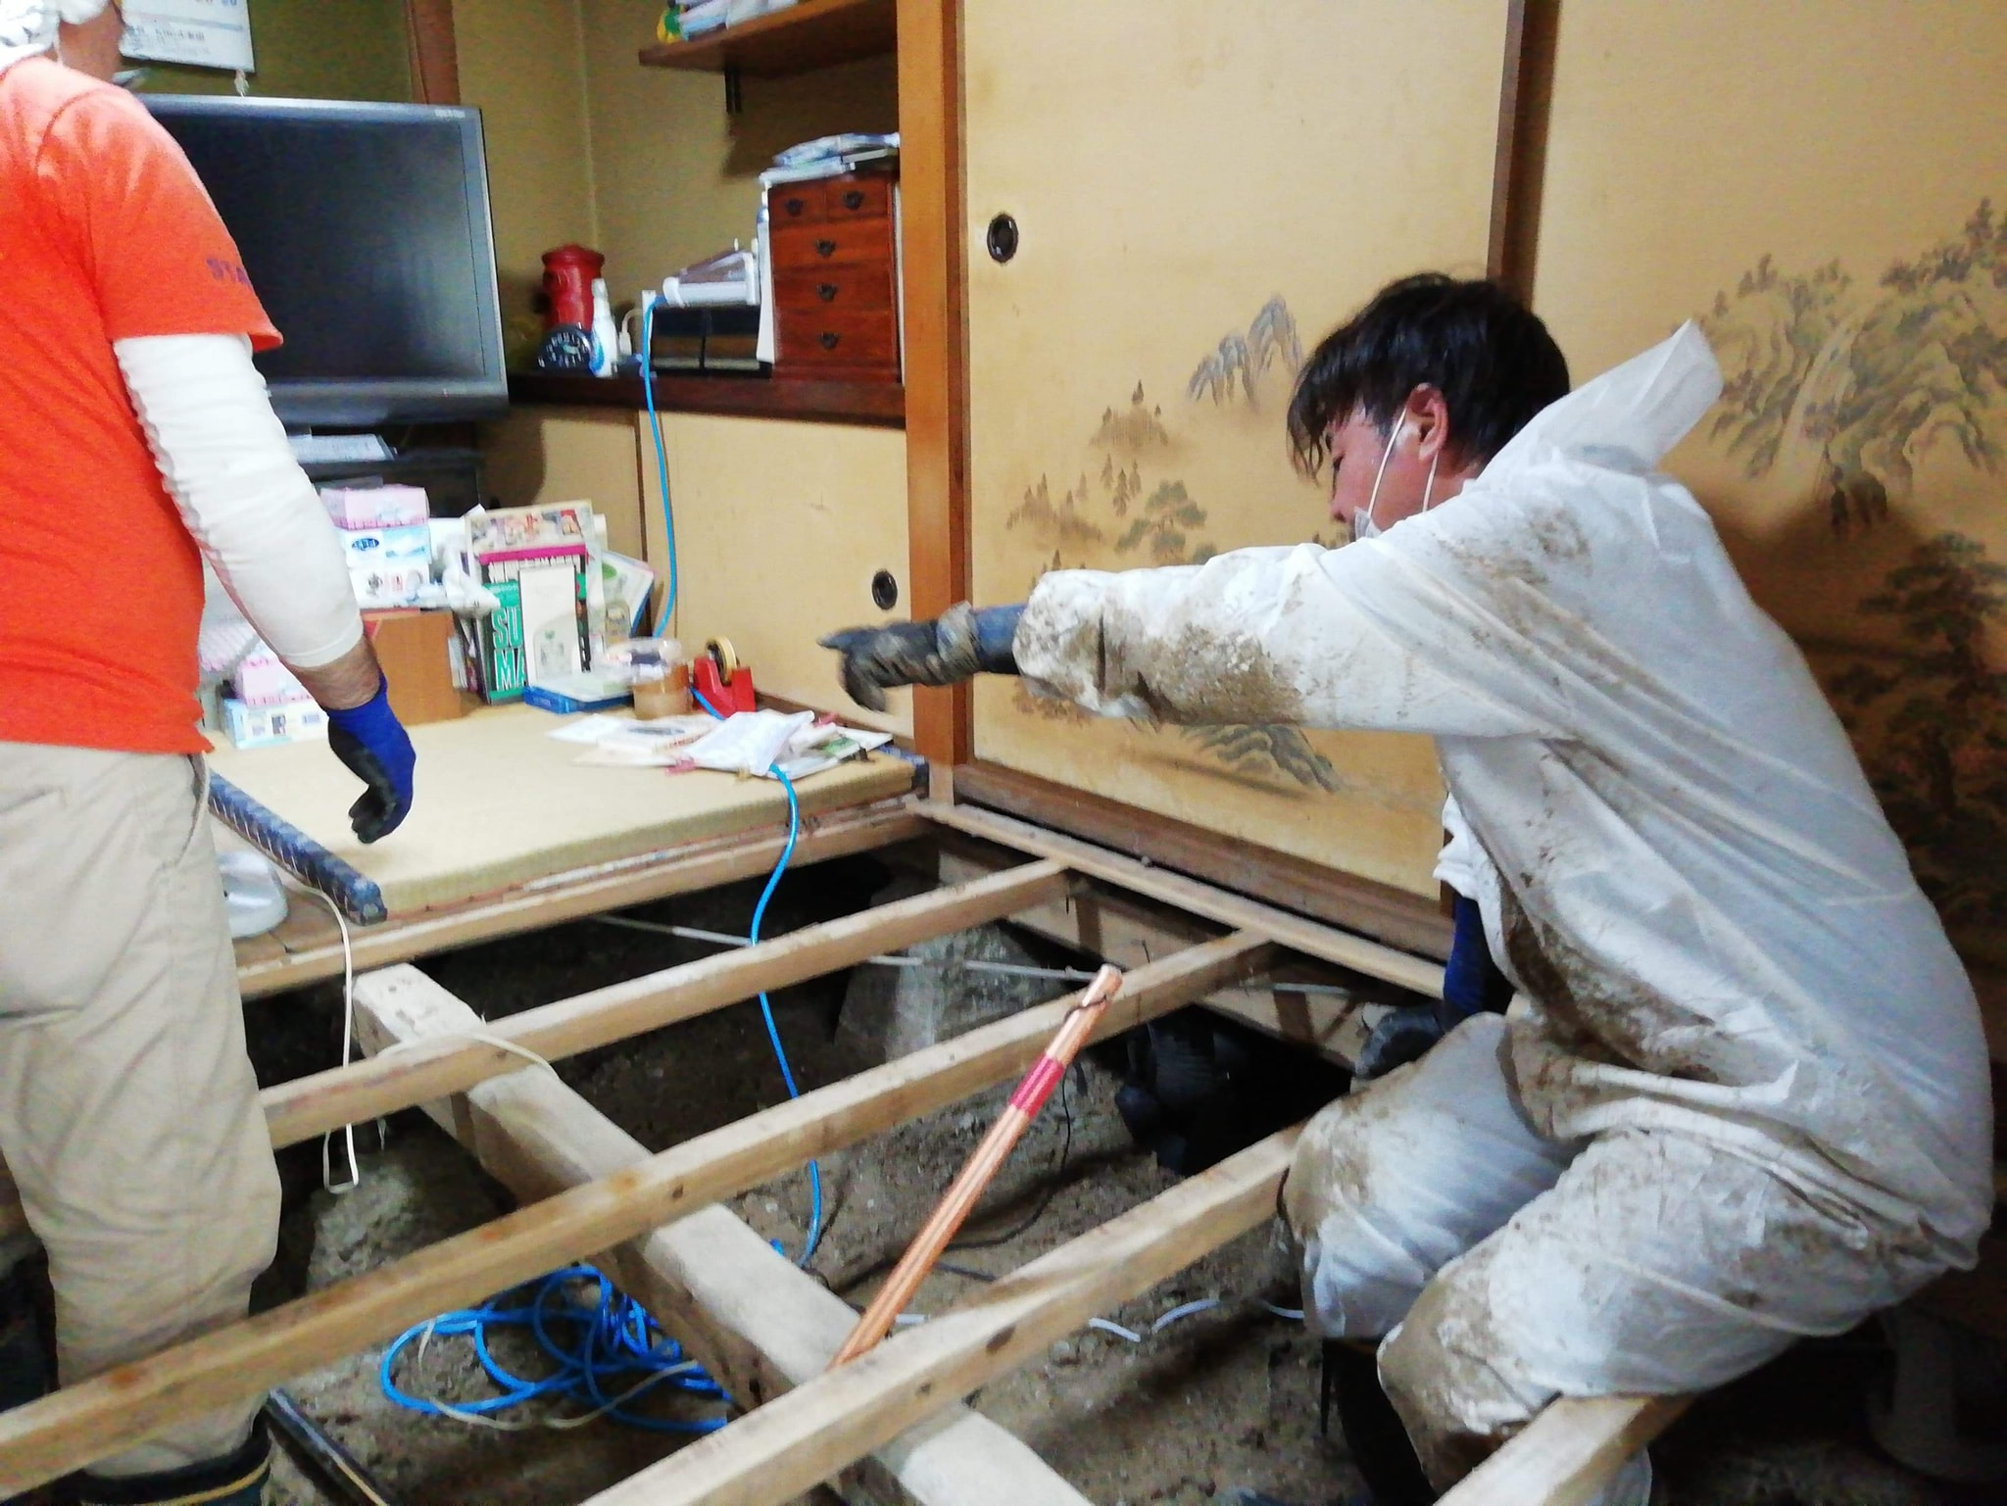
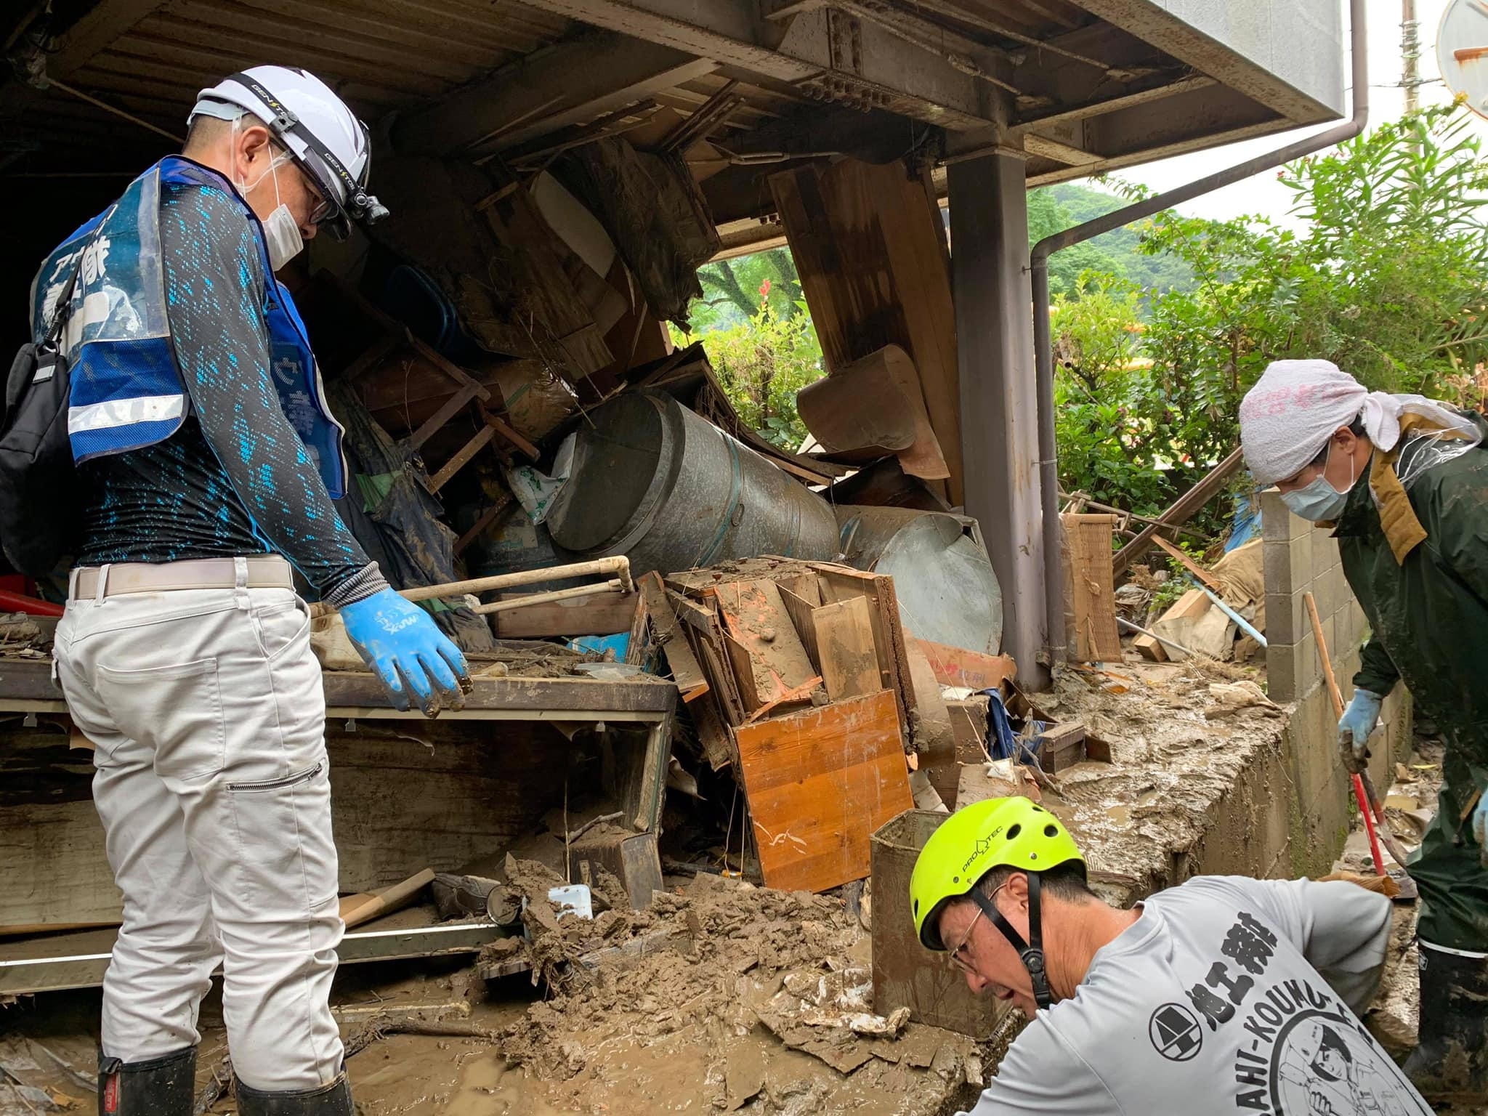
Volunteer Activities
©JRVC Kyushu
https://www.facebook.com/JRVC.Kyusyu
Yamagata and Kumamoto, Jul. 2020
Removing mud under the floor and in the working hut
©Isamu Tatsuno
https://www.facebook.com/profile.php?id=100014685488049

Slide 8
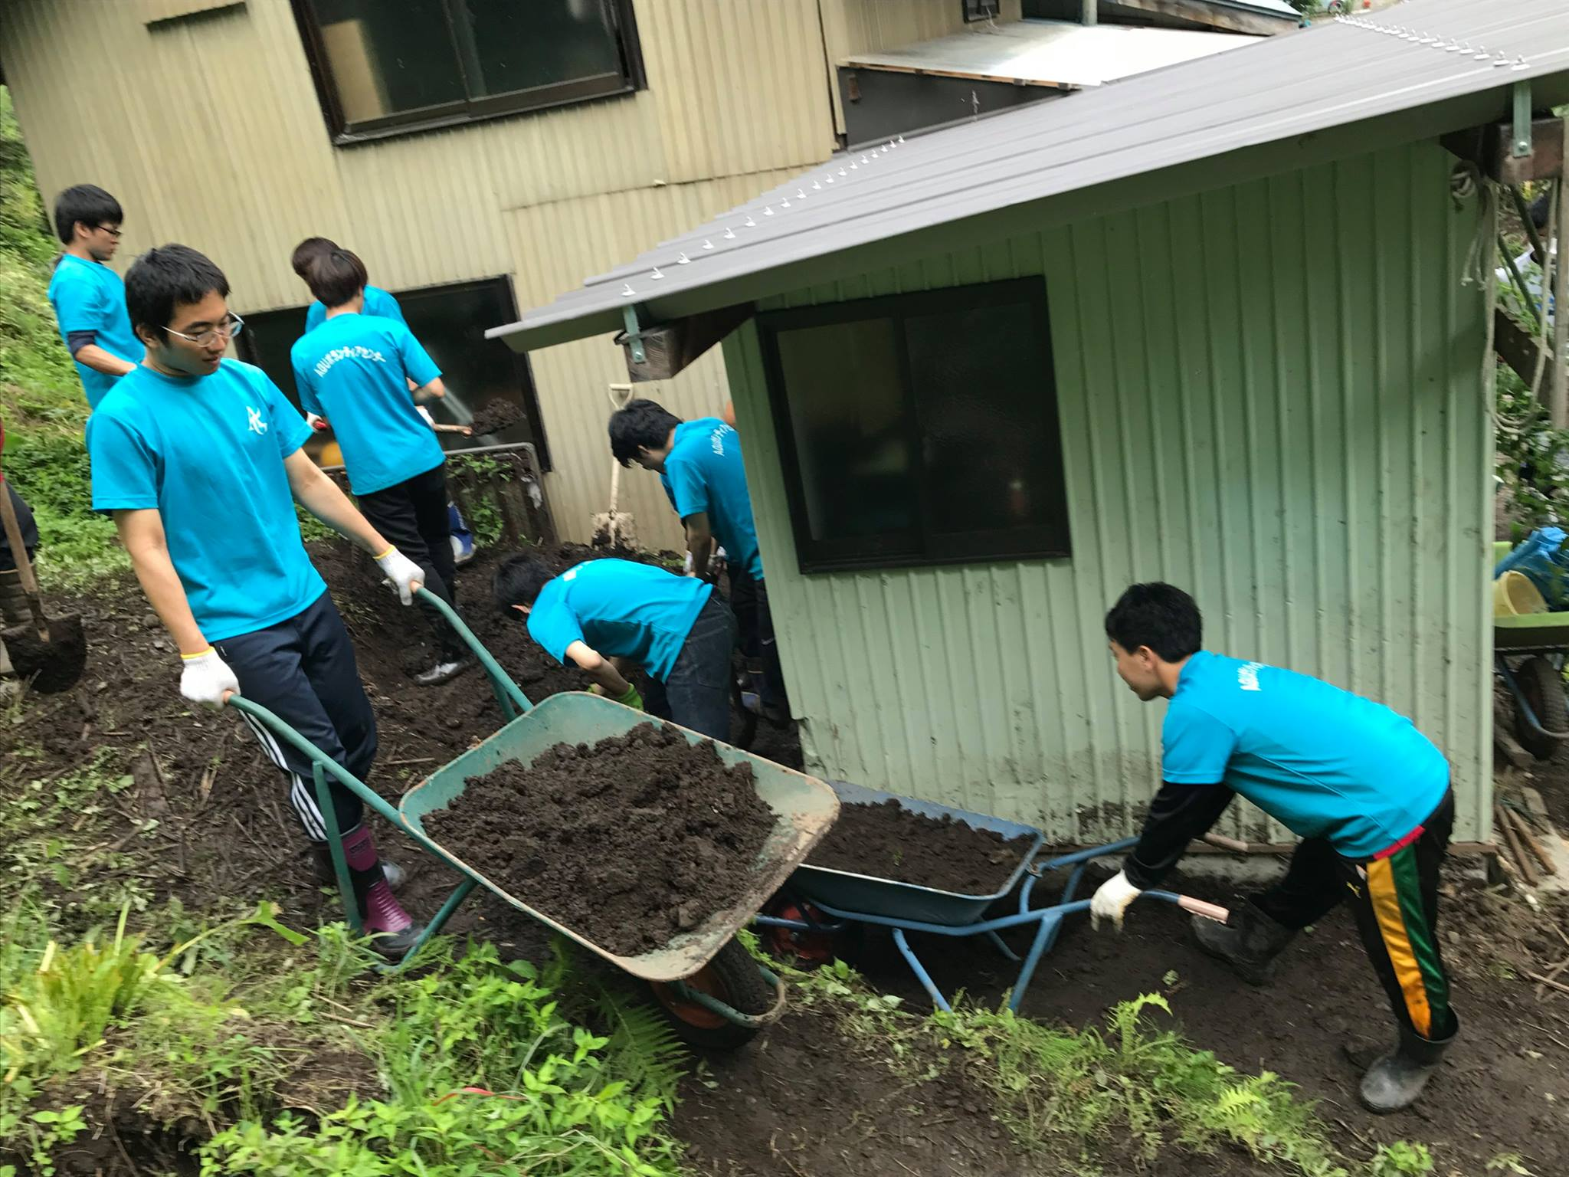
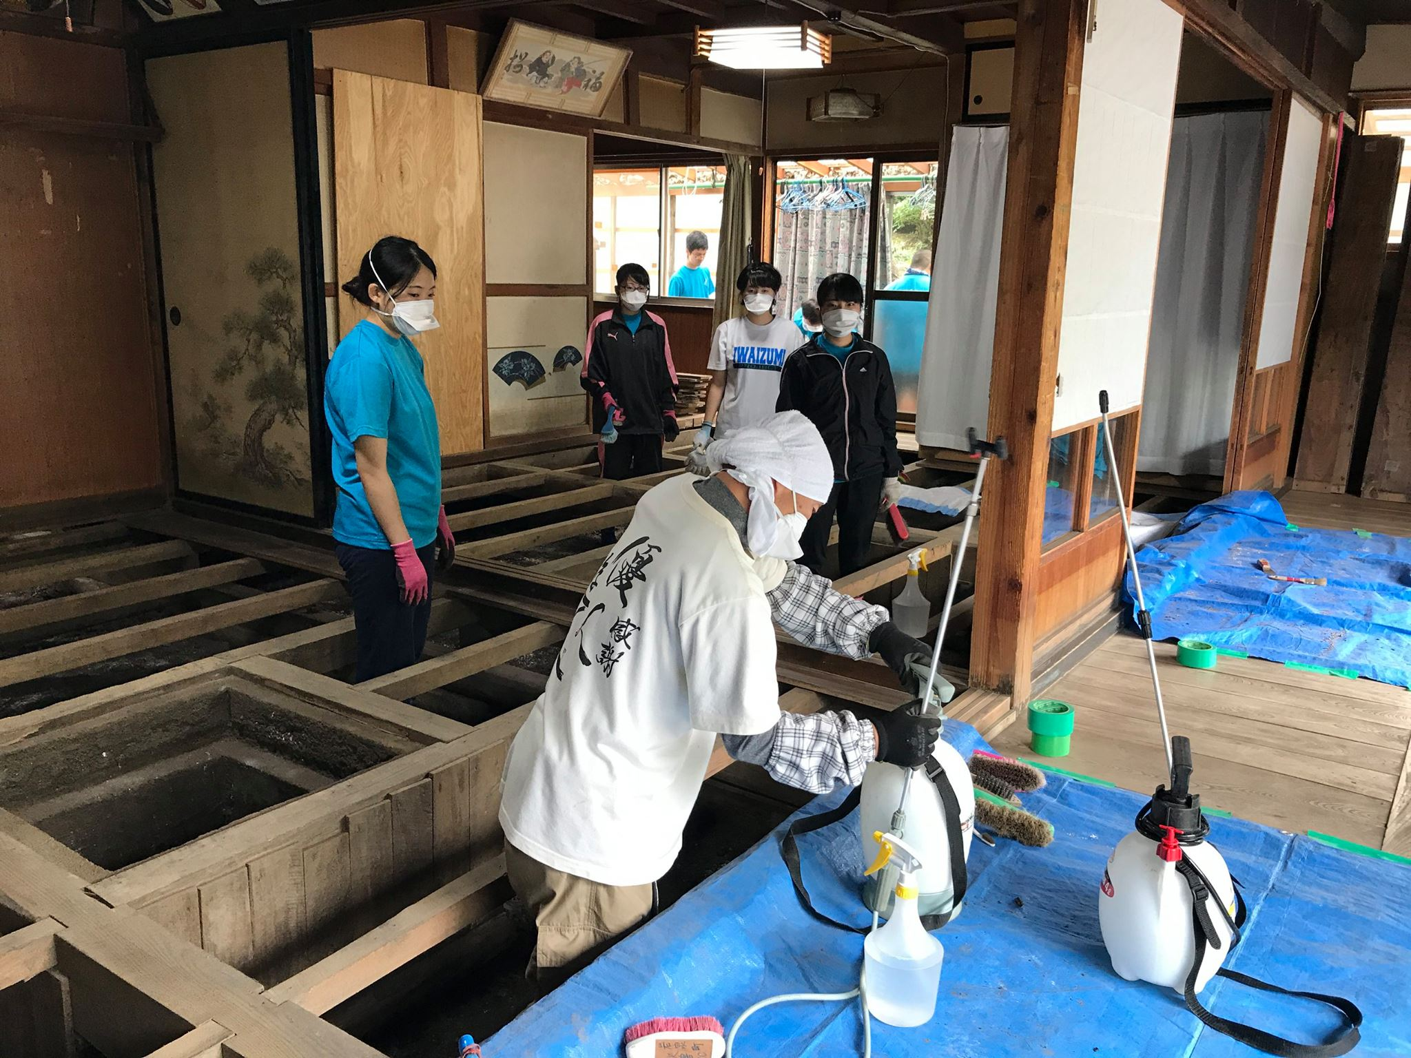
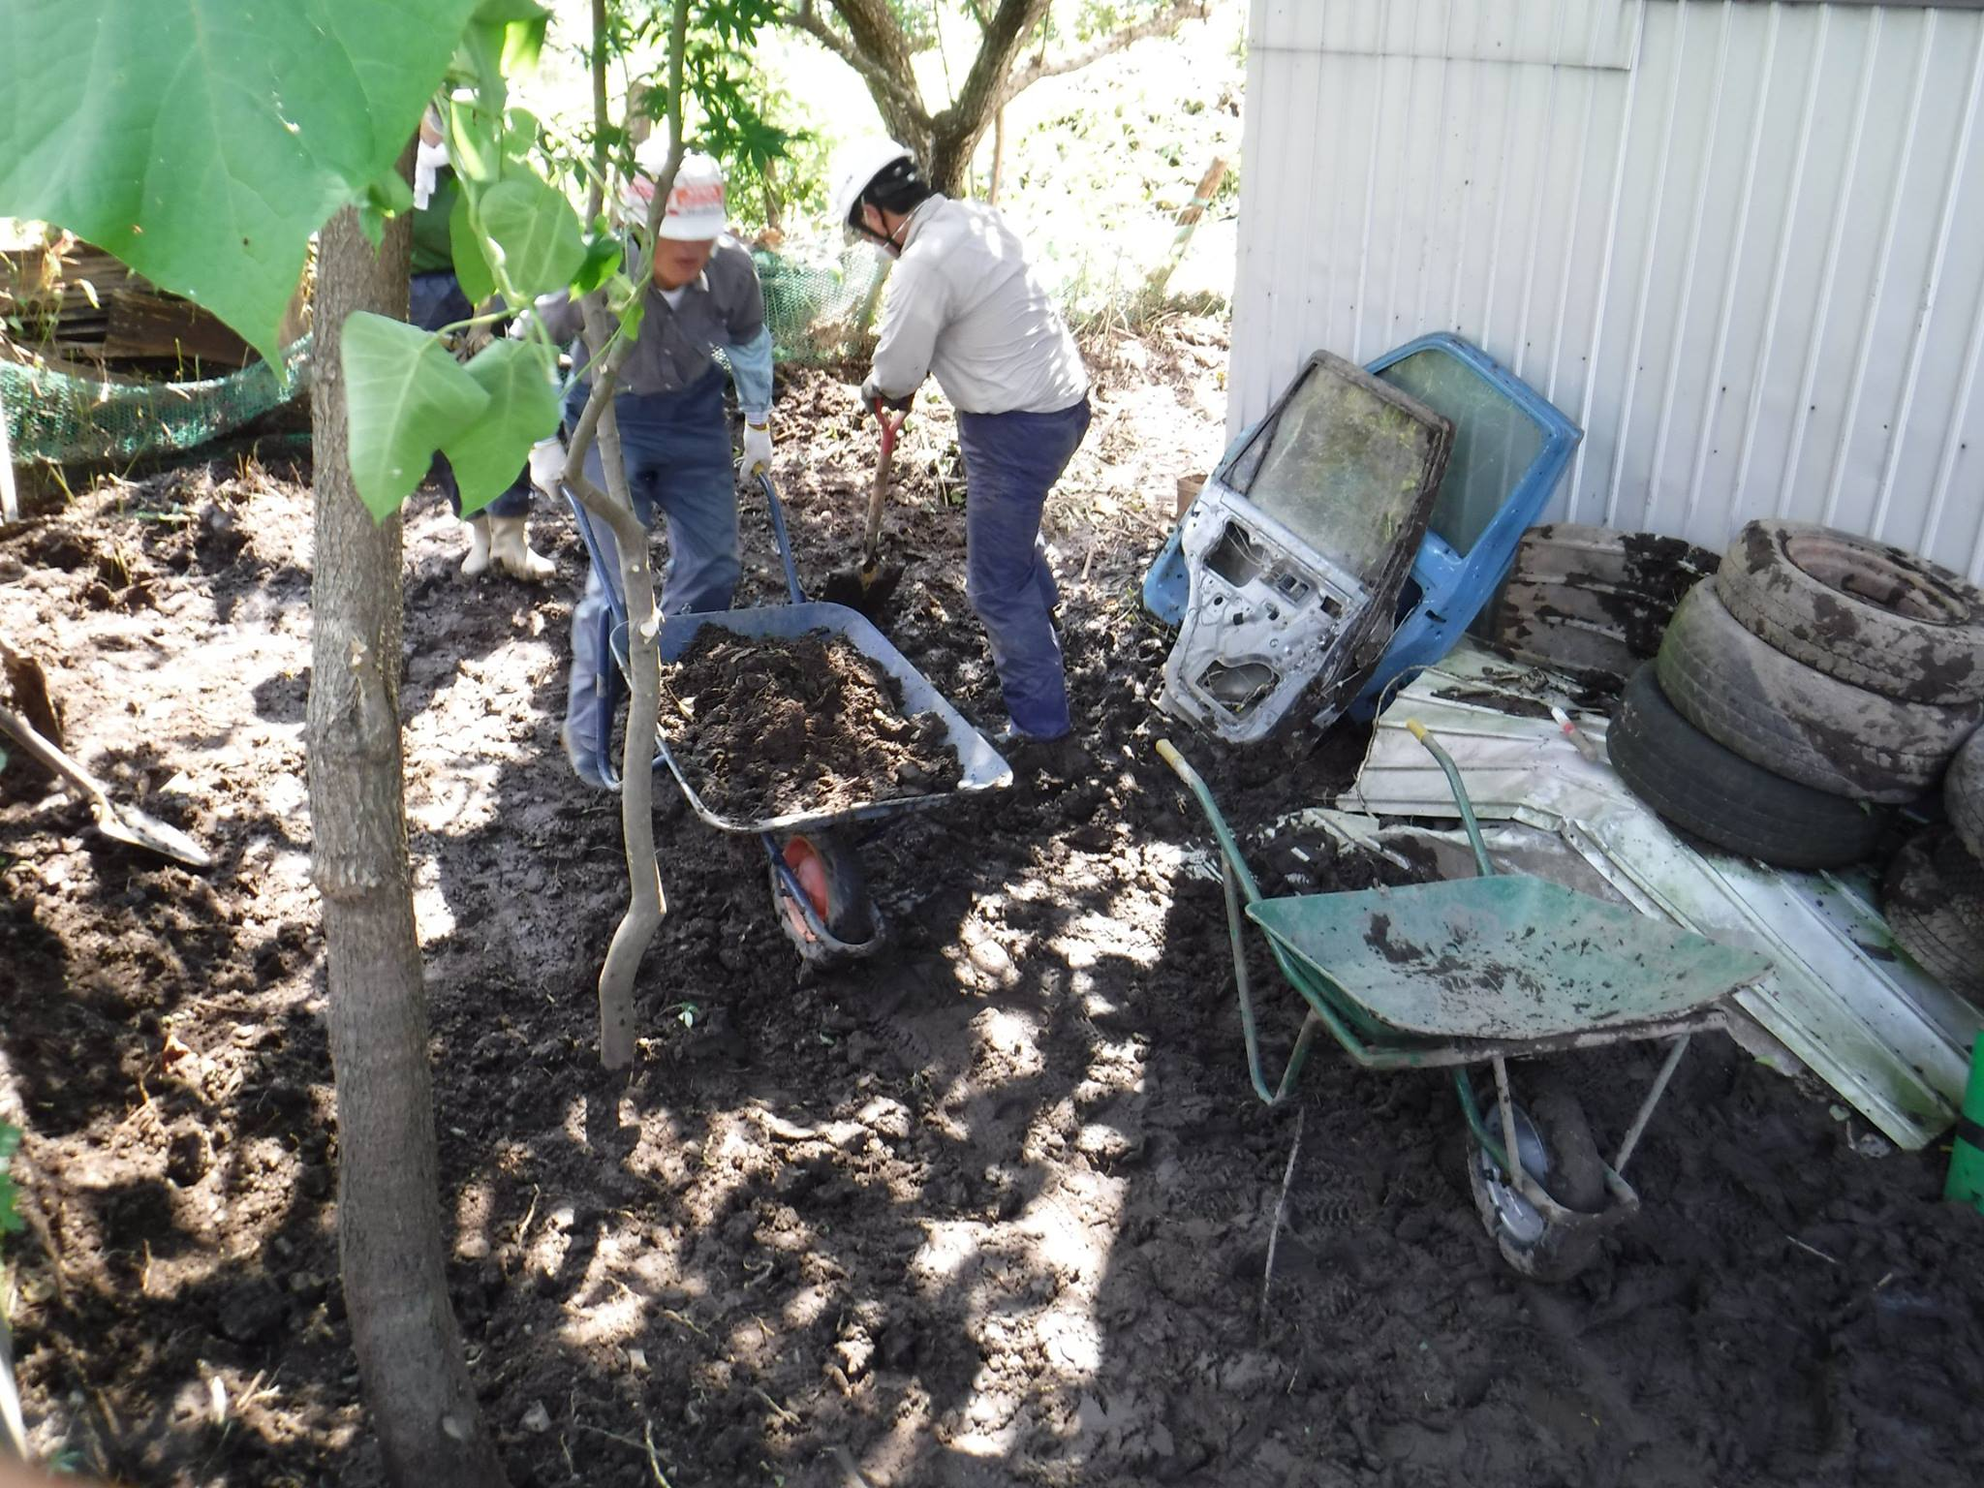
Volunteer Activities
Iwate, 2016
Removing mud under the floor and around the house
https://www.facebook.com/iwaizumivc/

Slide 9
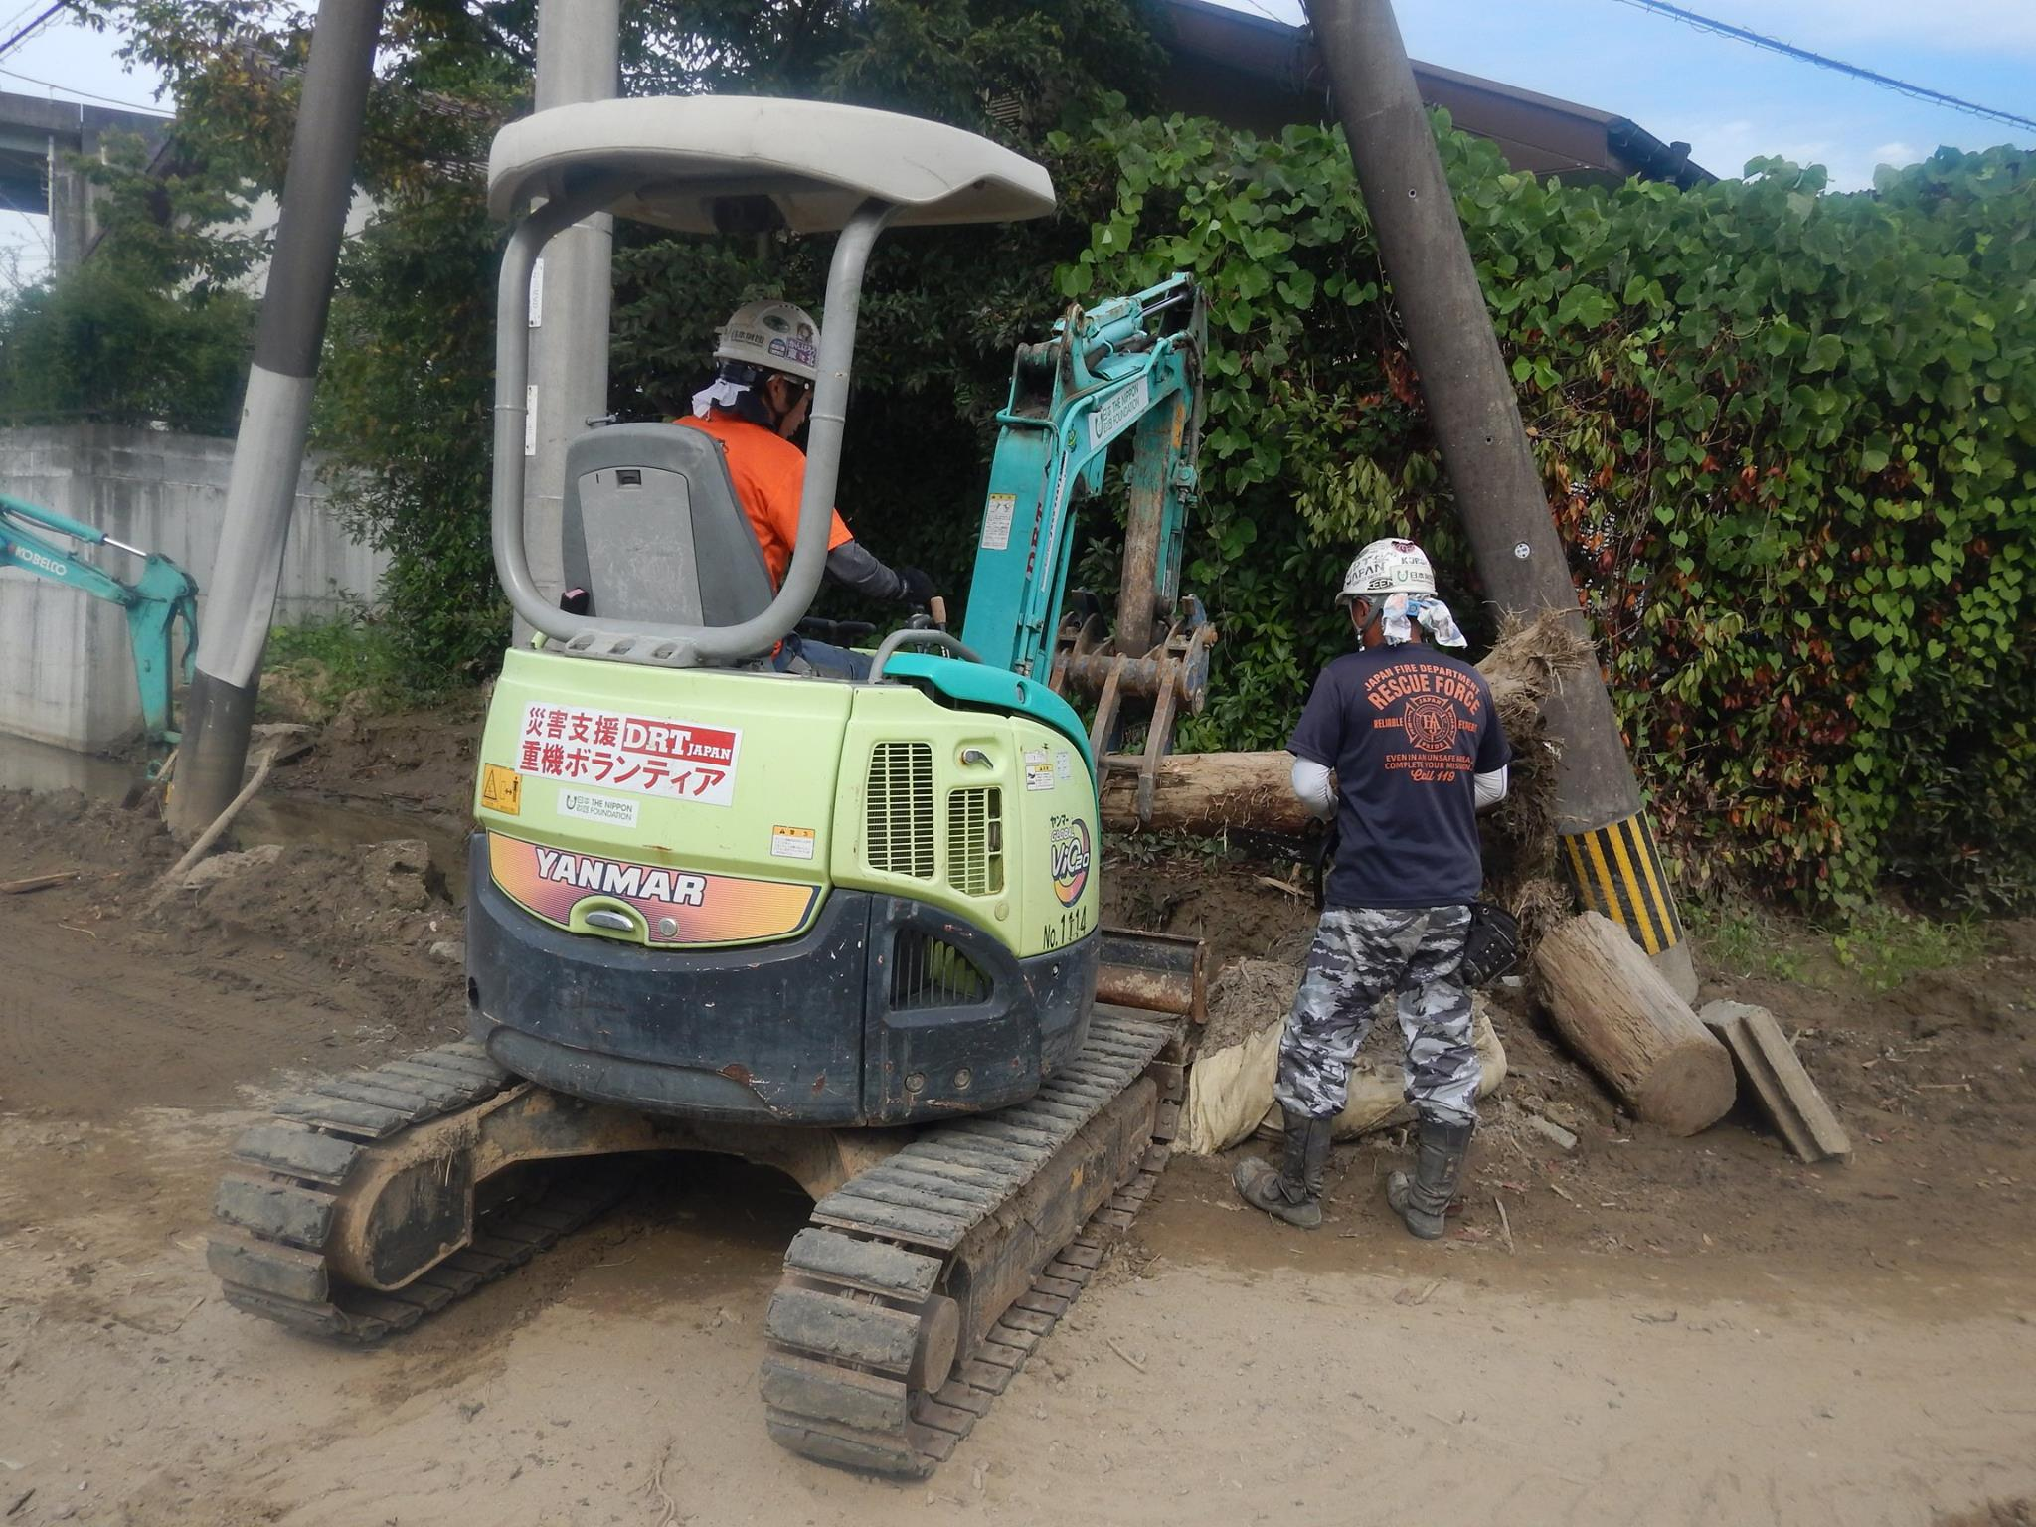
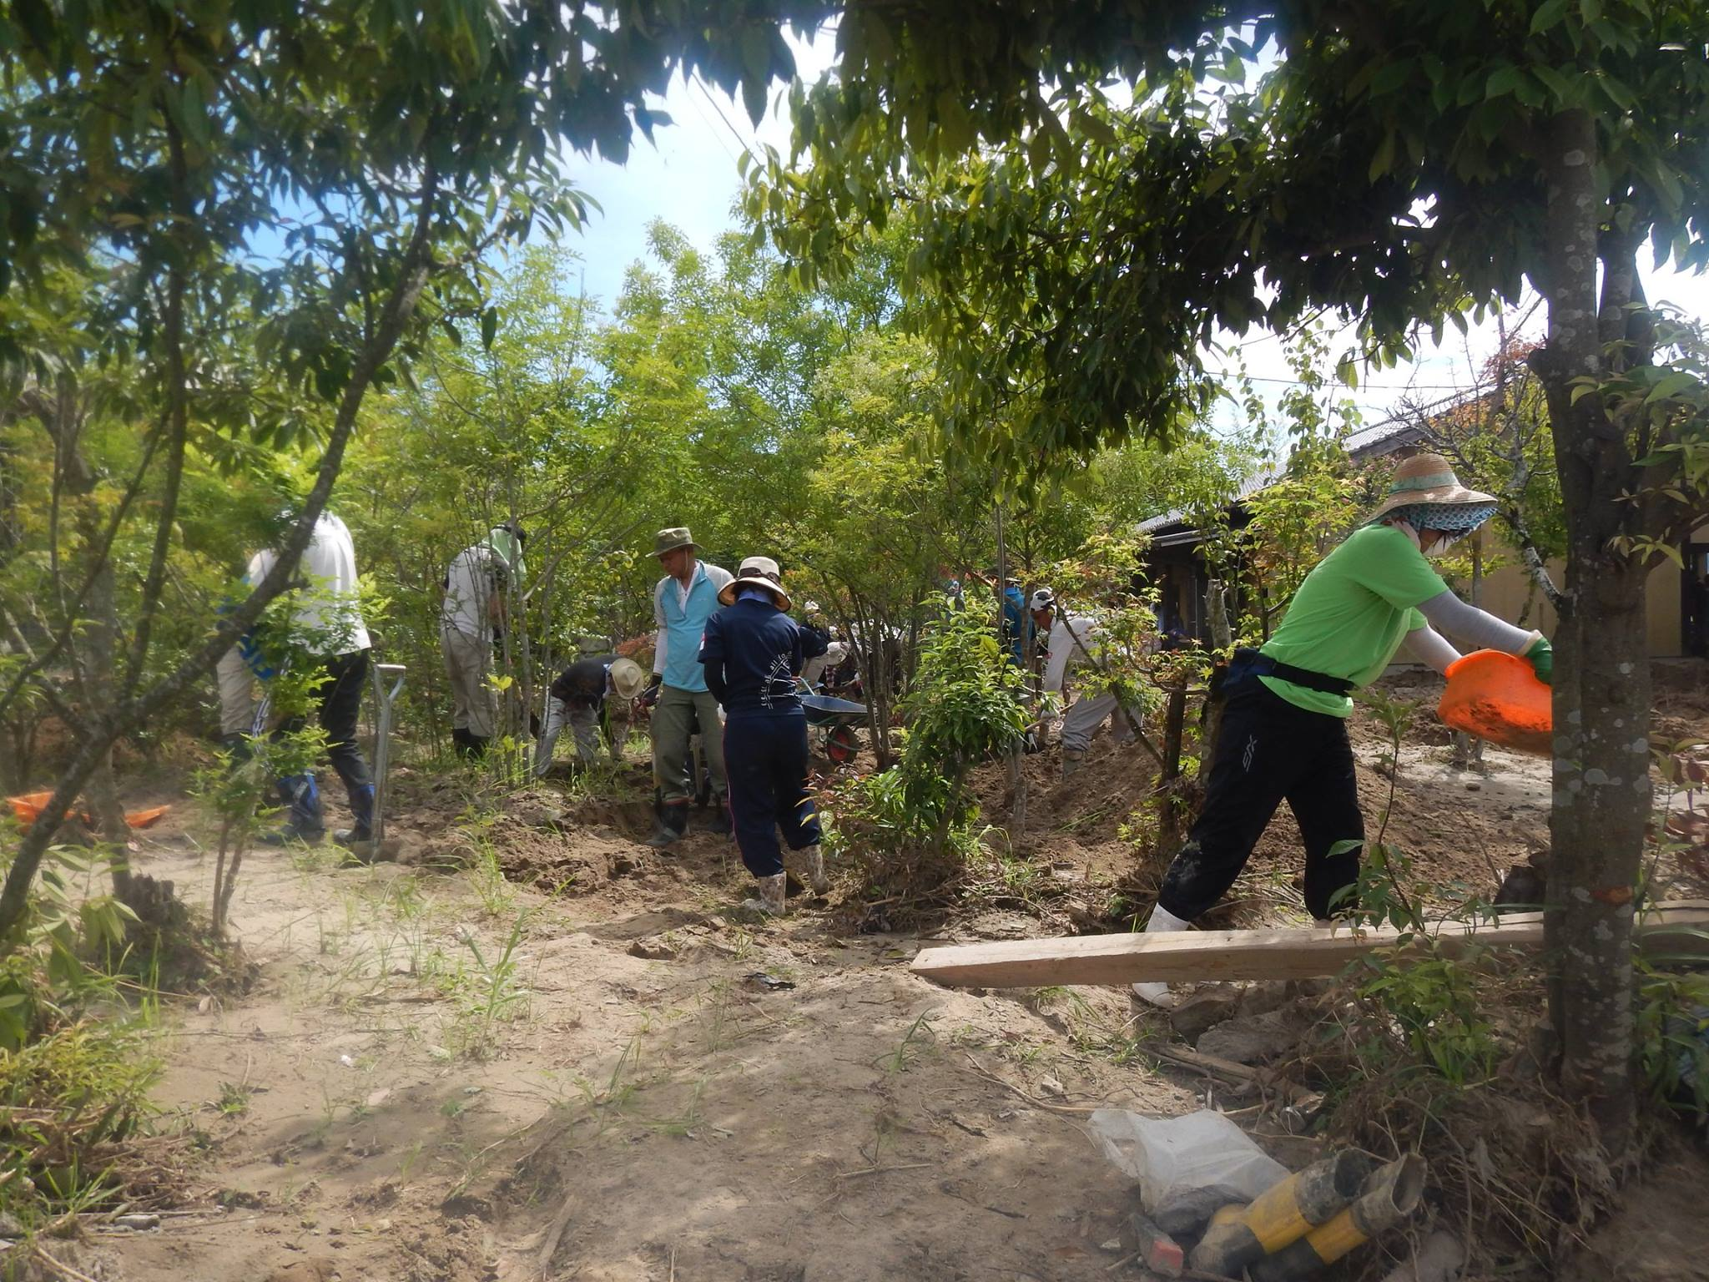
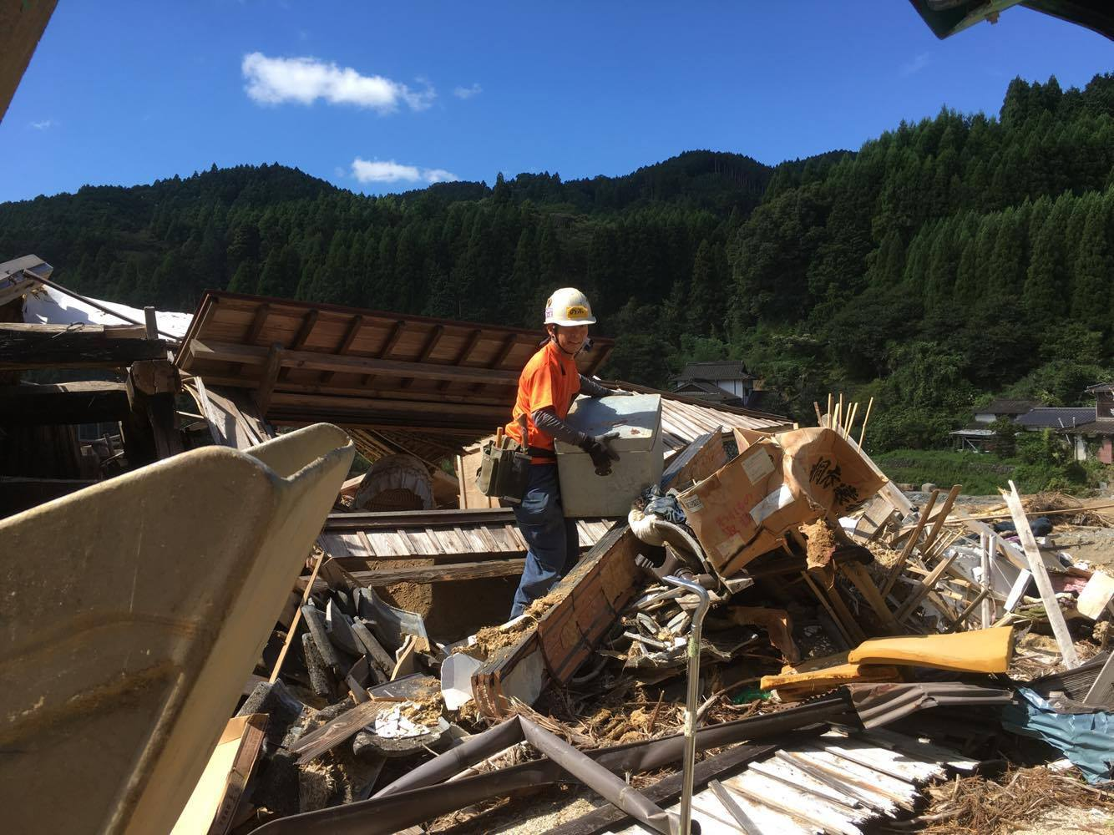
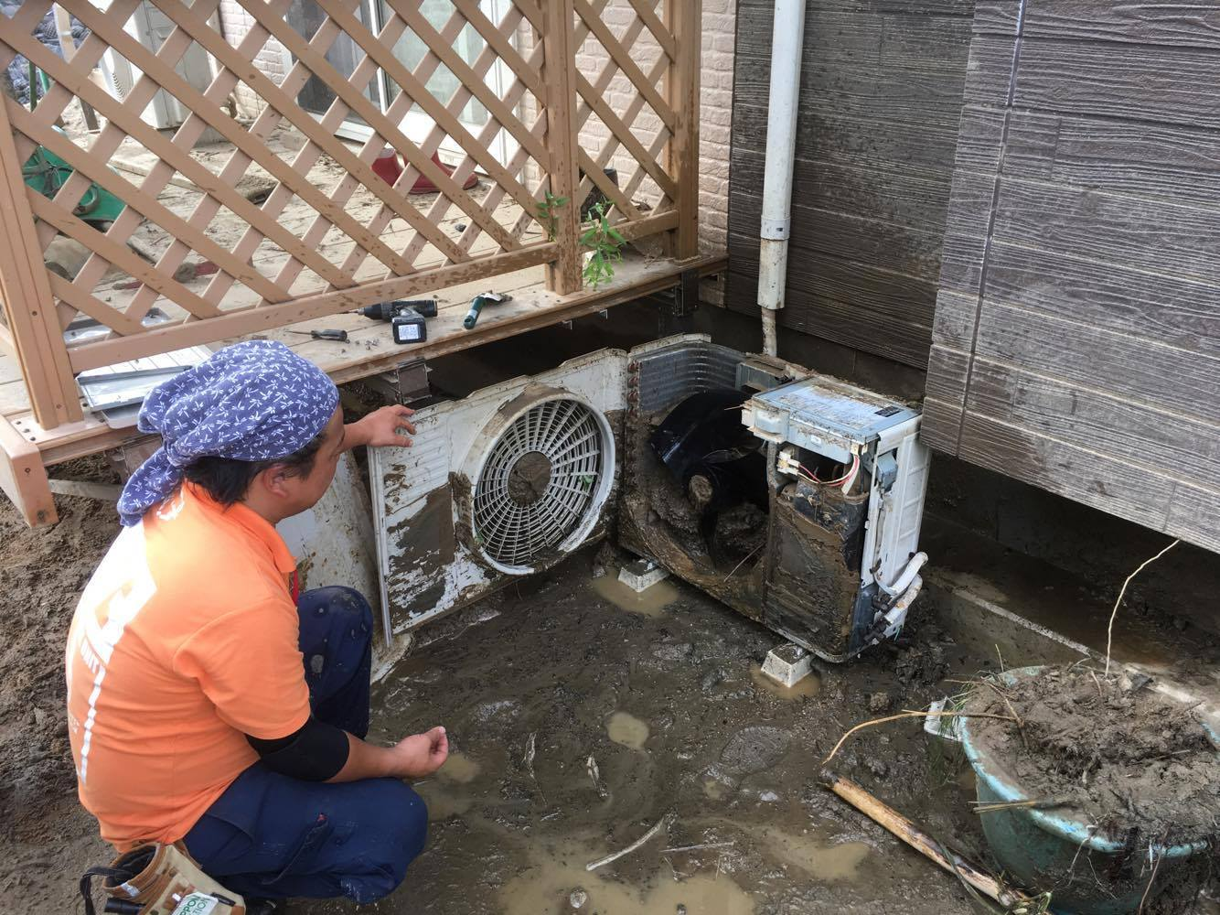
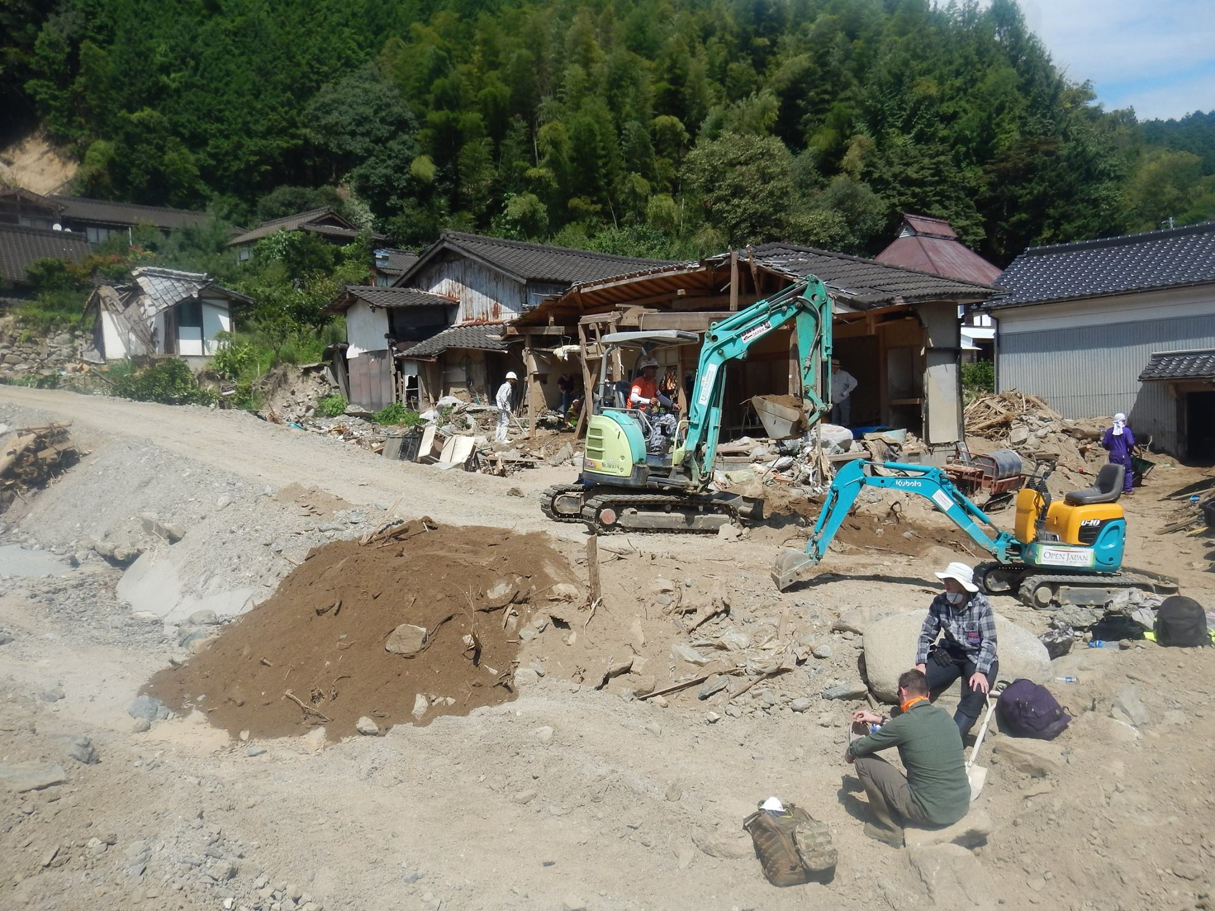
Volunteer Activities
Iwate, 2016
Mud, mud, mud, ... and debris
https://www.facebook.com/ngoyui/

Slide 10
Management of Volunteers
Disaster volunteer centers (DVCs)
Individual volunteers are mostly managed by DVCs.
DVCs are managed by Community-based organizations (social welfare councils and NPOs in the affected area)
Supports for the management of DVCs
by several nationwide volunteer groups.
Disaster response groups (NPOs, NGOs, etc.)
also recruits individual volunteers

Slide 11
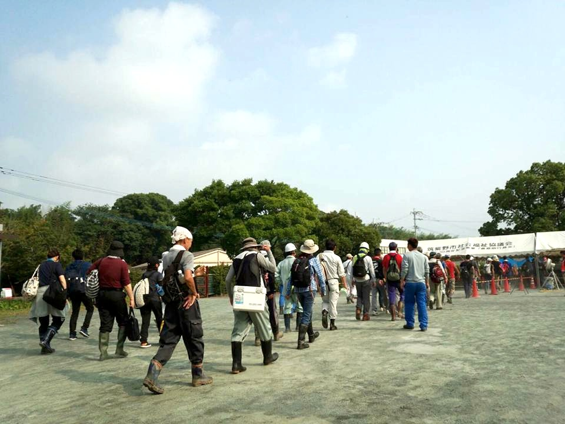
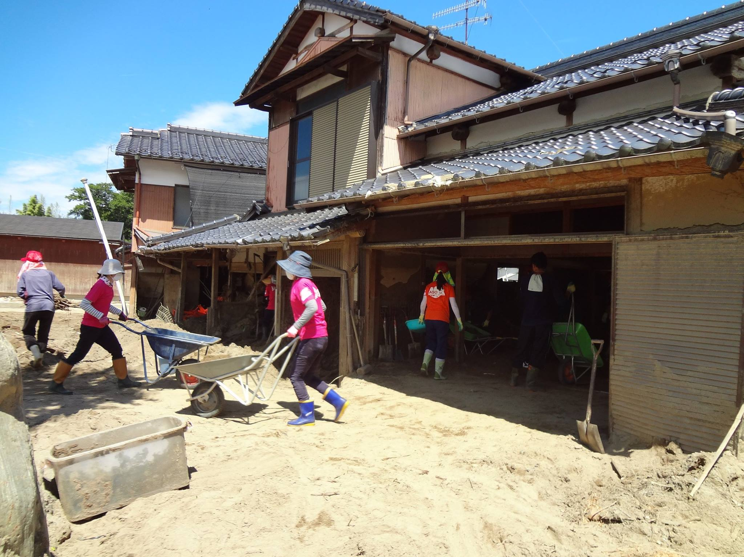
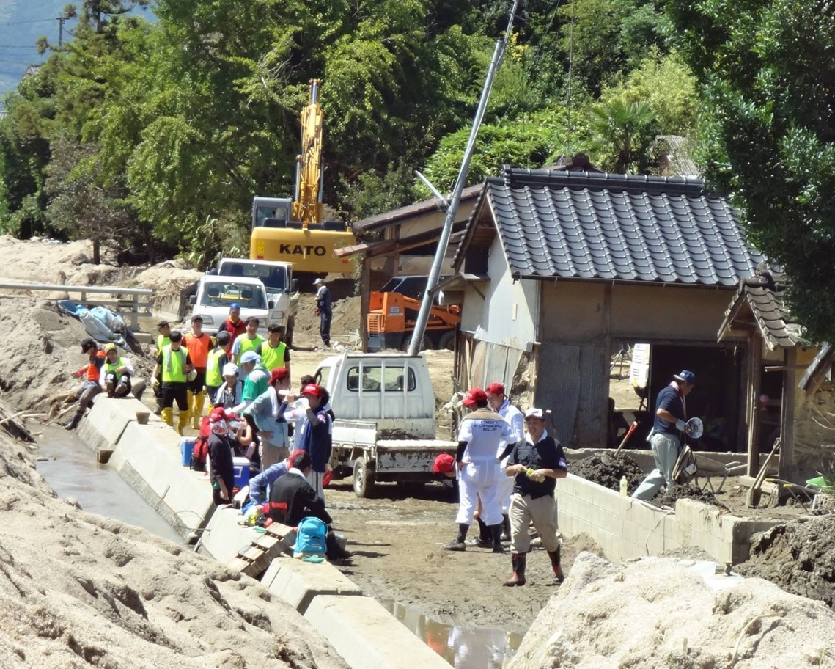
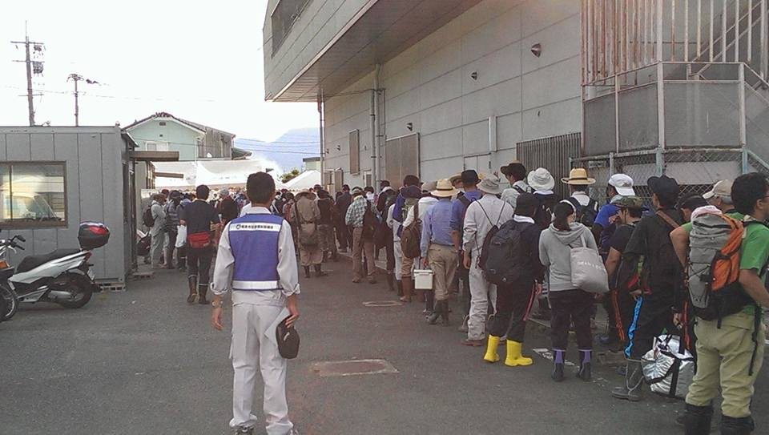
Disaster Volunteer Centers
Registration
Dispatch
https://www.facebook.com/asakuravc/
Notes:
３分／４枚

Slide 12
Management of Volunteers
Disaster volunteer centers (DVCs)
Individual volunteers are mostly managed by DVCs.
DVCs are managed by Community-based organizations (social welfare councils and NPOs in the affected area)
Supports for the management of DVCs
by several nationwide volunteer groups.
Disaster response groups (NPOs, NGOs, etc.)
also recruits individual volunteers

Slide 13
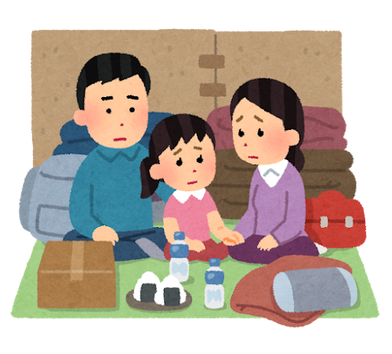
Entire Image of Disaster Support
Mutual Support
Public Support
Affected People
Disaster Volunteer
Centers
Management Support Groups
Independent
Volunteers
Local Governments
Direct Support Groups
Notes:
6 min

Slide 14
Number of opened DVCs
Heavy rain in Aug, Typhoon 15, 19
Heavy rain in Western Japan (2018 Japan Floods), Typhoon 21, Hokkaido Eastern-Iburi Earthquake
Heavy rain in Jul (Kumamoto Floods)

Slide 15
Disaster “ICT” Volunteers

Slide 16
The Great East Japan Earthquake, 2011
The first large-scale support with the Internet
Some DVCs use their blogs to recruit volunteers.
Affected people exchanged information through social media and BBS.
ICT experts tried to use the Internet efficiently.
collection of damages and support needs information
re-transmission of the organized information
supplying computers and NWs to support bases
... struggling
disaster ICT volunteers

Slide 17
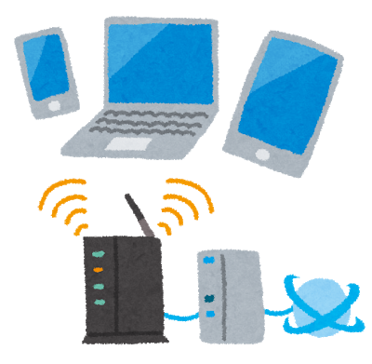
ICT experts in disasters
Problems of ICT experts: lacks of knowledge about onsite disaster response activities
what and how it is done
the real situations in affected area
how little onsite volunteers know about ICT.
They established “IT DART” and joined JVOAD.
new connections among online and onsite volunteers
disaster supporters are most effective target of ICT supports

Slide 18
Entire Image of Disaster Support and ICT Support
Mutual Support
Public Support
Affected People
Disaster Volunteer
Centers
Management Support Groups
Independent
Volunteers
Local Governments
Direct Support Groups
ICT Supports
Notes:
6 min

Slide 19
The Fukushima-Oki Earthquake

Slide 20
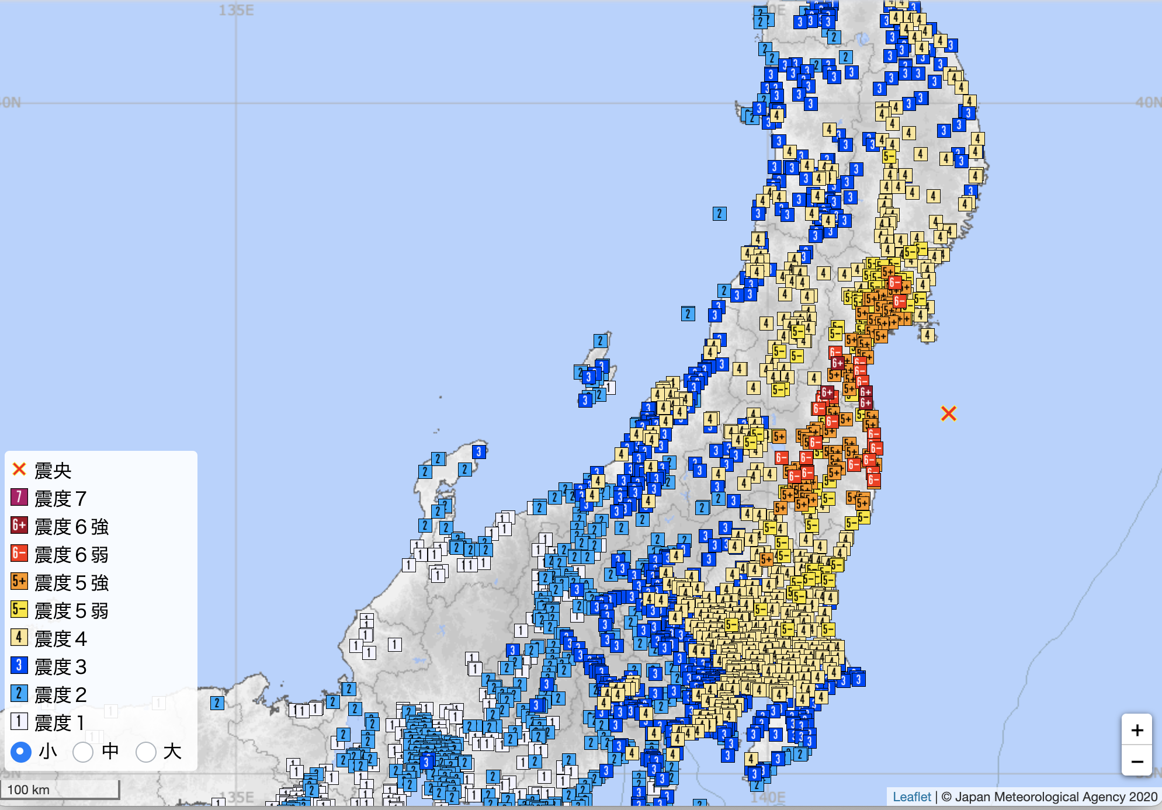
Fukushima-Oki Earthquake
13, Mar., 2021 18:30 (M 7.3)
Sendai
Epicenter
7
6+
6-
5+
5-
4
3
2
1
Tokyo
Seismic Intensity
Scale (JMA)

Slide 21
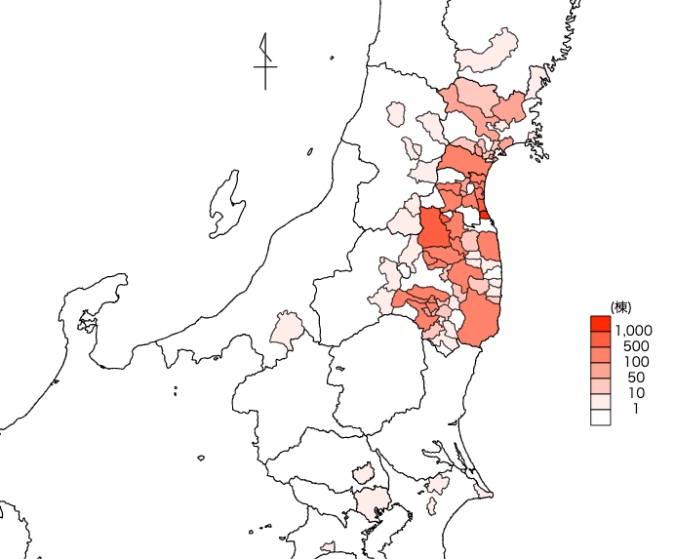
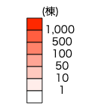
Data from Fire and Disaster Management Agency Mar. 12, 2021
Numbers of Broken Houses
Sendai:
353 / 500k
Kohri:
692 / 4,600
Yamamoto:
971 / 4,800
15.0%
20.2%
Fukushima:
650 / 124k
Shinchi:
1,300 / 2,900
44.8%
Ten-ei:
168 / 1,720
9.7%
Kagamiishi:
480 / 4,200
Tokyo
11.0%

Slide 22
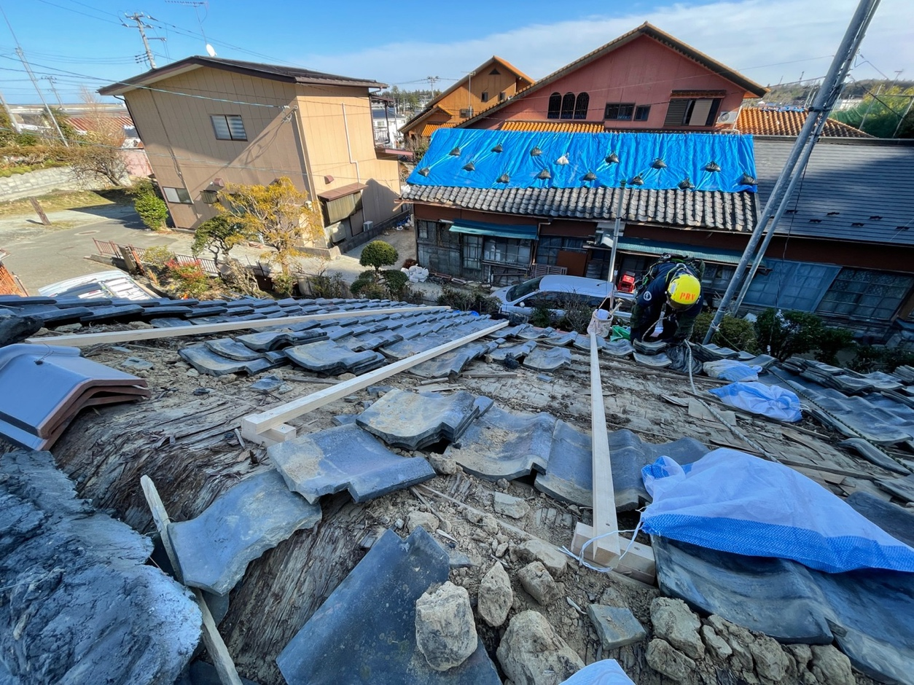
Volunteer Activities
The most of damages are on tile roofs.
Miyagi, 2021
PEACE BOAT Disaster Relief
https://pbv.or.jp/blog/?p=26760

Slide 23
What Disaster ICT volunteers contribute

Slide 24
1) Where to go?
The number of broken houses was not known just after the earthquake.
Damage information from the advance group should be share to determine the area which has many needs.
IT DART developed a “Observation Report System” for the case.

Slide 25
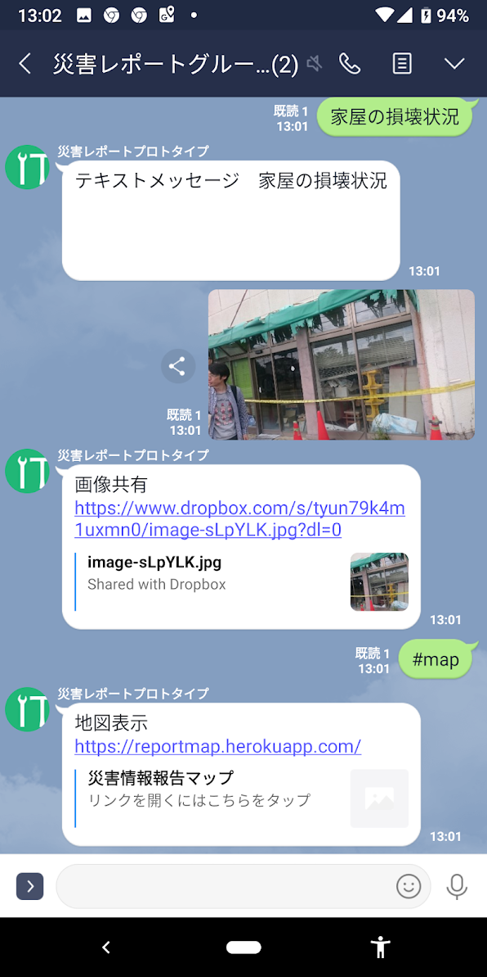
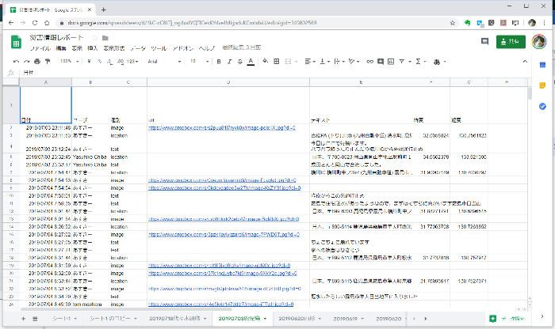
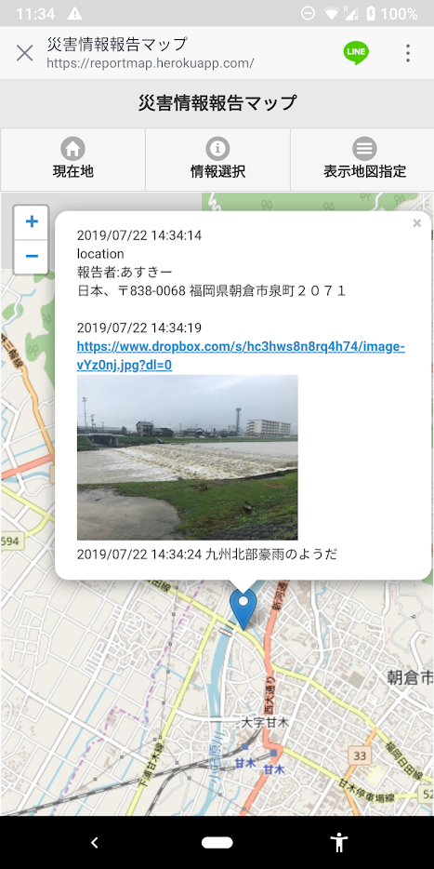
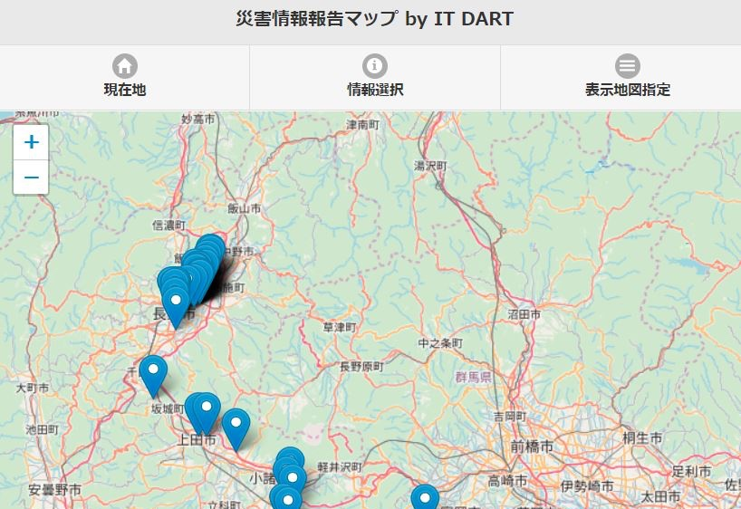
Observation Report System

Slide 26
2) Support bases were also damaged.
DVCs are managed by Community-based organizations (social welfare councils and NPOs in the affected area)
The social welfare councils of Yamamoto Town lost their office by the seismic damage.
Move to a small building of other organization without phone line.

Slide 27
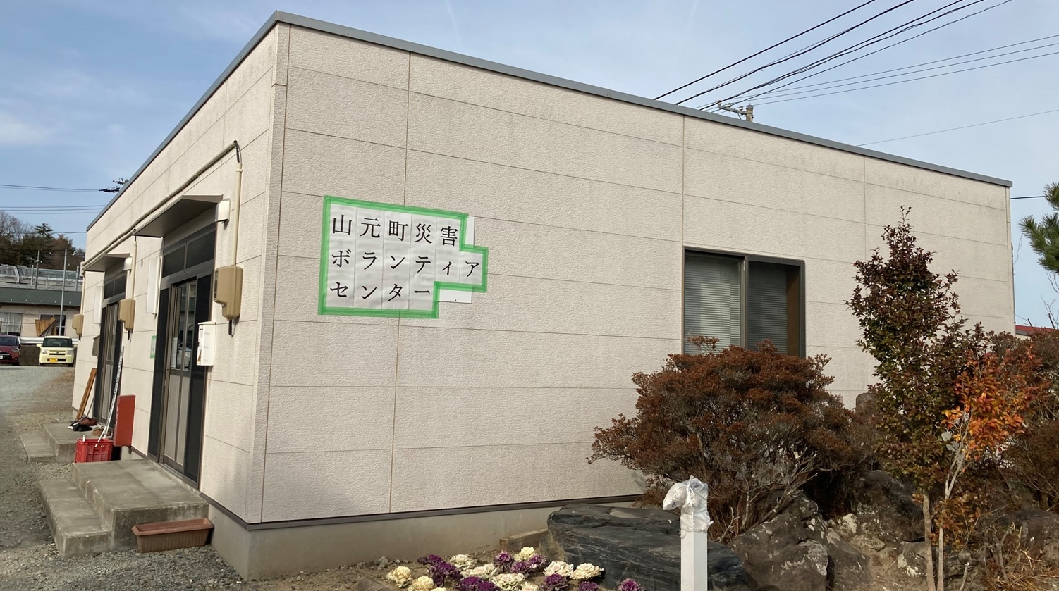
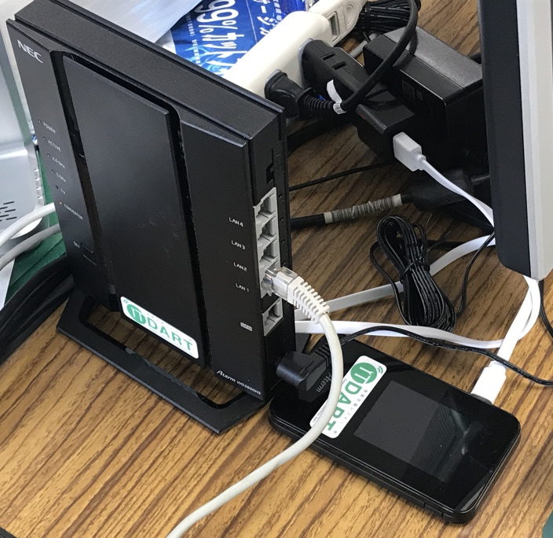
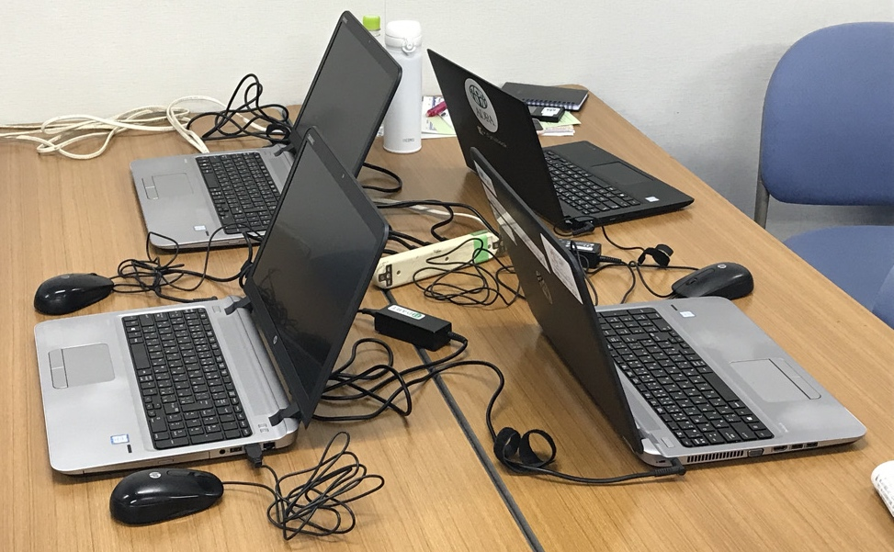
Network Installation
Internet
DVC
Office
WiFi router
router
AP
PC
hub
PC
PC
PC
PC
PC
printer
PC
printer
printer
PC
PC
PC

Slide 28
Summary

Slide 29
Summary
IT DART filled the gap between ICT supporters and disaster supporters, online and onsite.
Even technically simple things are often problematic for disaster supporters.
Skills to use ICT tools are needed.
ICT supporters near affected area are good for disaster supporters from far away
+ Knowledge of the local circumstances
+ Connections with local residents

