Slide 1
Support for IPv6-only CPU – an update from the HEPiX IPv6 WG
David Kelsey (STFC-RAL)
WLCG GDB, Taipei (ISGC2017)
8 Mar 2017

Slide 2
Outline
An update from the HEPiX IPv6 WG
Since January 2017 GDB
Reminder: WLCG MB approval (20 Sep 2016) of the plan to support IPv6-only CPU from April 2017
Recent news
Current status
Are there any known show-stoppers?
Are we ready?

Slide 3
HEPiX IPv6 WG meetings
Meetings held ~monthly
All one hour Vidyo meetings
16 March, 12 April 2017
Last F2F at CERN 2/3 Feb 2017
Next F2F at CERN 15/16 May 2017

Slide 4
Google IPv6 statistics

Slide 5
% BDII services (dual-stack)

Slide 6
News
(experiments)

Slide 7
Update from ATLAS
Input from Alastair Dewhurst (RAL)
Jobs have successfully run on IPv6-only WN at Brunel using test Panda Server
Planning on upgrading production Panda Server shortly
Possible Frontier issue still being investigated

Slide 8
ATLAS (2)
ATLAS will expect Tier 2s to provide dual stack storage by end of Run 2 (Jan 2019)
Sites that can’t will only be used for secondary data
More information at ATLAS Computing and Software week (13th -17th March 2017)

Slide 9
LHCb
Input from Raja Nandakumar
IPv6 is no longer something new or an "issue”
We can and do run in the same way whether it is ipv4 / ipv6 / dual-stack
Any issues will be dealt with by the production team as a normal incident with tickets opened through the usual means, like GGUS
look forward for more dual-stack storage site(s)
PIC is only one for now

Slide 10
LHCb (2)
Look forward to having 100% SEs that support LHCb running in dual-stack mode!
If any site wants to provide cpu in dual-stack or IPv6-only, that too should be fine with us
though notice needed for pure-IPv6-only WNs
until the majority of our SEs (esp. CERN) are dual-stack

Slide 11
News
(Tier 0 & 1s)

Slide 12
News CERN
Input from Edoardo Martelli
CERN has started deploying RFC 6939 (Client Link-Layer Address Option in DHCPv6) on its Campus and Datacentre routers
The deployment of the option has suddenly become urgent because the Network Manager of the latest CERN Centos 7 (CC7) distribution doesn't allow to set a DUID that contains the MAC address (-LLT or -LL)
fact that hampers the lease of addresses to CC7 machines

Slide 13
Tier 1 & IPv6
Good IPv6 adoption
9 Tier1s and the Tier0 peering over IPv6
dual-stack perfSONAR installed in all of them
LHCOPN IPv6 still missing from:
UK-T1-RAL (IPv6 Tier 1 on 8 March 2017)
KR-KISTI (new router hardware needed - by June 2016?)
RRC-KI-T1 KIAE (IPv6 deployment started)
RRC-KI-T1 JINR (will follow KIAE)

Slide 14
Tier 1 - PIC
Input from Fernando Lopez
All production squid servers now dual-stack
Aiming for 100% of WNs before summer
A lot of recent work with enabling dual-stack worker nodes, updated stats are:
Nodes: 36.2%
Slots: 34.7%
HS06: 38.0%
Second Tier 1 with dual-stack WNs (after NDGF)

Slide 15
News
(Tier 2s)

Slide 16
Brunel Tier 2
Input from Raul Lopes
The news from the Brunel IPv6-only node
Atlas can jobs on pure IPv6 node
It's even listed in the Atlas bigpanda website
LHCB can also run jobs on the pure node
CMS has been using IPv6-only node for several months

Slide 17
Other News

Slide 18
IGTF CA – CRLs & IPv6
Ulf Tigerstedt has been monitoring status for 1 year
http://cvmfs-6.ndgf.org/ipv6/overview.php
Lowest: 31 working, 8 "has AAAA-record but the network does not work" and 56 IPv4 only CRL servers to
1st March 2017: 42/1/52
So 11 more dual-stacked CAs during one year
IGTF is currently pushing for all!

Slide 19
“How to” deploy IPv6 - Tier 2
Andrea Sciaba
Started work collecting knowledge and advice
https://hepix-ipv6.web.cern.ch/content/how-deploy-ipv6-wlcg-tier-2-site
Tutorial in WLCG Workshop?
Manchester – June 2017

Slide 20
CHEP papers IPv6 & security
Two submitted to CHEP2016 proceedings
“Deployment of IPv6-only CPU resources at WLCG sites”
“IPv6 Security”
IPv6 Security checklist for Sites at:
http://hepix-ipv6.web.cern.ch/content/ipv6-security-checklist-wlcg-site-system-administrators-and-networking-teams

Slide 21
Monitoring Data Transfers
https://monit.cern.ch/
FTS Transfer plots
Add “data.ipv6:true” to any FTS monitor page for IPv6 only traffic

Slide 22
FTS transfers (last week) Total

Slide 23
FTS transfers (last week) IPv6

Slide 24
Need to keep this up to date
http://hepix-ipv6.web.cern.ch/sites-connectivity

Slide 25
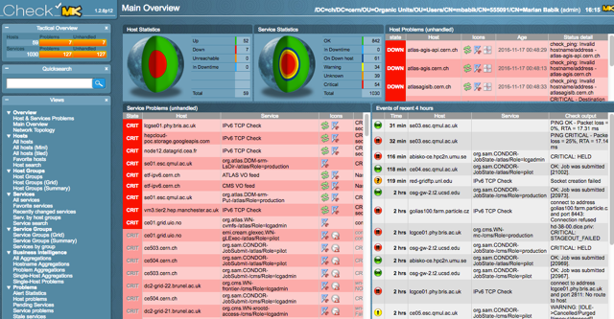
ETF and IPv6
Input from Marian Babik
ETF IPv6 instance provides dual-stack testing support for SAM

Slide 26
EFT IPv6 (2)
Works for all experiments (though only ATLAS and CMS are configured now)
Using experiments production topologies
custom hosts/services can be added manually
Does not publish data to SAM3
so the test results it takes are not part of the official reports (yet)
Aim is to help sites understand status/availability of their IPv6 resources as compared to IPv4
Some additional remarks:
ETF IPv6 test only services that have IPv6 address - it parses a list of CEs/SEs from the experiments feeds and only monitor those that have an IPv6 entry
Uses the exact same plugins and configuration we currently run in production and will thus receive all the updates (wrt. topology, metrics, updated tests, etc.)
It groups services to sites, accessible via host groups
Custom host groups and tests can be defined, such as e.g. ATLAS central services to check DNS/TCP reachability of the central services
Not auto-reloaded since central services are not part of the experiments feeds, but can be extended via API or manually from a static list of hosts/ports
This instance can be added to the ETF central, which provides an overview of site services across all experiments
so it can be used to compare how site services perform (wrt IPv4 vs IPv6)

Slide 27
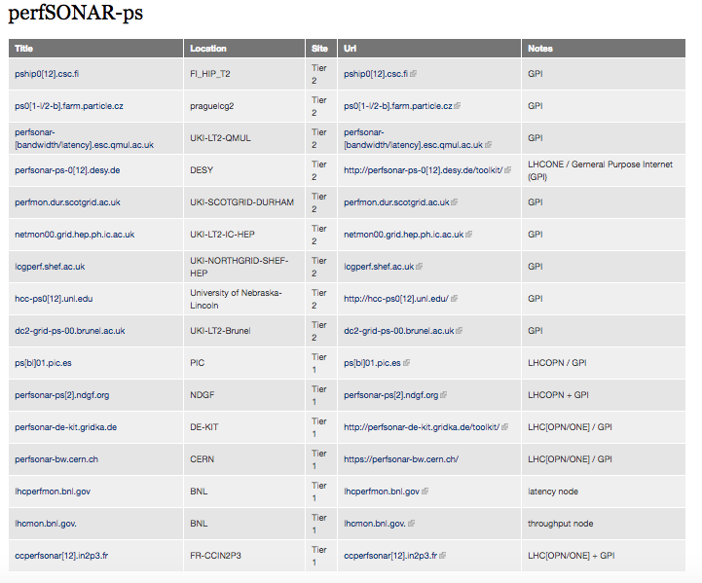
perfSONAR & IPv6
http://hepix-ipv6.web.cern.ch/perfsonar-ps
Another table to keep up to date

Slide 28
perfSONAR – dual-stack mesh
Production version
http://psmad.grid.iu.edu/maddash-webui/index.cgi?dashboard=Dual-Stack%20Mesh%20Config
Test version
http://maddash.aglt2.org/maddash-webui/index.cgi?dashboard=Dual-Stack%20Mesh%20Config

Slide 29
Dual-stack mesh

Slide 30
Summary
Much improved engagement by Tier 1s
Most are ready
BUT – still limited dual-stack storage
Except at working group sites who already had this
A good number of Tier 2s run dual-stack
BUT *MANY* do not!
WLCG Tier 2s must start planning NOW
No show-stoppers identified to date
Still a lot of work ahead of us!
How best to track/urge/encourage/support the Tier 2’s
A task for WLCG Operations

Slide 31
Links
HEPiX IPv6 web
http://hepix-ipv6.web.cern.ch
Working group meetings
http://indico.cern.ch/categoryDisplay.py?categId=3538
WLCG Operations IPv6 Task Force
http://hepix-ipv6.web.cern.ch/content/wlcg-ipv6-task-force-0
IPv6 working group CHEP papers
2013 - http://iopscience.iop.org/article/10.1088/1742-6596/513/6/062026
2015 - http://iopscience.iop.org/article/10.1088/1742-6596/664/5/052018
2016 – two papers submitted

Slide 32
Questions?

Slide 33
Backup slides

Slide 34
ALICE
ALICE central services have been dual stack for more than a year
Storage is fully federated
Any site can access data from any site
To support IPv6-only resources, all data must be available on some IPv6-enabled storage
ALICE will not be able to support IPv6-only CPU resources by April 1st 2017
ALICE can support IPv6-only CPU resources as soon as enough sites have upgraded their storage to dual stack
Goal of the end of Run II

