Slide 2
That this presentation about ?
Some remarks on the team, funding and high level objectives.
How to build reliable cloud systems
  Full High Availability Functionality
  Managing underlying storage; delegate storage (CEPH)
  Storage Federations
Managing your storage
  Quality of storage management (Admin View)
  Web 2.0 access
  How to integrate sync’n share with traditional storage technologies

Slide 3
The Technology Cheat Sheet

Slide 4
dCache Cheat-sheet
Combines heterogeneous storage nodes under a common virtual file system tree and scales into 100PB region.
Provides access to data via a variety of protocols, e.g. NFS4.1, WebDAV, GridFTP, etc.
Provides a variety of authentication mechanisms, like User/Pass, X509 Certificates, Kerberos, in preparation SAML and OpenID Connect, Macaroons.
Multi Tier support: moves data around between different media types, like Tape, Spinning Disks and SSDs.
  By user request.
  Automatically based on the access profile, hot spot.
Provides resiliency, e.g. through multiple automatically managed copies.

Slide 5
Some strategic considerations

Slide 6



The dCache.org collaboration
HTW
Berlin
(University)
Dubna, JINR
Moscow, KI

Slide 7


Funding and roadmap
EOSC
???
Standardization
Deploying new technologies into
Production and exploring new communities
INFRA-12/21-2017
2010
2013
2015
2018
NFS 4.1 / pNFS
Deployment
Interoperability
Reducing Costs
HTTP / WebDAV
Data Life Cycle
Contributing to the
Dynamic Federation
Multi Tier Storage
AAI
Quality of Service
Migration Archiving

Slide 8
Storage Cloud Infrastructures require
24/7 availability
Rolling updates / upgrades
Operator-less operation for ‘dark computer centers’
Reduced cost for managing low level storage
Large scale x-site and x-country federations
User defined quality (price) of storage

Slide 9
Improved System Management I
Full High Availability
With the
increasing size of dCache installations,
the usage beyond WLCG, with more challenging SLAs and with
the pressure to run ‘operator less’ for days
  Weekends
  Dark Data Centers
  Reduce Costs
High Available functionality became inevitable.

Slide 10



High Availability
Redundant Doors
(Protocol Engines)
NFS
NFS
https
https
Headnodes :
Filesystem, Pool Management
Single Point of Failures
Redundant Pools
(Replica Manager)
Multiple File Copies

Slide 11
High Availability
Mainly the following issues need to be fixed for dCache HA
The dCache core “message passing system” had to be fixed to overcome failures on single path segments: ‘rerouting’
dCache sub-services needed to become redundant
  Single point of failure services
  state-less services

Slide 12
High Availability: Message Passing
Any single component can fail, w/o breaking the service
Stolen from Gerd Behrman, NDGF

Slide 13
High Availability
Stateless services : use publish subscribe
Stateless Service
Stateless Service
Randomize
Singletons (build quorums, e.g. using Zookeeper)

Slide 14
Result (With 3.0)
At any point in time, one internal service (node) can fail without consequences for the overall service.
Essential for a huge 24/7 installations.

Slide 15
Improved System Management II
Delegating low level storage functionality

Slide 16
Delegating work to external Storage Layers
Provides a single-rooted namespace.
Metadata (namespace) and data locations are independent.
Uniquely handles different Authentication mechanisms, like x509, Kerberos, login+password, auth tokens.
Provides access to the data via variety of access protocols (WebDAV, NFSv4.1/pNFS, xxxFTP. DCAP, Xrootd, DCAP).
Provides data migration between multiple tiers of storage (DISK, SSD, TAPE).
Aggregates multiple storage nodes into a single storage system.
Manages data movement, replication, integrity.
Can be delegated
Slide stolen from Tigran Mkrtchyan

Slide 17
Integrating low level storage technologies
Unlimited hierarchical Storage Space
NFS 4.1, WebDAV, GriFTP
X509, user/passwd, OIDC, Kerberos
SSDs
Spinning Disks
Tape, Blue Ray …
Benefits: Best of two worlds
Low maintenance CEPH functionality
High level dCache functionality : access protocols and authentication mechanisms

Slide 18
CEPH in dCache, what we have now
dCache provides high level service
Data replication and storage management is a core dCache service
Each pool is attached to its own disk.
Slide stolen from Tigran Mkrtchyan

Slide 19
CEPH in dCache, phase 1
dCache provides high level service
Data replication and storage management is a core dCache service
Each pool has its own partition on a shared storage system.
Slide stolen from Tigran Mkrtchyan

Slide 20
CEPH in dCache, phase 2
dCache provides high level service
All pools can see all partitions on the shared storage
Any pool can deliver any data from any partition.
The object storage takes care of replication and data resiliency
Slide stolen from Tigran Mkrtchyan

Slide 21
CEPH in dCache, phase 2
dCache provides high level service
dCache can move data between ‘regular’ and Object Store pools.
Slide stolen from Tigran Mkrtchyan

Slide 22
Managed Storage
or
Quality of Service in Storage
Why ?

Slide 23
Why do we need to talk about Quality of Storage ?
Different Data Sets have different purposes
  Scratch (Intermediate Storage)
  Heavy Processing (HPS analysis access)
  Long Term preservation for 100 years.
Different storage devices or brands have different qualities
  Tape
  Blue Ray
  Disk, SSD
Different Data intensive groups have different budgets
Different storage technologies have different prices

Slide 24

QoS initiative organized by
INDIGO-DataCloud
HGF, Germany
  DESY
  KIT
INFN, Italy
  Bari
  CNAF, Bologna
Poland
  PSNC
Involving RDA and SNIA

Slide 25
Pre-requisite for
”Support for Quality of Service in Storage”
Integrated support for different storage media
Transparent transition between media types based on
  Internal rules
  APIs for remote “Platform as a Service” systems
  Manual intervention (Operator , User)
Consistent and transparent management of replica
  System must be aware of media attributes (Speed, Latency, Price)
  System must be aware of locations (Rack, Power supply group, Buildings)

Slide 26
How to steer QoS ?
SRM : Storage Resource Manager
  exists for over 10 years
  no longer “en vogue”
CDMI : Cloud Data Management Interface
  Partial support, not great in the standard definition
  Extensions possible (INDIGO DataCloud and RDA)
  Concept not sophisticated enough.
RESTful
  No standard definition (dCache proprietary)
GUI or predefined directory structure
  End user friendly
  Limited functionality

Slide 27


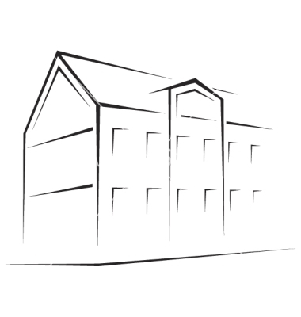
Directory Based Storage Quality selection
Your Home

Slide 28
Storage Management GUI
Locality
QoS
DISK
TAPE

Slide 29
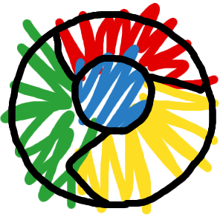
QoS Management interfaces
Frame
Works
&
PaaS
e.g.
INDIGO
OneData
SRM
Migration Engine &
Replica Manager
REST
CDMI
GUI

Slide 30
Managed Storage II
Managing data flows in federated systems.

Slide 31
Federating Storage
The Michigan Setup
Ann Harbor, MI Campus
100 Km
3 ms
WRITE
Either AH or LN
Depending on Space
READ
Always from ‘local’
Possibly cache copy
Lansing, MI Campus
Provided by Shawn McKee

Slide 32
The Cloud Part

Slide 33
The cloud feeling, The Sharing
My Home
Your Home
Share this one with you

Slide 34
We decided to go for ownCloud © to get this done.

Slide 35



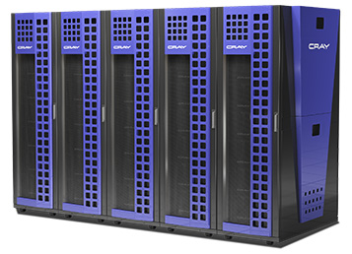
Current Implementation
Sync’n Share
GridFTP
NFS

Slide 36
Missing Bit ….
Share only exists though the OwnCloud interface.
Not available in NFS and GridFTP
My Home in OwnCloud
My Home in NFS/GridFTP
My File
Shared
My File

Slide 37
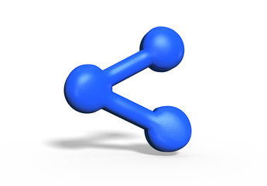
The Solution
Files
Directories
Levels
Tags
Shares
dCache namespace gets a new object : The Share
The sync’n share interface (e.g. OwnCloud) only refers to the Share in the dCache namespace.
Share is somewhere between hard and soft link.

Slide 38

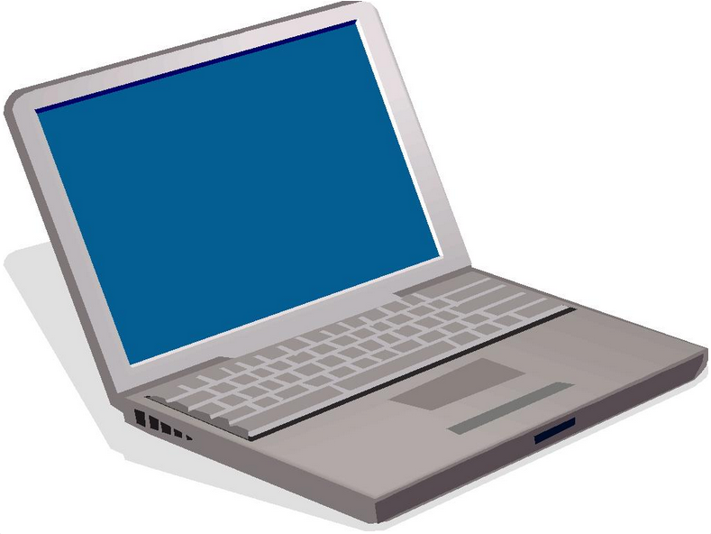
The Hybrid System

Slide 39
Putting it all together …..

Slide 40


The scientific Data Cloud
High Speed
Data Ingest
Fast Analysis
NFS 4.1/pNFS
Wide Area Transfers
(Globus Online, FTS)
by GridFTP
Visualization
& Sharing
by WebDAV, OwnCloud

Slide 41
Conclusion
Well on the way for new strategic direction on storage:
Bringing costs down for operations
  Using ‘low maintenance’ storage backends (e.g. CEPH)
  Introducing High Availability mechanisms to support ‘dark data centers’
Allowing Quality of Service in storage to be defined by sysadmins and users.
  With GUI
  Remotely : SRM, REST, CDMI
Introducing Cloud mechanisms (e.g. sharing) not only for home directory type data but as well for experiment data.
Implementing the “Scientific Storage Cloud”
Stick with industry standards
  Allow sharing resources at sites
  Benefit from development and fast turnaround in security components and mechanisms.

Slide 42
The END further reading www.dCache.org

Slide 43
Integrated Media Technology Support
Technology | Driver
Spinning Disk | POSIX Driver
SSD | POSIX Driver
Shingled (SMR) | POSIX (disable remove)
 | TAPE Driver
Removable devices | TAPE Driver
CEPH | New CEPH Block Driver

