Slide 1


Exploring Multi-Core on ATLAS@home
Wenjing Wu on behalf of ATLAS Collaboration
Computer Center, IHEP
wuwj@ihep.ac.cn

Slide 2
Outline
Brief introduction of volunteer computing
ATLAS@home project
Setting up Multi-Core on ATLAS@home
Performance tests and tuning
Summary

Slide 3
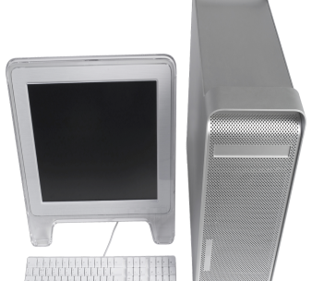

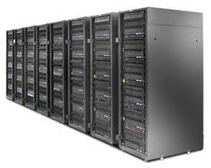





Scientists
Have a large amount of data to process/a big computing task
XX@home
Project
BOINC
Continuous Jobs sent to BOINC server

Slide 4
Volunteers
Features of volunteer computing resources:
Idle CPU resources on personal computers harnessed by BOINC
computing tasks run at a lower priority
Shared by multiple VC projects.
Most hosts have limited network bandwidth and hard disks
suitable for CPU intensive, low latency computing tasks
CAS@home
SETI@home
LHC@home
ATLAS@home

Slide 5

Middle Ware for VC
BOINC(Berkeley Open Infrastructure for Network Computing) is the most popular middle ware for VC
It was firstly developed by the SSL Lab of UC Berkeley for SETI@home in 1998
It was rewritten to generic software for VC

Slide 6
The scale of BOINC Volunteer Computing(1)
Around 50 VC projects :HEP, biology, cosmology, chemistry, physics, environment.
260K active volunteers
830K active volunteer computers
Real time computing power: 17PetaFLOPS
Successful Individual projects:
  Einstein@home (819 TeraFLOPS),
  SETI@home (711 TeraFLOPS)
  LHC@home (17TeraFLOPS)
  ATLAS@home(7.6TeraFLOPS)
Both LHC@home and ATLAS@home use virtualization which limits its available hosts (hosts are not powerful enough or volunteers have trouble to install VirtualBox on their hosts)

Slide 7
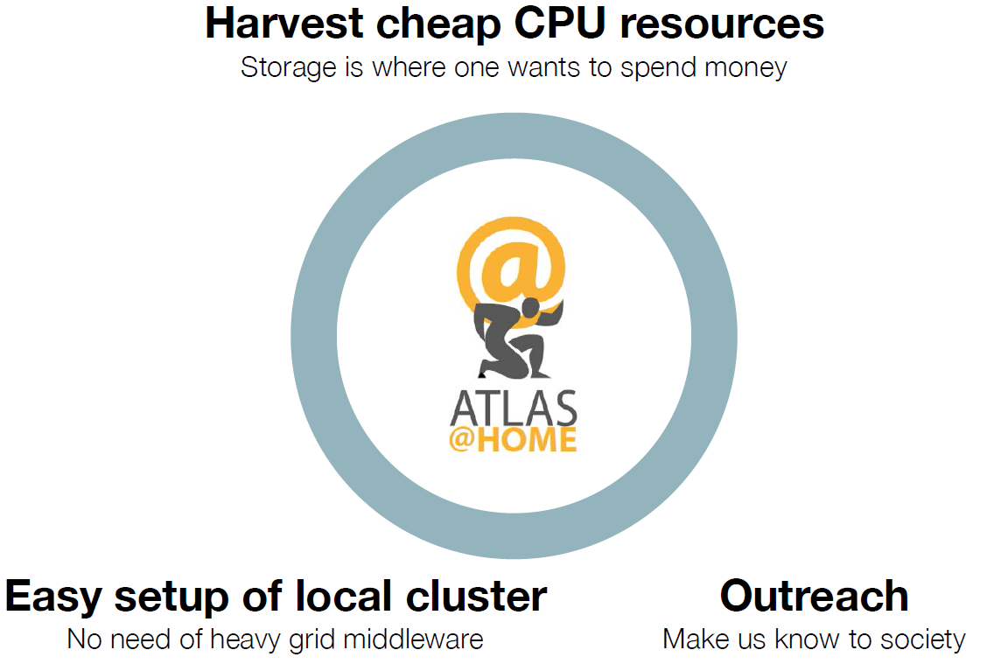
ATLAS@home
Why ATLAS@home
  Add significant computing power to ATLAS computing
  Increase publicity for the ATLAS experiments
  Find easy ways to harness Tier3 resources.
Goal:
  to run ATLAS simulation jobs on volunteer computers
2017-2-17

Slide 8
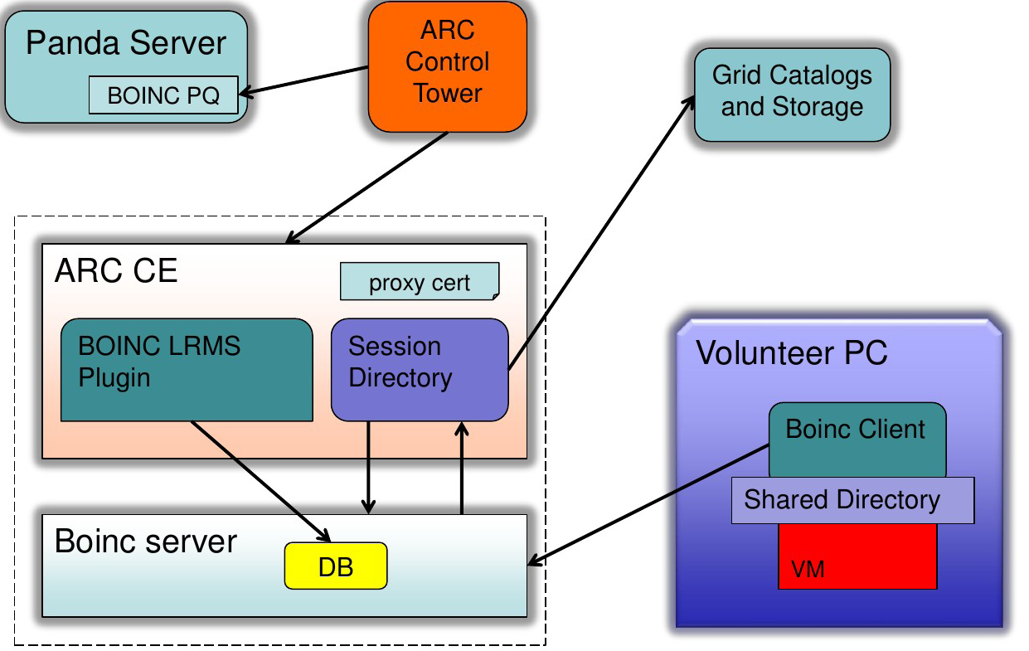
Architecture
2017-2-17

Slide 9
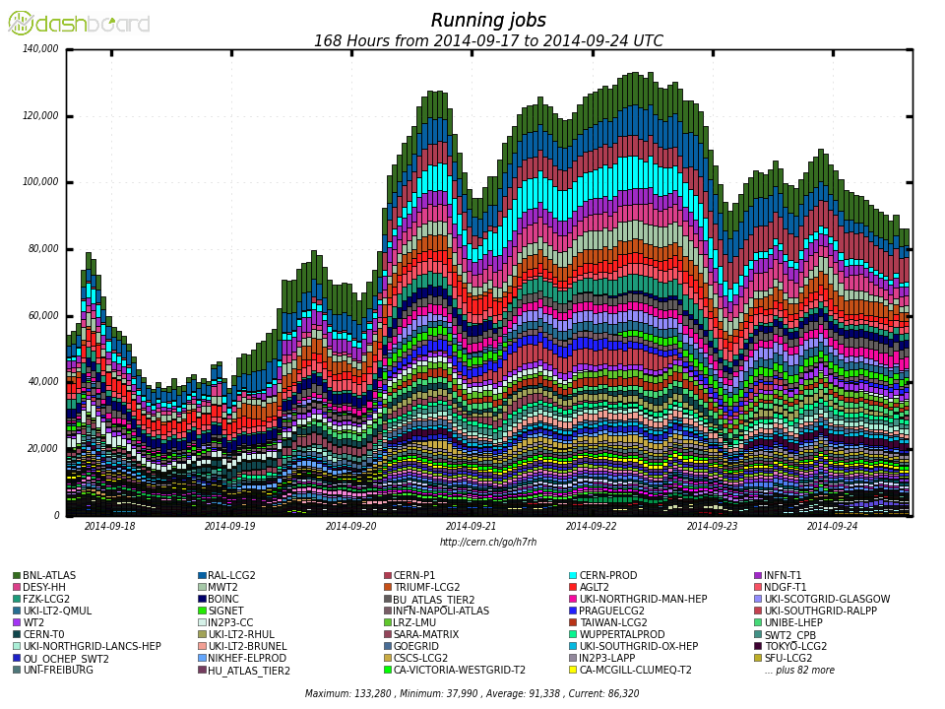
the Whole ATLAS Computing
ATLAS@home(BOINC) is the biggest site for simulation, it account for 3% of the whole atlas computing power!
ATLAS has ~150K CPU cores from all Grid sites
ATLAS@home

Slide 10
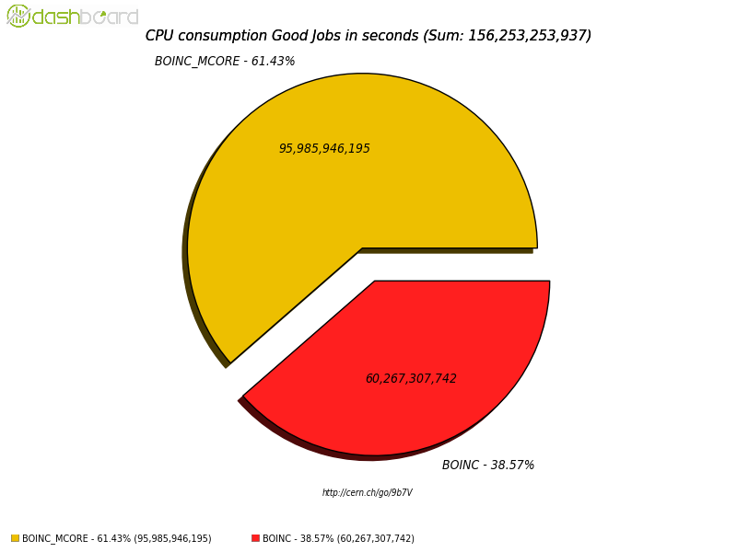
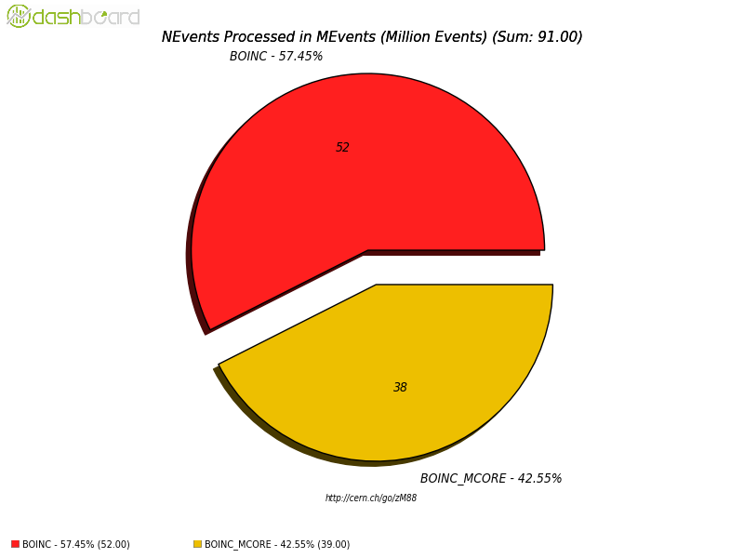
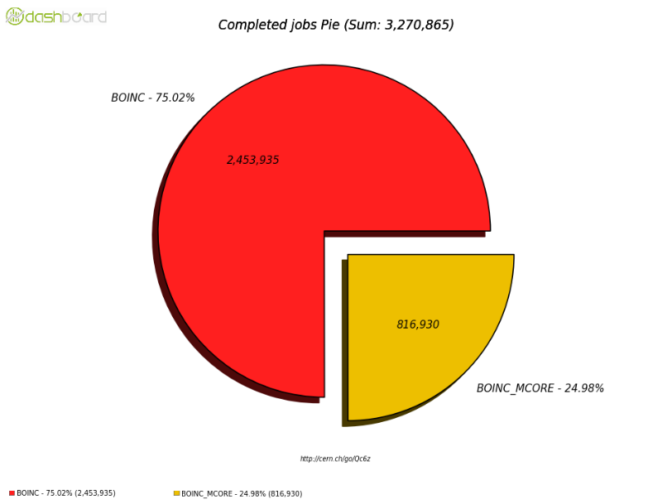
In a year, completed 3.3M jobs (99% MC simulation, 1% MC reconstruction), consumes 43M CPU hours, processed 91M events, running 6K jobs/day, processed 154TB data, produced 94TB data, Job failure 11.84%

Slide 11
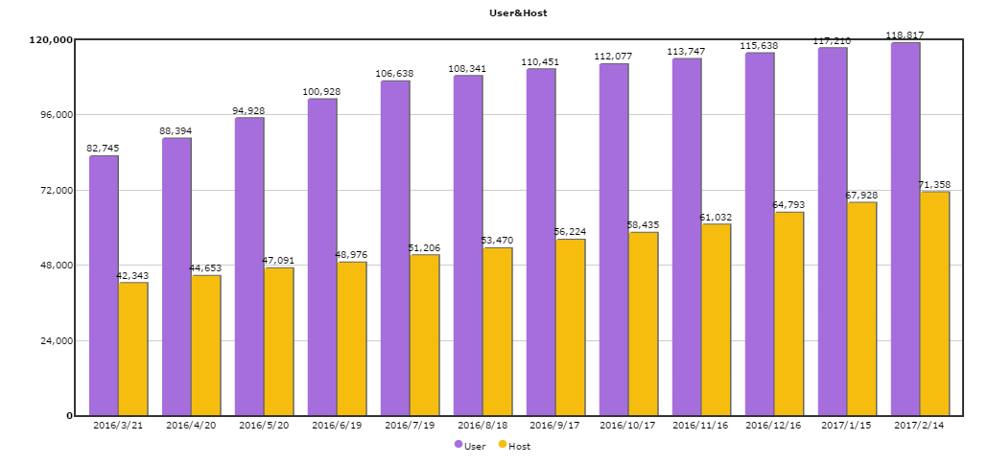
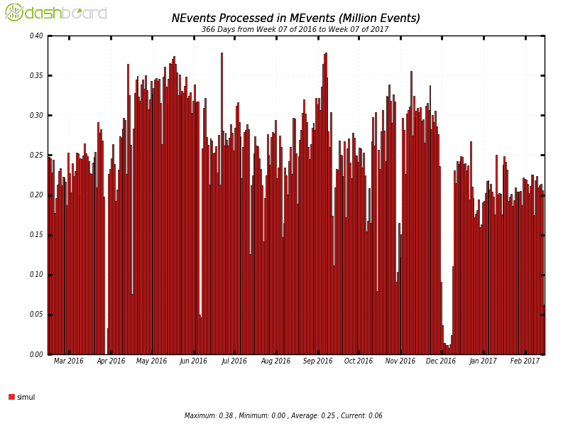
Participated hosts and users keep growing, but the total amount of CPU remains flat!

Slide 12
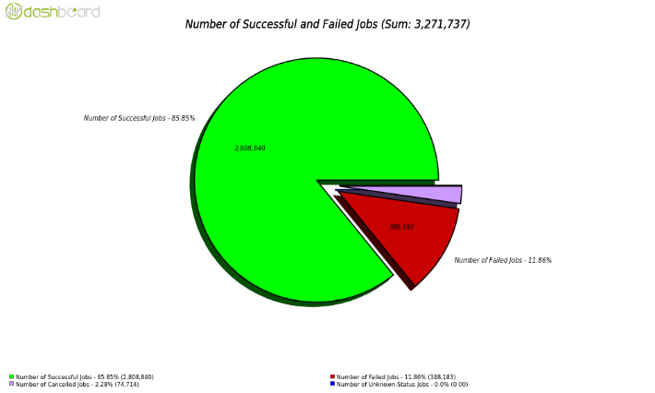
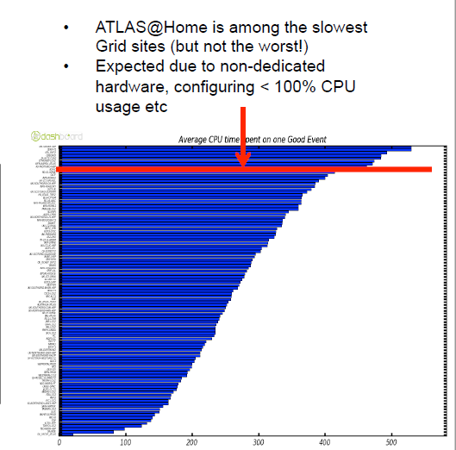
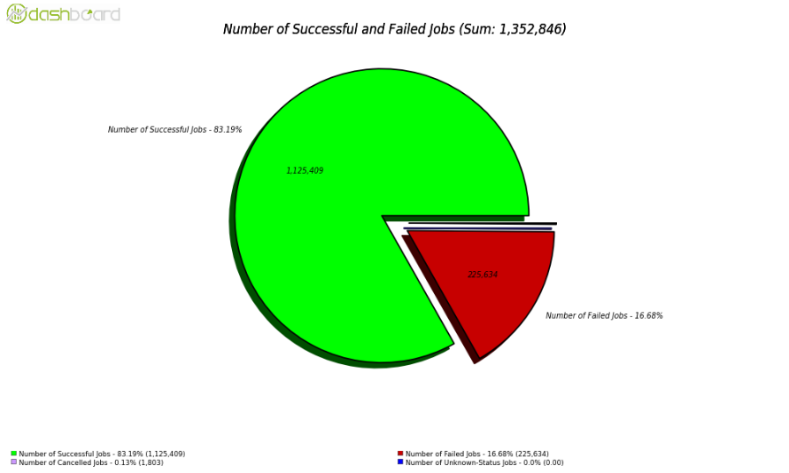
ATLAS@home Performance
BOINC Job (simulation jobs) Failure rate is 11.84% , while the average for ATLAS is 16.68%

Slide 13
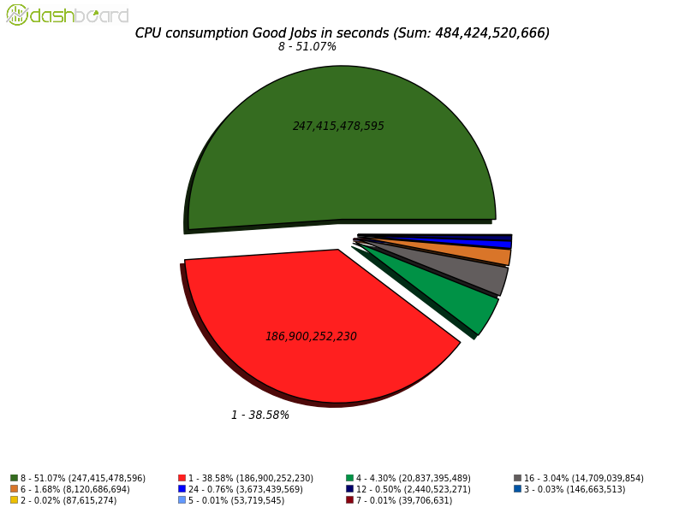
ATLAS@home Single->Multi Core (1)
Athena (ATLAS Software for production and analysis) already supports Multi Core(Athena MP), and most grid sites support multi-core queues.
Athena MP can significantly save memory usage by utilizing the same amount of CPU cores (save up to 50% memory).
CPU consumption in a month(2017.2) with all ATLAS sites, Single Core uses only 38% of CPU

Slide 14
ATLAS@home Single->Multi Core (2)
A lot of volunteer hosts have more than 1 available cores
  Available cores == cores volunteers configured to be used by BOINC
  The majority has 4 or 8 cores
The Single core ATLAS@home app spawns a virtual machine for each core on a host.
Single core is inefficient if a host has multiple available cores (multiple virtual machines will be spawned on the host)
  Memory: It requires more memory, 2.3GB RAM per core (Per virtual machine)
  Network: Each virtual machine needs to download software and cache
  Hard disk: Each virtual machine needs 10GB space (the vm image and extra hard disk space for the vm)

Slide 15
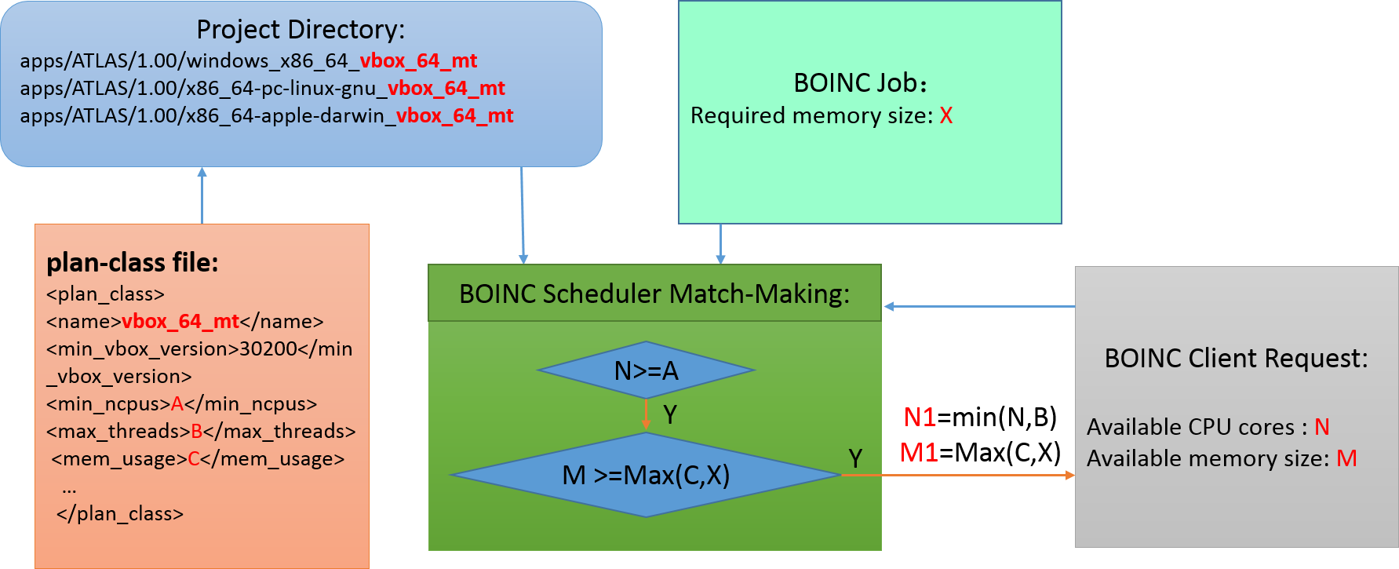
BOINC support for multi core
Plan class defines tags
Each tag includes different attributes
  CPU numbers range
  Memory size
Tag assigned to jobs which define jobs’ resource requirements
Clients report their available resources, and request jobs.
Scheduler match the job requirements and the available resources from the clients.
CPU
BOINC Multi core scheduler supports only fixed amount of memory, regardless of the CPU cores.
Not suitable for the ATLAS jobs whose memory usages is proportional to the number of Cores.
Memory

Slide 16
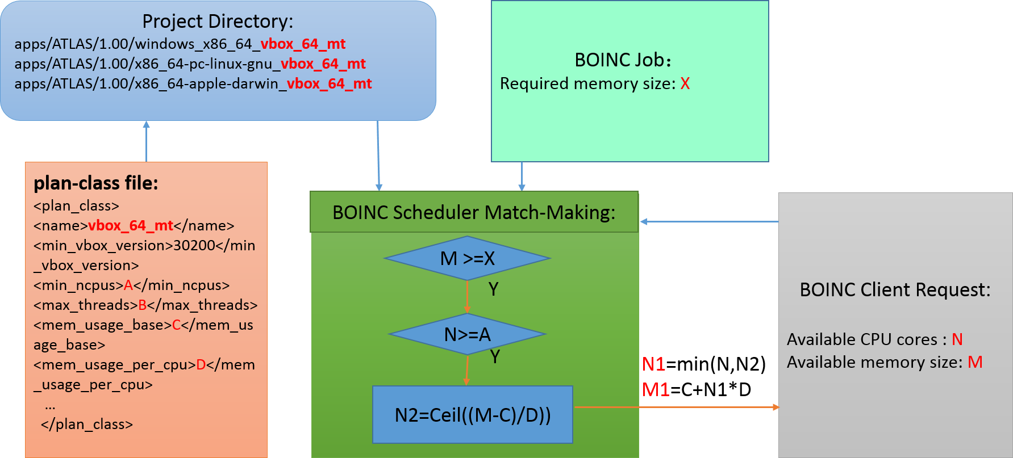
Customized multi core scheduler for ATLAS@home
Dynamical memory allocation
Memory usage is based on a formula:
  C+D*N1
  C is basic memory size, D is memory size per Core, N1 is the number of Cores
Both Number of Cores (N1) and Memory usage(M1) are calculated based on the job resource requirements and available resources from the clients.
Memory
In ATLAS Multi Core app:
Core range: 1~12
Memory usage: C=1.3GB, D=1GB
Memory usage formula: M1=1.3+1*N1, M1 is memory in GB, N1 is the number of Cores
CPU

Slide 17
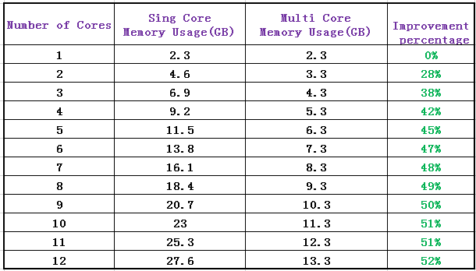
Memory usage improvement from multi core

Slide 18
Performance issues with different cores
From both local testing machines and ATLAS job dashboard, we found out some virtual machines with big number of cores have very bad performance
  ATLAS@home has standard jobs: simulation jobs, 100 Events/job
  Performance is measured by CPU seconds/event

Slide 19
Tests on given hosts
Goal: compare HT vs. Non HT, different versions of virtualbox
  Compare performance on 2 local hosts:
    Host 1, 2*8*2 Cores (2 physical CPU, each has 8 Cores, with Hyper Threading enabled)
    Host 2 , 2*8 Cores (2 physical CPU, each has 8 Cores, without Hyper Threading enabled)
  Compare performance on virtualbox 4.2 and 5.1
Method: test CPU performance with different number of cores, run ~20 jobs for each configuration, and calculate the average CPU time.
  Core No. 4, 6, 8, 10, 12
  To avoid competition, run only 1 vm on each host.

Slide 20
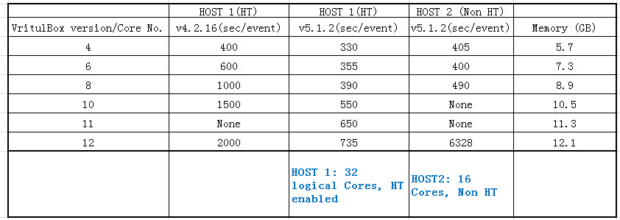
Test Result
Older VirtualBox
New VirtualBox
CPU of HOST 1 is more powerful than HOST 2
Conclusion:
Older version (<5.0.0) of virtualbox has really had performance
HT has no significant impact on performance
In both cases, performance starts to get really bad as the core number goes beyond 8.

Slide 21
Analysis from ATLAS Job Dashboard (1)
Performance of BOINC multi core site
month | BOINC
Core No | Event No | CPU | sec/event
1 | 0.07 | 22.8 | 326
2 | 0.06 | 16.1 | 268
3 | 0.14 | 40 | 286
4 | 1.5 | 332 | 221
5 | 0.23 | 58.6 | 255
6 | 0.27 | 106.6 | 395
7 | 0.11 | 44 | 400
8 | 0.46 | 205 | 446
9 | 0.01 | 3.5 | 350
10 | 0.02 | 11.7 | 585
11 | 0.01 | 2.8 | 280
12 | 0.44 | 373 | 848
Data is taken in a month period for BOINC_MCORE site
Performance is OK up to 8 cores.
For 9, 11 cores, the number is smaller, may not be representative .

Slide 22
Analysis from Job Dashboard (2) performance of different resources
month | grid
Core No | Event No | CPU | sec/event
1 | 31.32 | 8458 | 270
4 | 41.15 | 8527 | 207
6 | 13.17 | 3224 | 245
8 | 384 | 106179 | 277
12 | 2.39 | 297 | 124
month | cloud | boinc_mcore 8%
Core No | Event No | CPU | sec/event
1 | 4.75 | 2084 | 439
2 | 0.06 | 15.9 | 265
3 | 0.14 | 39.7 | 284
4 | 1.49 | 331 | 222
5 | 0.23 | 58.6 | 255
6 | 0.27 | 106 | 393
7 | 0.11 | 43.8 | 398
8 | 27.92 | 12114 | 434
9 | 0.01 | 3.5 | 350
10 | 0.02 | 11.7 | 585
11 | 0.01 | 2.8 | 280
12 | 0.43 | 372 | 865
month | BOINC
Core No | Event No | CPU | sec/event
1 | 0.07 | 22.8 | 326
2 | 0.06 | 16.1 | 268
3 | 0.14 | 40 | 286
4 | 1.5 | 332 | 221
5 | 0.23 | 58.6 | 255
6 | 0.27 | 106.6 | 395
7 | 0.11 | 44 | 400
8 | 0.46 | 205 | 446
9 | 0.01 | 3.5 | 350
10 | 0.02 | 11.7 | 585
11 | 0.01 | 2.8 | 280
12 | 0.44 | 373 | 848
Data is taken in a month period for different resources (cloud, grid, boinc, and all resources)
boinc contributes about 8% CPU of cloud resources

Slide 23
Analysis from Job Dashboard (3) performance of commonly used cores
1 Core
Core No | Event No | CPU | sec/event
grid | 31.89 | 8502 | 267
cloud | 4.75 | 2085 | 439
hpc | 0.88 | 202 | 230
4 Core
Core No | Event No | CPU | sec/event
grid | 41.17 | 8531 | 207
cloud | 2.17 | 655.5 | 302
hpc | 1.49 | 331 | 222
8 Core
Core No | Event No | CPU | sec/event
grid | 384.62 | 106330 | 276
cloud | 27.92 | 12114 | 434
hpc | 7.9 | 1829 | 232
12 Core
Core No | Event No | CPU | sec/event
grid | 2.4 | 298.4 | 124
cloud | 0.43 | 372 | 865
hpc | 4.26 | 1831 | 430
focuses on the most commonly used number of cores (1, 4, 8, 12)
Data is taken in a month period for different resources (cloud, grid, HPC)

Slide 24
Conclusions
CPU performance is very stable for grid sites despite the number of cores. It is even more CPU efficiently with more number of cores, but most grid sites have 8 cores, some have 12 cores.
  The number of cores in the grid sites are pre-configured, normally 8 or 12 cores
  The number of cores are configured according to the actual cores in the physical CPU
For cloud sites and HPC sites, similar to BOINC, the CPU performance starts to get bad with more than 8 cores.
  Do not understand the HPC sites
  Cloud sites’ performance are due to the number of cores of in the physical CPU.
    Most physical CPU has 8 cores
    Using more than 8 cores causes cross-physical CPUs, resulting in bad performance.

Slide 25
Solutions for ATLAS multi core
Reduce the max core number from 12 to 8 from the server side
  Core range: 1~8
Hosts with physical CPUs having more than 8 cores(minority) can configure on the client side to use more than 8 cores.

Slide 26
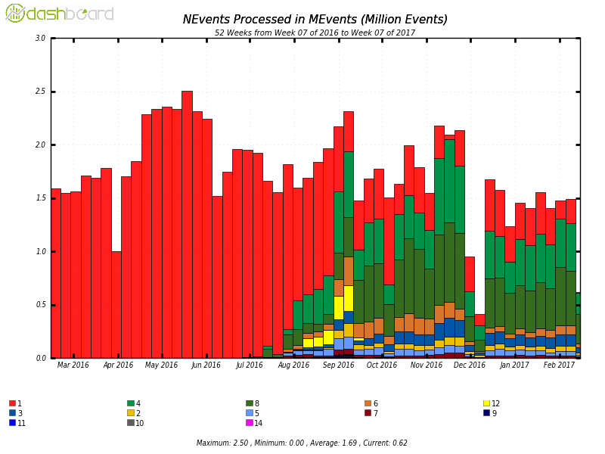
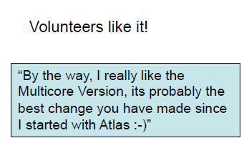
multi core vs. single Core (1)
The multi core Application was officially released in July 2017
Both single core and multi core coexists until December 2017
Volunteers prefer to run the multi core app, and gradually migrate to the multi core app
Volunteers can still run single core atlas job with the multi core app.
Single Core
Multi Core
Events processed in a year by different number of cores

Slide 27
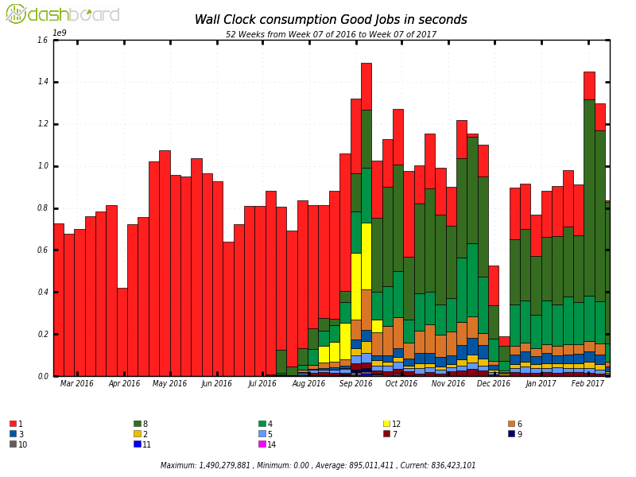
multi core vs. single core
By wall clock, switching to multi core slightly increased the contributed CPU, however the processed event numbers decreased slightly.
Single core jobs: 25 events/job
Multi core jobs: 100 events/job
Single Core
multi Core
Wall clock consumption in a year by different number of cores

Slide 28
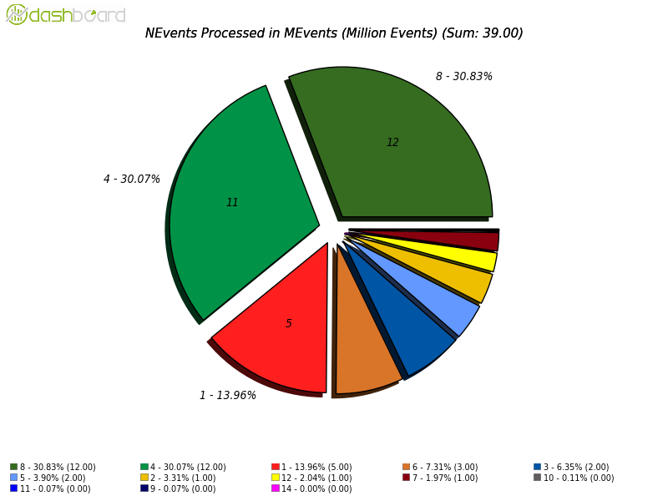
Multi core numbers breakdown
Among multi cores, 30% uses 8 cores, 30% uses 4 cores.
Event processed in a year by different number of cores

Slide 29
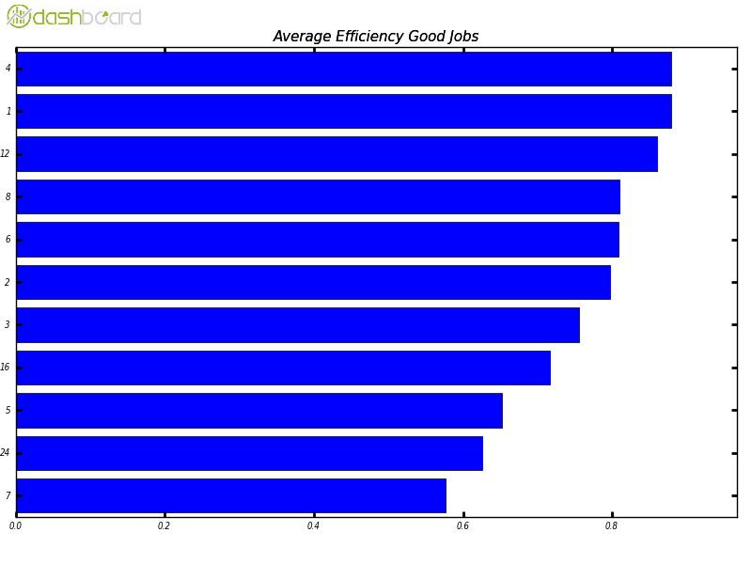
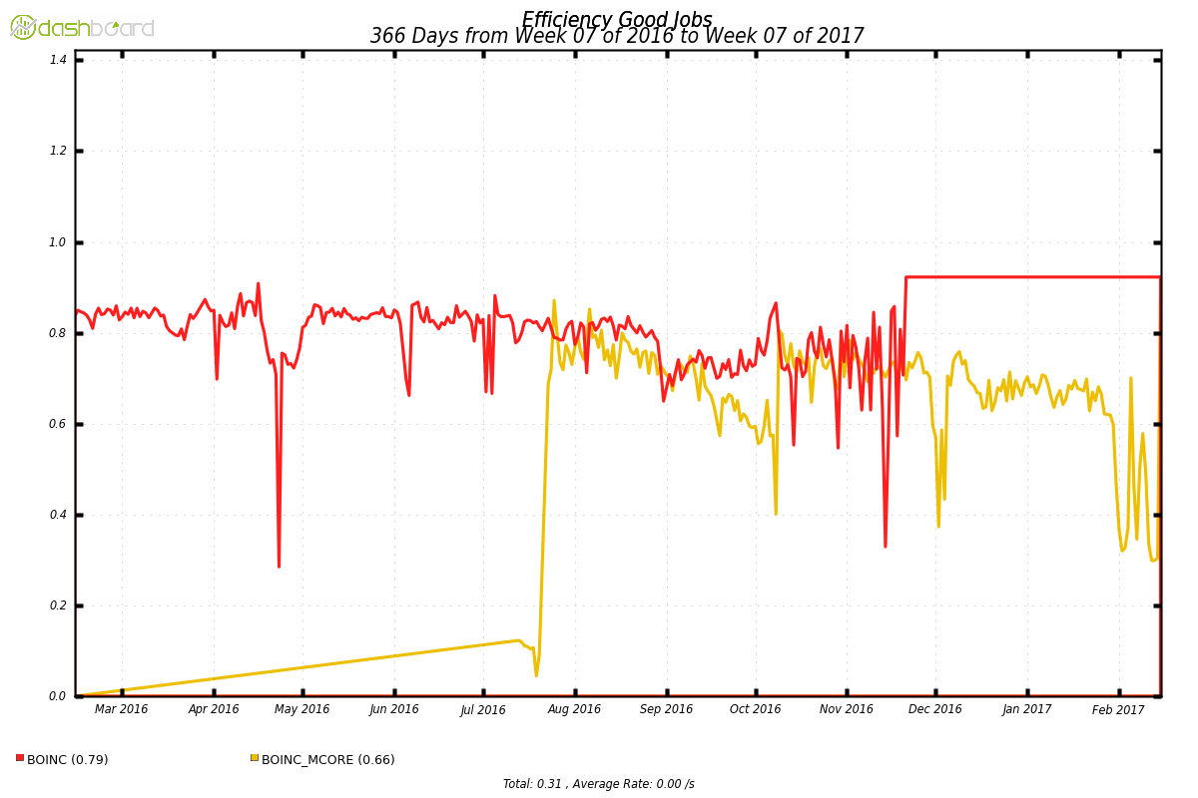
Multi Core doesn’t improve CPU Efficiency
BOINC Site: Single Core: 0.79, Mcore 0.66
CPU Efficiency by different number of Cores, for ALL ATLAS computing resources

Slide 30
Summary
ATLAS@home is a pioneer volunteer computing project in the HEP field
Has been providing ~ 3% to the whole ATLAS computing and performs well!
Switching from single core to multi core has significantly reduced to memory usage on the volunteer hosts (up to 50%), volunteers are very happy with this feature
Multi core is less CPU efficient, but more memory efficient
ATLAS@home multi core makes it possible to exploit more available cores from the volunteer hosts by reducing its memory/hard disk/network usage.

