Slide 1
Imbalanced Malicious Traffic Detection Based on Coarse-grained Data Labels
Presented by Li Zhenyu
Computing Center, IHEP

Slide 2
01
Background
02
Key Technology
CONTENTS
03
Result of Experiments
04
Summary and Prospect

Slide 3
PART
ONE
Background

Slide 4
Background
Background
Cyber security is a necessary prerequisite for the normal operation of many scientific research and production service. Many scholars have carried out relevant explorations. IHEPSOC has studied and used many emerging technologies.
In order to ensure cyber security, researchers have carried out a lot of researches in machine learning, especially in the field of deep learning. For example, Wang et al. [1] first proposed to use representation learning for traffic intrusion detection with CNN. And with the popularity of Transformer structure, Su et al. [2] also tried to combine BLSTM with Transformer. Many of the methods proposed have achieved excellent results.
[1] Wang W, Zhu M, Zeng X, et al. Malware traffic classification using convolutional neural network for representation learning[C]//2017 International conference on information networking (ICOIN). IEEE, 2017: 712-717.
[2] Su T, Sun H, Zhu J, et al. BAT: Deep learning methods on network intrusion detection using NSL-KDD dataset[J]. IEEE Access, 2020, 8: 29575-29585.

Slide 5
Problem
Problem ONE
Problem TWO
Existing malicious traffic detection methods are mainly based on supervised methods, and it is difficult to obtain a large amount of traffic data with accurate labels in
real-world
In actual network traffic data, the proportion of malicious traffic is often small, which makes it difficult for many AI models to effectively learn its characteristics
Target
A detection model that does not require a lot of precious labels and is suitable for a imbalanced data distribution, which are very important for real-world scene and can save a lot of cost.

Slide 6
Proposed Methods
Modeling as Multi-instance Learning
In order to reduce the cost of data tagging, the malicious traffic detection task is modeled as a multi-instance learning (MIL) problem. Instead of labeling each data fine-grained, experts only need to label all the data in a time slice coarse-grained
Pre-estimate the Positive Score
Inspired by Carbonneau et al.[3], we use multiple clustering algorithms to pre-estimate the positive score of the coarse-grained labeled data from multiple sub-feature spaces, which will assist the MIL model to focus on true positive data with a small proportion
Positive Score Adjustment
We propose a method to dynamically adjust the positive score, which makes the MIL model more dominant in the prediction
[3] Marc-André Carbonneau,Robust multiple-instance learning ensembles using random subspace instance selection,Pattern Recognition,Volume 58,2016.

Slide 7
Flow Chart

Slide 8
PART
TWO
Key Technology

Slide 9
Terms
01
Instance
A cyber traffic data is called an instance. If the traffic data belongs to a malicious category, it is called a positive instance of that category, and if it does not belong to any malicious category, it is called a negative instance.
02
Bag
A collection of instances is called a bag. If there is at least one positive instance in the bag, it is called a positive bag of corresponding category; otherwise, it is called a negative bag. The labels for instances are consistent with the bag.
03
Multi-instance Learning(MIL)
MIL is one of weakly supervised learning. Compared with the supervised learning, the requirement of labels is reduced to the bag-level. The learning task of the model is to provide instance-level predictions with only bag-level coarse-grained labels.
04
Imbalance Rate
The Imbalance Rate is the ratio of the minority category in a data set. In our problem, this concept refers to the ratio of positive instances in the positive bag.

Slide 10
Coarse-grained Labeling
Note
Legend
The labels for instances are consistent with the bag
Benign data (Negative instance)
We only know that there is at least one positive instance in the positive bag, but we do not know which one is the positive instance.
Malicious data(Positive instance)
Label for negative bag/instance
Advantage
Label for positive bag/instance
Significantly reduce the cost of labeling. Experts only need to capture the traffic data during the time slice of malicious operation in the simulation as a bag and label it as malicious, without knowing the specific malicious item.

Slide 11
Loss Function
Loss Function
$φ\left(·\right)$ :Cross entropy function
$Y_{B}$: Label of the bag
$Y_{N}$: Value of the label for negative bag
$y_{i}$: Prediction of an instance

Slide 12
Pre-estimated the Positive Score
Multiple clustering algorithms (K-means, Mean-shift, DBSCAN) are used for clustering in multiple subspaces. Each time, the pre-estimated score of a category in a cluster is the proportion of the instances with label of that category in the cluster, and the score of the instances in this cluster are consistent with the score of the cluster
Note: This process is carried out many times in different subspace, each subspace will get different clustering results by using several clustering models, and the final pre-estimated score of an instance is calculated by the result in all the subspaces.

Slide 13
Loss Function with Score
Loss function with pre-estimated score
$φ\left(·\right)$ :Cross entropy function
$Y_{B}$: Label of the bag
$Y_{N}$: Value of the label for negative bag
$y_{i}$: Prediction of an instance
$E_{i}$: The pre-estimate positive score of $i_{th}$ instance
The effect of the pre-estimated score
Making the model focus on the instance with high probability of been positive, which reduces the impact of data imbalance. This process is similar to the weighting effect of supervised learning.
Reducing the bias caused by a large number of negative instances in the positive bag, which can greatly avoid the MIL model get a local optimal in a wrong direction

Slide 14
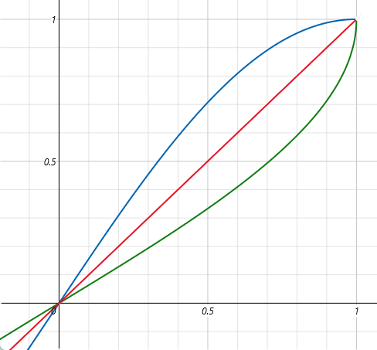
Update Scheme
Update the pre-estimated score
When an Instance is predicted to be positive, its pre-estimated score should be increased in the next step, and conversely, its pre-estimated score should be decreased. We update the score through the following function:
Effect of the updating
Making the MIL model more dominant for the predictions, and only relies on the pre-estimated result of the clustering model in the early stage of training.

Slide 15
PART
THREE
Result of Experiment

Slide 16
Setup
Dataset
Android Malware 2017，this dataset includes 5 categories of network traffic data, including Adware, Ransomeware, Scareware, SMSmalware and Benign, with about 4.67 million cyber traffic data
Coarse-grained handle
In the training set, data in Benign categories are randomly inserted into other categories to form positive bags, and labels of Benign are changed to other categories. The instance-level labels in bags are unreliable.
Indicator
We took AUC as the indicator of model performance (AUC takes TPR and FPR into account comprehensively, and the larger AUC value indicates the better model performance).
There three experiments: imbalance rate experiment, compare experiment and ablation experiment. The ratio of training set and test set of all experiments were 80% and 20% .

Slide 17
Setup
Environment
Python 2.7 , Tensorflow 1.12, scikit-learn 0.24.1
Ubuntu 20.04 LTS OS
NVIDIA Corporation Tesla T4 GPU

Slide 18
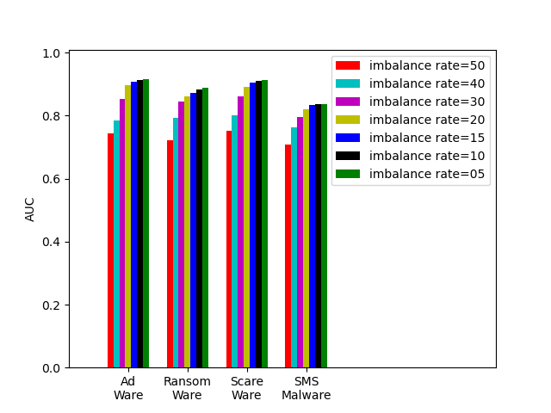
Imbalance Rate Experiment
Purpose
To study the influence of imbalance rate on the performance of the proposed model.
Setup
According to different imbalance rate, Benign data and malicious traffic are randomly mixed to form bags, all the other process are same.
Result
The performance increases significantly as the imbalance rate increases,
The gains approaches convergence after the imbalance rate is greater than 1:20

Slide 19
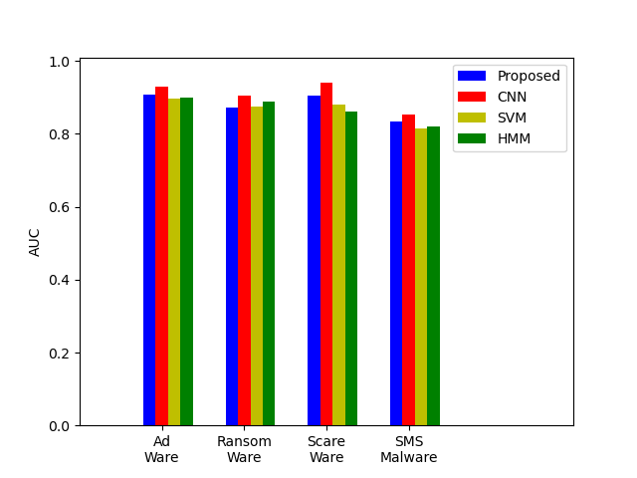
Compare Experiment
Purpose
To study the performance comparison between the proposed method and other supervised learning methods
Setup
Three methods are compared: CNN structure proposed by Wang et al, SVM and HMM.
The backbone neural network structure used in our method is the same as the CNN structure proposed by Wang et al.
Result
Compared with traditional machine learning algorithms, Our method achieves suboptimal performance under most categories.

Slide 20
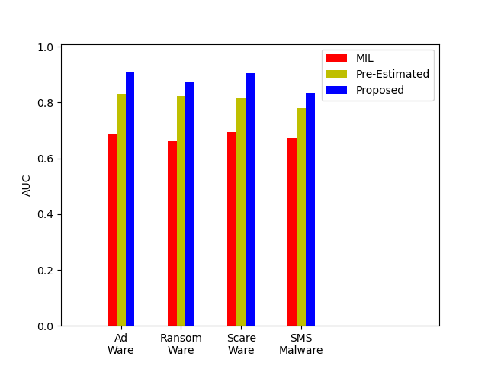
Ablation Experiment
Purpose
In order to study the influence of different parts in the proposed method
Setup
Add the pre-estimated method and adjustment function for positive instances to MIL model one by one
Result
Each part of our method works well.

Slide 21
PART
FOUR
Summary and Prospect

Slide 22
Summary and Prospect
Summary
We try to explore a malicious traffic detection method under weakly supervised learning.
We modeled malicious traffic detection as multi-instance learning problem.
A pre-estimation and dynamic adjustment method for positive score is proposed to solve the imbalance problem.
Every part works well.
We achieved suboptimal performance.

Slide 23
Summary and Prospect
Prospect
Try some more cutting-edge models as the backbone models.
Study the influence of distribution and correlation across multiple instances in a bag.
Call for more work to turn to the weakly supervised learning field.

Slide 24
THANKS

