Slide 1
e-Science Activities at IHEP/China
Gang Chen
With helps of Xuantong Zhang and Fazhi Qi IHEP, CAS
ISGC2022
March 23, 2022

Slide 2
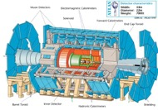
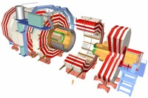
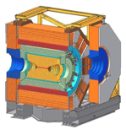
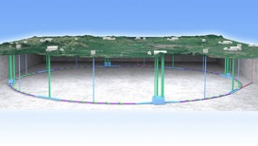
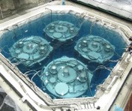
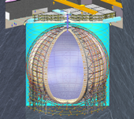
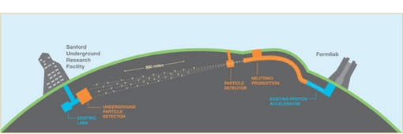
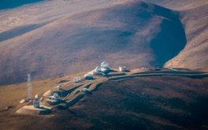
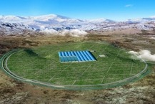
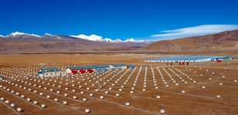
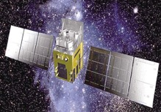
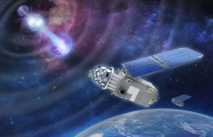
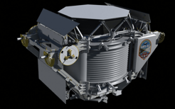
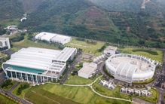
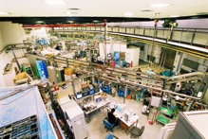
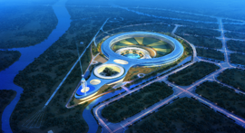
HEP Related Projects
Accelerator based particle physics
ATLAS
BESIII
CEPC
CMS
BELLE II
Neutrino experiments and CMB telescope
DYB
AliCPT
JUNO
DUNE
Cosmic ray and astrophysics experiments
AS𝛾
HXMT
GECAM
AMS02
LHAASO
BSRF
Neutron Source and Synchrotron Radiation Facilities
CSNS
HEPS

Slide 3
Science Facilities & Sites of IHEP
HEPS
IHEP, BEPCII/BESIII
BSRF
IHEP
Jinan Branch
AliCPT
AS𝛾
LHAASO
IHEP
Dongguan Branch,
CSNS
JUNO

Slide 4
Data Challenges @IHEP
BEPCII/BESIII: Running, up to 2030
LHAASO，CSNS (neutron source)，Running
JUNO: data taking from 2023
HEPS (photon source): data taking from 2025
ATLAS, CMS, LHCb, Belle II, …
~ 7 PB/year new data now
> 200 PB/year expected from 2025, when HEPS is operational
HTC for particle experiments
HPC for theoretic physics, neutron source and photon source

Slide 5
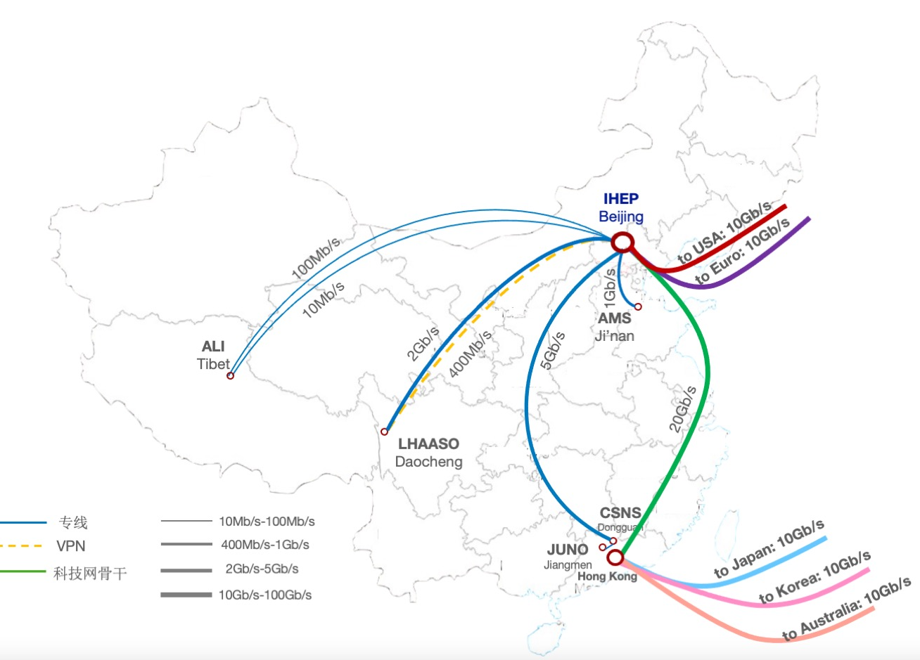
Domestic and International Links
Dedicated links for remote sites
10Mbps to 2Gbps
Some will be upgraded to 5Gbps and 100Gbps soon
International networks
IHEP-Europe: 10 Gbps + 10 Gbps
IHEP-USA: 10 Gbps + 10 Gbps
~33 PB data exchange in 2021
LHCONE
Peering to ESNet, Internet2, GEANT were established
All the LHCONE peers are finished

Slide 6
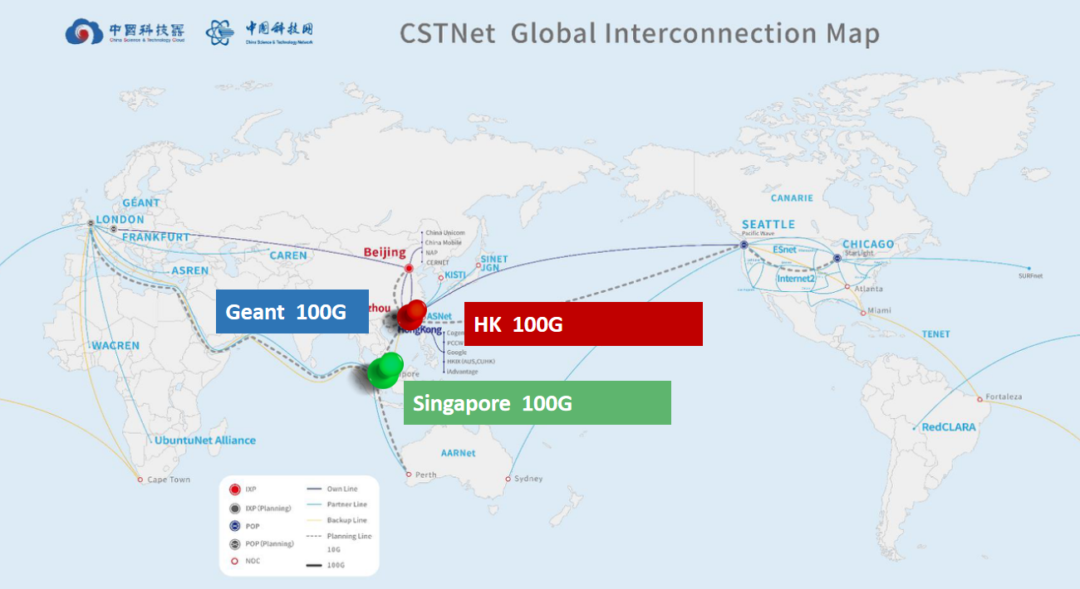
Plan: 100G global interconnection is coming (CSTNet)

Slide 7
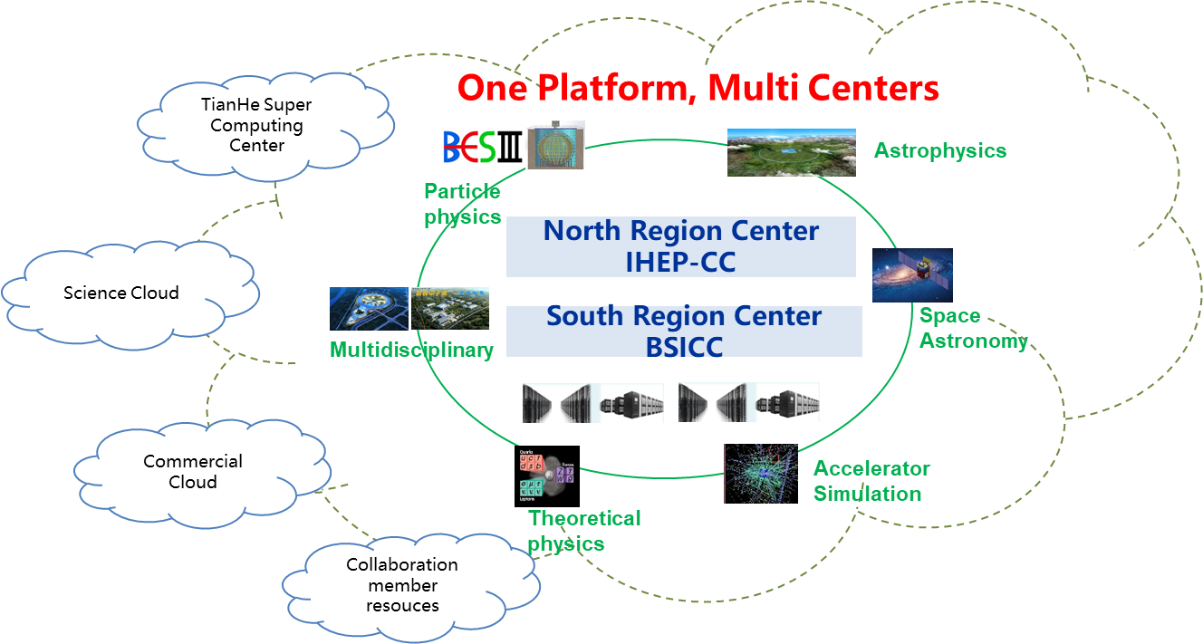
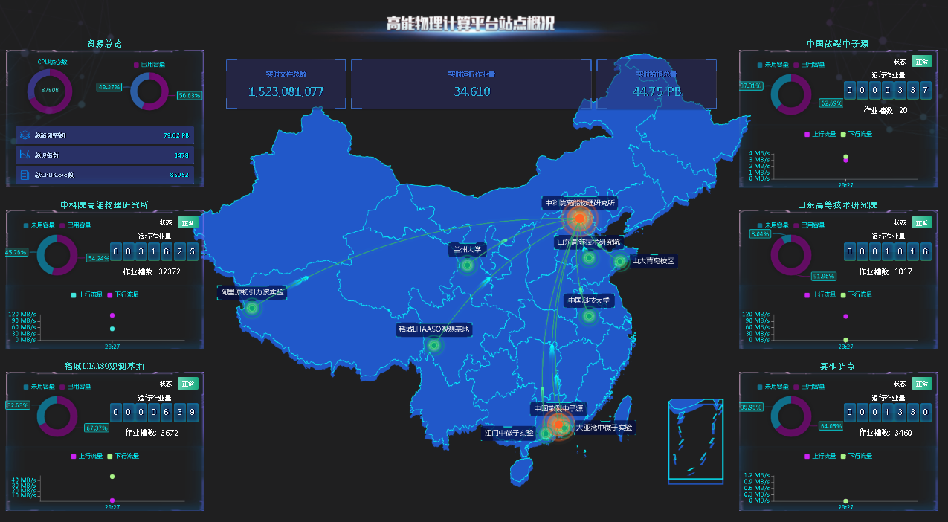
One Platform, Multi Centers (1/2)
The main strategy of IHEP-CC
A integrated platform serves the computing demands of different research fields.
particle physics, theoretical physics, space astronomy, ray science, and accelerator design
Access resources with as little change of user habit as possible.
Two main regional centers
Beijing
Dongguan, partly sponsored by local government
Several satellite sites in China
Experiments’ onsite resources.
For fast data processing.
CC from Collaboration members.
Shandong Univ., Univ. of Science and Technology of China, Lanzhou Univ. etc.).
On-demand resources, commercial clouds and super computing centers.

Slide 8
One Platform, Multi Centers (2/2)
Current Status
Resource of two main regional centers
OMAT, a Monitor tool, is developed and deployed to collect sites running status.
The solutions for computing and storage integration is undergoing
LHAASO simulation jobs from IHEP-CC (Beijing) HTC Cluster have been dispatched to BSICC (Dongguan) HPC cluster.
Xcache & EOS remote replica are being studied.
Token-based authentication and authorization are being studied.
 | CPU | GPU card | Disk | Tape | Network
Beijing IHEP-CC | 43,000 Intel-x86 | 200 Nvidia V100 | 72 PB | 41 PB | 40Gpbs Internet connection 400Gpbs internal connection
Dongguan (Big Scientific and Intelligent Computing Center) | ~20,000 intel-x86; ~10,000 arm | ~100 Nvidia v100 | 6PB | --- | 5Gpbs Internet connection 400Gpbs internal connection

Slide 9
Slurm Cluster in Beijing
CPU apps
8 apps.
176K jobs.
13M CPU hours.
GPU apps
7 apps.
223K jobs.
513K GPU hours.
Notes:
Here is the Slurm cluster status at IHEP-Beijing. We did about 400K jobs for CPU and GPU applications in total. Right figures are our Jobs and consumed hours distribution in this half year.

Slide 10
Federated Slurm Clusters in Dongguan
To share apps & resources between Slurm clusters at Dongguan.
Slurm federation founded at Dongguan, two cluster members.
Sharing same user authentication system & storage system.
User jobs can be submitted to any member clusters.
Cluster | CPU | GPU
CSNS | 5.7K intel x86_64 | 8 NVIDIA P100
BSICC | ~20K arm | 80 NVIDIA V100
CSNS Cluster
Jobs
Dongguan Data Center Cluster
Job Replica A
Job Replica A’
、
slurmd
Worker node
Login node
Login node
Worker node
Scheduler node
Database node
slurmdbd
Scheduler node
Database node
slurmdbd
Notes:
We founded a Slurm federation at IHEP-Dongguan Division to share applications and resources to each other. Between CSNS and Dongguan Data Center, we share same user authentication and storage system. User jobs can be also submitted to either cluster.

Slide 11
Grid Sites: WLCG & DIRAC
Resources and operation:
Updates:
572 cores added for LHCb last year.
Dongguan computing resources joined in JUNO DIRAC.
 | ATLAS | CMS | LHCb | BelleII | JUNO
CPU cores | 444 | 444 | 1,680 (572ꜛ) | 576 | 576
Storage | 400TB | 684 TB | 378 TB | 280 TB | 2000 TB
Jobs | 150k | 3,691K | 642K | 125K | 104K
CPU times | 1,251k hours | 1,372K hours | 4,747K hours | 902K hours | 178K hours
Upload | 520TB | 135 TB | 2590 TB | 575 TB | 227 TB
Download | 425TB | 514 TB | 85 TB | 40 TB | 51 TB
Notes:
Here is the WLCG and DIRAC sites resources and operation status at IHEP. Detailed data are shown in tables. For LHCb, 572 new cores were added in several days ago. BSICC joined as a flexible computing site in JUNO DIRAC.

Slide 12
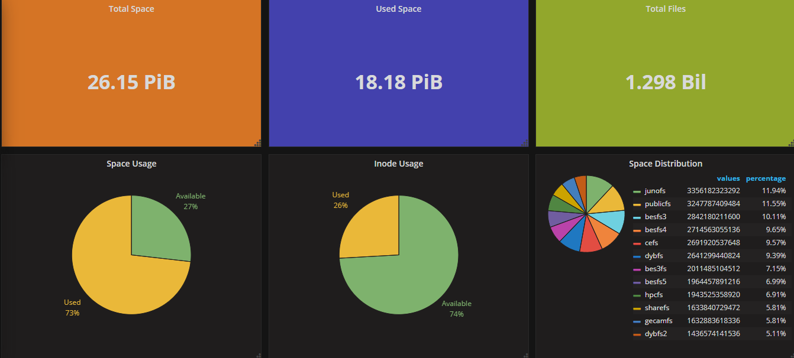
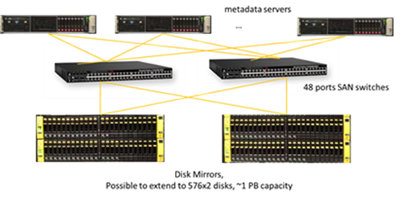
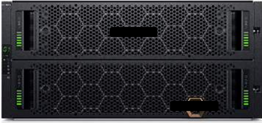
Disk Storage: Lustre
Software: community Lustre (2.12.6).
MDT: 2 mirrored HP 3PAR full SSD disk arrays.
OST: DELL MD 4086/HUAWEI OCEANSTOR,
with 8TB/10TB/12TB/14TB SATA disks.
19 instances, 15 experiments and services.
Average read: 12 GB/s, write: 457 MB/s, metadata ops: 22k.
Peak read: 24 GB/s, write: 2 GB/s, metadata ops: 134K.
Notes:
For the Lustre storage status. We use HP SSD disk arrays for MDT and DELL and HUAWEI SATA disk for OST. Lustre has 19 instances serving 15 experiments and services. It can reach 24 GB/s for peak reading, 2 GB/s for peak writing and 134K for peak Metadata OPS (Orbeon Presentation Server).

Slide 13
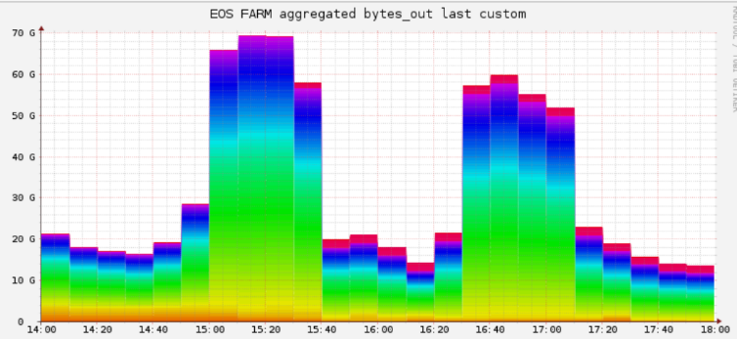
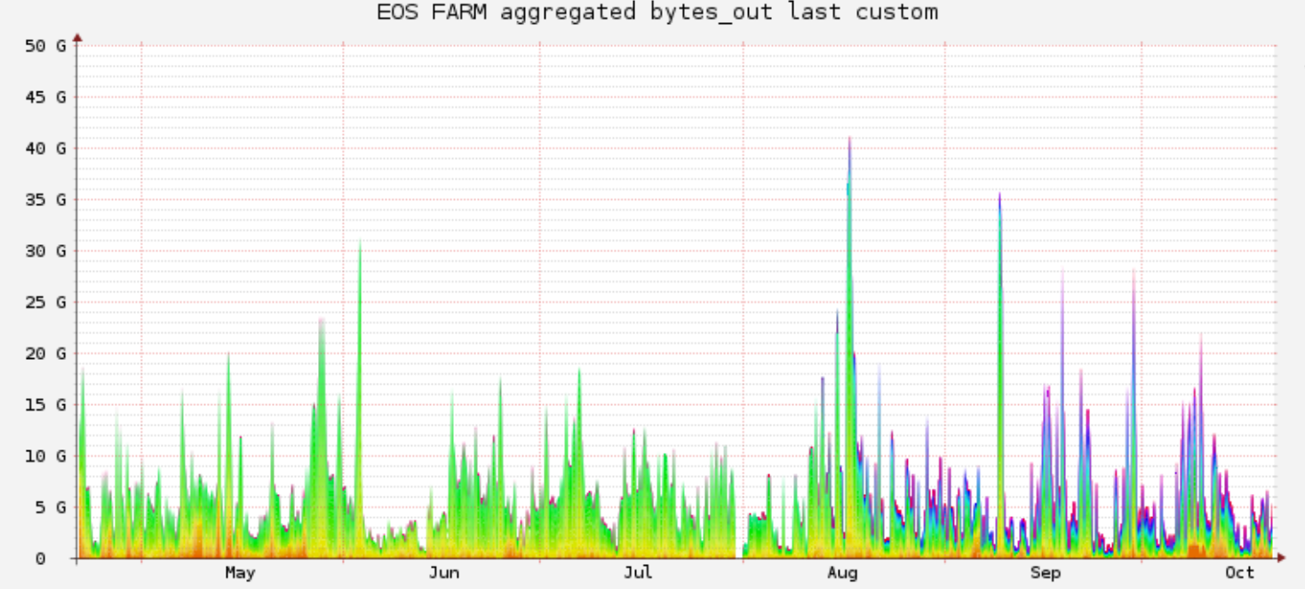
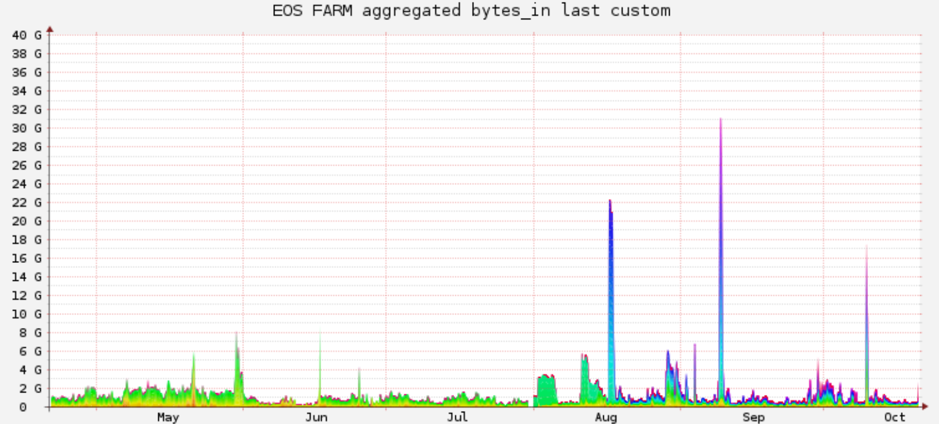
Disk Storage: EOS
5 instances, 4 experiments and public services.
Average read: 3.06 GB/s, write: 1.04 GB/s.
Peak read: 70 GB/s, write: 31 GB/s.
Peak Read Performance
Instance | LHAASO | Daocheng | Public | HXMT | JUNO
Version | 4.8.40 | 4.8.48 | 4.8.40 | 4.8.40 | 4.8.40
Usage | 14.55/35.72(PB) | 2.89/4.37(PB) | 128/200(TB) | 565/806(TB) | 1.1/2.94(PB)
# fst | 81 | 12 | 5 | 2 | 8
Notes:
Here is the EOS storage status. We have 5 EOS instances for 4 experiments and public services. This table shows the detailed information of those instances. EOS storage at IHEP can reach 70 GB/s for peak reading and 31 GB/s for peak writing.

Slide 14
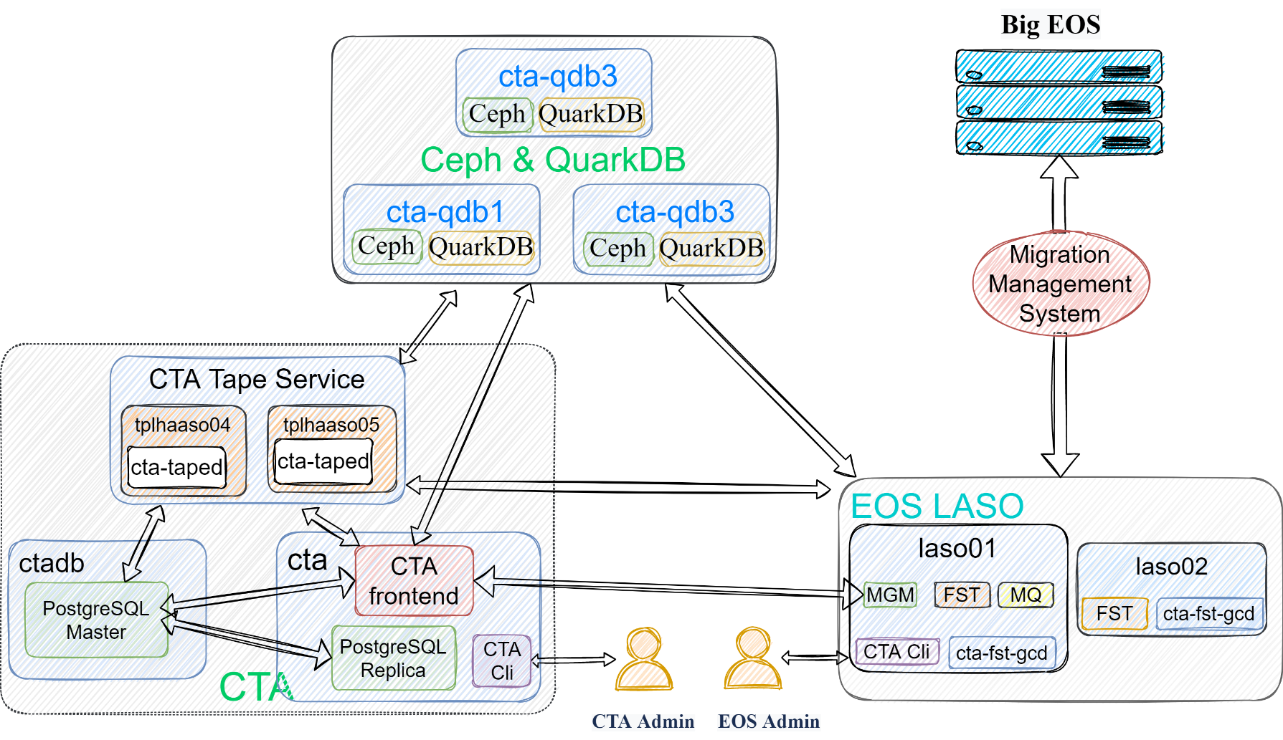
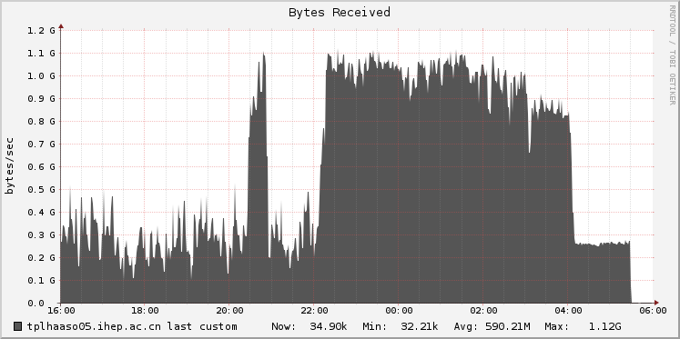
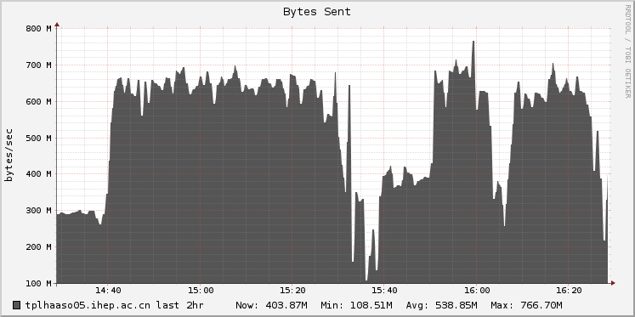
Tape Storage: CASTOR and EOSCTA
During 6 months, 1.92 PB raw data saved in CASTOR (2 copies).
Performance evaluation of EOSCTA
Configuration
1 tape server with 4 LTO7 drives
2 eos nodes with 25Gb/s NIC and 12 HDDs
CTA 4.2.1 + EOS 4.8.45 + Ceph 14.2.20 + PostgreSQL 9.6
Archive & Retrieve
18k files up to 13 TB in total
Archive speed up to 1.2 GB/s, Retrieve speed up to 0.8 GB/s
Migration Plan
New data archived to EOSCTA for LHAASO & BESIII this year
Data migration from CASTOR1.7 to EOSCTA will be started at early 2022
BESIII: 3.18 PB data 2.6M files will be migrated, LHAASO: 5.0PB data 6.39M files will be migrated.
all the LTO 4 tapes will be upgraded to LTO 7 tapes simultaneously.

Slide 15
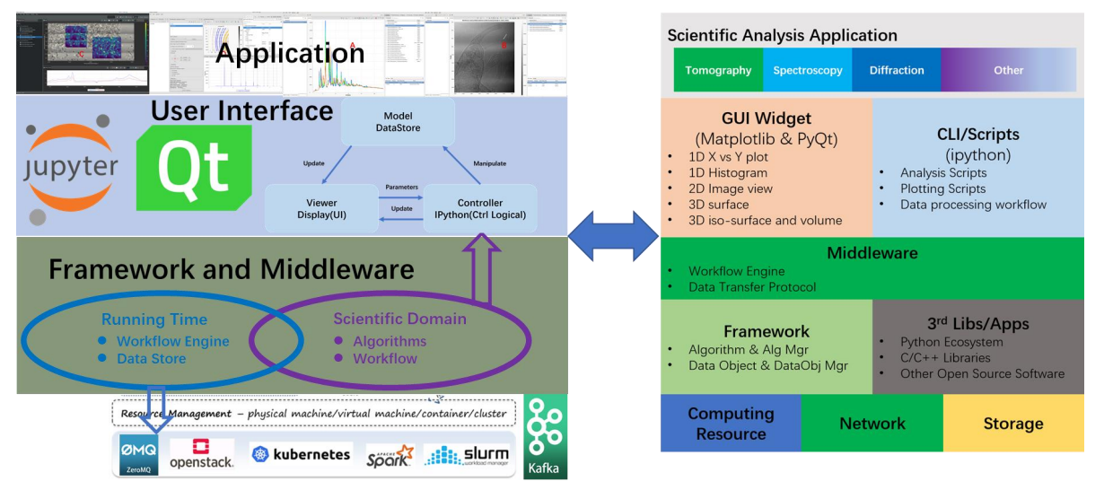
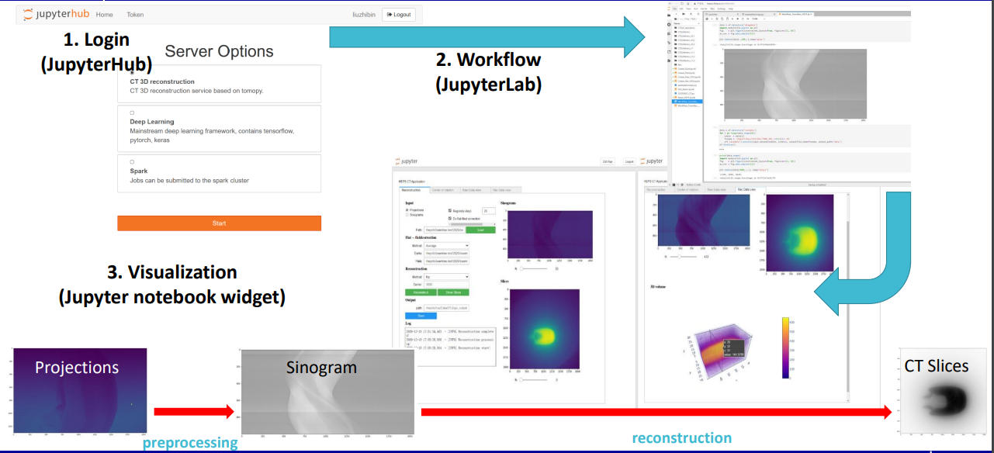
HEPSCC
High Energy Photon Source (HEPS), will be in production in 2025;
Computing & Communication system (HEPSCC)
Network, Computing, Storage, Data analysis framework, Data management, Database & Public Service , Monitoring, Security.
Progress of R&D for HEPSCC system
Computing
Docker+K8S+JupyterHub, supporting multi-core CPU and GPU.
Integrate with data analysis framework, deploy docker image.
Data management system
Metadata catalogue: API server + MongoDB.
Data transfer: full path data transfer with ACLs of files
and folders.
Data analysis framework
Develop IDE and user GUI base on PyQt.
Integrate methods and algorithms: Tomopy, UFO, pyFAI.
Provide data visualization and analysis based on Jupyter notebook Widget.

Slide 16
Conclusions
Computing system has been expanded in the last two years to accommodate more applications.
Big challenges for photo source: main focus of our work
R&D for the new demands from future experiments and challenges.
Regional collaborations are important.

Slide 17
Thank you

