Slide 1
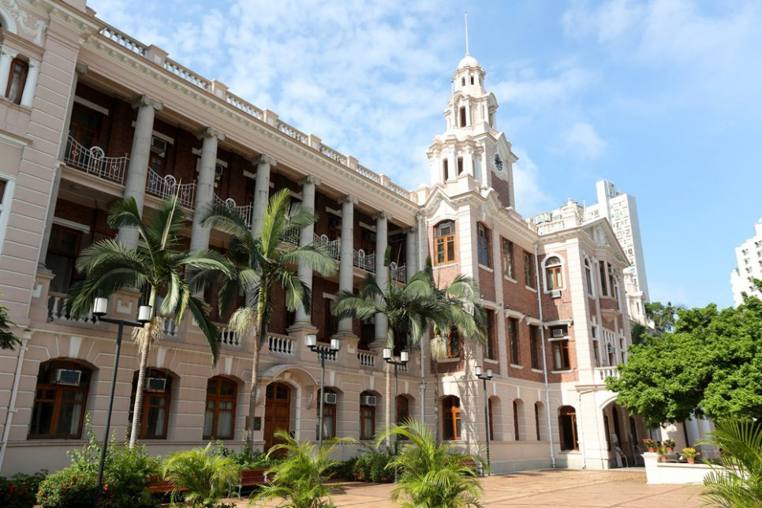
HKU Grid Certificate Authority (HKU Grid CA)
Self Audit & Status Report
Mar 24, 2022

Slide 2
Operating Organization
HKU Grid CA ~ Classical offline CA operates since 2009
CA Manager
Lilian CHAN
Examines subscriber’s information
Approve CA and RA operator to operate affairs
RA Operator
CA Operator
Helpdesk
Accept subscribing request
Check subscribers’ information and approve them
Operate and maintain the CA signing server & CA web server
Manage CA private key and its copy
Operate CA tasks: issue/revoke/re-key certificate and issue CRL
Update CP/CPS, operation manuals and security documents
Help users related to HKU Grid CA operation
Lilian CHAN
Bill YAU, Juilian YEUNG
Lilian CHAN, Bill YAU

Slide 3
Issued Certificates
(As of 23rd March, 2022)
HKU GridCA 2 | User Certificates | Valid | 2
 |  | Expired/Revoked | 16
 | Host Certificates | Valid | 26
 |  | Expired/Revoked | 83
The previous root certificate “HKU GridCA” retired in 2019.
Physical machine are disposed, but the hard disks are stored in safe location. Planned to be destroyed 3 years after retirement (due in a few months time).

Slide 4
Materials Used for Auditing
Guidelines for auditing Grid CAs version 1.1
Relevant IGTF Authentication Profile version 5.0
HKU Grid CA CP/CPS v3.0 (RFC 3647)
CA Repository:
http://ca.grid.hku.hk/
CA Certificate, CRL, End-Entity certificates
Document published on the web repository:
Certificate application procedure
Certificate renew and revocation procedure
HKU CP/CPS
OID: HKUITS.2.1.3.0, HKUITS.2.2.3.0
(v3.0, 9Feb2018)
OID Prefixes: HKU=1.3.6.1.4.1.30850
HKUITS=HKU.2.2.40000
IGTF=1.2.840.113612
IGTF Authentication Profile
OID: IGTF.5.2.2.1
(v5.0, 20160510)
CEDAR OID: IGRF.5.2.5.3 as defined in
IGTF Levels of Auth Assur.
OID: IGTF.5.2.6.1
(v1.1-2016)
IGTF PKI Tech Guidelines OID: IGTF.5.2.7.1
(v1.1-2016)
Guideline on Priv Key Protection
OID: IGTF.5.1.1.1.5
(v2.0 -2014)
OSG GWD-R.225 (July 2016)
(supersedes GFD.125)
Checklist derived as updated version of GFD-1.169 Guidelines for auditing Grid CA
Footnote: GFD-1.169 is at v1.0 but the checklist in Excel form was updated and called “v1.1”

Slide 5
Operation Inspection Items
CA room
Located in HKU ITS server room.
Access restricted to authorized persons and all events are recorded.
RA and CA machines
Both are running on dedicated machines.
CA signing machine is dedicated to CA operation and is completely offline.
Backup media of the CA private key and its place
Media storage of archived logs and other documents and their place
Locked in safe deposit box which is located at another room where access control is restricted.
Logs of RA and CA servers
Records of operation of the RA and CA
Access log on the CA room

Slide 6
Summary of Self Audit Result
Score A (Good) | 61
Score B (Minor Change) | 0
Score C (Major Change) | 0
Score D (Must Change) | 0
Score X (Could not evaluate) | 0
“Obsoleted Items” (per the checklist) | 6

Slide 7
Thank You

