Slide 1
Building a PaN analysis platform using EOSC
The PaN Cluster in EOSC Future
Presenter: Patrick Fuhrmann
Work done by: Paul Millar, Gianluca Santoni (ESRF), Colleagues from EGI and Michael Schuh and Tim Wetzel
ISGC 2023, Taipei, 2023 – 03 - 24

Slide 2
Plan for today
Science Clusters in Europe
Science clusters and the EOSC
The Photon and Neutron Community
EOSC Future
PaNOSC/ExPaNDS
Photon Science science projects
VISA
Science pipeline (data and analysis)
DEMO

Slide 3
The full landscape aka How it began
2019
2020
2021
2022
2023
2024 +++
Science Clusters
OSCARS
EOSC INFRA 2023 01 01
Environmental research
Social Sciences and Humanities
Life sciences (ELIXIR)
Astronomy and Particle Physics
Photon and Neutron Physics

Slide 4
The five European science clusters
ENVRI-FAIR for environmental research
ENVRI-FAIR will implement the ENVRI-hub - a virtual, federated machine-to-machine interface to access environmental data and services provided by the contributing RIs. The complete set of thematic data services and tools will be incorporated into the EOSC service catalogue, through the EOSC-hub Marketplace.
ESCAPE for astronomy and particle physics
ESCAPE brings together ESFRI facilities of astronomy, astroparticle & particle physics into a single EU collaborative cluster. Plus, it will create a cross-border & multi-disciplinary environment that will benefit EOSC thanks to the management of extremely large data volumes at the multi-exabyte level. It will also support “scientific software” as a major component of RI data to be preserved and exposed in EOSC through dedicated catalogues.
SSHOC for social sciences and humanities
SSHOC aims to provide an open cloud for social sciences and humanities where data, tools, and training are available and accessible for users. This open cloud aims to be a part of the EOSC. The consortium covers the whole data cycle, from data creation and curation, to optimal data reuse, and can address training and advocacy to increase actual reuse of data.
EOSC-Life for life sciences
EOSC-Life brings together biological and medical RIs to create an open collaborative space for digital biology. It aims to publish FAIR life science data resources for cloud use creating an ecosystem of innovative tools in EOSC and enabling groundbreaking data-driven research in Europe by connecting life scientists to EOSC.

Slide 5
The Photon and Neutron Science Cluster
PaNOSC/ExPaNDS for multidisciplinary scientific analysis
PaNOSC/ExPaNDS will help the Photon and Neutron facilities to adopt and implement data management, simulation and analysis services, and to make their open data available to the EOSC. It will work closely with EOSC-hub partners to integrate general-purpose distributed computing and data management solutions and promote its products through the EOSC Portal.

Slide 6
EOSC-Future Cheat Sheet
Call H2020: H2020-INFRAEOSC-2020-2
Coordinator: Technopolis Consulting Group
Number of partners : 34
Total Amount funding: 40,877,088.83 Euros
Timing: started 2021 - April,1 … for 30 months … 2023 – Sep, 30

Slide 7
The EOSC Future Ambition
EOSC Future will work with key stakeholders to ensure a smooth user experience, developing:
EOSC core, the set of enabling services needed to operate the EOSC
EOSC exchange registering resources and services from research infrastructures, other EOSC projects and science clusters to the EOSC and integrating them with the EOSC core functionalities
The EOSC interoperability framework will provide guidelines for providers that want to integrate services or data into EOSC

Slide 8
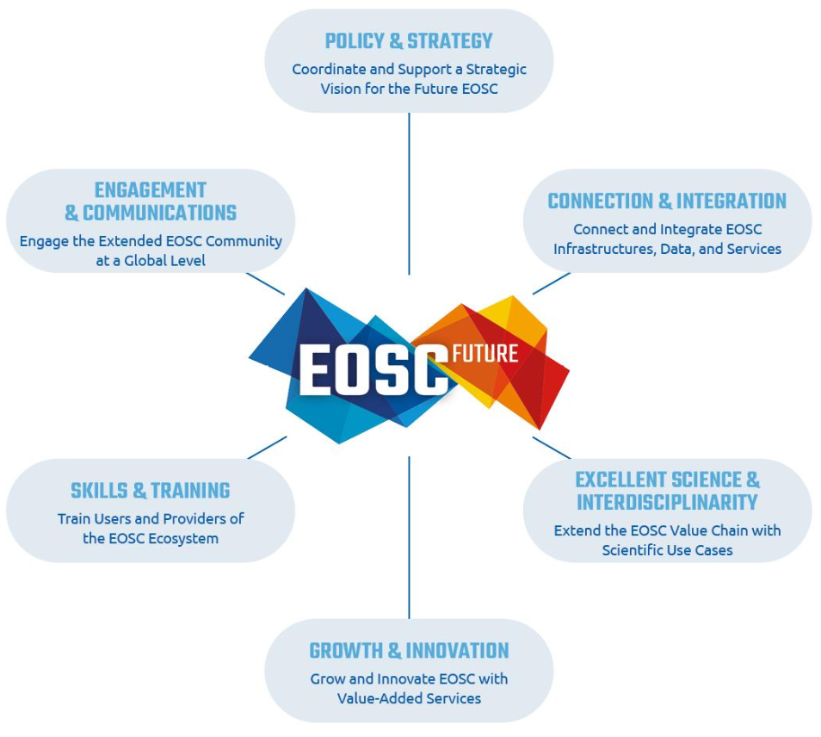
EOSC Future WP Structure
WP1 : Project Management
WP2 : Project Strategy and EOSC Alignment
WP3: Architecture and Interoperability
WP4: Design and Development of Portal Supply Layer
WP5: Design and Development of Portal Demand Layer
WP6: Integration of Community Services and Products into EOSC
WP7: EOSC Service Planning and Delivery
WP8: Commercial Services
WP9: Training and skills
WP10: Stakeholder engagement
WP11: EOSC Marketing and Communications

Slide 9
EOSC Future WP6 Objectives
The objectives of WP6 are threefold, as reflected in the three tasks it contains:
To coordinate and implement the pipeline which populates the EOSC with Providers and their Resources
Services
Data sets and
other research products.
To improve the offerings of Providers (including scientific communities) in EOSC by integrating their Resources into the EOSC-Core functions.
To bring together research communities from the scientific clusters with each other and with the EOSC Portal and EOSC-Core and validate the EOSC vision through Test Science Projects which highlight added value, multidisciplinary and composability of EOSC Resources. This WP populates, connects and supports both the supply and the demand use sides of the EOSC, ensuring there are valuable resources to empower digital research in Europe

Slide 10
EOSC-Future Science Projects
Prepared ahead of project start :
ESCAPE:
Dark Matter Science Project
Extreme Universe and Gravitational Waves
PANOSC/ExPaNDS:
Tracing Bio-Structures
Dynamics of biological processes
…. Others

Slide 11
Diving into a Photon and Neutron Science Project!

Slide 12
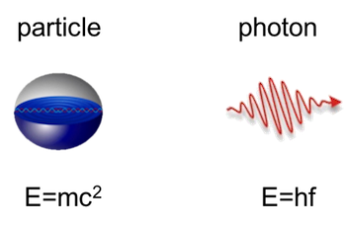
What is the photon and neutron community about?
Interacts with the Nucleus
Interacts with the Electrons in the hull

Slide 13
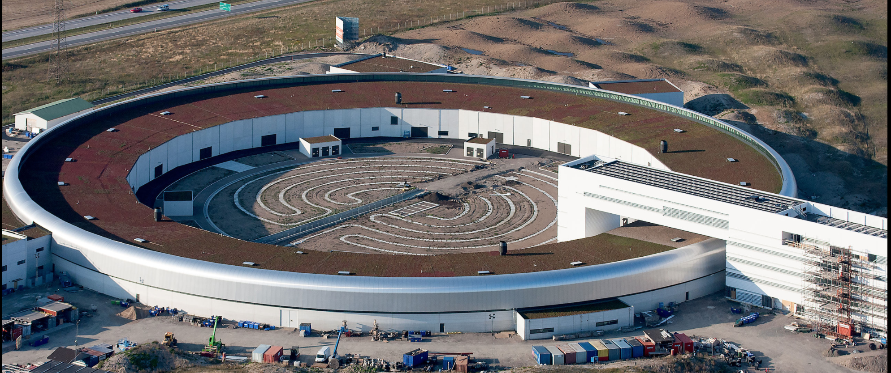
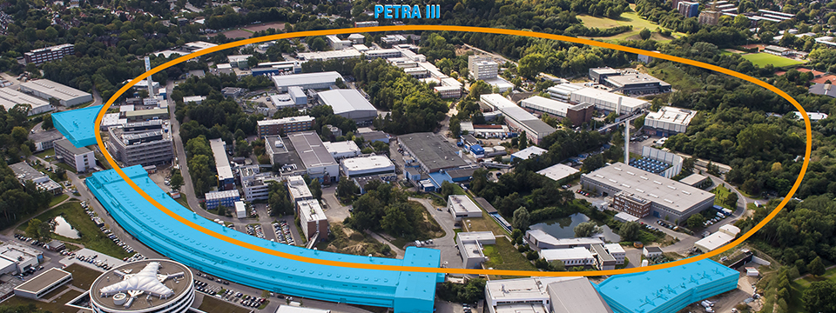
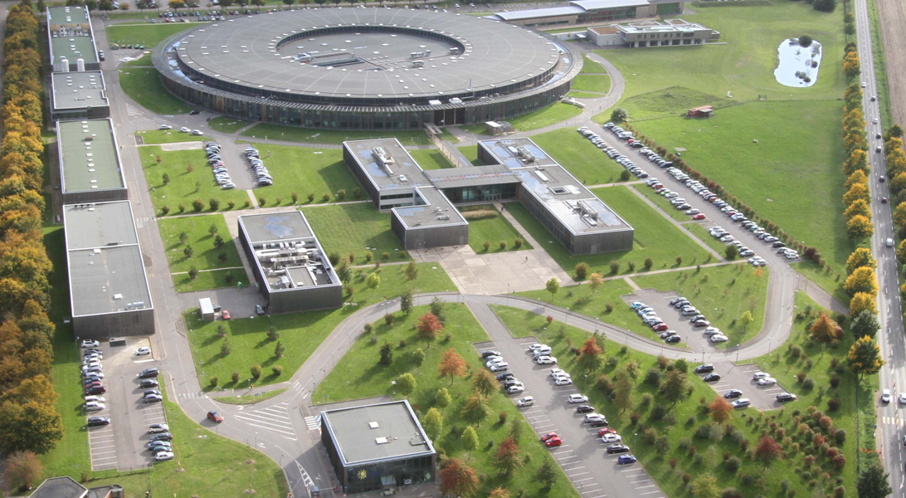
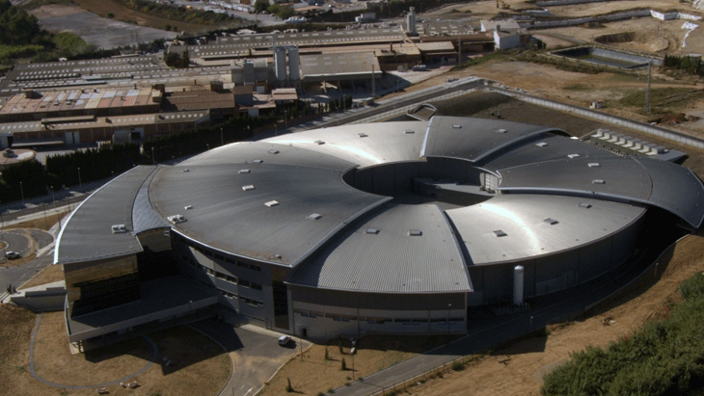
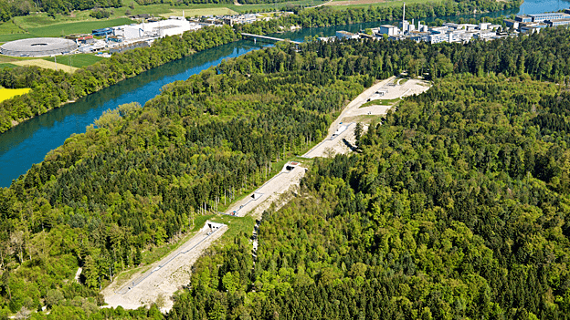
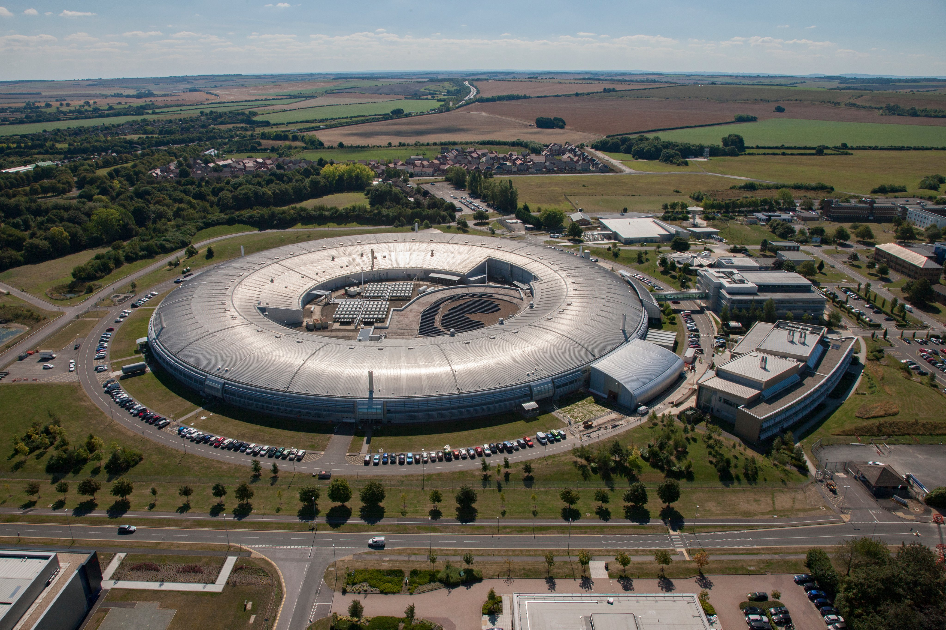
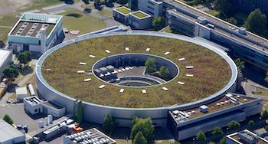
This is how our falicities look like!
Petra III
Max IV
SOLEIL
HZDR
ALBA
SwissFEL
Diamond
Bessy , HZB

Slide 14
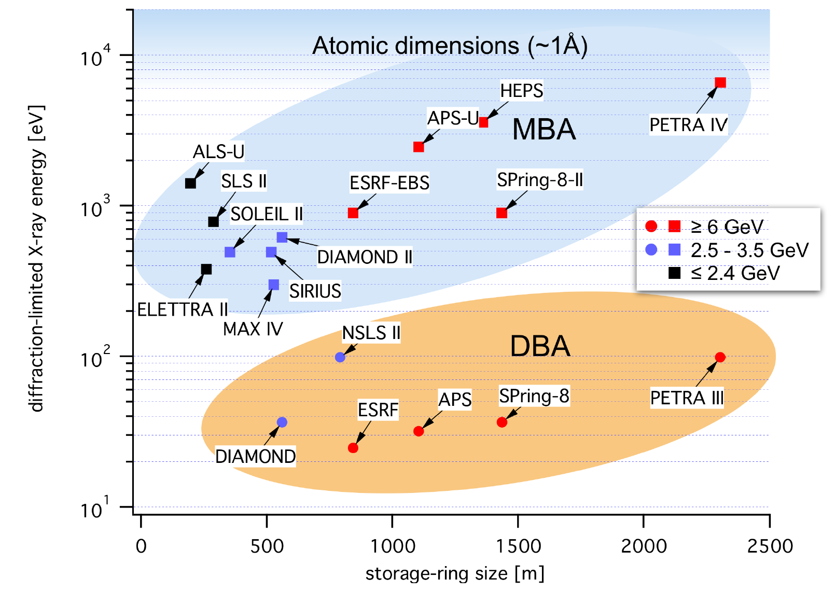
Photon facility upgrade program
Significant investment worldwide.
BNL
Argonne
PSI
JP
Soleil
BNL
JP
Argonne

Slide 15
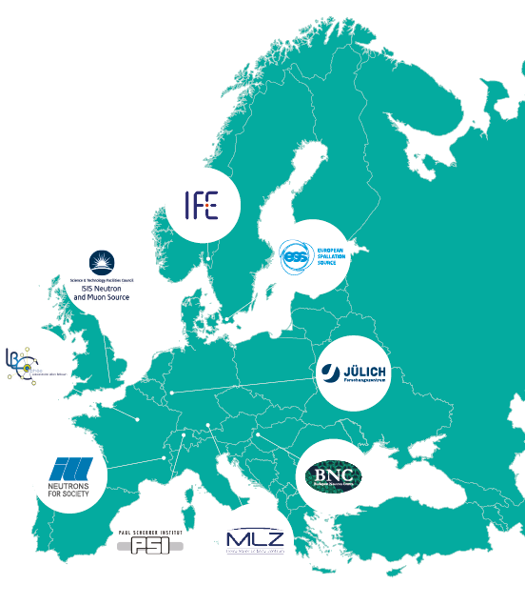
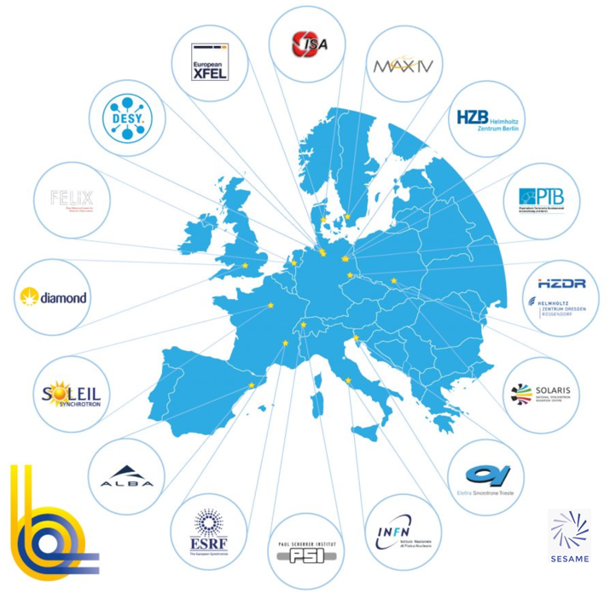
The Photon and Neutron community by PaNOSC and ExPaNDS
Photon (LEAPS)
Neutron (LENS)
More than 45.000 researchers

Slide 16
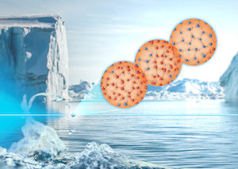
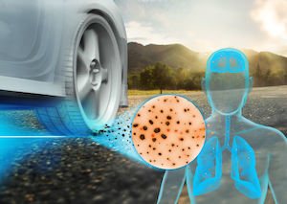
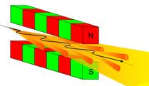
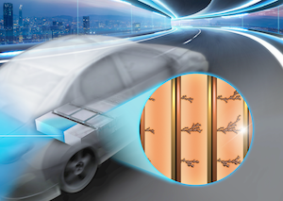
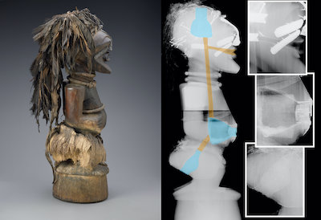
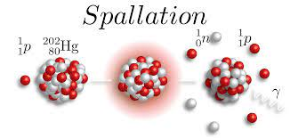
Photon / Neutron Science generation and techniques
Beam Generation
Instrument Technique
Domain Science
With high significance for bringing society forward.
Bendering
Full field tomography
Single crystal X-ray diffraction
Serial crystallography
Undulators
Role of Water
Ptychography
Small angle X-ray scattering
Fine Dust
Reactors
Ba
n
Neutron diffraction and tomography
n
U²³⁶
n
Battery
Kr
n
Reflectometry
Spallation
Terahertz spectroscopy
Superconductors
Scanning electron imaging
Cultural Heritage
And many more .......
Stolen from Petra IV TDR.

Slide 17
Two projects in preparation of the EOSC Future Science Projects
High level objective was to make Photon and Neutron data FAIR, use EOSC core services and integrate Photon and Neutron analyis pipelines and catalogues into the EOSC.
 | PaNOSC | ExPaNDS
Call | INFRAEOSC 04 | INFRAEOSC 5B
Budget | 12 M Euro | 6 M Euro
Number of Partners/Facilities | 1 ERIC / 5 ESFRI + EGI | 10 National + EGI
Start | 2018-12-01 | 2019-09-01
End | 2022-11-30 | 2022-08-31 / 2023-02-30
Target facilities | European/ESFRI | National

Slide 18
PaNOSC/ExPaNDS high level objectives
Catalogue Services
Analysis Services
Bio Portal
by NCBO
PaN Training
B2FIND
Open AIRE
PaN Portals
EOSC
Portal
Federated
Services
Doc’s
Metadata and Data
Notebooks
Horizontal
Infrastructure
Moodle
SciCAT
Other
K8/VMs
Notebooks
iCAT
Batch
FAIR
Activities
Ontologies for use in catalogues and data sets (NEXUS)
Consultation
Data Policies and DMP’s (21 data policy key elements)
EGI
PaN Research Infrastructures

Slide 19
PaN facilities NG
PaN
Search
API
Remote
Access
(e.g. VISA)
OAI-PMH
Open Data
Portal
OAI-PMH
Search
API
P
MetaData
Portal
Proposal
Portal
Remote
Desktop
SLURM
Jupyter
P
Meta-Data
Catalogue
Proposals
&
People
Data
Compute Resources
PaN Facility
NG

Slide 20
Architecture of the EOSC Future Data Transfer Service
Courtesy: EOSC Future WP3: The EOSC Interoperability Framework

Slide 21
PaN analysis and the EOSC
Domain
Services
Core
Services
Domain
Data
File Transfer
Analysis Facility
Storage
Facility

Slide 22
Starting with finding my data ?

Slide 23
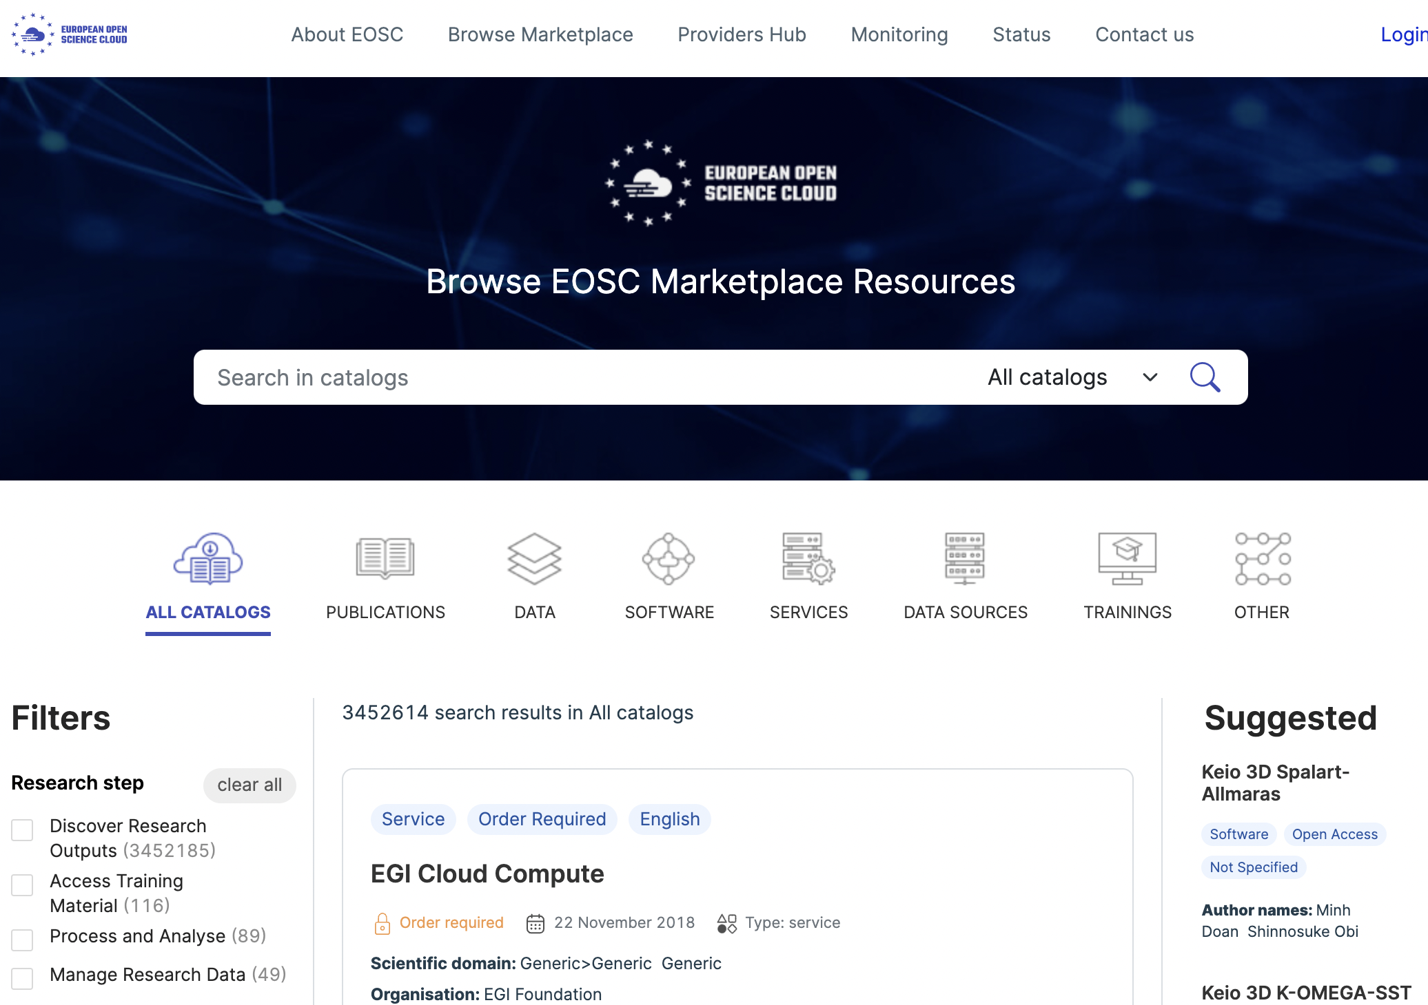
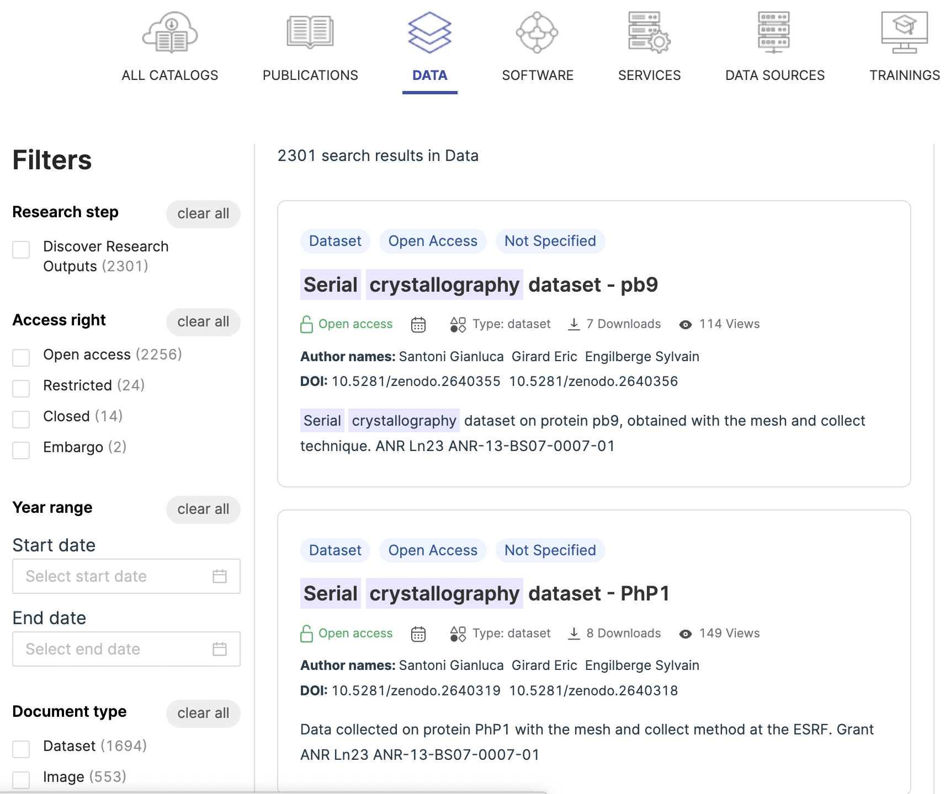
Find your data in the EOSC Marketplace
Search: Serial Crystallography
Serial Crystallography .
Zenodo DOI

Slide 24
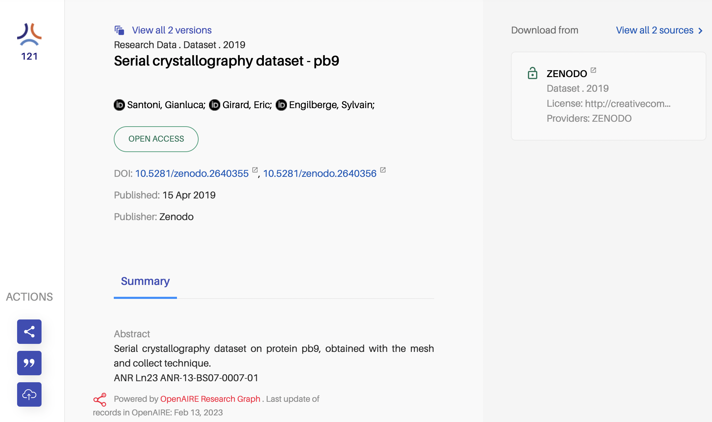
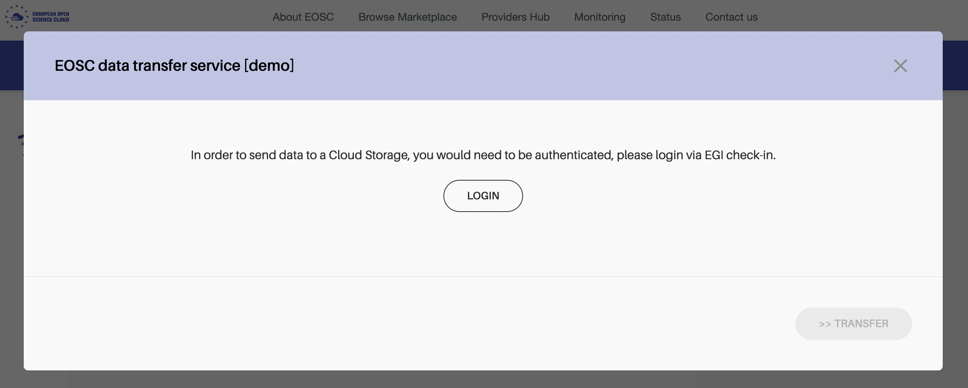
Prepare and transfer the datasets
Send data to
Cloud Storage

Slide 25
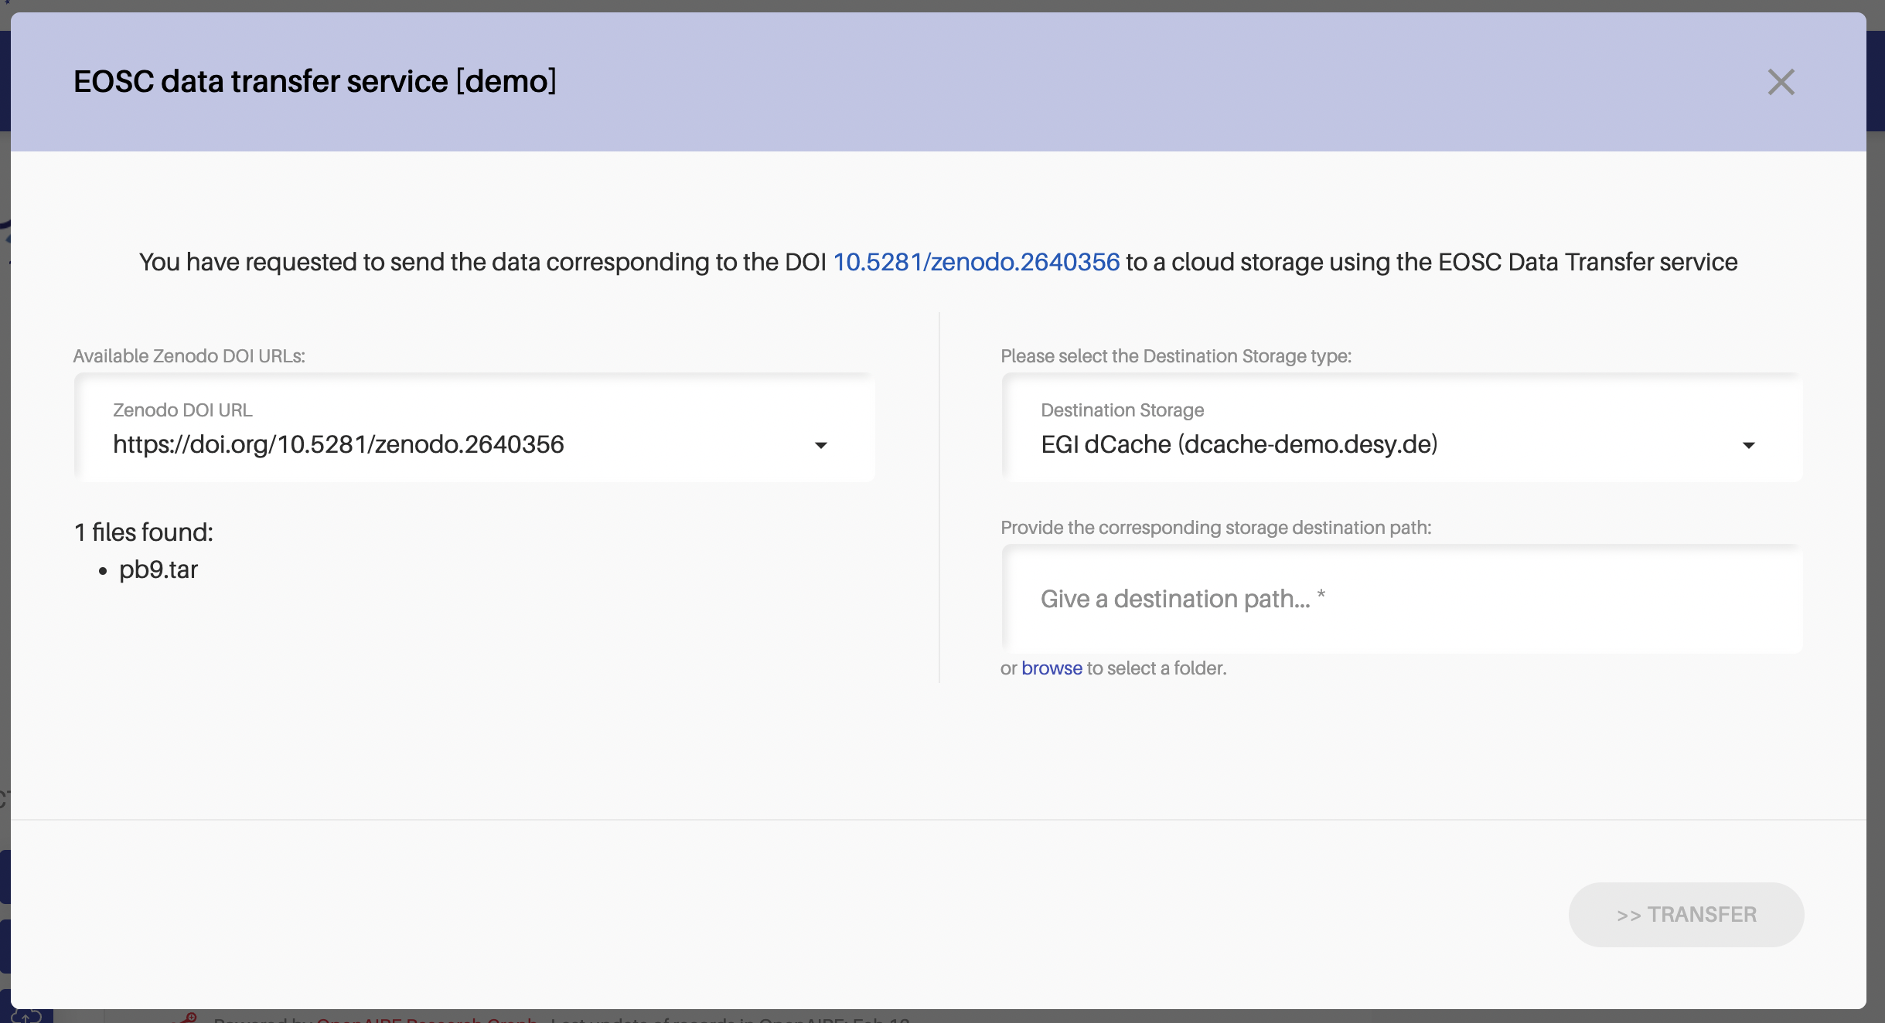
Specify the data transfer parameter
Destination
Site
Destination
Path
Source DOI

Slide 26
Find the infrastructure and prepare the pipeline!

Slide 27
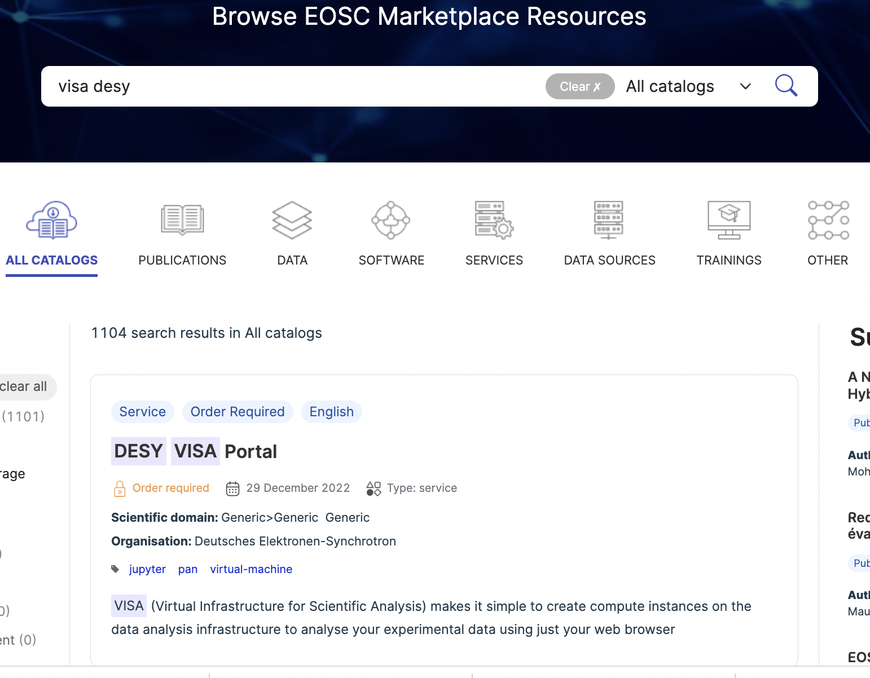
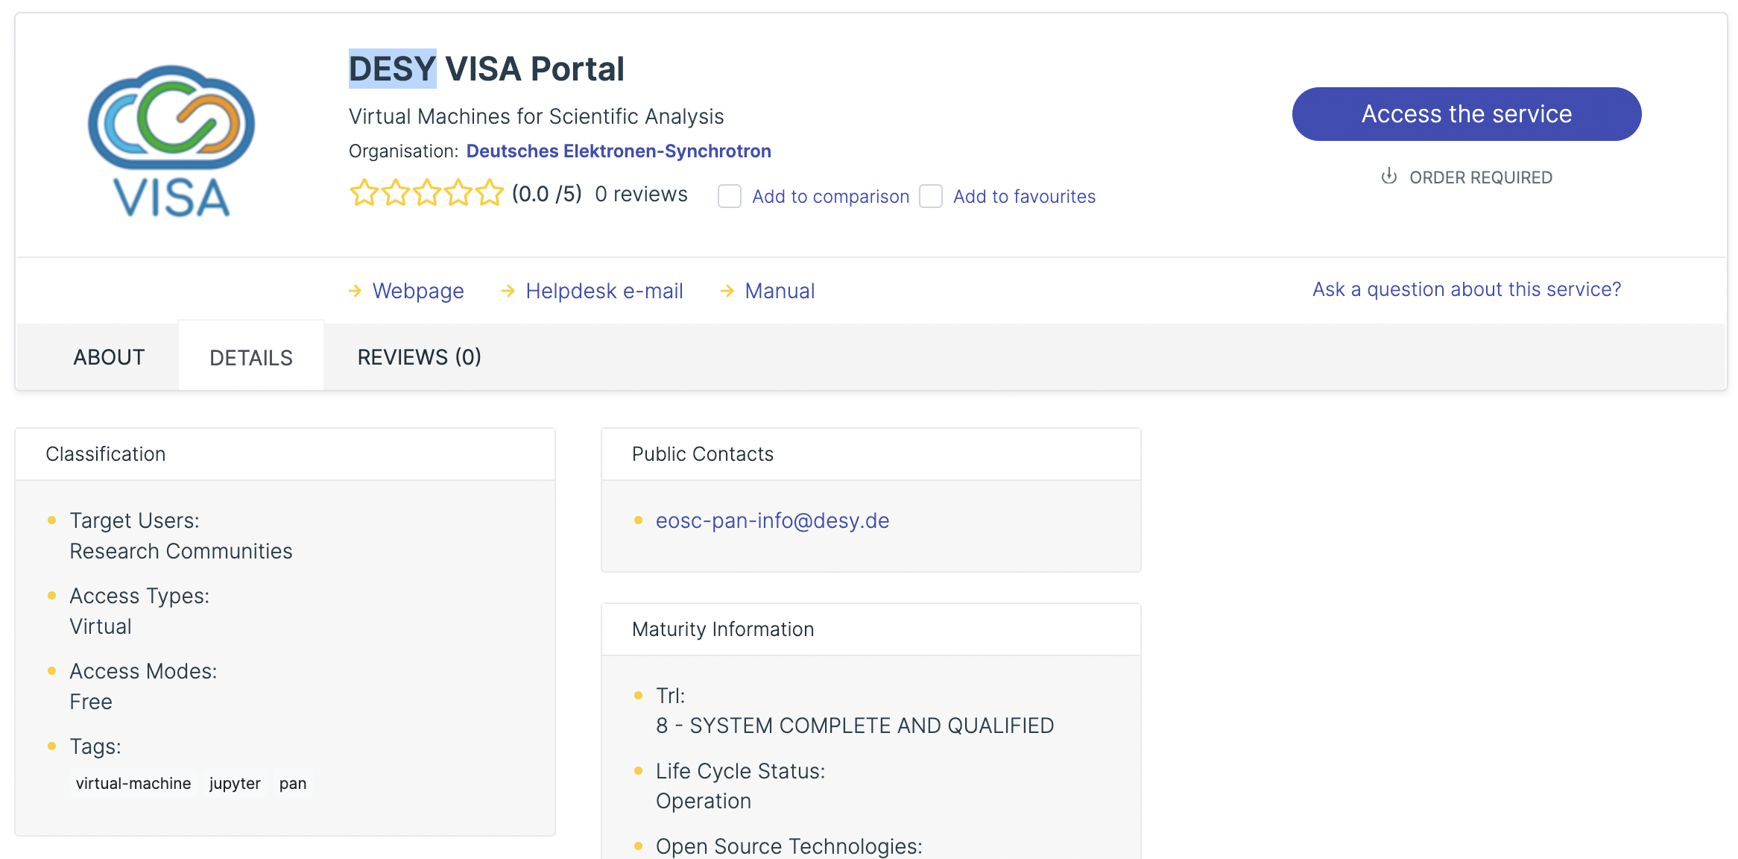
Let’s find a analysis facility first!
Order
required
VISA DESY .

Slide 28
What’s the VISA portal analysis system
VISA = “Virtual Infrastructure for Scientific Analysis “
It is
Open Source,
Science Agnostic ,
provided by ILL (“Institut Laue-Langevin” in Grenoble)
Small collaboration with Photon @ Neutron facilities.
Web based portal
Creates environment (applications, data) depending on membership at proposals (or Open Data)
Technology:
Starts pre-configured virtual machines
Mounts predefined (user depended) data space (experiment)
Allows sharing analysis environments amongst ‘proposal members’.

Slide 29
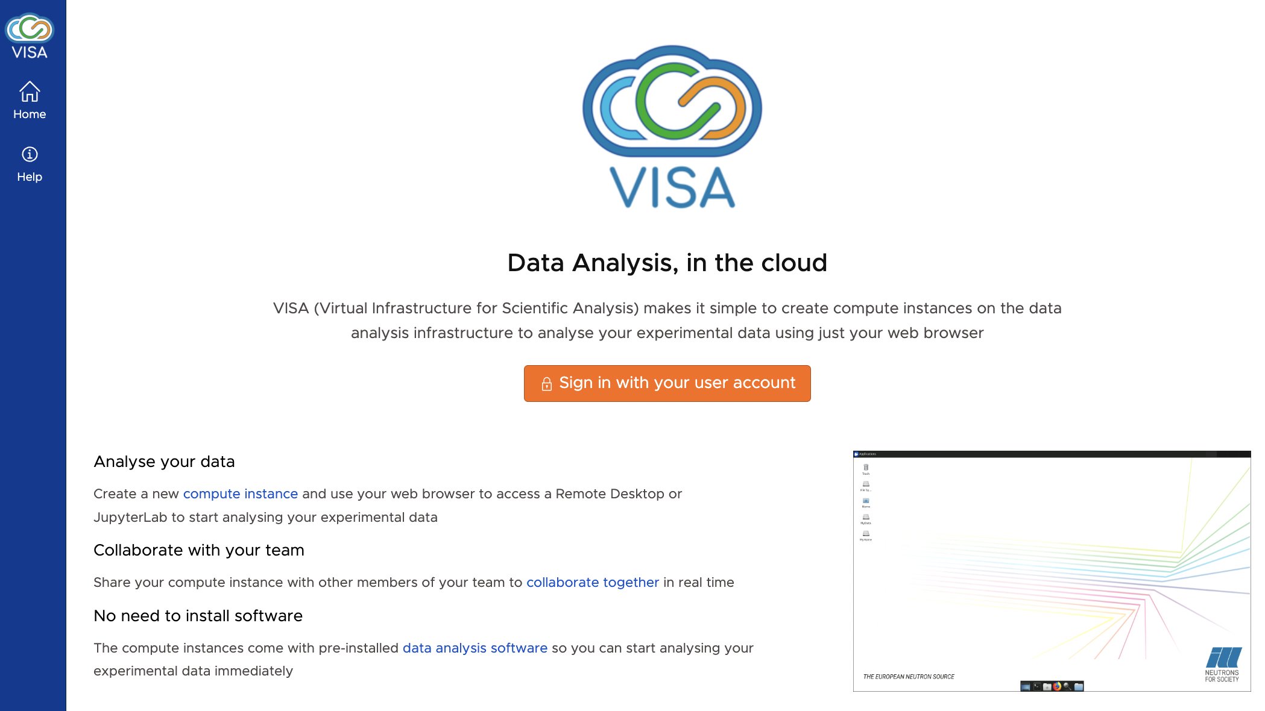
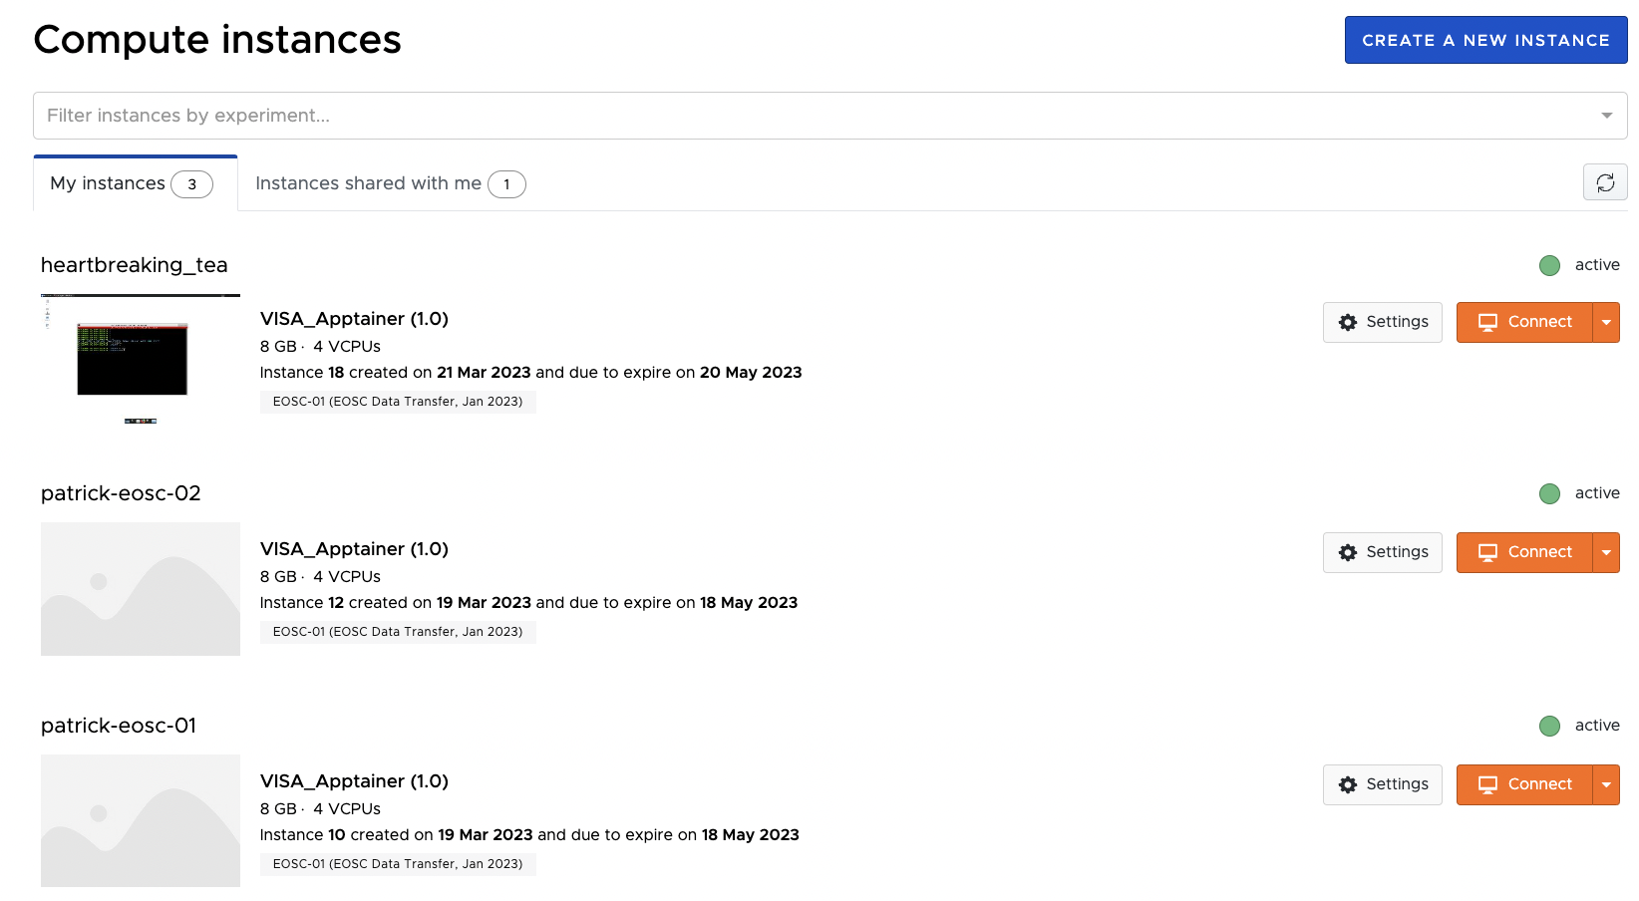
Select your data space
You log in and you’ll find your already running pipelines and the option to start new pipelines.

Slide 30
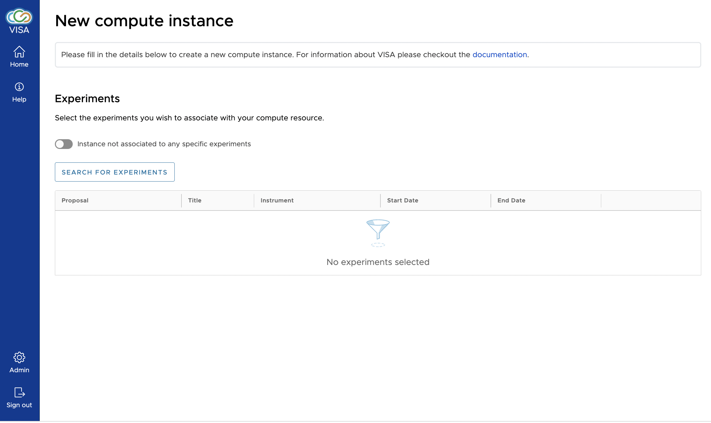
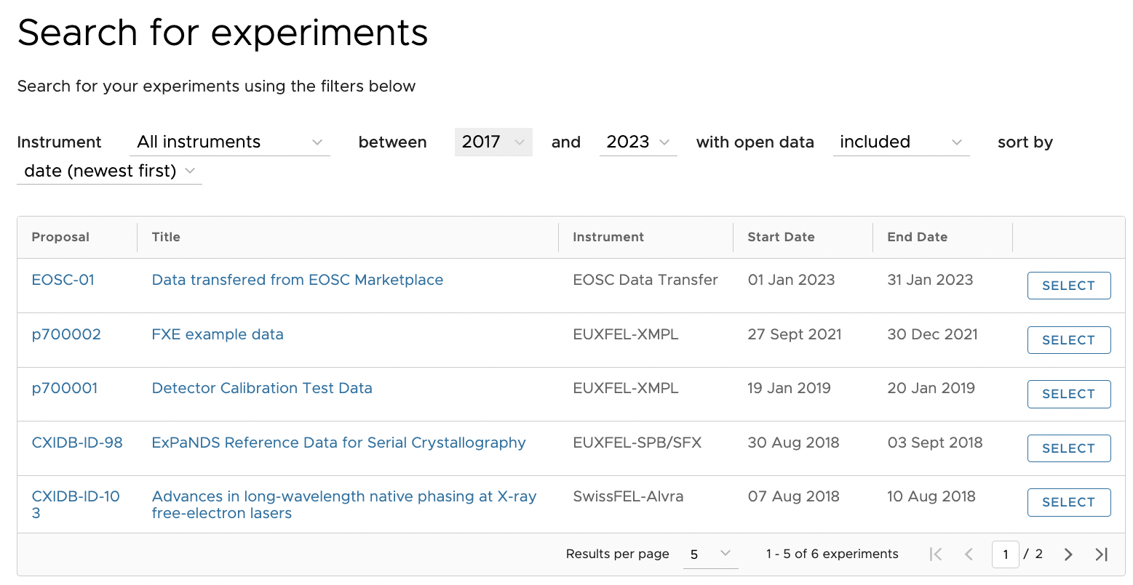
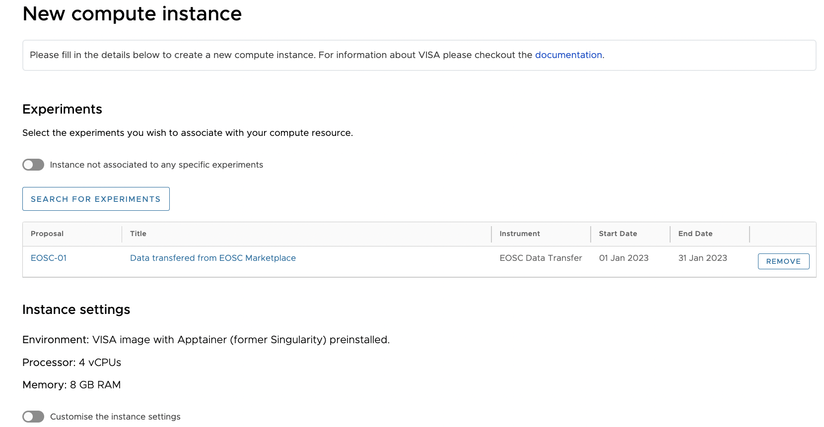
Create a new instance and select you data space

Slide 32
Select your preferred interface!
Connect to your instance
Building Launching ----

Slide 33
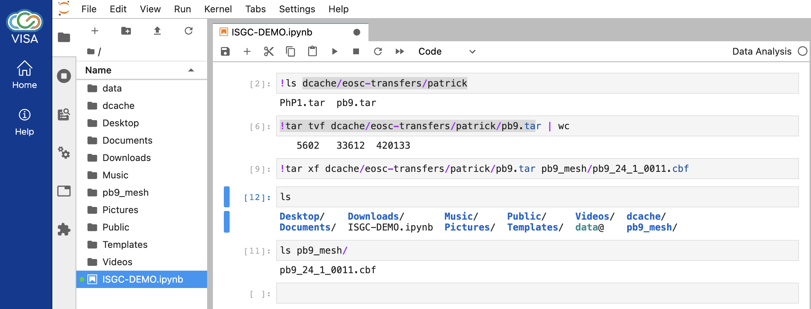
Jupyther Notebook

Slide 34
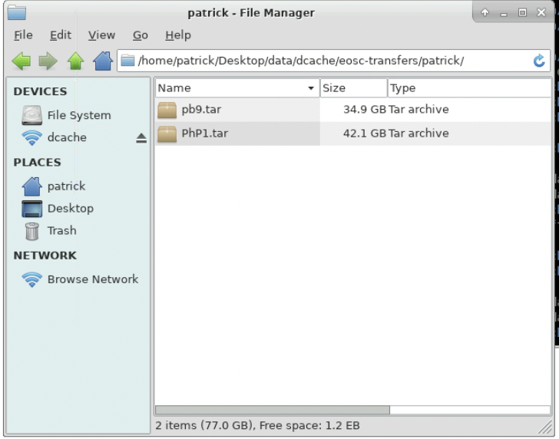
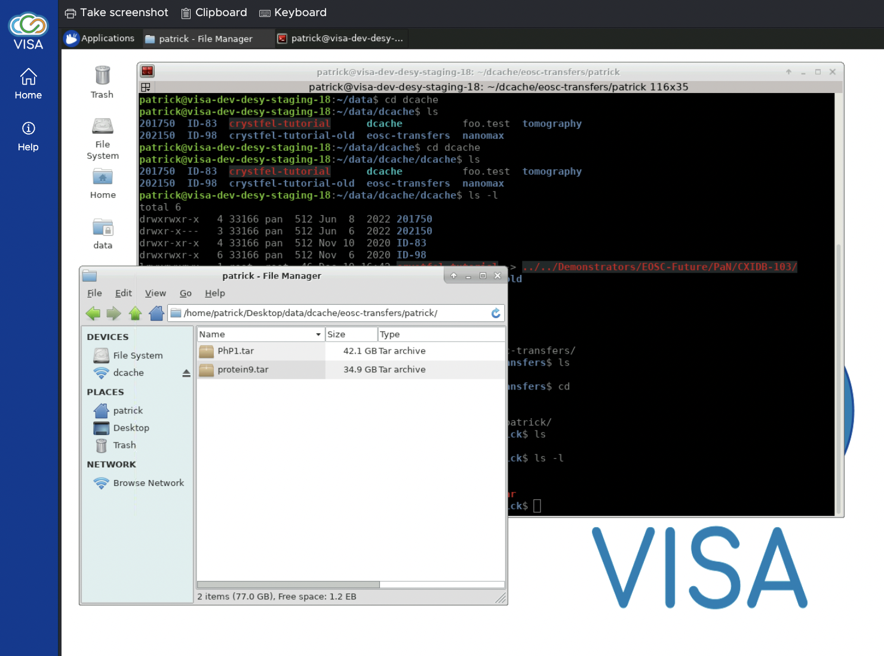
Remote Desktop

Slide 35
Conclusion
EOSC Future is supposed to build a common infrastructure for core and domain specific services in the EOSC.
The PaN cluster, respresented by ExPaNDS and PaNOSC. worked on this vision to provide PaN specific services, like catalogues and and analysis frameworks, into the EOSC.
The EOSC Future PaN science project combined the PaN specific analysis with a file transfer services provided by the EOSC core.
The ‘user’ can find data and matching services in the EOSC marketplace and can bind them together for his/her analysis.

