Slide 1
Academic Writing COIL, Tourism, Essay Writing, Press Release Writing Speakers: Prof. Ru-Shan Chen, Yi-Chien Wang & Tosh Yamamoto
Ru-Shan Chen ^{1*}, Tosh Yamamoto² , Yi-Chien Wang³
^{1,3} Department of Applied English, Chihlee University of Technology
² Department of Sociology, Kansai University of International Studies
rushan53@mail.chihlee.edu.tw*

Slide 2
Abstract
This study aimed to elaborate on how students develop cross-cultural awareness and interact with people of different cultures through a writing class. The paper describes International Project-type learning between college students from Taiwan and Japan.
In order to enhance students’ learning opportunities from two different countries to communicate and collaborate, various cloud-based tools such as Padlet®, Flipgird®, and Google Drive® are used during the entire learning journey so that students can share their artifacts in a virtual learning space, namely, ”on-the-same-page-of-learning” throughout the course.
As for generating students' writing ideas, PMI (plus, minus, Interesting) Analysis, mind mapping, and color-coding strategies are employed during the brainstorming and critical thinking processes. In addition, formative assessments, including rubric, peer-review, and self-review, are applied during the learning process. The uniqueness of this course is that at the end of the course, students wrote their reflections of learning in the course and drew and visualized learning curves including the ups and downs of their learning motivation while looking back the entire course.
The study results have shown that most students felt highly motivated when working in teams, and students also thought collaboration played an inessential role when working with others.
Academic Writing COIL, Tourism, Essay Writing, Press Release Writing

Slide 3
Collaboration across countries

Slide 4
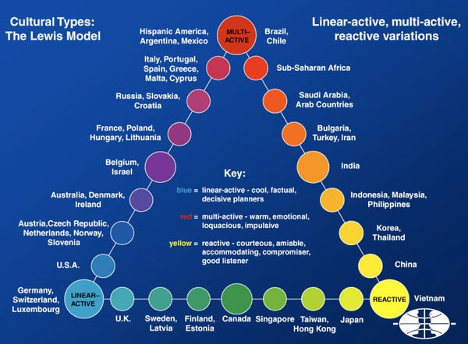
“English is the Global Language”
David Crystal (2003)
http://www.crossculture.com/services/cross-culture/

Slide 5
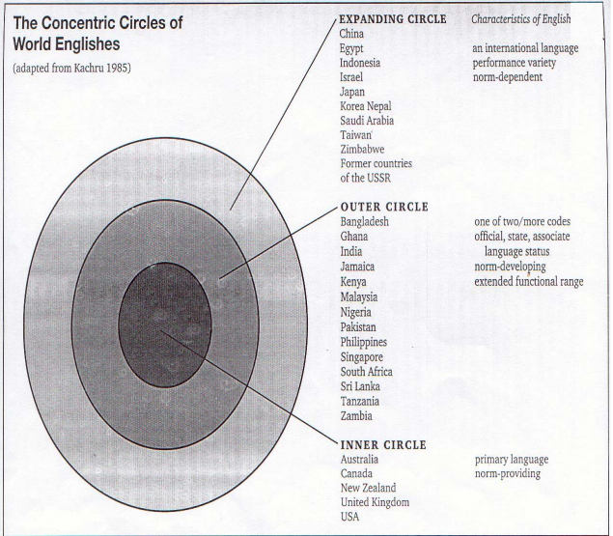
Braj Kachru (1985)
Simigné, F. S. (2003), The function of the English Language in the European Union, European Integration Studies, 2(2), 53‐64.

Slide 6
English as a Global Langue
Three Features:
ENGLISH
Communicational tools/purposes
(Crystal, 2003)
Cross-Cultural
Communicational Tool
Ownership
(Higgins, 2003; McKay, 2003)
Expression
(Sharifian, 2011)

Slide 7
Research Question:
Three Features:
ENGLISH
Communicational tools/purposes
(Crystal, 2003)
Cross-Cultural
Communicational Tool
Ownership
(Higgins, 2003; McKay, 2003)
Expression
(Sharifian, 2011)
How to develop students’ awareness and enhance their learning motivation through authentic cross-cultural learning experiences?

Slide 8
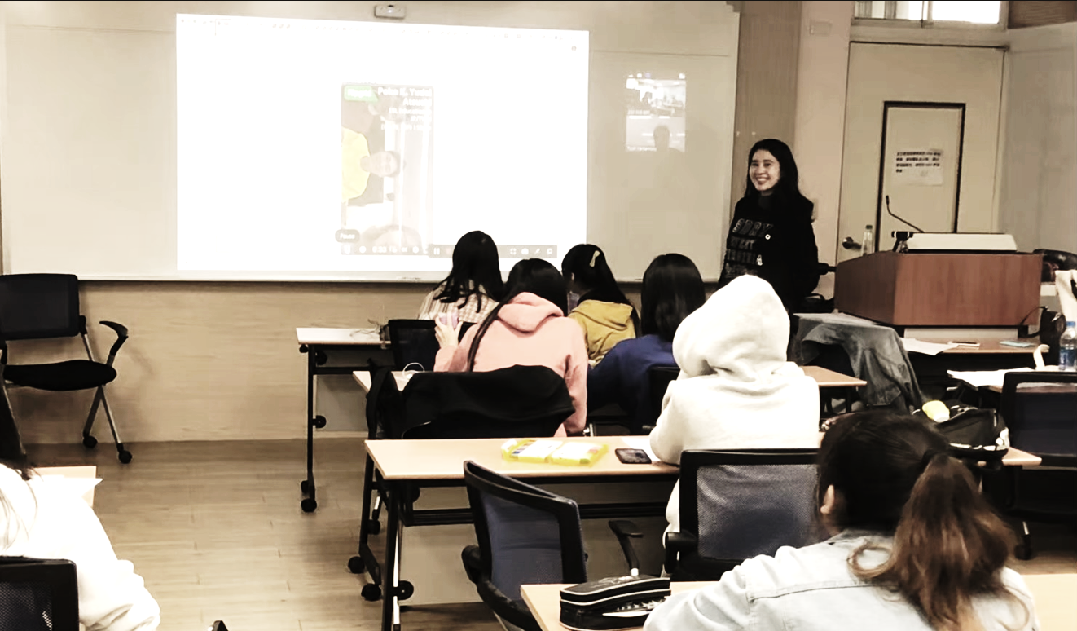
What is COIL?
COIL stands for
Collaborative
Online
International
Learning

Slide 9

COIL
It’s an approach to teaching and learning that utilizes information and Communication Technology (ICT) tools to create a virtual learning environment that can provide shared courses across the globe between educational institutions.
Collaborative
Online
International
Learning
<a href='https://www.freepik.com/vectors/friends-illustration'>Friends illustration vector created by freepik - www.freepik.com</a>

Slide 10

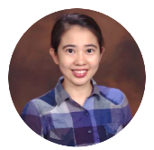





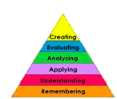
Course Title: English Writing
Course Description: The course follows the COIL (Collaborative Online International Learning) Model harnessed with ICT-enhanced Thinking Tools such as visual organizers and various cloud services for the team to be “on the same page” of the project throughout the course.
Syllabus
Pledge
Saying Hi
Writing & Sharing
Collaborative Learning
Reflection
Initial Stage
Middle Stage
Final Stage
W 1 | W 2 | W 3 | W 4 | W 5 | W 6 | W 7 | W 8 | W 9 | W 10 | W 11 | W 12 | W 13 | W 14 | W 15 | W 16 | W 17 | W 18

Slide 11
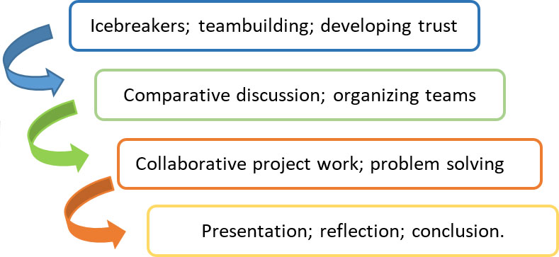
Course Design Structure
COIL Model
https://www.kpu.ca/international/partnerships/faculty-exchange/coil
Syllabus
Pledge
Saying Hi
Writing & Sharing
Collaborative Learning
Reflection
Initial Stage
Middle Stage
Final Stage
W 1 | W 2 | W 3 | W 4 | W 5 | W 6 | W 7 | W 8 | W 9 | W 10 | W 11 | W 12 | W 13 | W 14 | W 15 | W 16 | W 17 | W 18

Slide 12
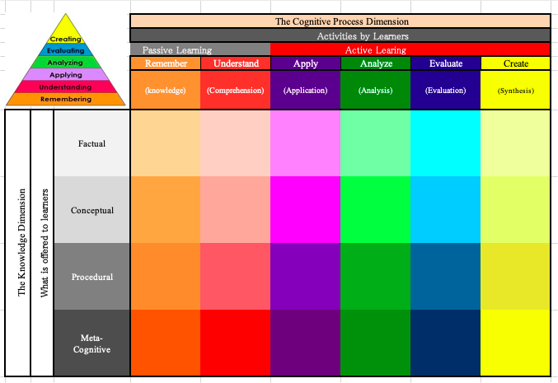
The Bloom’s Taxonomy Matrix
Tosh Yamamoto (2019)

Slide 13
Course Design Structure
Initial Pledge in Writing
Comprehensive
Reflective Writing
Mindset
Syllabus
Pledge
Saying Hi
Writing & Sharing
Collaborative Learning
Reflection
Initial Stage
Middle Stage
Final Stage
W 1 | W 2 | W 3 | W 4 | W 5 | W 6 | W 7 | W 8 | W 9 | W 10 | W 11 | W 12 | W 13 | W 14 | W 15 | W 16 | W 17 | W 18

Slide 14
Course Design Structure
Initial Pledge in Writing
Comprehensive
Reflective Writing
Mindset
Syllabus
Pledge
Saying Hi
Writing & Sharing
Collaborative Learning
Reflection
Initial Stage
Middle Stage
Final Stage
W 1 | W 2 | W 3 | W 4 | W 5 | W 6 | W 7 | W 8 | W 9 | W 10 | W 11 | W 12 | W 13 | W 14 | W 15 | W 16 | W 17 | W 18

Slide 15
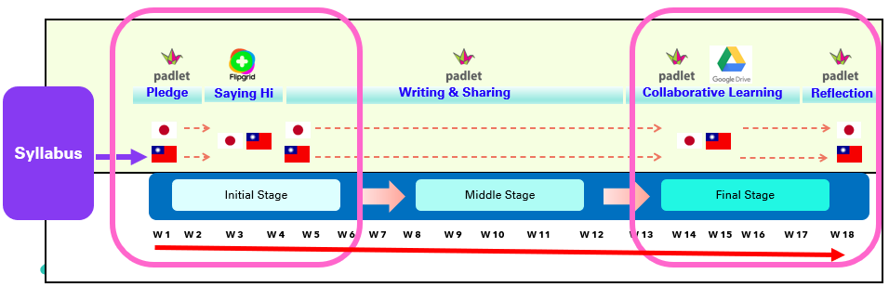
Comparison
Initial Pledge <-----> Reflective Writing
Initial Pledge
Reflective Writing
•Motivation of learning the subject
•Expectation of learning
•Self-set goals in learning, skills to master, etc.
•Anxieties, worries, etc.
•Learning motivation graph
•Self-assessment in learning
•Reflection (comparison between Pledge & Reflection)
•Planning a next step in learning and life-long
learning

Slide 16
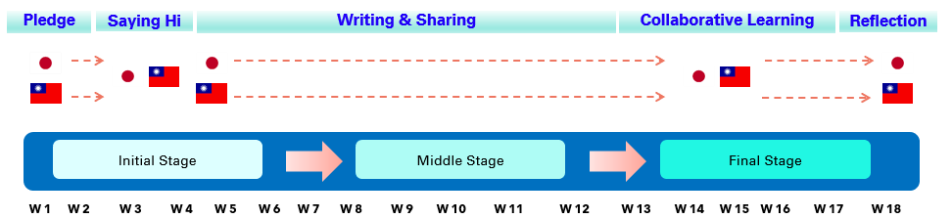

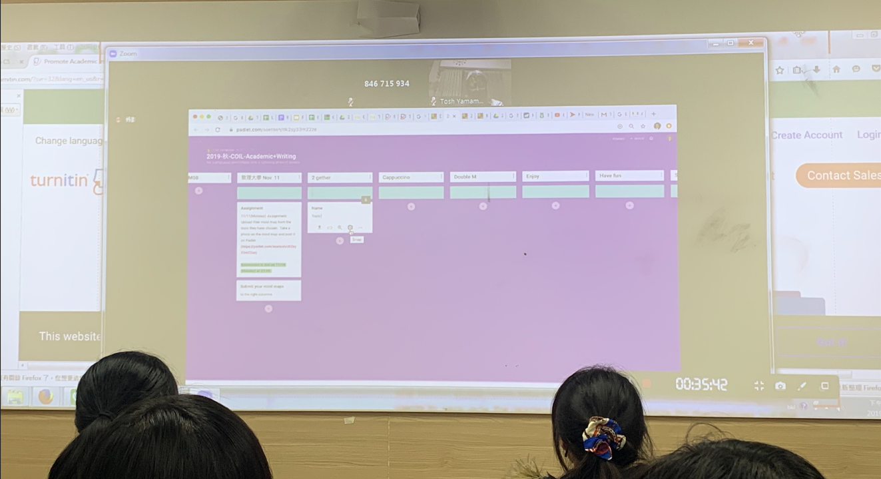
I. Initial Stage
A. Initial Pledge in Writing
B. Building Trust
Goal Setting
Team Building

Slide 17
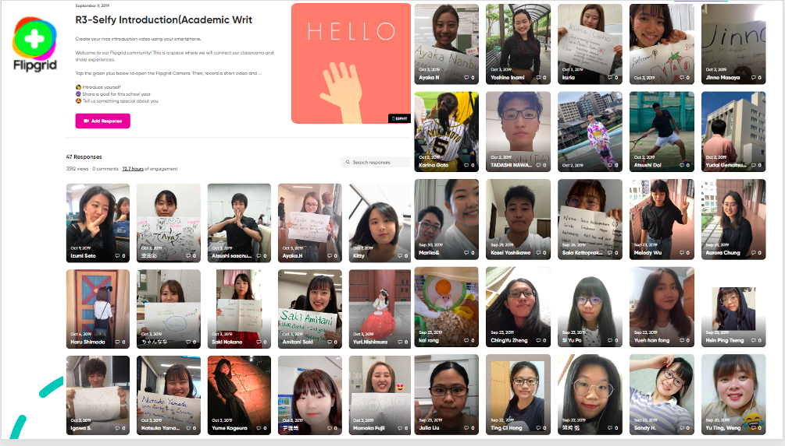
I. Initial Stage
A. Initial Pledge in Writing
B. Building Trust
Goal Setting
Team Building

Slide 18

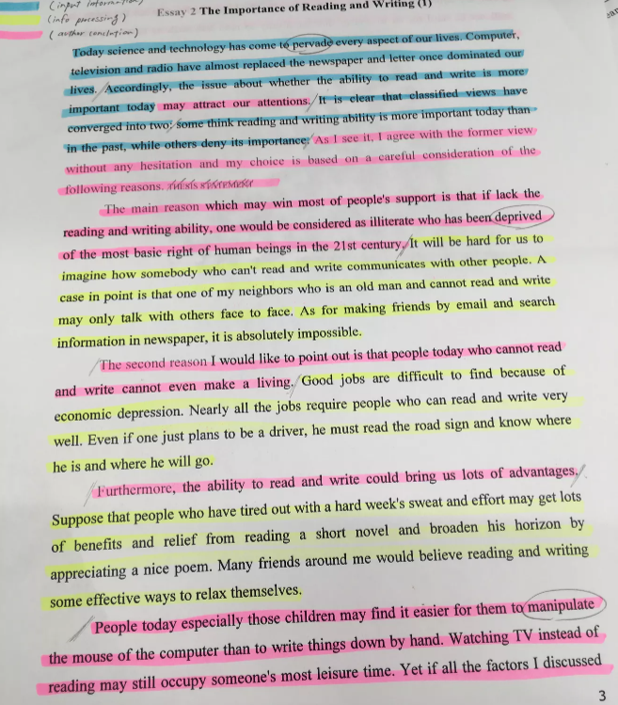
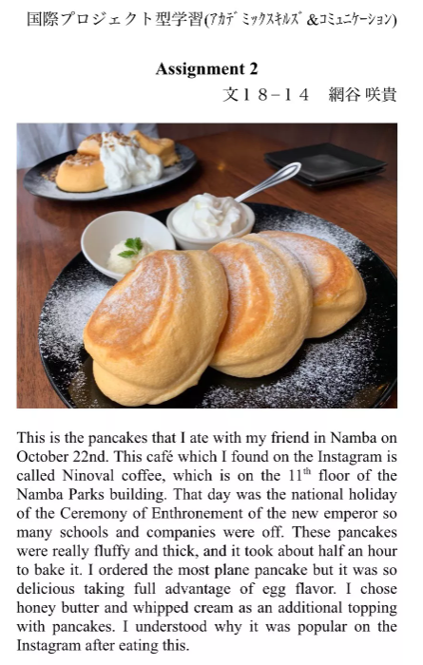
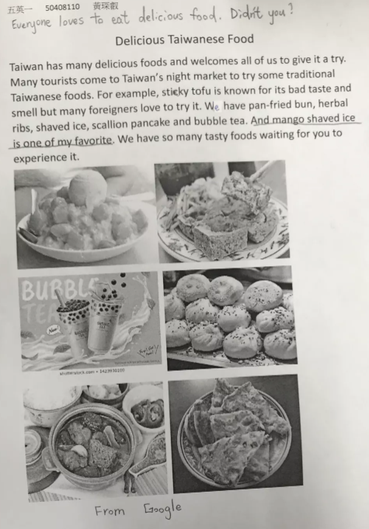
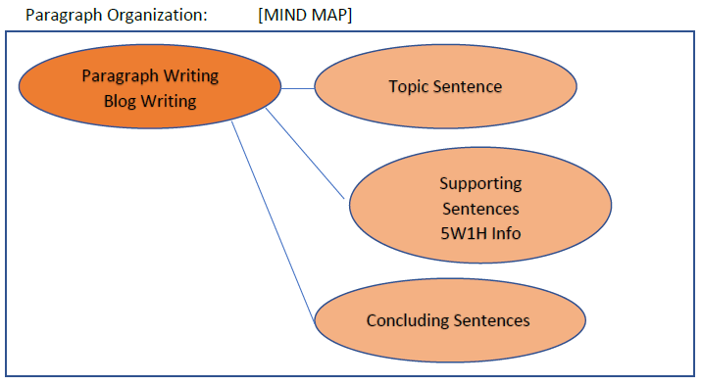
II. Middle Stage
A. Snapshot
B. Twitter Writing
C. Essay
5W1H

Slide 19
A. Snapshot
INSTRUCTION:
Take a snapshot with your smartphone.
Explain as much as possible making reference to 5W1H Information, (Who, Whom, What, Where, When, Why, How) in a paragraph.
Create a Word file with a photo and its description.
Print and bring your work.

Slide 20
II. Middle Stage
A. Snapshot
B. Blog Writing
C. Essay
5W1H
5W1H

Slide 21
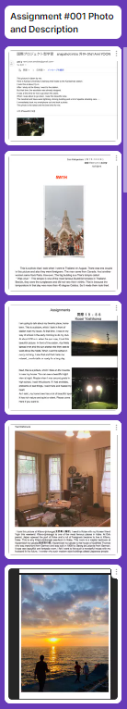
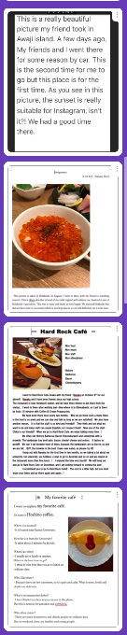
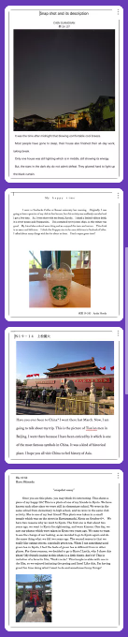
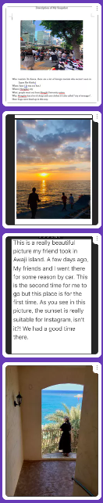
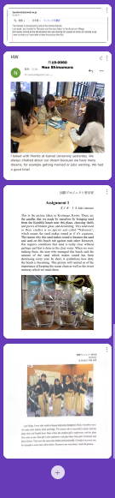
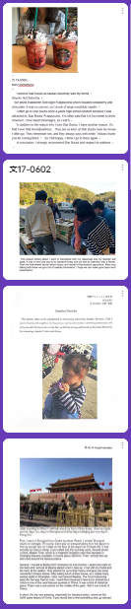
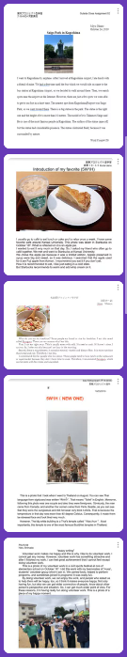
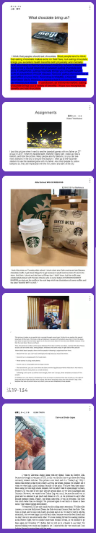
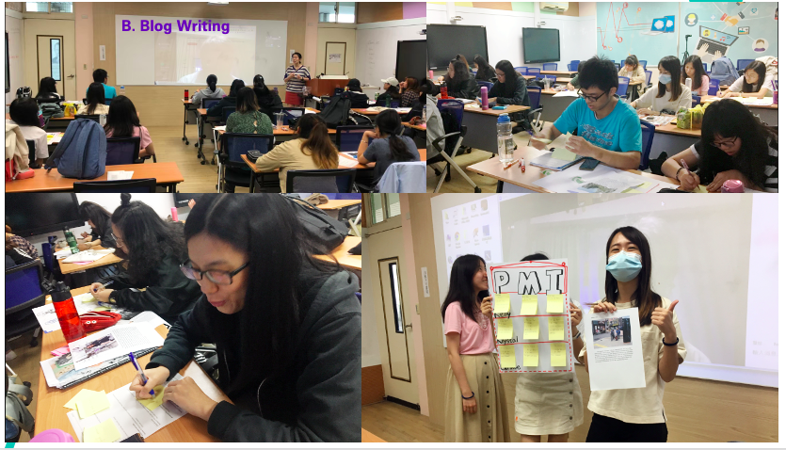
B. Blog Writing

Slide 22
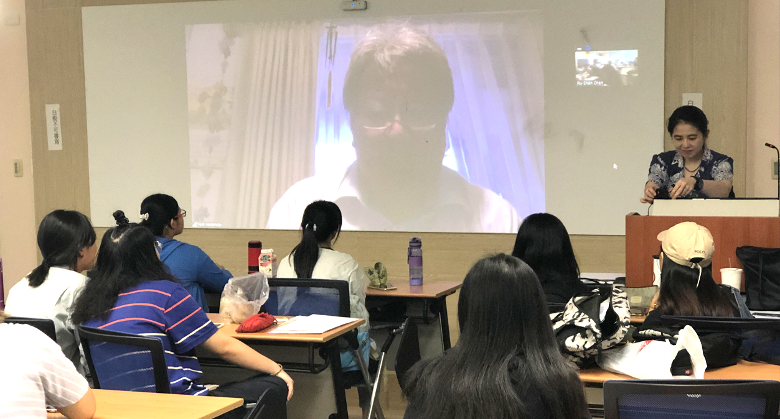
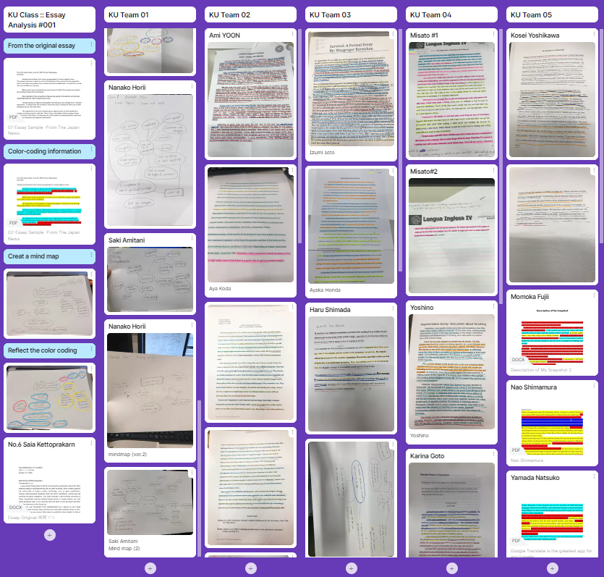
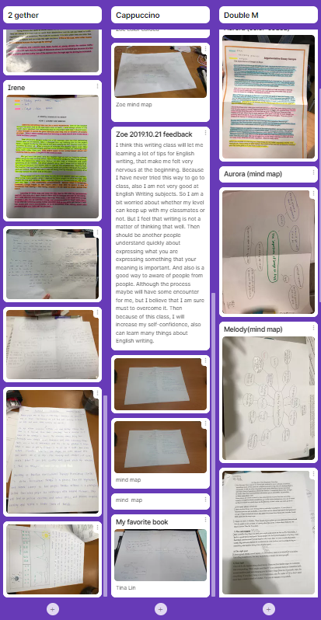
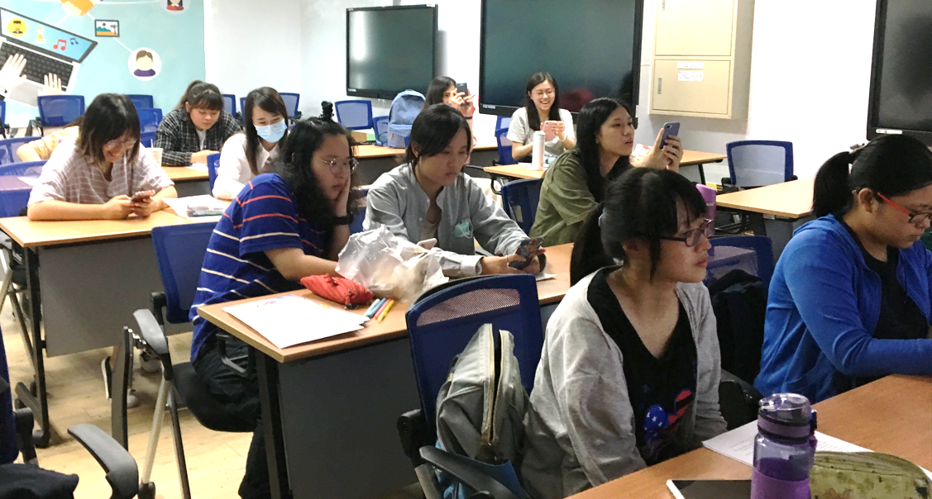
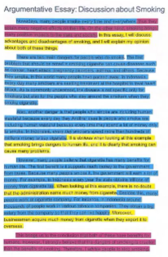
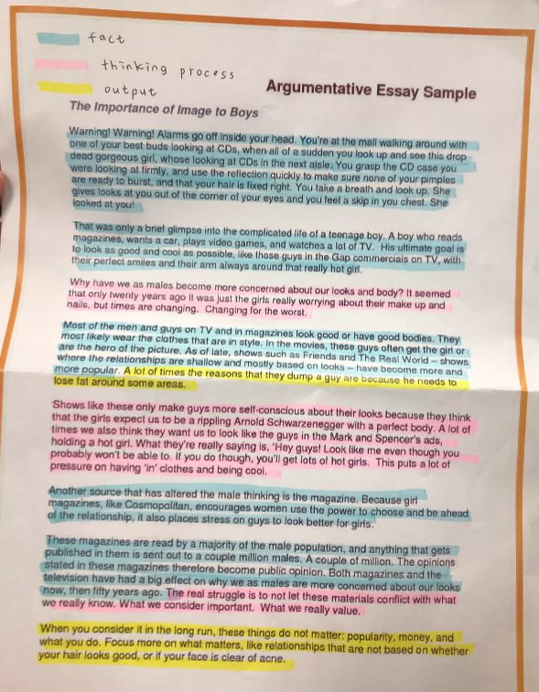
C. Essay

Slide 23

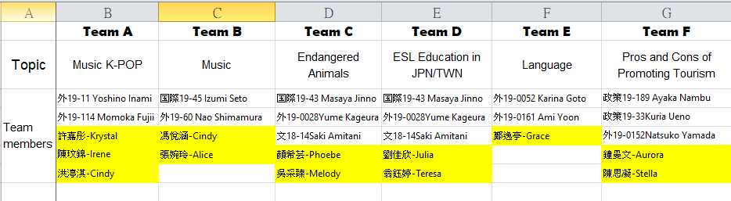
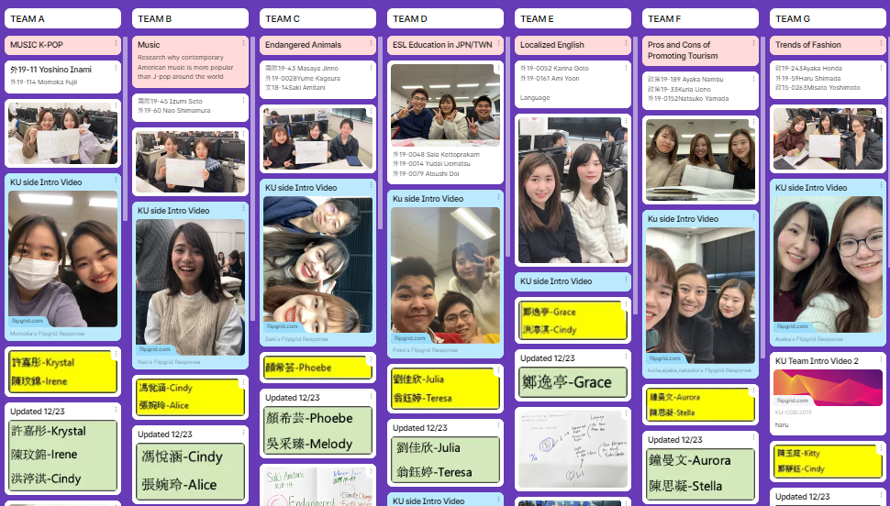
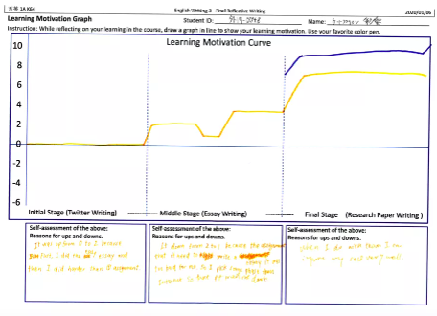
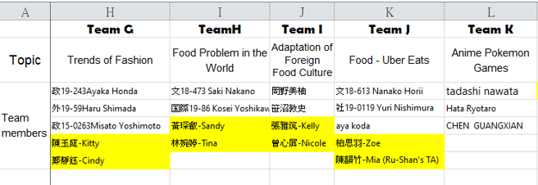
III. Final Stage
A. Collaborative Project: Research Themes
B. Motivation Learning Curve
Planning & Management
Working Together

Slide 24
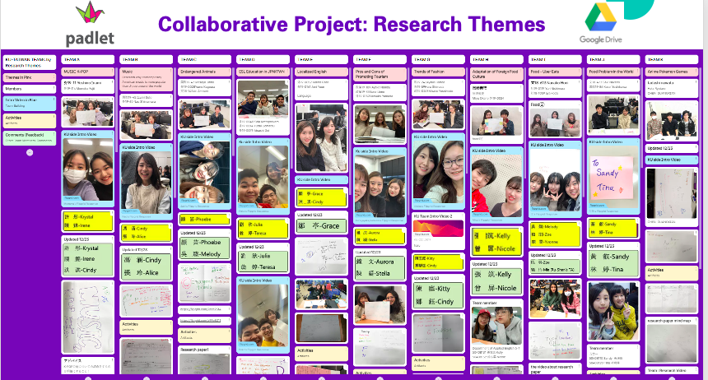
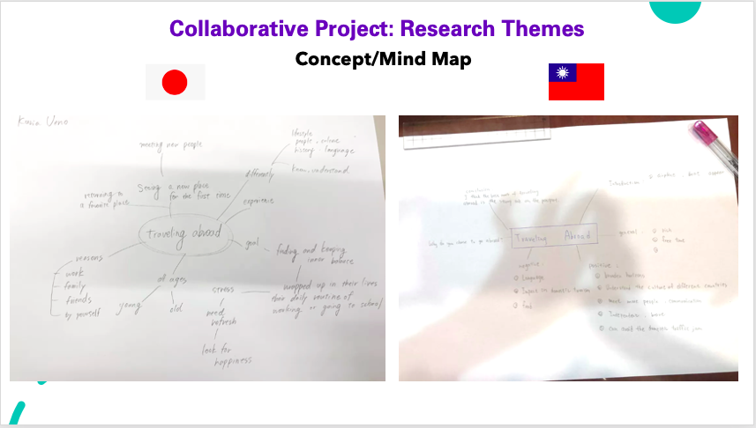
Collaborative Project: Research Themes
Pair up

Slide 25
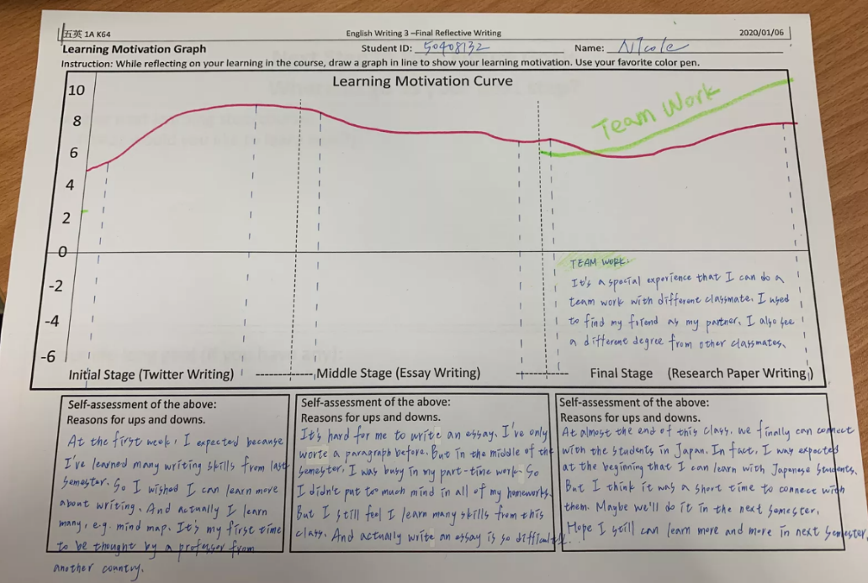
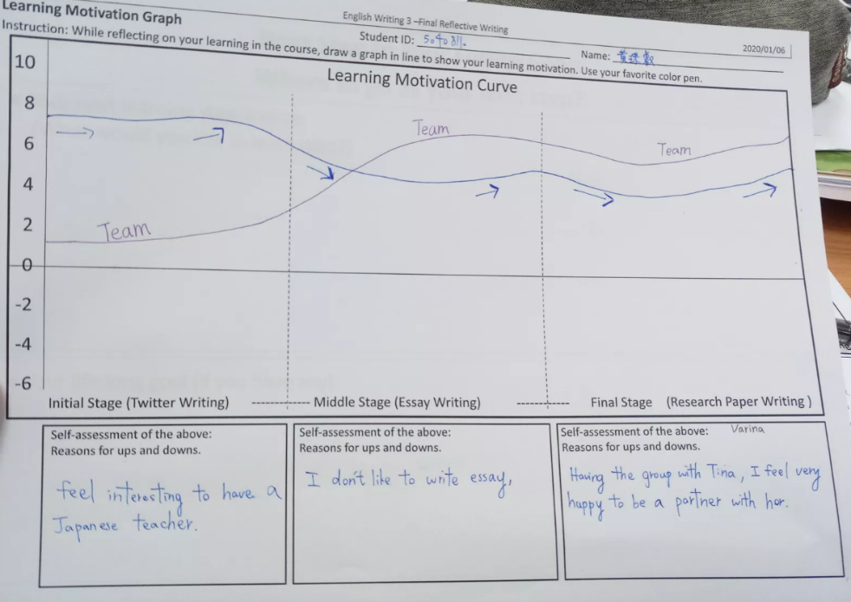
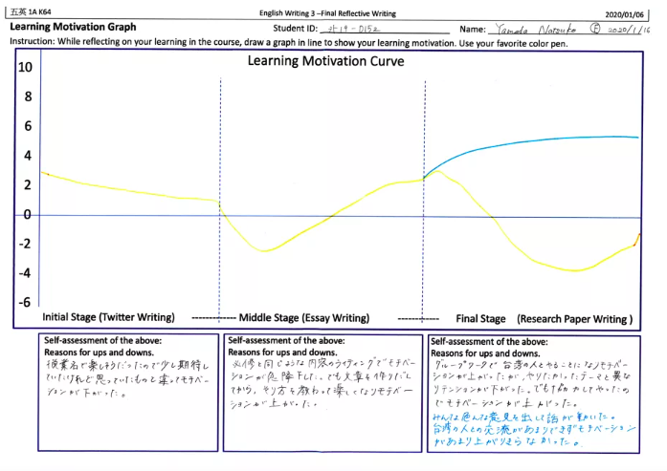
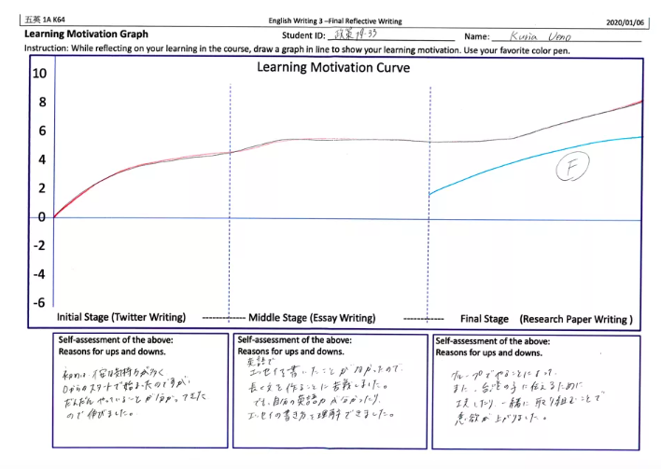
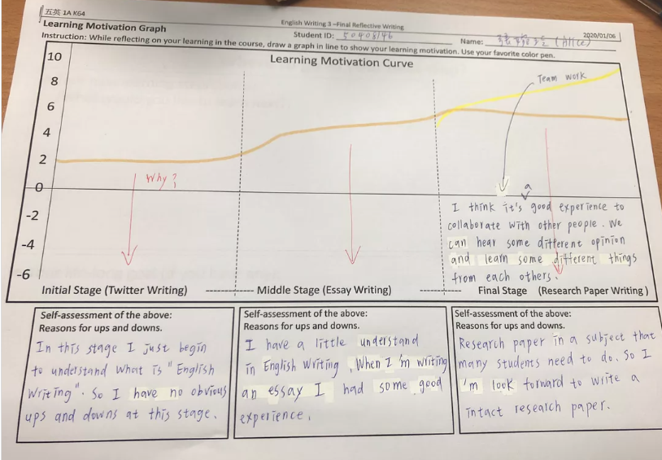
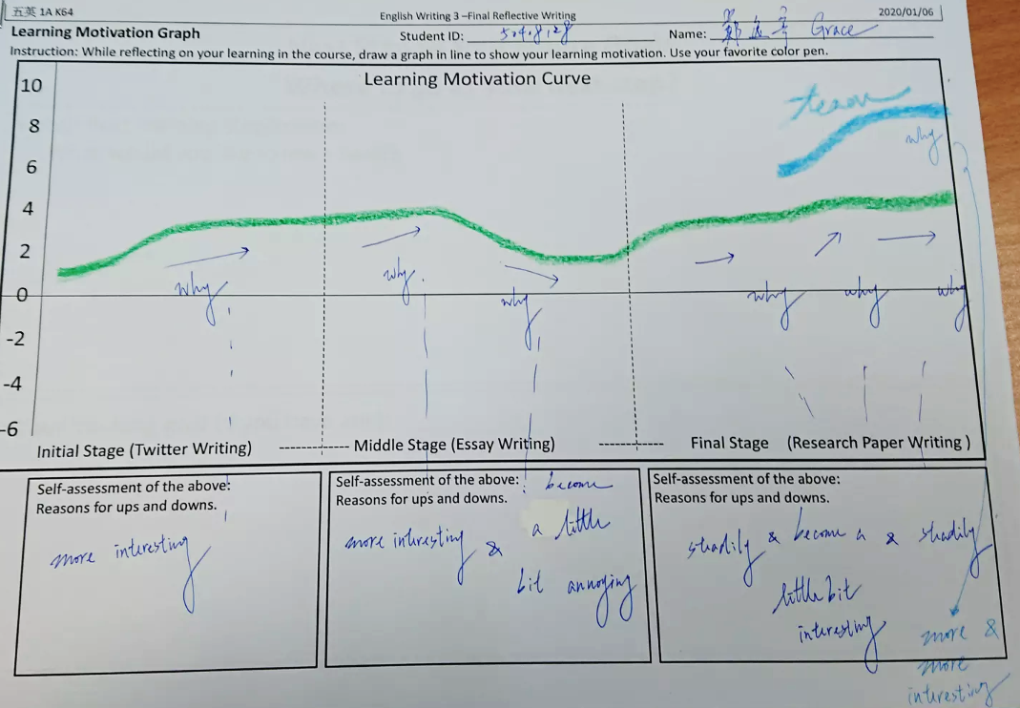
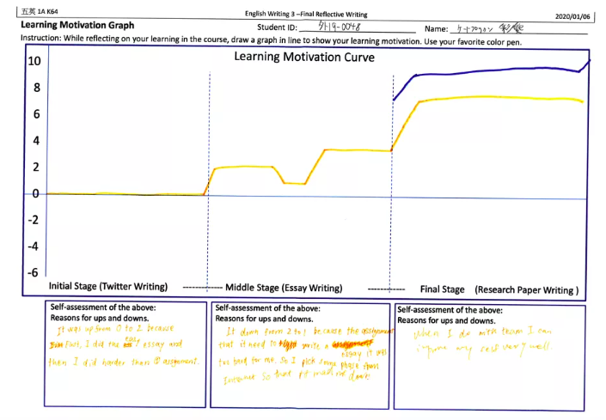
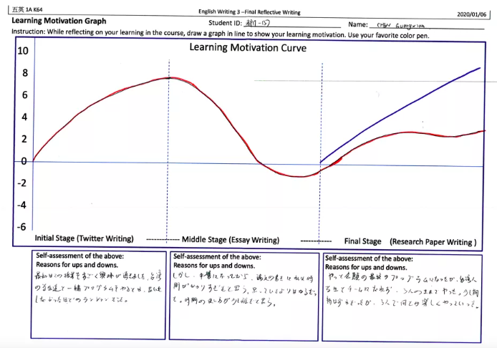
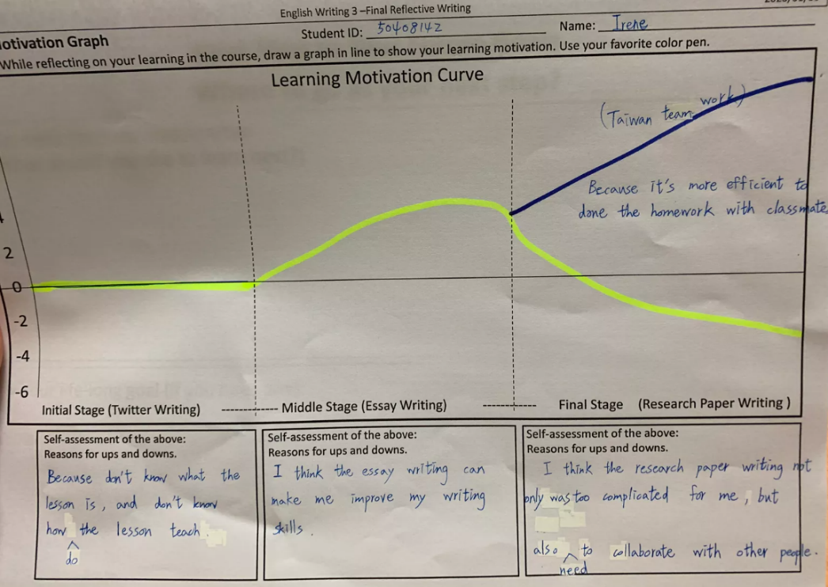
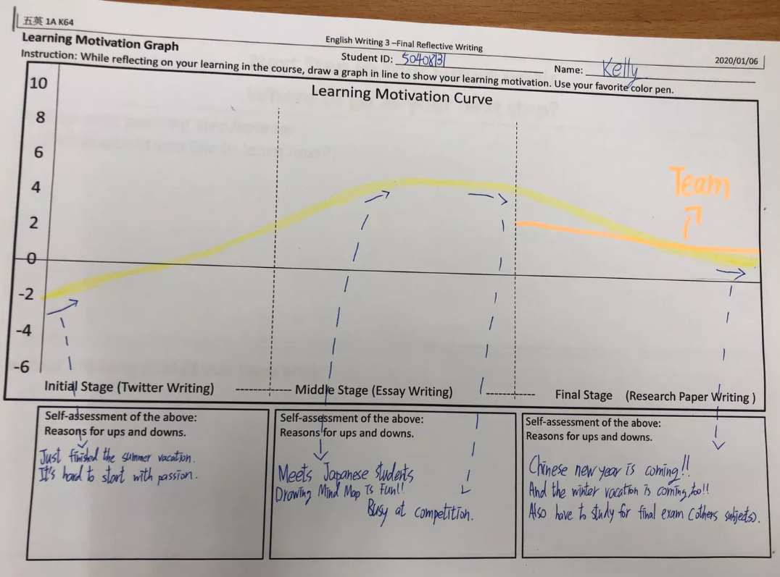
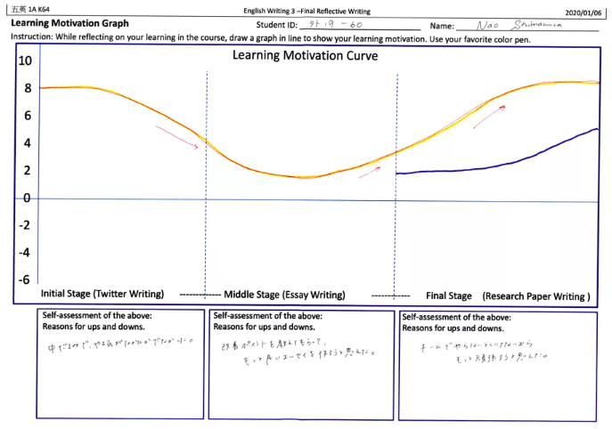
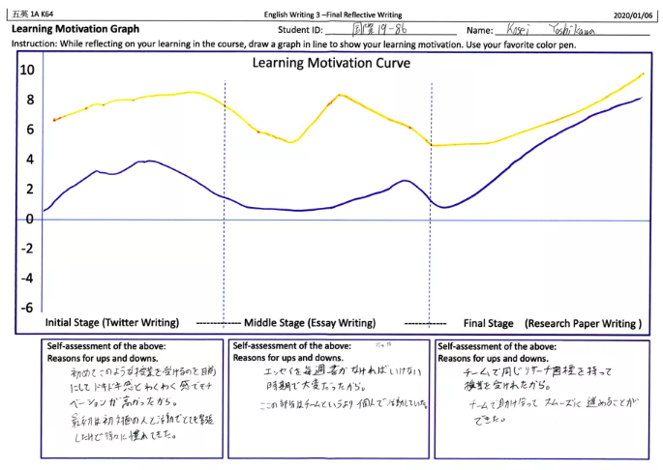
Learning Motivation Curve
Visualization with graphs:
Dynamics of Team-Level Learning Motivation
&
Individual Level - meta analysis of Learning Motivation
With reasons for ups and downs

Slide 26
Reflective Writing
Students’ reflective writings were analyzed in addition to Learning Motivation Curve.

Slide 27
Probing Questions to initiate/stimulate free writing

Slide 28
Summary of Reflective Writing
➢ Most students felt highly motivated when working as a team.
➢ Students seem to work harder than on previous tasks when
doing the collaborative research project.
➢ Team-Building at the beginning – crucial !
➢ Most students found difficulties communicating with their team members due to the language barrier since English was the common language.
➢One semester-long course is not long enough for students to have the global teamwork mindset, but we are in the right direction!

Slide 29
Academic Writing COIL, Tourism, Essay Writing, Press Release Writing Speakers: Prof. Ru-Shan Chen, Yi-Chien Wang & Tosh Yamamoto
Ru-Shan Chen ^{1*}, Tosh Yamamoto² , Yi-Chien Wang³
^{1,3} Department of Applied English, Chihlee University of Technology
² Department of Sociology, Kansai University of International Studies
rushan53@mail.chihlee.edu.tw*

