Slide 1
EGI Tutorial at ISGC 2023
Giuseppe La Rocca
Community Support Team Lead.
TLP: GREEN Limited disclosure
ISGC 2023

Slide 2
About me
Community Support Team Lead. @ EGI Foundation
Member of the EGI Foundation team since Dec. 2015
MSc in Computer Science Engineering from the University of Catania (Italy).
EGI-ACE Community Manager
Based on Catania, Italy
giuseppe.larocca@egi.eu
https://www.egi.eu/people/giuseppe-la-rocca/

Slide 3
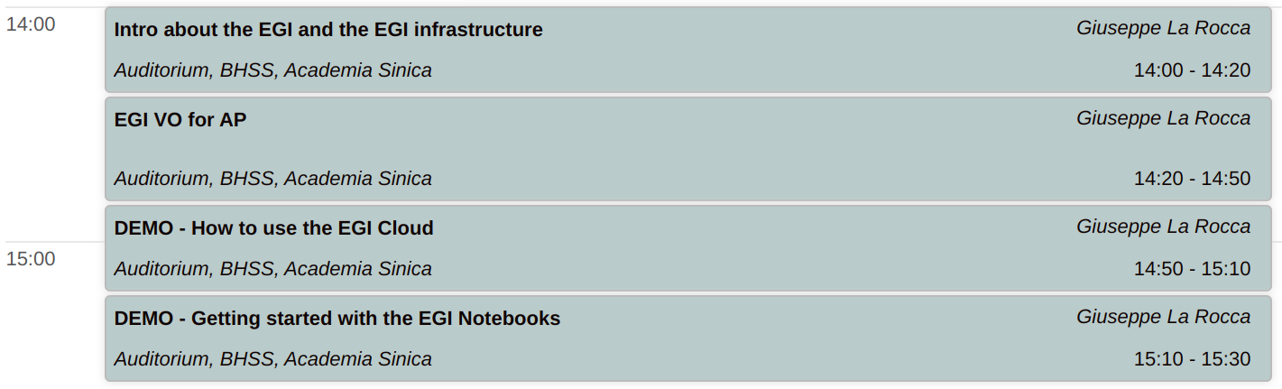
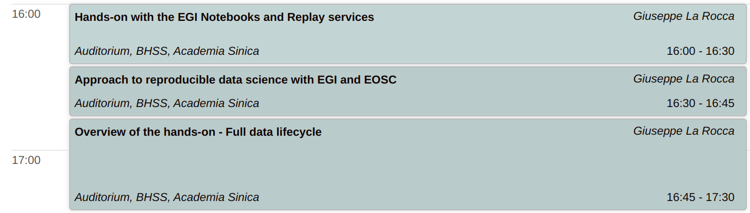
Agenda

Slide 4
Introduction about
the EGI and the EGI Infrastructure
TLP: GREEN Limited disclosure
ISGC 2023

Slide 5

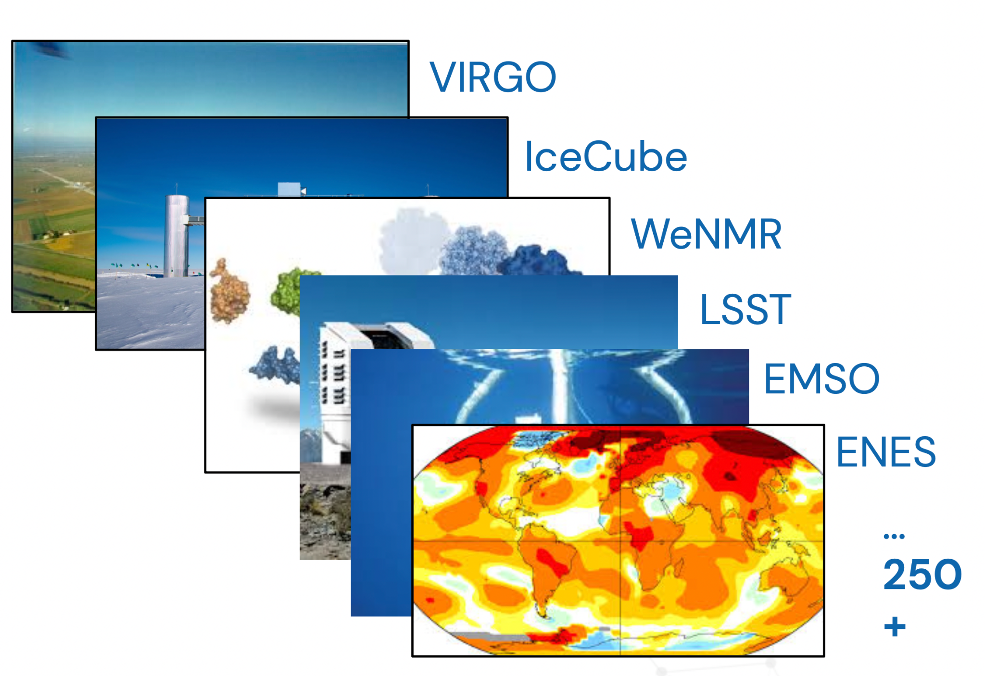
The EGI Federation is an international e-infrastructure
We provide advanced computing and data analytics for research and innovation
2010
From the high-energy physics compute grid
(WLCG)
2022
To a multi-disciplinary, multi-technology infrastructure

Slide 6
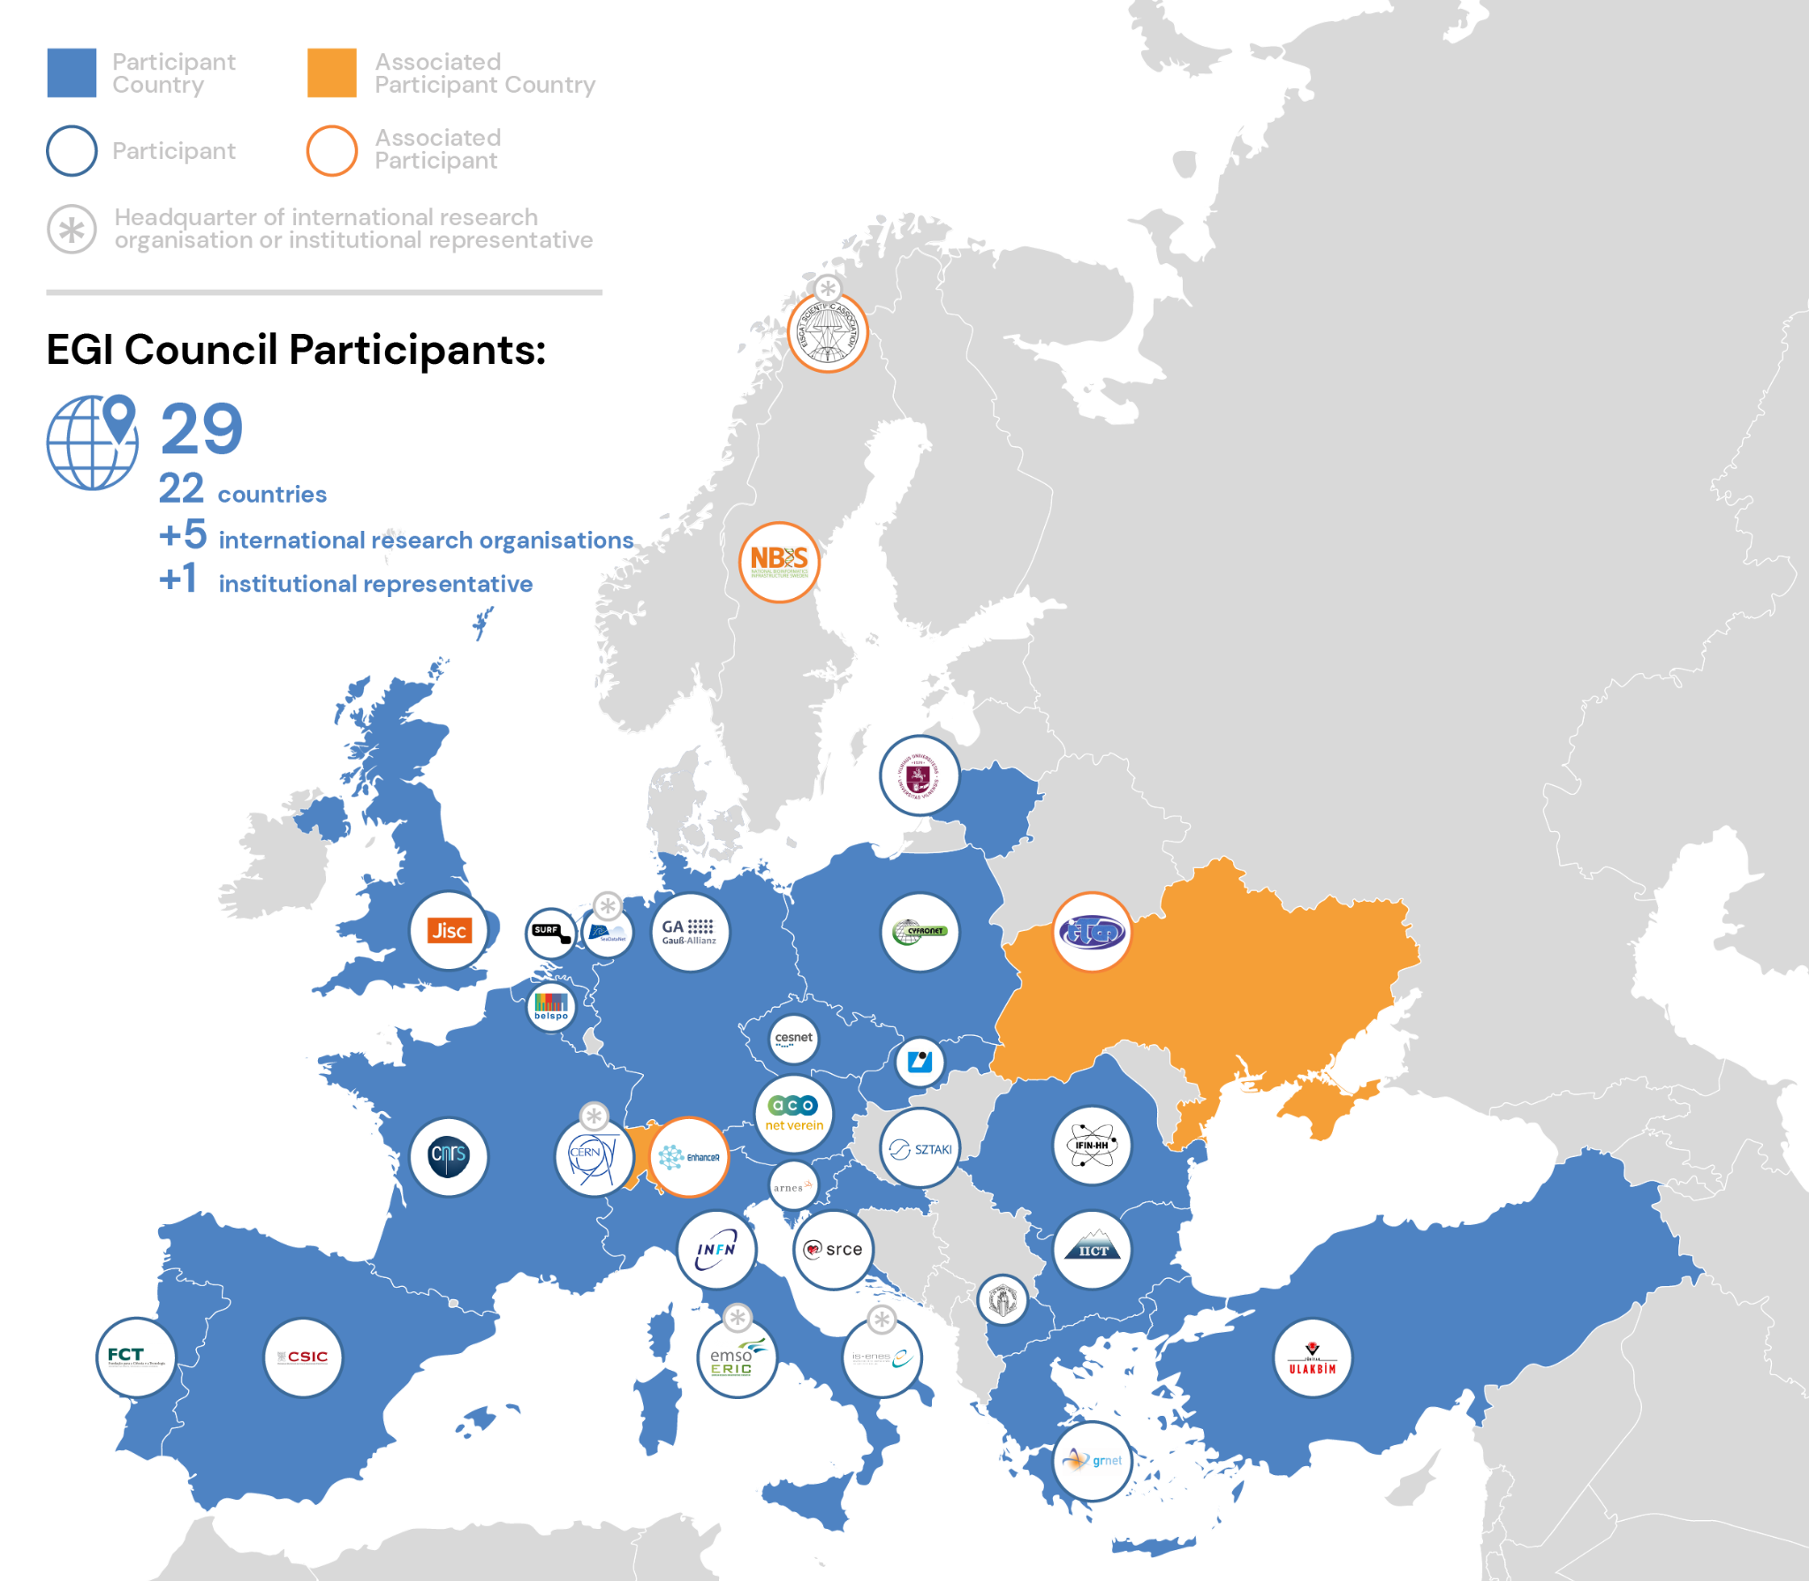
Vision
All researchers have seamless access to services, resources and expertise to collaborate and conduct world-class research and innovation
Mission of the EGI Federation
Deliver open solutions
for advanced computing and data analytics in research and innovation
Mission of the EGI Foundation
Enable the EGI Federation
to serve international research and innovation together

Slide 7
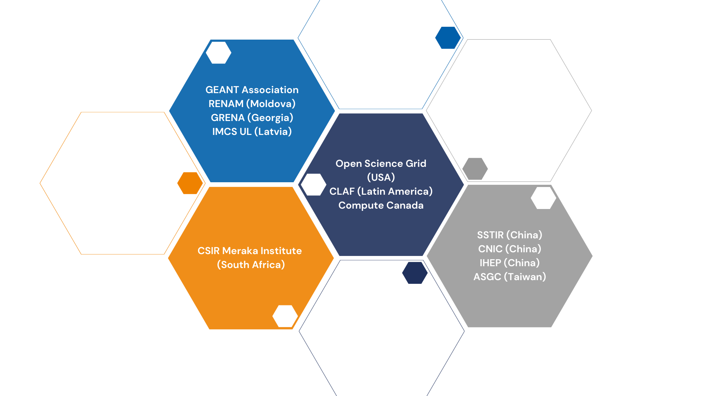
International Partnerships

Slide 8
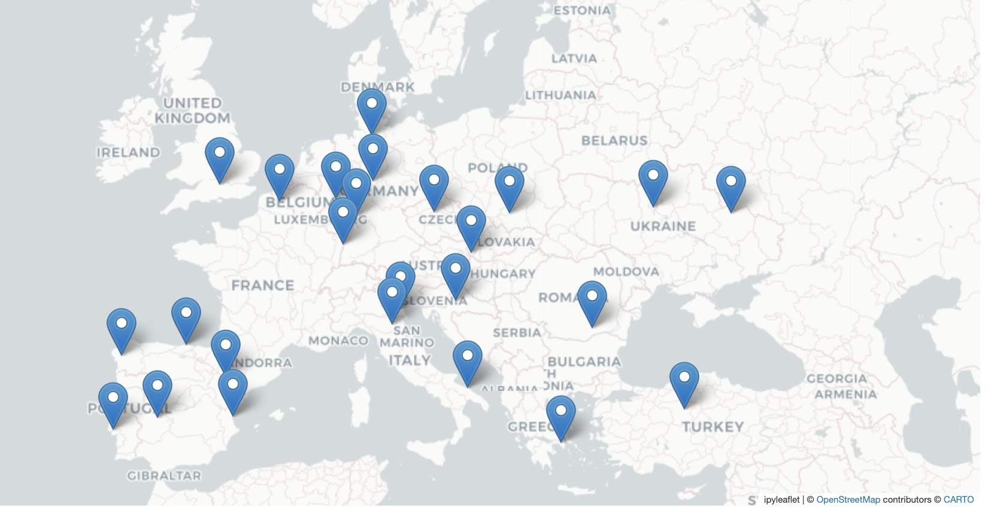
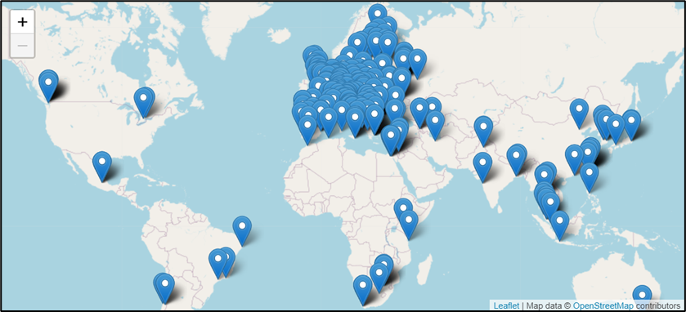
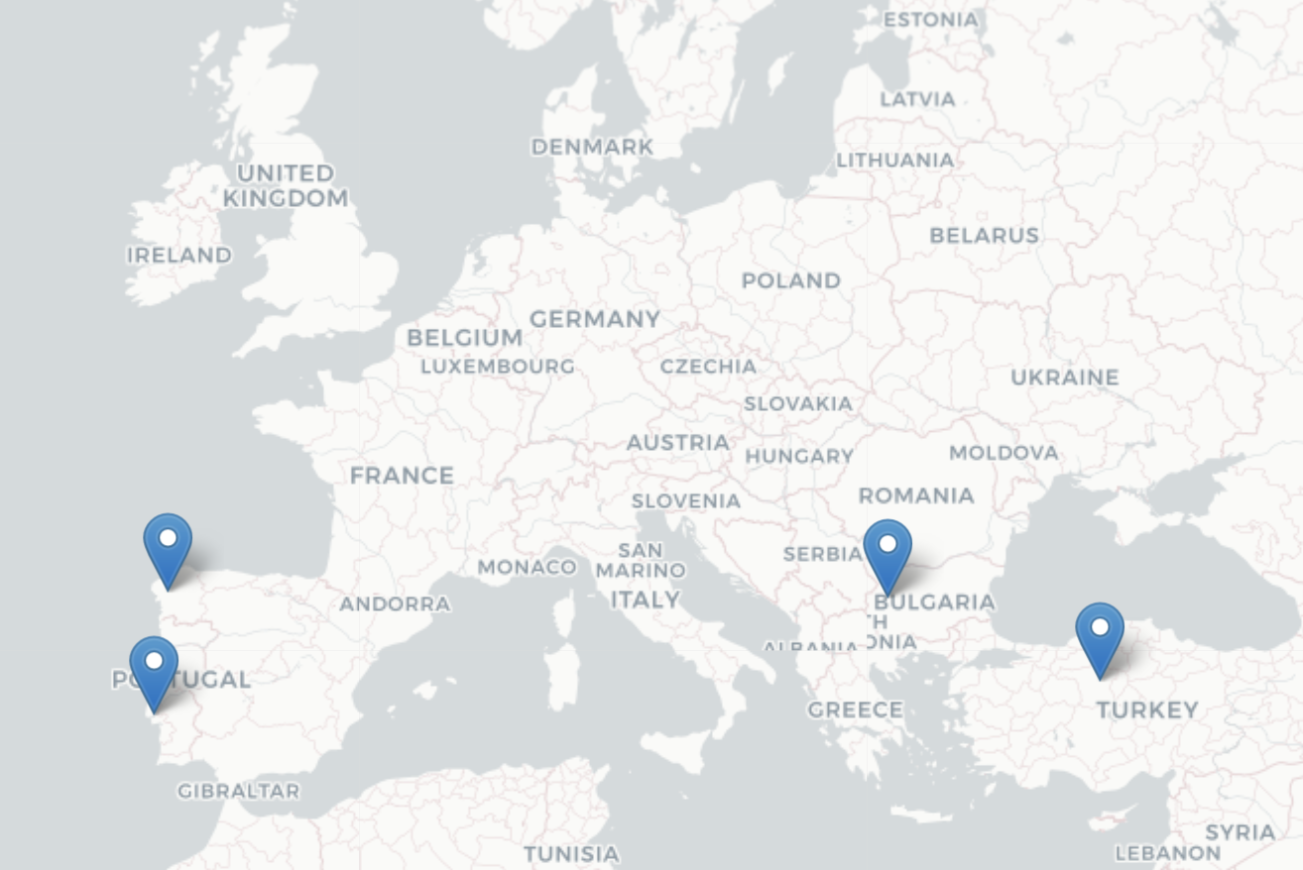
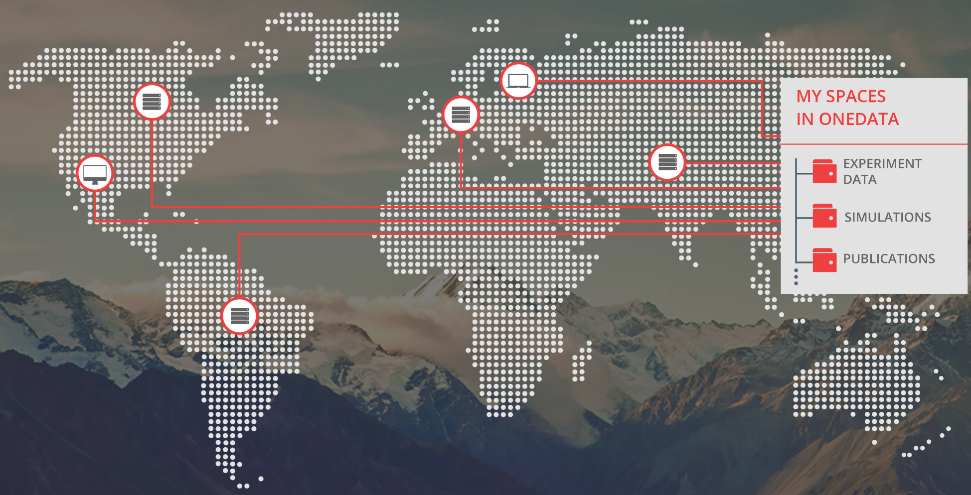
The EGI Infrastructure
Platform and community specific services built on top:
Scientific gateways, Virtual Research Environments, Application portals, etc.
High-Throughput Compute
(ARC-CE, HTCondorCE, SRM, webdav, XrootD)
Cloud Compute
(based on OpenStack. Since 2013)
EGI Internal services
Service registry
Monitoring
Accounting
Helpdesk
Single sign-in
Security oversight
Capacity management
etc.
High Performance Compute
(since 2022)
…
Data
(based on OneData)

Slide 9



EGI Value Propositions
Services for Research
Services for Federation
Services for Business
Our large-scale computing and data analytics services are helping scientists to accelerate their research.
Our internal services provide tools for coordination of the EGI Federation, improving how we work together.
We help companies to exploit and provide services and resources for compute- and data-intensive research and innovation.

Slide 10
Access policies
Wide access
Users can freely access scientific data and digital services provided by EGI resource providers
Policy-based
Users are granted access based on policies defined by the EGI resource providers or by the EGI Foundation
Market-driven
Users can negotiate a fee to access services either directly with EGI resource providers or indirectly with the EGI Foundation
Example:
EGI Notebooks open instance
EGI Cloud pool for application piloting
Example:
Biomed HTC VO pool for life sciences
INFN-Bari (IT), IN2P3-IRES (FR), ULAKBIM (TR) provide Clouds for the National Bioinformatics Infrastructure of Sweden
Example:
FitSM training by EGI Foundation
4 EGI Cloud providers deliver to Exprivia

Slide 11




Allocating services and resources
Type, number, size, cost, availability, etc.
Negotiator
Applic.
provider
Instance requirements
Conditions
Storage
provider
Cloud
provider
Foundation
HTC
provider
Users’ representative
Service Level Agreement
Operation Level Agreement
Training
Support
Regular satisfaction interviews
Federation members
Regular service delivery reports
Ensure satisfaction, capture achievements,
record feedback
Ensuring that agreed targets are met

Slide 12

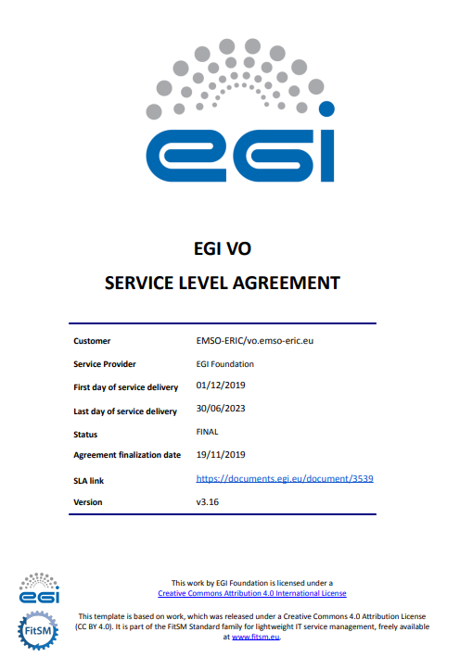


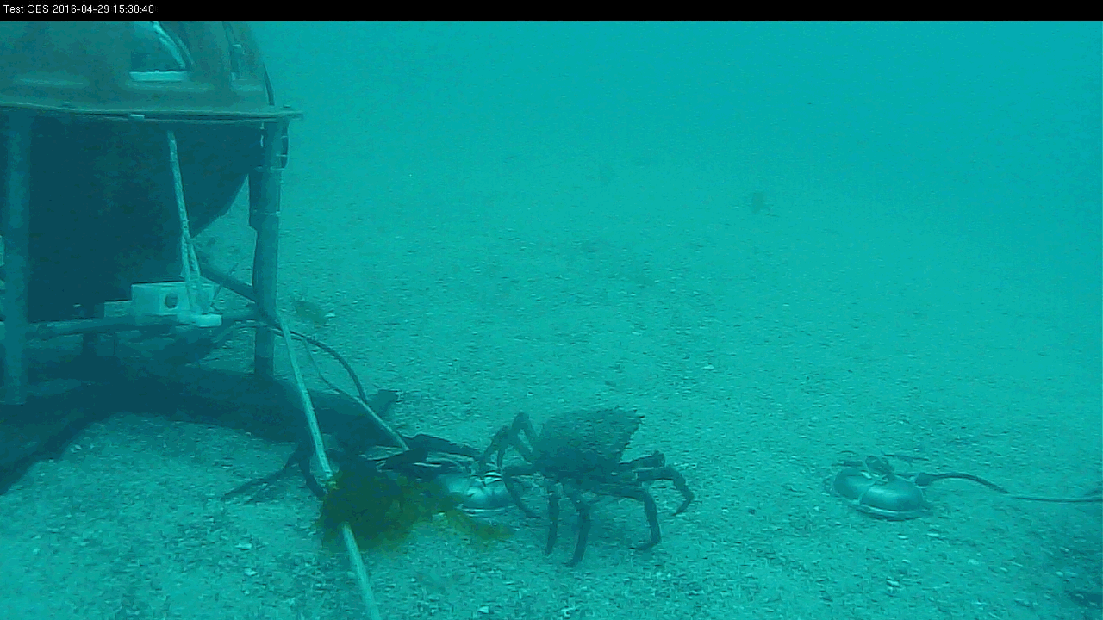
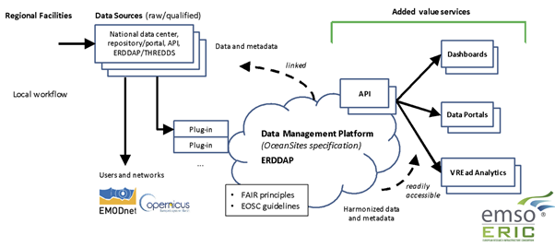
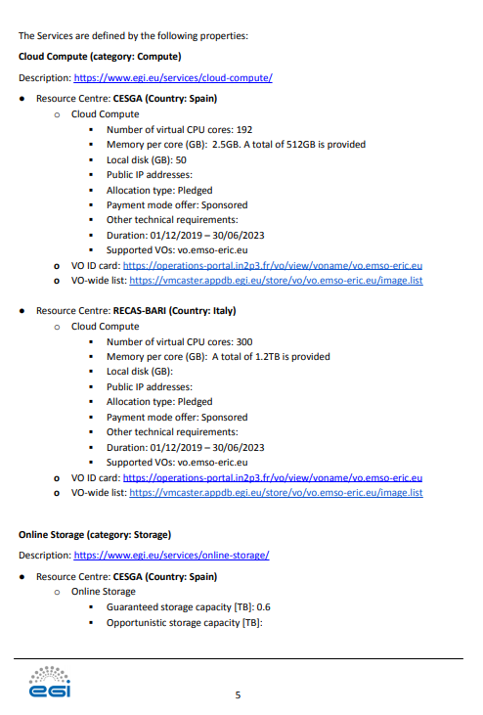
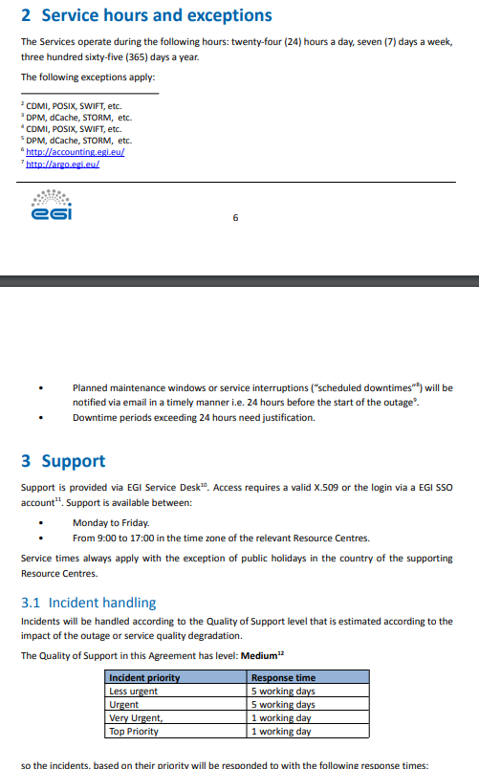



An SLA example
Read the full story: https://www.egi.eu/case-study/emso-eric/
SLA
Check the SLA-OLA documents and reports: https://documents.egi.eu/document/3539
OLA-1
OLA-2

Slide 13
EGI allocations for the Asian Pacific (AP)
TLP: GREEN Limited disclosure
ISGC 2023

Slide 14
EGI resource pool for Asia Pacific
A Virtual Organisation (alias resource pool) in the EGI cloud federation
With a community specific Notebooks installation
With a community specific Replay installation
Purposes:
    To facilitate open science in the region → IN THE SCOPE OF THE TUTORIAL TODAY
    To enable sharing of cloud resources from the region
    To facilitate application sharing from the region
    To facilitate data sharing related to environmental sciences from the region

Slide 15
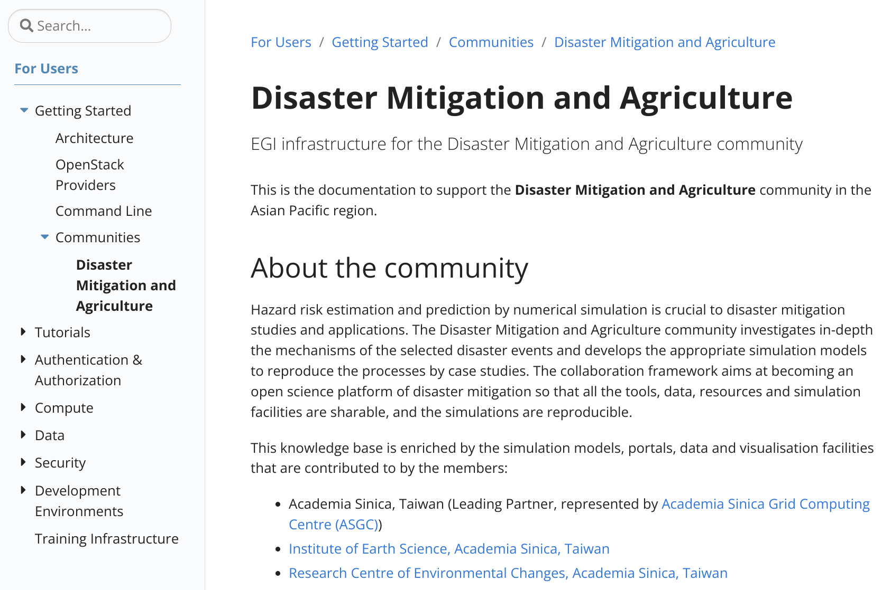
Documentation
https://docs.egi.eu/users/getting-started/communities/dmcc/

Slide 16
Demo: How to use the EGI Cloud resources pool for Asia Pacific
TLP: GREEN Limited disclosure
ISGC 2023

Slide 17
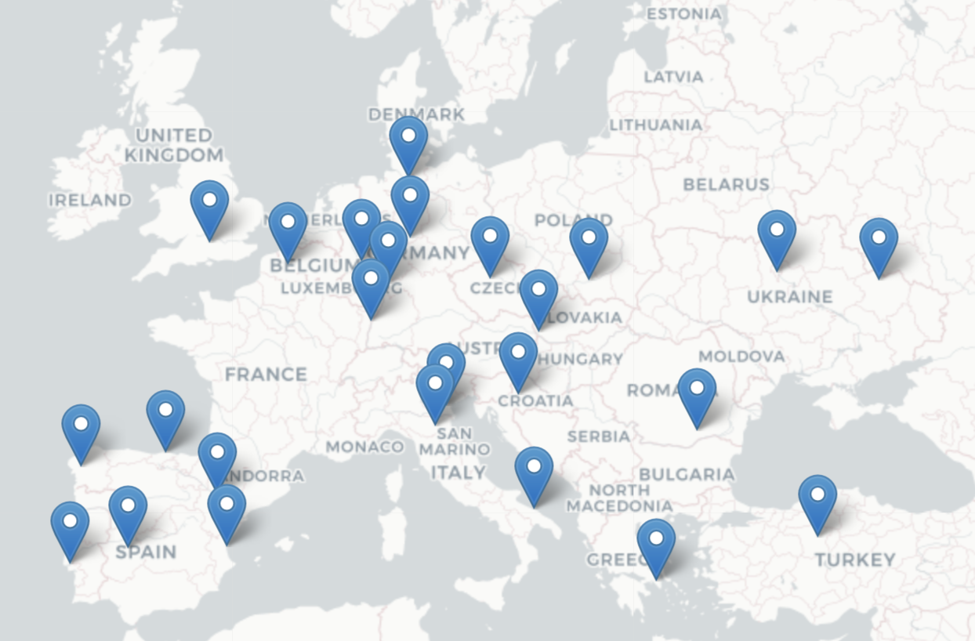
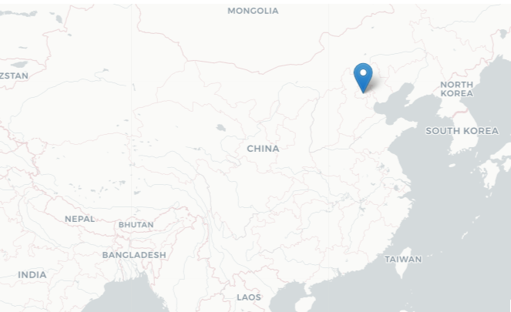
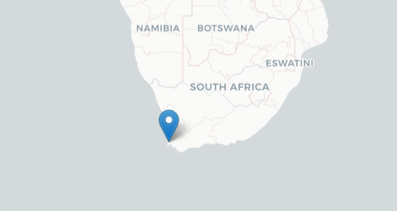
The EGI Cloud Federation
>1.2 Million computing cores
> 1 EB disk & tape
816 service endpoints
Operational since 2013
28 Cloud Providers (OpenStack)
Providing different functionalities and more dynamic platforms for scientists
69,863,034 Cloud CPU/h consumed in 2022
105 Virtual Organisations supported (Virtual Organisation = Resource pool)
Access via GUI, CLI, OpenStack native and libcloud APIs, Terraform

Slide 18
Kubernetes (Containers) in the EGI Cloud
Self-deployed by users
Spin up some VMs and deploy kubernetes (works with existing tooling targeting OpenStack)
Automated deployment with Infrastructure Manager (IM)
Select site, size of VMs and go
Rancher-based access to managed clusters (under development)
Rancher integrated with EGI Check-in
Access to pre-configured clusters managed by expert operators

Slide 19

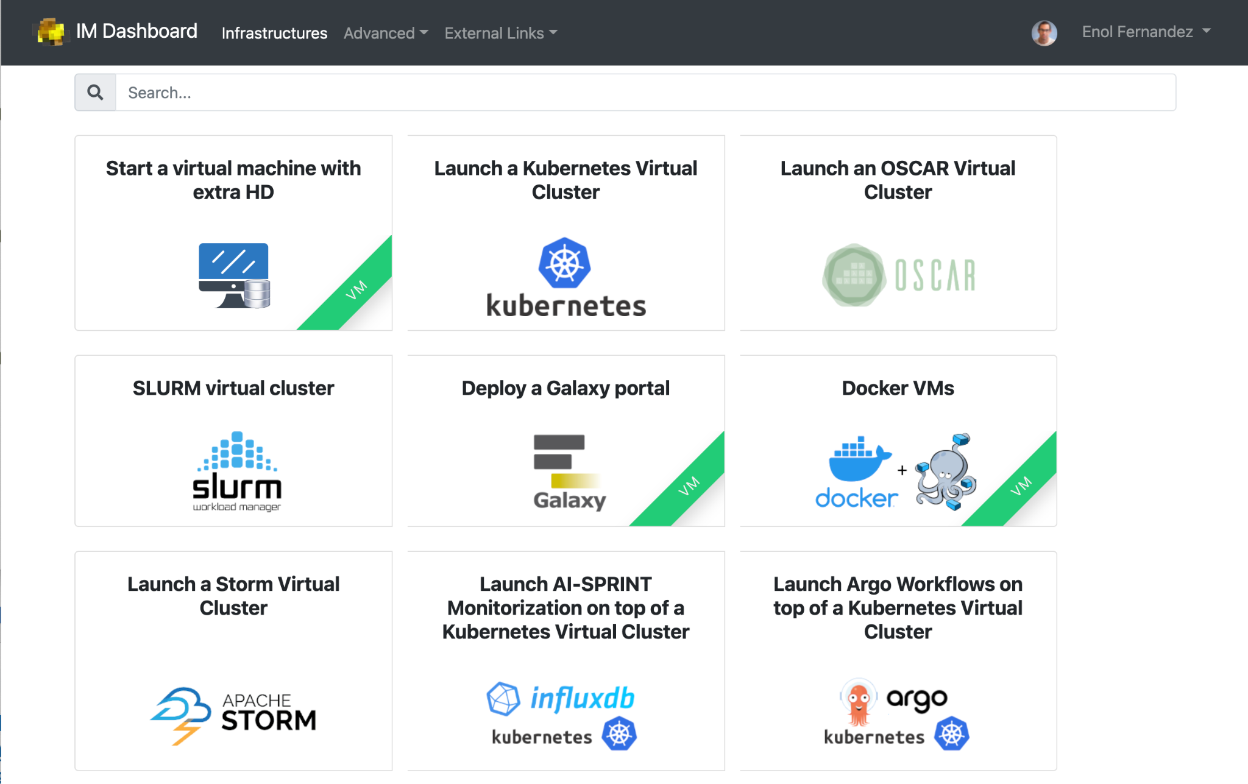
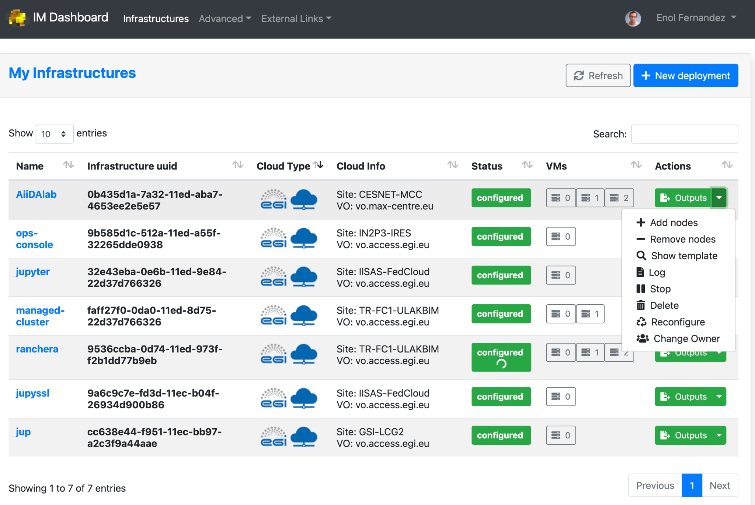
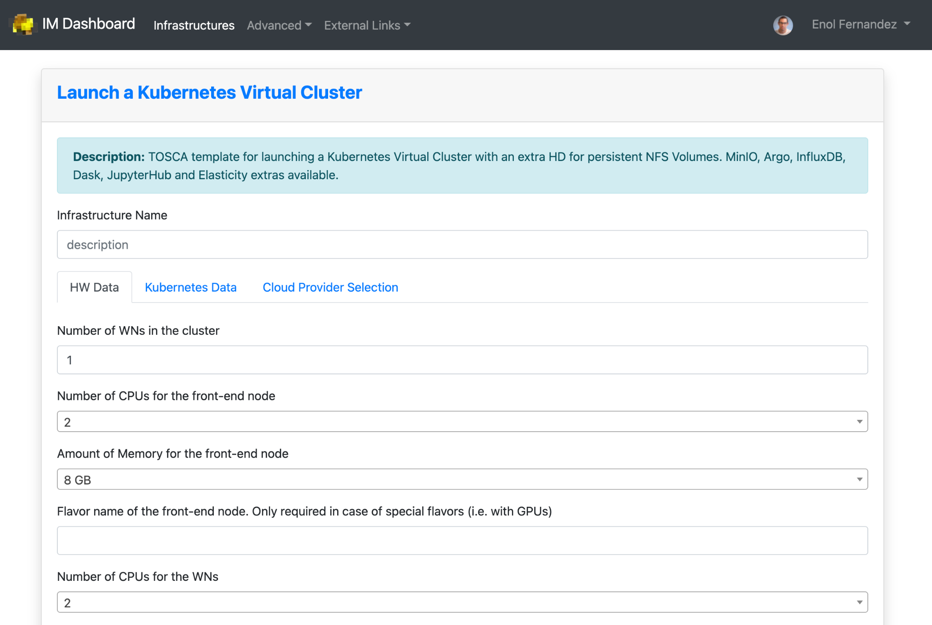
Federation services for Cloud
Infrastructure Manager orchestrates deployment of Virtual Infrastructures
Multi-cloud following Infrastructure as a Code (IaC) paradigm
Rely on Ansible and Helm to manage definition of complex infrastructure
Manages whole life-cycle: deployment, monitoring, reconfiguration (such as scaling-up or down) and removal.
Support for TOSCA

Slide 20
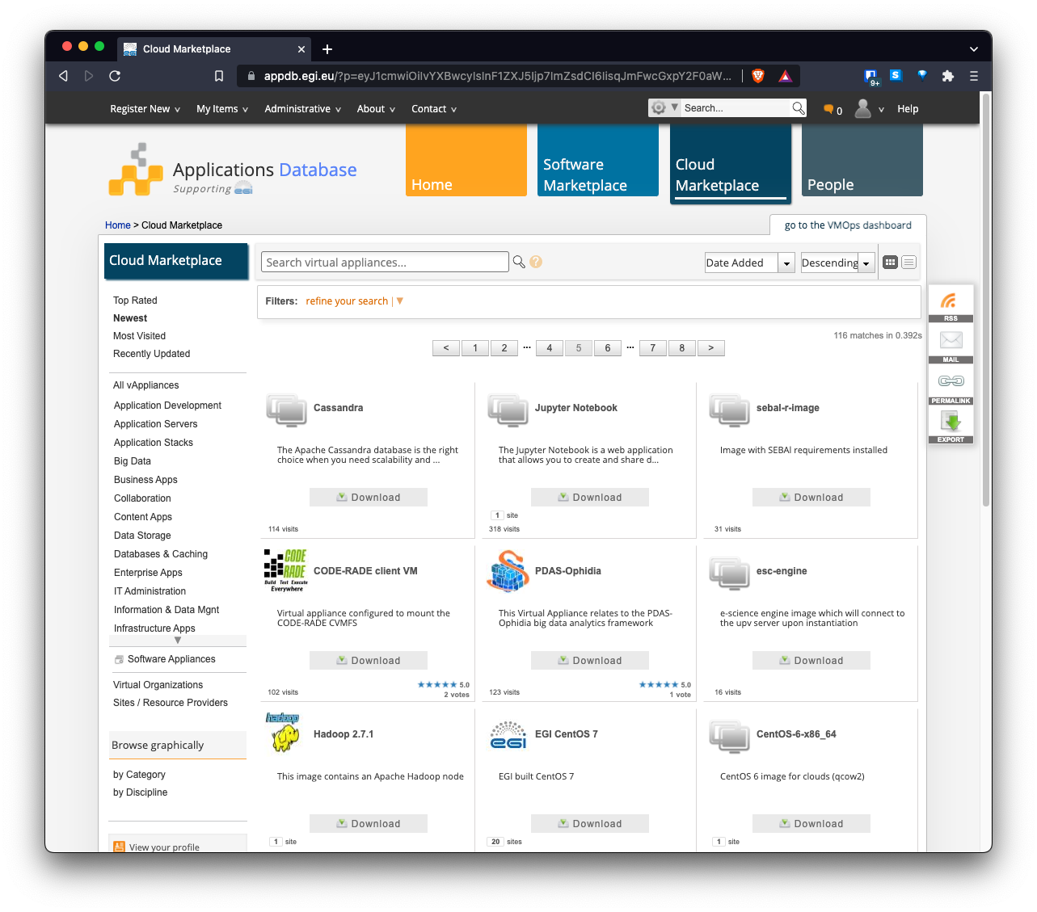
AppDB: an application store for EGI Cloud
Common registry for Virtual Appliances (VA)
VM image + metadata
Available for running at the EGI cloud or on any hypervisor
Community-level management of VAs
Automatic distribution to providers

Slide 21
EGI Notebooks in the Asia Pacific VO
TLP: GREEN Limited disclosure
ISGC 2023

Slide 22

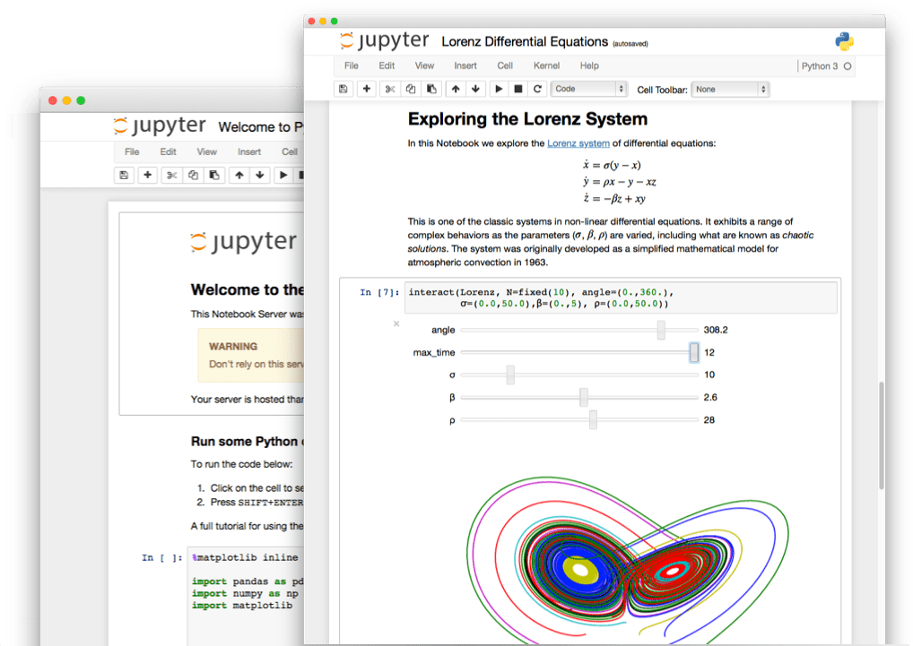
The Jupyter Notebook is an open-source web application that allows you to create and share documents that contain live code, equations, visualizations and narrative text.

Slide 23
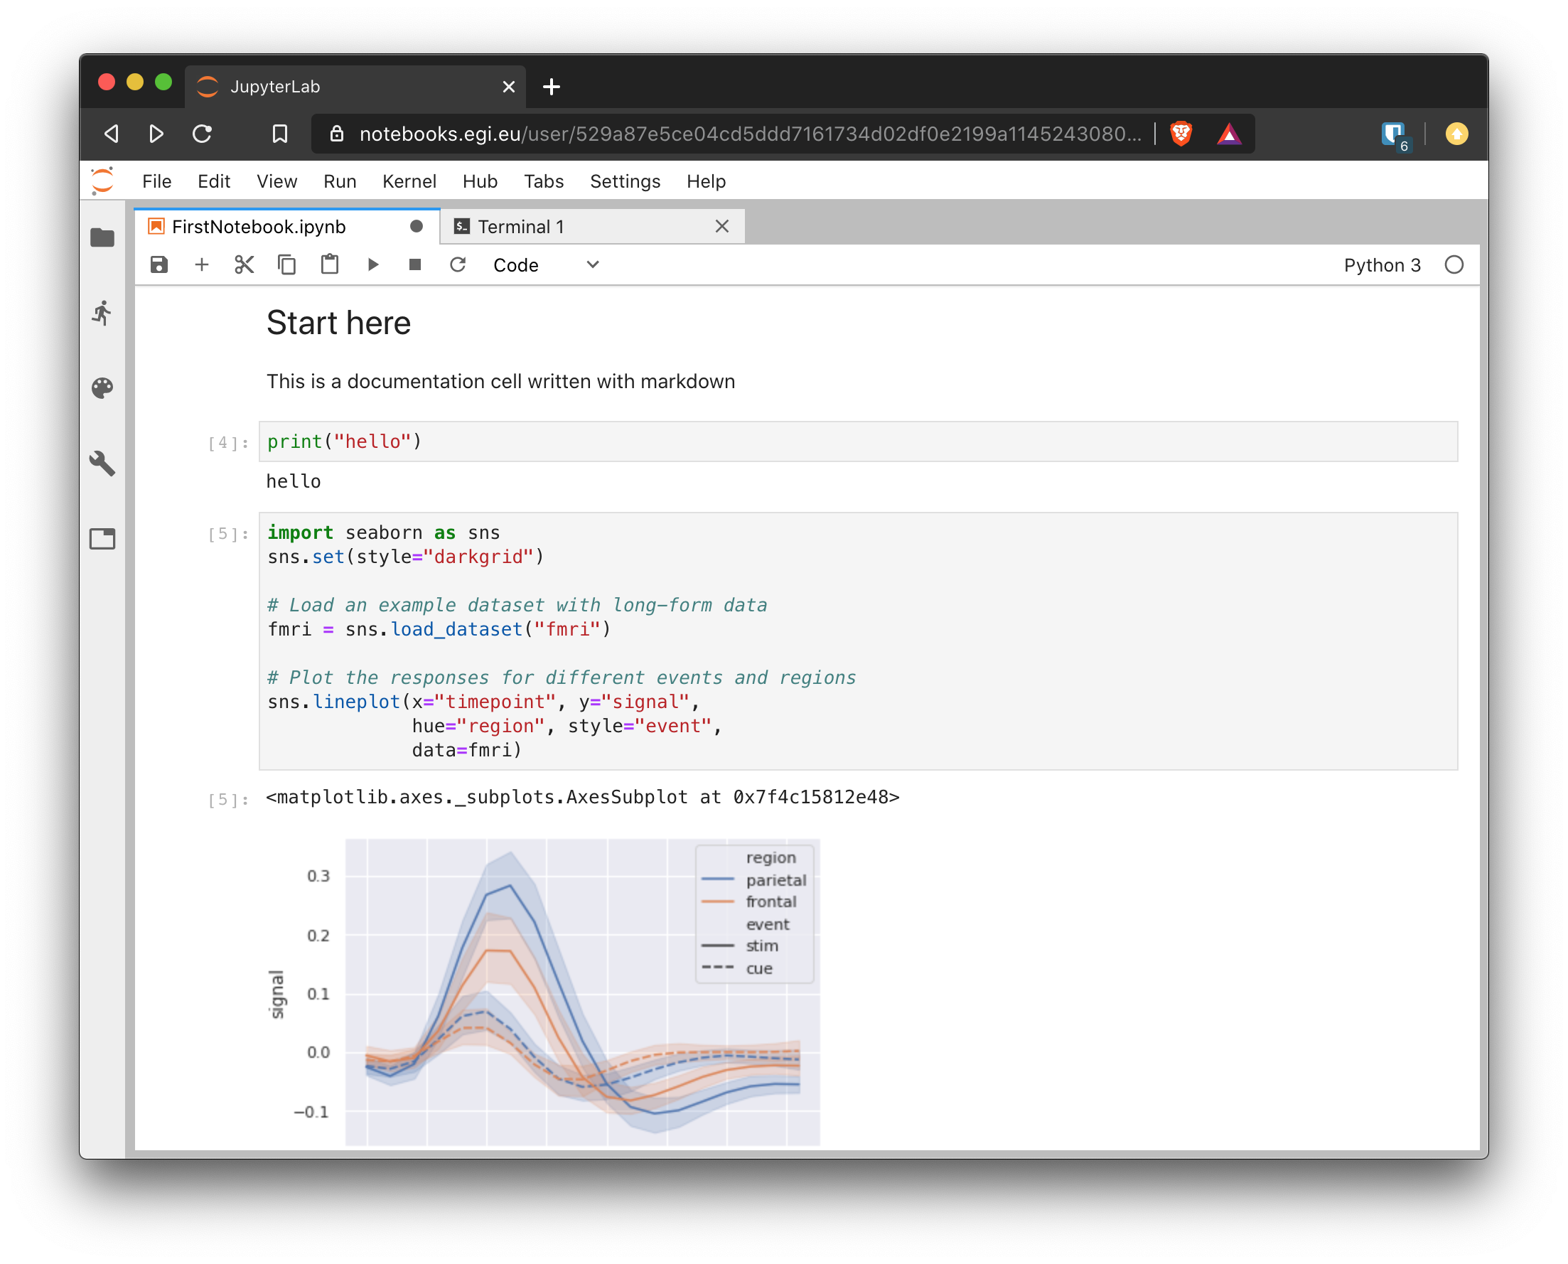




Jupyter
Documentation
Text formatted using Markdown/LaTeX
Code
Use your favourite language
Interactive
browser based environment
Output
Results of the code execution(e.g. plots)

Slide 24

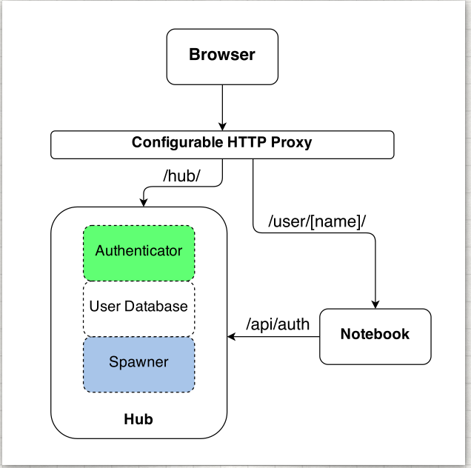
JupyterHub
Jupyter is single user by design
JupyterHub is a multi-user version designed for companies, classrooms and research labs:
  Manages Authentication
  Spawns single-users notebooks servers on-demand
  Gives each user a complete Jupyter server

Slide 25

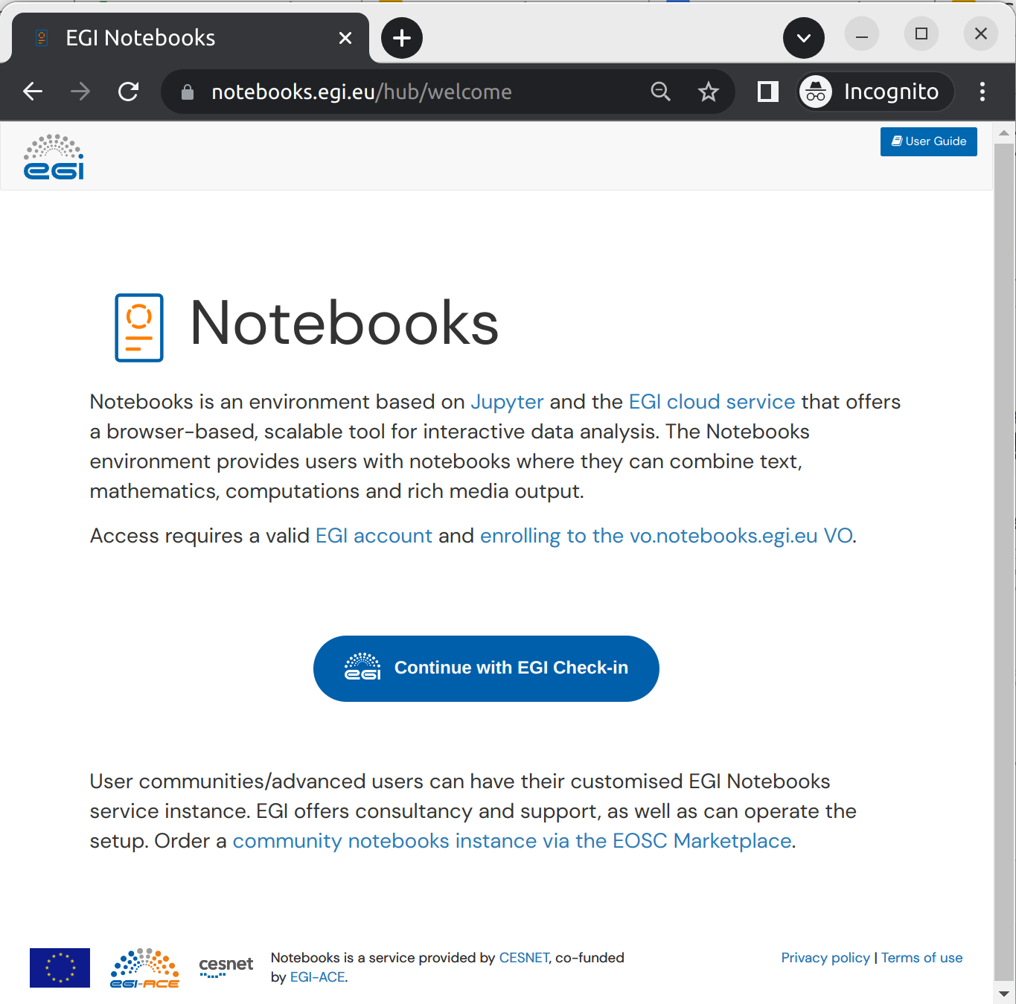
EGI Notebooks
https//notebooks.egi.eu
JupyterHub hosted in the EGI Cloud
  Offers Jupyter notebooks ‘as Service’
  One-click solution: login and start using
Main Features:
  Easy access: Login with the EGI AAI Check-In service
  Persistent storage for notebooks
  Use EGI computing and storage resources from your notebooks

Slide 26









EGI Notebooks integrations
CVMFS
Runs on EGI Cloud providers (Cloud Compute / Online Storage)
Uses Check-in for authentication + access to other services
Makes user-level software available from CVMFS
  DIRAC client for submission of jobs to Workload Manager / High Throughput Compute
  Fedcloudclient for interaction with Cloud Compute
Transparent access to Datahub spaces
Access to 3rd party services: B2DROP

Slide 27
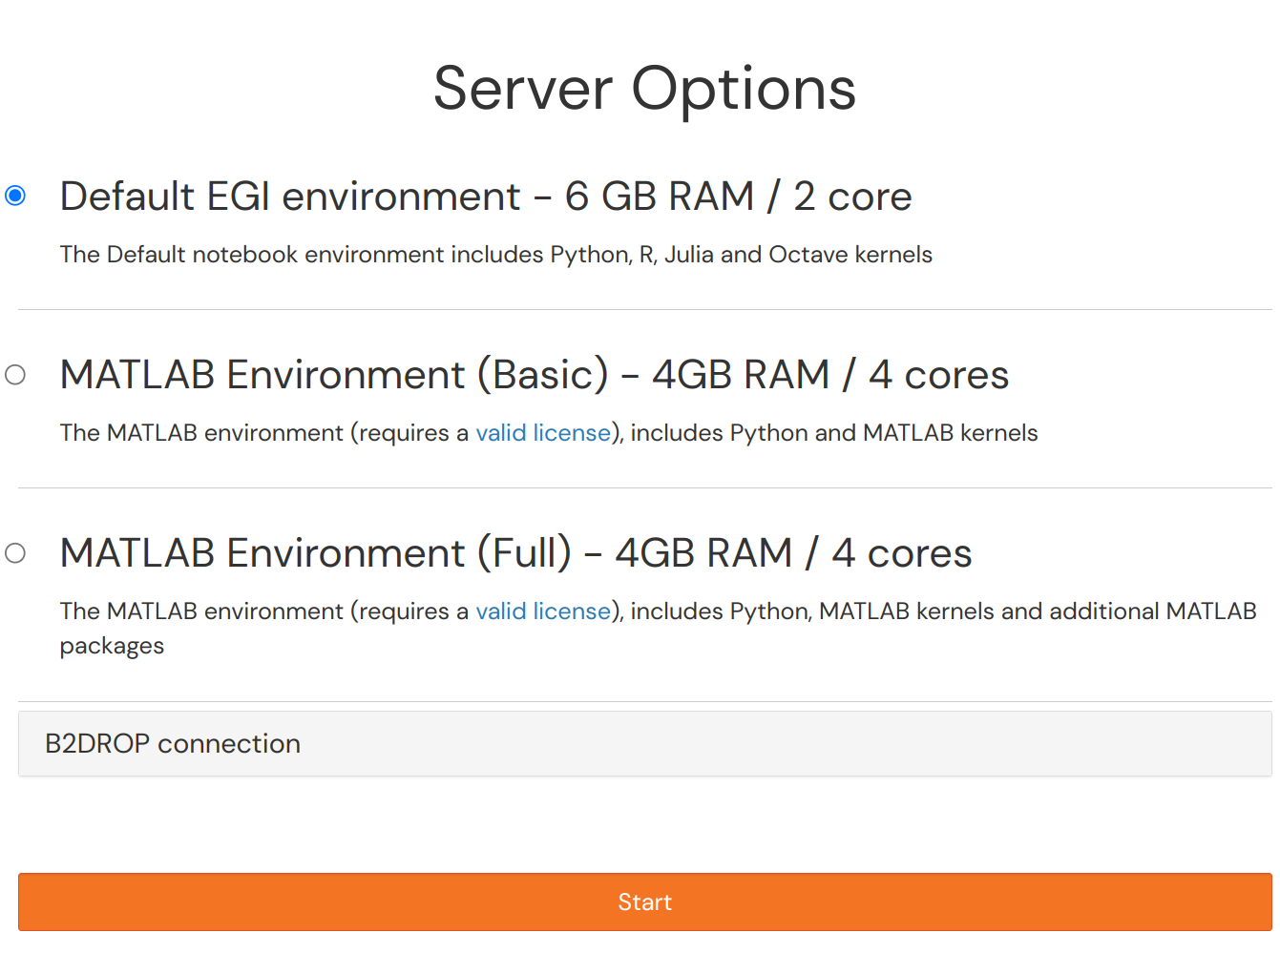
Starting your server
EGI Notebooks offers different computing environments:
  Default: Python, R, Julia, Octave and a wide range of data science libraries
  MATLAB (Basic/Full): Run MATLAB on EGI resources (requires a license!)

Slide 28
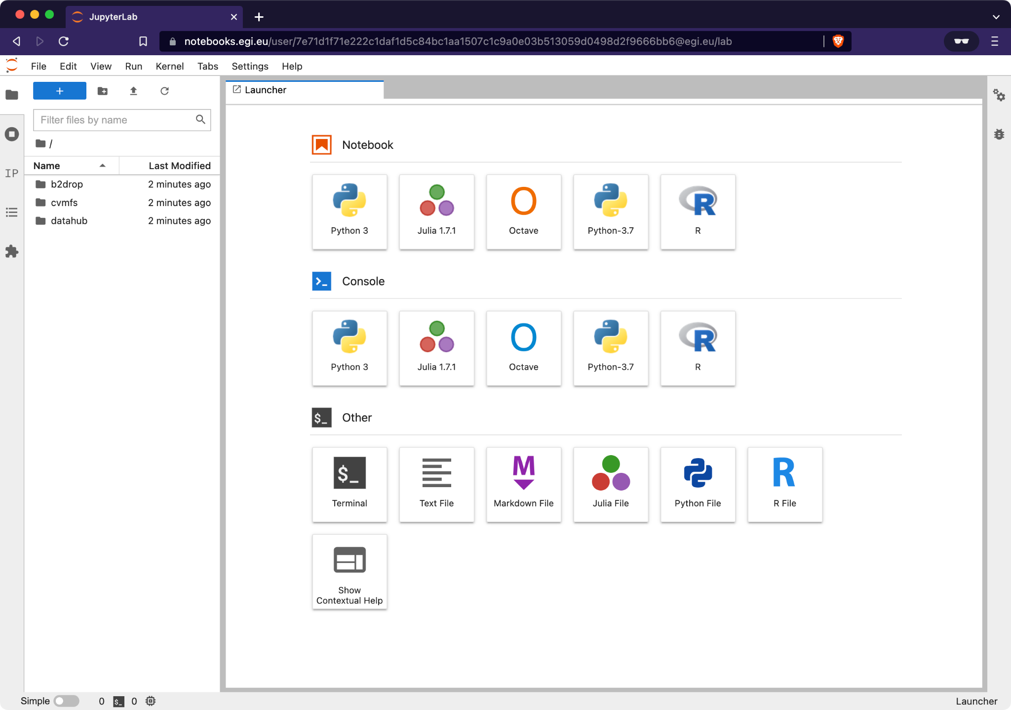
JupyterLab interface

Slide 29
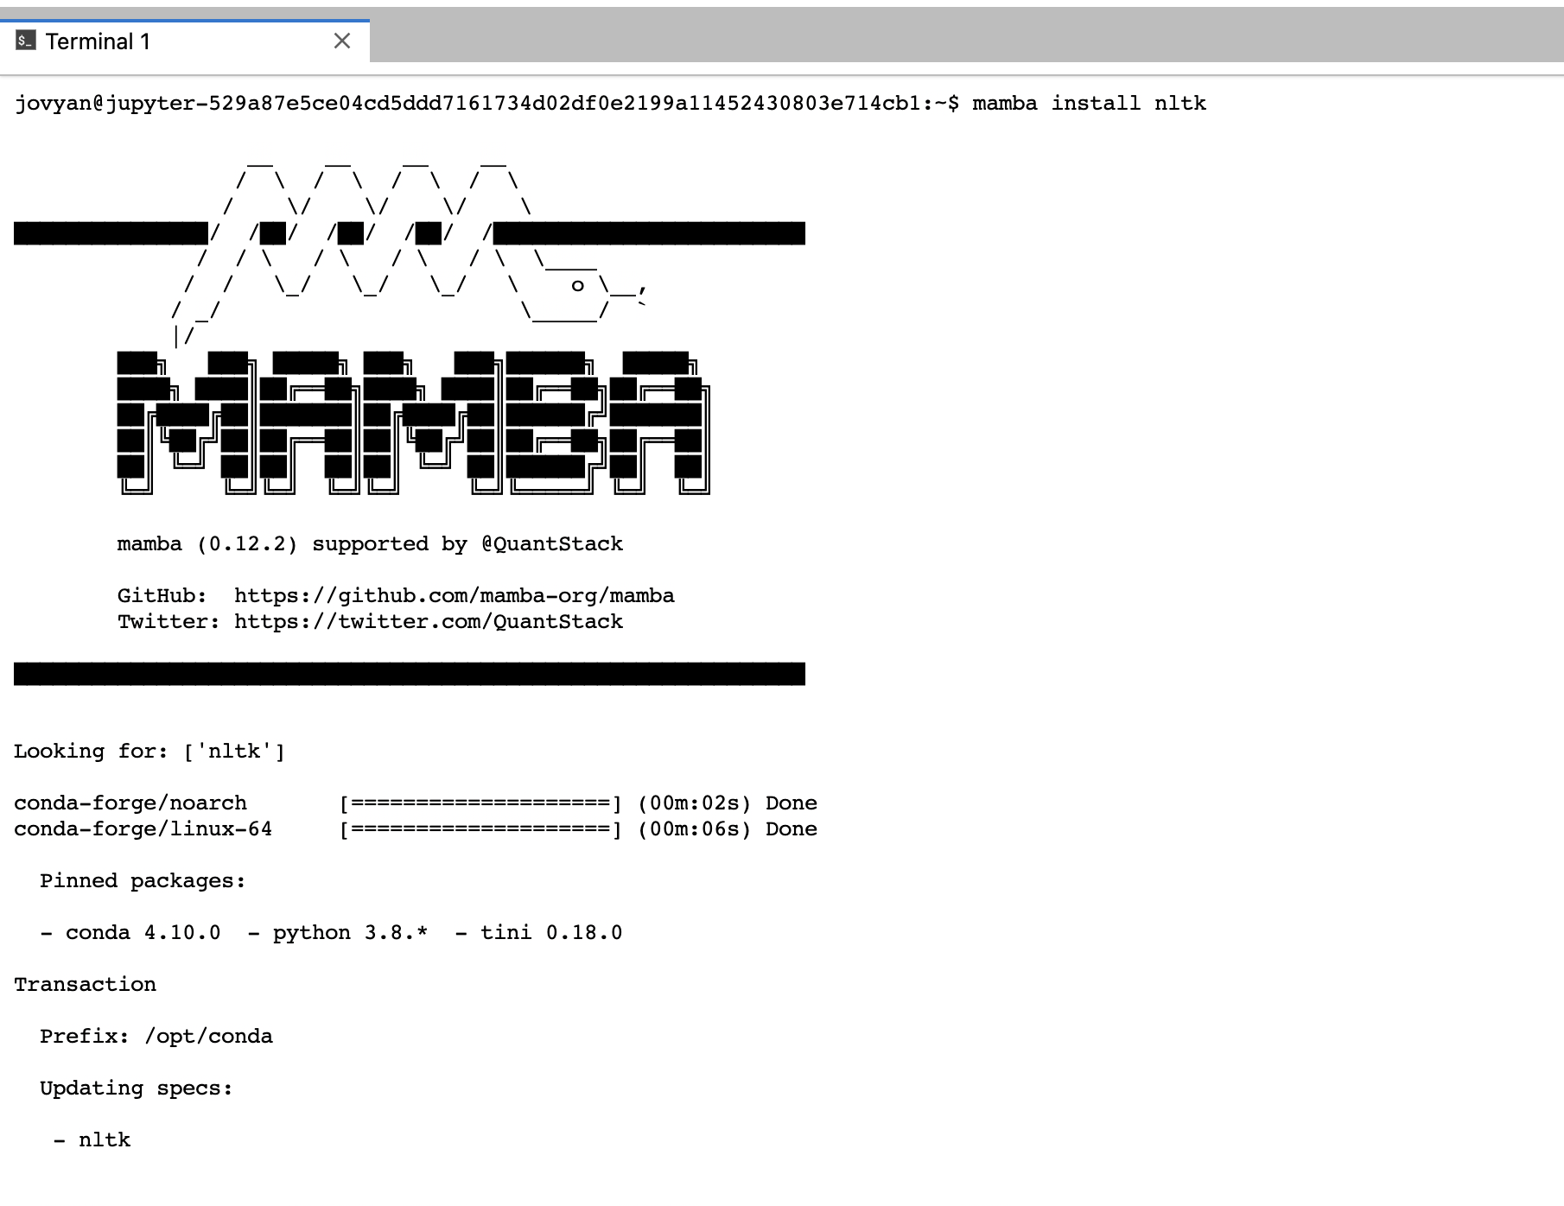
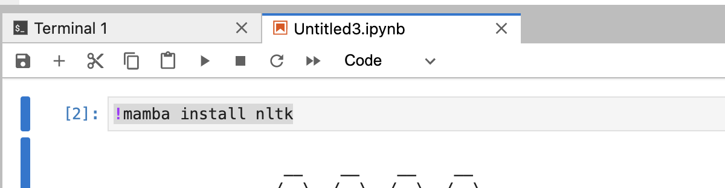
Installing Software
(Most) software in the environment is managed with conda (mamba)
Adding packages can be done at any time with mamba or pip
This is installed in /opt/conda which is wiped out for every new server session!
  Include a installation cell on your notebooks to avoid not having the needed libraries
  Ask us for adding them to the environment!

Slide 30
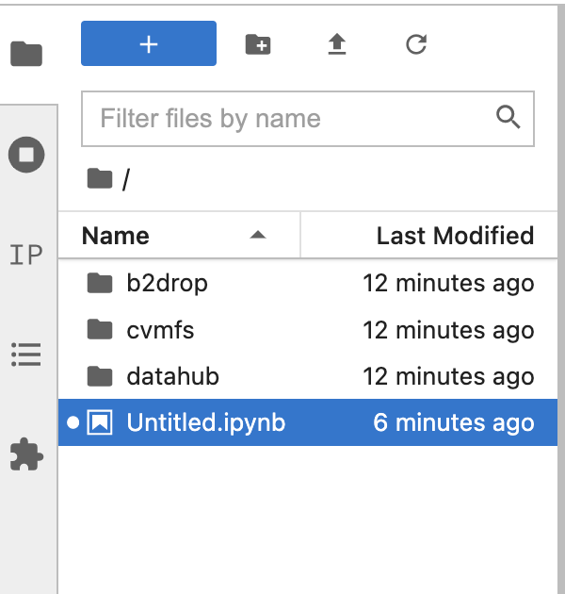
Accessing your data and code
Persistent home
  Can be used to store data (10GB limit)
  Files will be kept even if the notebook server dies
nbgitpuller
  Get code from any git repository from a single URL
  https://hub.jupyter.org/nbgitpuller/link.html
CMVFS
  Selected CVMFS repositories available
  Easy to add community specific ones
DataHub
  Access to your accessible spaces in datahub
  Share data and assign PIDs to shared spaces
B2DROP
  Access data stored in EUDAT’s B2DROP service
External web server
  ….

Slide 31
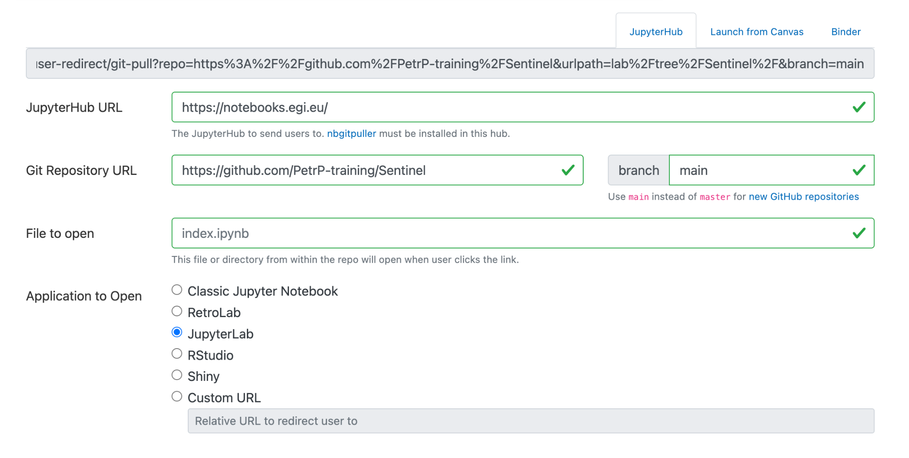
nbgitpuller
https://hub.jupyter.org/nbgitpuller/link.html
Easily clone GitHub repositories into your home with a shareable link.
Try it: https://go.egi.eu/x8oui

Slide 32
CernVM-FS
CernVM-FS (CVMFS) is implemented as a POSIX read-only file system in user space (a FUSE module).
Files and directories are hosted on standard web servers and mounted in the universal namespace /cvmfs.
Main features
Allows centrally managed software distribution across federated environments.
Allows to make content available as a read-only file system that efficiently downloads and caches files on demand
Documentation
https://docs.egi.eu/users/compute/software-distribution/

Slide 33
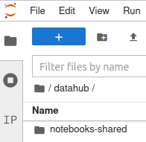

EGI DataHub
Service based on Onedata technology
It allows transparent data access under a common namespace
regardless of the location open access
Access restricted to members of a Virtual Organization (VO)
Data can be accessed via a GUI or APIs
Allows replication of data from data providers for resiliency and
availability purposes. Replication may take place either on­ demand or automatically.
Easy integration with other EGI components thanks to integration with EGI Check-in service, the EGI Authentication and Authorization Infrastructure (AAI)

Slide 34
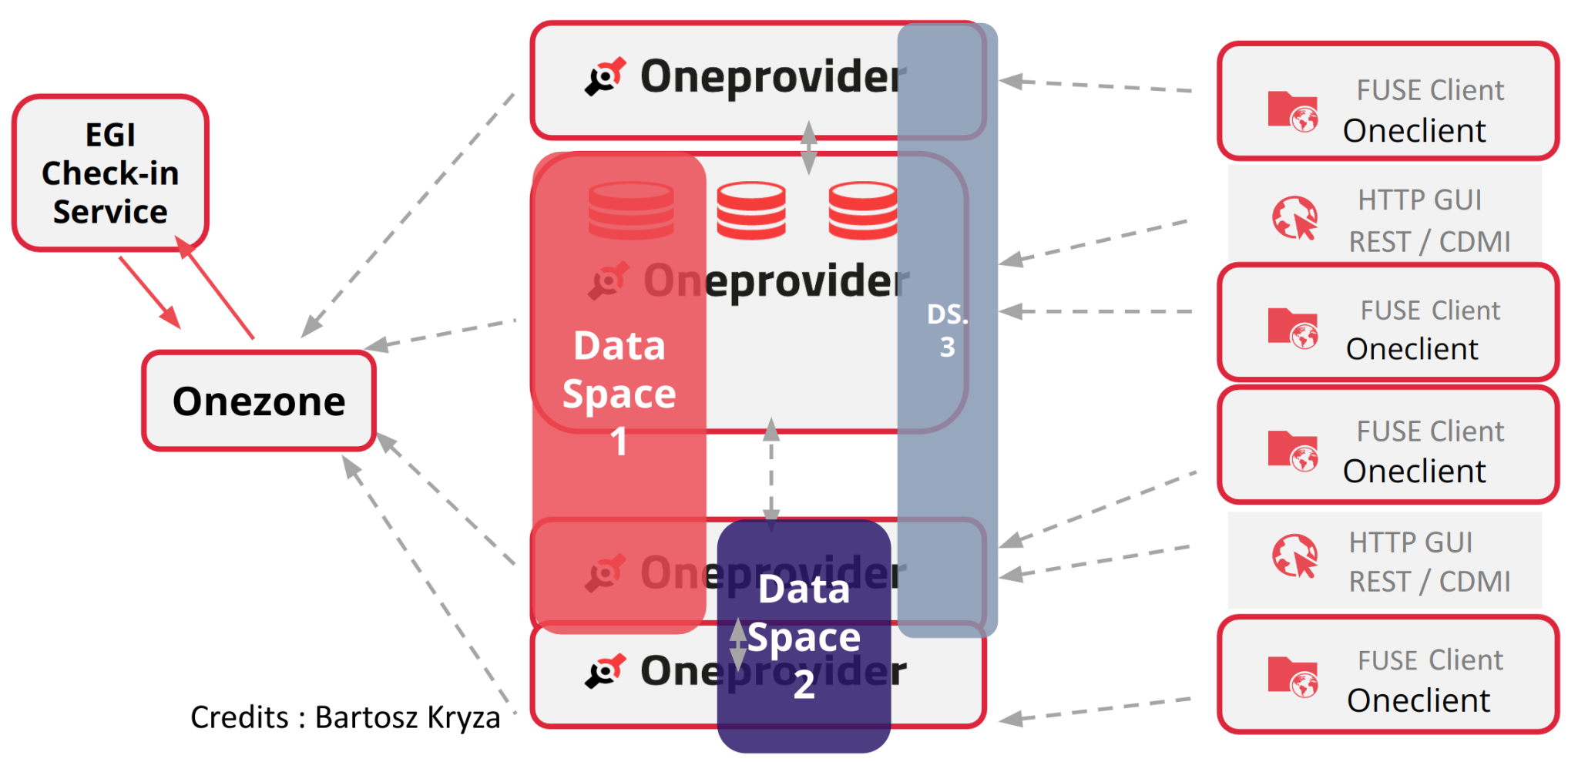
EGI DataHub - Architecture

Slide 35
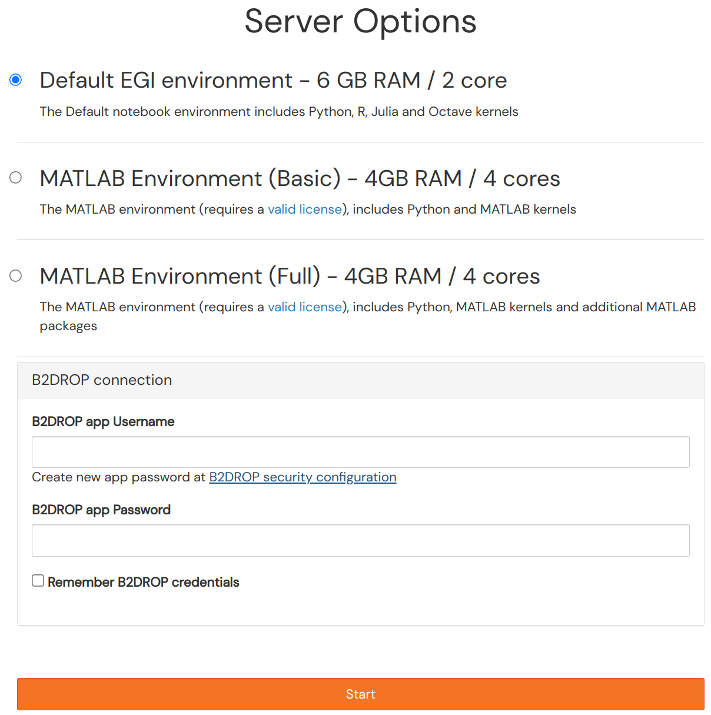
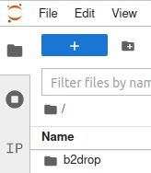
B2DROP
B2DROP is EUDAT Sync & Share solution
Based on NextCloud
WebDav interface that can be accessed remotely
If you want to access your space from the
EGI Notebooks:
Go to B2DROP security configuration
Create an app password
Copy credentials into the EGI Notebooks
Tick the “Remember B2DROP credentials” box to
not keep these credentials in your settings

Slide 36
Getting access with the EGI Notebooks
in the Asia Pacific VO
TLP: GREEN Limited disclosure
ISGC 2023

Slide 37

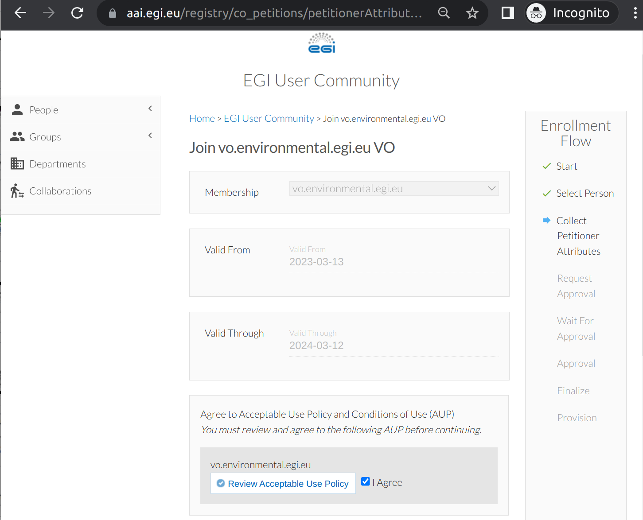
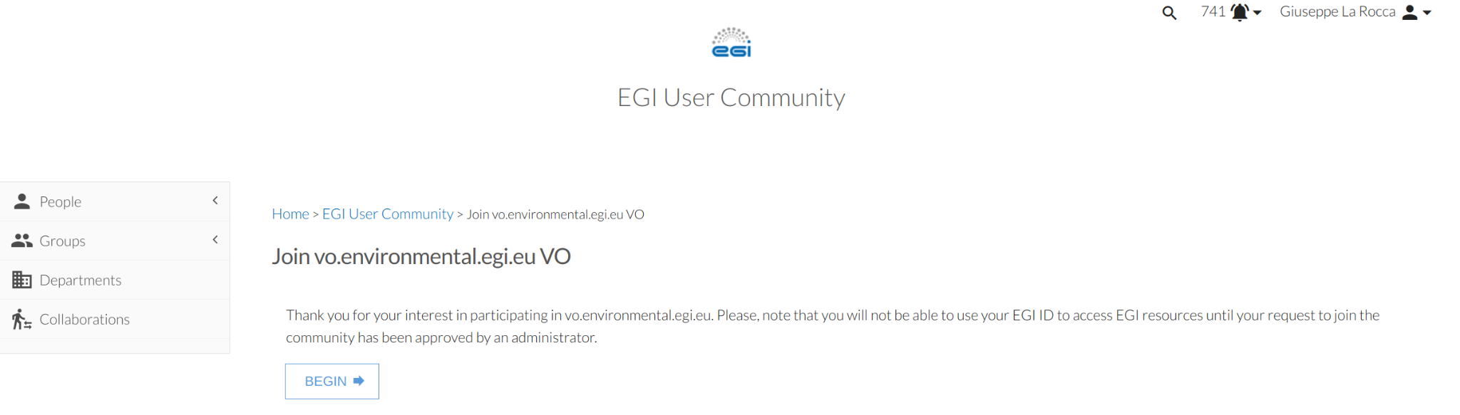
Sign-up and join the VO for the AP region
Sign-up (https://aai.egi.eu/signup) for an EGI Check-In account
Subscribe the vo.environmental.egi.eu Virtual Organisation (VO) by visiting the enrollment URL (https://go.egi.eu/8Hspz) with your EGI Check-In account.
The subscription requires approval from the VO Manager.

Slide 38
Hands-on: Running your first notebooks
TLP: GREEN Limited disclosure
ISGC 2023

Slide 39
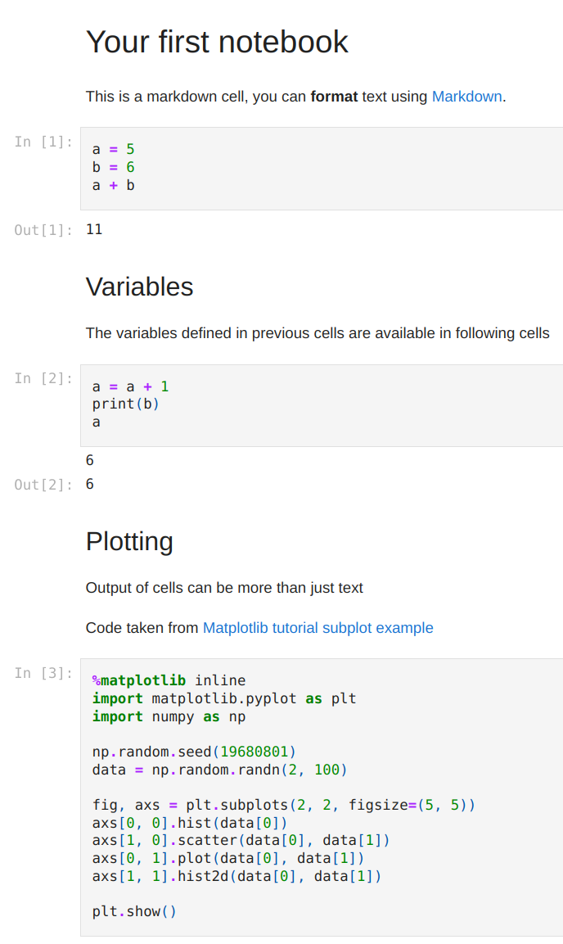
A very simple notebook
To launch the notebook ⇒ go.egi.eu/xABiu
00-first-notebook.ipynb
  GitHub repo for this notebook
  Notebook fetched with the nbgitpuller
Notes:
Create a GitHub repository for the ipynb

Slide 40
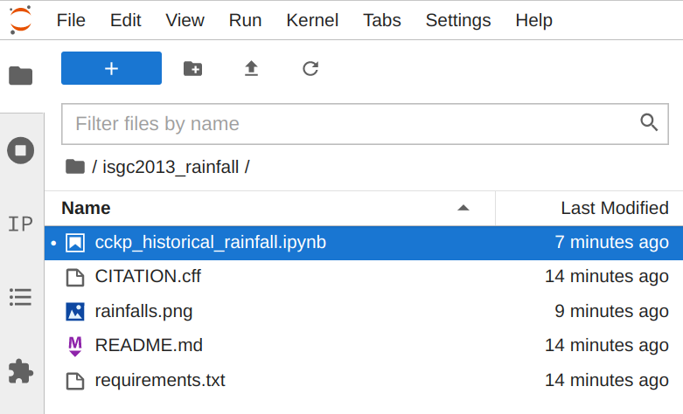
Climate Change Knowledge Portal (CCKP)
cckp_historical_rainfall.ipynb
  Monthly and annual precipitation by country for the period 1961-1999.
  Values are in millimeters (mm).
  Datasets are stored in CVMFS
To launch the notebook ⇒ https://go.egi.eu/KWIsA
See: “How to make datasets and application in CVMFS”
Notes:
Create a GitHub repository for the ipynb

Slide 41

Coffee break
ISGC 2023

Slide 42

EGI Check-in
Check-in provides authentication, authorization and user management for the EOSC Compute Platform
Standards based:
SAML 2.0 / OpenID Connect 1.0 / OAuth 2.0 / LDAP
Interoperable:
AARC and EOSC AAI compliant
Support for legacy X.509 services via MasterPortal
Community management:
Comanage and Perun supported
Other Community AAIs pluggable

Slide 43
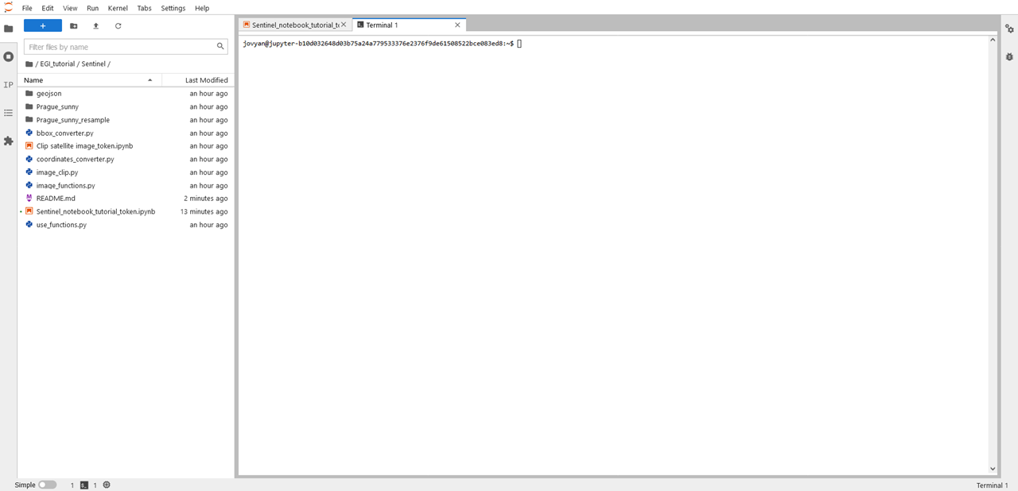
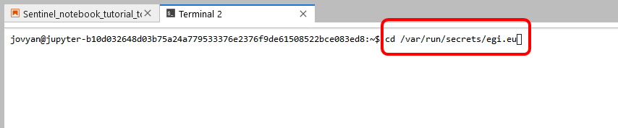
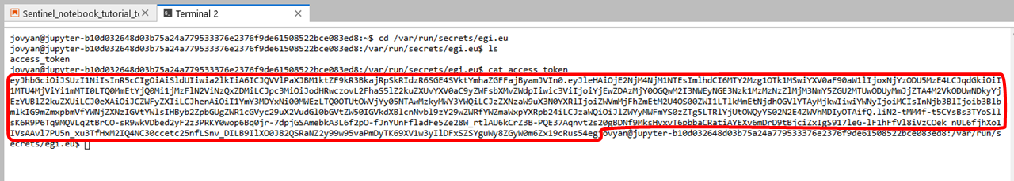
Where to found the token in the EGI Notebooks

Slide 44
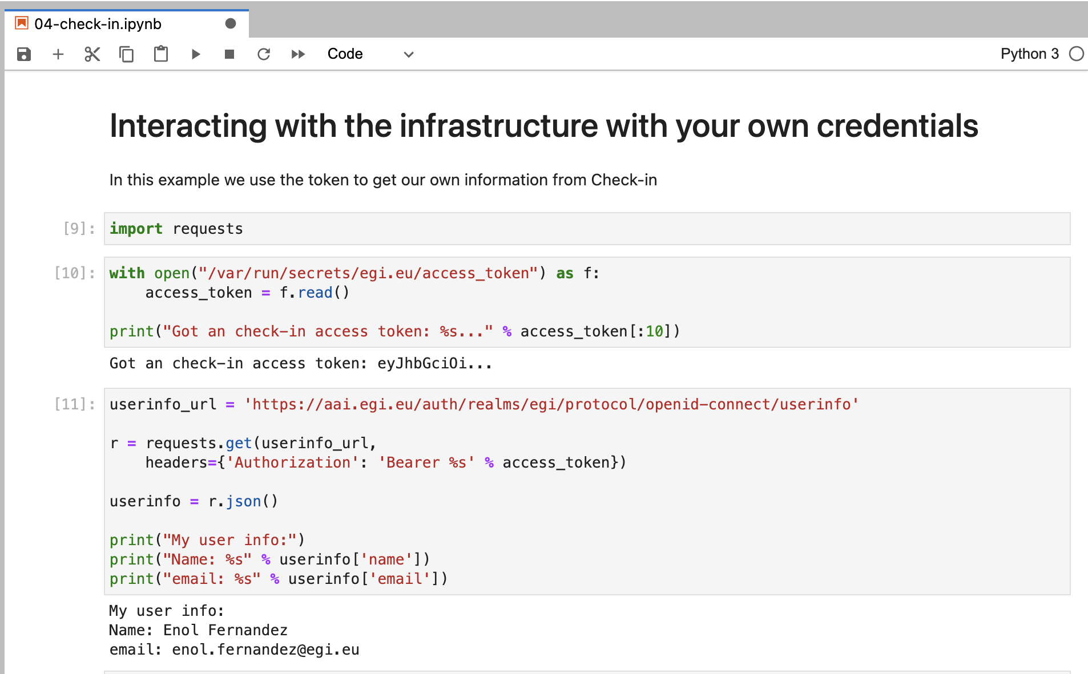
Get info about yourself

Slide 45
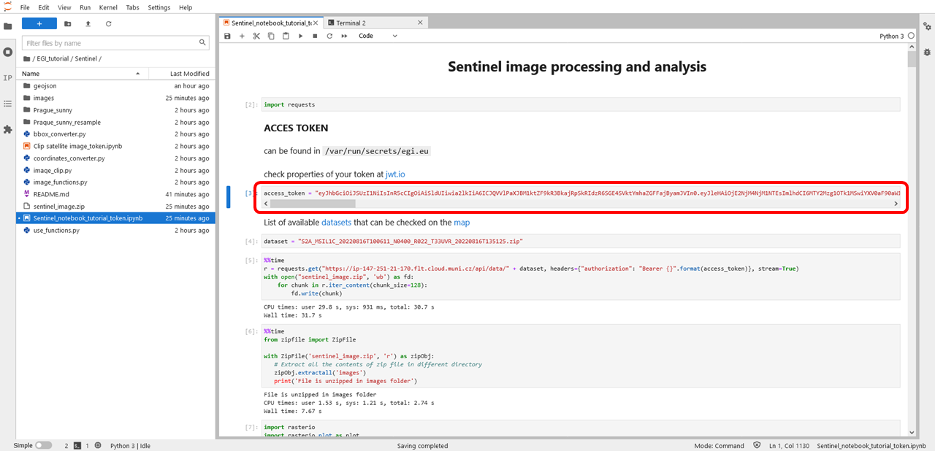
Sentinel image processing and analysis
Sentinel_notebook_tutorial_token

Slide 46
Approach to reproducible
Open Science with EGI and EOSC
TLP: GREEN Limited disclosure
ISGC 2023

Slide 47
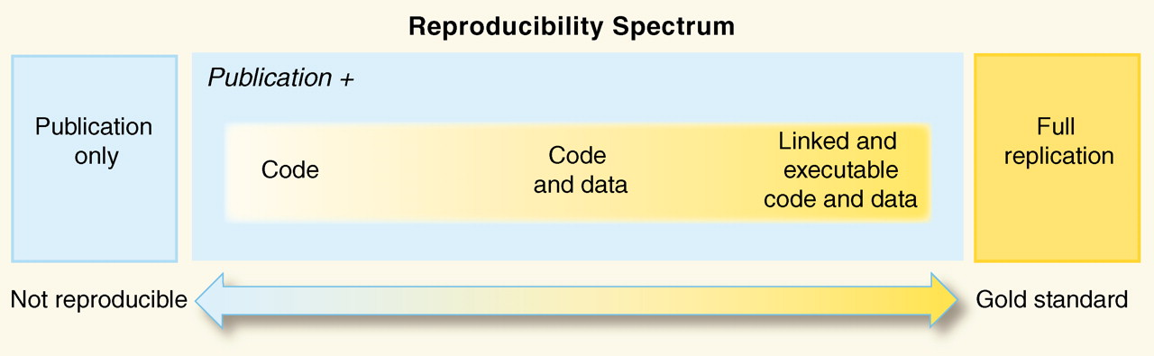
Reproducibility: beyond sharing code and data
Peng, Science, 2011

Slide 48
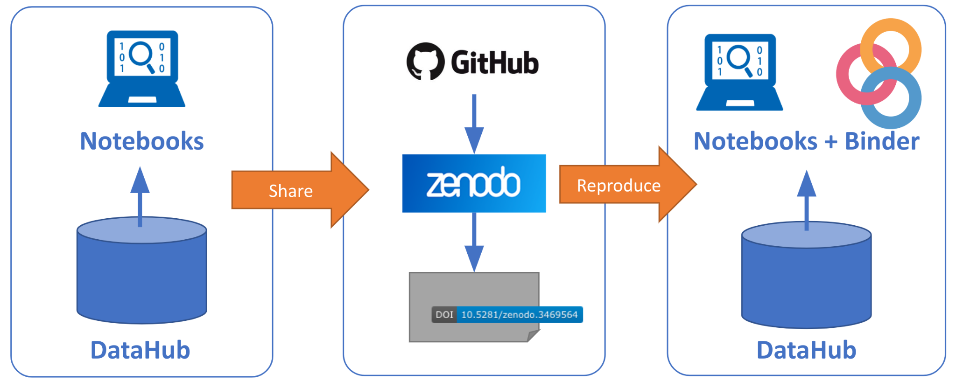
Reproducible Open Science in EGI/EOSC

Slide 49
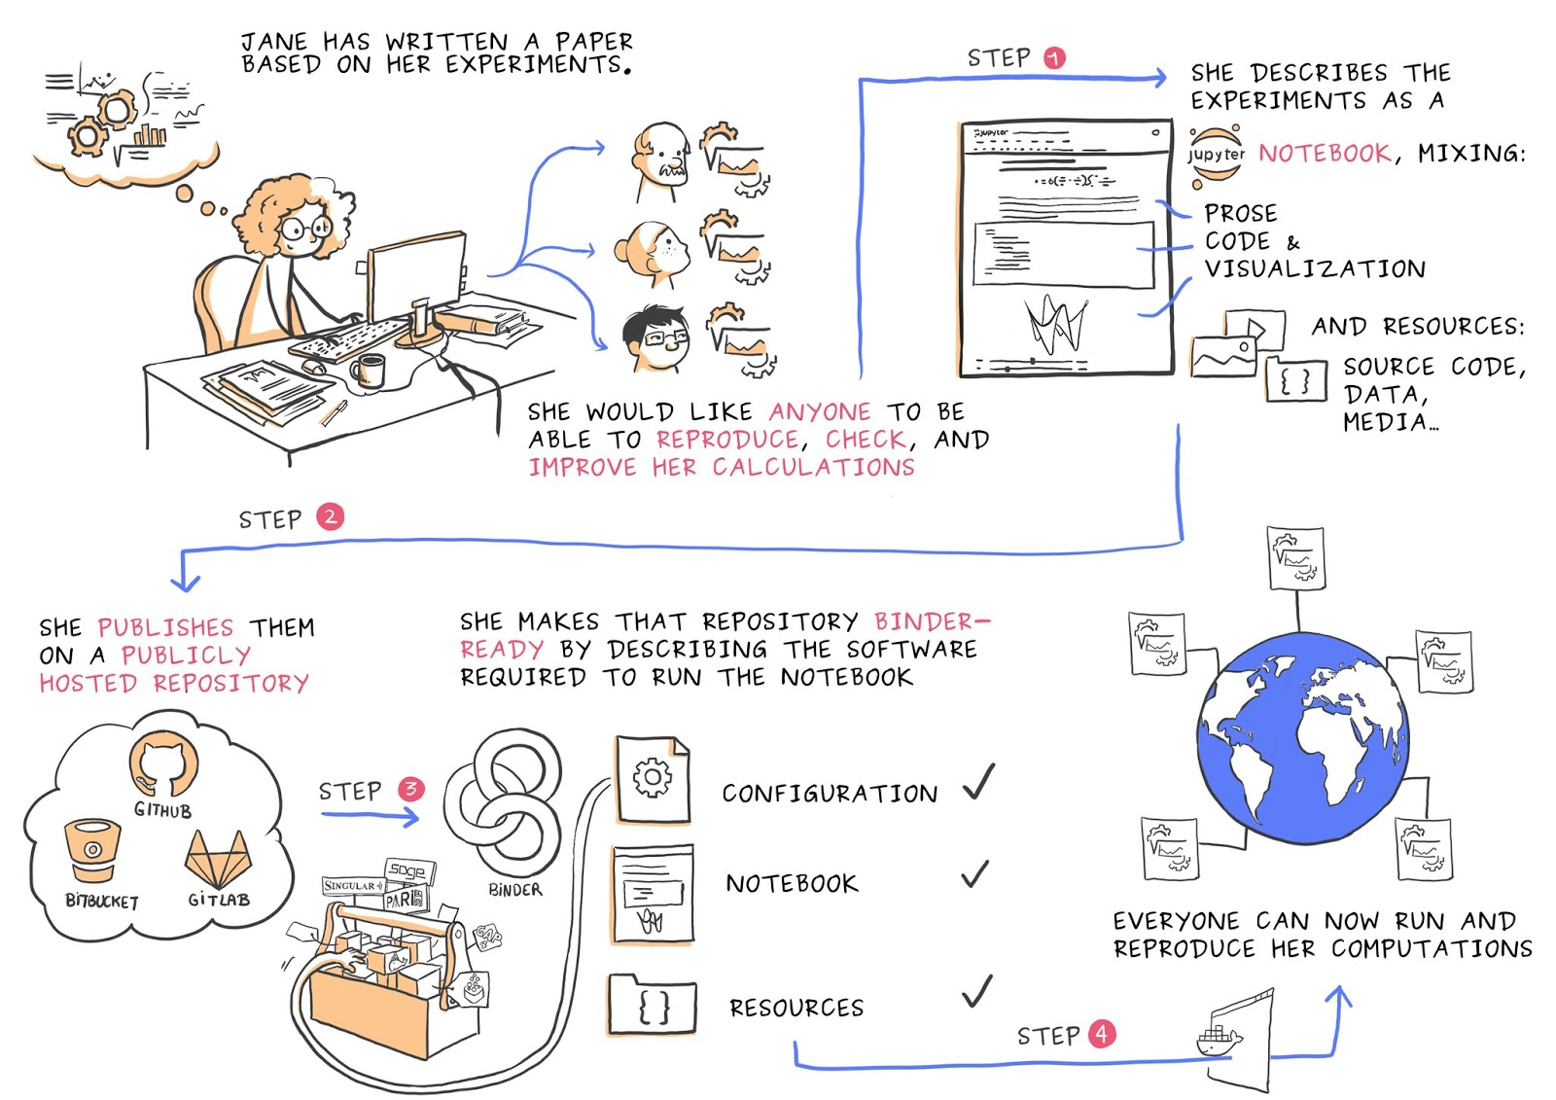
Binder: reproducing execution environments
An open-source web application to turn repositories in interactive notebooks
It uses modern technology in cloud orchestration (Kubernetes), interactive computing (Jupyter), scientific computing (the open-science ecosystem)
Notes:
Generate interactive notebooks from repositories

Slide 50

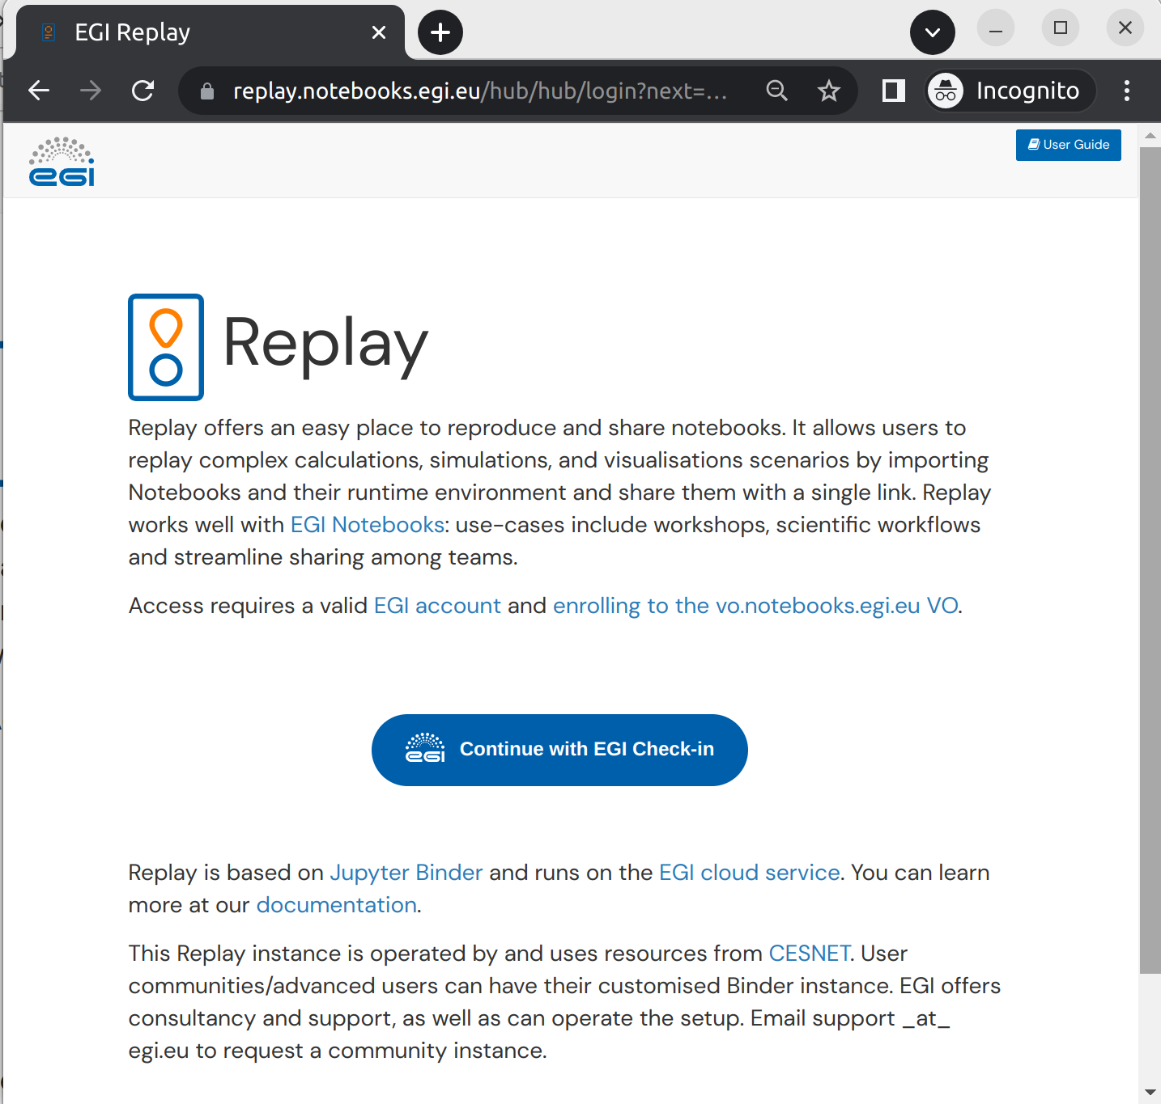
EGI Replay
BinderHub hosted by EGI
Offered ‘as Service’
Same access conditions as EGI Notebooks
Main Features:
Use any binder-compatible repository
Reproduce your notebooks with access
to EGI resources (e.g. DataHub)
No hard limits on sessions duration, customisable resource limits for users/communities

Slide 51
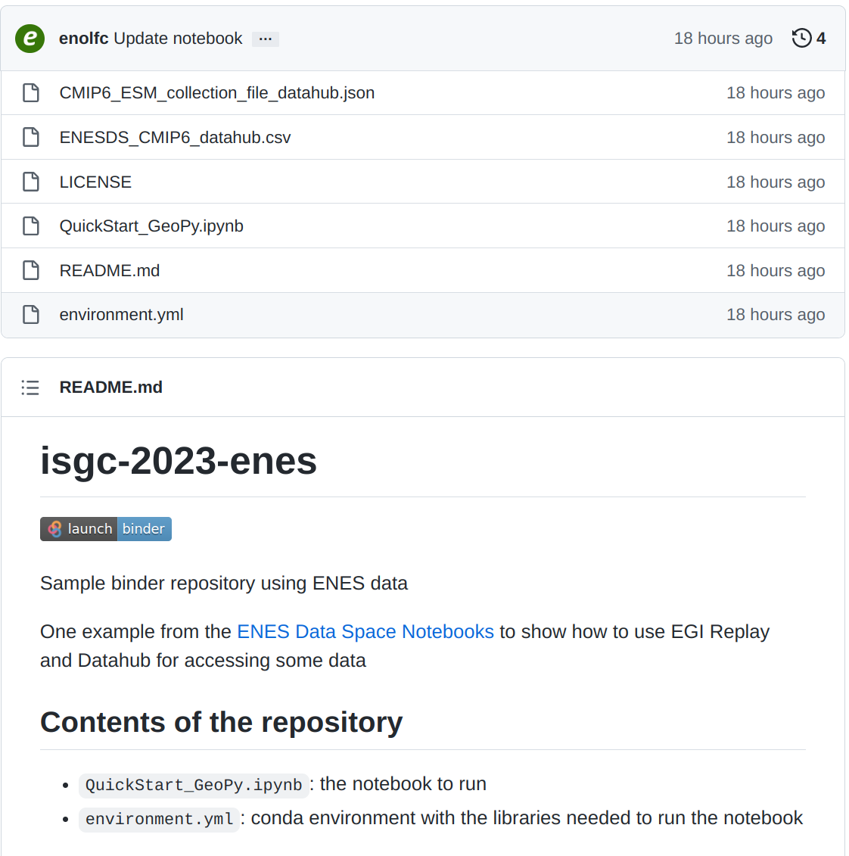
Example: Number of Summer Days in Taipei with EGI Replay
From https://github.com/enolfc/isgc-2023-enes
QuickStart_GeoPy
  Calculate the number of summer days in the specific location
  From the ENES Data Spaces
  Datasets are stored in DataHub
See: “How to make your datasets available in DataHub”

Slide 52
How to make notebooks
Reproducible and Shareable
TLP: GREEN Limited disclosure
ISGC 2023

Slide 53

Create your first sharable notebook
Download your first notebook in your laptop (*.ipynb)

Slide 54

2. Getting a GitHub account
Sign-up if you don’t have an account already

Slide 55



3. Creating a new GitHub repository
2.
1.
Notes:
https://github.com/glarocca/isgc2013_rainfall

Slide 56


4. Adding dependencies
Create the ‘requirements.txt’ file in your repo

Slide 57



5. Executing Notebooks in Replay
https://replay.notebooks.egi.eu/

Slide 58


Unable to launch the server
https://replay.notebooks.egi.eu/
Only 1 server per user is allowed!
Stop server at: https://replay.notebooks.egi.eu/hub/hub/home

Slide 59

6. Adding Binder badge in the GitHub repository

Slide 60


7. Create a new Release for the repository

Slide 61

8. Making repository citable
https://zenodo.org/

Slide 62


9. Synch Zenodo with repository

Slide 63

10. Get Zenodo DOI
Click on the Enabled Repository

Slide 64


11. Add Zenodo badge in repository
Click on the DOI icon to view details
Notes:
DOI: 10.5281/zenodo.7729979

Slide 65

12. Check if the DOI is valid
https://www.doi.org/

Slide 66

13. Use the DOI to reproduce the repository
https://replay.notebooks.egi.eu/
Notes:
10.5281/zenodo.7729979

Slide 67


14. About CITATION files to your GitHub repository
Add a CITATION.cff file to the root of a repository

Slide 68
Future outlook:
How to access and process data
from the European Open Science Cloud
TLP: GREEN Limited disclosure
ISGC 2023

Slide 69
European Open Science Cloud
https://eosc.eu/
The European Open Science Cloud (EOSC) is an environment for hosting and processing research data to support EU science.
The ambition of the European Open Science Cloud (EOSC) is to provide European researchers, innovators, companies and citizens with a federated and open multi-disciplinary environment where they can publish, find and re-use data, tools and services for research, innovation and educational purposes.
This environment will operate under well-defined conditions to ensure trust and safeguard the public interest.
EOSC ultimately aims to develop a Web of FAIR Data and services for science in Europe upon which a wide range of value-added services can be built. These range from visualisation and analytics to long-term information preservation or the monitoring of the uptake of open science practices.

Slide 70

EOSC Architecture
Processing services
(incl. OpenStack, Notebooks)
EOSC Data Transfer service
(currently prototype level)
Portal, Marketplace, Rules of Participation, Order Management, Helpdesk, Monitoring, etc.
EOSC Multi-Annual Roadmap 2023-2024 (May 2022)

Slide 71

EOSC Data Transfer
What we will see in this demo:
1.) Use the EOSC Marketplace to find a dataset
2.) Get the DOI of the dataset to be transferred
3.) Click on the dataset and open the EOSC Explore interface
4.) Select the settings for the data transfer (using the dev instance!)
5.) Initiate the data transfer
6.) Use the AWS CLI to check the files transferred to the destination

Slide 72

EOSC Data Transfer
1.) Find the dataset in the EOSC Marketplace
Access the EOSC Marketplace:
https://marketplace.eosc-portal.eu/
Select Data as “Category”

Slide 73

EOSC Data Transfer
2.) Get the dataset to be transferred (e.g.: Trialstreamer)
DOI: 10.5281/zenodo.5734208

Slide 74

EOSC Data Transfer
3.) Click on the dataset to access the file in the EOSC Explorer
WARNING
- Datasets must be stored in Zenodo!
- S3 support in EOSC Data Transfer portal is not fully working. It will be available in production in April 2023.

Slide 75

EOSC Data Transfer
4.) Start the data transfer using the dev instance
5.) Click on “Transfer” to initiate the data transfer

Slide 76

EOSC Data Transfer
6.) Use the AWS client to check the files transferred in the S3 bucket

Slide 77
Take-away message and next steps
TLP: GREEN Limited disclosure
ISGC 2023

Slide 78
Key messages
EGI established a cloud + Notebooks + Replay services to facilitate big data science in the Asia Pacific region
      Current provider: CESNET
      Documentation: https://docs.egi.eu/users/getting-started/communities/dmcc/
Use the EGI Notebooks and the EGI Replay services to facilitate applications sharing and reproducible
Use the EGI DataHub, B2DROP, CVMFS services to store and share datasets
Open to scientists to run simulations
Open for application developers to share big data applications
Open for data providers to share data
Open for OpenStack providers to share compute/storage

Slide 79

Upcoming EGI Conference
https://indico.egi.eu/event/6071/abstracts/
Call for Contributions is open!

Slide 80
Thank you!
Q & A
Feedback form: https://survey.egi.eu/576676

