Slide 1


Building Trust and Security with AARC, IGTF, EOSC, & EnCo
David Groep
davidg@nikhef.nl
Enabling Communities through Trust, Identity, and Security in our Open Science era
part of the work programme of
GEANT 5-1 EnCo, EGI-ACE, and EOSC-Future
the work has received co-funding from the Horizon programme of the European Union
co-supported by Nikhef and the Dutch
National e-Infrastructure coordinated by SURF

Slide 2



Meanwhile in the EUGridPMA+ …
EUGridPMA - constituency and developments
S/MIME BR – separating authentication and email signing
European Open Science – Security in the EOSC Interoperability Framework
Attribute Authority Operations guideline
Enabling Communities with GÉANT in GN5-1
AARC’s Technical Revision for Enhanced Effectiveness

Slide 3
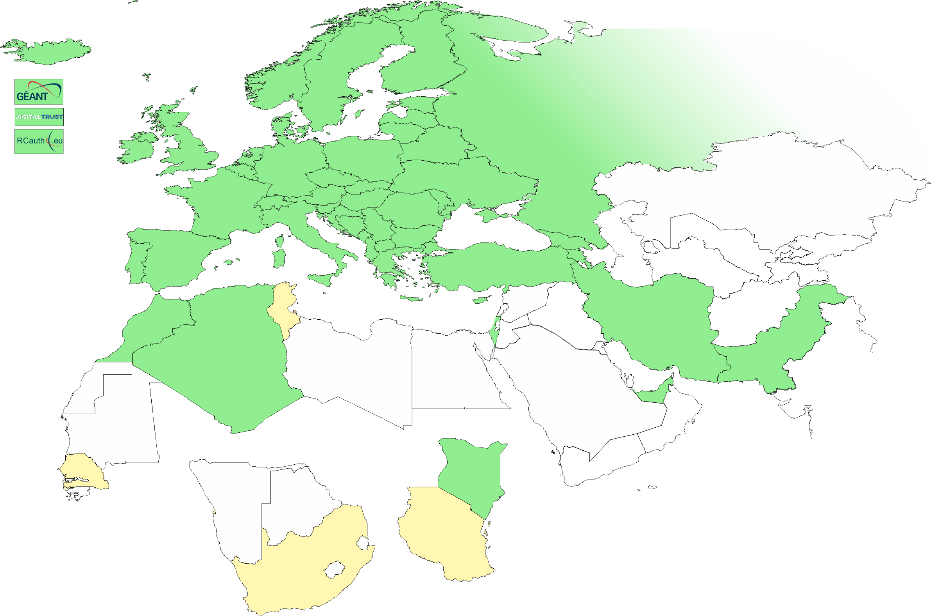
EMEA area membership evolution
Europe⁺: GEANT TCS, and CZ, DE, DK(+FI+IS+NO+SE), FR, GR, HR, HU, NL, PL, PT, RO, SI, SK; AM, GE, MD, ME, MK, RS, RU, TR, UA, UK
Middle East: AE, IR, PK
Africa: DZ, KE, MA
CERN, RCauth.eu,
DigitalTrust (AE)
Emphasis on collaboration
across the whole T&I space

Slide 4
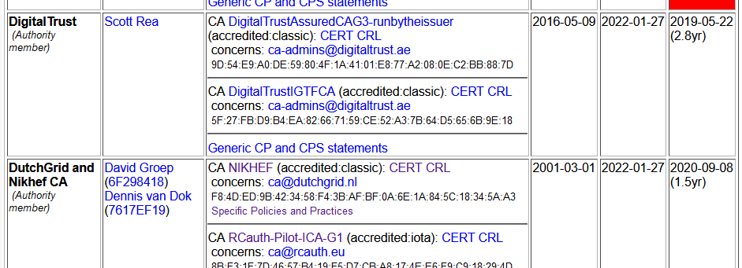
Membership and other changes
Identity providers: both reduction and growth
  migration to GEANT TCS is still ongoing
  https://wiki.geant.org/display/TCSNT/TCS+Participants+Sectigo
  CERN joining TCS via Renater (FR)
Self-audit review
  Cosmin Nistor as review coordinator
  new self-audit model: real-time interaction
  between authority and reviewers helps!
Next meeting in Amsterdam, NL (SURF offices) May 22-23, 2023!

Slide 5
RCauth.eu – a ubiquitous federated IOTA
RCauth is an IGTF accredited IOTA (DOGWOOD class) CA
  Online credential conversion
  Connected to eduGAIN (R&S+Sirtfi) plus direct,
  e.g. EGI Check-in and eduTEAMS
Inspired by and leveraging the delegation service from CILogon
EOSC Future implemented High Availability setup across 3 sites

Slide 6
WLCG and server credentials study WG
Increased use of automatic public cloud deployment (and at times lack of documentation) highlight the fact that in ‘conventional’ grid middleware server-trust and client-trust cannot be distinguished
Similarly, while combined-assurance (DOGWOOD) is available for client-auth, there is no equivalent for server trust
Although issues will change on introduction of ‘token-based’ access (which does distinguish client & channel trust), of limited help now
WLCG, with participants from the IGTF, set up a WG to study the issues
https://docs.google.com/document/d/1Sl0C_q-lGMCifChmFArHjsGzdnd-RM7O7jbpsGa8XRw

Slide 7
S/MIME Baseline Requirements
CA/B Forum developments

Slide 8
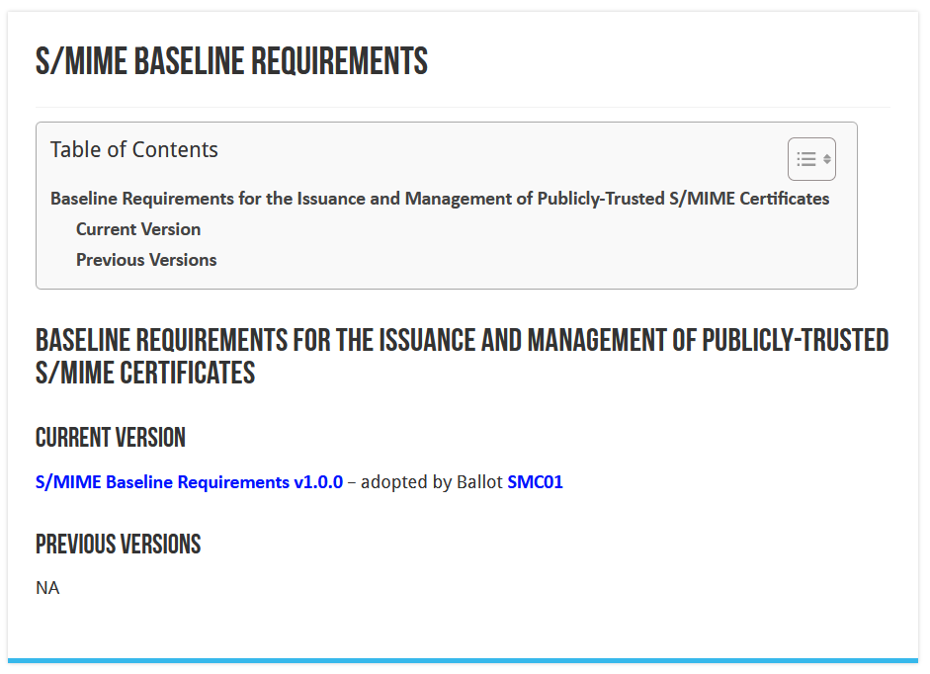
CA/BROWSER Forum

Slide 9
Public Trust S/MIME (personal) is getting regulated
It was basically a ‘free-for-all’, as long as the email address worked
most ‘useful use’ for the general public signing was in bespoke certificates types (Adobe) or in Qualified Certificates (EC regulated)
until now, the IGTF personal requirements were much stricter than ‘public’ email signing, in that we did insist on a reasonable name and a ‘sponsor’ (organization) that was validated
Now CA/BF is putting requirements on S/MIME for the first time
https://cabforum.org/wp-content/uploads/CA-Browser-Forum-SMIMEBR-1.0.0.pdf

Slide 10
Different ‘profiles’ and validations
Strict
  825-days (2yr), limited RDN attributes allowed
  intended only for S/MIME
Multi-purpose
  825 days (2yr), slightly more eKUs allowed
  crossover use cases between document signing and secure erossover use cases between document signing and secure emailmail
Legacy
  1185 days (3yr)
  transitional profile (likely to be phased out in the end)
  bit more freedom in subject, still allows DC naming, but otherwise not much more than MP
mailbox-validated
  just the rfc822name (only!)
organization-validated
  includes only Organizational (Legal Entity) attributes in the Subject
sponsor-validated
  Combines Individual (Natural Person) attributes and organizationName (associated Legal Entity) attribute
individual-validated
  Includes only Individual (Natural Person) attributes in the Subject

Slide 11
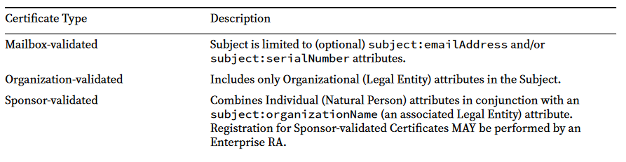
Sponsor validated
Sponsor‐validated:
‘Refers to a Certificate Subject which combines Individual (Natural Person) attributes in conjunction with an subject:organizationName (an associated Legal Entity) attribute. Registration for Sponsor‐validated Certificates MAY be performed by an Enterprise RA where the subject:organizationName is either that of the delegated enterprise, or an Affiliate of the delegated enterprise, or that the delegated enterprise is an agent of the named Subject Organization.’

Slide 12
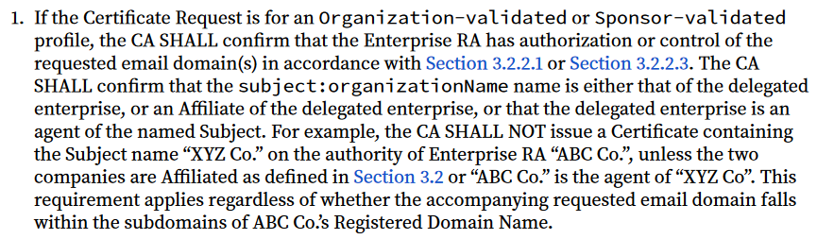
Validation requirements

Slide 13
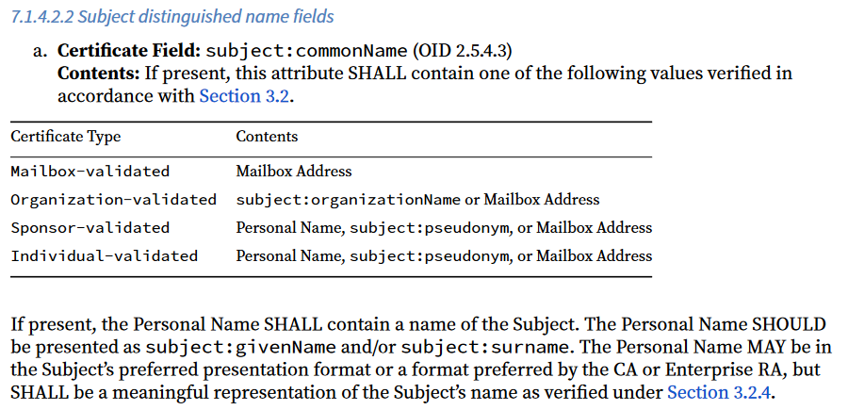
commonName

Slide 14
Where does that leave us?
The ‘Legacy’ profile (still) allowed ‘other’ attributes, so for the moment e.g. DC prefixing would be OK
However the commonName is regulated, which
  impacts uniqueness identifiers (like ePPN as used in TCS)
  does not allow for ‘Robot’s in the commonName
  these would go to Pseudonym, which is an ill-supported attribute,
  and anyway inflicts a subjectDN change
who knows when the legacy profile will be deprecated! Will not be long ☹

Slide 15
However …
… contrary to the host-cert issue, there is no joint-trust needed for email signing and client authentication!
separating these should always have been done:
using TCS Personal certs for authentication is bad (since they are not unique), and
using TCS IGTF MICS client certs for S/MIME email is bad (since it’s 7-bit ASCII only)
this just formalizes that move beyond restricting keyUsage & eKU

Slide 16
Anticipated moves
Have the S/MIME personal certs move to sponsor-validated (multi-purpose) BR-compliant certificates
Move the client authentication trust to a ‘private CA’ (non-public trust anchor), retaining exactly the same subject DNs, just a different ICA issuerDN
Add some additional ICAs and non-public Roots to the IGTF distribution
and for IGTF RPs the change is minimal and transparent
Inform relying parties, also outside of the IGTF, that client trust will become a specific decision. This is probably good, also for OpenVPN services, web access (.htpasswd), &c. The IGTF RPs are not impacted, others likely will be.

Slide 17
User awareness
This is a change in communications and documentation as well,
not only a set of technical changes
In request systems, have to clearly distinguish for users
which product to order. For example:
  “Personal” == only for EMAIL and NOT for authentication
  renaming “IGTF MICS Personal” to “Personal Authentication” and explain
  renaming “IGTF MICS Robot Personal” to “Personal Automated Authentication”?
  forking “IGTF Classic Robot Email”
    Authentication-only (IGTF) profile “Classic Robot Email”
    Email signing profile “Organisation-validated S/MIME signing” (i.e. team-based or role-based)

Slide 18
Other CABF things to keep in mind
Server SSL BR has already been updated
  the provision for using DC prefixing has been retained
But expect shorter validity periods in the future
  start preparing for 90-day max in your service deployment automation systems
  increased use of automation (ACME OV using client ID+secret)
[root@hekel ~]# certbot certonly \
--standalone --non-interactive --agree-tos --email davidg@nikhef.nl \
--server https://acme.sectigo.com/v2/GEANTOV \
--eab-kid DUniqueID_forthisclient --eab-hmac-key mv_v3ryl0n9s3cr3tK3y \
--domain hekel.nikhef.nl --cert-name OVGEANTcert

Slide 19
A Security Baseline for diverse infrastructures and the EOSC
European Open Science Cloud
EOSC Security Baseline

Slide 20

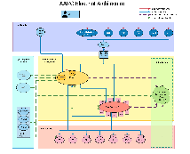


European Open Science Cloud - Interconnecting communities
https://aarc-community.org/about/aegis/

Slide 21
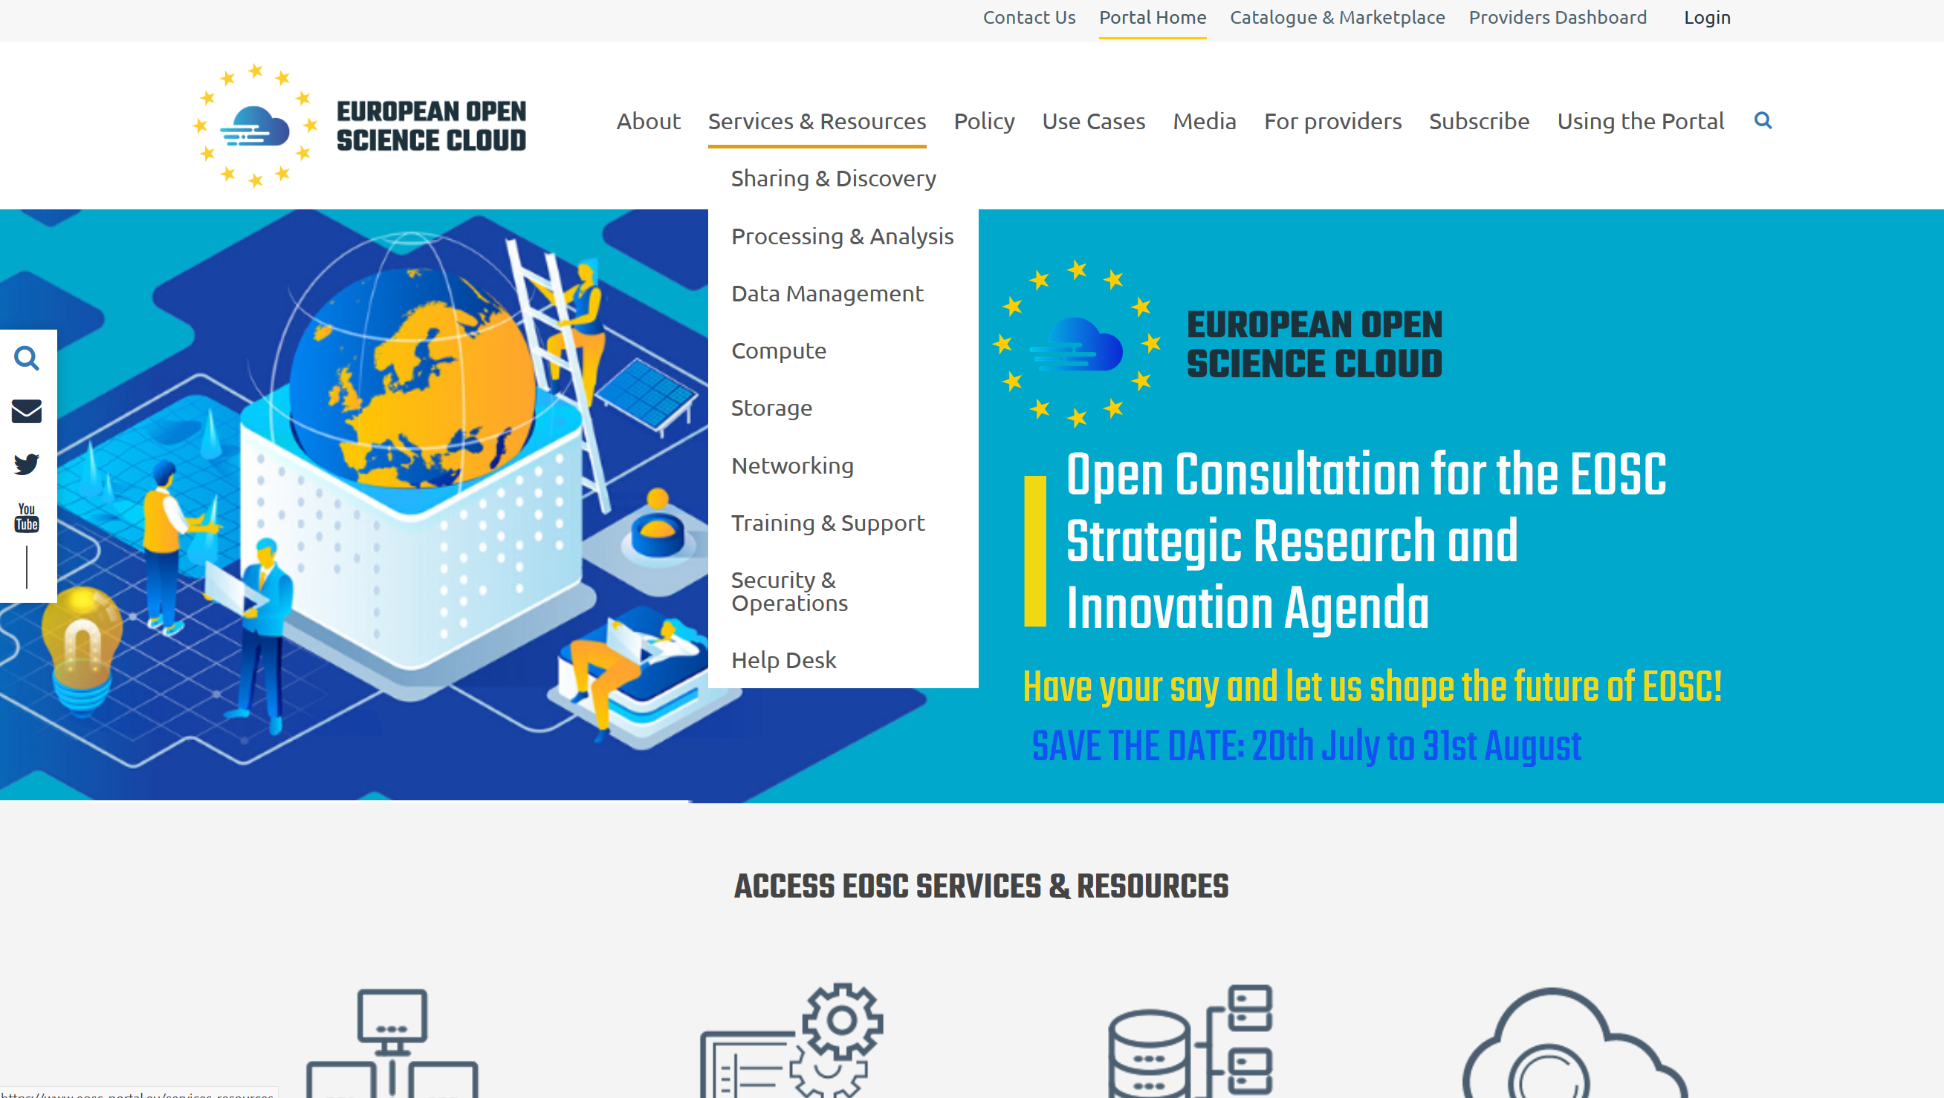
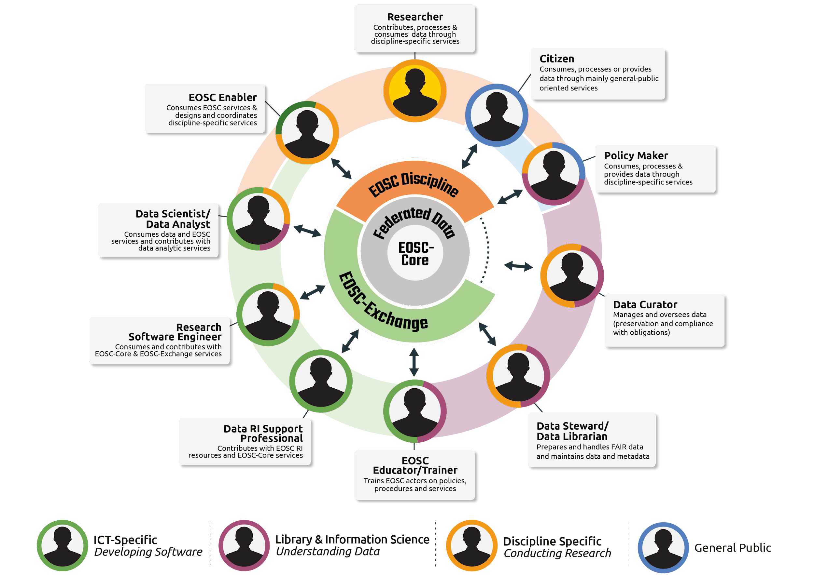
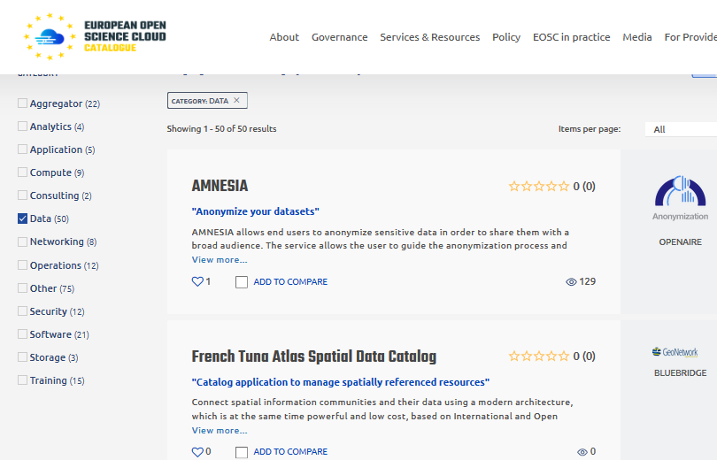
An ecosystem more than just the infrastructure
circle diagram: from Ignacio Blanquer’s ISGC 2022 keynote
Digital Skills for FAIR and open science doi.org/10.2777/59065
EOSC Portal (https://www.eosc-portal.eu/) – as built by EOSChub

Slide 22
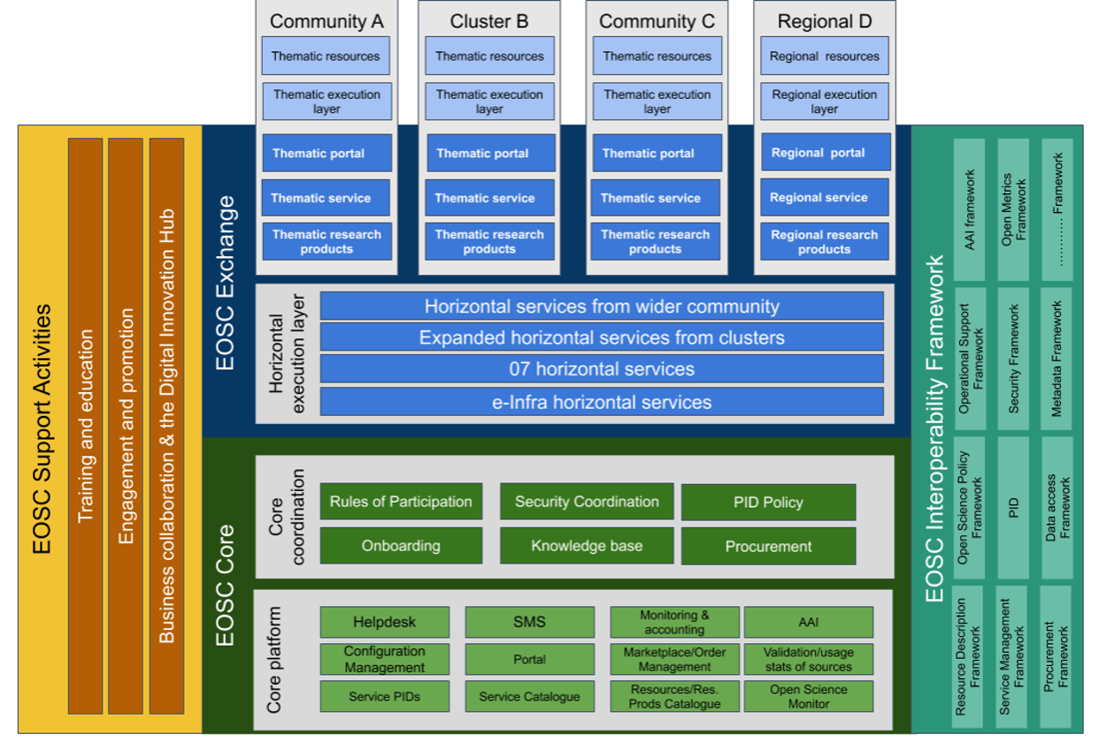

The EOSC ecosystem – core and an ‘exchange’

Slide 23
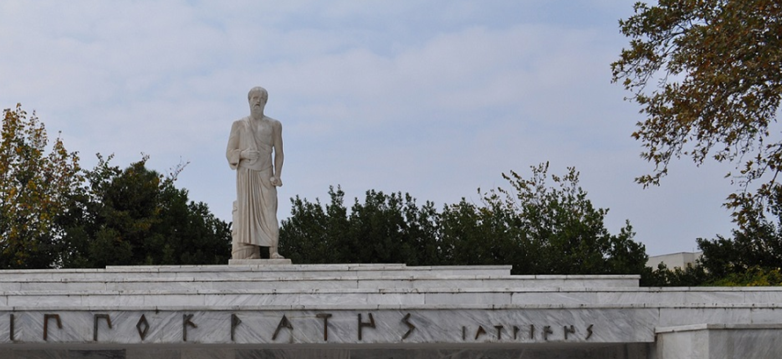
Back to Basics: the few tenets for the ecosystem security
A service provider should
do no harm to interests & assets of users
not expose other service providers
in the EOSC ecosystem to enlarged risk
as a result of their participation in EOSC
be transparent about its infosec maturity and risk to its customers and suppliers
From promoting and monitoring capabilities
to managing core risk
this will mean some minimum requirements in the Rules of Participation
Photo Hippokrates tomb: Melania Stubos, CC-BY-SA-3.0
http://himetop.wikidot.com/hippocrates-funeral-monument

Slide 24
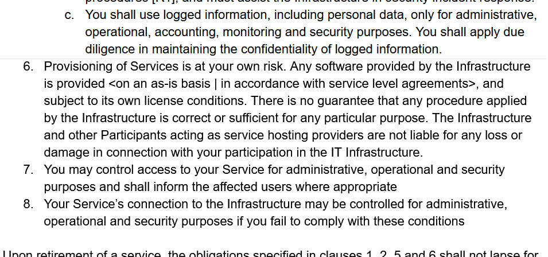
Security: from infrastructure to ecosystem view
Original AARC PDK version of “Service Operations” was specific & prescriptive
includes ‘service-internal’
operations and software
embedded in the PDK
document suite:
does not work well as
a ‘stand-alone’ document
has built-in assumption of
coherent and coordinated
single infrastructure

Slide 25
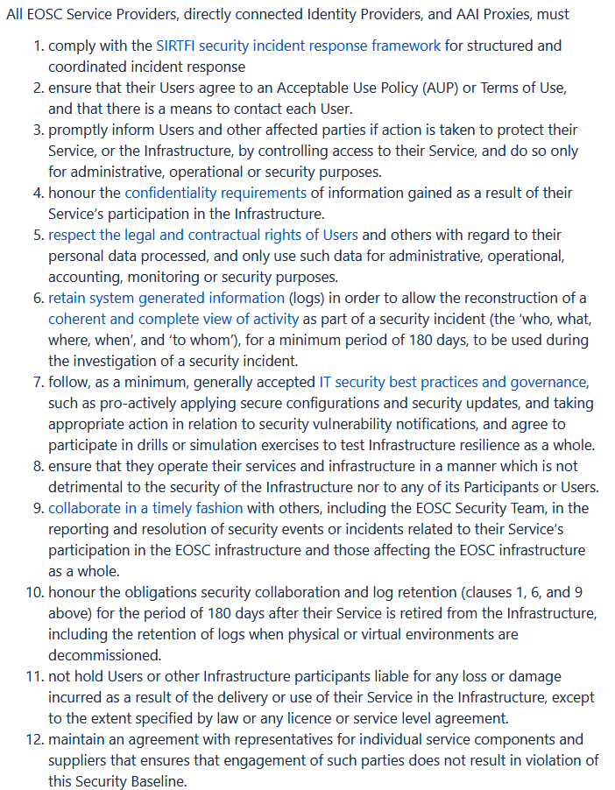
New EOSC Baseline Process
Co-development of EOSC Future & AARC Policy Community
version based on UK-IRIS evolution of the AARC PDK
specifically geared towards the looser EOSC ecosystem
mindful of urgent need for collective coherent response
AARC Policy team consultation > AEGIS > EOSC
just 12 itemised points: https://wiki.eoscfuture.eu/display/PUBLIC/EOSC+Security+Operational+Baseline
complemented by an ‘FAQ’ with guidance and refs
(no new standards, there is enough good stuff out there)
leverages Sirtfi framework
connects to the Core Security Team

Slide 26
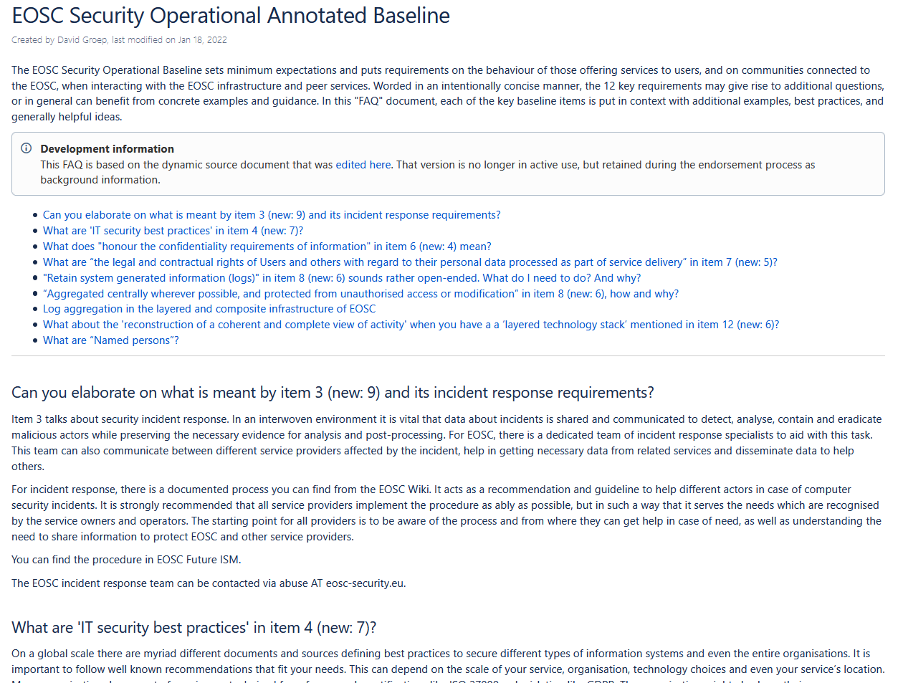
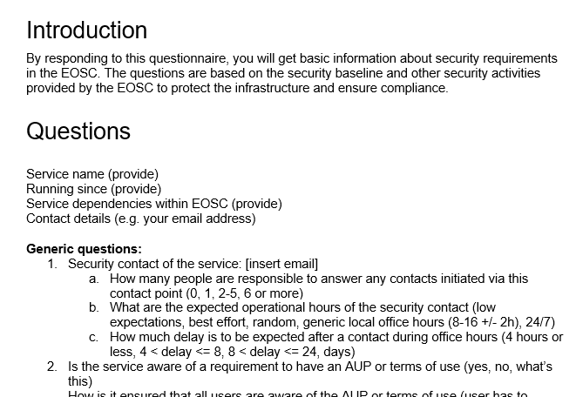
But an FAQ is almost mandatory
and a way to both get the required information out of providers, gauge maturity, and raise awareness …

Slide 27
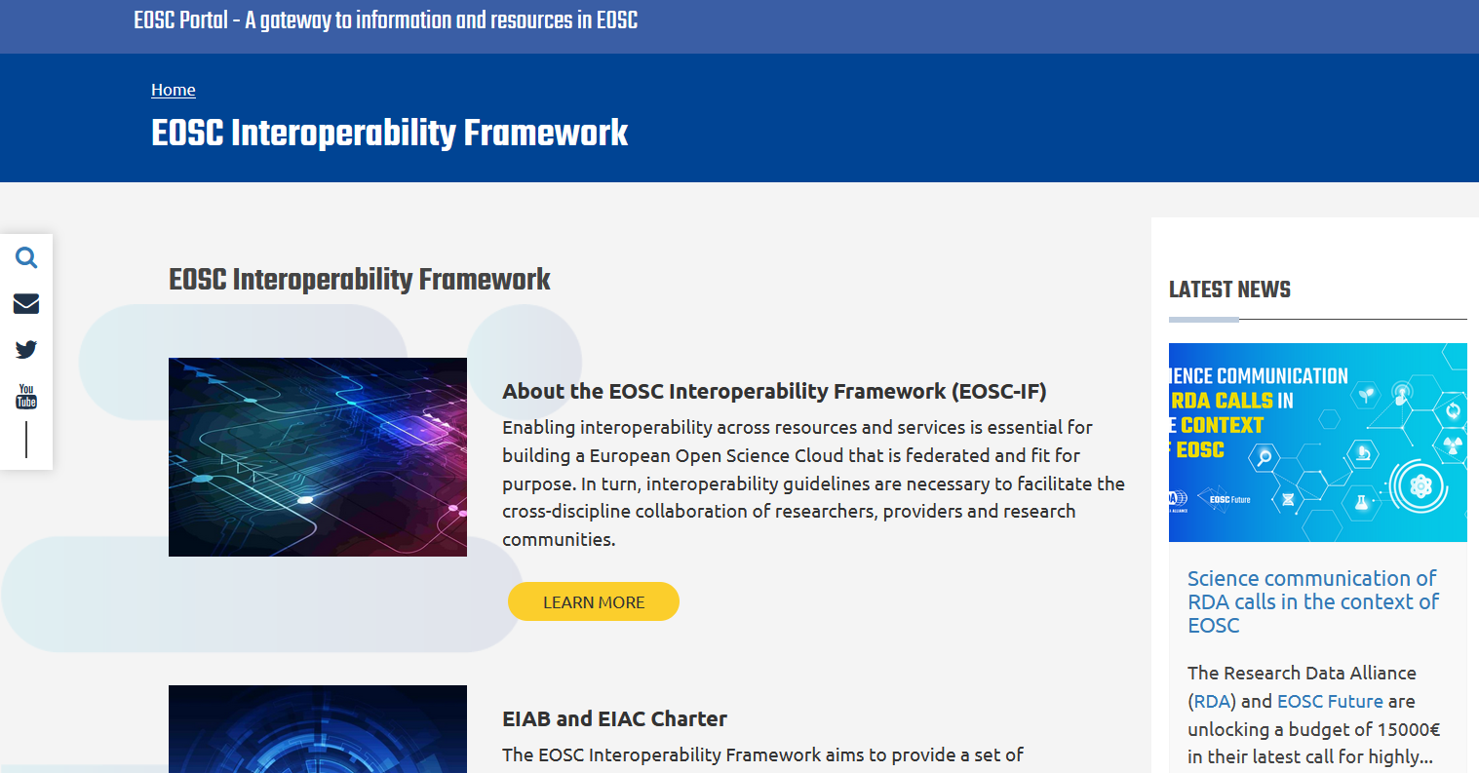
EOSC Interoperability Framework
https://eosc-portal.eu/eosc-interoperability-framework

Slide 28

Attribute Authority operational security
AARC-G071
IGTF AAOPS (https://www.eugridpma.org/guidelines/aaops/)

Slide 29
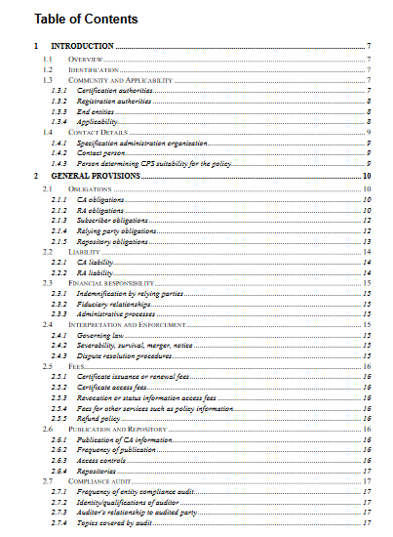
Taking proper care of trust sources
The AAI relies also on other attribute sources, and on the hubs & AARC Proxies
only generic guidance
proxies fully hide ID source
Protections for (IGTF) identity providers are known and documented
RFC3647
IGTF Guidelines
Technical profiles

Slide 30
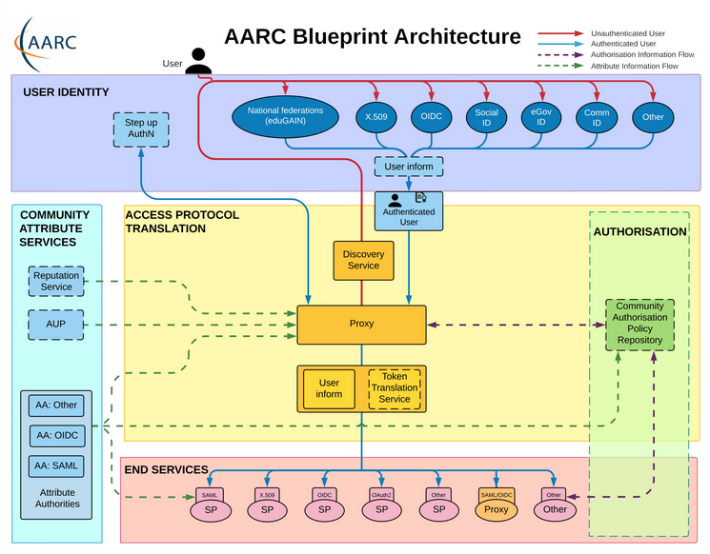
Operational guideline landscape for - proxy or source - AAI components
Authentication/identity sources
Sirtfi
(eduGAIN) baselining, RAF
IGTF AP Profiles
NIST SP800-63
eduGAIN sec. team workflow
RFC6238/4226
FIPS140
NISTSP800-53
Ephemeral credentials
trusted credential stores
protection at rest
Service provider operations
ISO27k
Sirtfi
Infrastructure response plans

Slide 31
Operational security focus in the BPA: beyond just the IdPs
Community membership management directories and attribute authorities
integrity of membership
identification, naming and traceability
site and service security
protection on the network
assertion integrity
Community membership management directories and attribute authorities
integrity of membership
identification, naming and traceability
site and service security
protection on the network
assertion integrity
Guidelines for Secure Operation of Attribute Authorities and other issuers of access-granting statements
(AARC-I048, in collaboration with IGTF AAOPS)

Slide 32
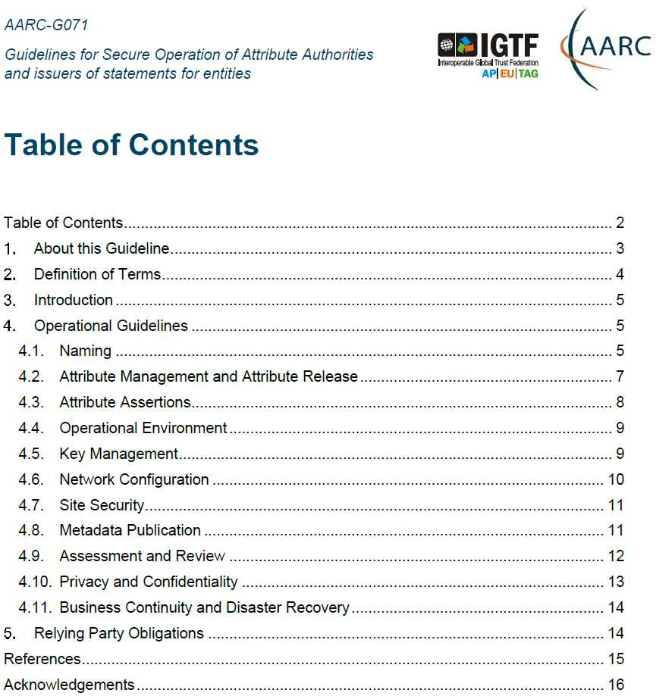
AARC-G071: keeping users & communities protected, moving across models
Structured around concept of “AA Operators”,
operating “Attribute Authorities”
(technological entities or proxies),
on behalf of, one or more, Communities, that are
trusted by Relying Parties
formerly AARC-G048bis
https://www.igtf.net/guidelines/aaops/
https://aarc-community.org/guidelines/aarc-g071/
Notes:
And dwells also on naming since that is the unique hook for the service providers to actually track back persistently to the proper community as well as operator …

Slide 33
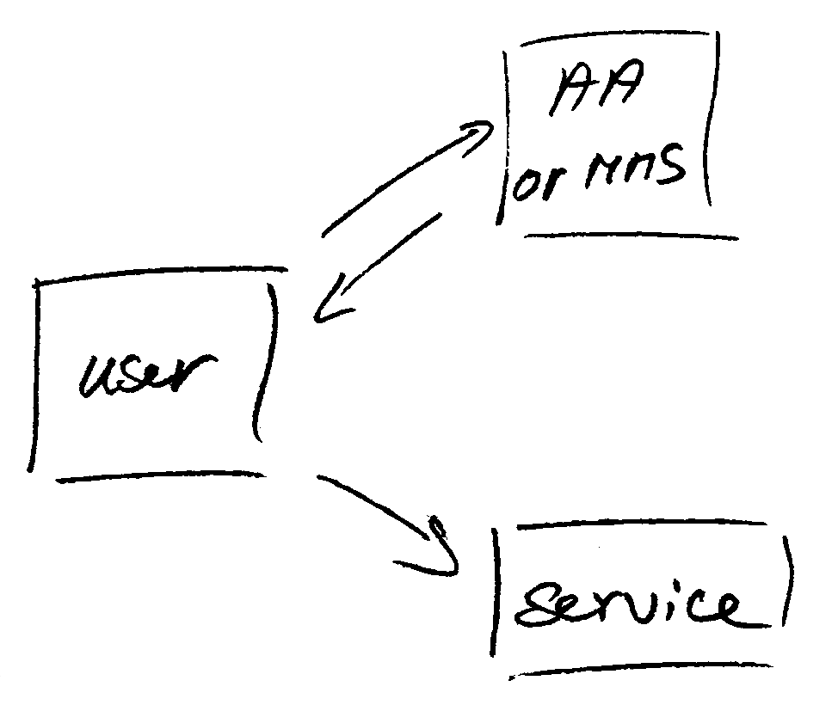
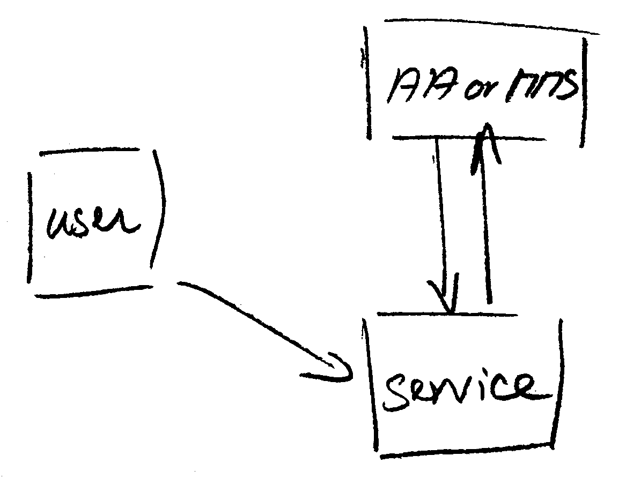
Protecting the community membership data and its proxy
Intentionally targeted broader than just the push model, since operational security spans
data centres and infrastructures using other forms of AA membership management
(SAML, OIDC, LDAP, …)
push model – the common BPA method
(e.g. SAML AttributeStatement, VOMS AC)
pull model – common when using directories
(e.g. LDAP in PRACE, userinfo endpoint in OIDC)
push and pull model diagrams as per RFC2904 – the 3rd (agent) model is uncommon in research/collaboration scenarios except for provisioning

Slide 34
When the AA is in a managed environment …
Many of the recommendations are already implemented ‘implicitly’
because common software implements it: e.g. signing SAML assertions and JWTs
because a good data centre already has network monitoring and central logging in place
because you signed up to Sirtfi (didn’t you?) – so you collaborate in incident response
because you have trained IT operations personnel looking after the service
And some are intuitive best practice
like assigning a unique and lasting name to a group
because implemented controls ought to be those that have been documented
Some items contain reminders about appropriate values and recommendations
that are good practice - based on the relevant standards involved

Slide 35
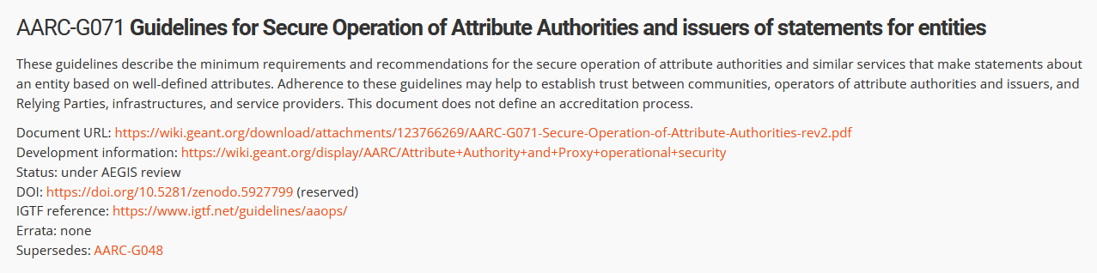
Implementation of the AA Operations (“AAI proxy”) Security guidelines
Major RPs and Infrastructures reviewed it based on current use cases and models
Guideline aimed at both Infrastructure and Community use cases
Useful input to e.g. ‘EOSC’ connected proxies as a good practice guideline
Assessment or review process is separate – could be IGTF or an RP consortium,
but does state what needs to be logged and saved to do a (self) assessment
https://aarc-community.org/guidelines/aarc-g071/

Slide 36
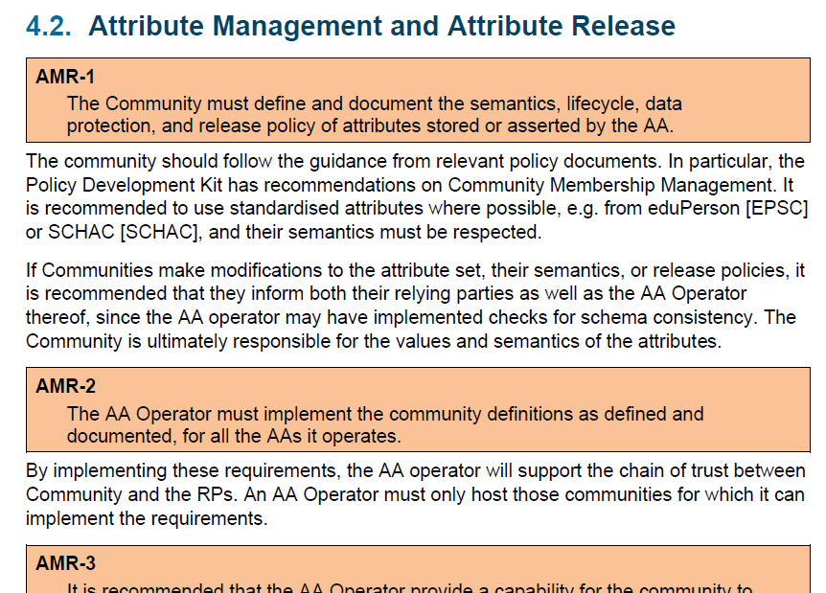
Deployment guidance included …

Slide 37
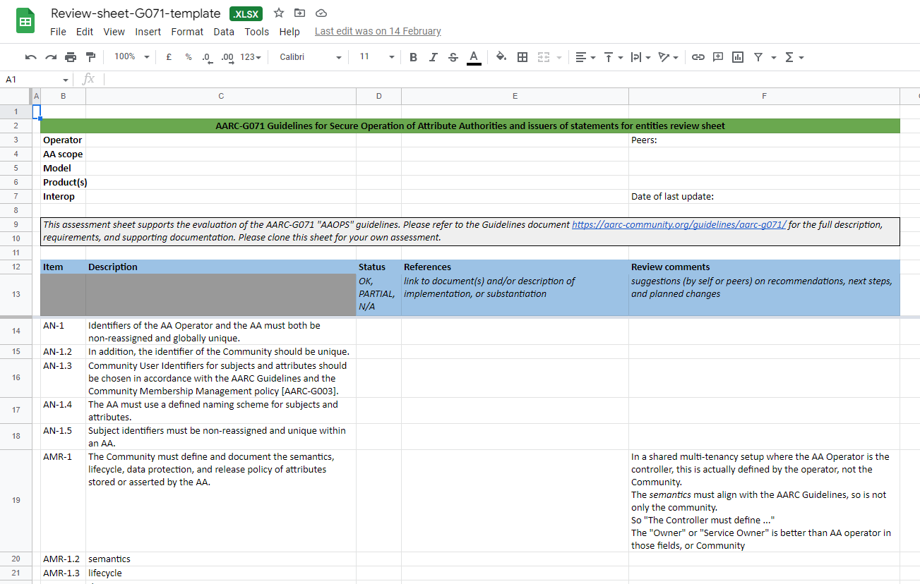
G071 self-assessment process
Self-assessment by WLCG, UK-IRIS and eduTEAMS
mutual review process also improves on the G071 guideline itself!
https://edu.nl/88dwf

Slide 38
Enabled Communities in GÉANT GN5-1
Federated Services
eduGAIN
T&I Incubator
and … (ask Maarten Kremers!)

Slide 39
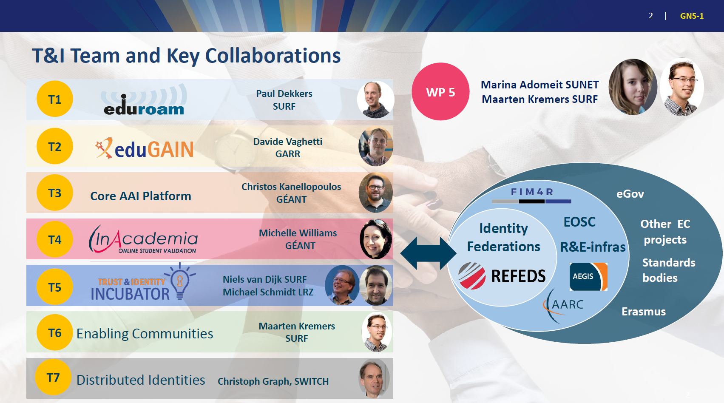
slides by: Maarten Kremers, SURF

Slide 40
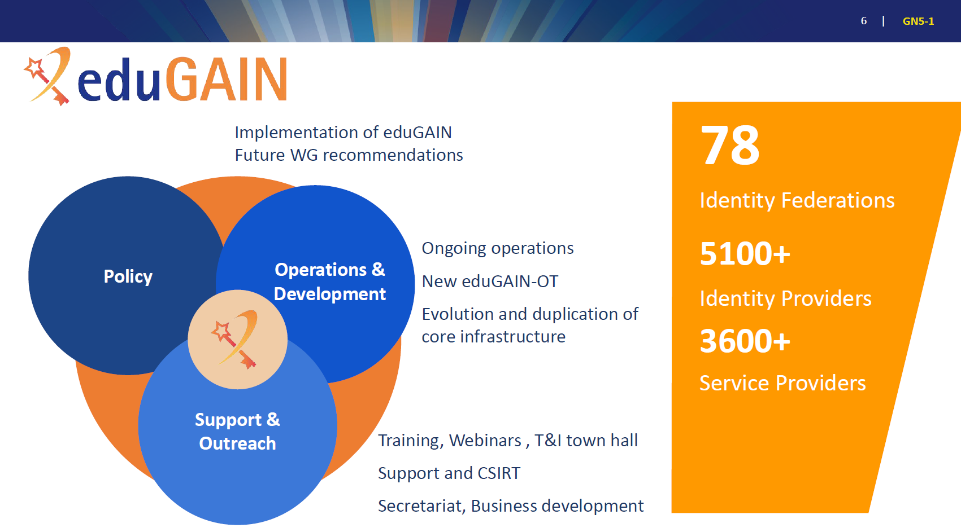
slides by: Maarten Kremers, SURF

Slide 41
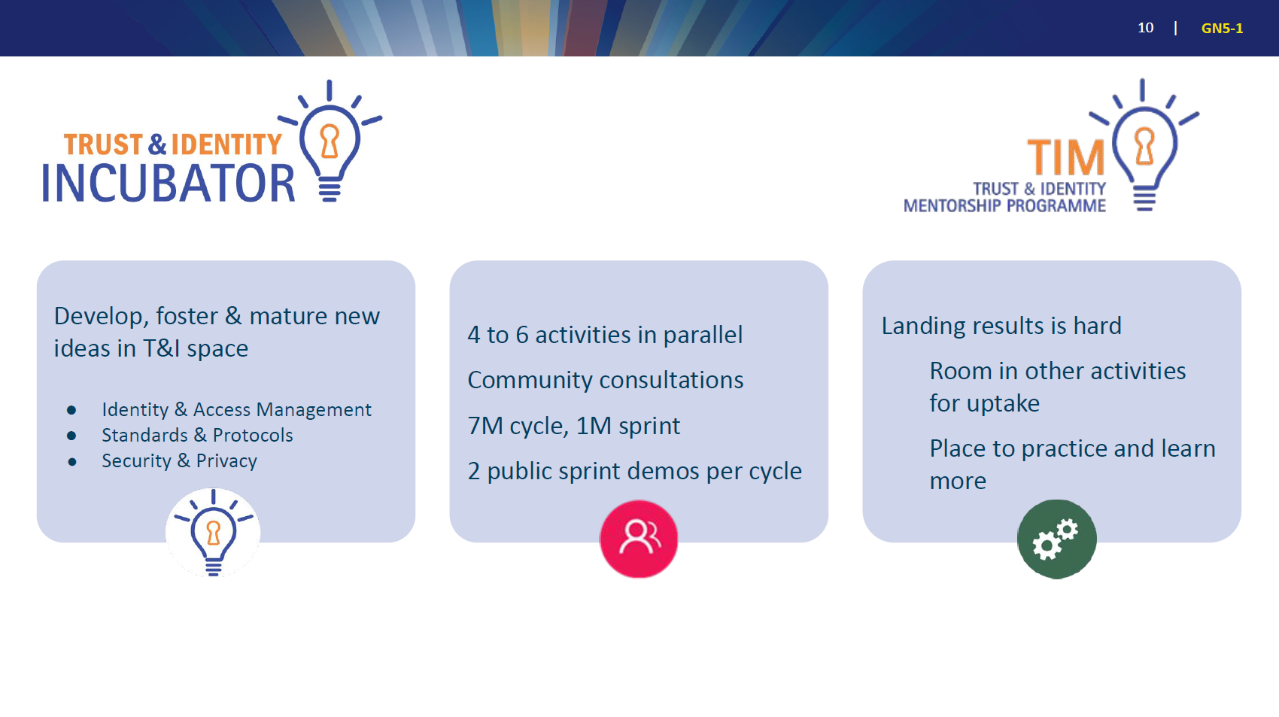
slides by: Maarten Kremers, SURF

Slide 42
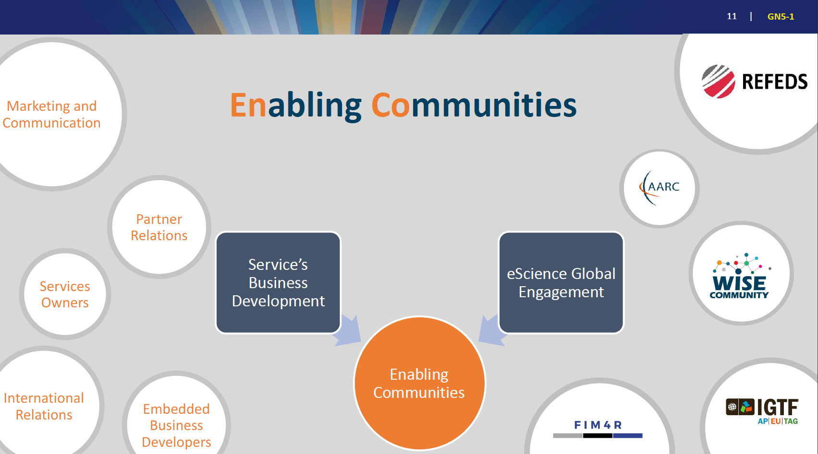
slides by: Maarten Kremers, SURF

Slide 43
Technical Revision for
Enhanced Effectiveness
AARC Community – you can check in, but never leave!

Slide 44
Collaboration and sharing is critical for research
“Authentication and Authorisation Infrastructures (AAIs) play a key role in enabling federated interoperable access to resources.”
AARC Technical Revision to Enhance Effectiveness (AARC TREE) plans to
define common strategies for the development and deployment of AAIs in the pan European Research Infrastructures at large
to improve access and sharing of scientific resources and
to improve interoperability among research infrastructure communities across the thematic areas

Slide 45
Technical Revision objectives
Capture and analyse new Authentication and Authorisation interoperability requirements
(as emerging that support integration use-cases across the thematic area) and
provide a landscape analysis of AAIs services (including gaps) in the RIs represented in AARC TREE
Define and validate new technical and policy guidelines for the AARC BPA that address RIs use-cases. This will improve the integration of RIs across thematic areas and increase the ability of RIs to support emerging needs
Expand the number of research communities that can implement the AARC BPA and/or the AARC guidelines, by providing a validation environment and toolkits. At the same time support existing AARC communities in adopting new guidelines
Bring RIs, e-Infrastructures and relevant stakeholders together to align strategies to integrate new technologies, better interoperate and share resources across thematic areas and produce a compendium and recommendations for different stakeholders

Slide 46
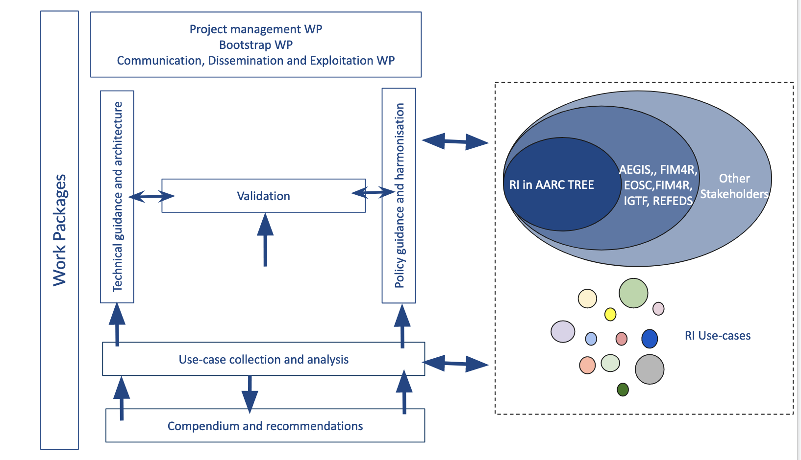
Leveraging our AARC community & structures

Slide 47

Building OUR global trust fabric
Questions?
David Groep davidg@nikhef.nl
https://www.nikhef.nl/~davidg/presentations/ https://orcid.org/0000-0003-1026-6606

Slide 48


this work is co-supported by the Trust and Identity work package of the GEANT project (GN5-1)
in collaboration with many, many people in the AARC+ Community, including Christos Kanellopoulos, Nicolas Liampotis, Licia Florio,
Hannah Short, Maarten Kremers, Niels van Dijk, David Crooks, Dave Kelsey, Ian Neilson, Mischa Sallé, Jens Jensen, and so many others!
davidg@nikhef.nl
EOSC Security work has received funding from the European Union’s Horizon research and innovation programmes under Grant Agreement No. 101017536 (EOSC Future).

