Slide 1
Scenarios for Digital Forensics Training
FOCUSED ON WINDOWS ENVIRONMENT
By Zdeněk Skalický

Slide 2
Introduction
This presentation aims to:
Give a firm grasp on potential attacks by introducing the real-time attack demo
Show the behavior of the malicious software
Show the source code of the malware
Teach the user how to act

Slide 3
Introduction
Presentation is focused on Windows machines
Techniques will be fundamentally similar in other operational systems
The scenarios were selected to include different and frequently used attacks on Windows servers
You will see malware behaviour, data collection and analysis in real-time

Slide 4
DIGITAL FORENSICS
Data collection
Artifact preservation
Analysis
Data restoration

Slide 5
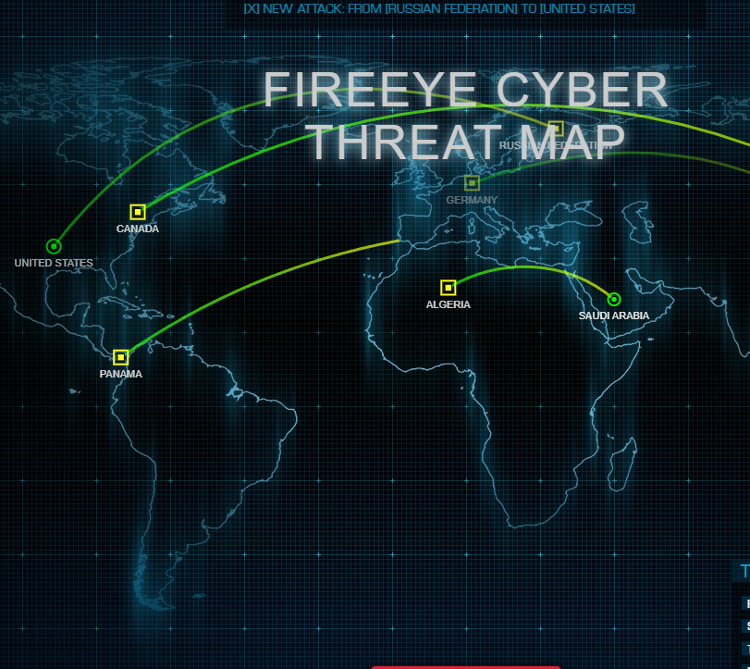
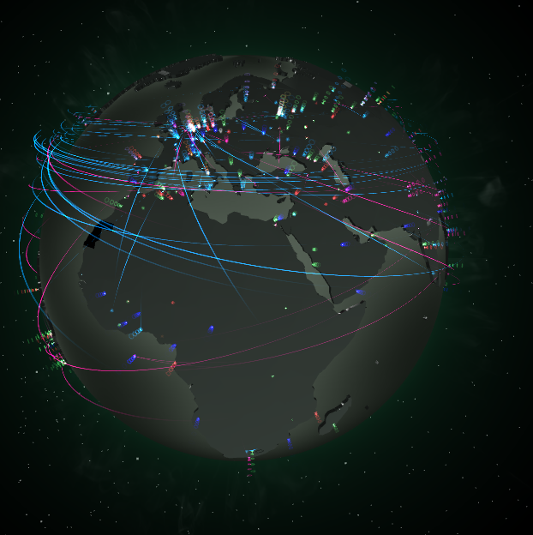
Why the LIVE DEMO?
People working within the IT field know the fundamentals that we will discuss
But usually only theoretically
We need to collect the data as the attack arises
Live demo can show you how to convert the theoretical part to actual practice
The number of attacks keeps climbing
Try to look at

Slide 6
CLASSIFICATION of Attacks
Different types of cyberattacks are overlapping
A phishing attack could lead to the execution of ransomware in the target system
To better understand the discussed types of attacks, study the matrix at

Slide 7
The reality
Companies generally outsource the analysis and handling of the malicious content and incidents
Or have their own incident response team capable of doing the analysis
• We will see different actions in different scopes of competence

Slide 8
Types of users
We will talk about different level of users
Level 1
Simple system user
Basically anyone who is using the system
Level 2
User with eleveted right and competence
Administrators, Operators or Developers
Level 3
Professional forensics analyst

Slide 9
General User Competence
This would be level 1
When you encounter any incident
Report
Document
Communicate
Do not investigate without authorization

Slide 10
GENERAL ADMINISTRATOR STRATEGY
This is level 2 user
Collect as much information as possible
In a safe way
In a technically and procedurally correct way
Within your competence
Both actual and assigned
Communicate
Comunication also creates evidence
Document everything
Main goal is to create unquestionable and satisfactory evidence

Slide 11
GENERAL FORENSICS STRATEGY
Steps within the first phase should help with BUT NOT CONTAIN
At all user levels
Removal of the malicious content from the system
Killing processes
Mitigation of ongoing attacks
Defending against further attack

Slide 12
Phishing
The best attackers do not attack the machines
They attack the people
Still mostly done by e-mails and phone calls
Attackers send malicious messages designed to trick people into downloading files or clicking on links that seem to lead to legitimate websites
Attackers have improved significantly over the years
Counterfeit webpages can look indistinguishable from the real ones

Slide 13
PHISHING – REPORT
Level 1 User
Know your general contacts
Incident response team
DPO
CISO
SuperVisor
Special contacts
Are you a part of critical infractructure?
Police
National Authorities for information/cyber security

Slide 14
AFTER REPORTING and COMMUNICATING
Blue slides regard the user Level 2+
Create copies of your drives or volumes
Virtual machines use virtual drives
To create a copy of your VM volume, read your environment manual
AWS example
Phisical machines
You can use several tools
I recommend using Disk2vhd.exe from Sysinternals

Slide 15
What could you do?
Your superior authorized you to gather more intel
You are a level 2 administrator
Document every step – always
You create two copies of the system and work in one of them
Try to examine the files, links, processes and handles in the system
You will see this in the live demo

Slide 16
Phishing EXAMPLE - Context
Your colleague got an email that looked like it was sent from you
This email contained a microsoft word document posing as a conversion table
After downloading the files and allowing the macros to run, your colleague became suspisous
You are now tasked to inspect the file

Slide 17
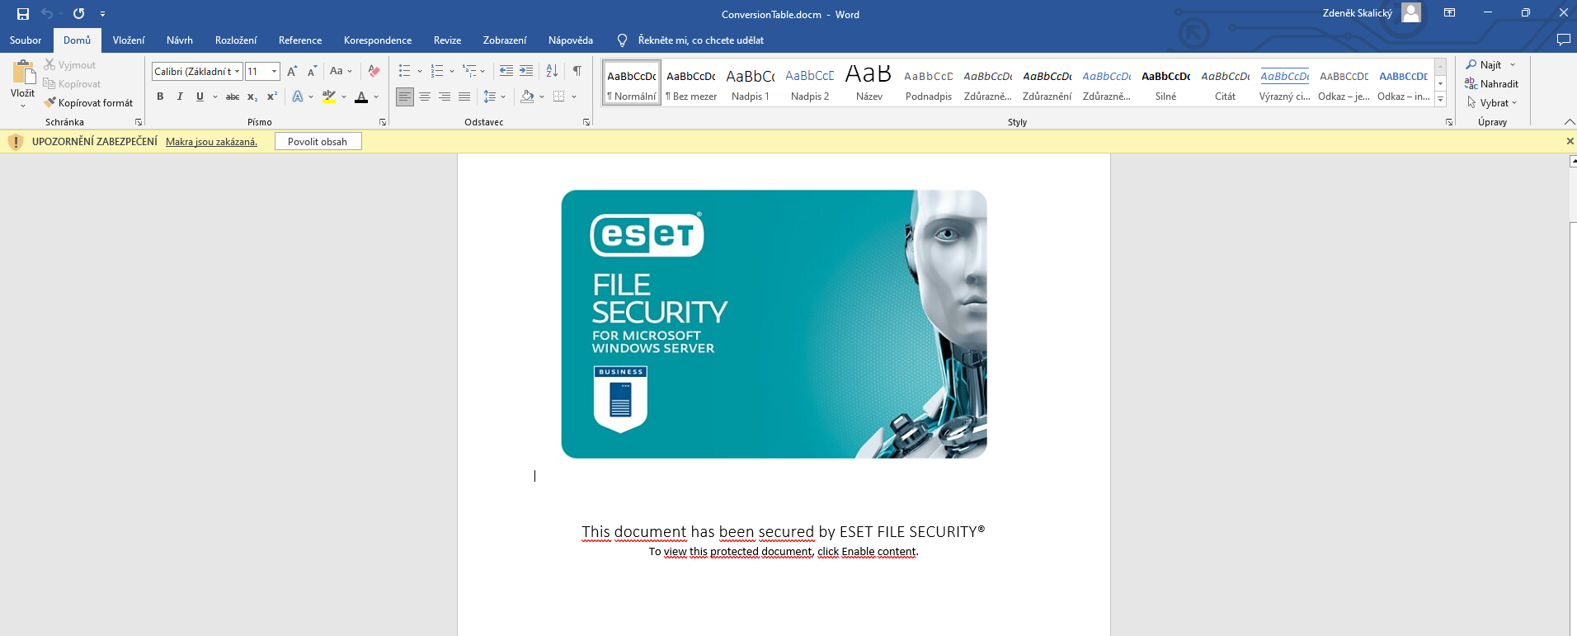
Not enough information yet

Slide 18
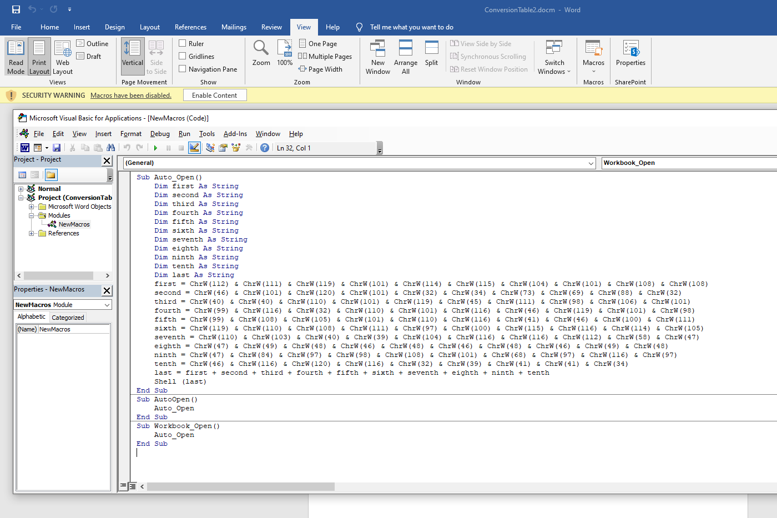

Slide 19
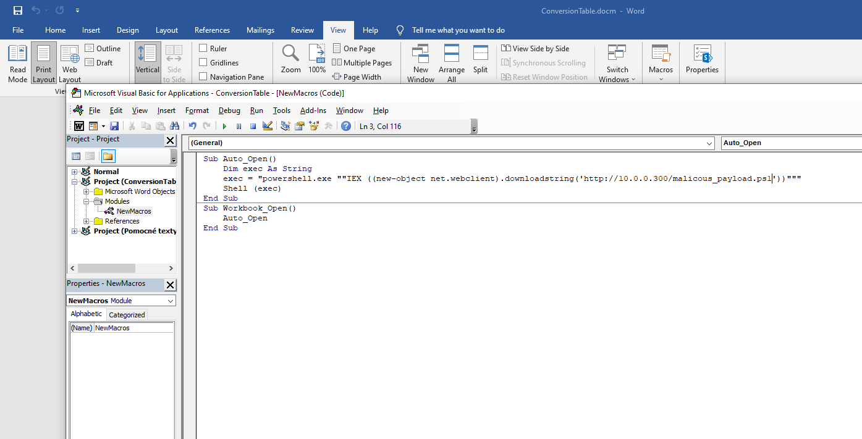

Slide 20
ARTIFACT PRESERVATION
Always mantain:
Chain of custody
Who, when, where, why?
Tamper detection
Ensure that modifies the evidence
For example by creating hashes
Storage devices security
Encrypt your data storage
Protect the data with access controll

Slide 21
Key-logging
Keylogger takes the user input to the system and logs it
Keyloggers can also log other system activity
It can exfiltrate the data using numerous methods
Usually via e-mail, FTP, cURL etc.
More advanced solutions can use TOR and other techniques to mask the behavior and exfiltration path
Exfiltration is a process of leaking data out of a secured environment

Slide 22
Keylogger - Actions
Consider everything user-written exfiltrated
Change your passwords
Revoke certificates
Start or check network monitoring
You can create a network dump using Wireshark or another network protocol analyzer/monitor
Create a file containing active processess and handles
For example by using handle.exe and Powershell command Get-Proccess
Find the keylogger process
For example, by using a task manager or procexp64.exe

Slide 23
Keylogger Context
Let‘s pretend
After the colleague executed the macros in the Microsoft word document
A lot of sensitive data, like active directory passwords, was found on Pastebin.com
Imagine you are the system administrator, an you are supposed to investigate
We have already created documentation of the incident, a copy of the system drive, ensured integrity, and saved everything securely
Let‘s analyze now

Slide 24
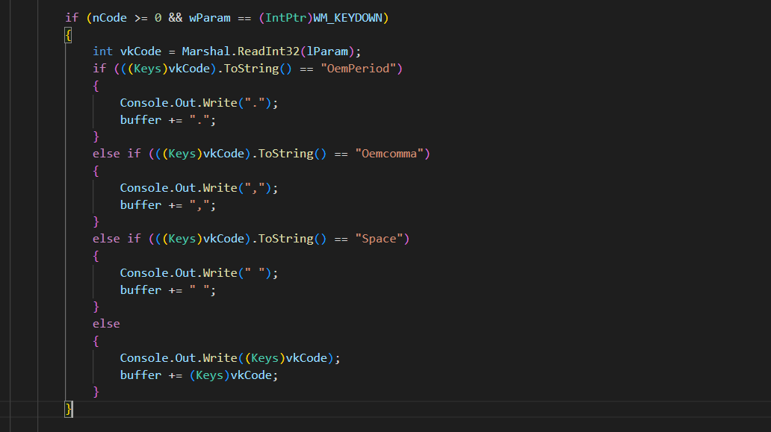

Slide 25
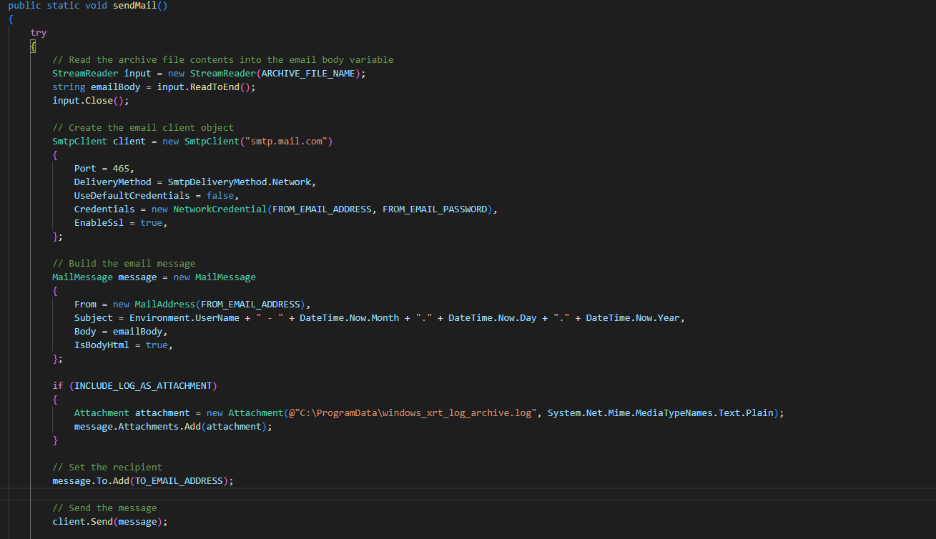

Slide 26
Ransomware
Ransomware blocks access to certain system functions or encrypts data.
After the execution, the user has to pay a ransom to gain access to the asset
Ransomware does not necessarily need to encode data
It can lock some parts of the system
It can also exfiltrate some of the data before encoding it
Change passwords, revoke certificates, generate new keys

Slide 27
RANSOMWARE Running – Actions
Do not panic
Report everything
Find the process
Use any tool capable of dumping memory (Task manager, PowerShell)
Do not kill the process or shut down the machine before saving the memory dump
You would lose everything already encoded
Create and save a memory dump
Create a memory dump of all suspicious processes
After the process finishes or is stopped, another process is usually launched to demand the ransom
Do not let your security solutions (antiviruses) delete the malware (after it encrypted the data)
Losing the malicious code could make data restoration harder
Document everything (preferably on another device than the infected one)
Write all the steps you have taken and include time and screenshots of everything

Slide 28
Ransomware - HELP
After your data were encrypted
Use decryptor
Try seeking help from professionals
No more ransom project

Slide 29
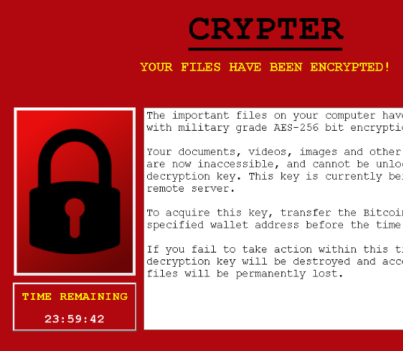
Ransomware DEMO
The ransomware could also be downloaded when the Word macros were executed
Then the ransomware waited for some trigger
For example:
Time
User logs off
Connectivity to particular IP addresses…

Slide 30
Sources of THE MALWARE source code
Obfucation used in phishing by CODESYNCED
https://pastebin.com/bD6xEP9a
Keylogger by joshmadakor1
https://github.com/joshmadakor1/Key-Logger-With-Email
Ransomware by sithis993
https://github.com/sithis993/Crypter

Slide 31
WINDOWS SERVER BASICS
ACCESS CONTROL
PROCESS EXPLORER
HANDLES AND OBJECTS
KERNELS AND CRASH DUMPS
WINDOWS SERVER TROUBLESHOOTING

Slide 32
INTERESTING LINKS AND SOURCES
Ransomware Decryptor
Preservation of digital evidence: Application in criminal investigation
Preservation of Fragile Digital Evidence by First Responders
Study of malware
SysInternals
Digitalforensics.com

Slide 33
Feedback
Feedback will help us a lot
https://forms.gle/RkijN2SW1zbRcjN1A

Slide 34
Contact
Zdeněk Skalický
skalicky@gymla.cz

Slide 35
Thank you!

