Slide 1
The service of DiCOS Apps
ASGC
Tsung-Hsun Wu

Slide 2
The Category of DiCOS app
DiCOS Apps:
1. Bio-Apps:
cryoSPARC version, 2, 3, 4 (1080 ti, p100, rtx 3090) .
Relion version, 3, 3.1, 4-beta (1080 ti)
AlphaFold (v100, A100) and RoseTTAFold. (1080 ti)
Dynamo, IMOD, EMAN2, cisTEM, Jupyter CryoCare.. Etc.
2. Phys-Apps
Deepmd-kit, MAML, PyRoot, Paraview, Ovito, Qiskit.
3. Machine-learning-Apps:
Jupyter-Lab (PyTorch, Tensorflow) (cpu, 1080ti, v100, A100, rtx3090), Triton

Slide 3
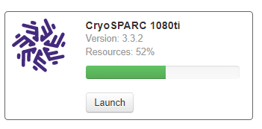
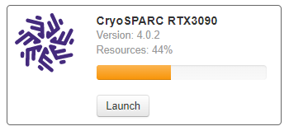
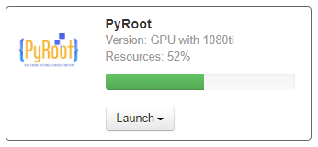
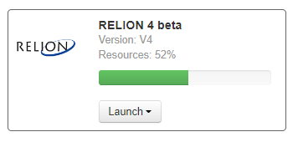
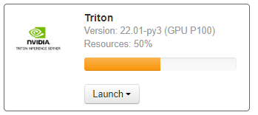
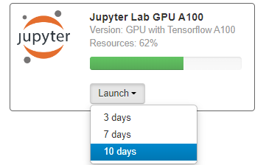
https://dicos.grid.sinica.edu.tw/dockerapps/

Slide 4
The path of Disk Space
All user:
/dicos_ui_home/{user} (UI)
cryoEM group:
/activeEM/data/{group}/{user}
NSTCCore group:
/ceph/work/{group}/{user}
/ceph/project/{group}/{user}

Slide 5
Example 1.1 (Open a Jupyter RTX 3090)

Slide 6
Example 1.2 (Open a Jupyter RTX 3090)

Slide 7
Example 1.3 (Open a Jupyter RTX 3090 with terminal)

Slide 8
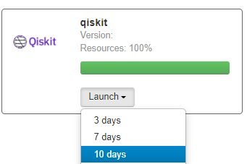
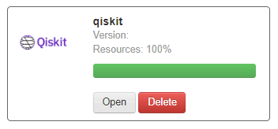
Example 2. (Open a QisKit app)
Shift + Enter

Slide 9
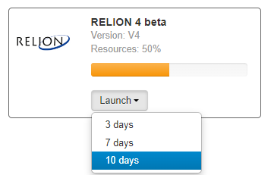
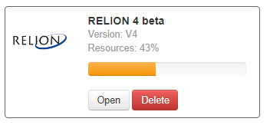
Example 3. (Open a Relion 4-beta app)

Slide 10
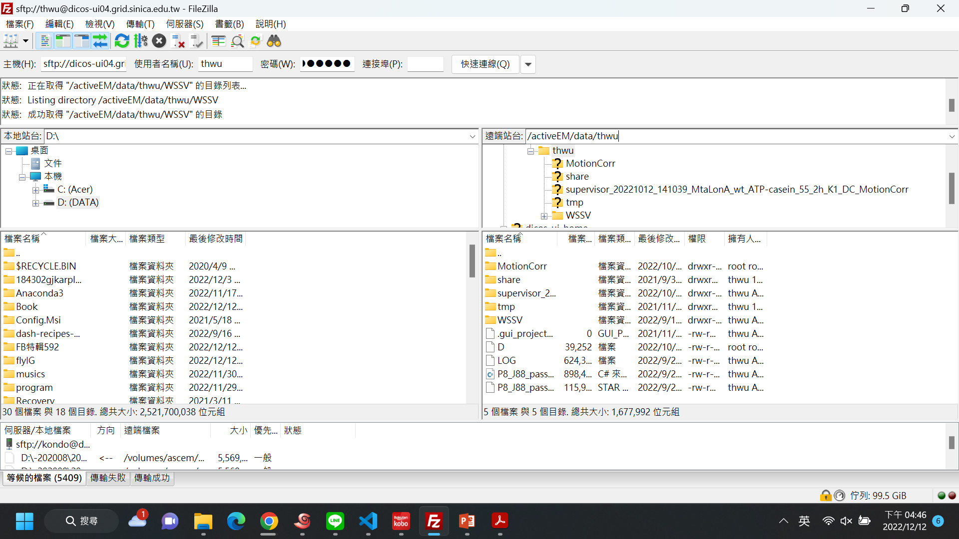
Upload and Download your data
Download FileZilla Client
Host (主機): dicos-ui.grid.sinica.edu.tw
Account (使用者名稱): account
Password (密碼): password
Port (連接埠): 22

Slide 11
Thanks & Questions and Answers.
DiCOS Support E-Mail: DiCOS-Support@twgrid.org

