Slide 1
Sitting under a broad-leaved AARC-TREE
making authentication & authorization for research collaboration even better
David Groep
Nikhef Physics Data Processing programme and UM Dept. Advanced Computing Sciences
International Symposium on Grids and Clouds (ISGC) 2024
Taipei, March 2024

Slide 2
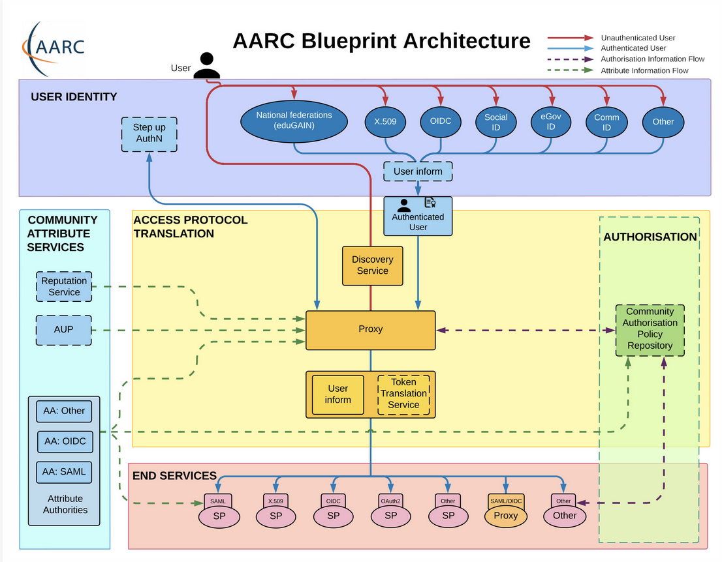
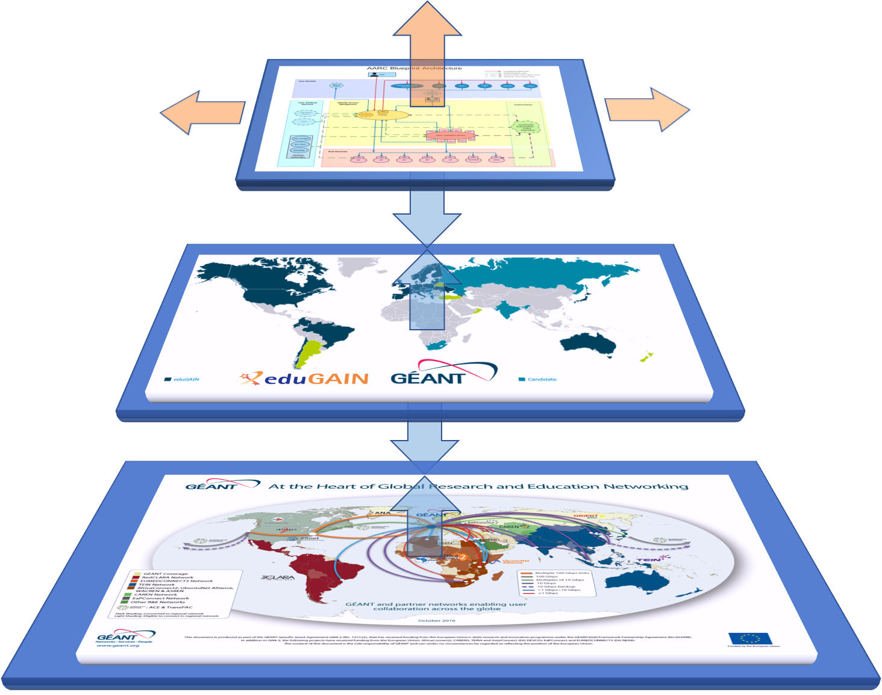









AARC – Authentication and Authorisation for Research Collaboration

Slide 3
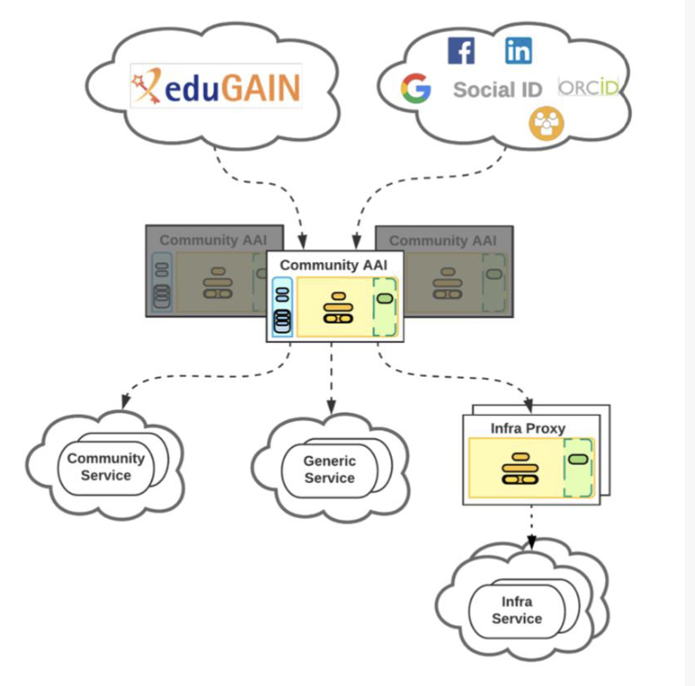
The Community AAI and the Infrastructure Proxy: definition
Community AAI
The purpose of the Community AAI is to streamline researchers’ access to services, both those provided by their own infrastructure as well as the services provided by infrastructures that are shared with other communities.
Infrastructure Proxy
The Infrastructure Proxy, enables Infrastructures with a large number of resources, to provide them through a single integration point, where the Infrastructure can maintain centrally all the relevant Policies and business logic for making available these resources to multiple communities

Slide 4
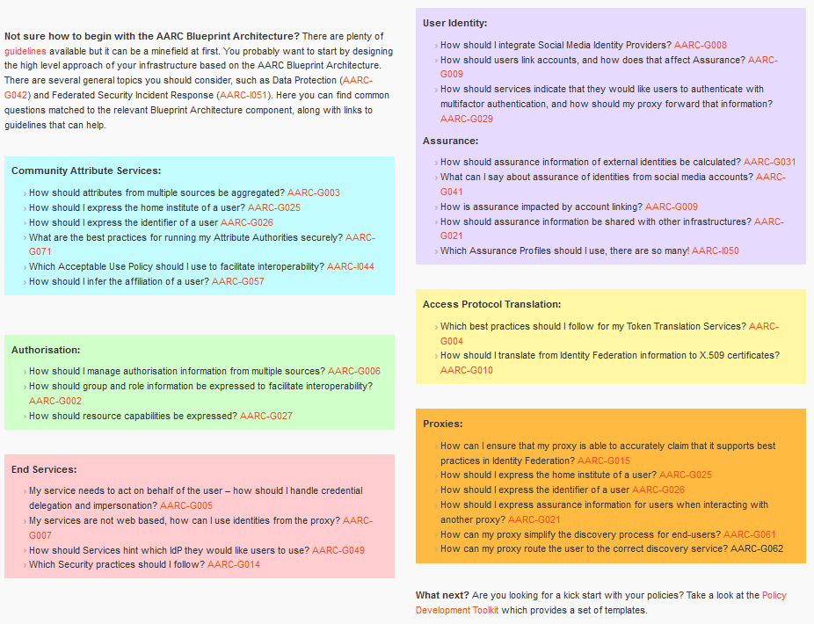
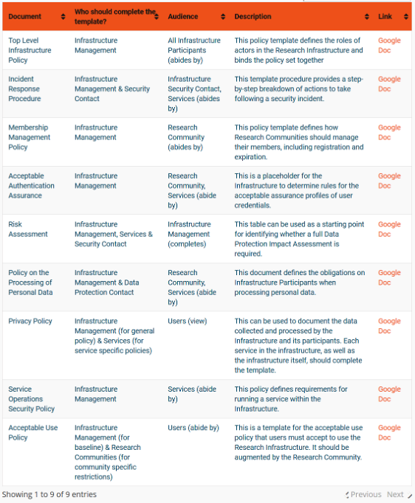

Interoperability – more than just the nice colours
https://aarc-community.org/guidelines/

Slide 5
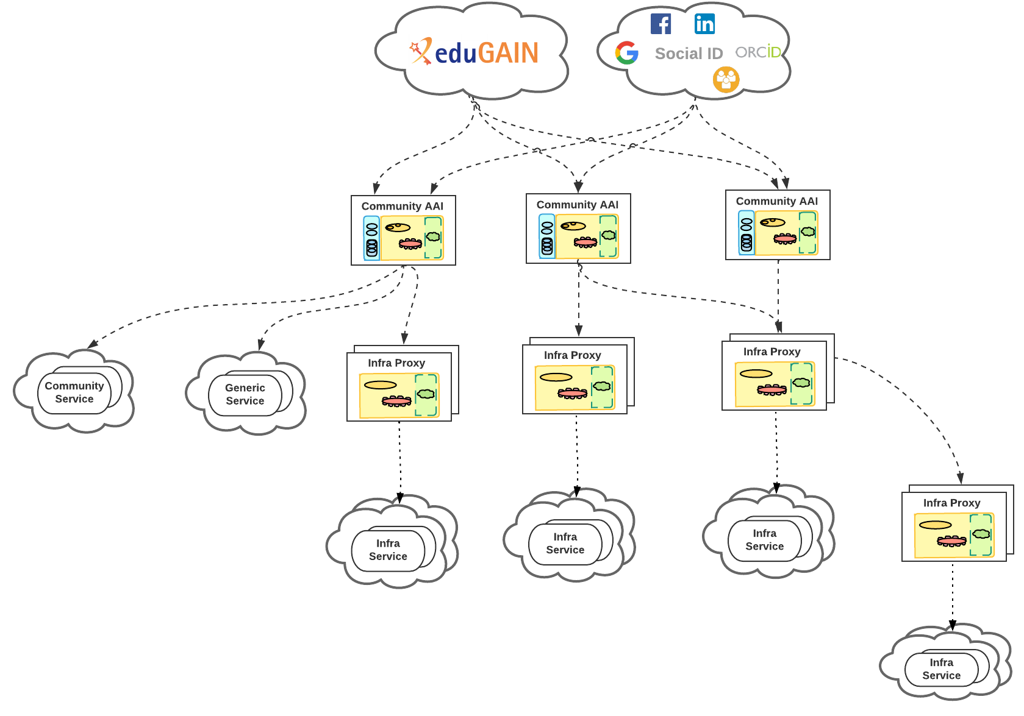
But it’s getting more complex …
… it’s time for a Technical Revision to Enhance Effectiveness!

Slide 6
What will AARC TREE bring?
Capture and analyse new authentication and authorisation interoperability requirements (that support integration use-cases across the thematic area) and provide a landscape analysis of AAIs services (including gaps) in the RIs represented in AARC TREE
Expand the number of research communities that can implement the AARC BPA and/or the AARC guidelines, by providing a validation environment and toolkits. At the same time support existing AARC communities in adopting new guidelines
Define and validate new technical and policy guidelines for the AARC BPA that address RIs use-cases. This will improve the integration of RIs across thematic areas and increase the ability of RIs to support emerging needs
Bring RIs, e-Infrastructures and relevant stakeholders together to align strategies to integrate new technologies, better interoperate and share resources across thematic areas and produce a compendium and recommendations for different stakeholders

Slide 7

AARC TREE Main Facts: Expected results
Updated AARC BPA
Recommendations for a common long-term strategy for AAI services
Updated interoperability framework

Slide 8
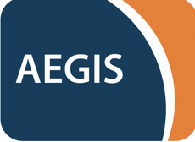
The AARC TREE in the Trust and Identity Landscape
AARC Engagement Group for Infrastructures
The forum of e/r-Infras that operate an AARC BPA complaint AAI.
It’s a closed group on purpose as we want to get feedback from the hands on group.
They approve the AARC guidelines.
Technical WG
Led by Nicolas and Christos
This is where technical guidelines are discussed
Anybody can join the discussion:
https://lists.geant.org/sympa/info/aarc-architecture
Policy WG
Led by Dave and David
Supported by EnCo and IGTF
Anybody can join the discussion: policy@aarc-community.org
https://lists.geant.org/sympa/info/aarc-na3

Slide 9
Technology

Slide 10
Evolve the BPA to address the more complex (and the simpler) worlds
guidelines for harmonising expression of community user attributes
reduce inconsistencies between implementations
improve interoperability & end-user usability across research community communities and infrastructures
Extend AARC BPA
improve scalability
leverage emerging standards
like OpenID Federation
Authorisation guidelines
best practises to enable efficient & effective sharing of federated resources
2025
Decentralised identities
guidance for digital wallets linked to BPA

Slide 11
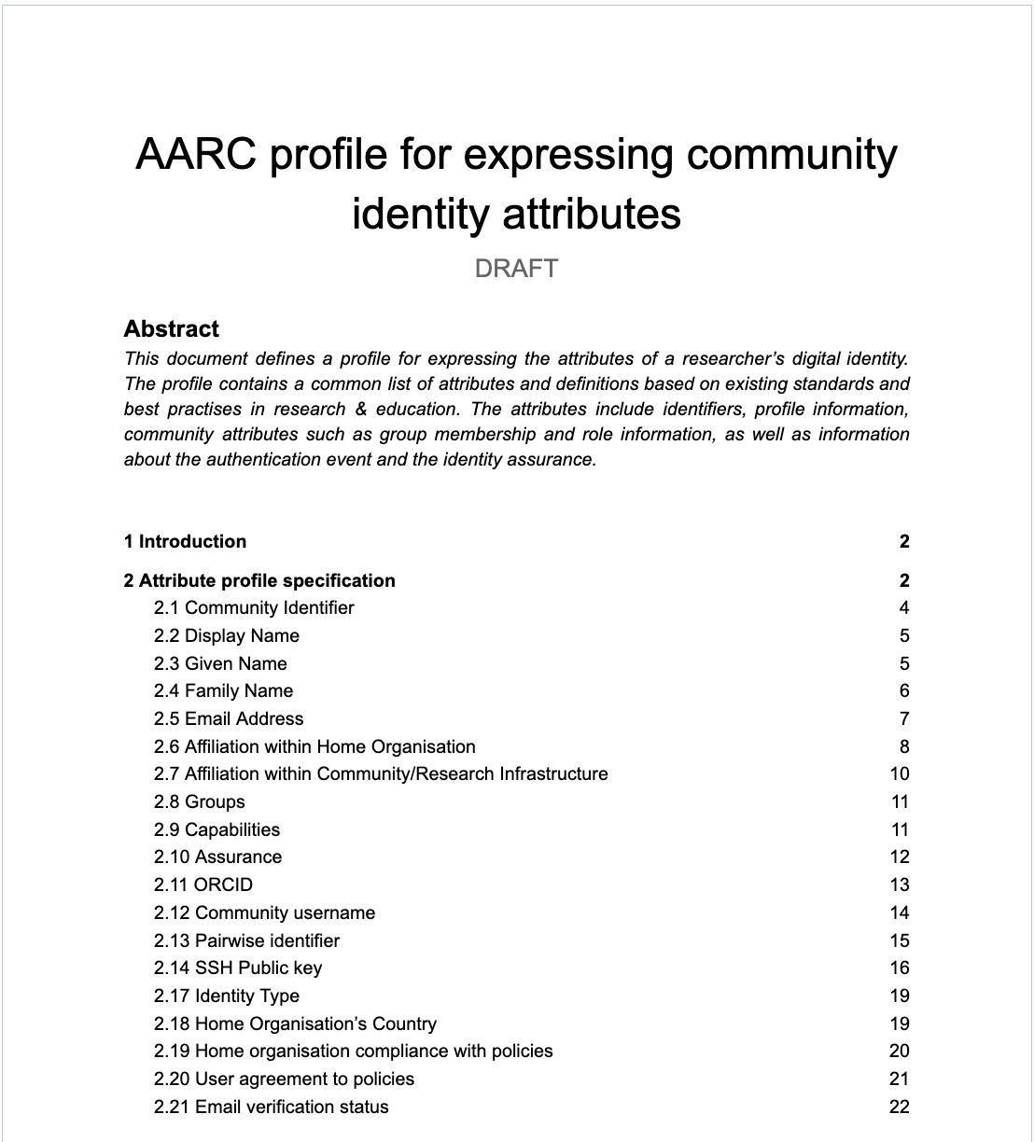
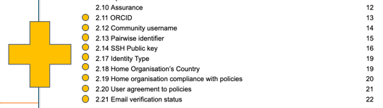
How to express community identity attributes?
AARC-G056
“How to express the identifier of a user?”
→ AARC-G026
“How to express the groups and roles of a user?”
→ AARC-G069 (was AARC-G002)
“How to express resource capabilities of a user?”
→ AARC-G027
“How to express the home institute of a user?”
→ AARC-G025
How to express user assurance information
when interacting with another proxy?”
→ RAF & AARC-G021

Slide 12
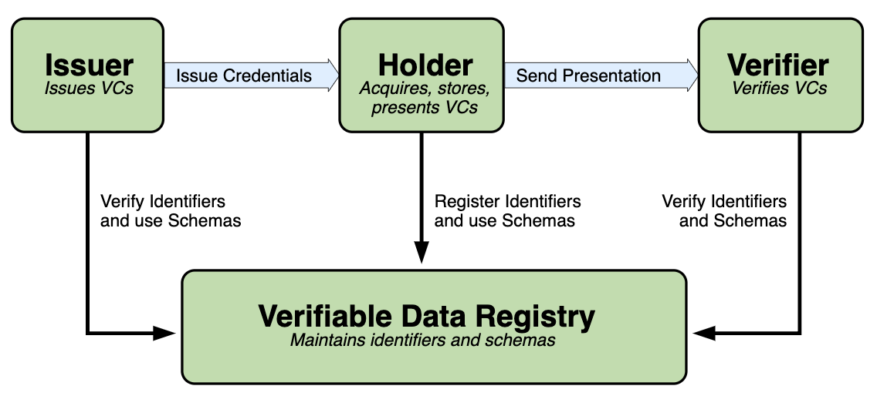
Decentralised identities
Provide guidance on the use of decentralised identities and digital identity wallets
  Explore Distributed Identifiers, Verifiable Credentials/Presentations & trust frameworks
Support the EU Digital Identity Wallet (EDIW) initiative
https://www.w3.org/TR/vc-data-model/

Slide 13
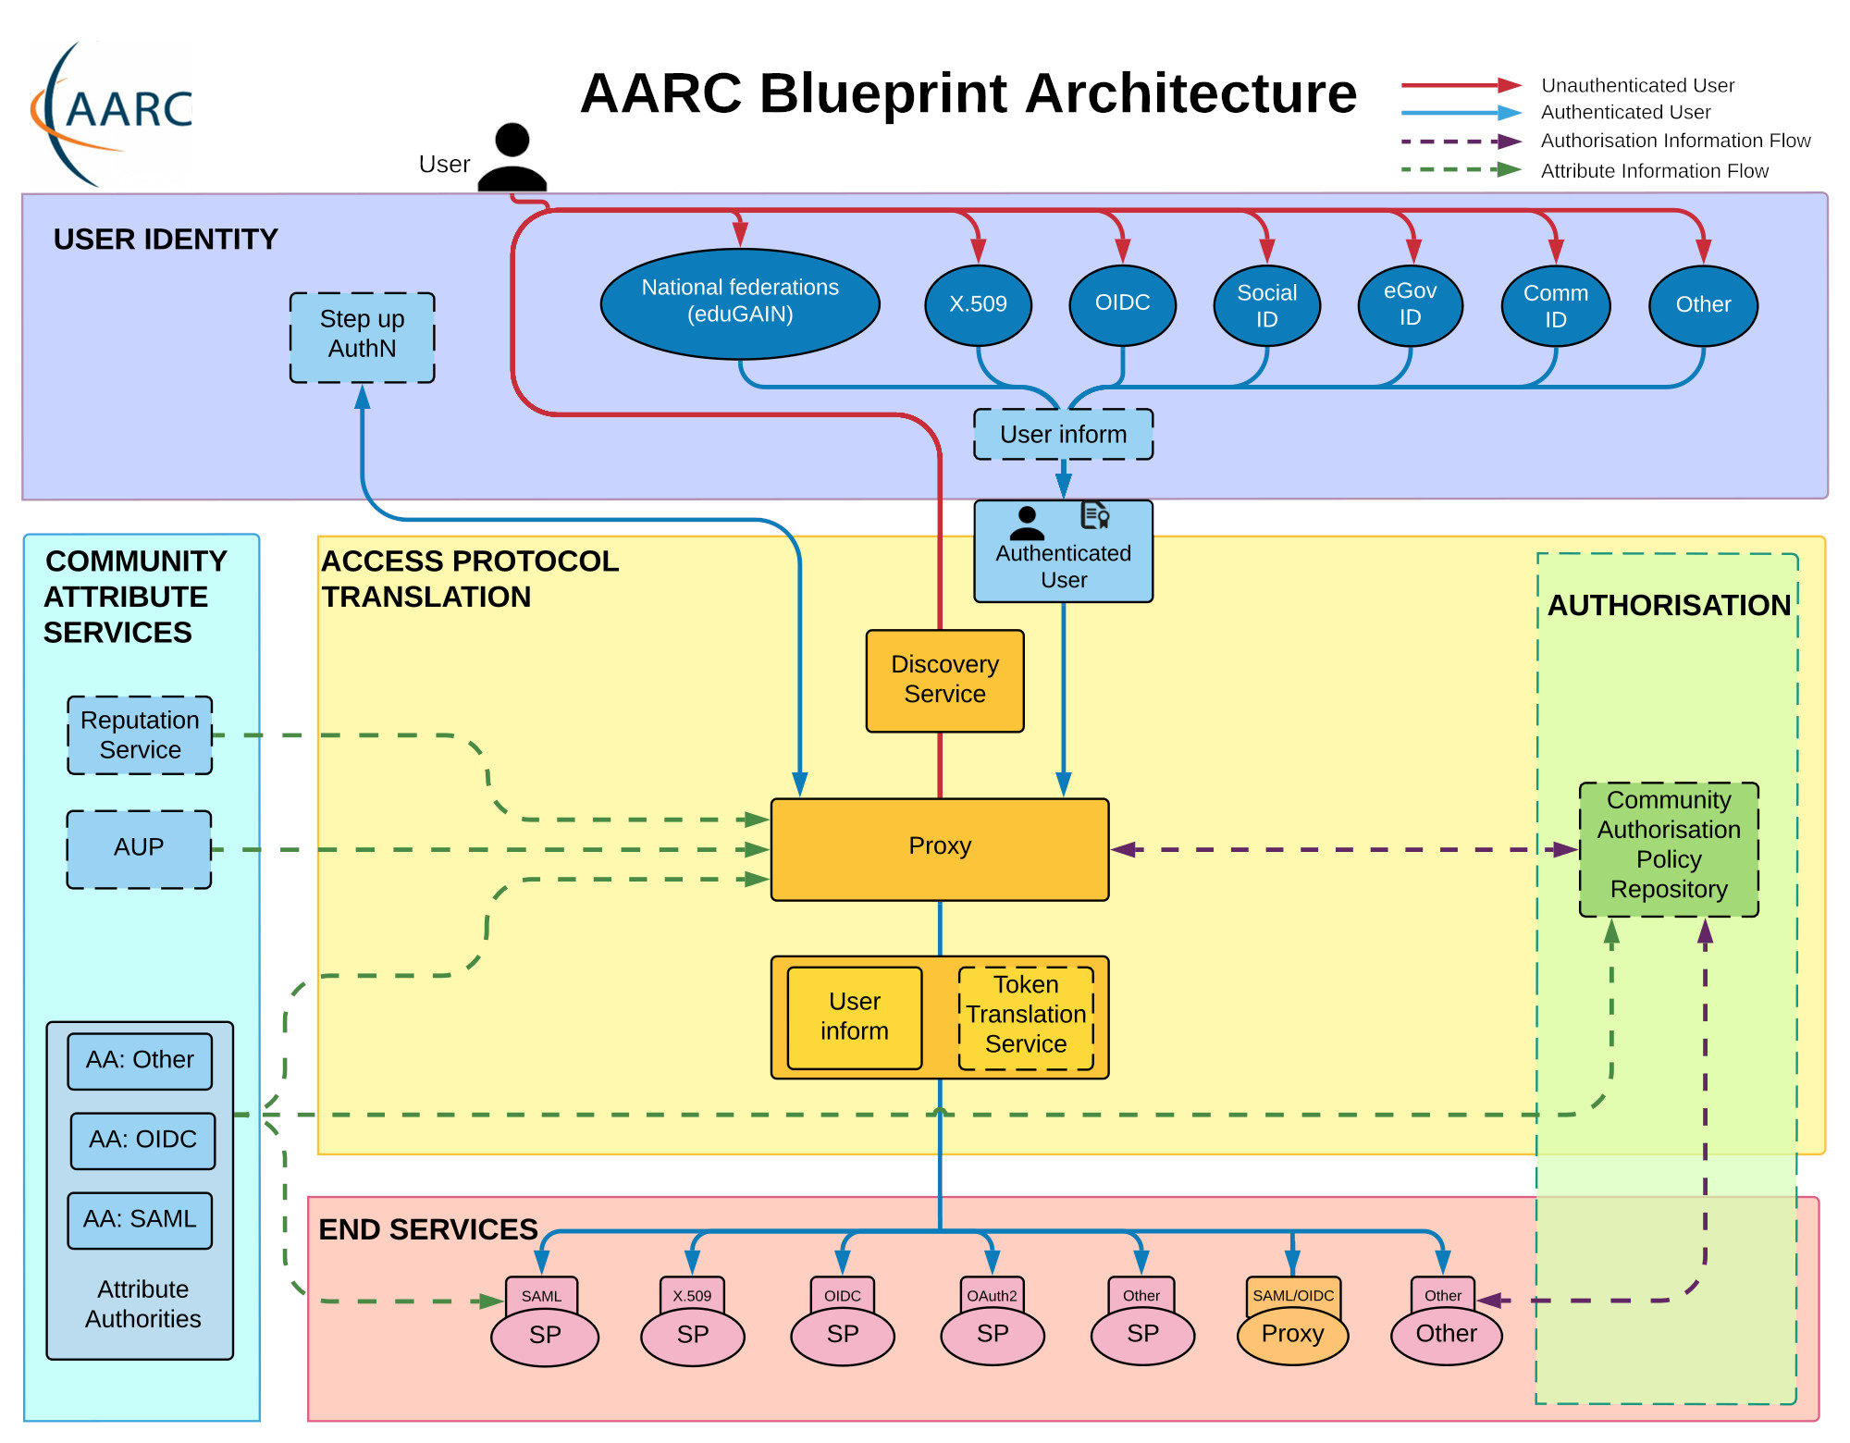
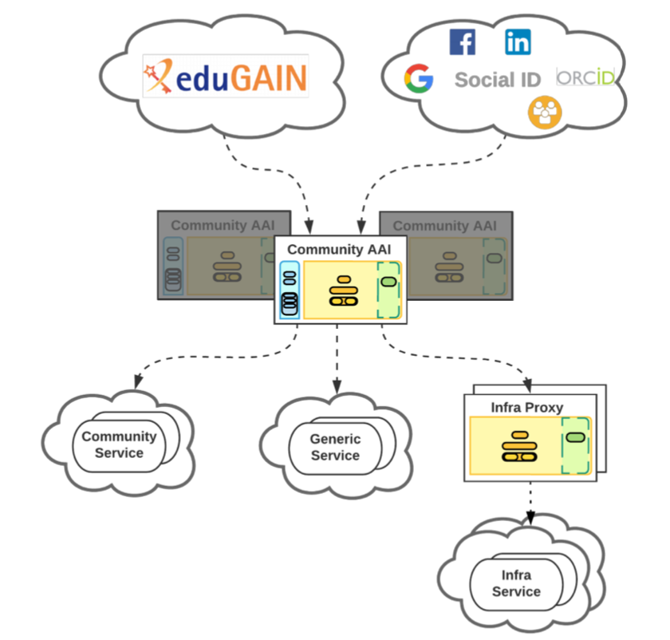
AARC Blueprint Architecture ‘BPA2025’!
AARC BPA 2019
AuthZ for Federated Resources
Decentralised Identities & Wallets
OpenID Federations
AARC BPA 2025

Slide 14
Policy and good practice harmonisation

Slide 15
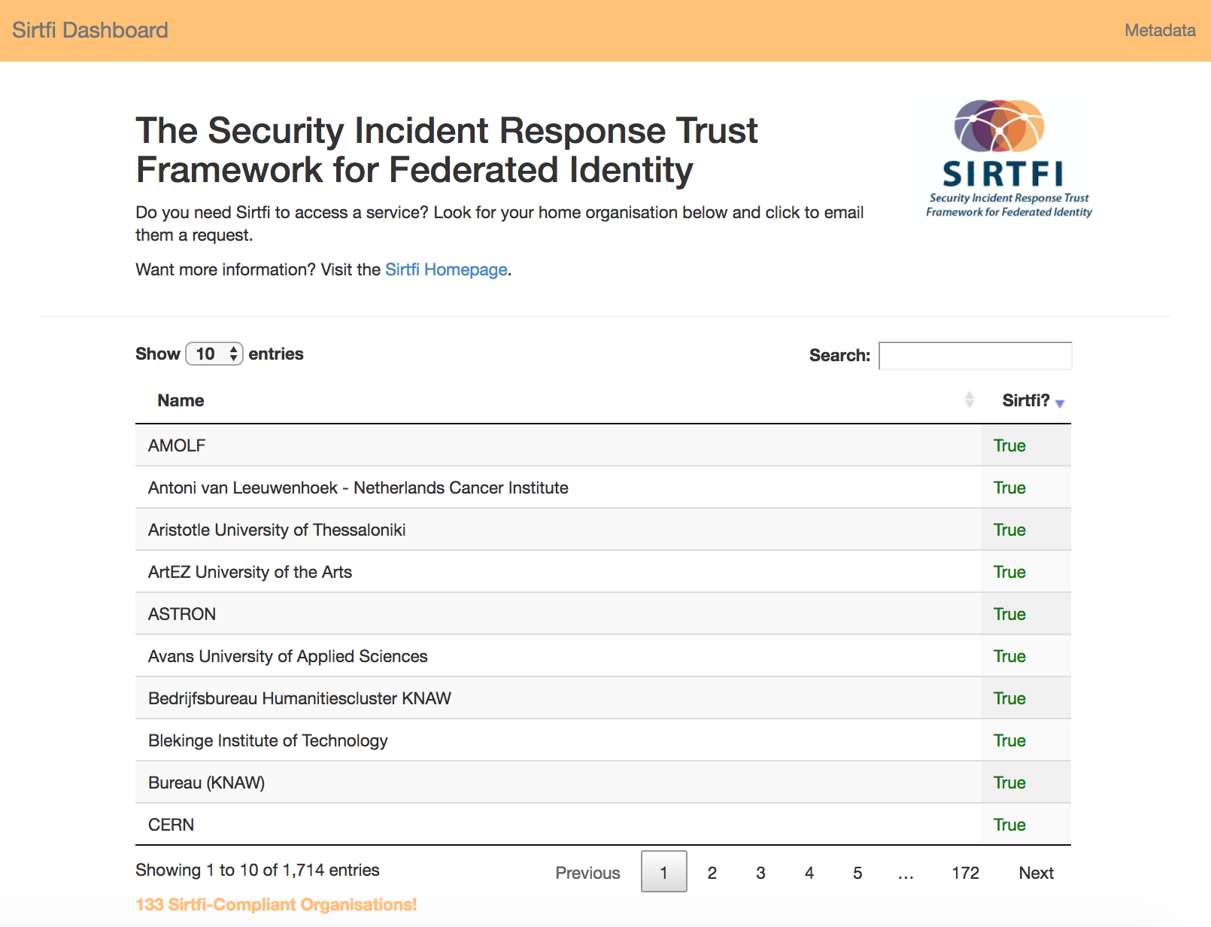
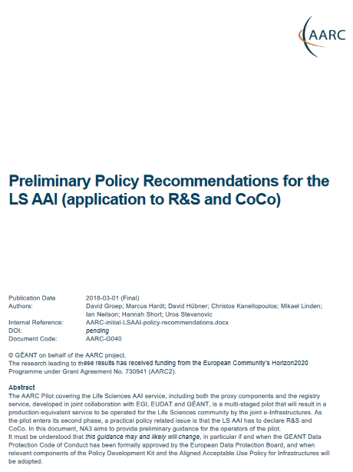

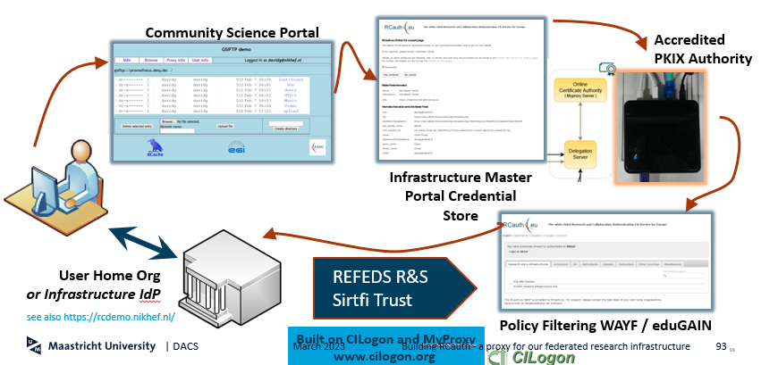
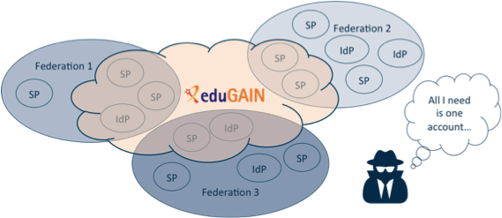
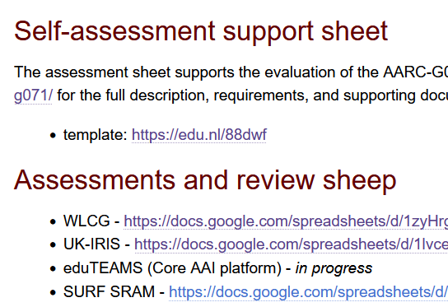
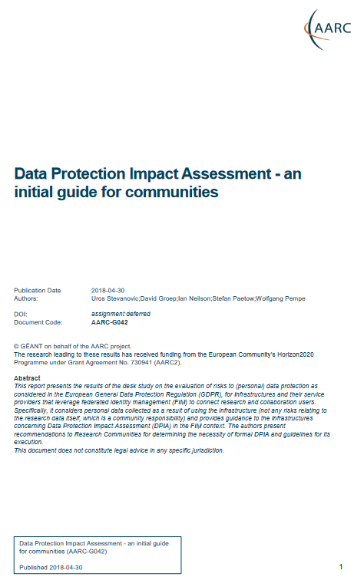



An AARC beyond the Policy Development Kit?
Current PDK is targeted at large and structured communities – and quite complex
https://aarc-community.org/policy

Slide 16
Objective: support the diverse and different policies needed now
Infrastructure alignment and policy harmonisation: helping out the proxy (started)
Operational Trust for Community and Infrastructure BPA Proxies
Increase acceptance of research proxies by identity providers through common baselines
Review infrastructure models for coordinated AUP, T&C, and privacy notices, improving
cross-infrastructure user experience (users need to click only once)
User-centric trust alignment and policy harmonization: helping out the community (starts in Q4 2024)
Lightweight community management policy template
Guideline on cross-sectoral trust in novel federated access models
Assurance in research services through (eIDAS) public identity assertion
Anchored in the research user communities by co-creation with FIM4R, through policy workshops validating the restructured policy framework … together with the new BPA

Slide 17
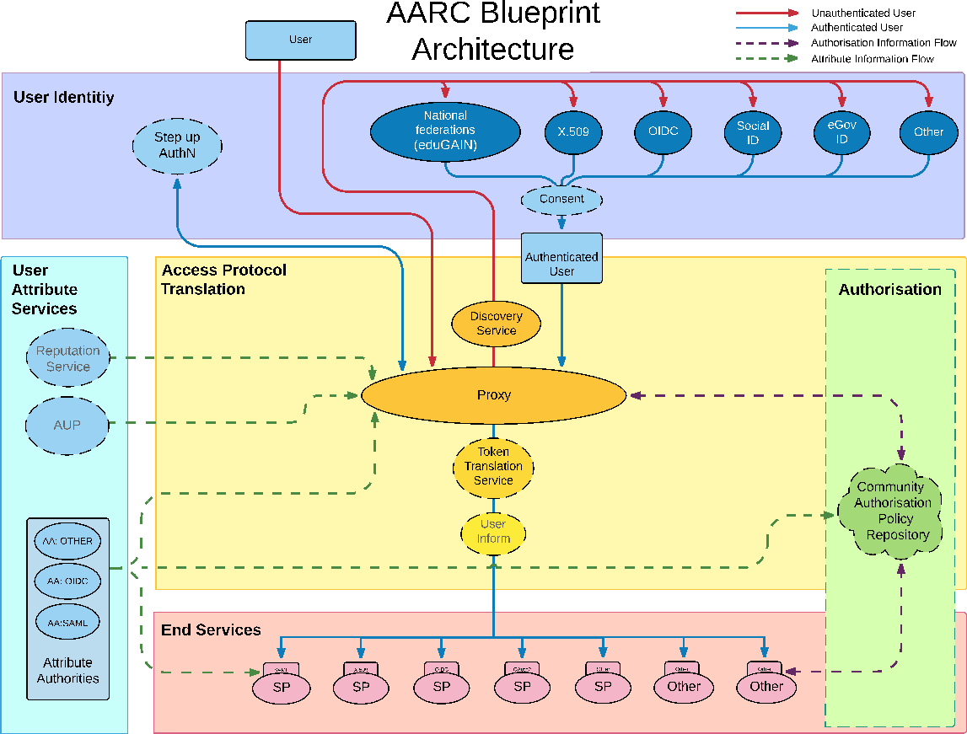

AARC G071 is there to help, but do we ‘get the trust across’?
Community membership management directories and attribute authorities
integrity of membership
identification, naming and traceability
site and service security
protection on the network
assertion integrity
Community membership management directories and attribute authorities
integrity of membership
identification, traceability
site and service security
network protections
assertion integrity
> Trust marks and expression
But when proxies are proxying proxies, can we proxy the trust?
Agree to a
common baseline
… an approach that was successful previously!
… set of (one or more) guidelines that represent a widely agreed and jointly-developed
operational trust baseline for infrastructure membership management and proxy components.
Supplemented by policy guidance on how to connect sectoral federations with more specific policies.
Driven by your (FIM4R, WISE, EOSC, …) feedback, and those of current proxy operators (in AEGIS).
See https://www.igtf.net/guidelines/aaops/ and https://aarc-community.org/guidelines/aarc-g071/

Slide 18
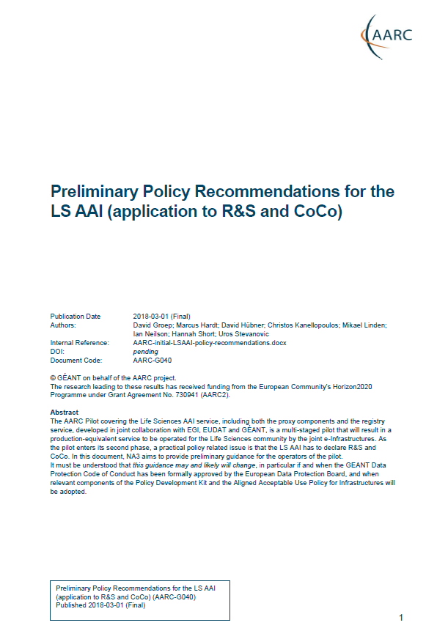
Proxies have their own challenges as well: AUPs, T&Cs, Privacy notices, …
For large ‘multi-tenant’ proxies:
some subset users in some communities use a set of services – how to I
present their Terms and Conditions, and their privacy policies, so that the users
  only see the T&Cs and notices for services they will access
  this does not to need to be manually configured for each community
  is automatically updated when services join
as well as for community and dedicated proxies:
when new (sensitive) services join, who needs to see the new T&Cs?
can we communicate acceptance of T&Cs to services even if ‘we’ are small and ‘they’ are large?
What is an acceptable user experience in clicking through agreements?
What is most effective in exploiting the WISE Baseline AUP? What do you need?
With Fewer Clicks to More Resources!
beyond AARC-G040

Slide 19
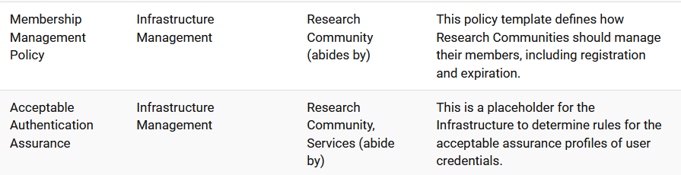
Helping out the community – a simpler policy toolkit for communities
What we heard and observe:
“small to mid-sized communities do not have the resources to maintain a bespoke community management policy”
Leaves both communities and operators of membership management services unclear about trust assurance level of members - current templates in toolkit too complex and prescriptive
community consultation on the ‘minimum viable community management’ – we are here!
template and implementation guidance (FAQ) on community lifecycle management
how to implement the community management in the (EOSC) AAI services

Slide 20
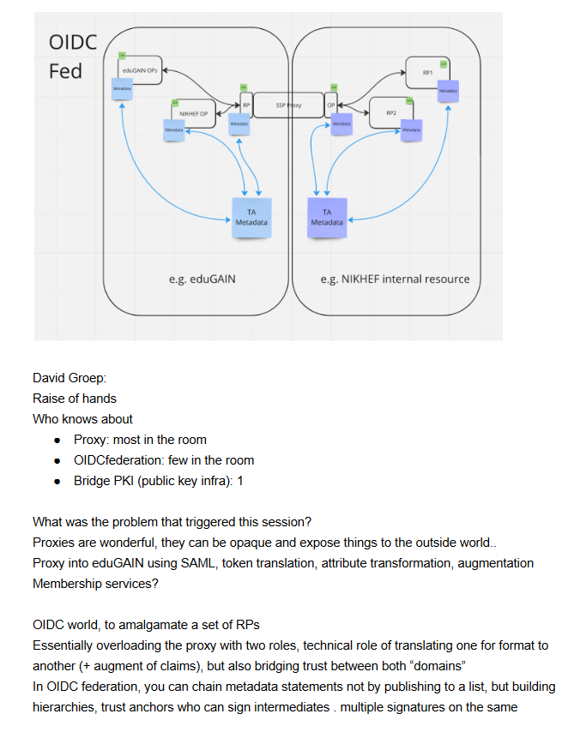
New trust models – what is the role of the proxy in OIDCFed?
In today’s BPA proxy links both sides by being
opaque, both for attributes as well as for trust
does it have to be that way?
separate claims/attribute transformation from trust bridging?
can OIDCfed structure convey trust transparently? Should it?
can we then be more flexible? or will it just confuse everyone?
easier to bridge trust across sectors this way?
e.g. linking .edu, .gov, and private sector federations?
See also ACAMP at TechEx23 and TIIME

Slide 21
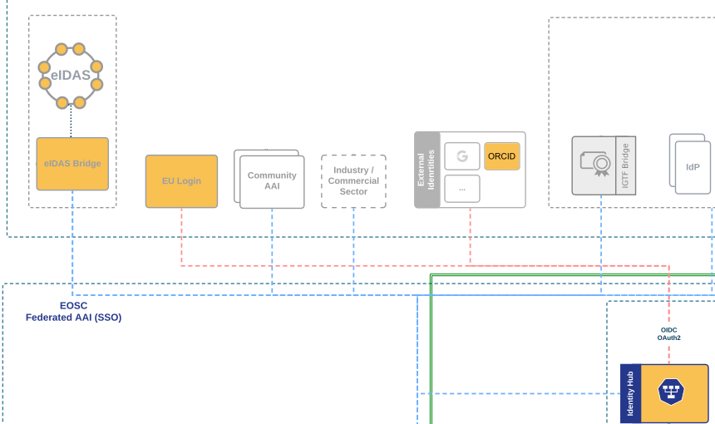
We’ll see more diverse sources of identity & assurance anyway
Most reliable (and most ‘available’) source of assurance may be the European government identity ecosystem.
Step-up to at least substantial level can now readily be done ‘at home’ by users
through their national eID schemes
Joint work on eIDAS, Erasmus Student Mobility,
and more makes this more accessible
Better attainable than relying on home institutions?
… but:
what to do with non-European users?
how to link the identities together

Slide 22
All About Enabling Research – FIM4R & communities are the driving factor
Also in AARC-TREE we target a “co-creation process” with the research communities:
support FIM4R to increase the reach of workshops in the next 2 years
community review and your ideas and input on both policy and architecture
start from the high-level requirements and broad community input
Really a global activity: we want to engage everyone
in AARC TREE and beyond

Slide 23
Involving the user community from start to finish

Slide 24
Dedicated work package to collect requirements from (new) communities
  Conduct an AARC BPA adoption survey among the RIs,
  online survey accompanied by the arranged conversations with the individual RIs
  Collect information on current deployment of AARC BPA AAIs and adoption of guidelines
Result: Landscape analysis of AARC BPA adoption (around December 2024)
Landscape analysis of AARC BPA adoption
  Design and create survey (including technology and policy questions)
  based on FIM4Rv2 paper, Evolution, EOSC AAI TF requirements
  Engage FIM4R, AEGIS, EOSC AAI TF, National Ris, EU data spaces to capture requirements
  Discus with our ESFRIs to get expectations & requirements via consultations, workshops etc
Result: Use cases requirements described in a white paper (target Q1 2025)
Use cases requirements & consultations
Handover to Compendium

Slide 25
Adoption and validation
Pilots
  Validate the guidelines
  Technical feasibility
  Cross RIs
Validator suite
  Including online validator service
Start with:
WISE AUP and Privacy Notice across RIs
OpenID Federations
Engage partners
  Get feedback
  Feasibility
  Technical correctness
Continuous cycle!
  Collect feedback from outside the project
  Provide feedback to technology and policy
Validators to test implementations of guidelines
Online validation service available to all
Collaboration with AEGIS to test participating RIs

Slide 26
Compendium and Recommendations
In the ‘2nd year’ of climbing the tree (April 2025 - February 2026)
Publish the compendium of AARC best practices
and deliver recommendations for a common long-term strategy
for AAI services in pan-European Research Infrastructures in Europe
based on the use case input ☺
promotes proposed approach from architecture and policy activities
iterate with the infrastructures at large to produce the final version

Slide 27

Let’s climb the AARC TREE together!
Let’s climb the tree together!
Image generated by Adobe Firefly 2 with the text prompt
“image of a broad-leaved lemon tree with a person sitting below it leaning against the trunk in the sunshade”

Slide 28
Thanks to the AARC Community, including folk from whom I re-used graphics and material in this overview. In random order: Licia Florio, Nicolas Liampotis, Christos Kanellopoulos, Marina Adomeit, Janos Mohacsi, Ilaria Fava, Slavek Licehammer, Dave Kelsey, Ian Neilson, Marcus Hardt, Mischa Salle, Hannah Short, and Maarten Kremers.
davidg@nikhef.nl

