Slide 1
Closer to IPv6-only on WLCG

Slide 2
Closer to IPv6-only on WLCG
Bruno Hoeft¹, David Kelsey³, Edoardo Martelli⁴, Carmen Misa Moreira⁴ ISGC 2024, Taipei, 27 March 2024
1 - Karlsruhe Institute of Technology (KIT), Germany
3 - UKRI Science and Technology Facilities Council (STFC UK), United Kingdom
4 - Conseil Européen pour la Recherche Nucléaire (CERN), Switzerland

Slide 3
On behalf of all co-authors in the HEPiX IPv6 working group
Active in HEPiX IPv6 Working Group – last 12 months
M Babik (CERN), M Bly (RAL), N Buraglio (ESnet), T Chown (Jisc), D Christidis (U Texas/ATLAS), J Chudoba (FZU Prague), P Demar (FNAL), J Flix (PIC), C Grigoras (CERN/ALICE), B Hoeft (KIT), H Ito (BNL), D P Kelsey (RAL), E Martelli (CERN), S McKee (U Michigan), C Misa Moreira (CERN), R Nandakumar (RAL/LHCb), K Ohrenberg (DESY), F Prelz (INFN), D Rand (Imperial), A Sciabà (CERN/CMS), C Walker (Jisc)
many more in the past, and others join from time to time
and thanks also to WLCG operations, WLCG sites, LHC experiments, networking teams, monitoring groups, storage developers…

Slide 4
Outline
The HEPiX IPv6 working group
WLCG Data Challenge 2024 (DC24)
Special connection between DE-KIT and CERN for DC24
IPv6/IPv4 traffic analysis of the Tier-0 to Tier-1 LHCOPN
DC24 results
Tier-1/2 Dual-Stack WorkerNodes GGus ticket campaign
Migration towards IPv6 at DE-KIT
Summary

Slide 5
HEPiX-IPv6 Working group
working group
-- created in April 2011
Phase 1 to consider whether and how IPv6 should be deployed in HEP (especially for WLCG). Readiness and gap analysis of
HEP applications,
middleware,
security issues,
system management and monitoring tools and
end to end network monitoring
Phase 2 → dual-stack deployment:
dual-stack at fileserver (at Tier-1 – realized end of 2020 / at Tier-2 – realized at end of 2023)
a GGUS-Ticket campaign at end of 2023 → dual-stack WorkerNodes incl. middleware (@Tier-1/2)
Phase 3 : move towards single protocol → decommission of IPv4 and migrate to IPv6 only

Slide 6
WLCG Data Challenge 2024 (DC24)

Slide 7
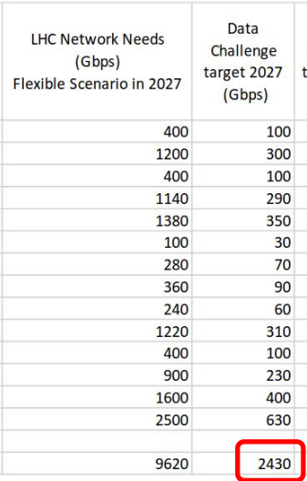
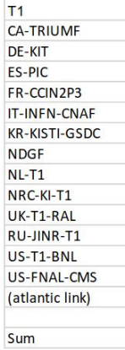
DC24
9
4
Flexible Scenario in 2029 9620 Gbps
Sum
9620
2430

Slide 8
DC24 February 12 - 23
Proposal to distribute different exercises (independently of the experiment exercises) over the challenge days, e.g.
Day 1-3: T0 export
Day 4-5: Reprocessing like traffic
Day 6,7 (weekend): Keep things running…
Day 8-9: MC like traffic
Day 10-11: Increase to flexible scenario + experimental traffic flow (NOTED)
Day 12: Repeat things e.g. with adjusted setting
(Day 13-14 (tentative weekend): Hope that nothing completely broken)
URL: https://indico.cern.ch/event/1307338/contributions/5657133/attachments/2749065/4784409/DC24%20Welcome%20Logistics%20Introduction.pdf

Slide 9
Experiment plans at DC24
special Exeriments plans
CMS → 250Gbps T0 to T1 (to DE-KIT 60Gbps) +…
Atlas → 270Gbps T0 to T1 (to DE-KIT 61Gbps) + …
detailed table with expected transfer rates of each site
HEPiX-IPv6 → IPv6 only Networking IPv4 → finding of leftovers at LHCOPN URL: Inspect remaining IPv4 dataflows LHCOPN between T0 (CERN) and T1 (DE-KIT) https://indico.cern.ch/event/1307338/contributions/5663197/attachments/2749306/4785227/DC24-IPv6-project-1.pdf

Slide 10
DE-KIT (3+100G) LHCOPN only for DC24
LHCOPN – Connecting DE-KIT to CERN → 2 x 100 G
Additional 100 G LHCOPN DE-KIT to CERN
DFN loan of 100 G DE-KIT to DFN PoP Frankfurt incl. link to Géant Router in Frankfurt
Géant Frankfurt to Géant Geneva
Splitting the 1 x 100 G to 2 x 50 G as overlay to the 2x400 G CERN/Géant interfaces
DFN
FRA
Géant
CERN
L513-E-RJUP1-1
DE-KIT r-ig-i
et-0/1/6
Géant-CERN
400G Inteface
DFN FRA
Géant rt1.fra.de.re0
50 G
DFN 100 G loan
et-2/0/1
50 G
CERN
L773-E-RJUP1-2
DE-KIT r-ig-ii
Géant-CERN
400G Inteface
Belwü
Switch
et-0/1/7

Slide 11
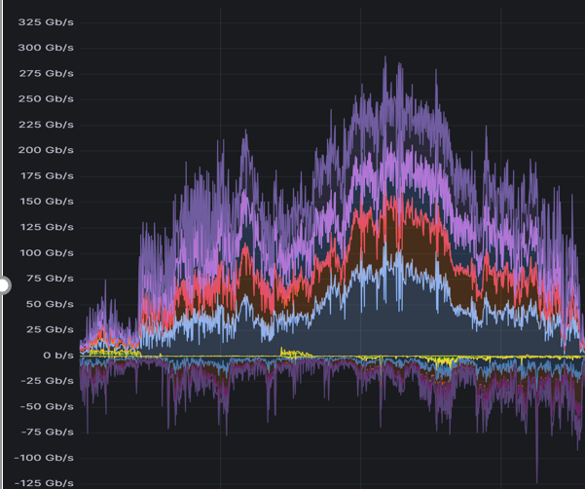
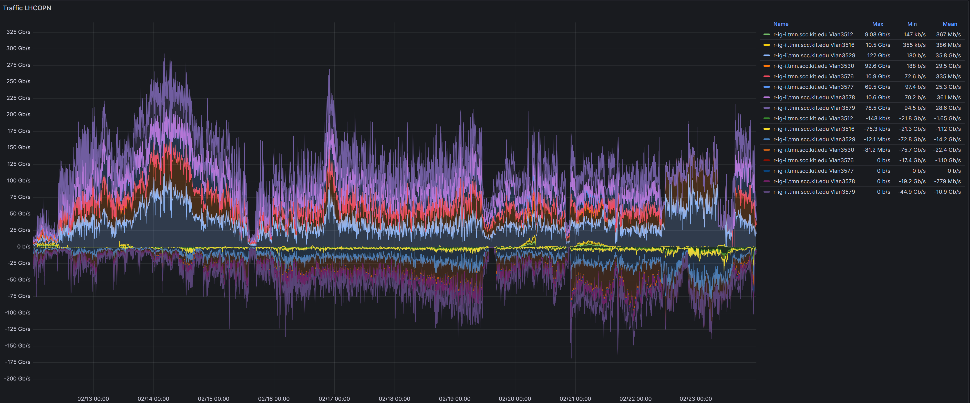
DC24 graph over two weeks
in
out
out
out
out
in
in
5
3
4
1
2

Slide 12
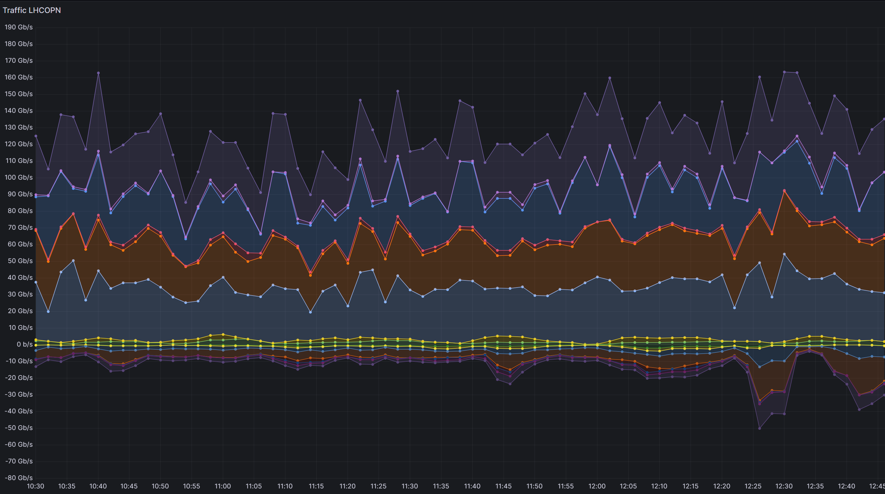
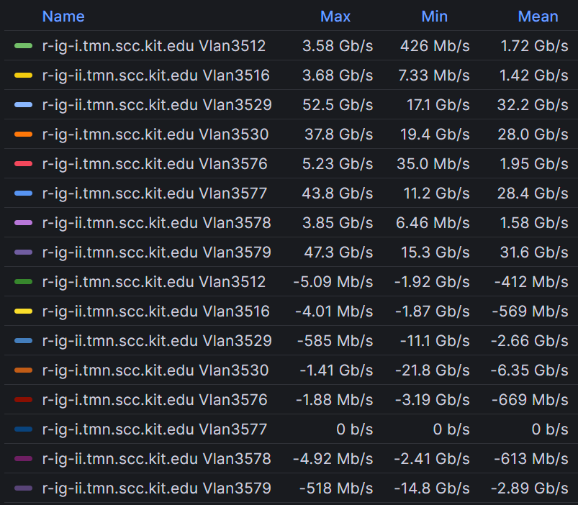
1
IPv4
IPv4
IPv4
IPv4
IPv4
IPv4
IPv4
IPv4
Notes:
20240213 Dienstag 10:30 bis 12:45

Slide 13
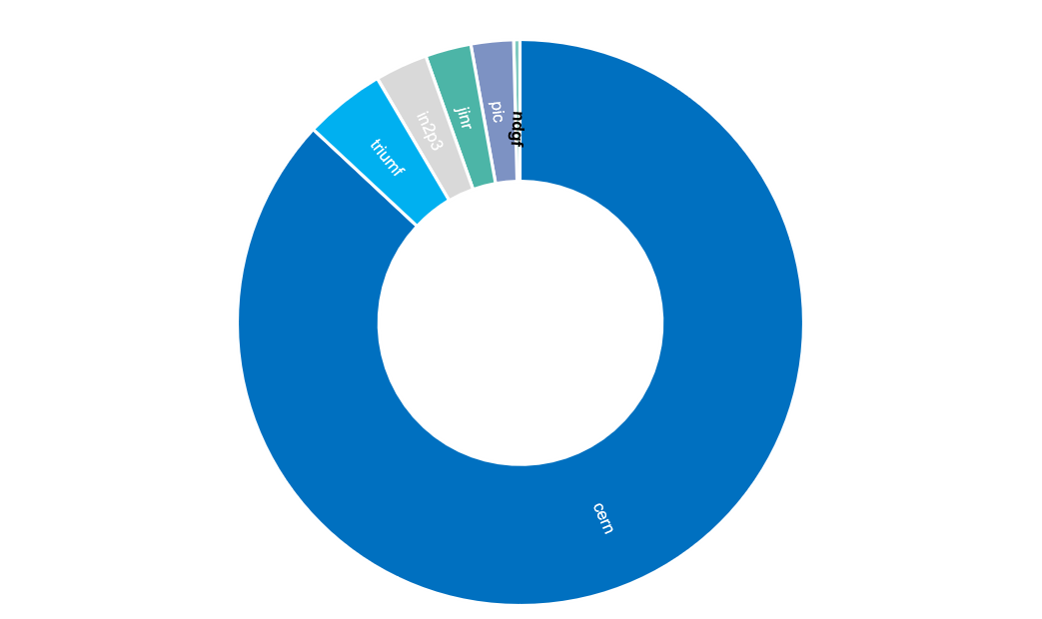
DC24 first day
1
shown graph are network monitoring graphs with dedicated SVI interface for IPv4 and IPv6
further analysis with netflow (nfsen)
source/destination host and port
Outgoing traffic during first DC24 day
IPv4 traffic was mainly to CERN – 3,0 TeraByte (data transfer to aliendb (experiment Alice)) and file server (failed transfers are falling back from IPv6 to IPv4 (e.g. Alice))
IPv4 flows to other sites are mainly data exchanged between perfsonar server
→ except a little dataflow to jinr and bdii flows → bdii at DE-KIT IPv4 only (bdii shall be decommisioned)
server at CERN :
atlasfrontier09.cern.ch.
front-lcg0[1234].cern.ch.
p06636710n27239.cern.ch.
p06636710e56718.cern.ch.
p06636710x02074.cern.ch.
p06636710g94481.cern.ch.
p06636710d42351.cern.ch.
p06636710t37894.cern.ch.
p06636710r35645.cern.ch.
p06636710e11348.cern.ch.
aliendb[45].cern.ch.
aliendb[78].cern.ch.
aliendb10.cern.ch.
pcalimonitor.cern.ch.
pcaliendb06a.cern.ch.
st-048-bb35f9c9.cern.ch.
st-096-hh1510b1.cern.ch.
st-192-e1bf9e17.cern.ch.
st-192-c6995aa0.cern.ch.
vocms0334.cern.ch.

Slide 14
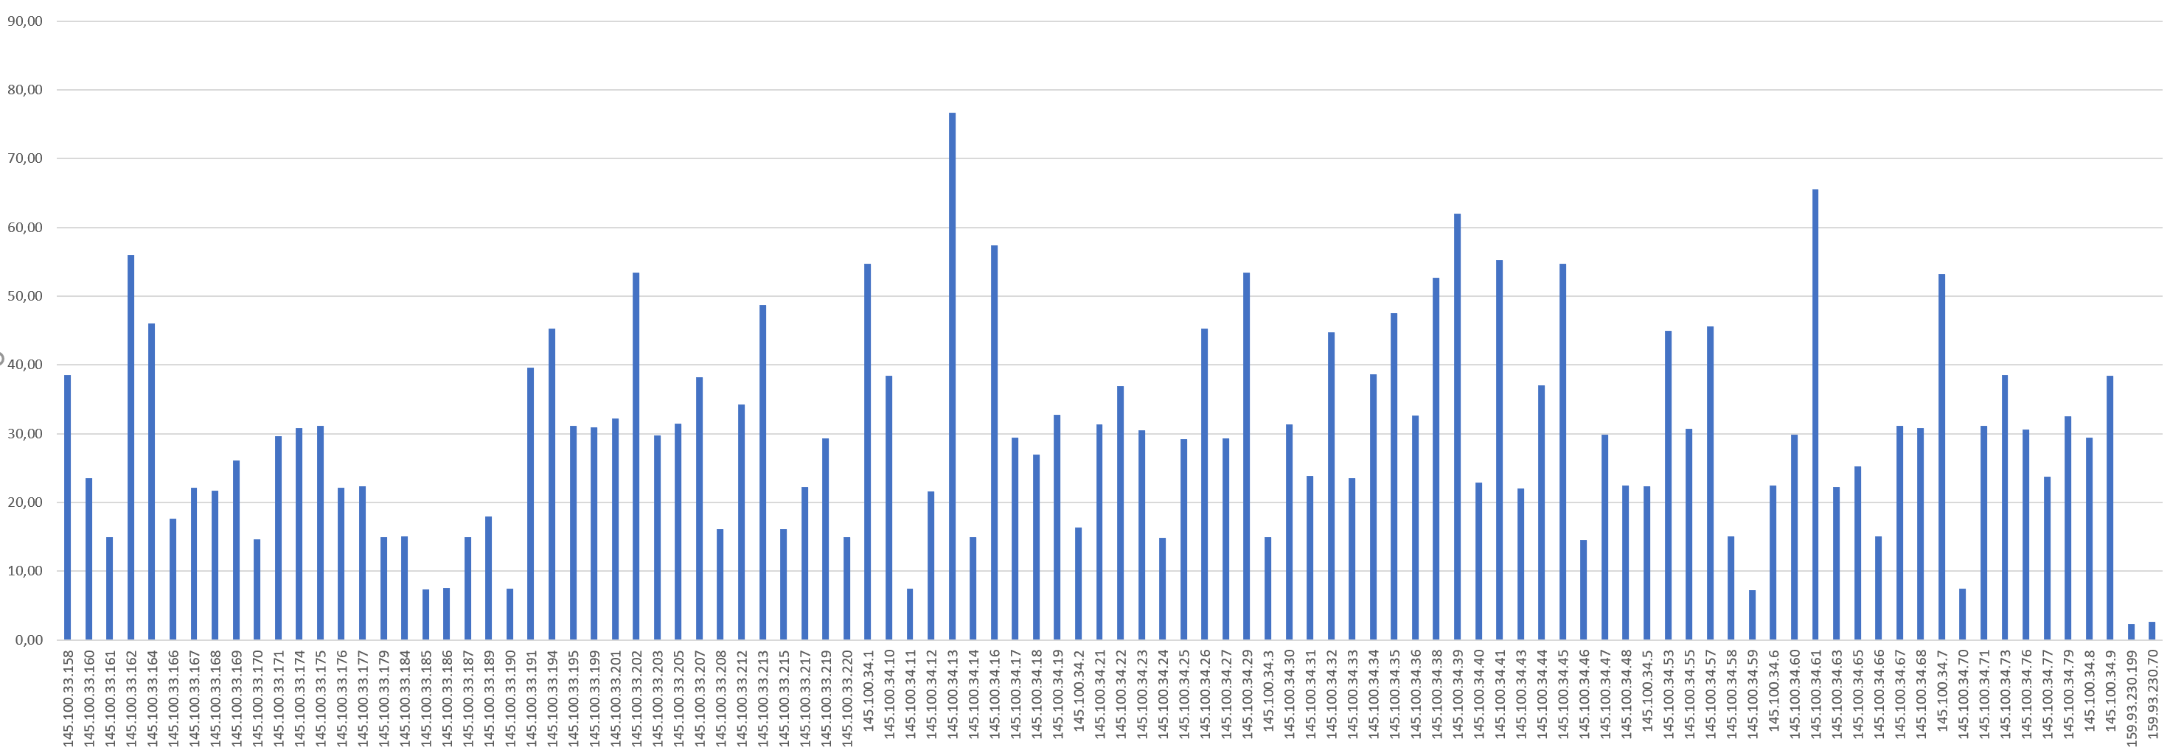
3,0TeraByte Data DE-KIT to NLT1
2
Summary: total flows: 9634, total bytes: 3.0 TeraByte
At NLT1 98 different hosts involved
Reason:
NLT1 turned to accept IPv6 connections, but initiate IPv4 (to reduce amount of IPv6 connections)
instability reason with IPv6 connections
neighbour discovery (nd) not reliable
memory overflow with many concurrent IPv6 connections

Slide 15
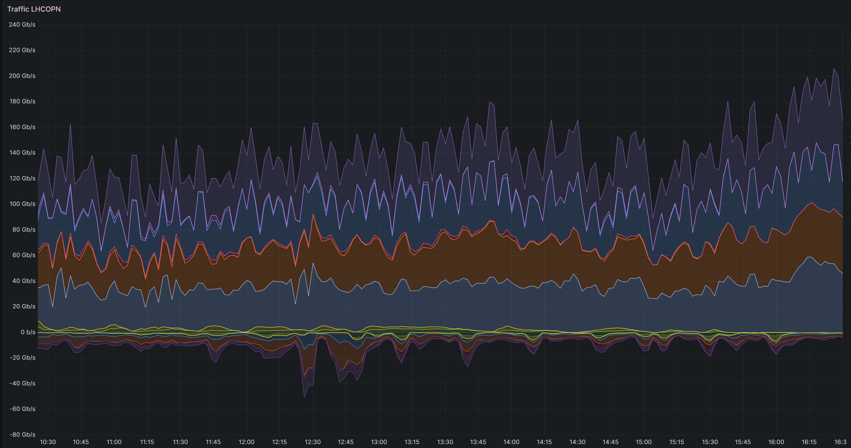
2,1TeraByte Data DE-KIT to NLT1
3
BNL hosts (IPv4 only) (Experiment Belle2):
192.33.128.21 bldiracvm02.sdcc.bnl.gov.
192.33.128.23 bldiracvm04.sdcc.bnl.gov.
192.33.128.25 bldiracvm05.sdcc.bnl.gov.
192.33.128.41 blrucio01-vrrp.sdcc.bnl.gov.
192.33.128.42 blrucio02-vrrp.sdcc.bnl.gov.
192.33.128.44 blcond03.sdcc.bnl.gov.
192.33.128.45 blcond04.sdcc.bnl.gov.
192.33.128.49 blcond06.sdcc.bnl.gov.
192.33.128.98 blrucio03.sdcc.bnl.gov.
192.33.128.99 blrucio04.sdcc.bnl.gov.
Summary: total flows: 536, total bytes: 2.1 TeraByte
2 file server at DE-KIT transfer data to 98 file server at NLT1, all hosts at DE-KIT and NLT1 dual-stack deployed
* 64GByte
transfered to CERN, kiae, BNL
and a small leftover to other sites (manly perfsonar)

Slide 16
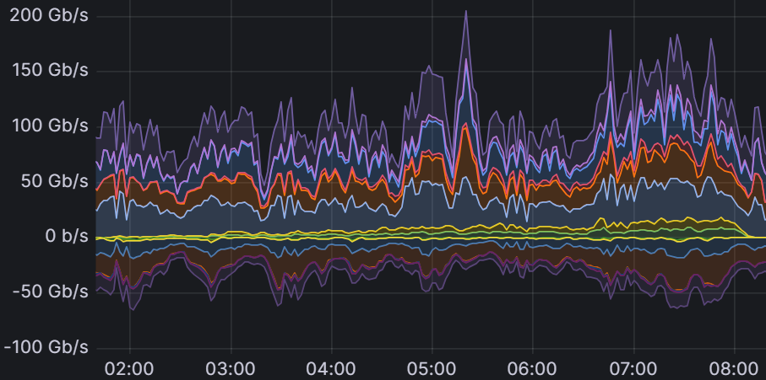
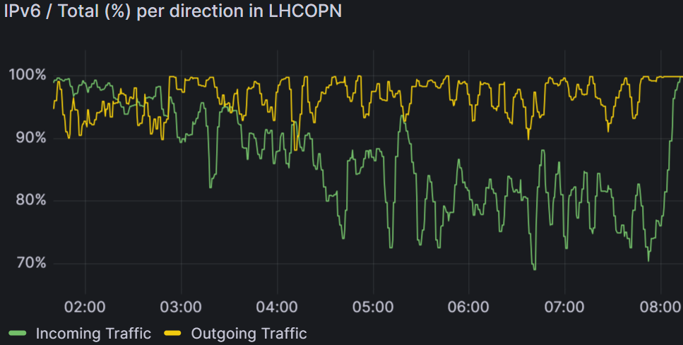
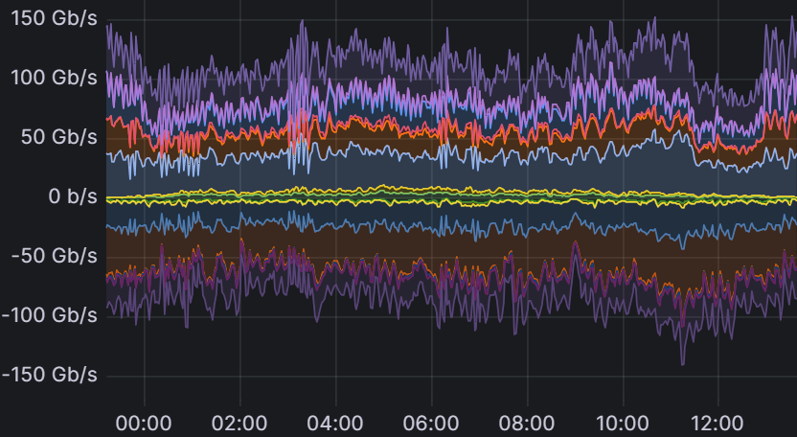
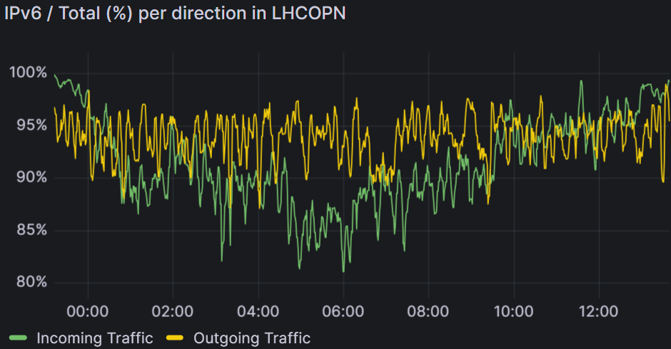
XRootD file transfer from CERN
2024-02-20 06:02:38.012 16.000 TCP 128.142.57.111 40594 192.108.47.89 1094 2.7 M 4.1 G 2.1 G 1499 1
2024-01-31 09:33:31.833 11.653 TCP 128.142.63.105 43670 192.108.46.89 1094 2.8 M 4.2 G 2.9 G 1498 1
Summary: total flows: 597053, total bytes: 33.0 TeraByte
1625 Server at CERN
Squid service Port 3401
XRootD Port 1094
4
Only 16 Server at KIT
f01-032-114-e.gridka.de.
f01-124-110-e.gridka.de. dual-stack
f01-124-159-e.gridka.de. dual-stack
f01-124-160-e.gridka.de. dual-stack
f01-124-161-e.gridka.de. dual-stack
f01-125-159-e.gridka.de. dual-stack
f01-125-160-e.gridka.de. dual-stack
f01-125-161-e.gridka.de. dual-stack
cvmfs-sq4.gridka.de. dual-stack
cvmfs-sq1.gridka.de. dual-stack
cvmfs-sq3.gridka.de. dual-stack
cvmfs-sq5.gridka.de. dual-stack
cvmfs-sq6.gridka.de. dual-stack
cvmfs-sq2.gridka.de. dual-stack
frontier-sq1.gridka.de. dual-stack
fw-nat-inside-outside.gridka.de.
XRootD Port 1094
2024-02-20 23:26:09.012 0.500 TCP 128.142.249.74 38908 192.108.68.144 1094 12 2266 36256 188 1
2024-02-21 02:39:33.262 0.250 TCP 128.142.240.76 55700 192.108.46.89 1094 10 706 22592 70 1
Summary: total flows: 1460049, total bytes: 43.1 TeraByte
f01-124-109-e.gridka.de.
f01-124-110-e.gridka.de.
f01-124-112-e.gridka.de.
f01-124-155-e.gridka.de.
f01-124-159-e.gridka.de.
f01-124-160-e.gridka.de.
f01-124-161-e.gridka.de.
f01-125-109-e.gridka.de.
f01-125-110-e.gridka.de.
f01-125-155-e.gridka.de.
f01-125-159-e.gridka.de.
f01-125-160-e.gridka.de.
f01-125-161-e.gridka.de.
f01-117-137-e.gridka.de.
f01-152-140-e.gridka.de.
f01-152-191-e.gridka.de.
f01-152-192-e.gridka.de.
Squid service Port 3401
2426 Server at CERN
cvmfs-sq4.gridka.de.
cvmfs-sq1.gridka.de.
cvmfs-sq3.gridka.de.
cvmfs-sq5.gridka.de.
cvmfs-sq6.gridka.de.
cvmfs-sq2.gridka.de.
frontier-sq1.gridka.de.
fw-nat-inside-outside.gridka.de.
5
Only 25 Server at KIT

Slide 17
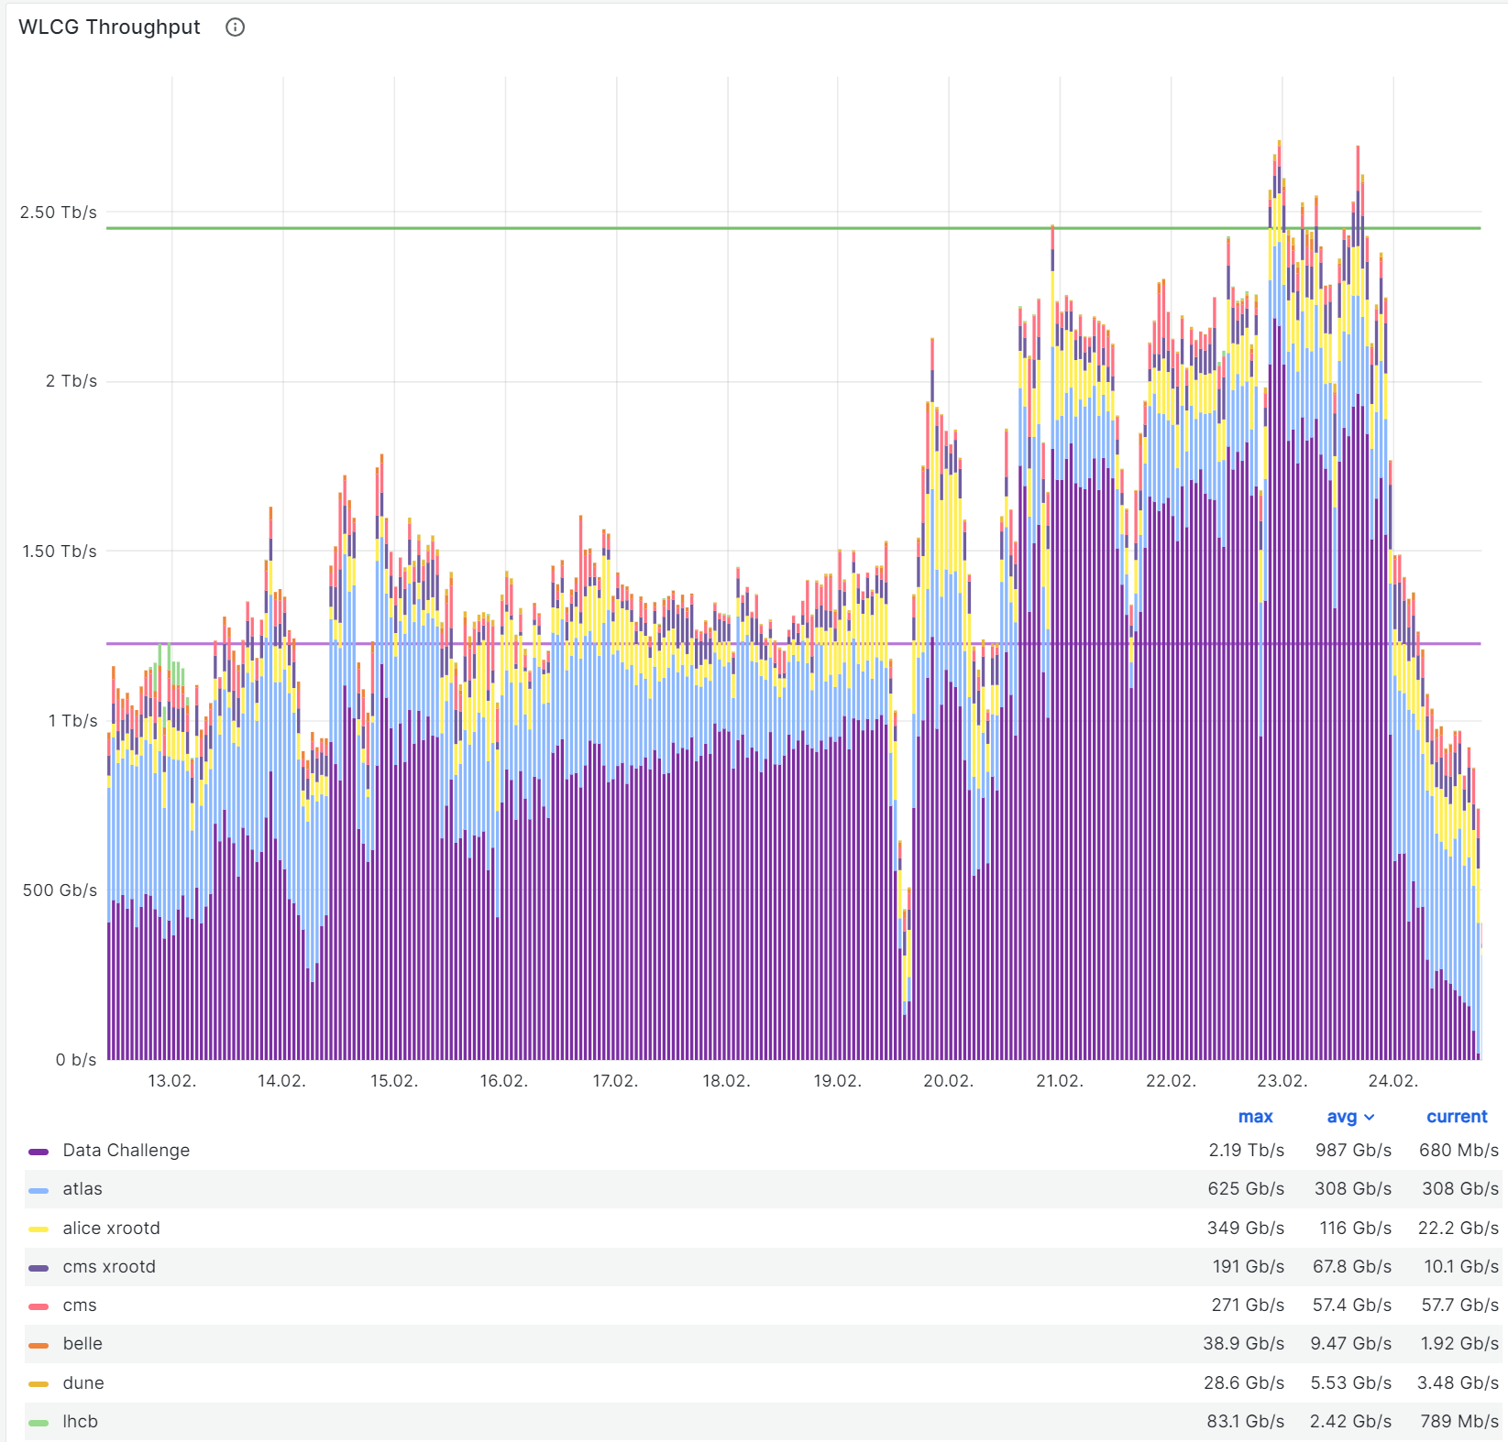
Some DC24 results
token
Aggreagated WLCG Traffic over 48 hours above 2.5Tbit/sec
not realised, but the traffic rate itself where reached (25% of LHC-HL)
Source/outbound performance of DE-KIT was good (1.033)
Destination/inbound performance was a little less (0.897), there were sites identified with more open points to solve as DE-KIT, DC24 brought issues to light
the week bevor DC24 DE-KIT could achive a sustained inbound rate of 300 Gbps, but during DC24 the following issu was hitting us:
problems with HTTP WebDAV third-party transfers
„file deletion process“ initiated by FTS only was to slow – multiple deletion proccesses were required
Change from x.509 to token was not as smooth as envisioned → livetime of tokens too short (running out before / or during execution)

Slide 18
Tier-1/2 Dual-Stack WorkerNodes GGus ticket campaign

Slide 19
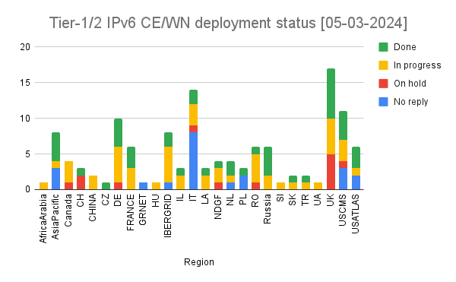
Tier-1/2 WN and CE @ Dual-Stack
Motivations
scarcity of IPv4 addresses
full IPv6 support
by the experiment middleware stacks,
readiness for adoption of packet marking in network traffic
reduction of residual IPv4 traffic
fulfillment of government mandates by some countries
GGus Ticket campaign
Goal
Storage services successful deployed
Next step is deploying IPv6 fully enabled infrastructure at entire WLCG
WLCG management board and LHC experiments approved
deployment plan for IPv6 requires that Tier-1 and Tier-2 sites
deploy dual-stack connectivity (IPv4 + IPv6)
on their computing elements (CE) and worker nodes (WN)
by 30 June 2024
→ For more details see https://indico.cern.ch/event/1225423/

Slide 20
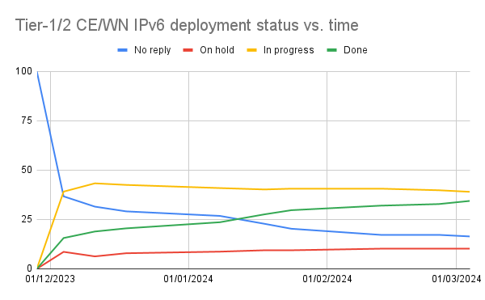
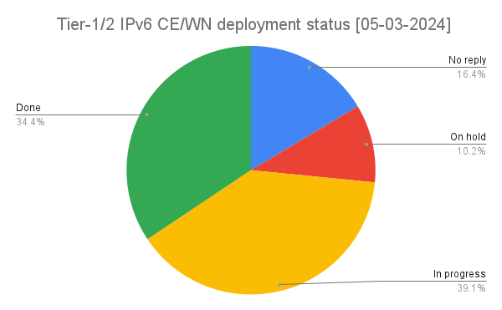
IPv6 deployment steps
Switching off IPv4 is not requested nor recommended at this stage: any step in this direction should first be discussed with the LHC experiments you support and WLCG. In general terms we should have to wait until all traffic happens via IPv6.
The practical objective is to allow worker nodes to contact IPv6-only central services, and central job submission services (e.g. pilot factories) having only IPv6 connectivity to submit jobs to computing elements. There is no requirement to allow incoming connections in the WNs, as it has always been the case.

Slide 21
Migration towards IPv6 at DE-KIT

Slide 22
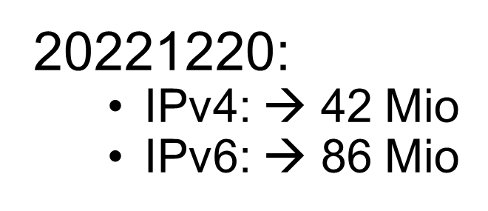
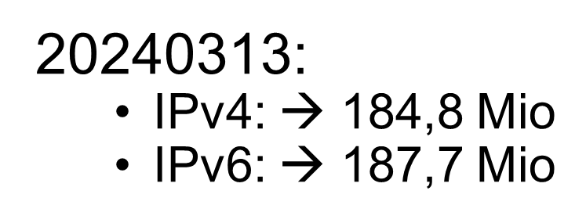
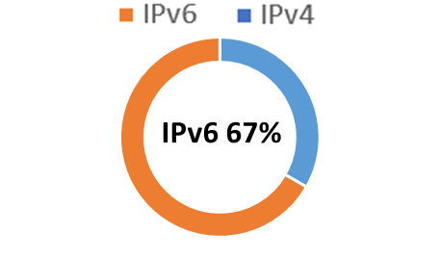
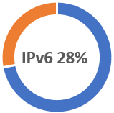
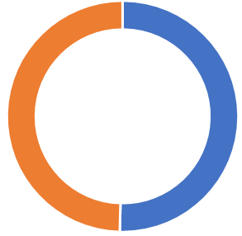
DE-KIT IPv6 WorkerNodes migration
detailed monitoring is still in place for narrowring down IPv4 communication
to list all unhandled IPv4 packets
8884 – Alice: operation report
2049 – NFS
1094 – XrootD
961[89] – LRMS (20% only internal to WN-Farm)
A view statistics
20220415:
IPv4: → 80 Mio
IPv6: → 31 Mio
IPv6 50,3%

Slide 23
Details of Squid
SQUIDS (Proxyserver and Web-Cache):
some SQUIDS still IPv4 only (migration to dualstack in proccess)
significant part of connections via public IPv4
=> to check: if CVMFS can prefer IPv6? (CVMFS → CernVM-File-System)
CVMFS sending via http request to squid
CVMFS has DN configuriert that needs to be resolved → default chooses IPv4 address
Solution => cvmfs_ipfamily_prefer=6

Slide 24
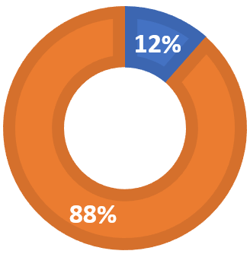
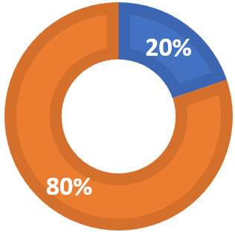
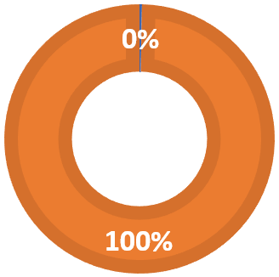
SQUIDS migrated all to dual-stack
later all SQUIDS migrated to dual-stack deployment
CVMFS now
- mainly IPv6 but:
- on WorkerNodes uses IPv6 (with deployed flag: CVMFS_IPFAMILY_PREFER=6 )
- CVMFS frontier uses still IPv4 even while both systems dual-stack
- but switching of IPv4 → froniters will operate over IPv6
- the CMS CVMFS frontiers offers in site-local-config.xml the Option:
<frontier-connect>
...
<prefer ipfamily="6"/>
...
</frontier-connect>
26-07-2022
23-10-2022
25-10-2023
IPv4 : 1,25 mio. IPv6: 9,6 mio.
IPv4 : 4,44 mio. IPv6: 18 mio.
IPv4 : 64 k IPv6: 22 mio.

Slide 25
Summary
WN + CE -- next step towards IPv6
dual-stack deplyment
ongoing and activley monitored (by HEPiX-IPv6 Working Group (Andrea Sciaba))
DC24
analysing all the figures collected during DC24 still ongoing
detailed (/in depth) result understanding
Enabing LHC-HL requested performance (data throughput)
still pending LHCOPN IPv4 traffic
ongoing analysis and following up required
DE-KIT IPv6 migration not done yet
new WorkerNodes with ARM processor will be deployed → analyse protocol behaviour
new experiments → with IPv6 only,
no migration „nightmare“

Slide 26
Thanks for your attention
Questions

