Slide 1
Support to experiments in the transition
from X.509 authN/Z to SciTokens
International Symposium on Grids & Clouds (ISGC) 2024
Alessandro Pascolini
alessandro.pascolini@cnaf.infn.it

Slide 2
Outline
What is INFN – CNAF
What are X509 and SciTokens
Users AuthN/Z, state of the art
User Support strategies
Conclusions

Slide 3
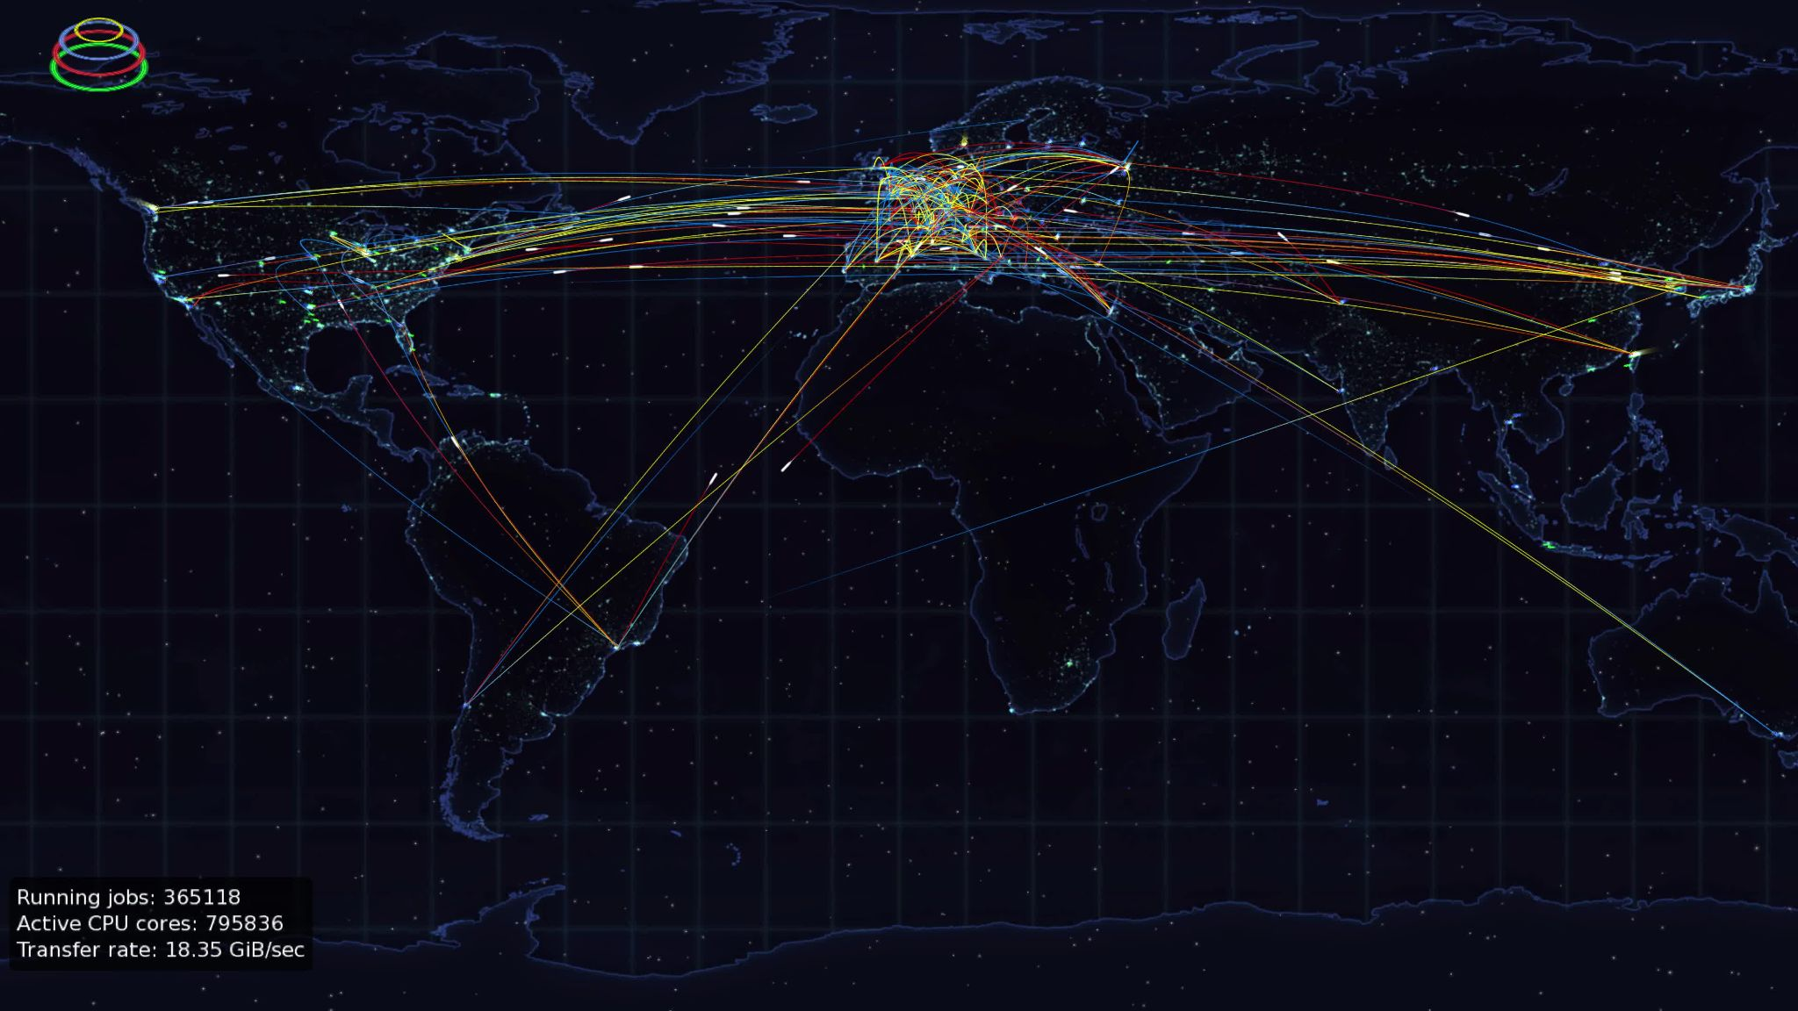
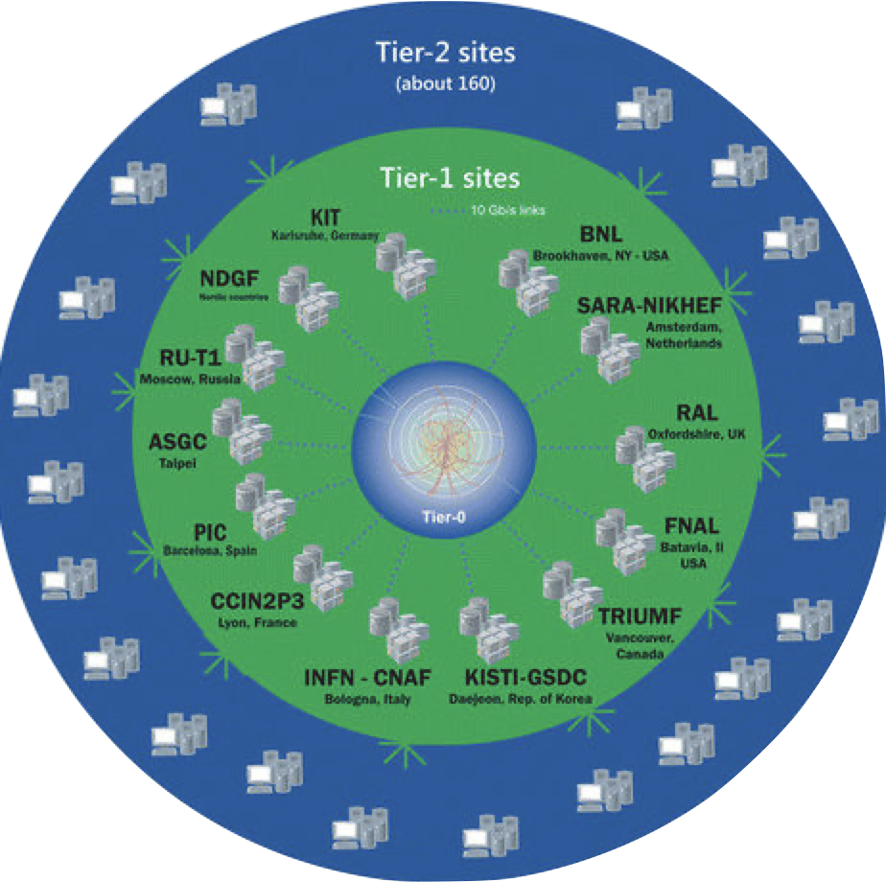
INFN - CNAF
Worldwide LHC Computing Grid (WLCG) [1]
~170 computing centres in more than 40 countries
Providing computing resources to LHC and many other experiments worldwide
According to their dimensions and resources, all the centers are divided in Tier-0 (CERN), Tier-1 and Tier-2
[1] https://wlcg.web.cern.ch/

Slide 4
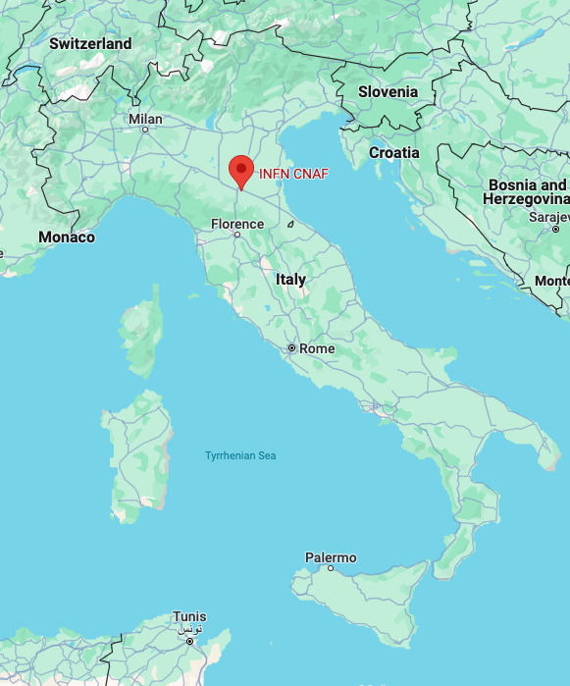
INFN - CNAF
INFN – CNAF [2] hosts the Italian Tier-1 since 2003
Provides resources to more than 60 scientific communities →(~1500 local users)
~2.000 computing nodes → ~60.000 cores managed by an HTCondor [3] cluster
~70 PB disk and ~130 PB tape
[2] https://www.cnaf.infn.it/
[3] https://www.htcondor.org/

Slide 5
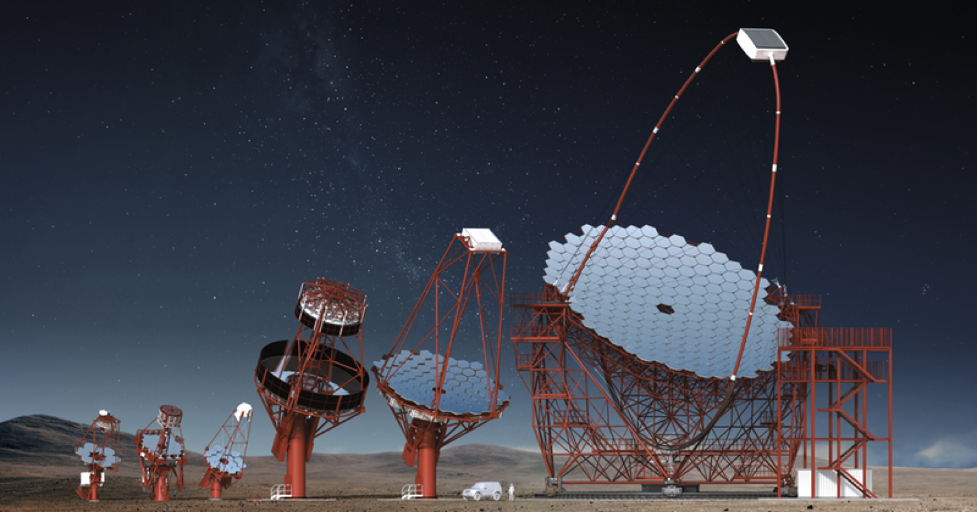
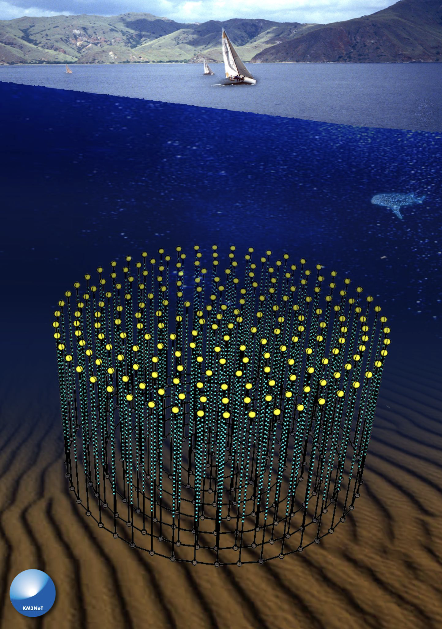
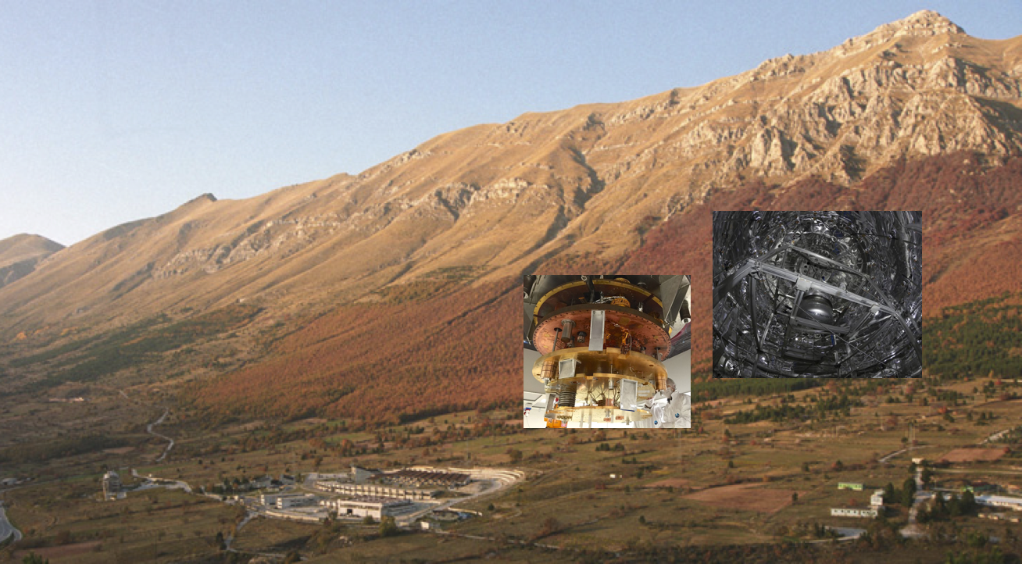
Not only WLCG
Supported scientific communities:
High-Energy Physics: 8
Astroparticle Physics: 18
Gravitational Waves: 2
Nuclear Physics: 15
Dark Matter: 6
others: 10

Slide 6
INFN – T1 Internal organization
Farming & Cloud
Infrastructure
User Support (First Level)
Network
Storage
Users
Second Level Support

Slide 7
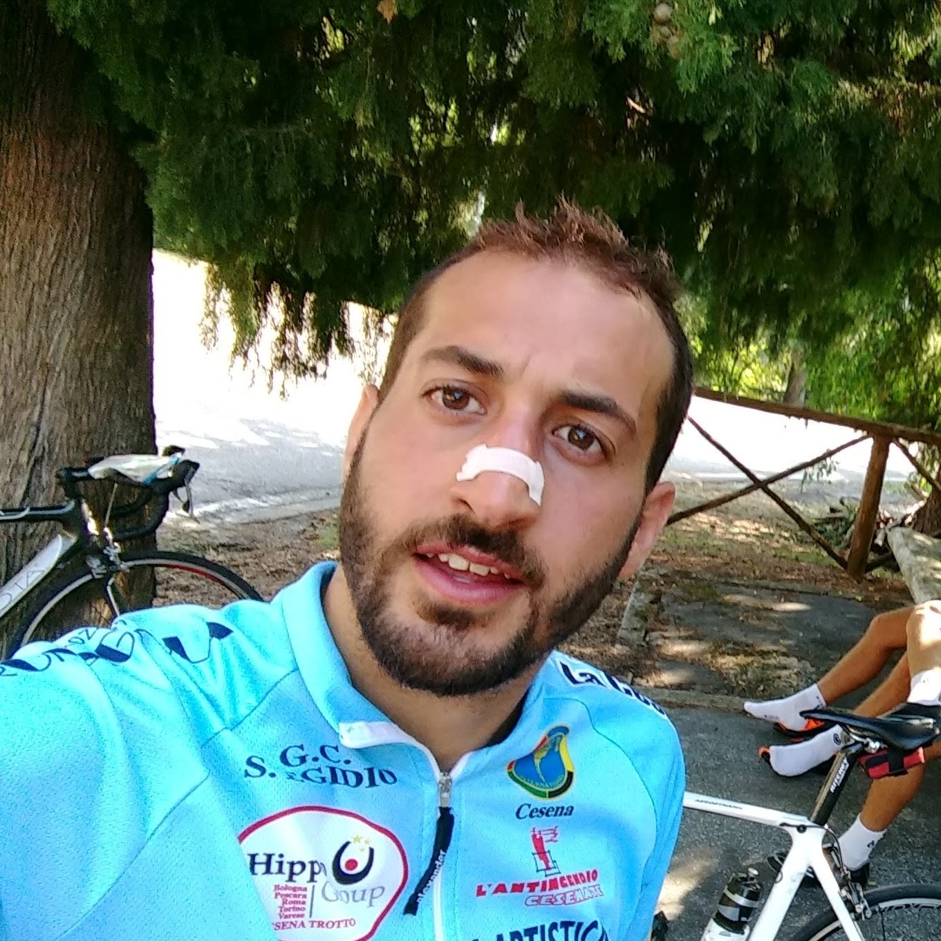
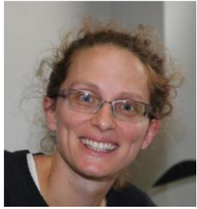
INFN – T1 Internal organization
BUSTED
New Entries !!
User Support Team

Slide 8
X509 GSI AuthN/Z
Server (CA)
Pros:
Widely used method of AuthN/Z
E.g.: HTTPS protocol
Computing Services
Cons:
Need for custom solutions to be integrated in other services
No Fine-Grained AuthZ*
Proxies last up to several days*
Client Key
Client Cert
Client Proxy
* Security Issues!!
Client

Slide 9
SciTokens
Token Request
Pros:
Based on JWT technology, widely integrated with other services’ workflow
Short-lived
Provide fine-grained authZ based on scopes or groups
Client
Access-Token
Oauth AuthZ server
Cons:
Short-lived*
oidc-agent is restricted to the user machine and can’t be forwarded
oidc-agent
Access-Token
Computing Services
Local User
*an issue as well, in some cases

Slide 10
Users Toolkit – State of the art
Tokens Management
Storage Access
Job Submission
oidc-agent*
mytoken
htgettoken
StoRM*
StoRM WebDAV*
XrootD*
HTCondor-CE*
ARC-CE
* Currently supported at CNAF

Slide 11
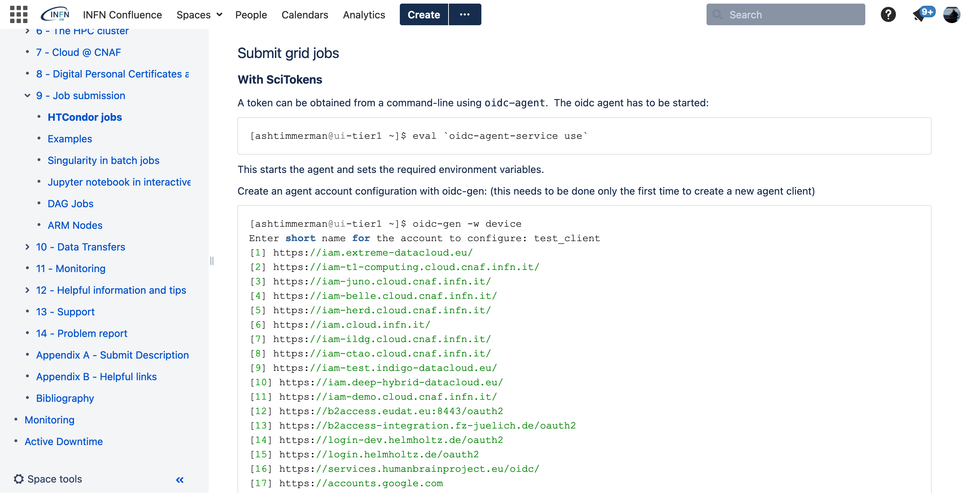
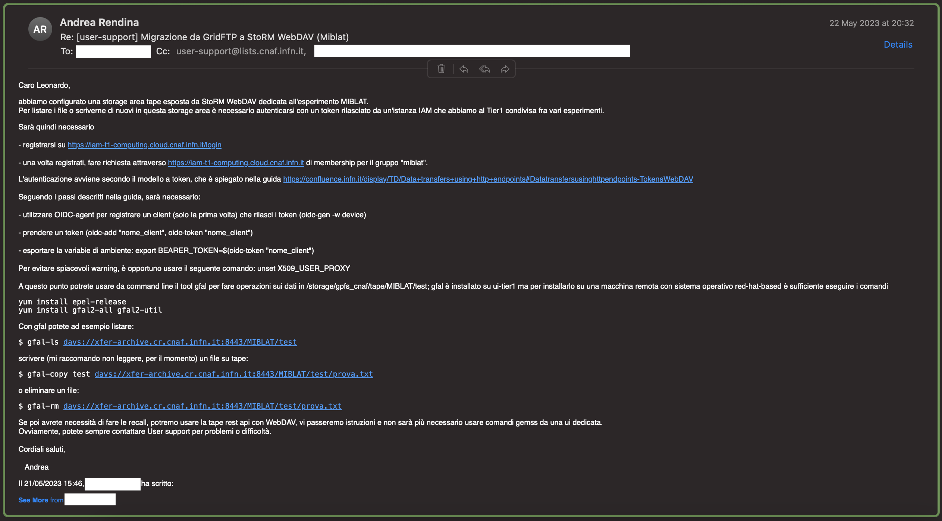
Issues with tokens
OAuth flow is quite complex
→ need to provide simplified guides to users → spot on assistance via email or in person meeting
Long lasting job can’t use a short lived token created during submission! → need a way to get fresh tokens during job execution!

Slide 12
Issues with tokens
Long lasting job can’t use a short-lived token created during submission! → need a way to get fresh tokens during job execution!
Possible Solutions*
DIY solution
mytoken [4]
htgettoken
*Marteen Litmaath’s talk during GDB session on 27th March [5]
[4] https://mytoken-docs.data.kit.edu/
[5] Token-Transition-update-240327

Slide 13
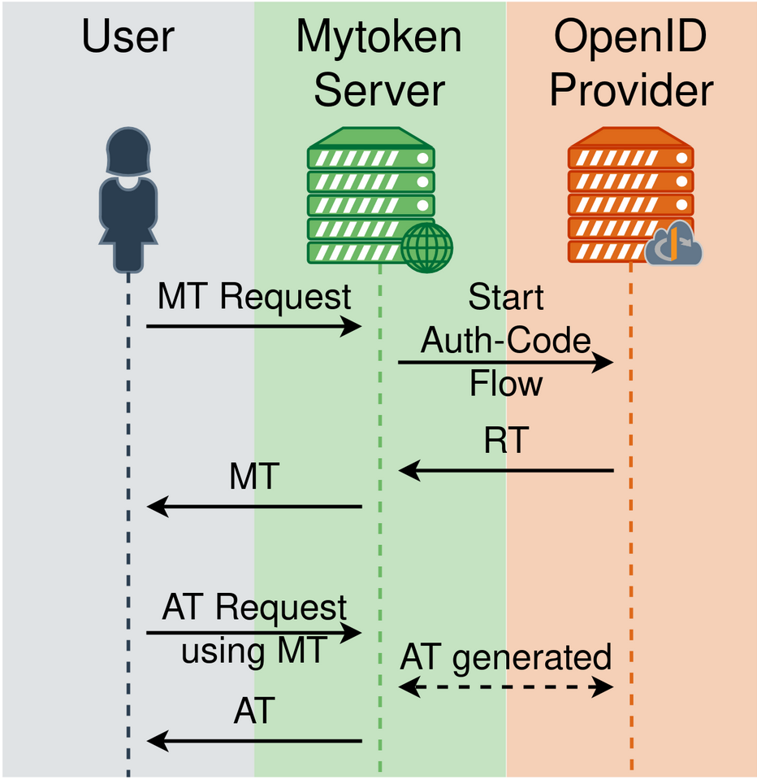
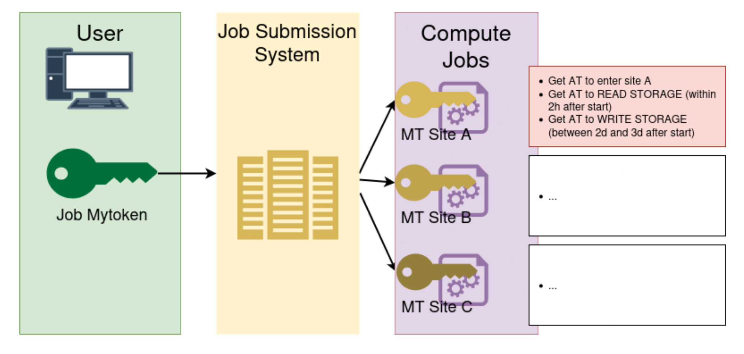
mytoken workflow
https://cvs.data.kit.edu/talks/2403-mytoken-wlcg-ops/
https://cvs.data.kit.edu/talks/2306-mytoken-egi/

Slide 14
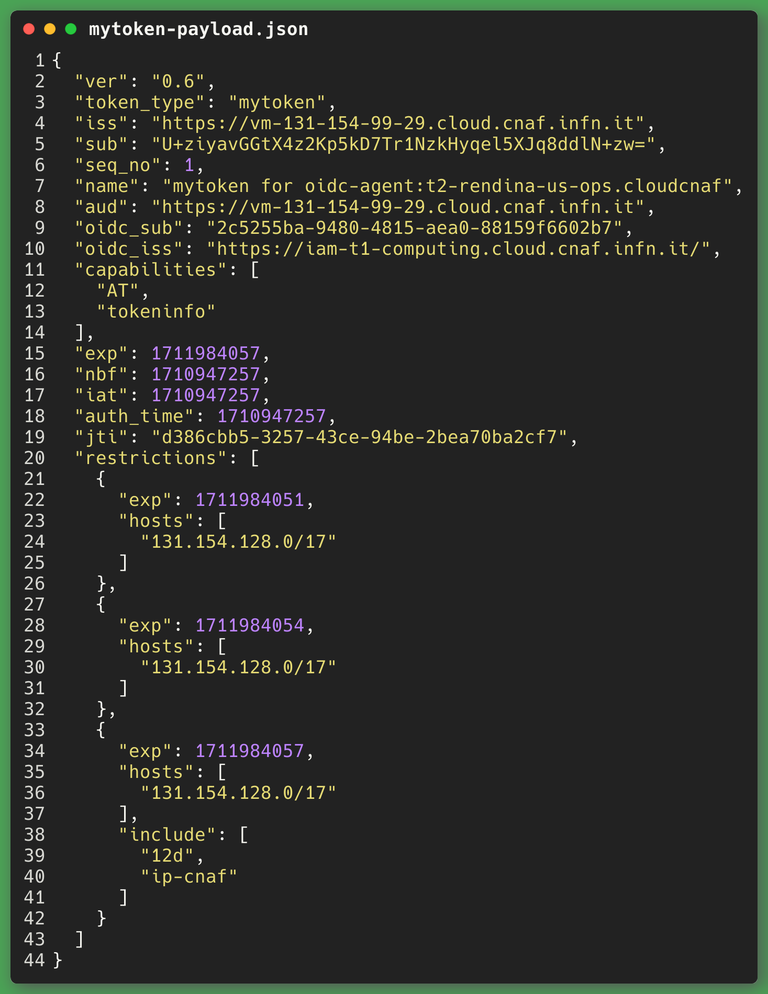
What is a mytoken?
Extension on the concept of Refresh-Token
JWT based
Implements new features: →Rotation →Restrictions - how much time it lasts - from which hosts/country - how many times can be used →Capabilities - AT (get access-tokens) - tokeninfo (retrieve information about mytoken) → Profiles (includes the previous)
It can be used like a refresh-token to connect to the oidc-agent on the mytoken-server

Slide 15
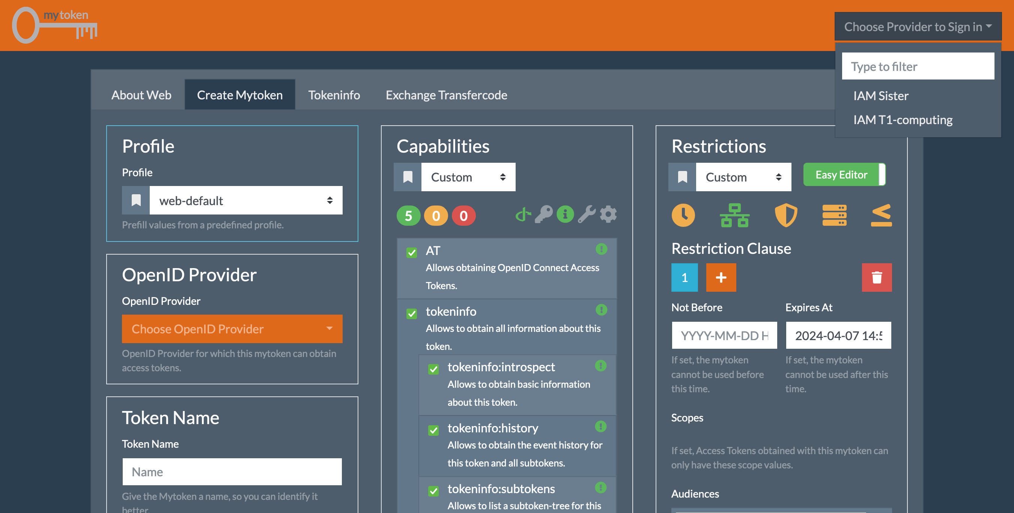
Why mytokens?
Pros:
Really close to our idea of resolving the issue
Easy to configure → YAML config file → few steps to follow → utility scripts to configure server features
Customizable
Responsive developers to help troubleshooting
Integrated with OIDC flow

Slide 16
Current activity
Deployment of a self hosted mytoken-server → server configuration → setup CNAF profile (rotations, restrictions, capabilities, templates) → connect to Tier-1 IAM instance
Test phase on how to get and use mytokens → client choice (mytoken-client, oidc-agent) → submission tests to manage files with AT requested via mytoken flow

Slide 17
Future actions
Keep on testing the mytoken solution → scalability tests → security evaluation → understanding of users needs to implement new profiles
Provide mytoken solution to INFN Tier-1 users in order to dismiss POSIX access to data from worker-nodes

Slide 18
Conclusions
User-support challenges in the future:
support all collaboration and users transitioning from X509 to SciTokens
Keep updated guides on how to implement tokens into users’ workflow
Test new solutions to ease token usage

Slide 19
Acknowledgments
Many thanks to Gabriel Zackmann → main contributor to mytoken project → very helpful on solving configuration issues we had
How to deploy mytoken-server https://mytoken-docs.data.kit.edu/server
How to configure mytoken-server https://mytoken-docs.data.kit.edu/dev
mytoken-server git repo https://github.com/oidc-mytoken/server
“mytoken - OpenID Connect Tokens for Long-term Authorization” G. Zackmann (Phd Thesis)

Slide 20
Thank you!

